Slide 1
Warm Bore movement study
Anis Ben Yahia, Andy Marone
11/9/2020

Slide 2
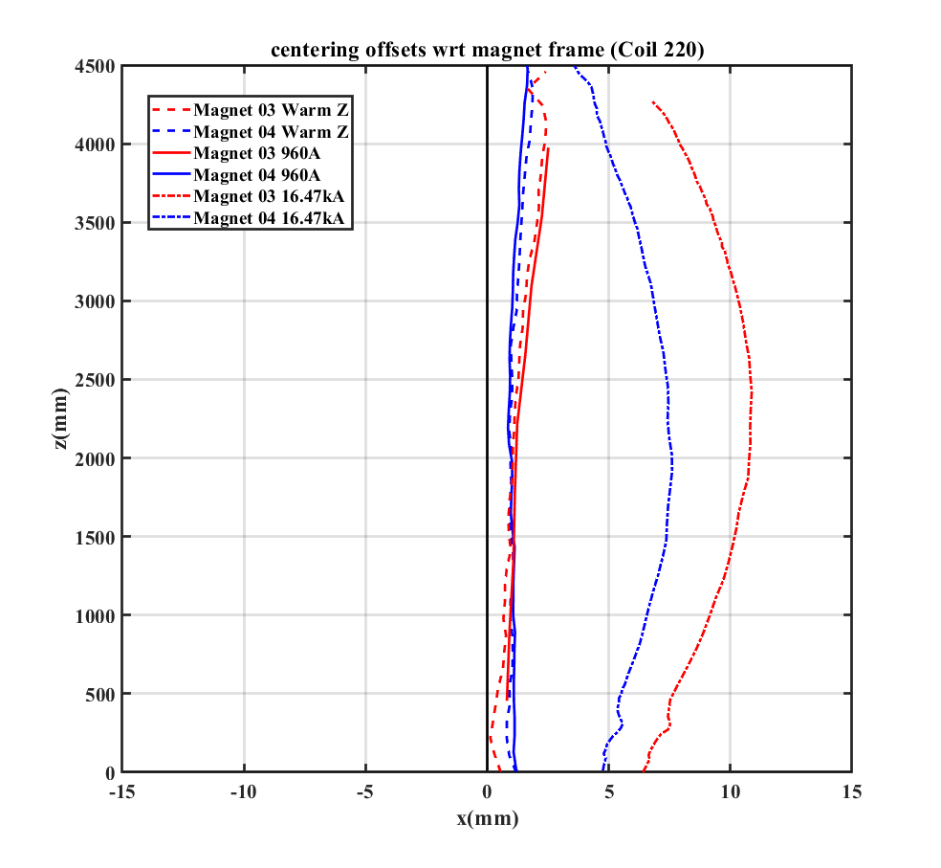
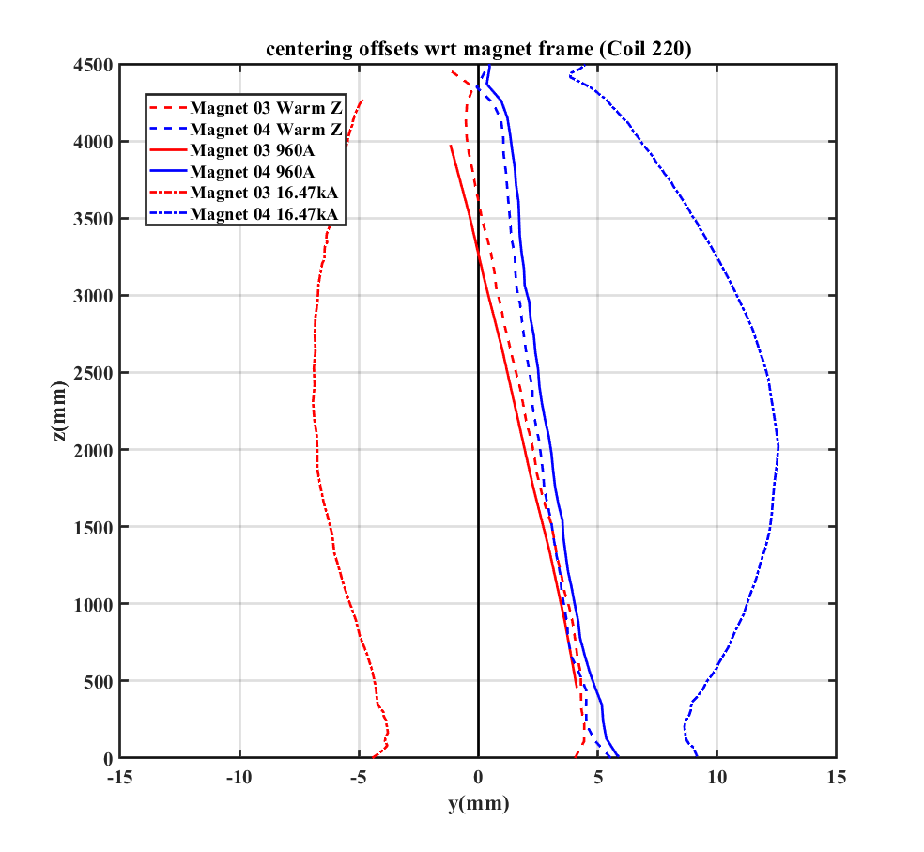
Misalignment between the Warm Bore Tube and the magnet
Warm and low current (960A) cold Z scans show an initial offset, indicating a misalignment between the WBT and the magnet.
Similar for both magnet 03 and 04.
XZ view
YZ view
MM centering offsets: warm and 960A Z scans
Blue magnet 04
Red magnet 03

Slide 3
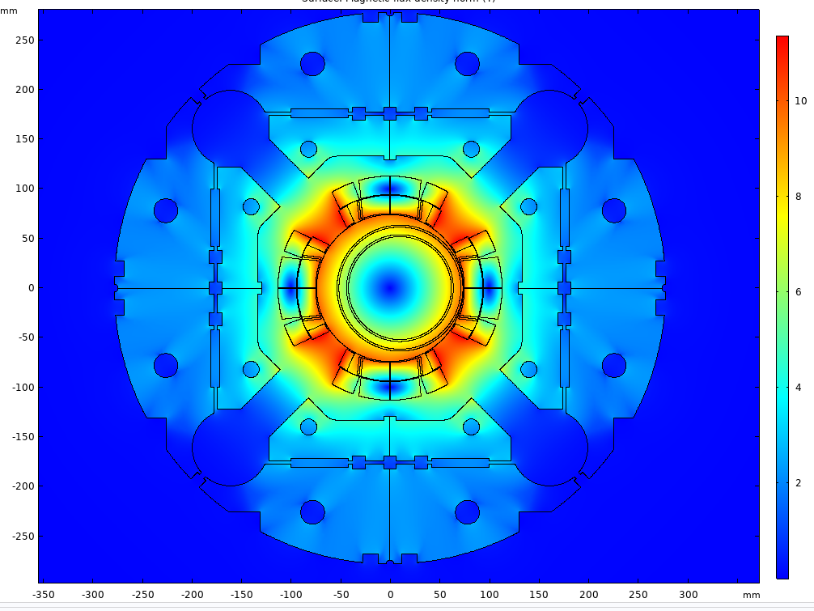
Misalignment between the Warm Bore Tube and the magnet
The permeability of the WBT was measured: µ_{r}=1.01
Outer tube: 5” x .083 wall
Inner tube: OD=4.24”, ID=4.08”
Offset: 5 mm
Forces @ 16.47 kA:
Inner tube= 463 N/m ~ 104 lbf/m
Outer tube= 553 N/m ~ 124 lbf/m
Offset: 10 mm
Forces @ 16.47 kA:
Inner tube= 927 N/m ~ 208 lbf/m
Outer tube= 1148 N/m ~ 258 lbf/m

Slide 4
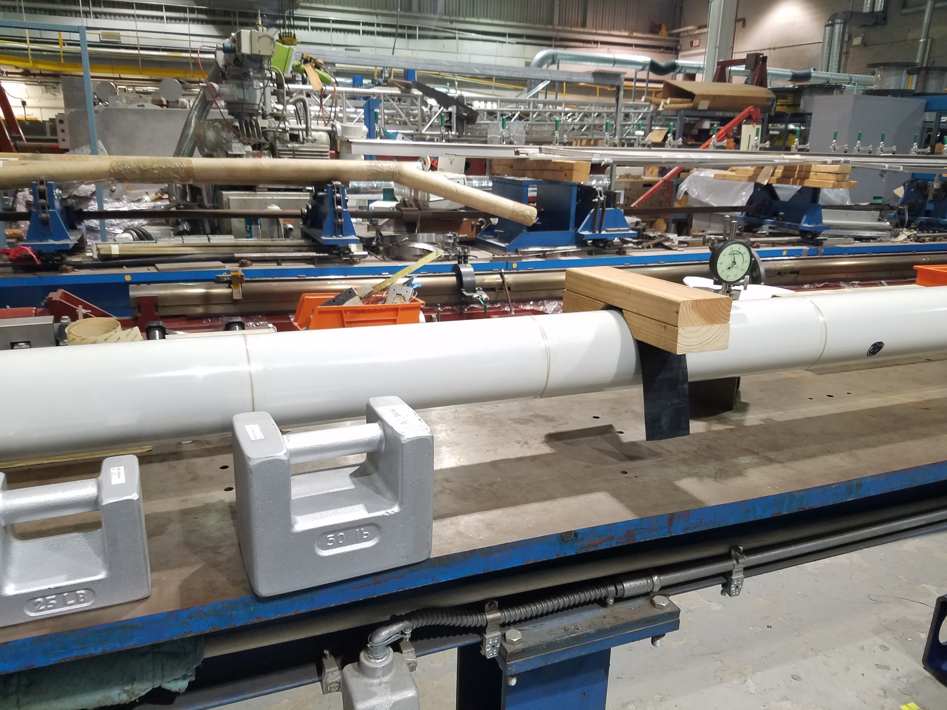
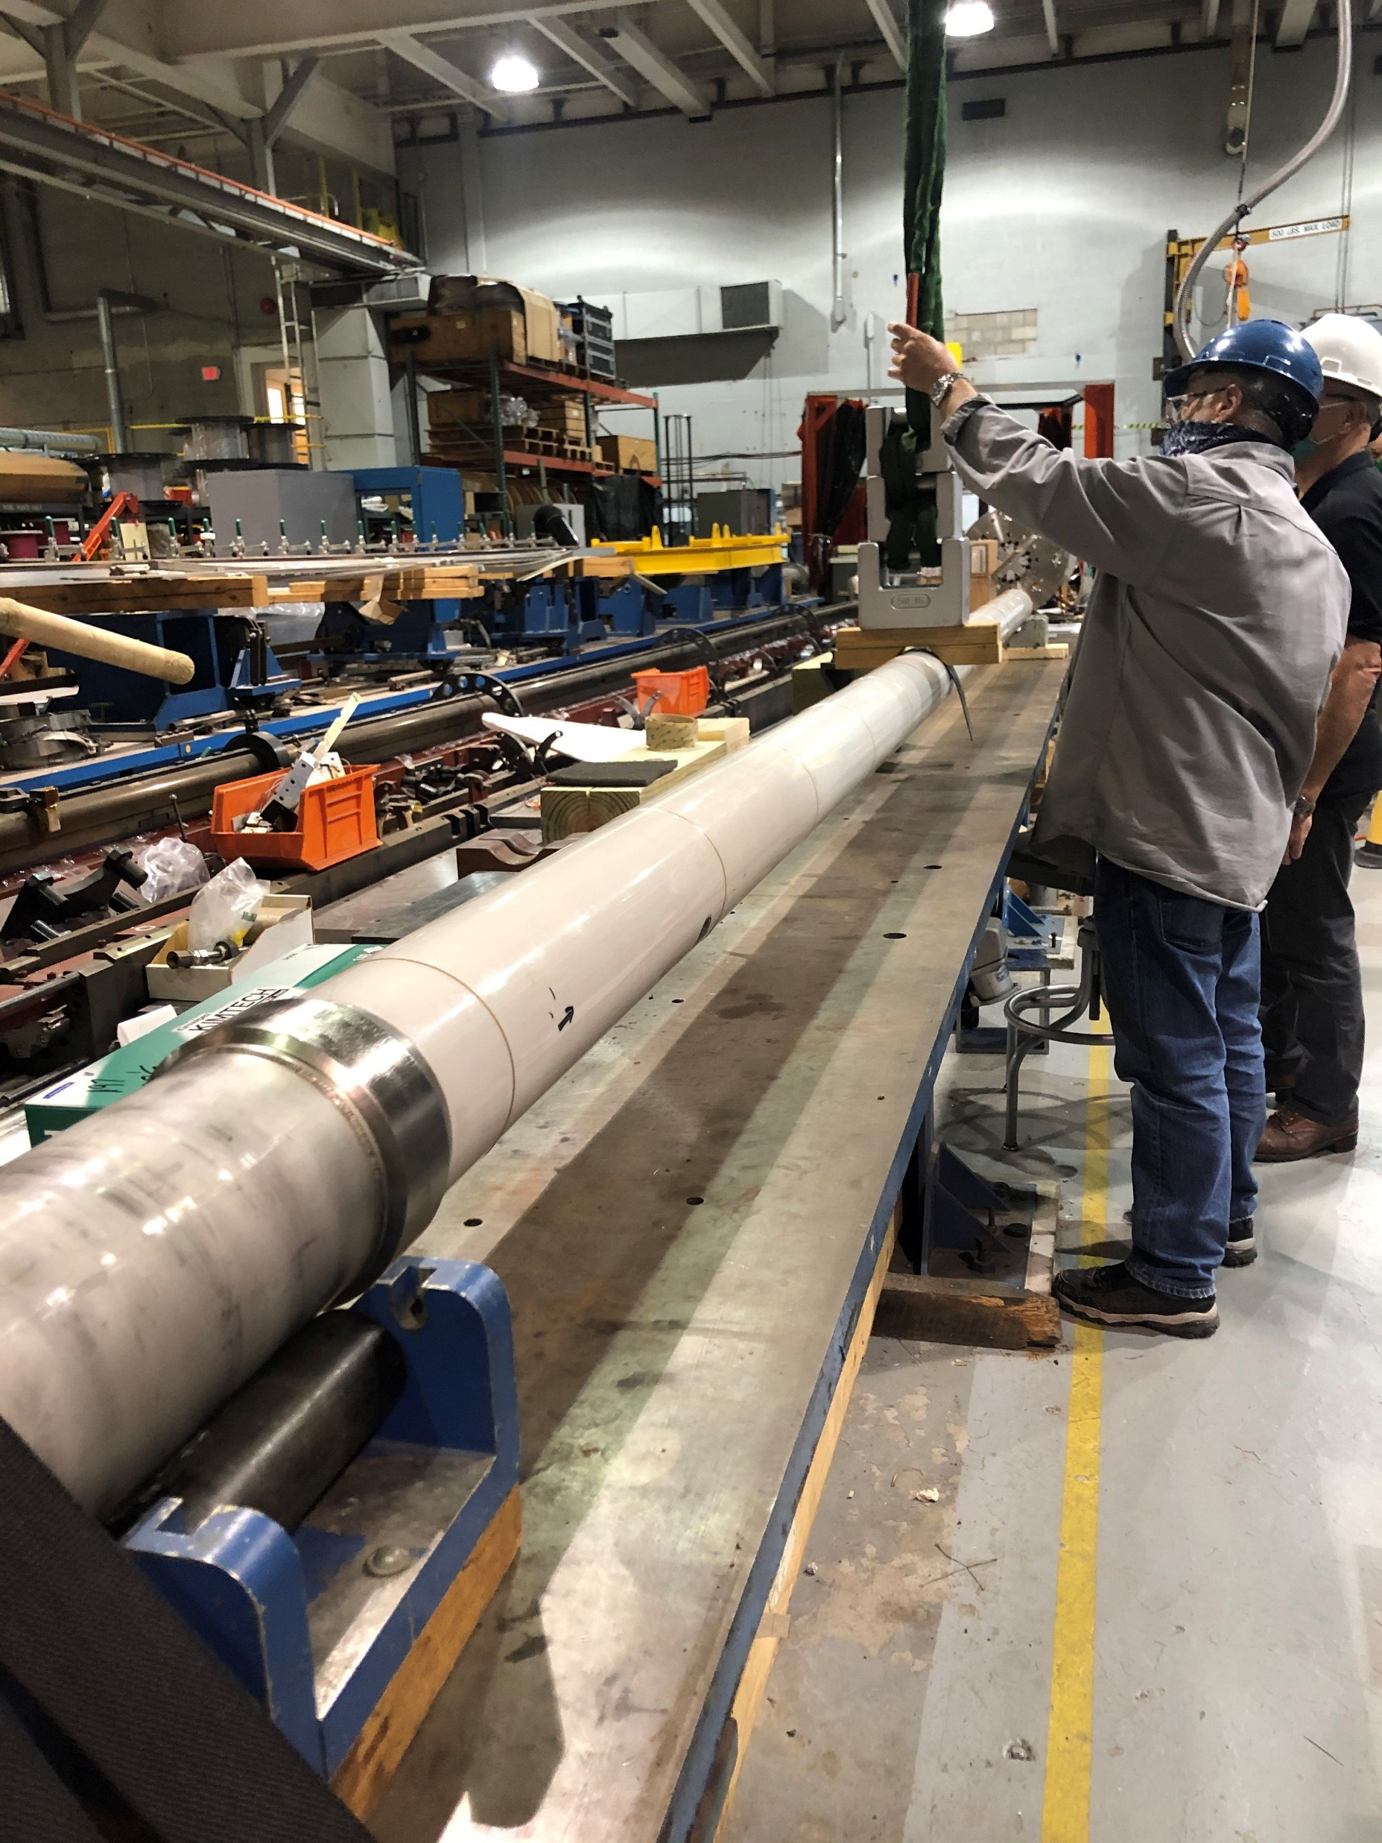
Basic defection test on the Warm Bore Tube
The tube was simply supported at the approximate locations that it would be as installed.
The deflections were measured with 50 lb. and 100 lb. concentrated loads applied at the midpoint between supports.
The measured deflections were .056” (1.42 mm) and .116”(2.95 mm) respectively.

Slide 5
Basic defection test on the Warm Bore Tube
The calculated deflections based on the outer tube only would be .071” and .141” respectively. So, the inner tube is contributing to the stiffness of the assembly from very early on in the application of bending loads.
The deflection for a distributed load is approximately 60% that of a given concentrated load. Therefore we can say that a concentrated load of 300 lbs., would result in a deflection approximately equal to that of a 500 lbs. distributed load.
Based on the results herein, the application of a 300 lb. concentrated load (or a 500 lb. distributed load) would result in a deflection of 3x(.116”) =.348” (8.84mm).

Slide 6
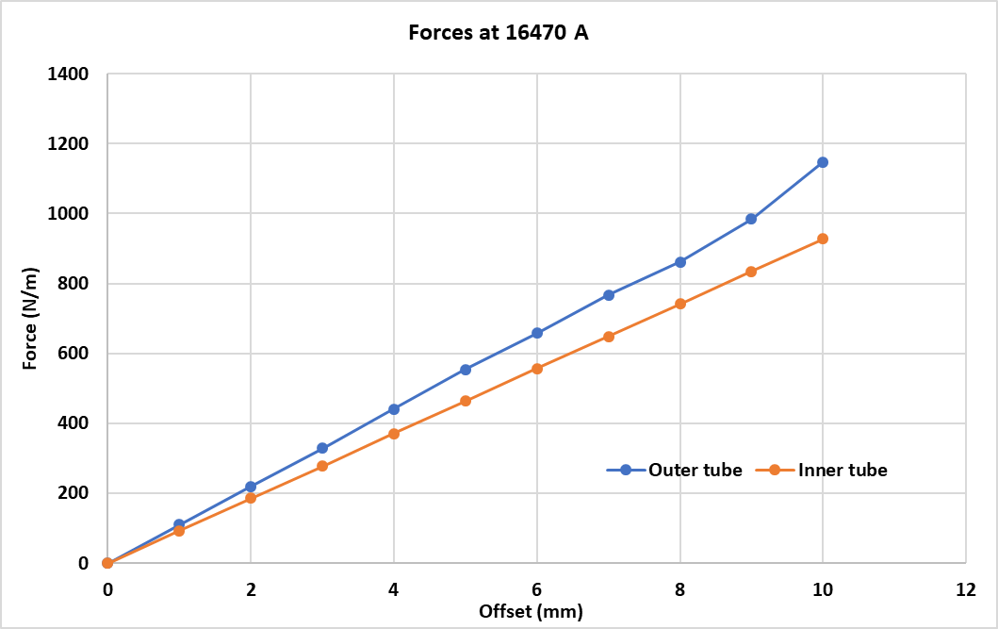
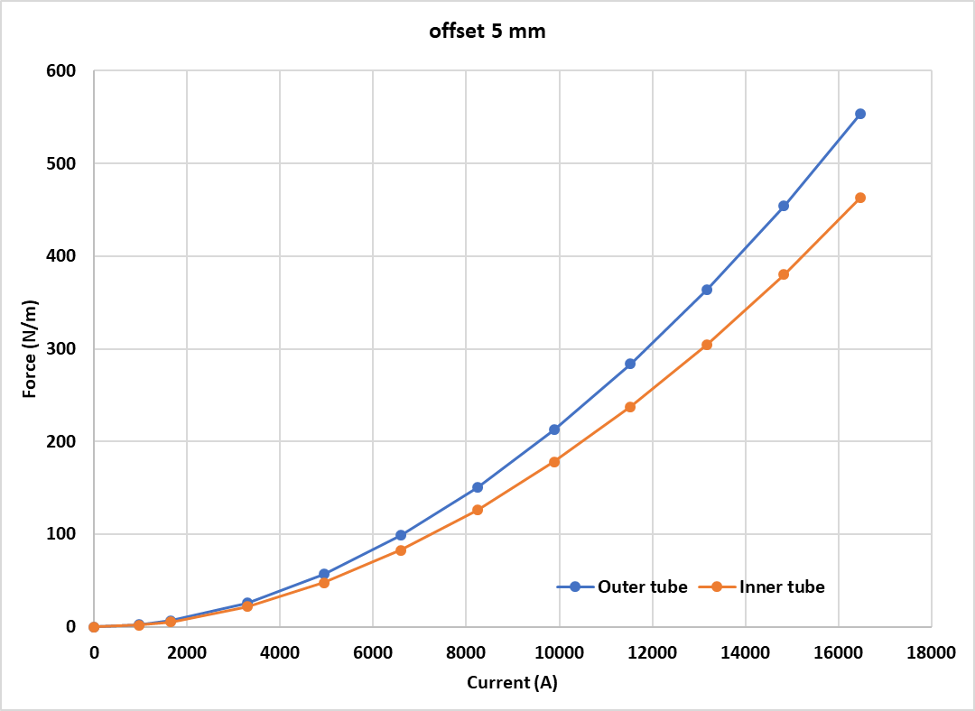
Defection estimate based on the initial centering offsets
At a given current, the forces are linear wrt the offset and quadratic wrt the current.
Given the initial offsets and assuming that the forces remain constant during the deflection, at 16470 A, the average force acting on both tubes together is about 700N/m (157 lbf/m).
Over 4.2m, this is a total of 2940 N (660 lbf).
Based on previous tests on the warm bore tube assembly, these forces result in a calculated deflection of .48” (12mm).
Keep in mind that as the tube deflects the force trying to bend it will increase.

