Slide 1
The CERN Neutrino Platform
AF2 Accelerators for Neutrinos Town Hall
10 December 2020, M.Nessi

Slide 2
Some history ……
2012 : a CERN project was presented for a neutrino new short baseline at CERN (LOI presented in March 2013).
At the same time a European long baseline, pointing to Finland from CERN was under discussion.
In all these proposals, LAr TPCs technologies were among the main options.
2013 : the European strategy priorities put CERN neutrino among the 4 CERN priorities : “….. pave the way for a substantial European role in future long-baseline experiments. Europe should explore the possibility of major participation in leading long-baseline neutrino projects in the US and Japan.”
June 2014 Paris APPEC meeting: we announced that CERN would stop any plan for a CERN based Neutrino beam, in favour of an active cooperation with the US and Japan programs.

Slide 3
The CERN Neutrino Platform (NP) mandate
Assist the various groups in their R&D phase (detectors and components) in the short and medium term and give coherence to a fragmented European Neutrino Community
Provide to the ν community a test beam infrastructure (charged particles)
Bring R&D at the level of technology demonstrators in view of major technical decisions
Continue R&D on ν beam, as a possible base for further collaborations
Support the short baseline activities (infrastructure & detectors)
Support the long baseline activities (infrastructure & detectors)

Slide 4
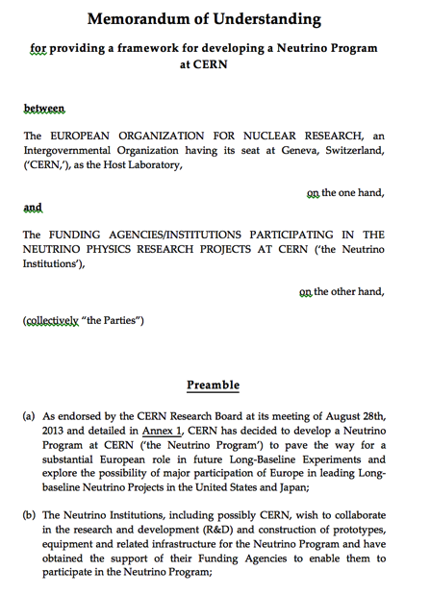
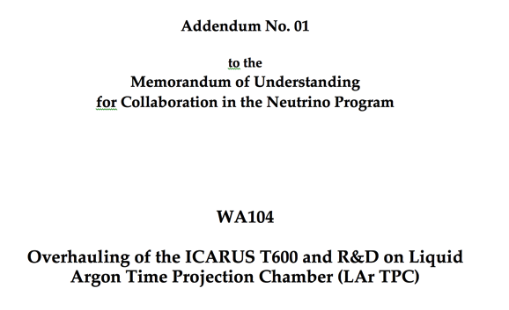
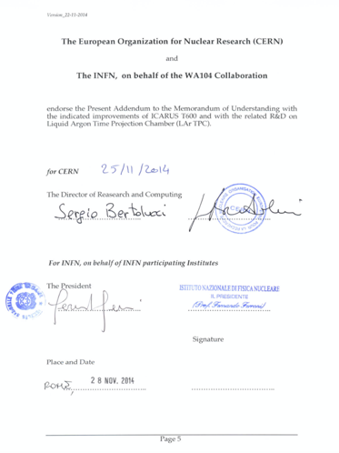
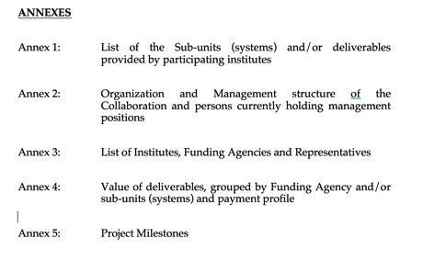
MOU frame
https://edms.cern.ch/document/1353815
NP01
STEPS:
Present to the CERN SPSC a LOI or an expression of interest
When approved by CERN RB prepare an MOU
Then a CERN experiment is created (NPxx, …), with all privileges and requirements

Slide 5
Present status of NP activities
7 MOUs signed:
NP01: ICARUS overhauling + FNAL activities
NP02: R&D on a double phase LAr TPC technology (including protoDUNE DP)
NP03: generic R&D on neutrino detectors and facilities
NP04: R&D on a single phase LAr TPC technology (protoDUNE SP)
NP05: Baby Mind muon spectrometer for a T2K near detector
NP06: ENUBET, R&D on a neutrino beta beam
NP07: ND280, a new T2K Near Detector
Cooperation agreements
CERN participation in the USA LBNF/DUNE project
CERN delivery in kind to USA of the first large LBNF cryostat
CERN participation in the FNAL short baseline Neutrino program (ICARUS+SBND)
CERN technical participation in the DarkSide project at LNGS
Other activities
NP participation in the CERN FASER project

Slide 6
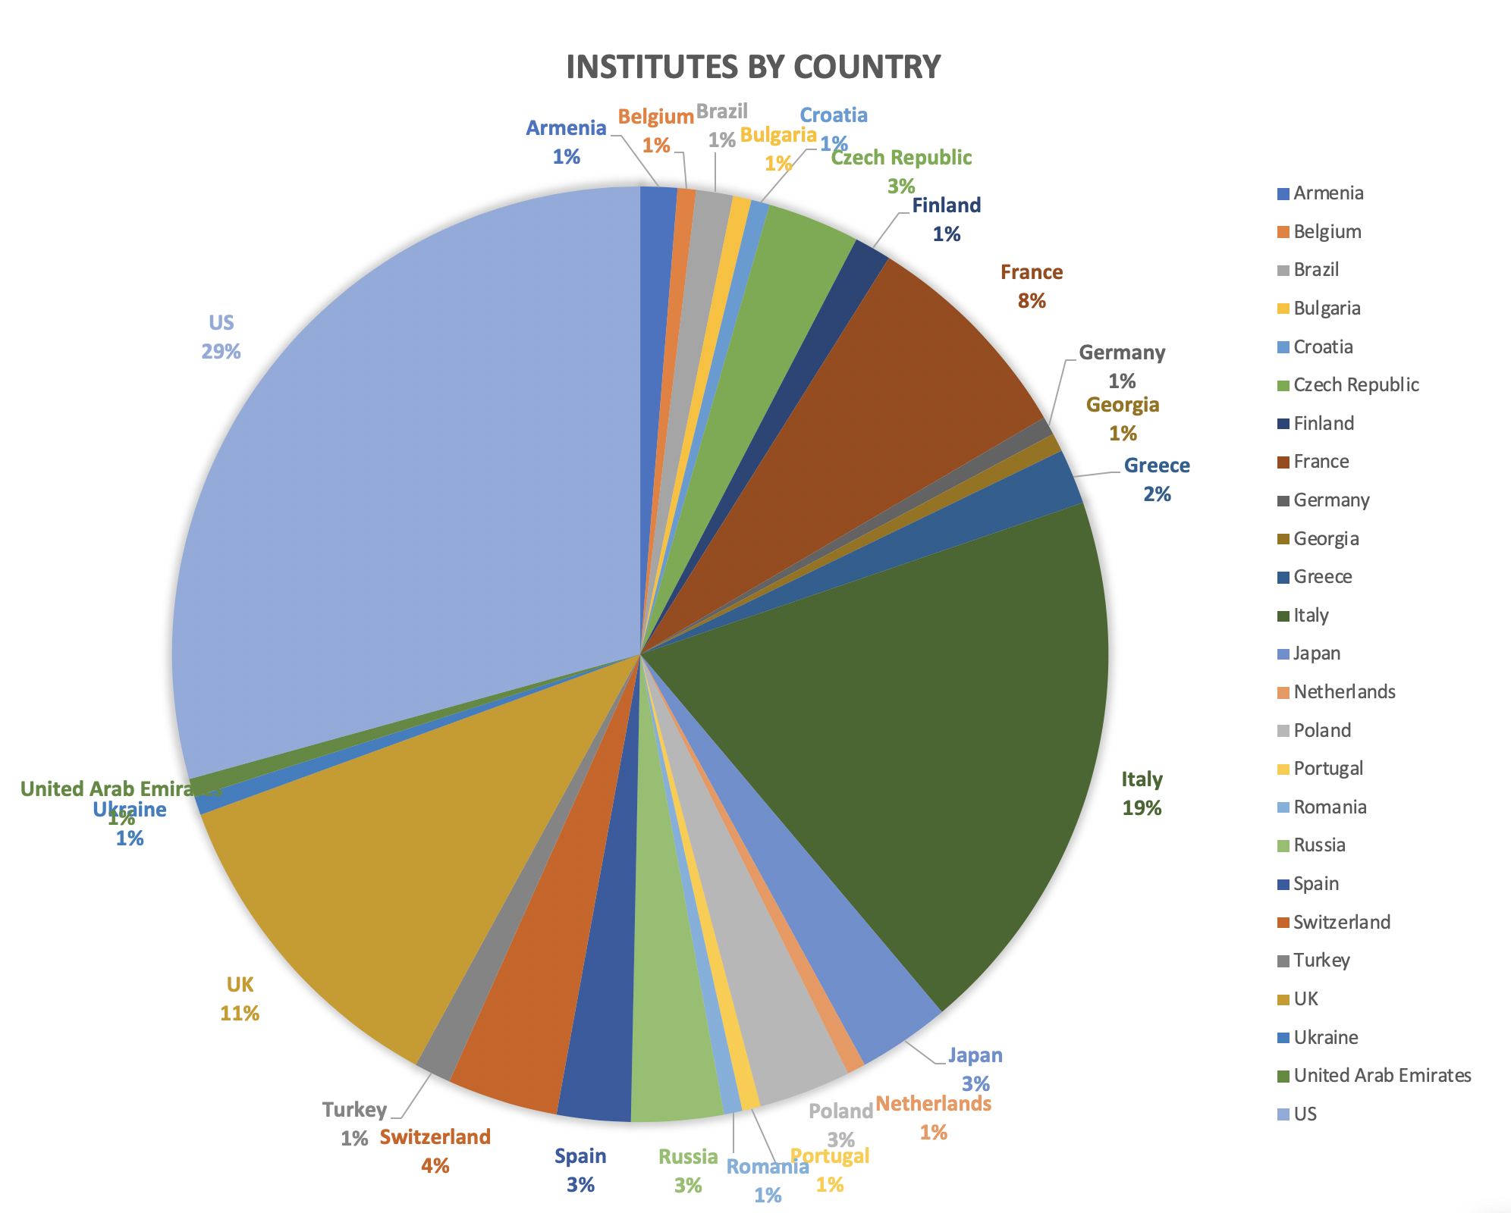
Institutes 157
Collaborators 858
NP Platform serves the community

Slide 7
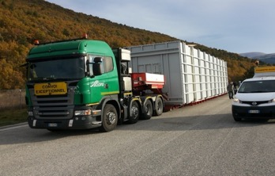
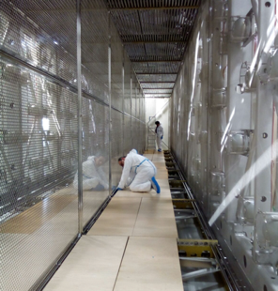
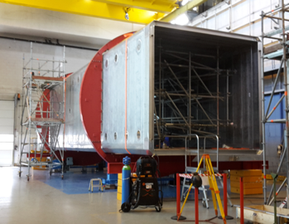
NP01 : the ICARUS new detector at the SBN FNAL
CERN & INFN
Steps :
Bring the 2 ICARUS active detectors from LNGS to CERN
Construct new cryostats (cold and warm)
Reshape ICARUS in a new clean room at CERN
Insert the 2 ICARUS detectors in their new cold cryostats
Bring the two cold cryostats to FNAL
Assemble there a new large warm cryostat
Insert the two new cold vessels, close the warm structure
Procure and install the necessary LAr cryogenics system
Provide a large muon tagger
Participate in the cool down and filling phase, qualify the cryostat
Participate in the commissioning and physics exploitation

Slide 8
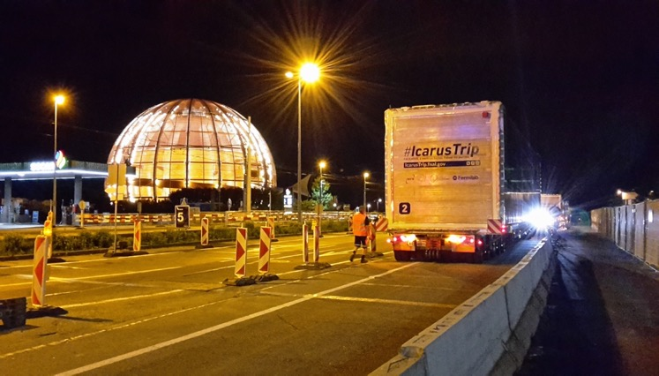
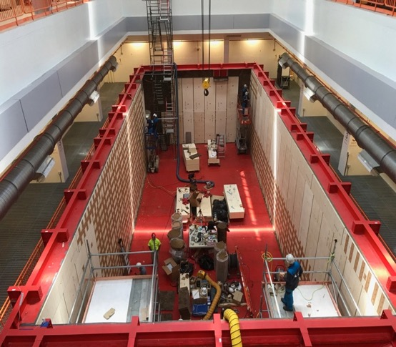
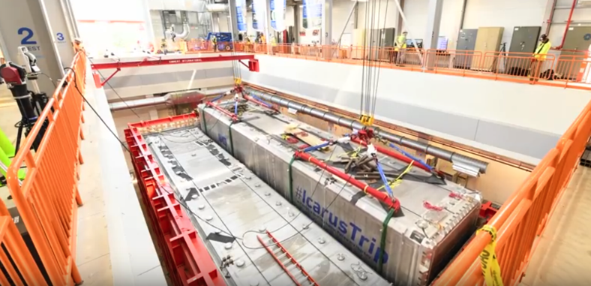
ICARUS at FNAL
Warm cryostat construction at FNAL
Leaving CERN 12 June 2017
Positioning of the two ICARUS modules (cold cryostats) in final position in a new building at FNAL
CERN NP

Slide 9
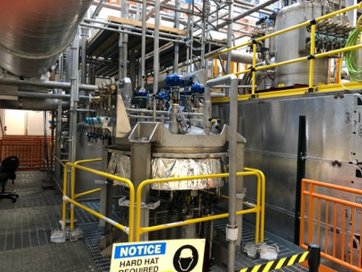
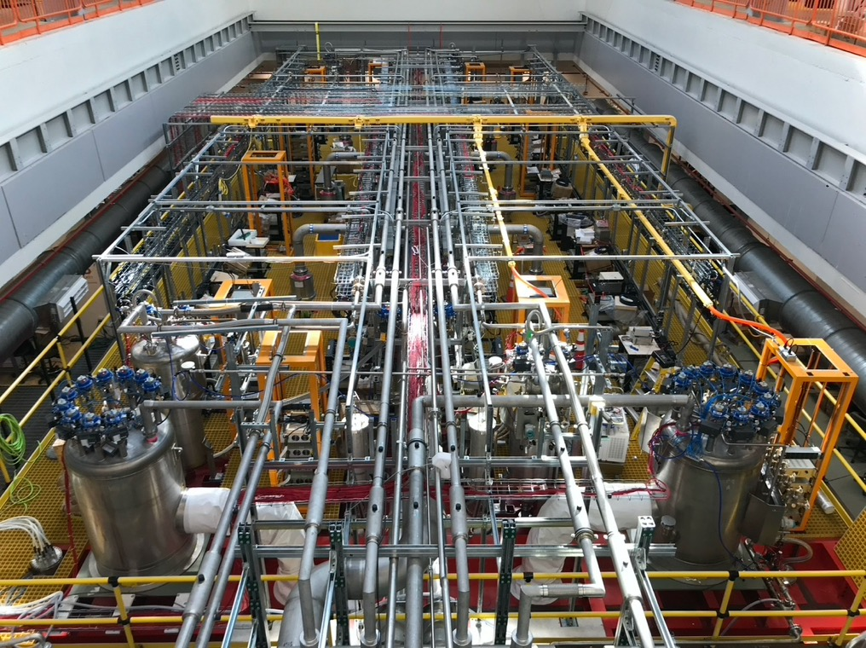
ICARUS filled with LAr and ready
Started on Feb 13th, 2020 by breaking the vacuum in the two main cold vessels.
Cooldown started on Feb 14th by injecting liquid nitrogen in the cold shields.
4 days duration, maximum temperature gradient on the TPC chambers 35 K.
Gas recirculation units activated on Feb 18th for purification of Ar gas before filling.
Filling started on Feb 24th, interrupted at around 50% to regenerate the filters, and stopped again when the liquid reached 6 cm below the nominal level to perform the final pressure test of the two cold vessels.
Filling completed on April 19th.
Liquid recirculation started on April 21st, at 1.85 m3/h in the West cryostat and 2.25 m3/h in the East.
Cryogenic stabilization completed around end of May. Steady performance since
Cryostat works perfectly and it has been qualified for operation
Common effort of CERN/Fermilab teams
ICARUS is not in the exploitation phase

Slide 10
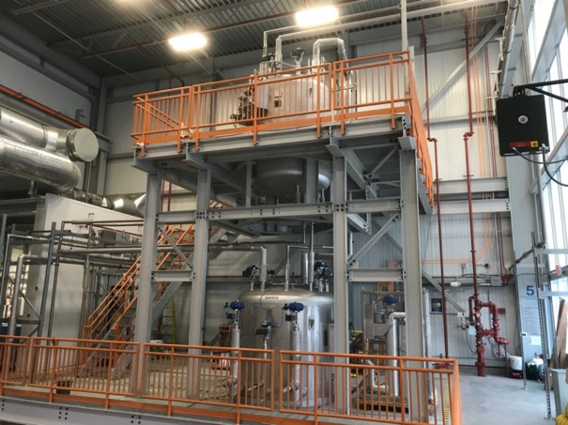
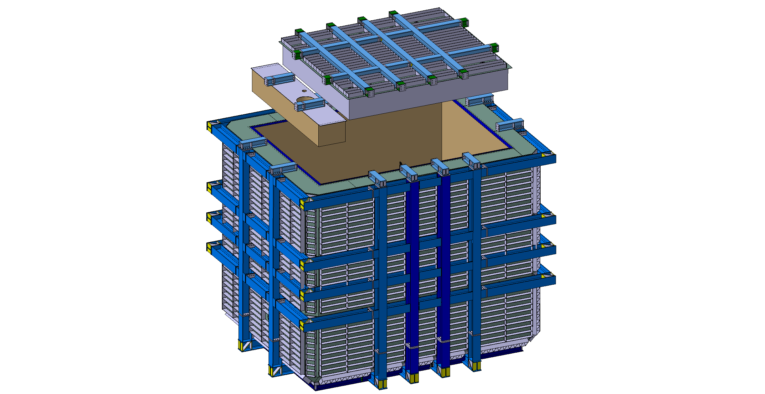
SBN: SBND near detector
LAr cryogenics installed
Seen at the last prototype before LBNF
Many structural and design changes done form the original protoDUNE experience both in the warm and the cold structures
Excellent opportunity to prove the new design
SBND : 200 T LAr membrane cryostat , warm vessel installed at FNAL in 2019, cold vessel will be installed in 2021

Slide 11
LBNF/DUNE neutrino Long baseline
- To search for the origin of matter (CP violation, ν oscillations, …)
- To learn more about neutron stars and black holes
- To shed light on the unification of nature’s forces (proton decay?)

Slide 12
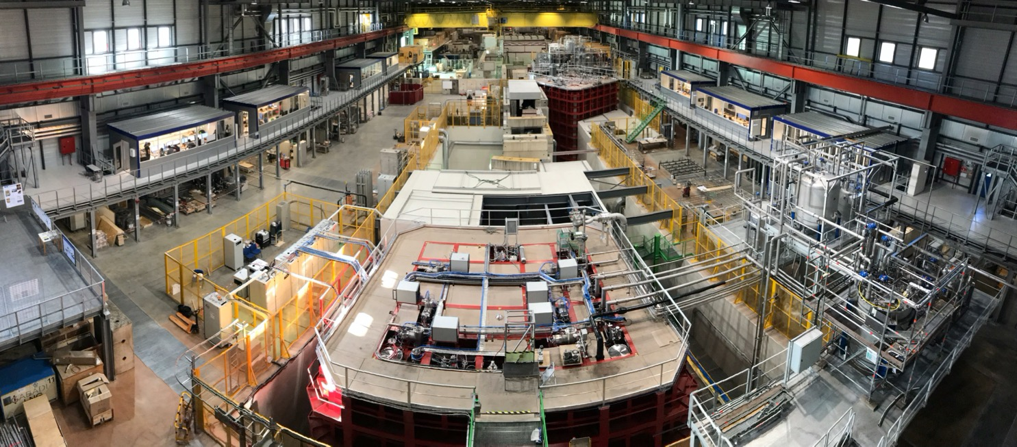
ProtoDUNE as the necessary step to demonstrate the feasibility of the LAr technology for large detectors
Prototypes at the scale 1:20, with modules at the DUNE scale
Two technologies investigated (LAr single phase, LAr double phase)

Slide 13
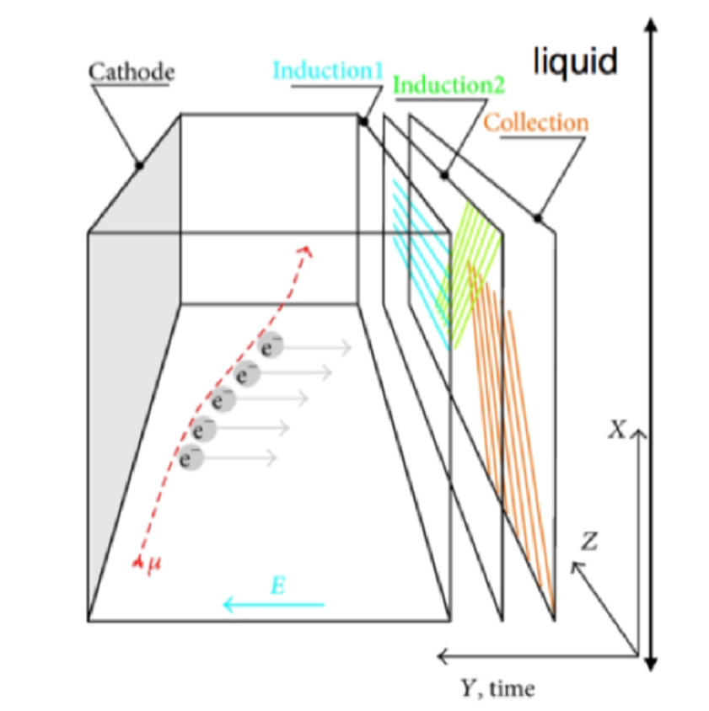
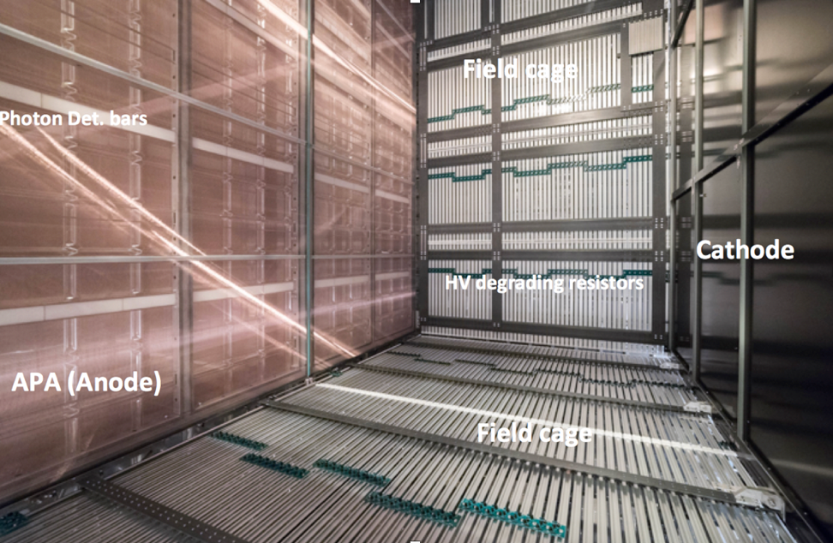
NP04: protoDUNE SP

Slide 14
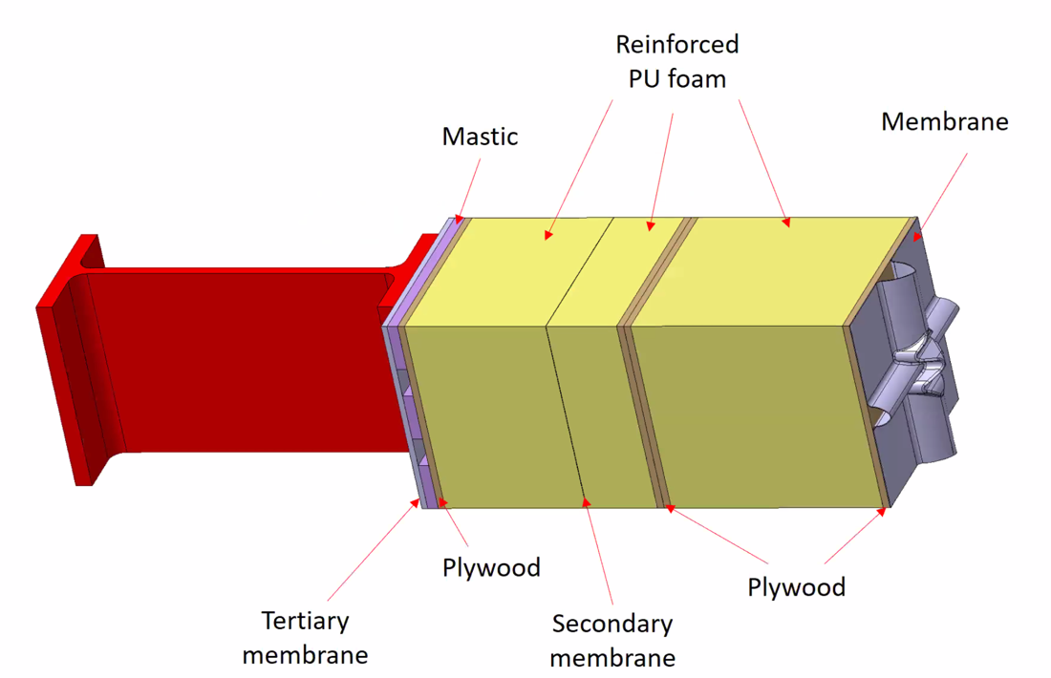
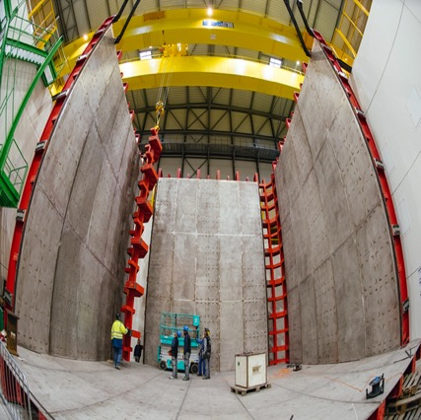
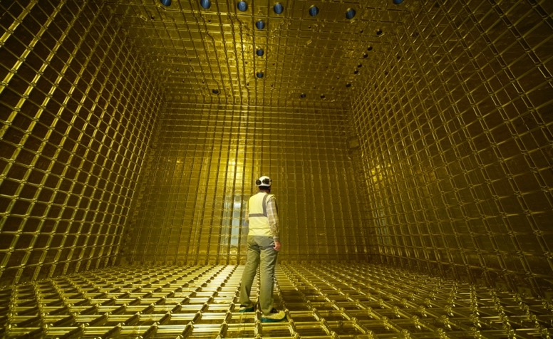
LNG membrane cryostat concept and key ingredients
warm
cold
EHN1 hall constructed in 2016
First cryostat ready in Sep. 2017

Slide 15
2018

Slide 16
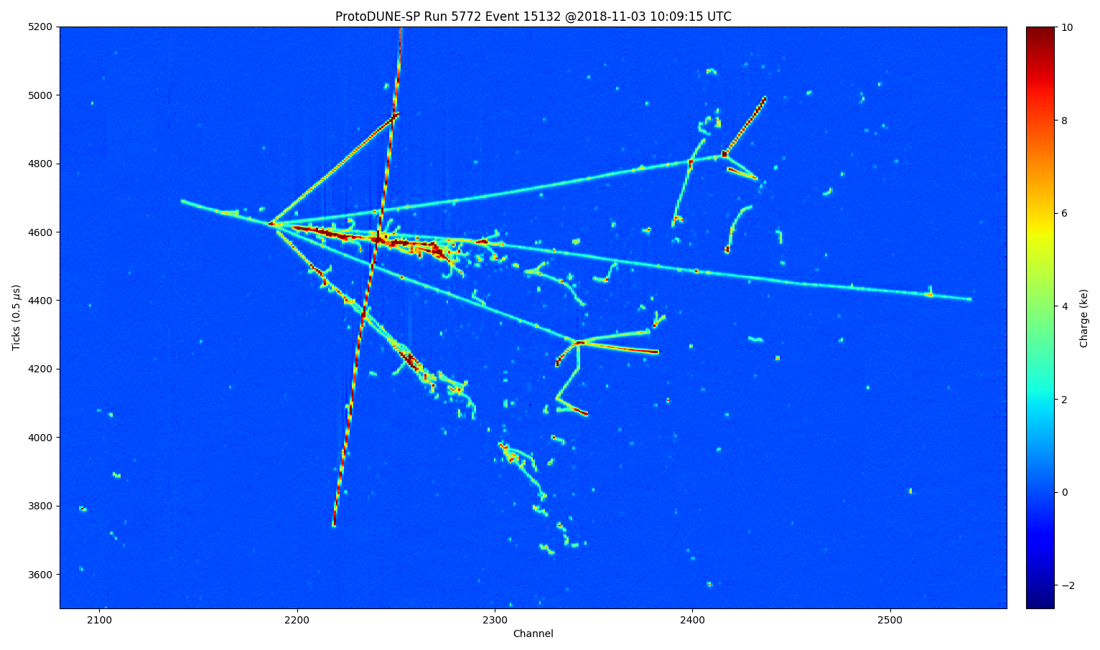
A spectacular collection of events with an extensive variety of nuclear and particle processes
~ 3 months of beam before LS2, large statistics collected
We kept the detector on cosmic events for about 20 months, proving the stability of the system and its reliability
The vessel is now warm and empty

Slide 17
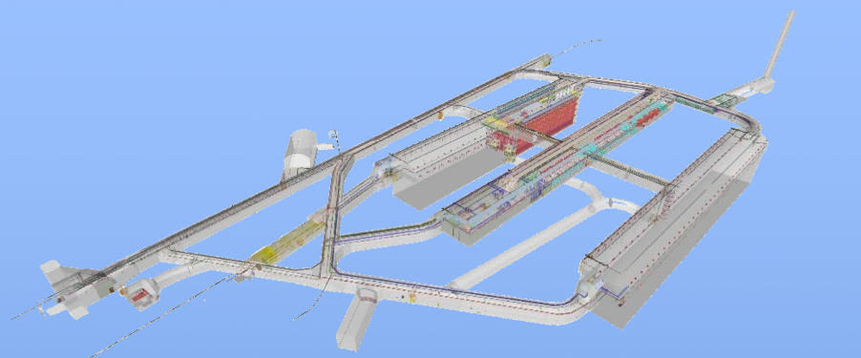
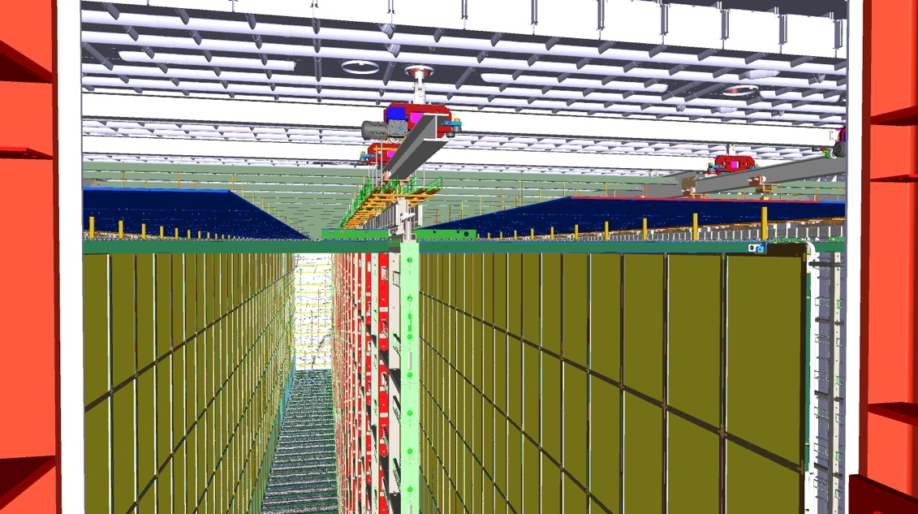
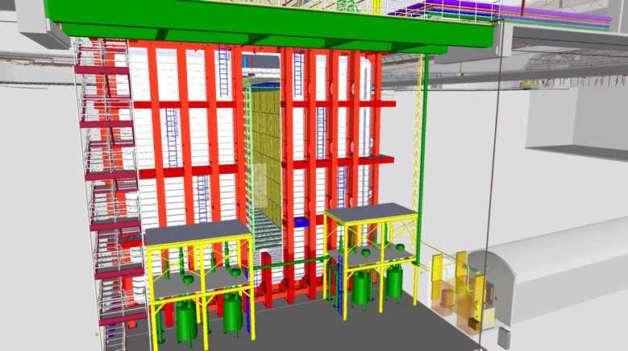
NP04 as the baseline for the first DUNE far detector
With the NP leading integration and engineering activities

Slide 18
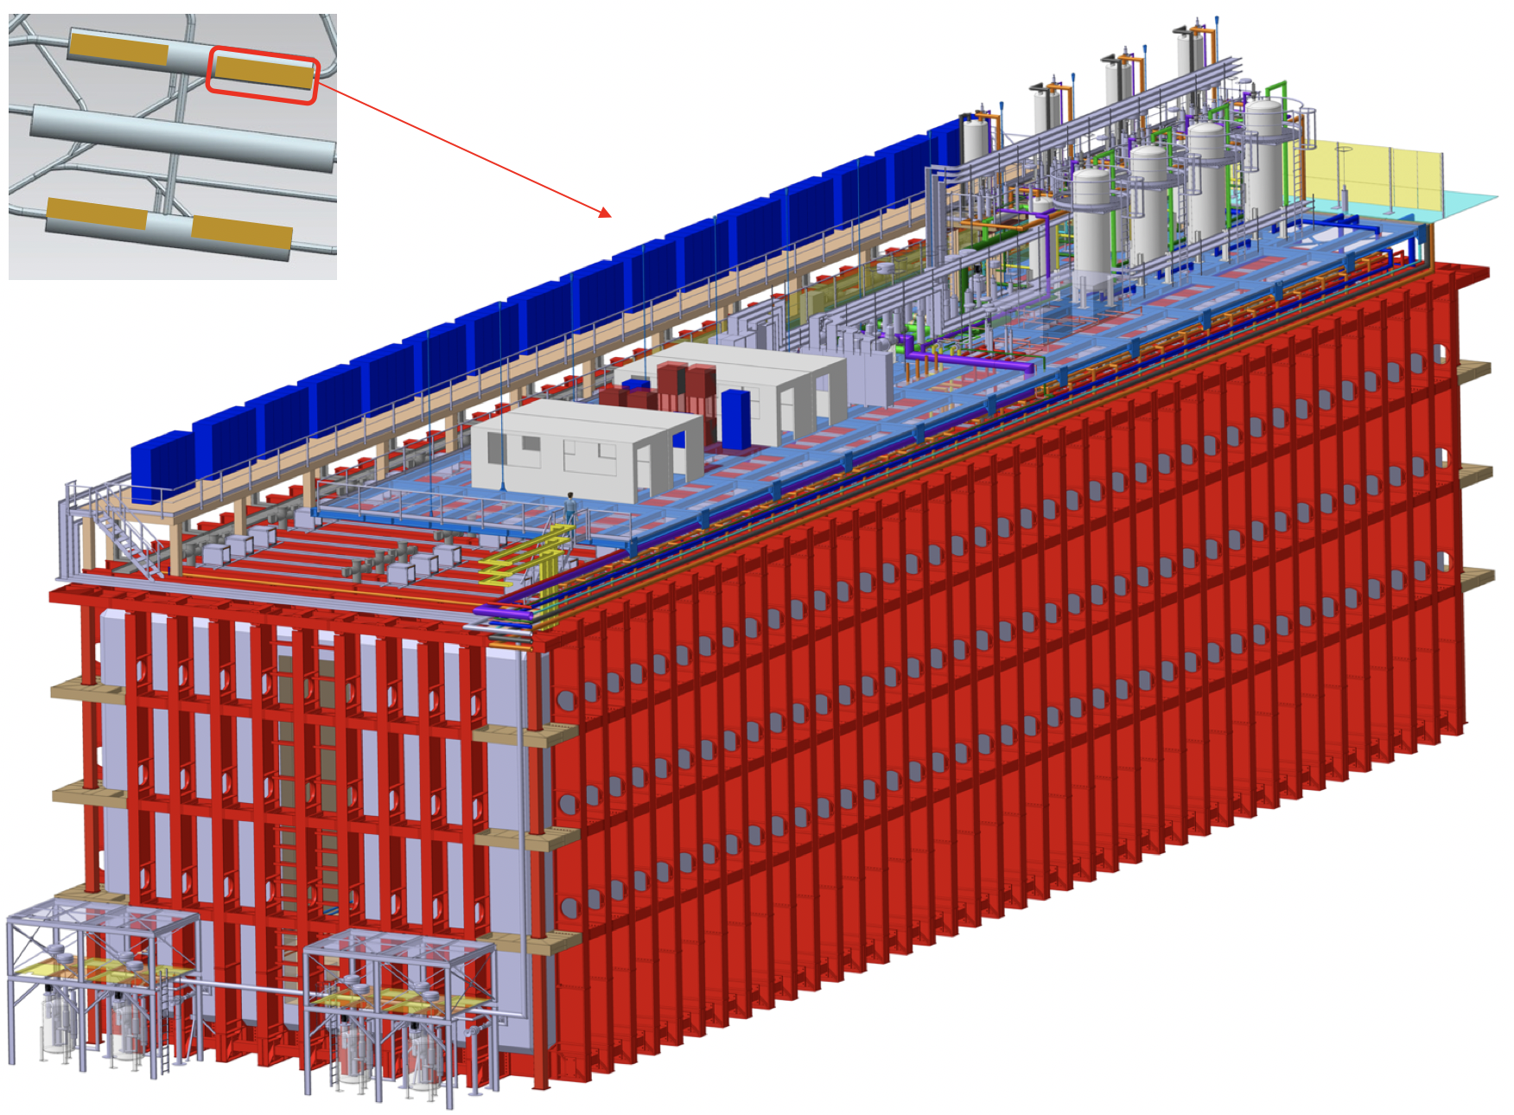
LBNF cryostat #1
Cryostat # 1 is a CERN in kind contribution to LBNF

Slide 19
NEXT : protoDUNE NP04 – phase II
Insert all final detector components (Module 0 concept)
Verify that all is fine and ready to move to mass production
Continue the investigations with beam (different polarity, cross section mesurments)
Period 2021-2023
NEXT : LBNF/DUNE schedule
LBNF has a new schedule: end of civil engineering for the far detector (caverns ready) March 2024, start Cryostat assembly April 2024
In 2021 we will start the LBNF cryostat procurement project at CERN
Discussions are now happening in Europe to secure a second cryostat

Slide 20
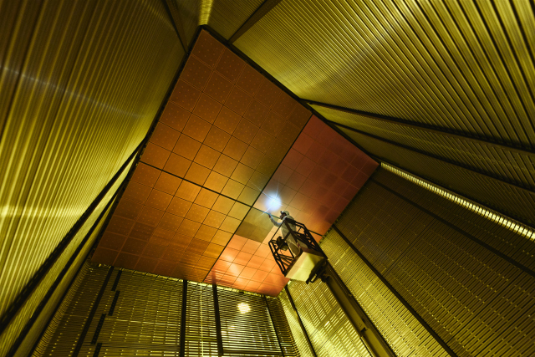
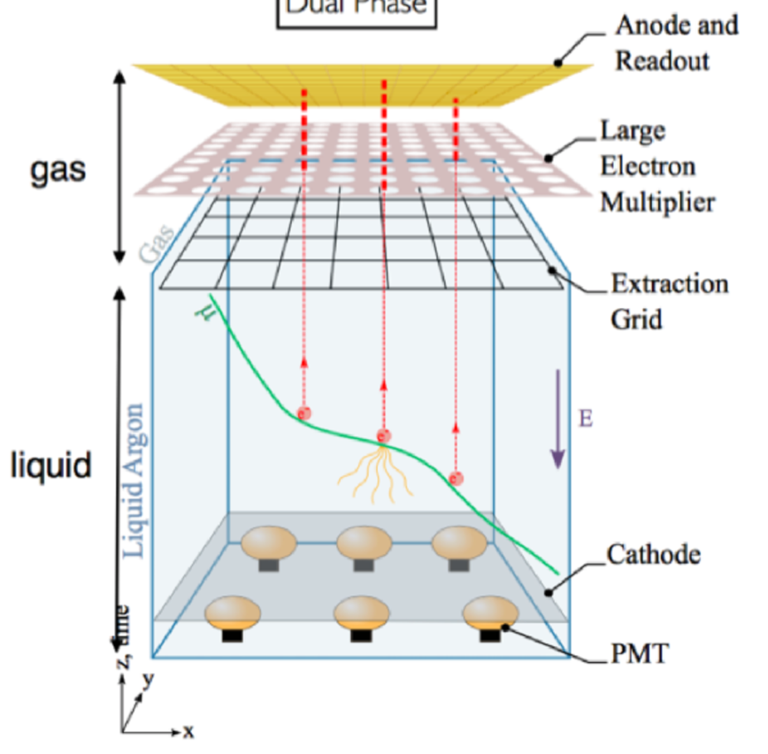
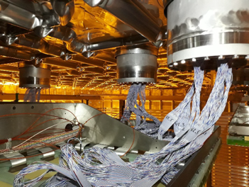
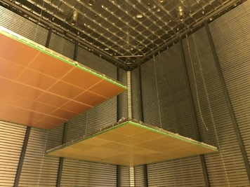
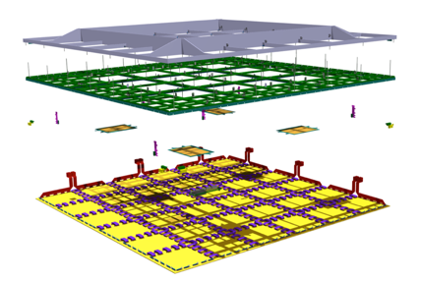
NP02: protoDUNE DP
CRP
DP= Dual Phase
Simple layout
No dead material in the drift region
Signal amplification
Electronics not in liquid
LEMs + anodes

Slide 21
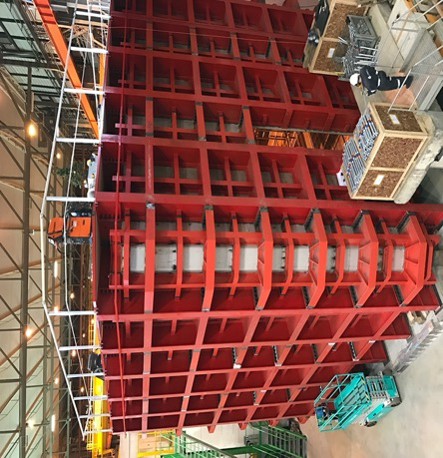
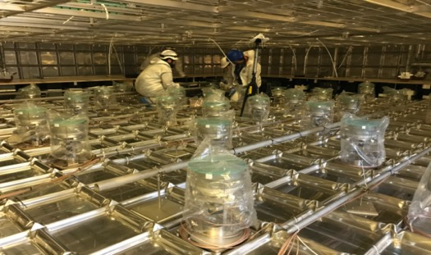
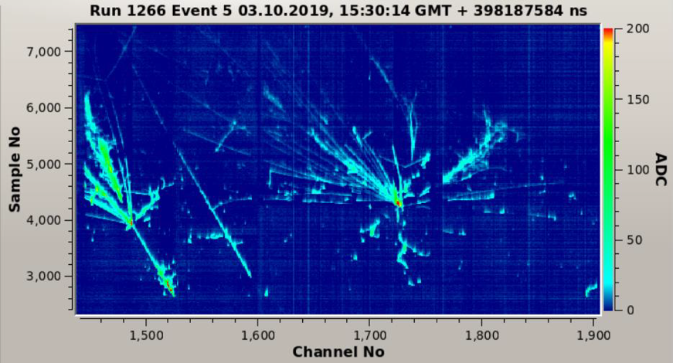
NP02 : protoDUNE DP
March 2018
Steps : Double Phase large prototype in EHN1
Construct the LAr membrane cryostat (760 T of Argon)
Construct a clean room in front of the cryostat
Assemble the active readout components (CRP) in the ICARUS (b185) cleanroom (CEA, Lyon, LAPP, CERN)
Construct and operate a cold box for testing all CRPs in b182
Assemble the cathode (EHN1) and the field cage
Bring all components to the EHN1 clean room
Assemble and test the field cage
Install 4 CRPs
Install the bottom PMTs (prepared in Spain)
Install the cathode plane
Install the LAr cryogenics
Clean the inside of the cryostat and detector, close the cryostat
Cooldown and fill with LAr
Commission and debug the detector
Closing April 2019
Cold tests July 2018
→ Good results, but stability not proven

Slide 22
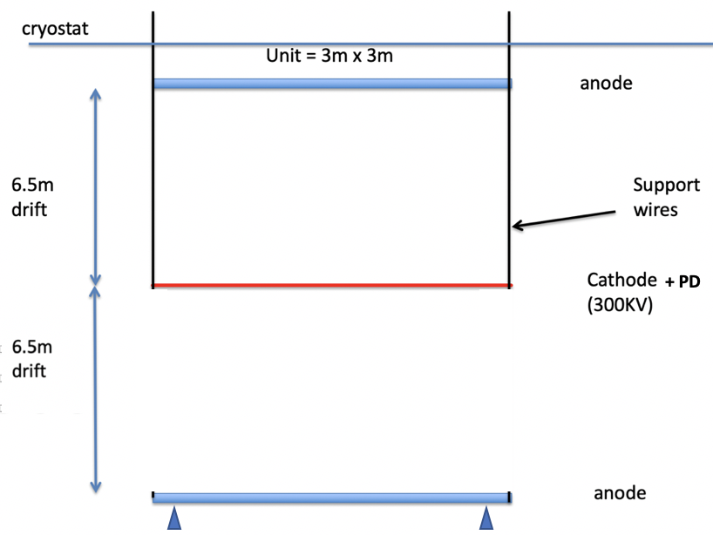
NEXT : Developing a new concept based on DP
Main idea: keep all what was done for NP02, but the LEMs (signal amplification)
Profit from the excellent electronic noise, move to a single phase system, all immersed, to avoid sparks and instabilities
First small scale R&D successfully done, full DUNE detector proposal being prepared
Possibility to have a full demonstrator on the existing cold box very fast (mid 2021)
A ProtoDUNE-II will then be eventually considered as a Module-0
Liquid

Slide 23
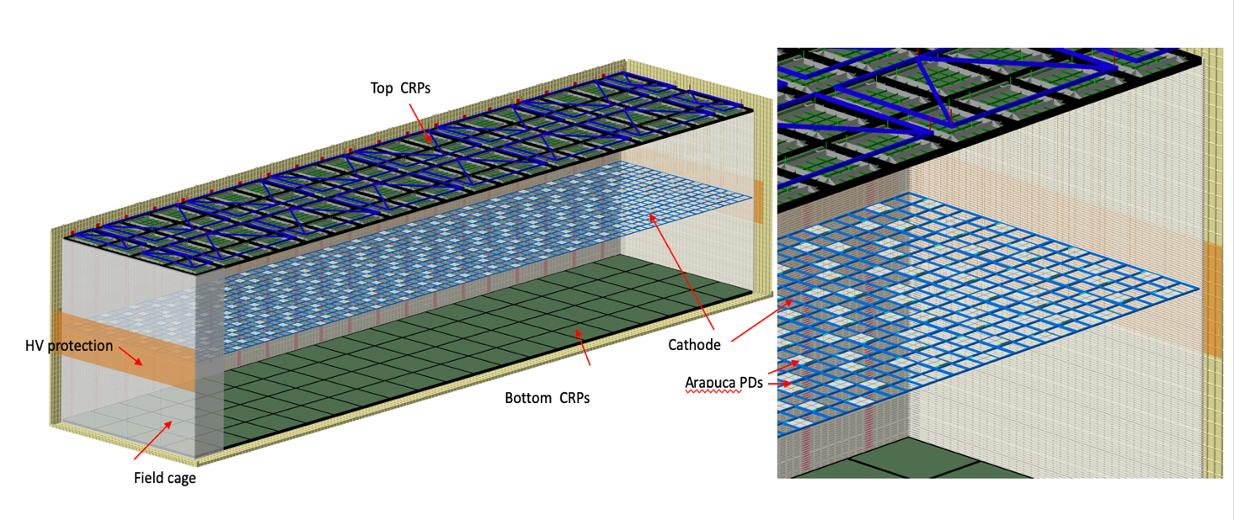
We have extensive proposal: https://edms.cern.ch/document/2429382
CRP= 3x3.375 m² readout units (anode)
Drift ~6.5m
160 CRP units (80 on top, 80 on the bottom)
Drift active volumes 2*5’265 m³ = LAr 14.74 Ktons

Slide 24
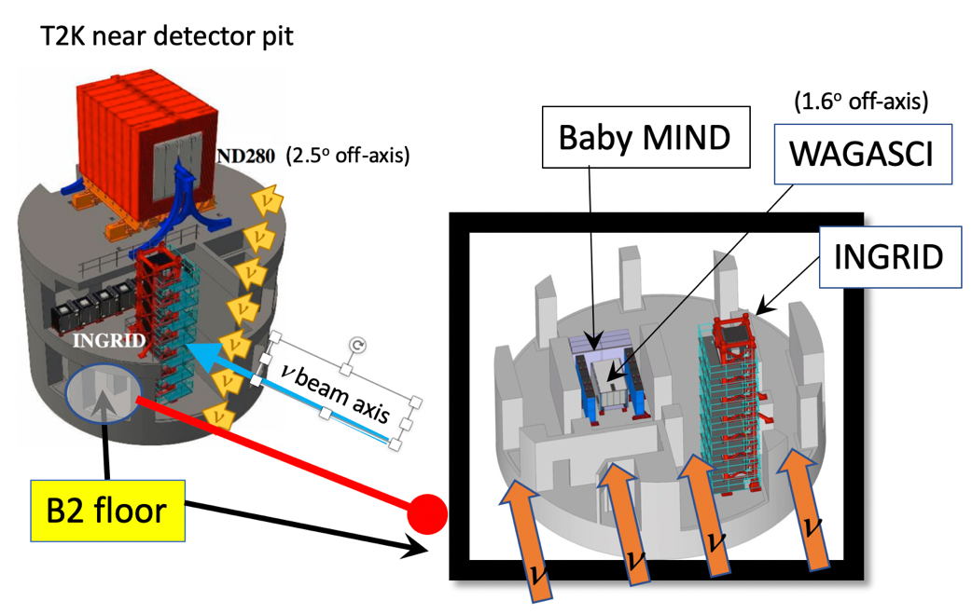
NP05 : Baby Mind NP07 : ND280
Contribution to the Japanese program: T2K Near detectors

Slide 25
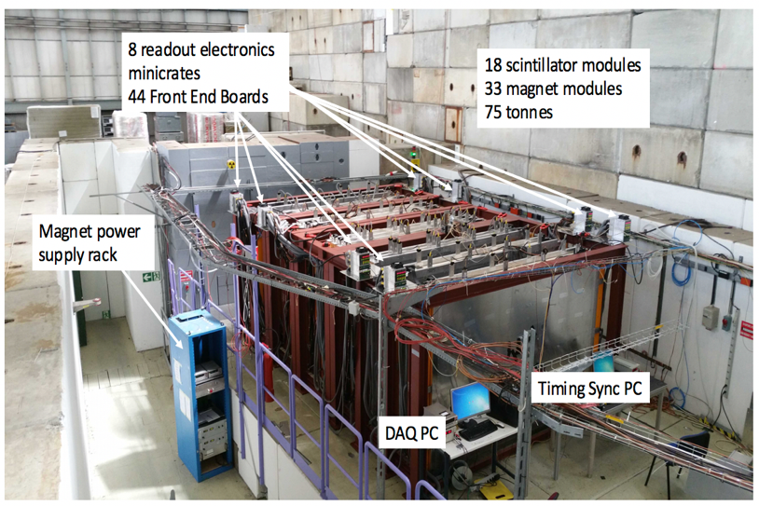
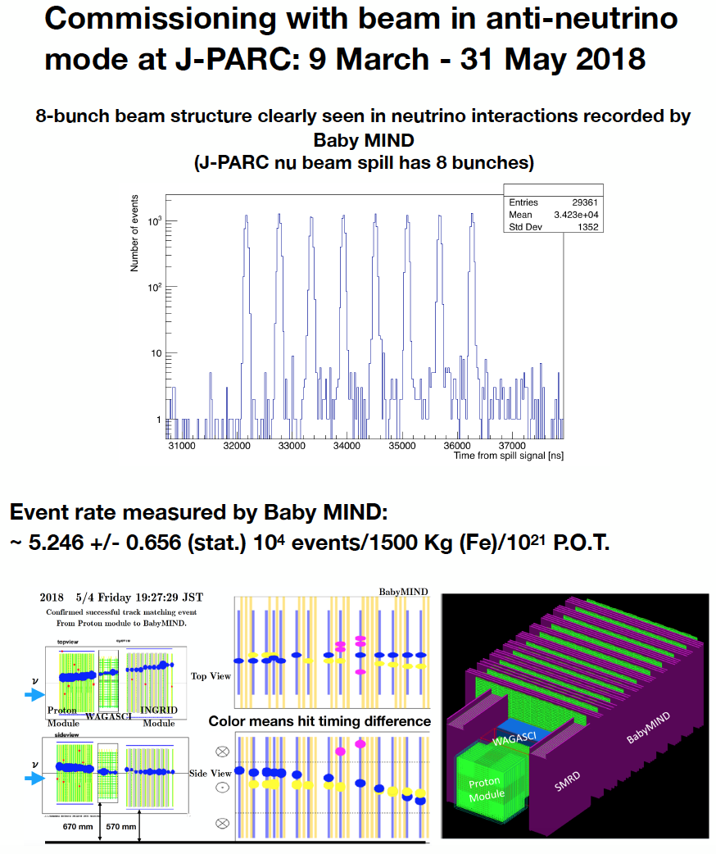
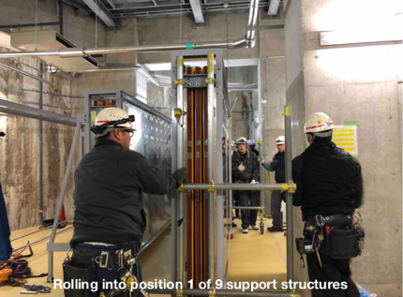
WAGASCI/Baby Mind muon detector
Assembled and tested in the SPS test beam in 2017
Transported and reassembled at J-Parc in February 2018

Slide 26
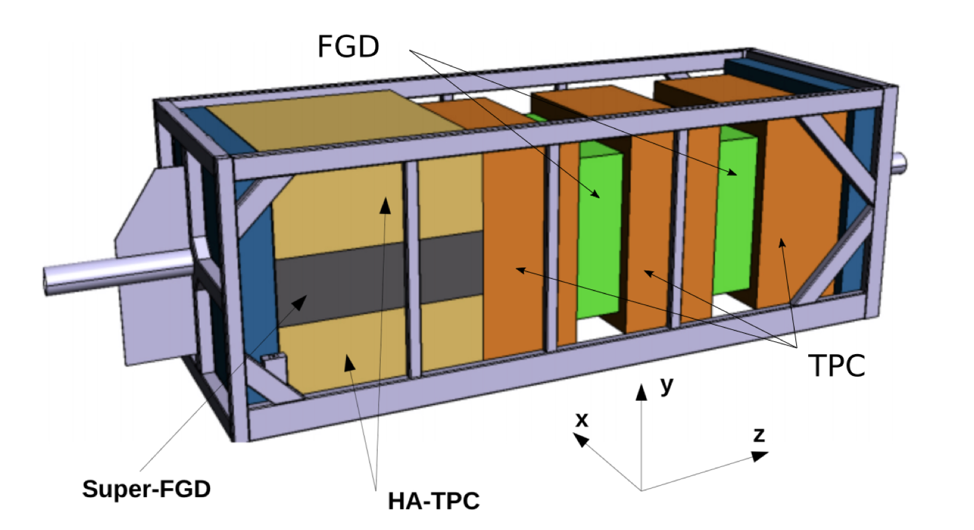
NP07: T2K upgraded near detector
Support to the test beam activities (TPC with micromegas readout and the SuperFGD tracker) in 2018
A new laboratory at EHN1 for the assembly and test work, new technical proposal
MOU under signature for the final detector, it will be operational in 2022
existing
It includes a fiducial mass of a few tons and highly efficient 4π tracking for low energy πs and protons to determine event topology, with proton-pion identification. Furthermore, good timing determination (at the 0.5 ns level) that can be used to distinguish inward going background events from outward going neutrino interactions.
HA-TPC =High Angle TPCs read by a micromegas system
SuperFGD = many optically independent 1 cm scintillator cubes
new

Slide 27
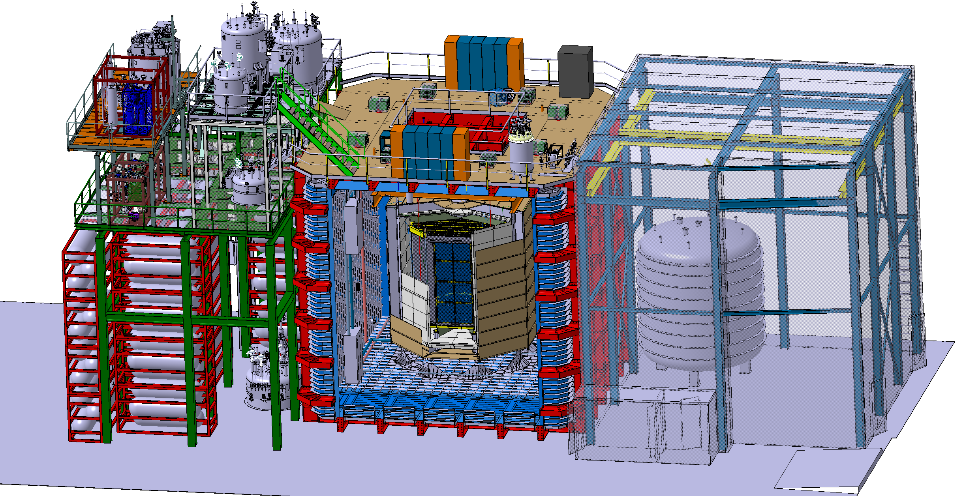
DarkSide
New concept based on the NP04 cryostat
The central TPC with primordial Argon 40 (no 39) is immerged in the large LAr bath. Internal TPC cryostat and material removed. Goal : a background free DM experiment!
With INFN personnel at CERN the entire engineering concept has been worked out and is ready for implementation
A CERN-INFN collaboration agreement on the subject signed

Slide 28
NP03: PLAFOND
PLAFOND
as first step before proposing a new experiment or a change on an existing one
as informal way to try out new ideas, to develop new concepts and alternatives
as a first entry point to Neutrino or non accelerator based fundamental research
as a way to initiate collaborations and explore synergies with new research partners
for young scientists as a first pragmatic approach to our methods and technologies. A place to learn basic tools and instruments
→ Very successful R&D program for the benefit of the entire community

Slide 29
Short baseline at CERN, LOI’s
DUNE cryostats
LBNF cryostat design and engineering
Virtual reality development for the DUNE far detector
Fundamental R&D on LAr properties
LAr purification system R&D (new approach)
UV Light propagation velocity in LAr R&D
Studies of liquid argon scintillation light properties with radioactive sources and cosmic rays
ICARUS
ICARUS readout and DAQ test and qualification
Tests and development of the ICARUS T600 scintillation light detection and trigger systems
Test and characterization of Hamamatsu PMT for ICARUS: timing, linearity and saturation
Studies of direct SiPM’s performance as a future alternative for PMTs with alternative readout methods.
Test and qualification of LAr-TPC read-out with BNL cold analogue end and ICARUS warm digitizers/DAQ
DUNE/ProtoDUNE
Aluminum modular field cage R&D for ProtoDUNE SP and DP
R&D on UV reflector( with WLS) foils on cathode in LAr and related Electric field uniformity map
HV system qualification (feedthough, power supplier, ripple suppression filters)
LAr doping tests and qualification with Xenon and Xe-N2
Alternative solutions to classical WLS ….. PEN?
In general project lasting 2-3 months,
making use of the existing infrastructure, a cryogenic laboratory, some minimal technical and engineering support …
…. and an healthy and informal proactive collaborative approach …..
Dark Matter search
Test and qualification of Dual phase detection in LAr for extremely low energy events
LAr Doping ternary mixture Xe-CH4 for active shielng in Dark Matter experiments
Future developments for LAr detector
Vertical drift TPC readout and concept with perforated anode PCB replacing wires
SIPM in LAr on HV substrate with powering over fiber and optical read-out
Other R&D
superFDG for T2K near detector and ND280upgrade
Silicon pixels for photon detection, fast
Most of this is now part of the existing research program!

Slide 30
Summary
Very intense level of activities over a period of 6 years
Most of the activities are R&D, with all the risks associated (technical, financial and scientific)
CERN focused on membrane cryostat technologies (7 constructed, 3-4 in the pipeline). Our contribution to this industrial technology is today well visible also outside our field
The path chosen after the 2013 European Strategy update has been confirmed in the 2020 update
The NP continues to serve the community in their path towards the next generation of ν physics
LBNF/DUNE and SBN, today also exist because of the NP fundamental contribution and delivery success

Slide 31
The Neutrino Platform concept
It seems to be effective
It gives access to external users (not necessary already at CERN) of CERN infrastructure and specific technical knowhow
An effective way to bring in new ideas on fundamental research not directly related to the LHC program
A way to start new collaborations and bring in CERN as a collaborating partner (outside CERN)
It might extend to other fields of fundamental science in an effective way

