Slide 1
Loss prediction through modeling of high dynamic range beam distributions
Kiersten Ruisard, Alexander Aleksandrov, Sarah Cousineau, Oak Ridge National Laboratory
Snowmass21 AF2 Town Hall Workshop
12/10/2020

Slide 2
Summary of concept
Neutrino facilities are driven by high-intensity proton beams
Better predictive models for high-intensity beam evolution are needed
  Beam loss, halo growth, profile shaping
  Modern PIC should support loss-inclusive modeling
  To date, no demonstration of accuracy at loss level
Test stands can support advanced diagnostics and extensive beam time not available in production accelerators
  High dynamic range and fully-correlated 6D phase spaces
Notes:
There is a gap between sophisticated modeling tools and demonstrated success in their application.
Operators rely on empirical tuning and intuition;

Slide 3
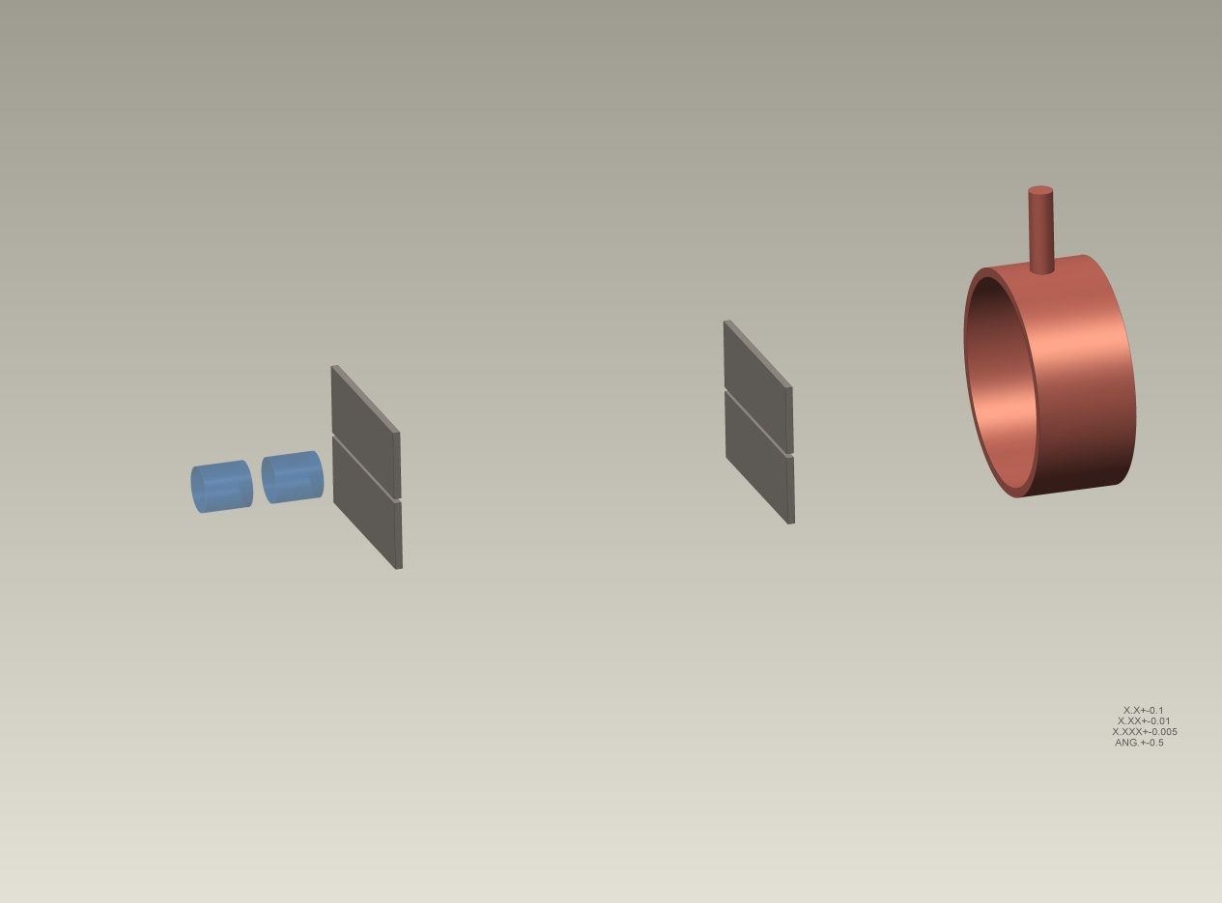
Investment at ORNL
H- ion source + LEBT
RFQ
SNS Beam Test Facility
  model of SNS injector with beamline extension
  2.5 MeV, 40 mA H-
High dimensional measurement
  Full 6D phase space
High dynamic range measurement
  capable of measuring to loss-threshold (1 ppm)
SLIT_2
SLIT_1
L
BEAM
FARADAY CUP
Notes:
Focus on downstream losses resulting from dynamics at injector.

Slide 4
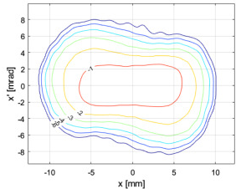
What we’ve learned
High dimensional measurement
Longitudinal hollowing in beam core
  Signature of nonlinear space charge
  Reproduced in RFQ simulation
  May influence downstream evolution
High dynamic range measurement
  Very little halo out of RFQ
Increasing core:edge ratio
10.1088/1748-0221/15/07/P07025
10.1103/PhysRevLett.121.064804
10.1103/PhysRevAccelBeams.23.124201
High dynamic range measurement
10.1016/j.nima.2020.164829
Notes:
Specific ties to Neutron source community needs

Slide 5
GARD Grand challenge #1 (beam intensity): How do we increase beam intensities by orders of magnitude?
Demonstrate ability to predict beam evolution including lost particles
Investment in test stand analogs for high-power accelerators
  Advanced phase space diagnostics
  Research staff for in-depth test-stand studies
  Platform for benchmarking and model improvement
Collaboration for benchmarking of PIC codes
Computing resources for large-scale PIC simulation

Slide 6
Involvement in Snowmass
LOI submitted to AF1+AF2
Concept presented at joint CompF/AF interest group
  Highlighting need for benchmarking studies
Potential AF2 white paper contribution, preferably with co-authors
Notes:
Either test-stand angle or modeling/benchmarking angle

Slide 7
Extras

Slide 8
BTF follows footsteps of earlier attempts to benchmark 3D bunch evolution
matched
mismatched
LEDA @ LANL: extensive simulations aimed at benchmarking halo evolution measurements
Qiang, J., Colestock, P. L., Gilpatrick, D., Smith, H. V., Wangler, T. P., & Schulze, M. E. (2002). Macroparticle simulation studies of a proton beam halo experiment. Phys Rev ST-AB, 5(12), 35–47.
Simulations of high-intensity ion front-ends cannot reproduce tails/halo.
Hypothesis: Limited knowledge of initial distribution to blame for discrepancies
Notes:
IMPACT simulations; distributions simulated starting at plasma boundary of source

Slide 9
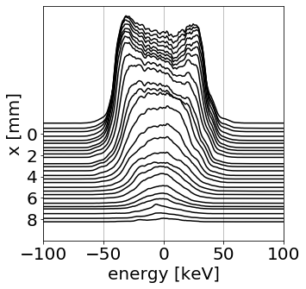
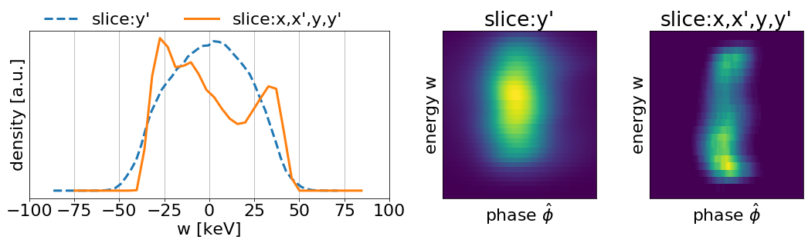
Beam core

Slide 10
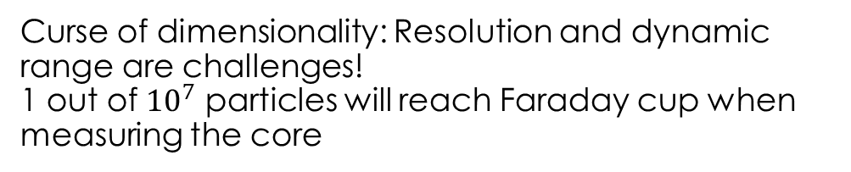
Measurement strategy
BENDING MAGNET
SLIT_Y_2
SLIT_X_2
SLIT_2
SLIT_1
L
SLIT_Y_1
SLIT_X_1
dx⋅dy⋅dx´⋅dy´
BEAMLET
BEAM
dx⋅dy
BEAMLET
FARADAY CUP
SLIT_X_3
RF deflector
SLIT_X_4
Plane of measurement
Curse of dimensionality: Resolution and dynamic range are challenges!
1 out of ${10}^{7}$ particles will reach Faraday cup when measuring the core

