Slide 1
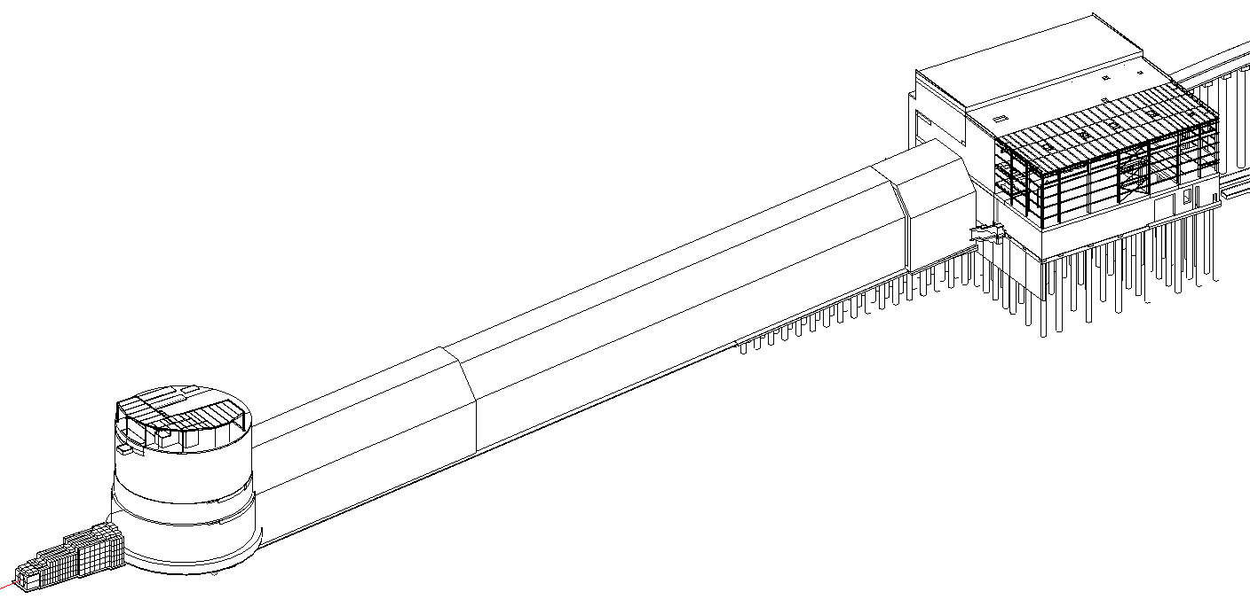
Decay Region Construction and Operation Geometry
Beam Interface Working Group
Jonathan Lewis
19 November 2020

Slide 2
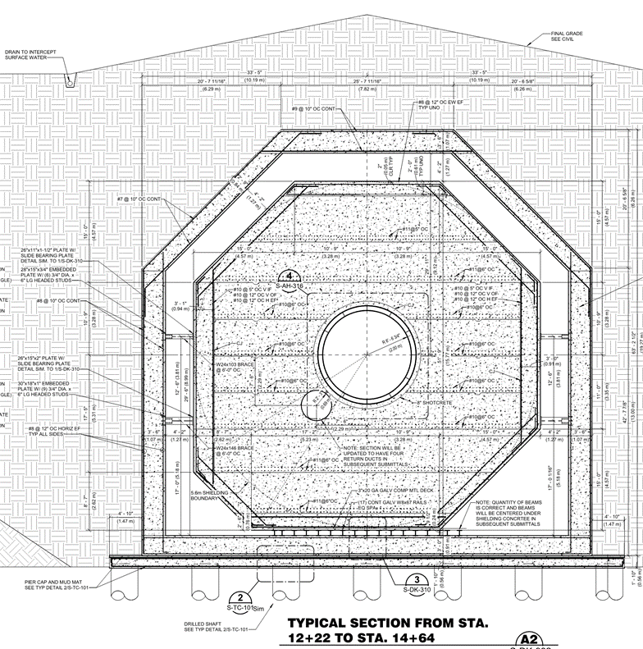
Overall Design
The project has adopted the “box in a box” design
Decay vessel shielding is contained within an outer concrete structure
Barrier to water ex- and infiltration
Allows for inspection
Nitrogen Gas Cooling Channel
Nitrogen Return

Slide 3
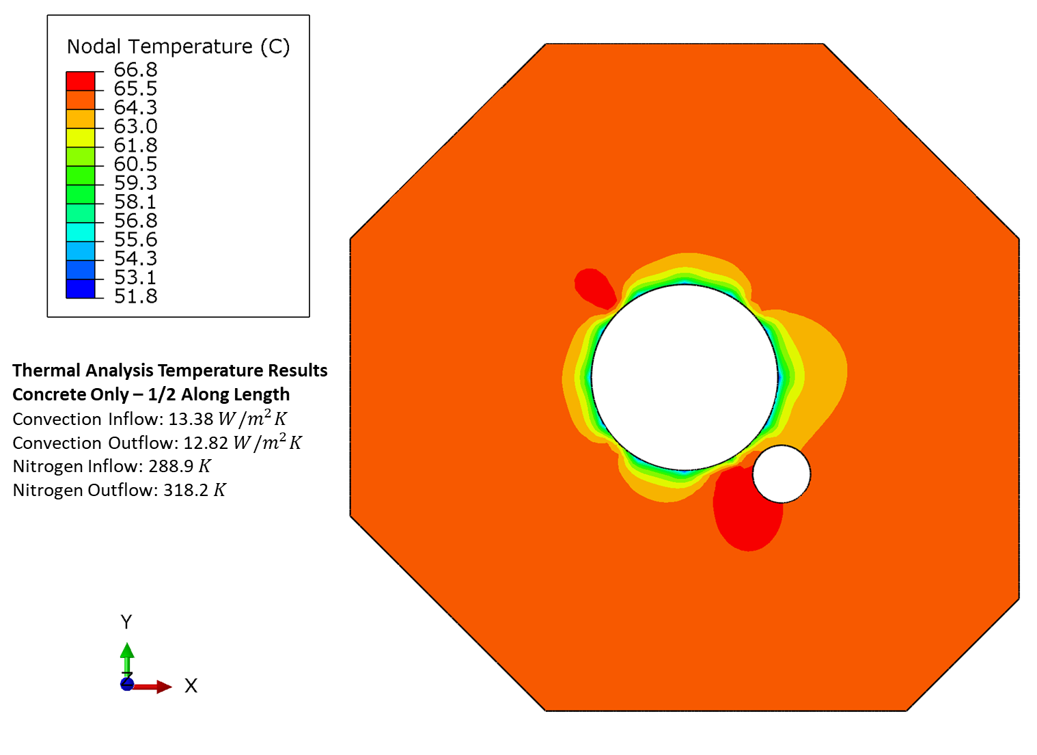
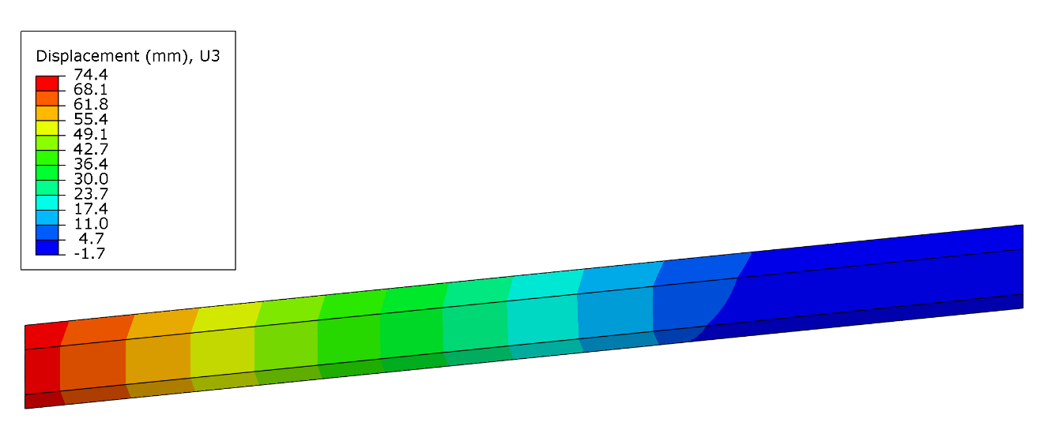
Thermal Expansion
Energy Deposition results used in thermal FEA
Temperature 60C for 2.4MW operation
Shows expansion of 5-8cm along 200m length
Single cooling return pipe causes lateral distortion
Will revert to design left-right symmetry

Slide 4
Construction Features
Structure is locked to base slab at top
Expansion is toward absorber hall
Avoids displacement of target
Locked to foundation
Sliding on base slab
Slab on bedrock
Slab on piers that rest on bedrock

Slide 5
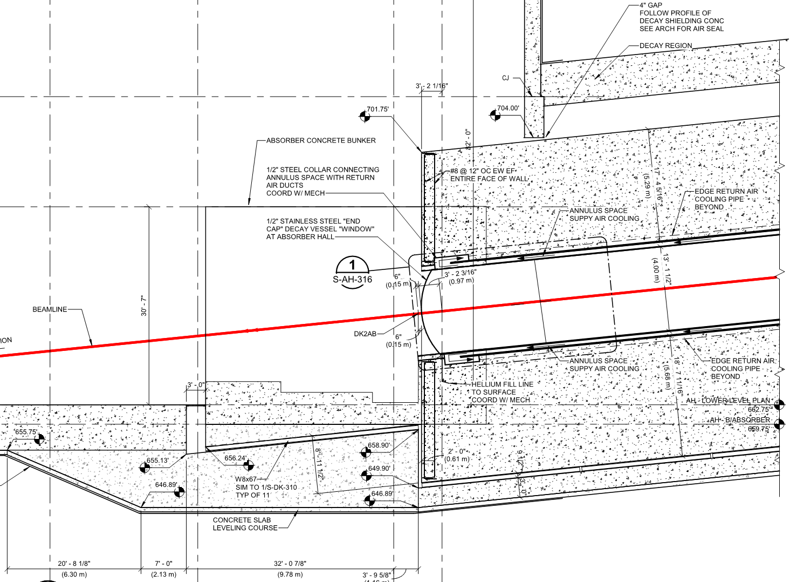
Absorber Moves with Decay Pipe
The arrangement solves many structural and cooling problems
Decay region length will change depending on decay pipe heating
Should reach a steady state after a few weeks of operation
Have access to top of decay structure, so this can be measured
Measure Here?
Absorber
Slip Plane

Slide 6
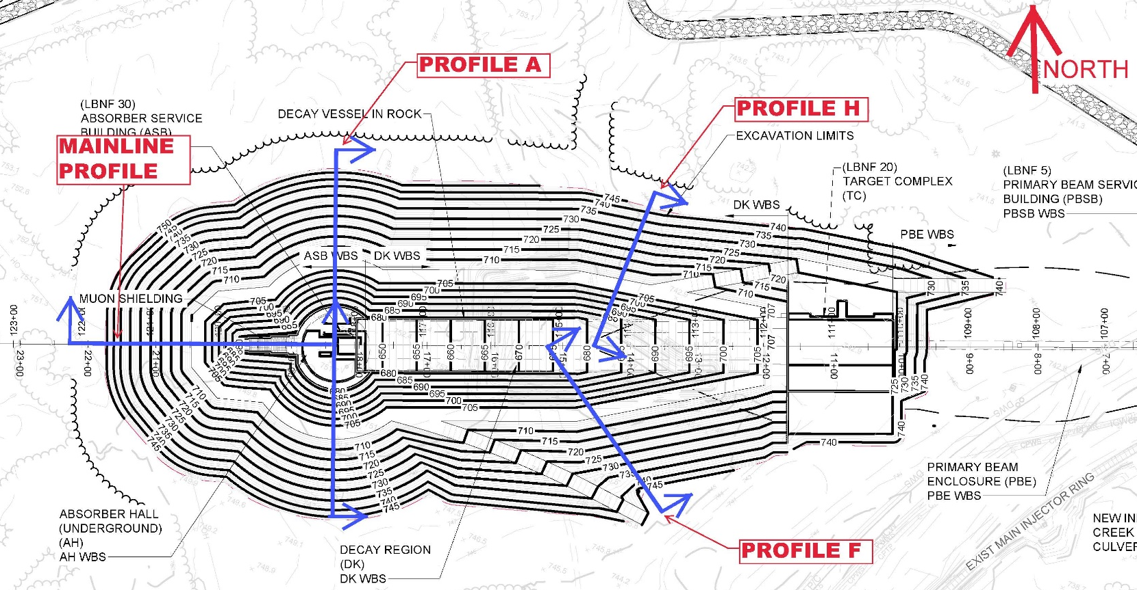
Construction Process
Start with a massive excavation
Then build the base slab

Slide 7
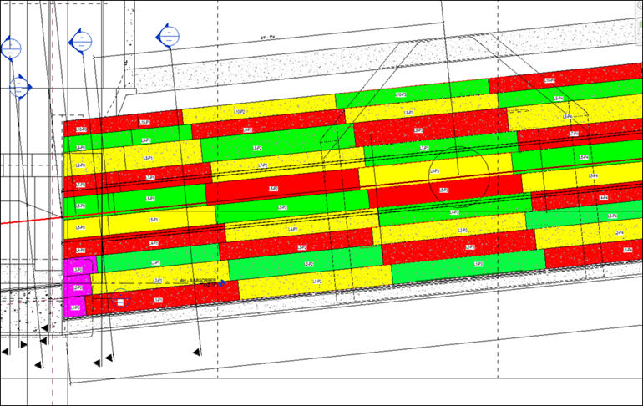
Construction of Decay Structure
Build in sections
Concrete set in a series of 5-foot lifts
Add sections of pipe as you go along
Pipe set with typical construction tolerances: ~1/4 inch
Add outer structure
Fill in excavation

Slide 8
Concerns and Questions
Pipe position will be set by survey crew as it is built
Will check for residual magnetic fields after welding
Will sink ~1 inch after structure is complete and excavation is filled
Awaiting calculations for current design
Not a perfect cylinder
Some amount of wiggle expected
1-2 cm out of round with axis varying over length of pipe
How concentric does the pipe need to be with beamline?
Do we need to compensate for expected movement when it is placed?
How well does position need to be measured?
In principle can get mm accuracy from Alignment staff
Is measurement required after settlement is expected to be complete?
Could we measure the outside of the structure to before and after to look for settlement?
How well do we need to measure elongation?

Slide 9
Backup

Slide 10
Construction of Decay Structure
Build in sections
Concrete set in a series of 5-foot lifts
Add sections of pipe as you go along
Pipe set with typical construction tolerances: ~1/4 inch
Add outer structure
Fill in excavation

