Slide 1
Decay Pipe Size on Fluxes and Precision Requirements
Pierce Weatherly
BIWG Meeting
November 19, 2020

Slide 2
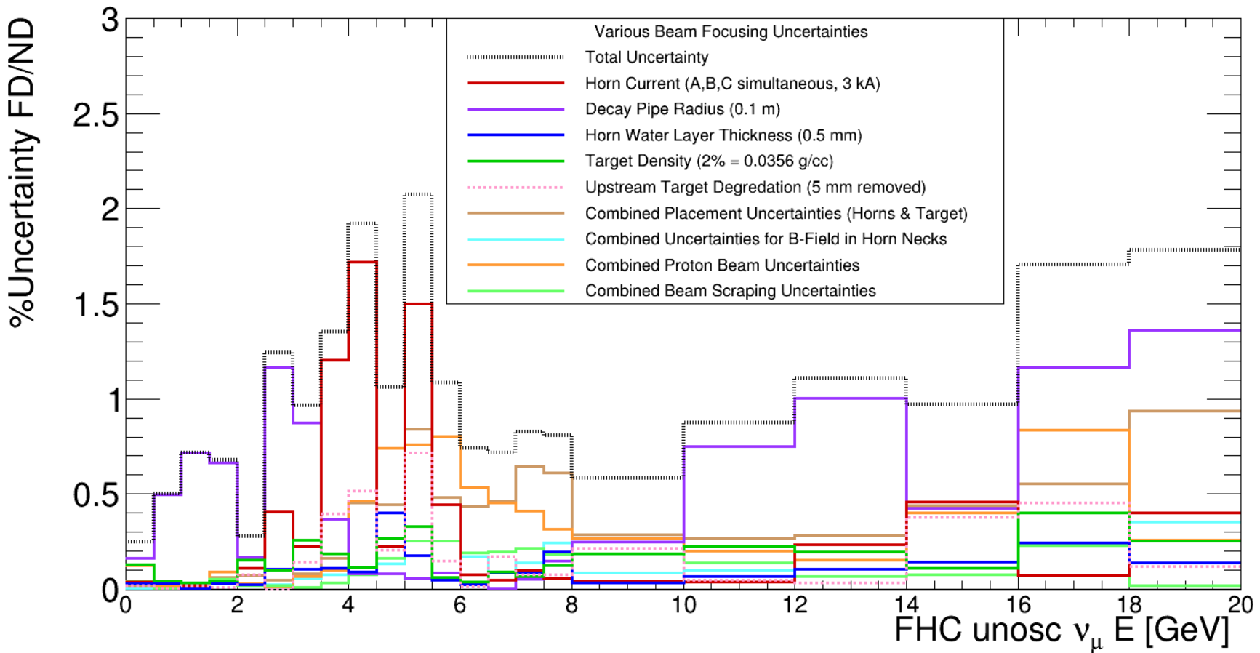
Motivation/Goal
Decay Pipe Size is a significant systematic uncertainty source in beam focusing uncertainties for primary physics region.
Uncertainties are for Unoscillated $ν_{μ}$ flux
Asked to see how uniform we need the decay pipe to be to reduce uncertainty.
In terms of deviation in “decay pipe radius” dR
“Radius” is a stand in for multiple deformation effects of the pipe
Find an acceptable level of deviation in muon neutrino flux, corresponding dR value, that fits within engineering budget/constraints

Slide 3
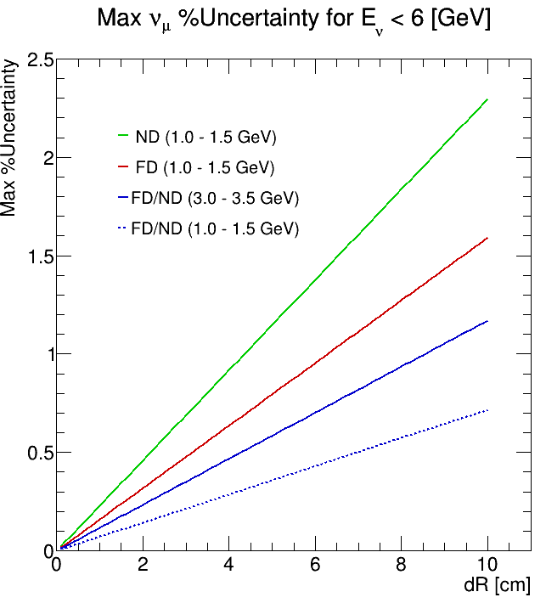
Max %Uncertainty($dR$) in Flux ROI
R₀= 2.0 m, 1$σ$ = 10 cm
-5$σ$ – +5$σ$ & Sub-1$σ$ samples:
$±$0.2, $±$0.4, $±$0.5, $±$0.6, $±$0.8 $σ$ (2-8 cm)
Fit in $σ$ for each energy bin with all simulations
Include Sub-1$σ$ simulation samples
1$σ$ sample has very high stats (>1e9), so no significant change to best fit after including
Result (right)
extract values from fit (1 mm steps)
All 4 are very shallow P₂’s
Notes:
$±$0.2, $±$0.4, $±$0.6, $±$0.8 generated with 250 million PoT each
$±$0.5 have 500 million PoT

Slide 4
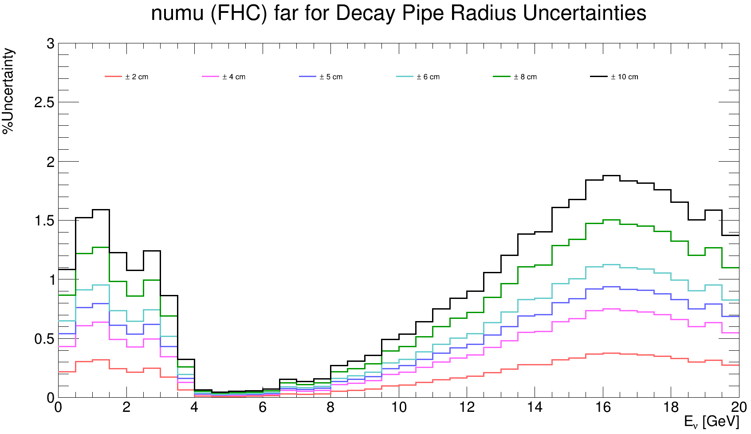
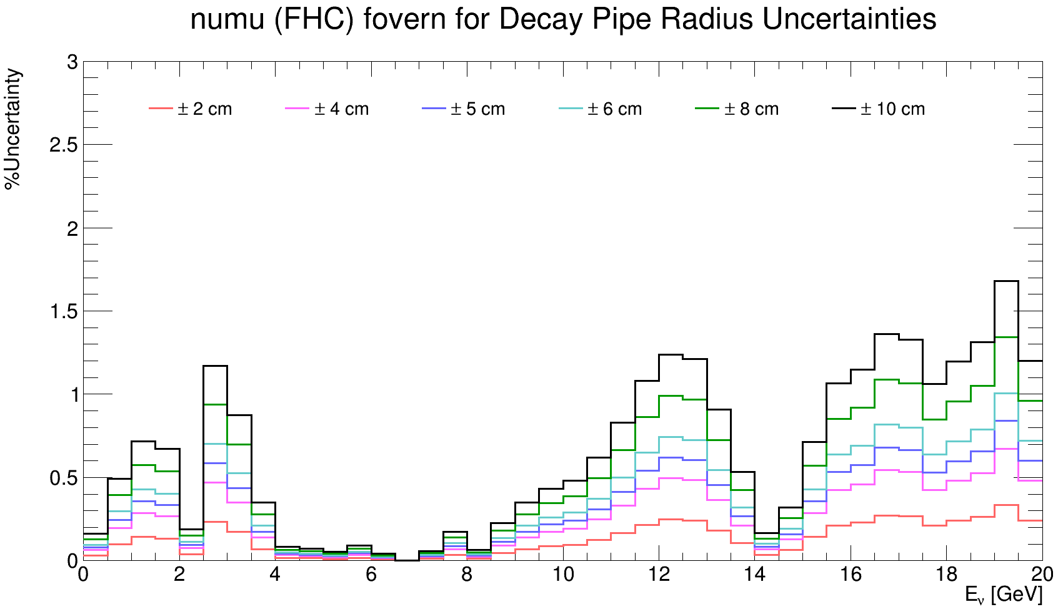
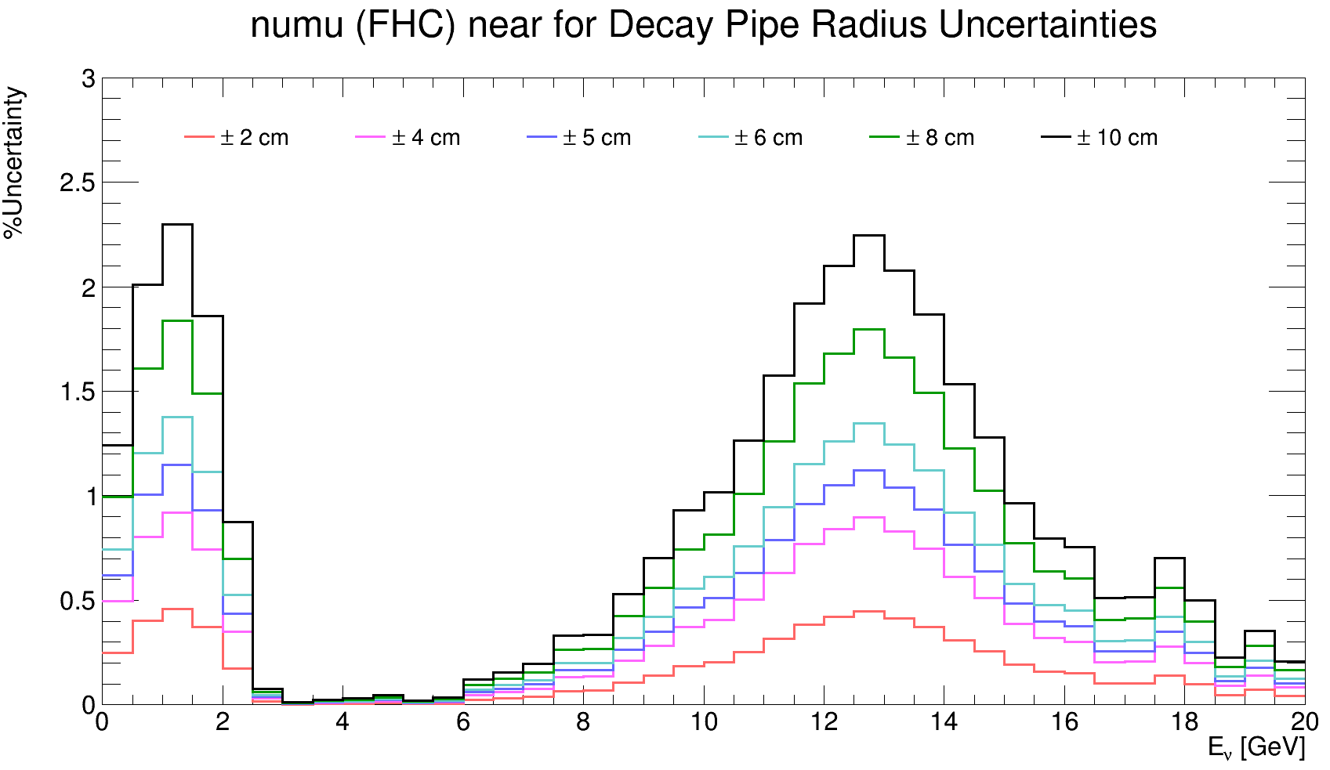
Details
This page: %Uncertainties for FD, ND, FD/ND
Large plots on following pages
$±$1$σ$ has > 1e9 PoT
-5$σ$ to 5$σ$ samples ~ 0.5e9 PoT,
Sub-1$σ$ samples
$±$0.2, $±$0.4, $±$0.6, $±$0.8 $σ$ samples generated with 0.25e9 PoT each
$±$0.5$σ$ have 0.5e9 PoT
FD
FD/ND
ND

Slide 5
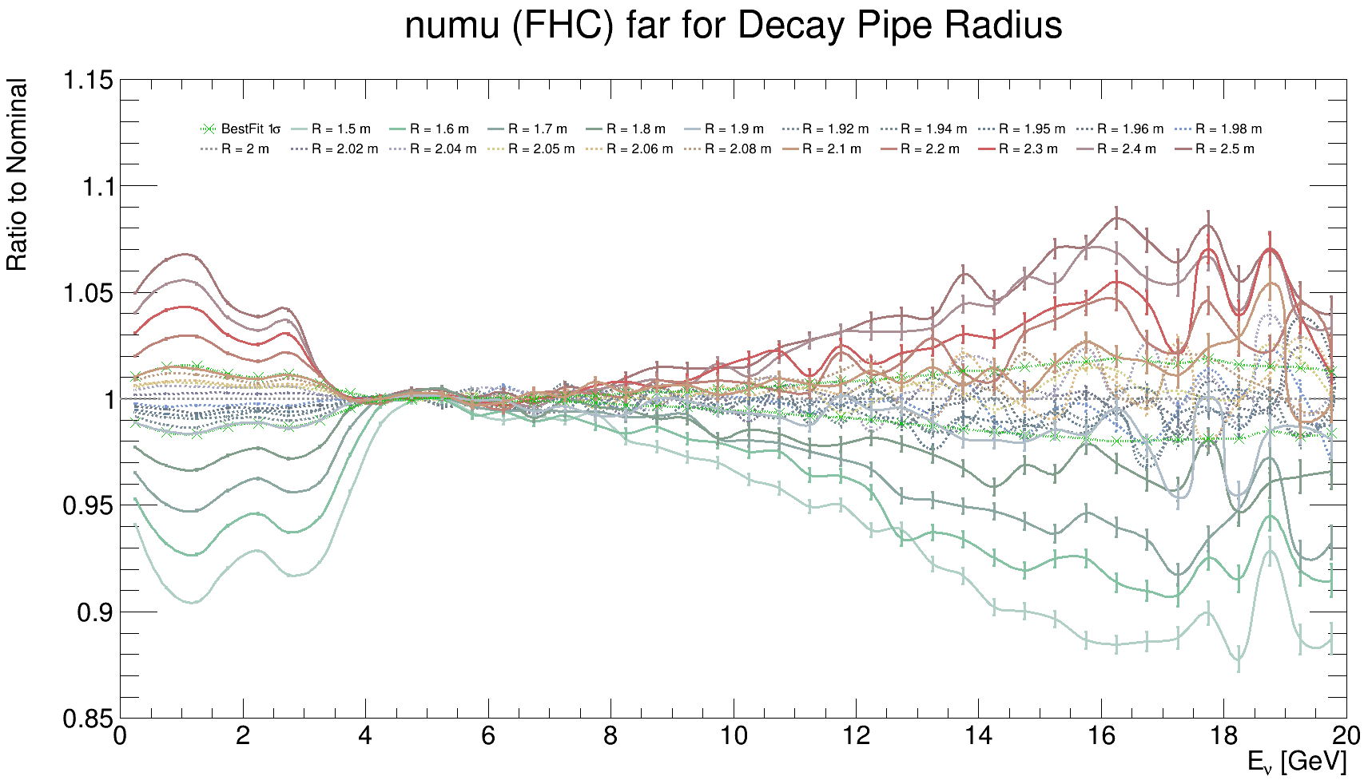
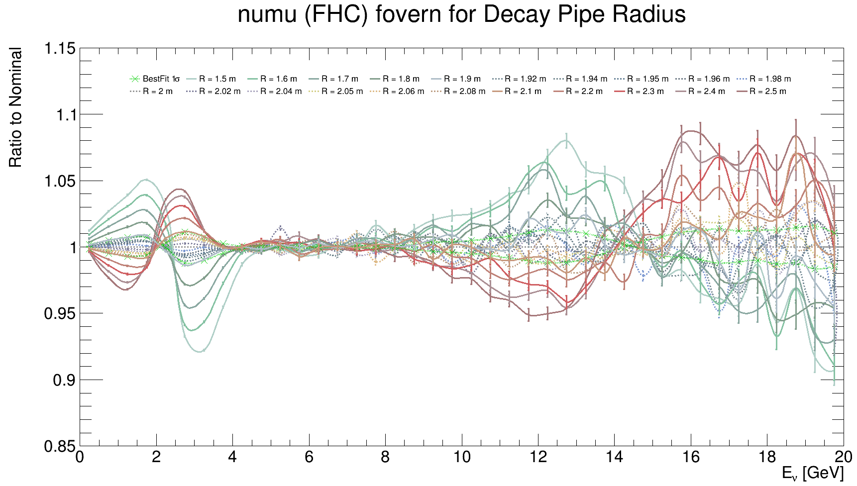
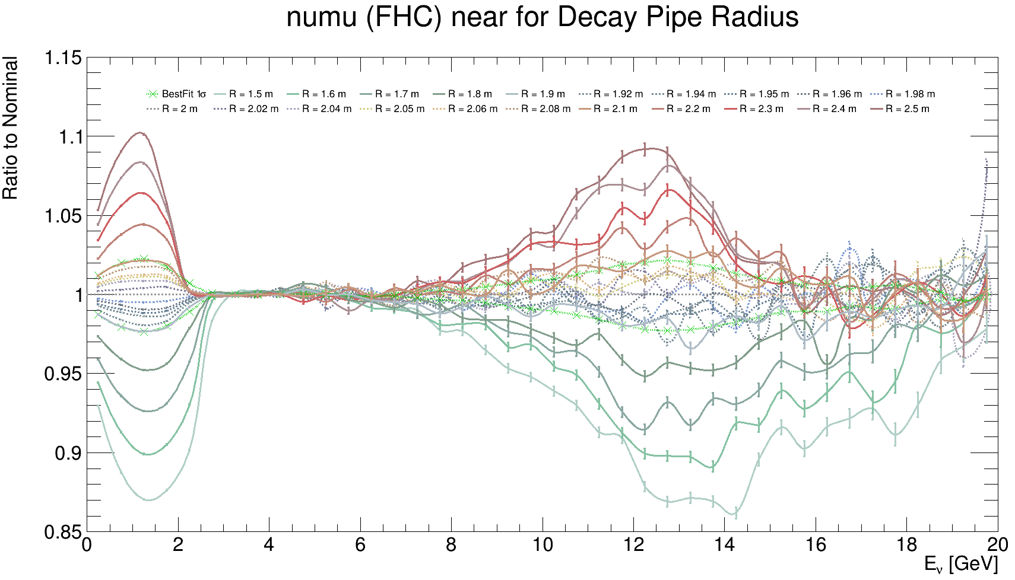
Flux Ratios to Nominal Simulation: -5$σ$ to 5$σ$, d$σ$ = 1$σ$ & $±$0.2, $±$0.4, $±$0.5, $±$0.6, $±$0.8$σ$
FD
Fits are performed in each energy bin on the data from these plots (including errors)
FD/ND
ND

Slide 6
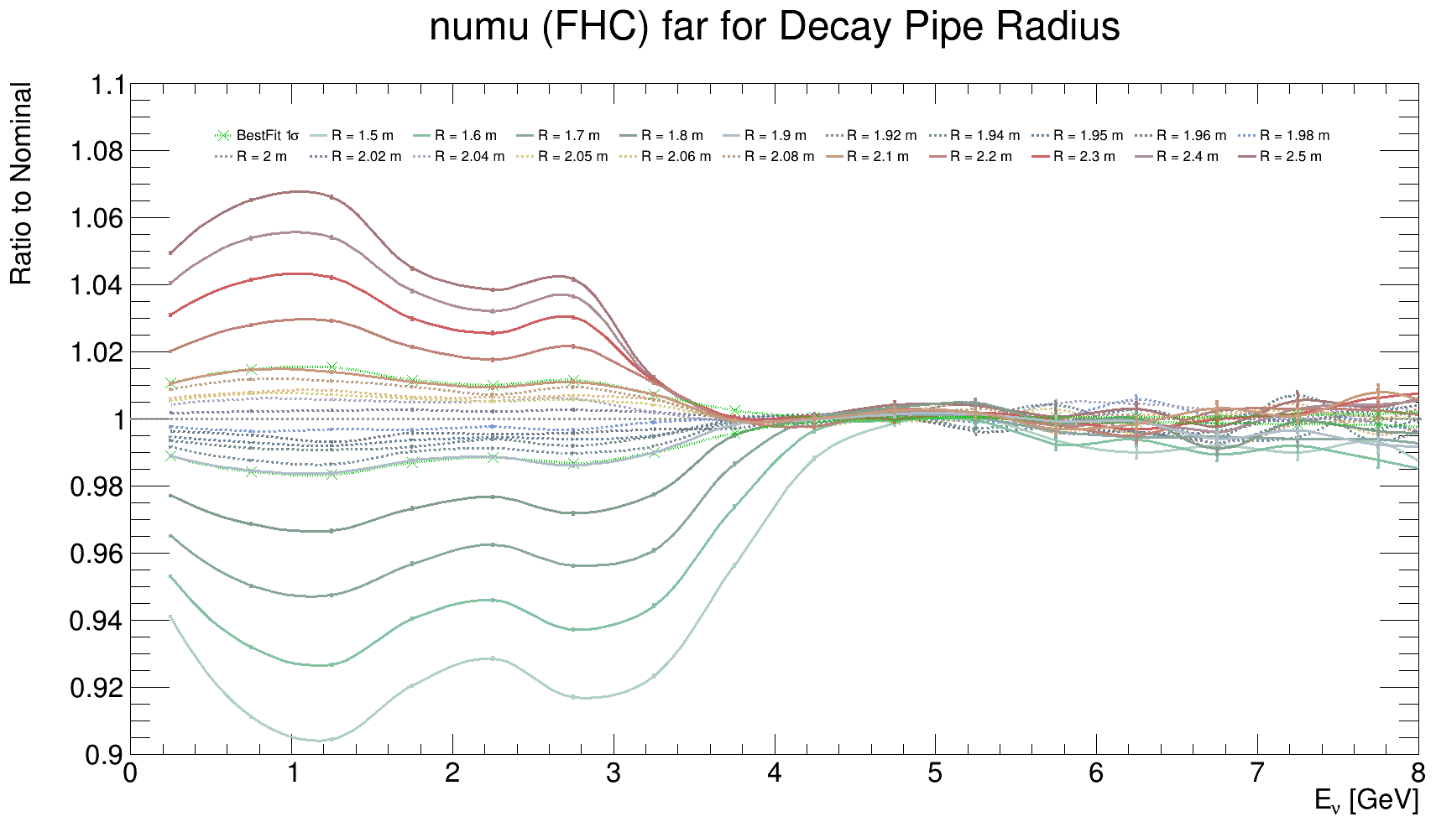
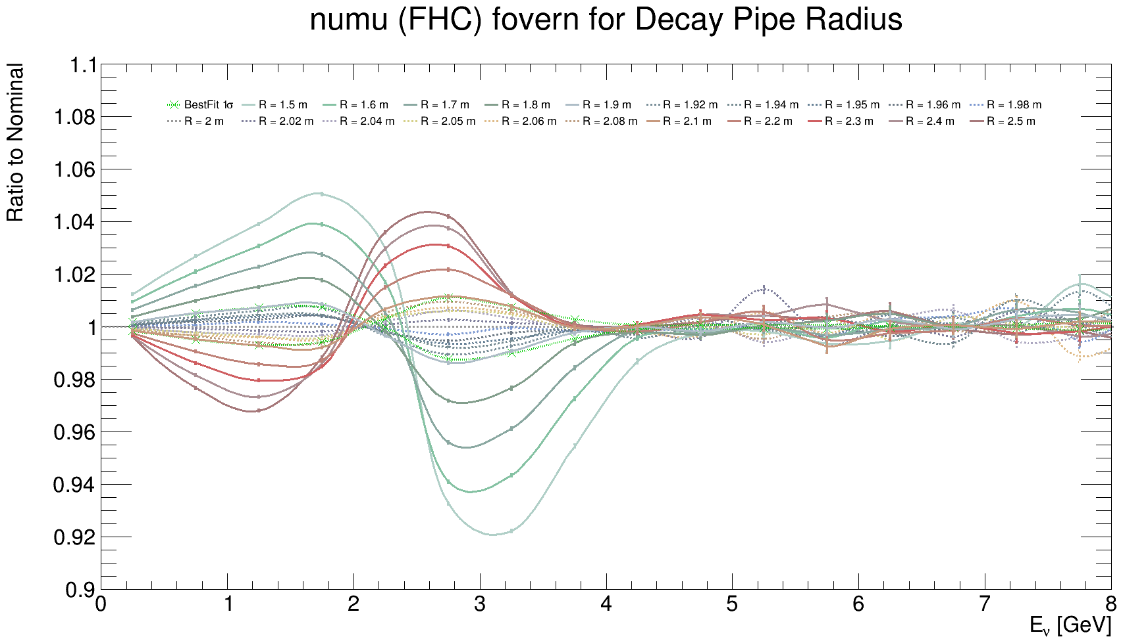
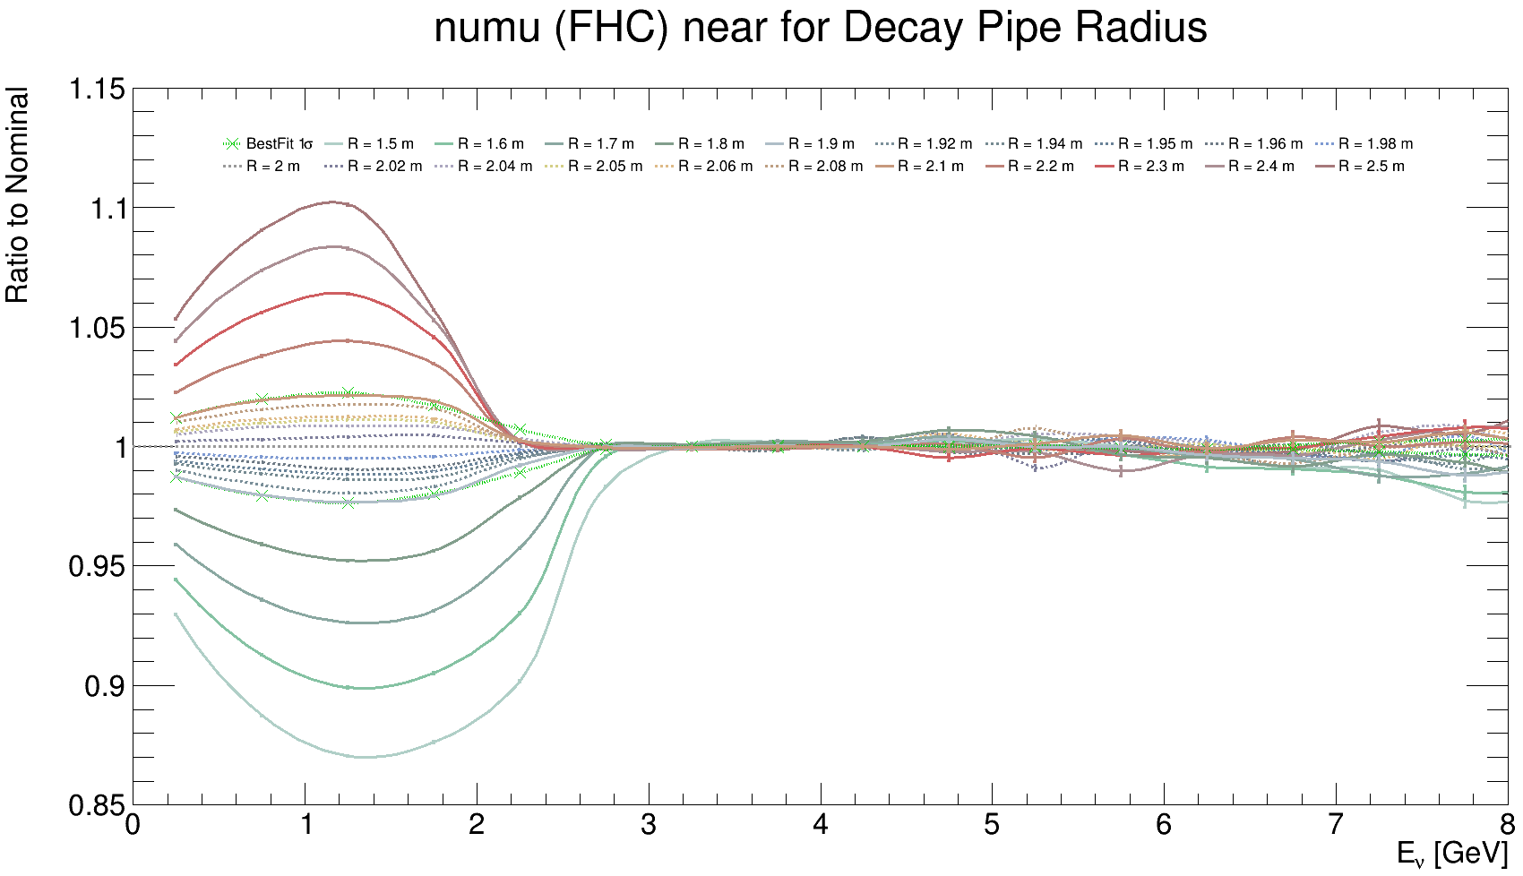
Flux Ratios to Nominal Simulation: -5$σ$ to 5$σ$, d$σ$ = 1$σ$ & $±$0.2, $±$0.4, $±$0.5, $±$0.6, $±$0.8$σ$
$ν_{μ}$ FD flux -5$σ$ to +5$σ$ comparison including $≤1σ$ (dashed), $E_{ν}≤8 GeV$
Fits are performed in each energy bin on the data from these plots (including errors)
$ν_{μ}$ FD/ND flux -5$σ$ to +5$σ$ comparison including $≤1σ$ (dashed), $E_{ν}≤8 GeV$
$ν_{μ}$ ND flux -5$σ$ to +5$σ$ comparison including $≤1σ$ (dashed), $E_{ν}≤8 GeV$

Slide 7
$ν_{μ}$ ND flux $≤1σ$ comparison

Slide 8
$ν_{μ}$ FD flux $≤1σ$ comparison

Slide 9
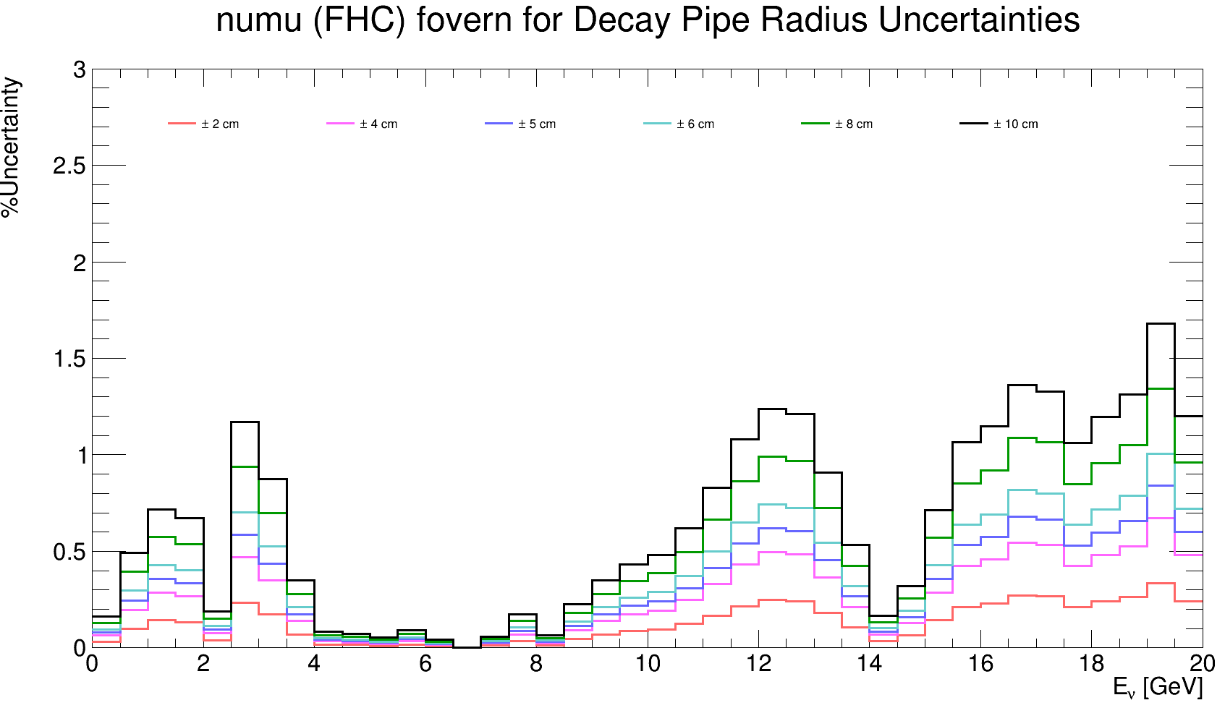
$ν_{μ}$ FD/ND flux $≤1σ$ comparison

Slide 10
$ν_{μ}$ ND flux -5$σ$ to +5$σ$ comparison including $≤1σ$

Slide 11
$ν_{μ}$ ND flux -5$σ$ to +5$σ$ comparison including $≤1σ$, $E_{ν}≤8 GeV$

Slide 12
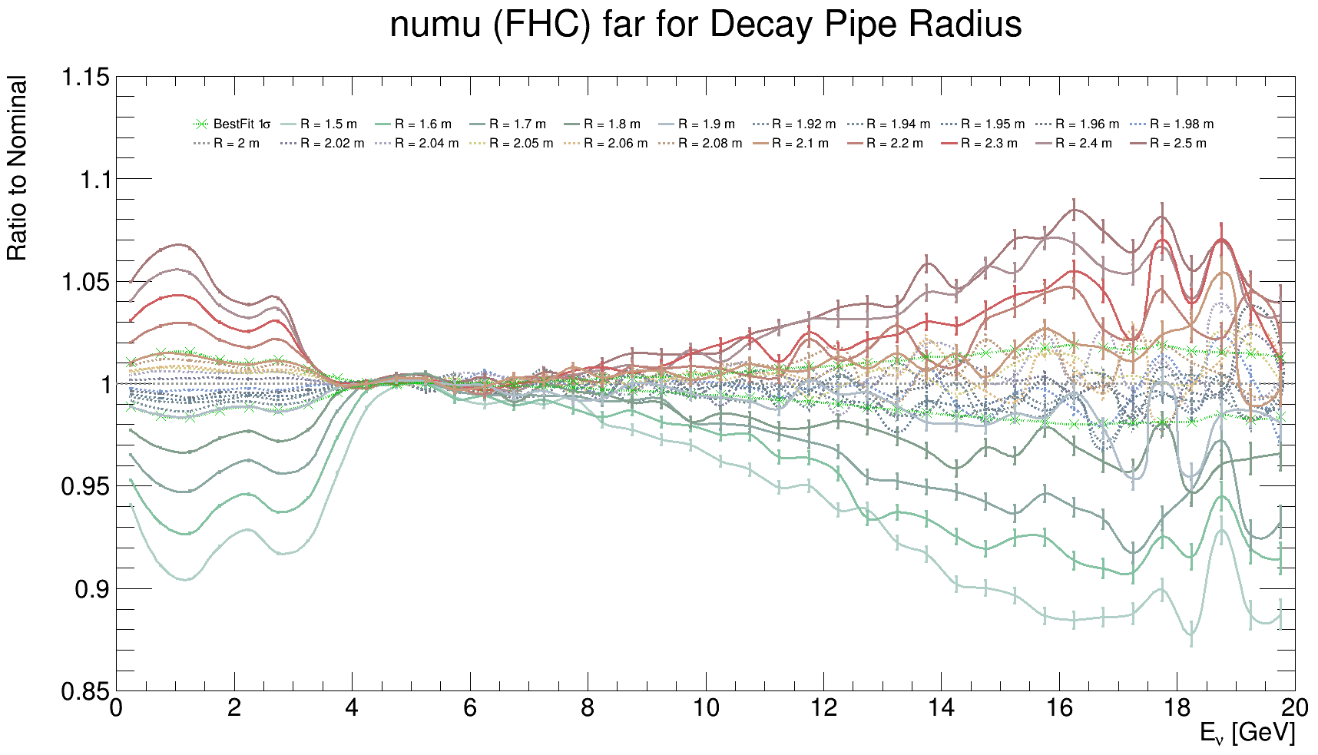
$ν_{μ}$ FD flux -5$σ$ to +5$σ$ comparison including $≤1σ$

Slide 13
$ν_{μ}$ FD flux -5$σ$ to +5$σ$ comparison including $≤1σ$, $E_{ν}≤8 GeV$

Slide 14
$ν_{μ}$ FD/ND flux -5$σ$ to +5$σ$ comparison including $≤1σ$

Slide 15
$ν_{μ}$ FD/ND flux -5$σ$ to +5$σ$ comparison including $≤1σ$, $E_{ν}≤8 GeV$

Slide 16
Backup

Slide 17
Uncertainties for FHC FD/ND, all flavors
$$ν_{μ}$$
$${\overline{ν}}_{μ}$$
$$ν_{e}$$
$${\overline{ν}}_{e}$$
17
Pierce Weatherly | DUNE Collaboration Meeting

Slide 18
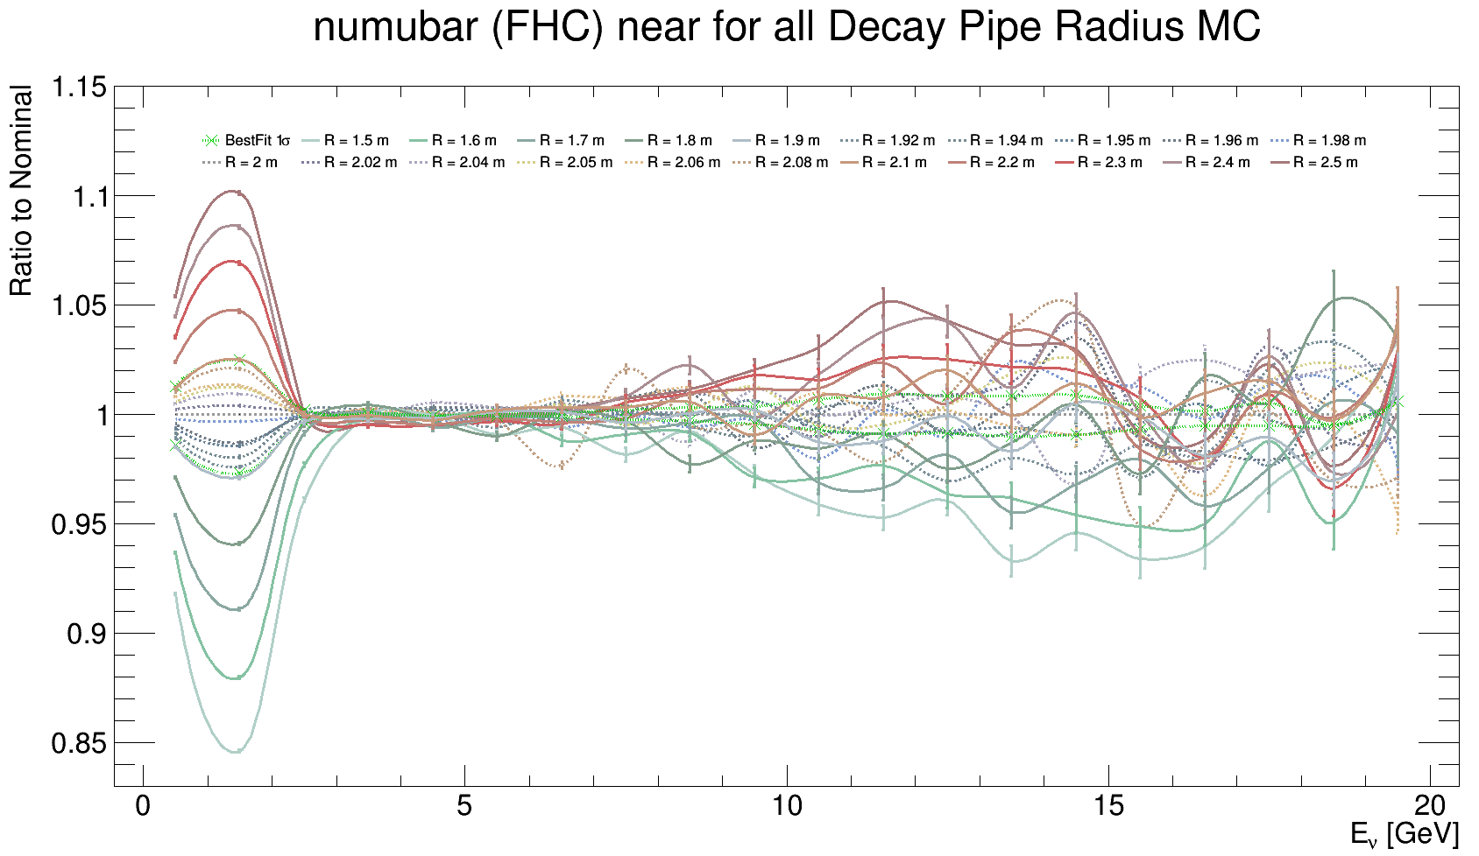
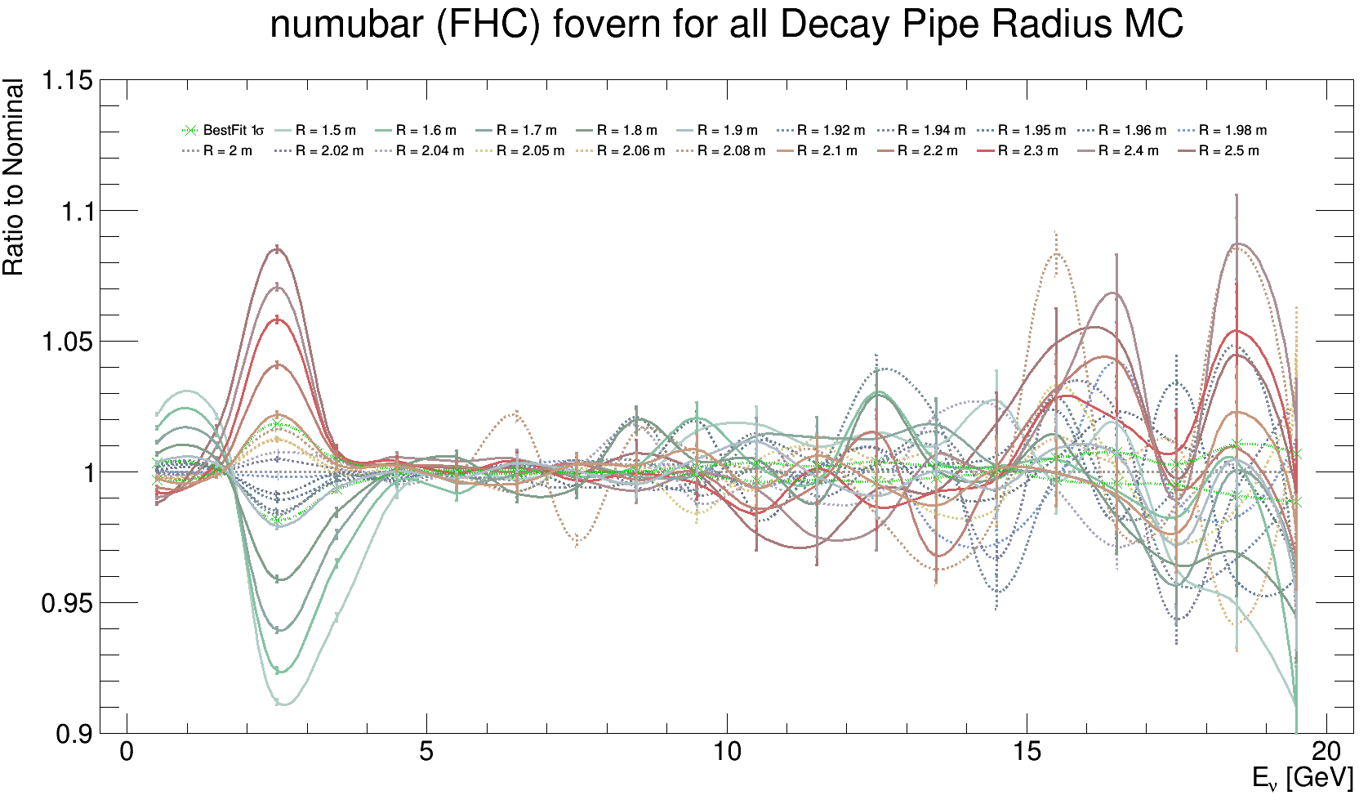
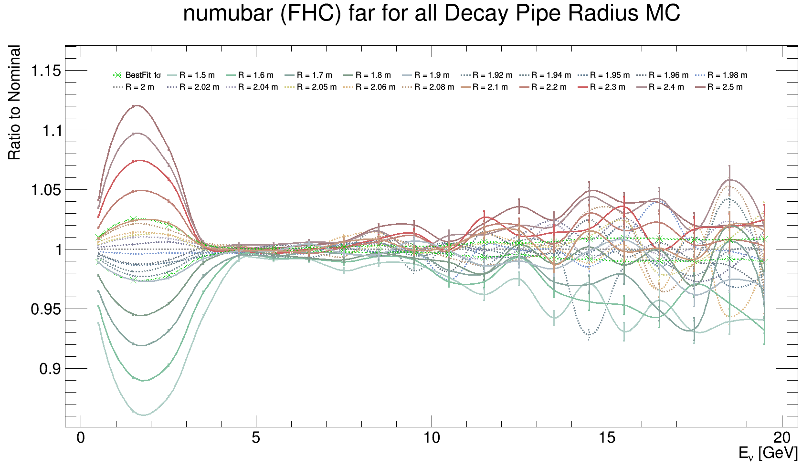
${\overline{ν}}_{μ}$Flux Ratios to Nominal Simulation: -5$σ$ to 5$σ$, d$σ$ = 1$σ$ & $±$0.2, $±$0.4, $±$0.5, $±$0.6, $±$0.8$σ$
FD
Fits are performed in each energy bin on the data from these plots (including errors)
FD/ND
ND

Slide 19
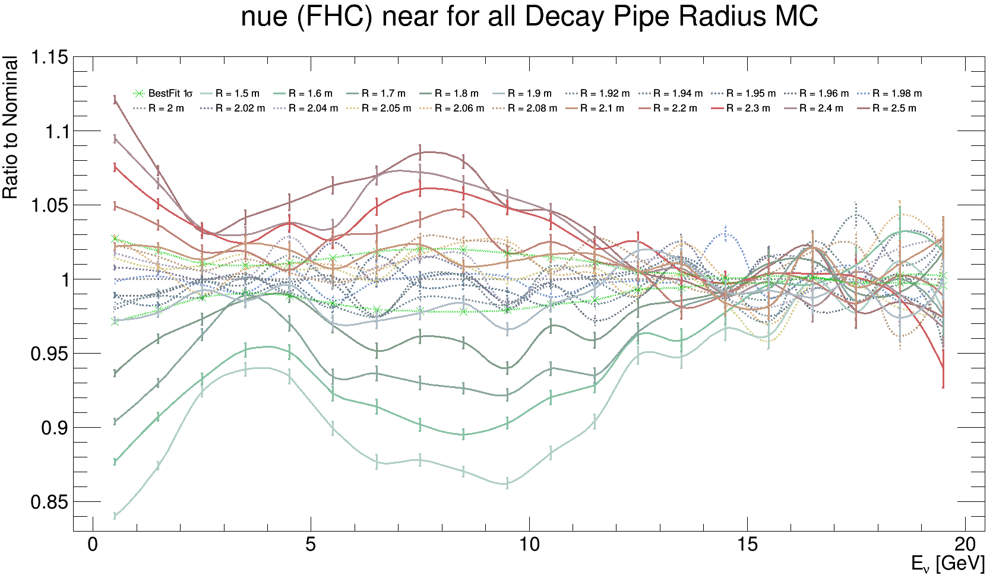
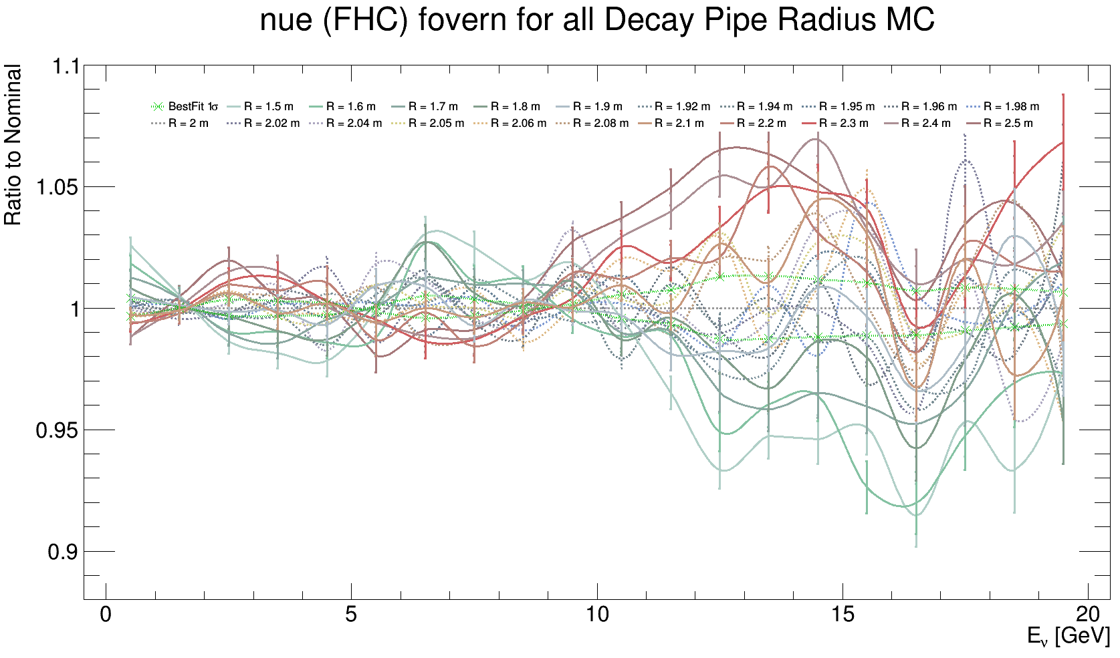
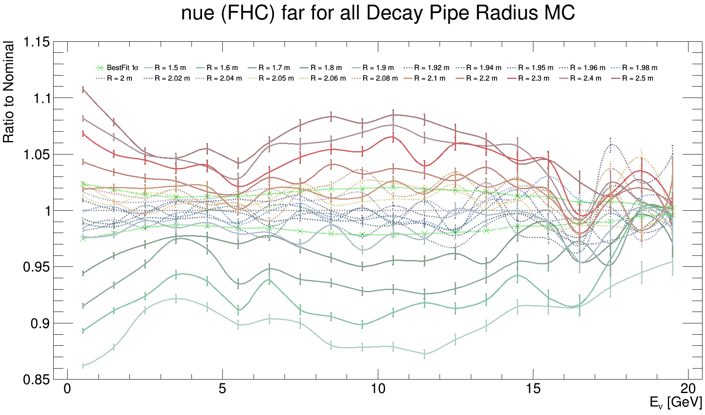
$ν_{e}$Flux Ratios to Nominal Simulation: -5$σ$ to 5$σ$, d$σ$ = 1$σ$ & $±$0.2, $±$0.4, $±$0.5, $±$0.6, $±$0.8$σ$
FD
Fits are performed in each energy bin on the data from these plots (including errors)
ND
FD/ND

Slide 20
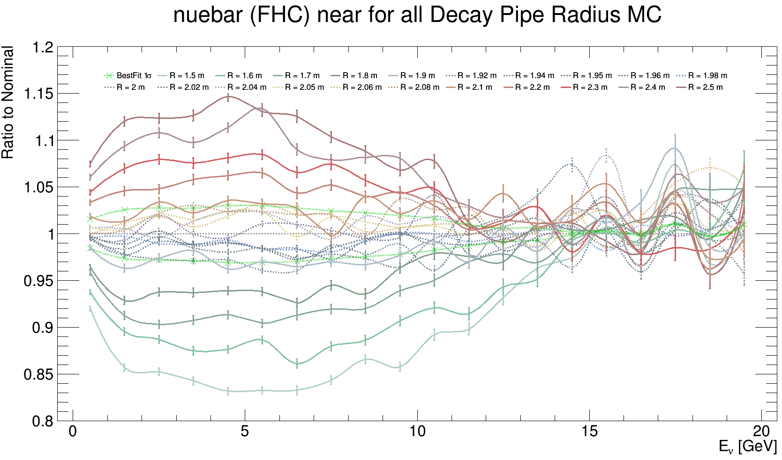
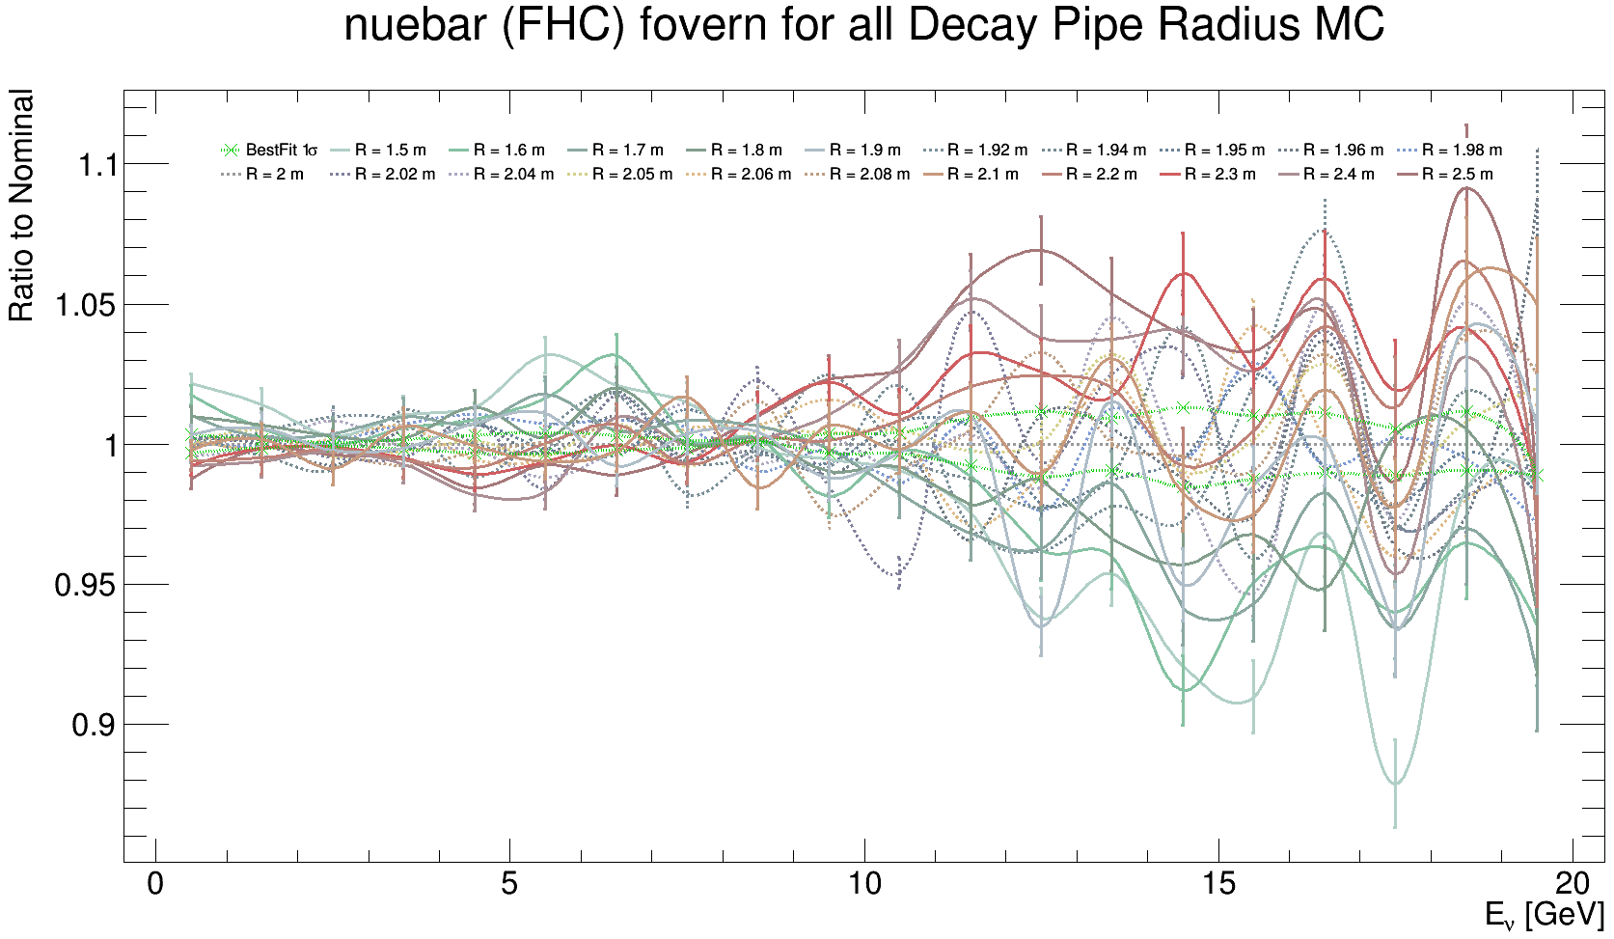
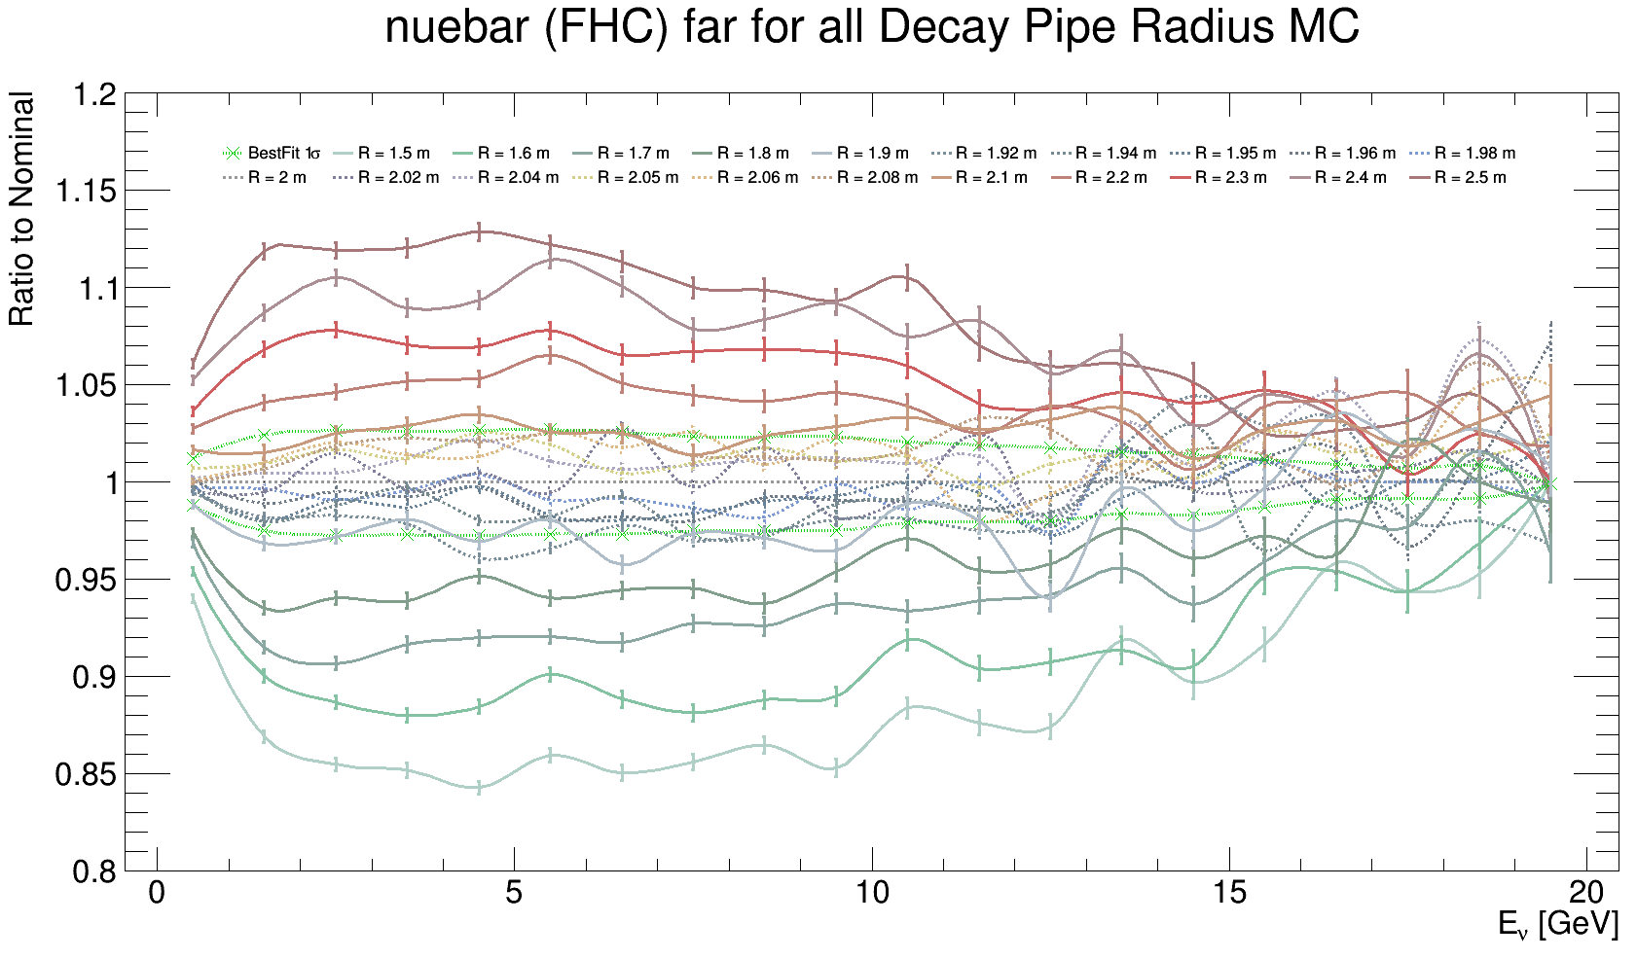
${\overline{ν}}_{e}$Flux Ratios to Nominal Simulation: -5$σ$ to 5$σ$, d$σ$ = 1$σ$ & $±$0.2, $±$0.4, $±$0.5, $±$0.6, $±$0.8$σ$
FD
Fits are performed in each energy bin on the data from these plots (including errors)
ND
FD/ND

Slide 21
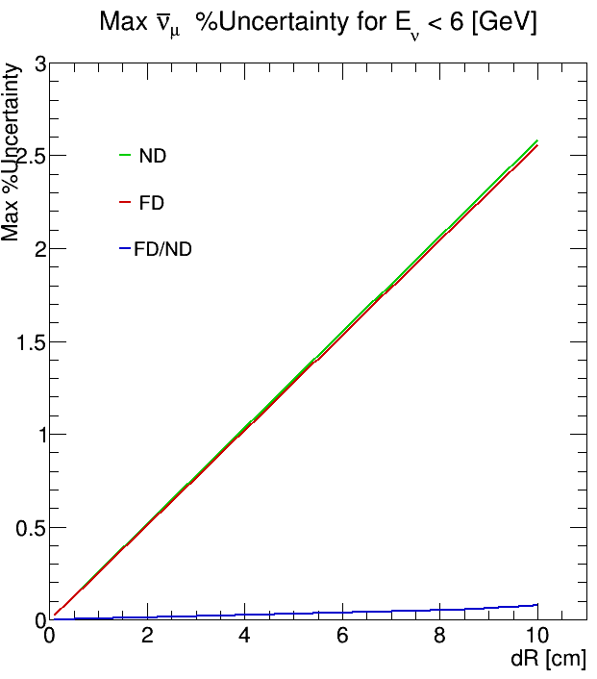
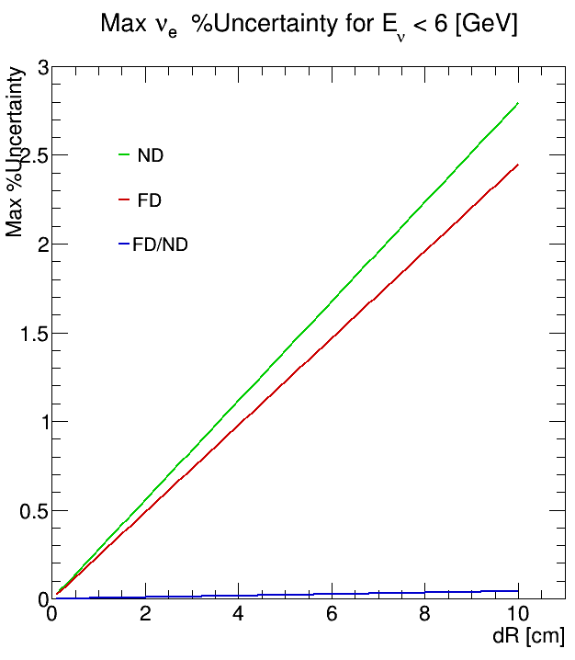
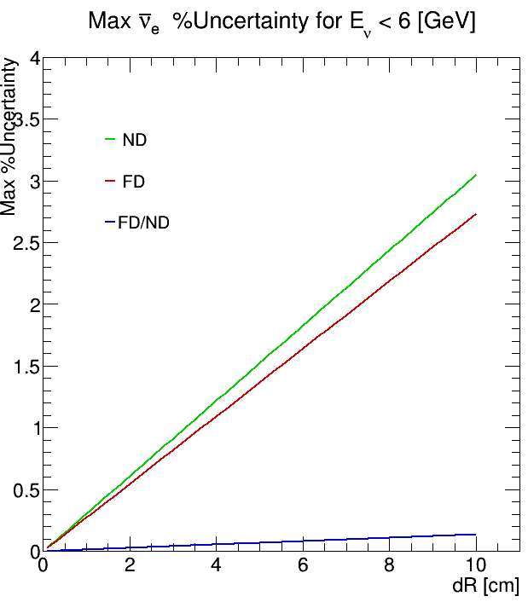

Slide 23
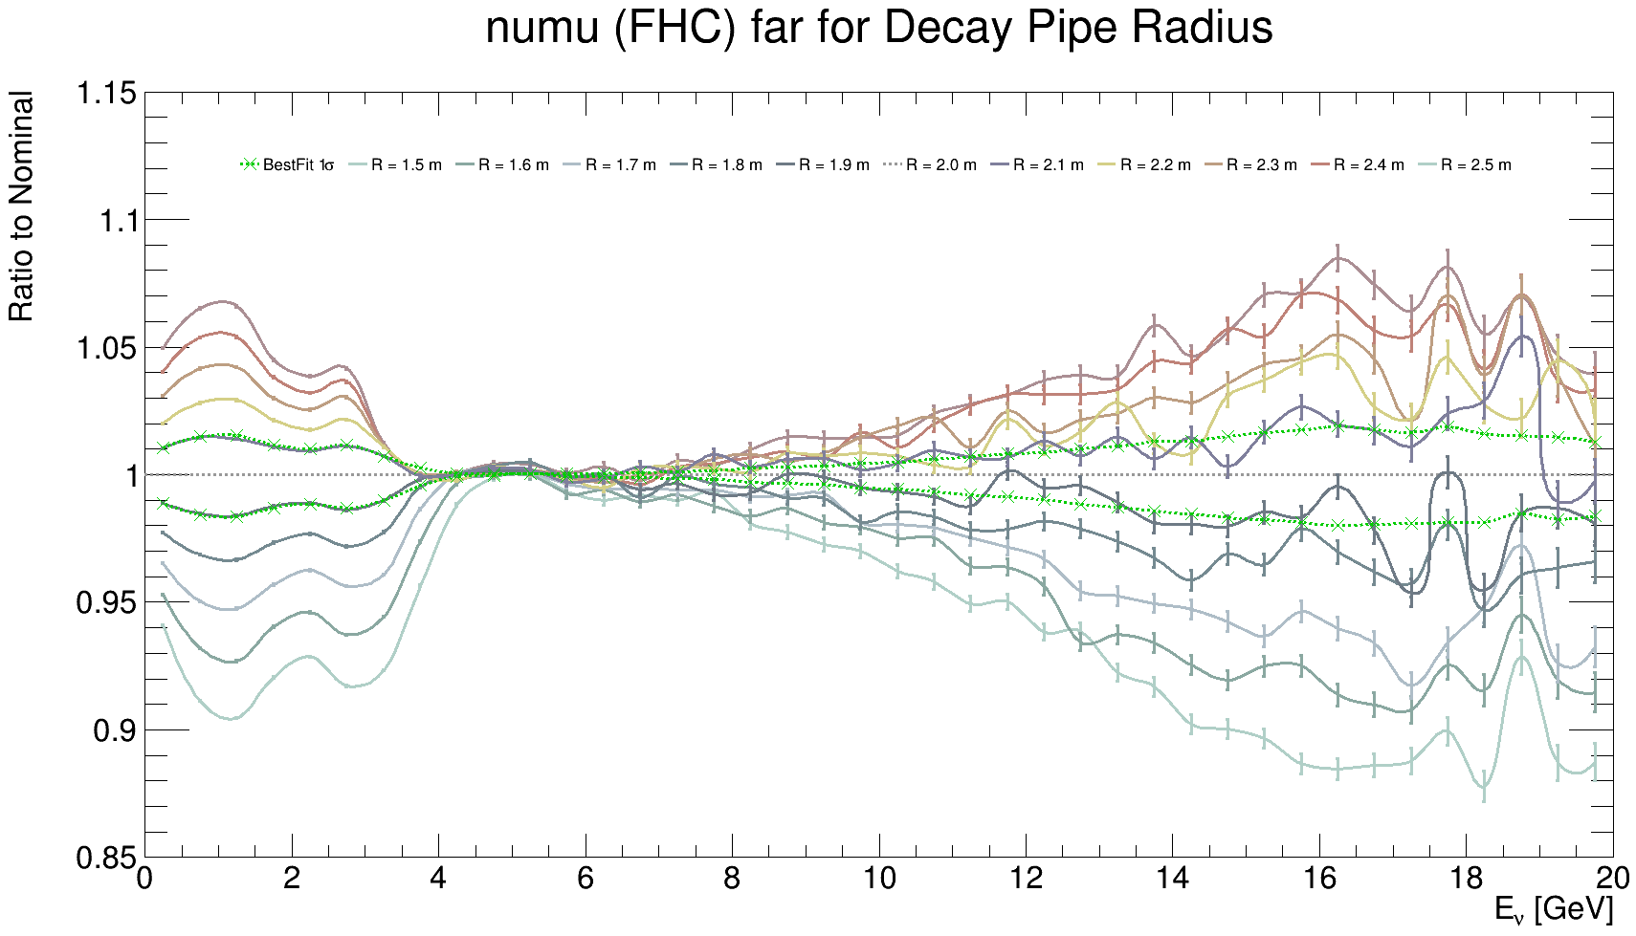
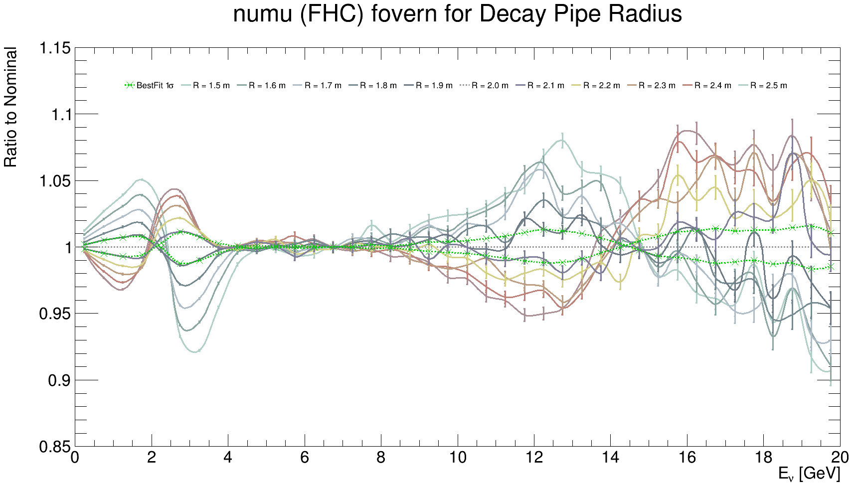
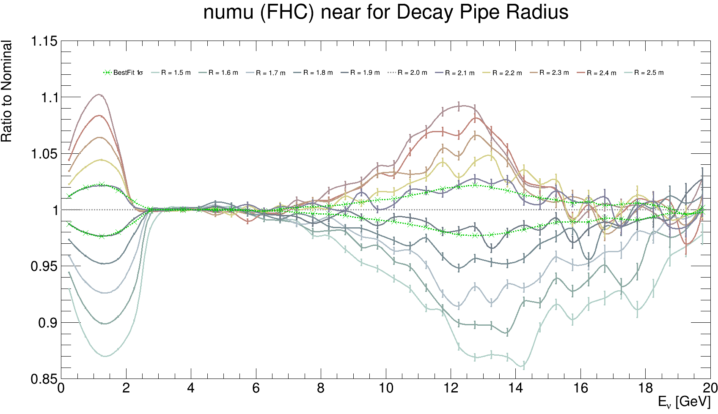
-5$σ$ to 5$σ$, d$σ$ = 1$σ$
FD
FD/ND
ND

Slide 24
$ν_{μ}$ ND flux -5$σ$ to +5$σ$ comparison

Slide 25
$ν_{μ}$ FD flux -5$σ$ to +5$σ$ comparison

Slide 26
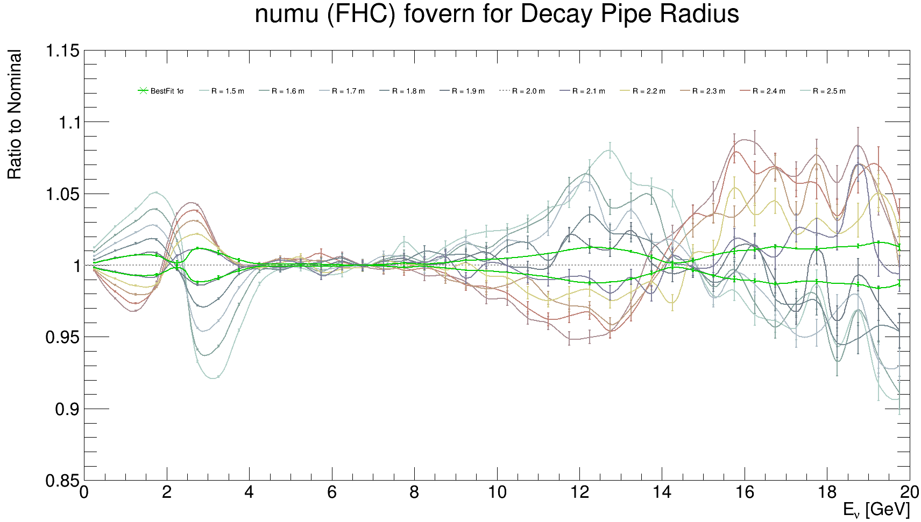
$ν_{μ}$ FD/ND flux -5$σ$ to +5$σ$ comparison

Slide 27
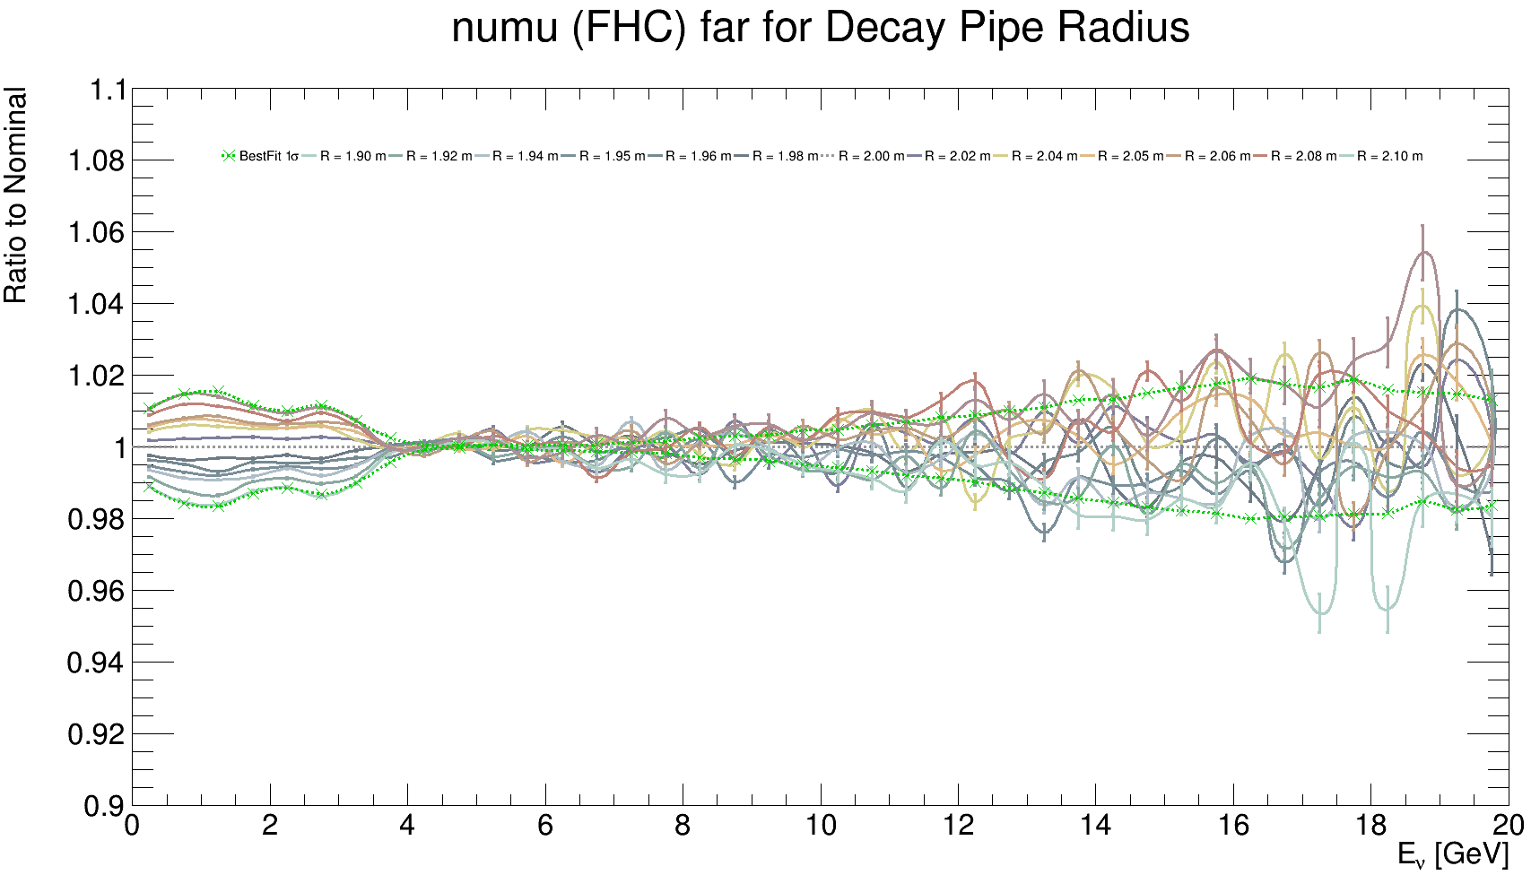
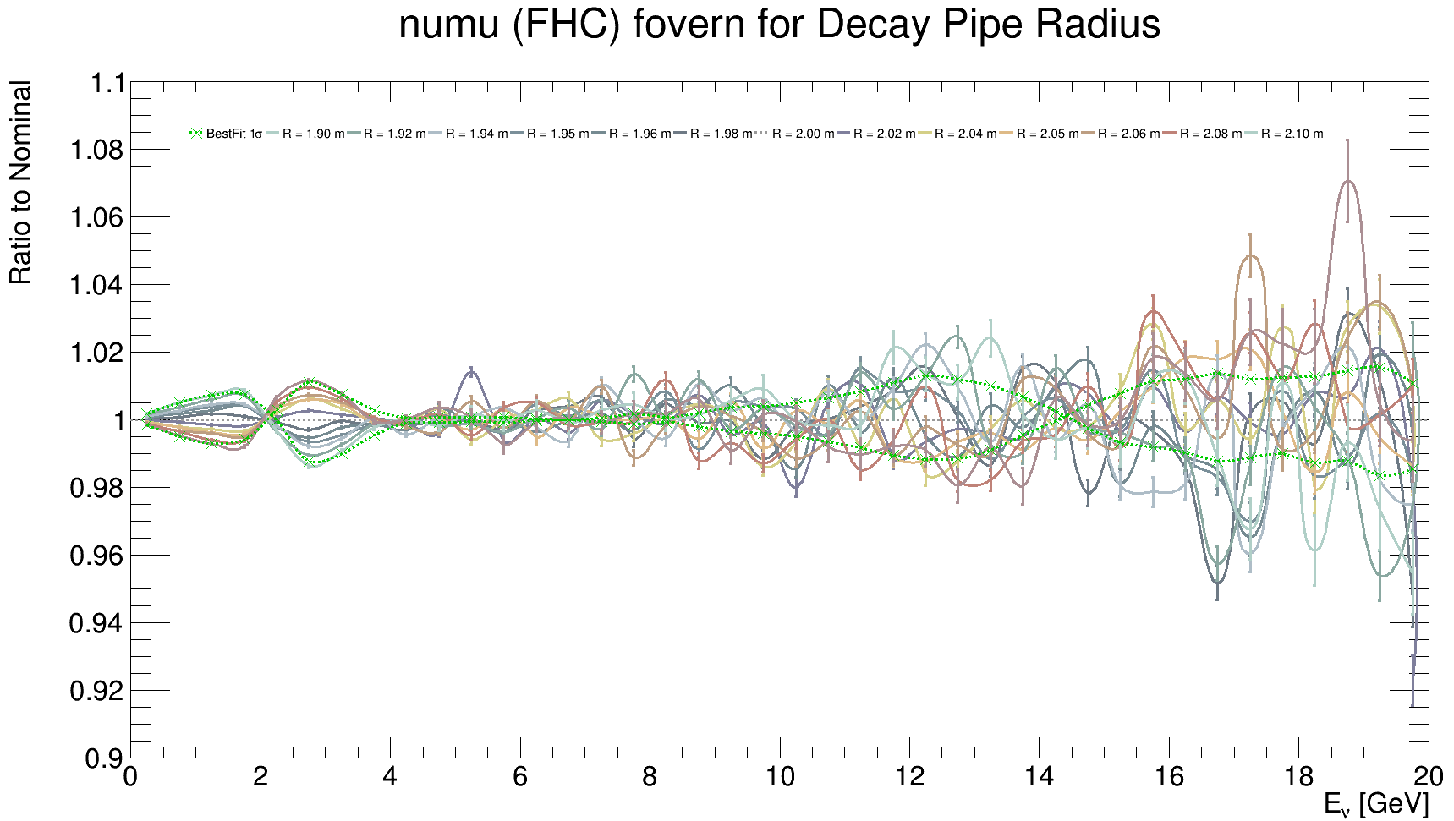
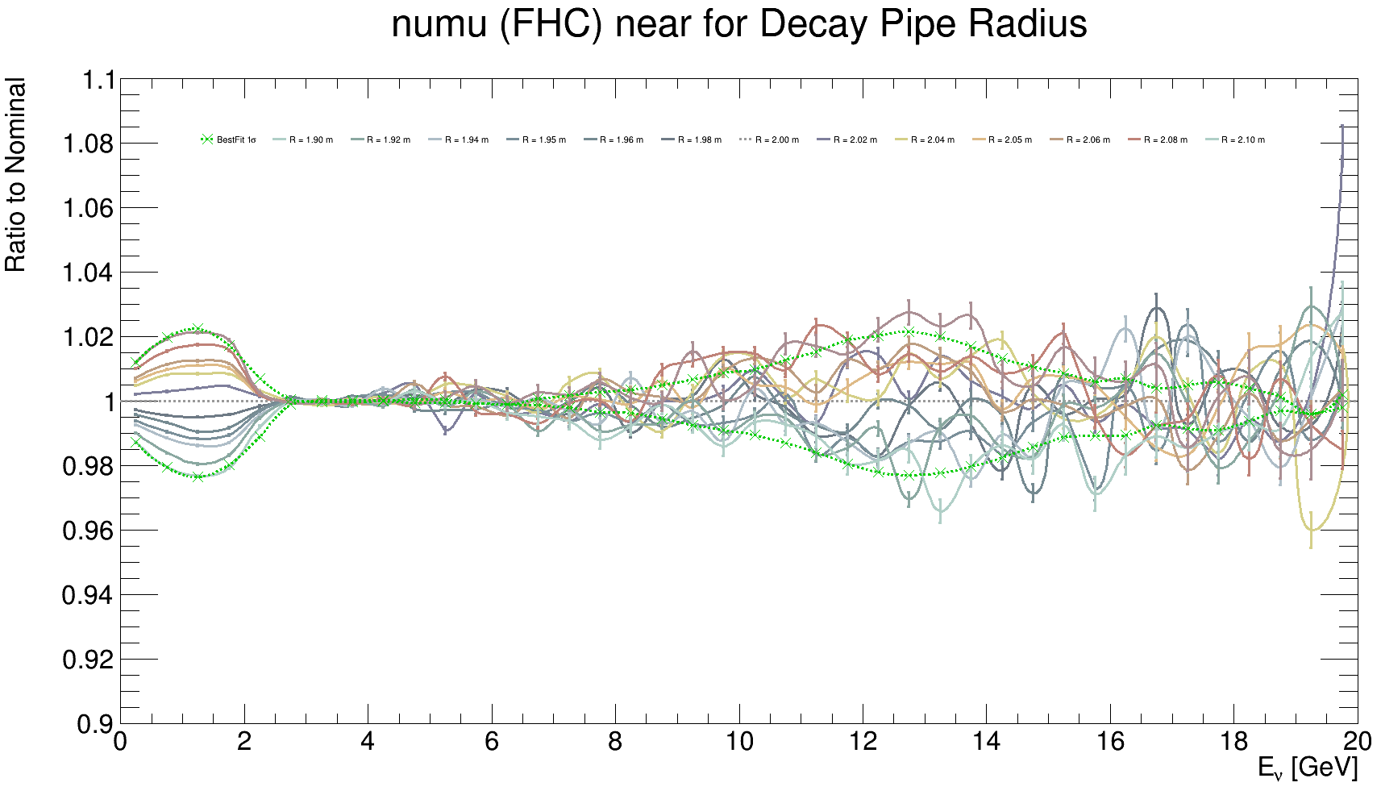
$≤$1$σ$ simulations $±$0.2, $±$0.4, $±$0.5, $±$0.6, $±$0.8$σ$
FD
FD/ND
ND

Slide 28
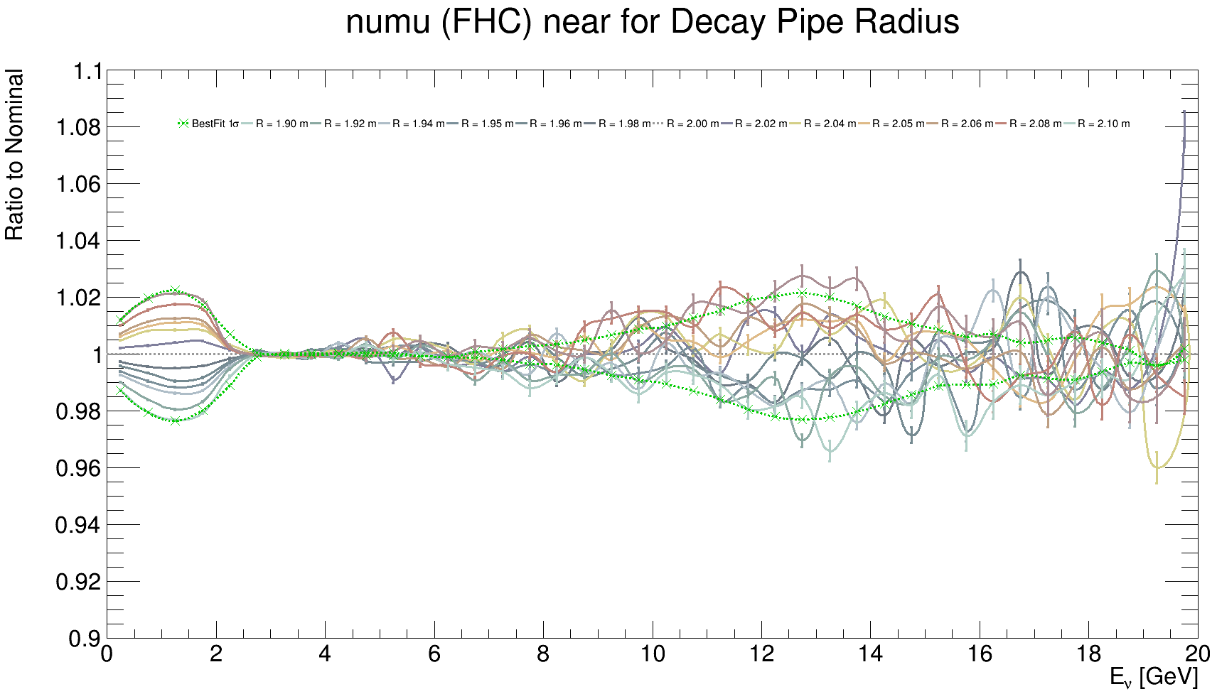
$ν_{μ}$ ND flux $≤1σ$ comparison

Slide 29
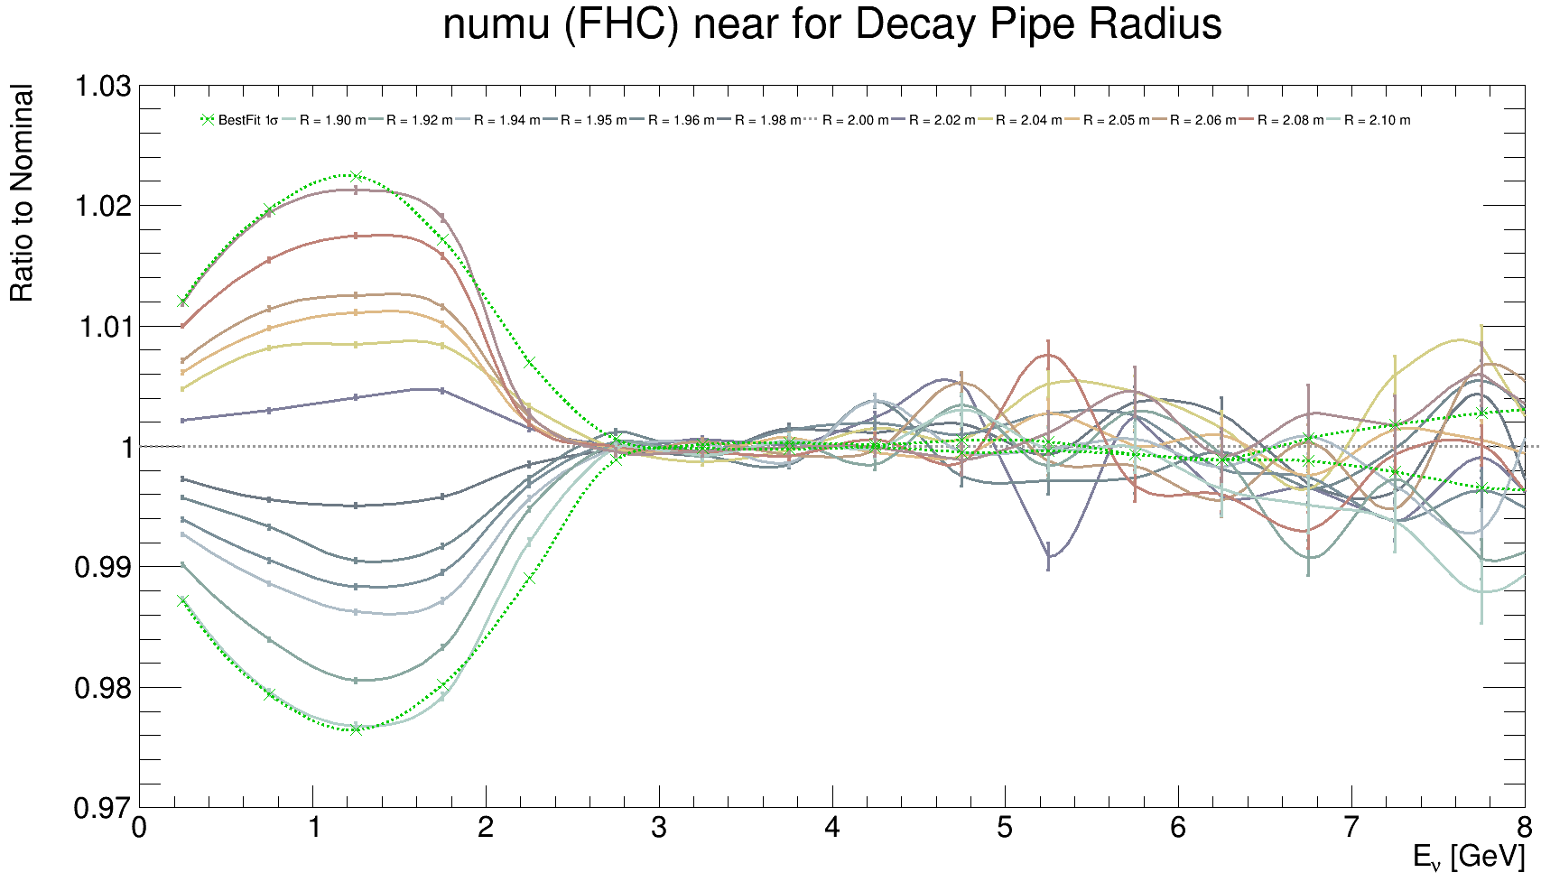
$ν_{μ}$ ND flux $≤1σ$, $E_{ν}≤8 GeV$ comparison

Slide 30
$ν_{μ}$ FD flux $≤1σ$ comparison

Slide 31
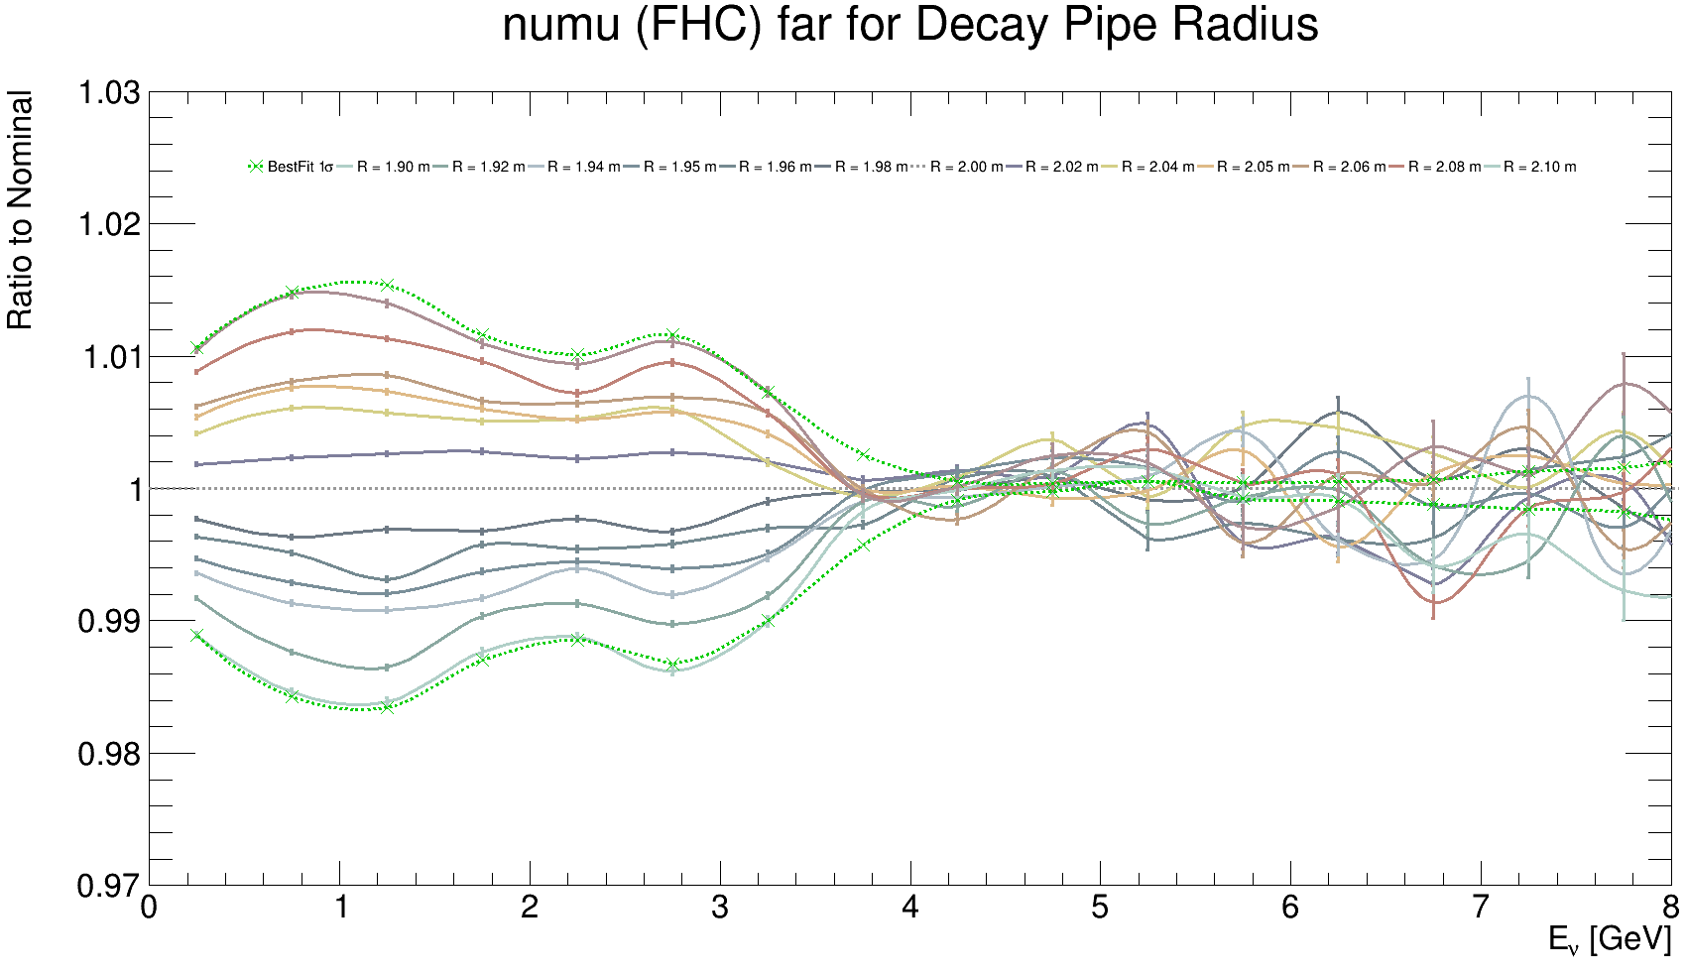
$ν_{μ}$ FD flux $≤1σ$, $E_{ν}≤8 GeV$ comparison

Slide 32
$ν_{μ}$ FD/ND flux $≤1σ$ comparison

Slide 33
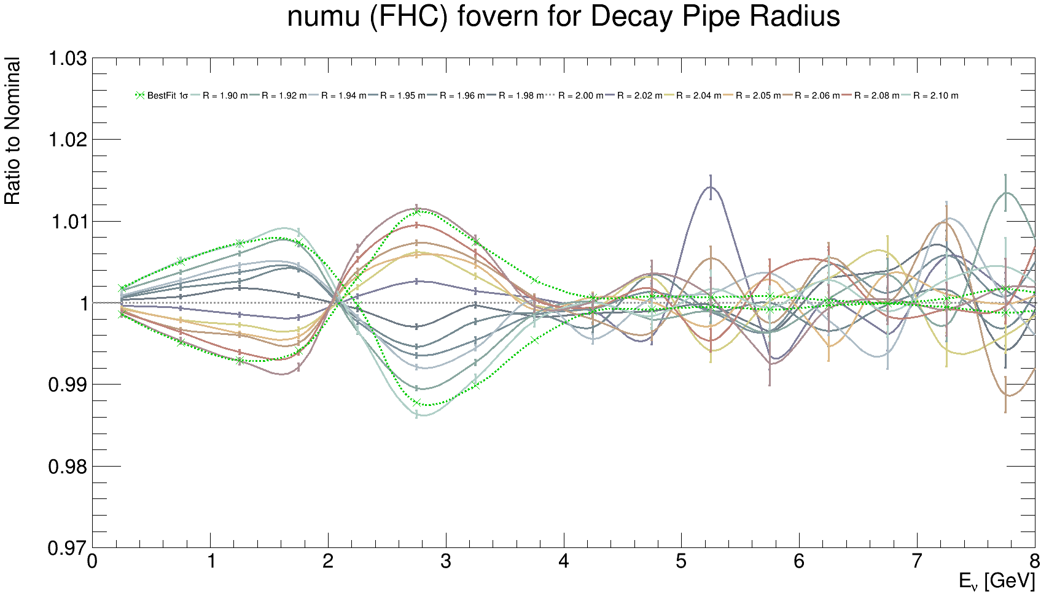
$ν_{μ}$ FD/ND flux $≤1σ$, $E_{ν}≤8 GeV$ comparison

Slide 34
