Slide 1
Muon Collider 6D Cooling Model Magnets
M. Tartaglia
Technical Division, Magnet Systems Dept.
Fermilab

Slide 2
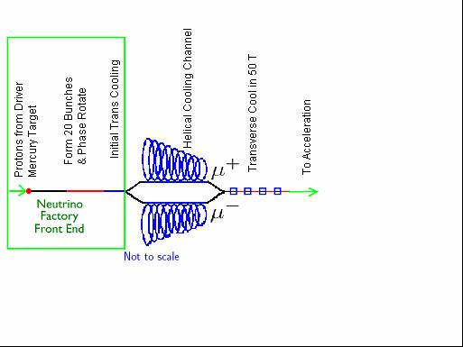
Interesting Magnets in Muon Colliders
Very High Field Solenoids
Transverse Cooling up to 50 T
6-D Cooling Channel
Colliding Ring/IR Magnets ~10 T, wide aperture/ open midplane
HCC solenoid rings up to 20 T (one of many options-most challenging magnet-wise)
Wide aperture 20 T solenoids
Topical Workshop on the Neutrino Factory and Muon Colliders

Slide 3
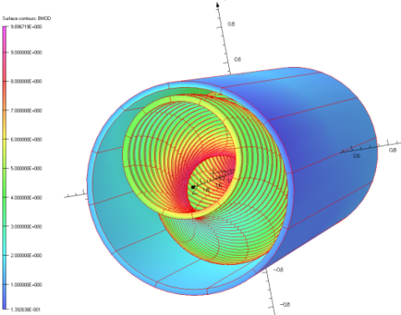
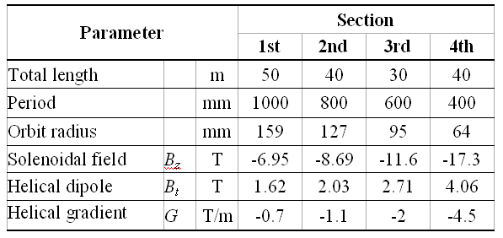
Helical Cooling Channel
The helical solenoid (HS) concept (FNAL/Muons Inc.) :
Coils follow the helical beam orbit generating solenoidal, helical dipole and helical quadrupole fields
Multi-section HCC
Would require 160 meters of magnets
Wide range of fields, helical periods, apertures
Room for RF system
Field tuning is more complicated at high fields
NbTi, Nb3Sn/Nb3Al and HTS in final stage (progression of models)
Early Specs, ca. 2006-K. Yonehara, S. Kahn, R. Johnson et al.

Slide 4
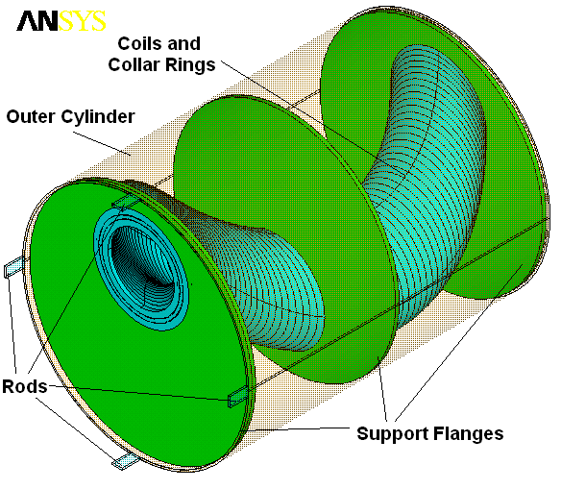
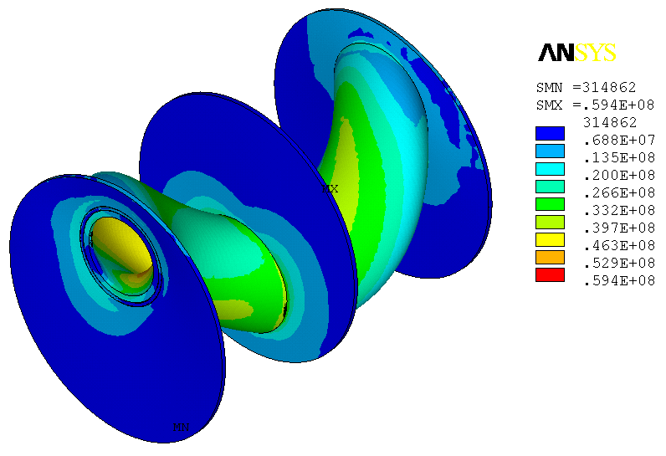
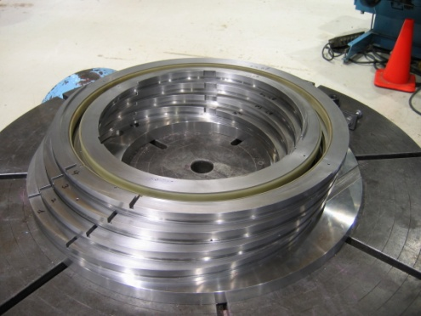
HS Mechanical Concept (FNAL)
Two short models built and tested successfully
Hoop Lorentz forces intercepted by stainless steel rings around the coils
Transverse Lorentz forces intercepted by support flanges
Outer LHe vessel shell provides mechanical rigidity to the structure
The peak stress is ~60 MPa

Slide 5
HSM01, HSM02 NbTi Model Magnet Design & Documentation
Design, Fabrication, Testing Primary Responsibility
Program Oversight Mike Lamm
Sasha Zlobin, John Tompkins
Magnetic Design Vladimir Kashikhin
Mechanical Design & Fabrication Sasha Makarov
Nikolai Andreev, Miao Yu
Testing & Analysis Mike Tartaglia
Guram Chlachidze, MTF !
Documents
Tiweb.fnal.gov Magnet Description Documents
TD-09-011 Test of Four Coil Helical Solenoid Magnet HSM01
PAC’09 Four Coil Superconducting Helical Solenoid For
MANX
TD-11-012 HSM02 Magnet Fabrication and Test Summary
MT-22 Model NbTi Helical Solenoid Fabrication and Test Results

Slide 6
HSM01, HSM02 NbTi Model Magnet Design Features
4 coil prototype model magnets with large aperture
1st Two models in planned series: Technology Demonstration
HSM02 same design with improvements based on HSM01 experience
Largest diameter that can be tested in VMTF R&D stand (OD ~ 25”)
“Hard Way Bend” winding of NbTi cable (LHC quad – not optimized)
Smooth transition without splices between 4 offset coils
“keystoned” cable hard to wind with high packing factor
HSM02 cable flattened, improved winding
Embedded quench protection strip heaters
Epoxy-impregnated coil package
Stainless steel rings control hoop Lorentz stresses
Sharp edges require care with insulation scheme
but provide no pre-stress on coils to constrain conductor motion
Next step in the progression will use Aluminum outer rings
No Iron Flux Return
Large stray field, forces on SC leads
SC Lead motion in HSM01 led to some quenches, ground fault

Slide 7
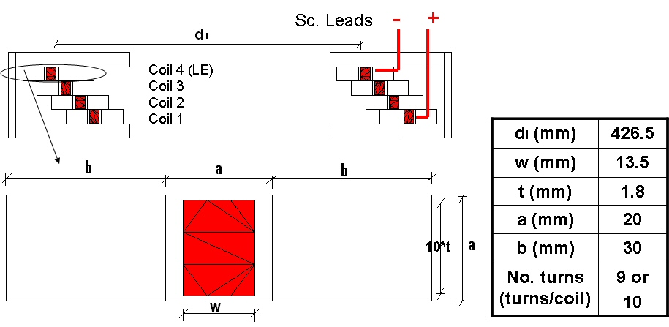
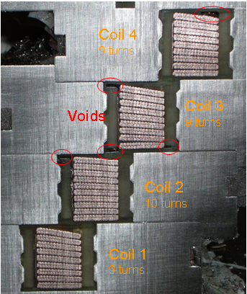
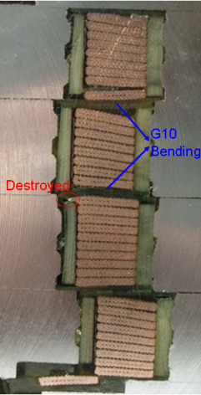
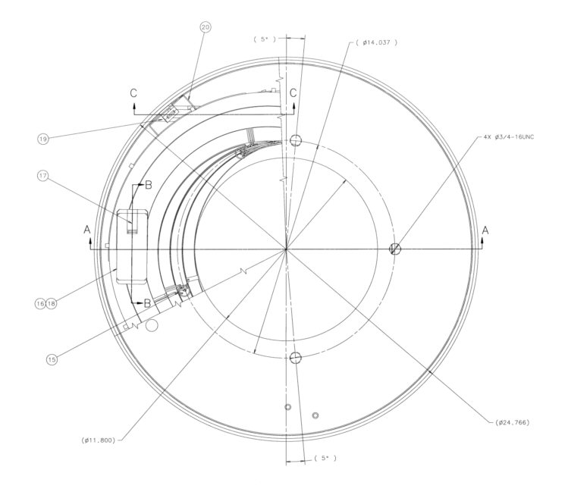
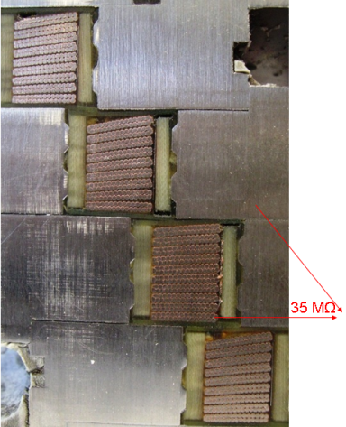
HSM01, HSM02 NbTi Model Magnet Design
HSM01 Dissection
After Testing

Slide 8
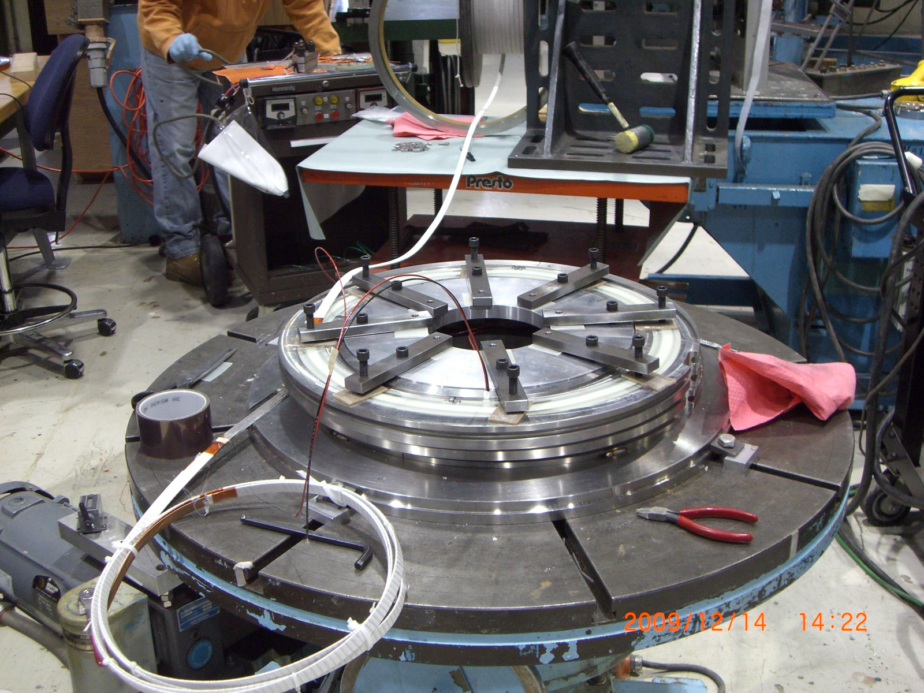
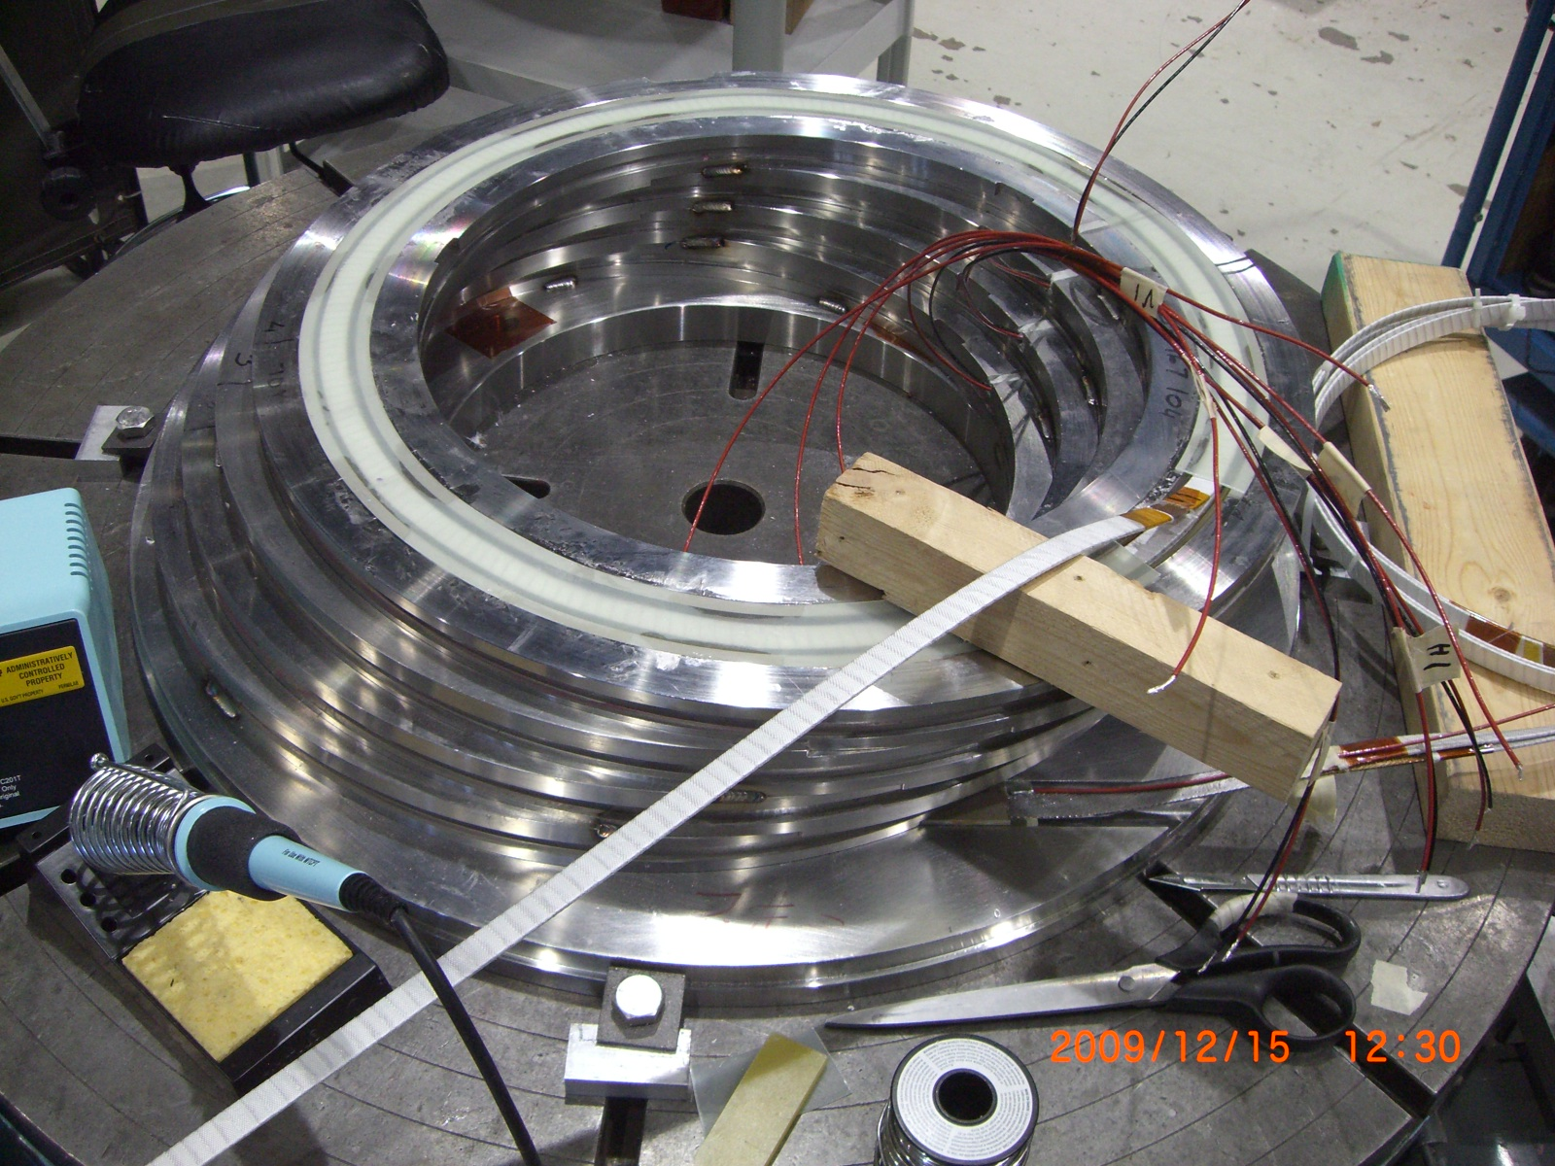
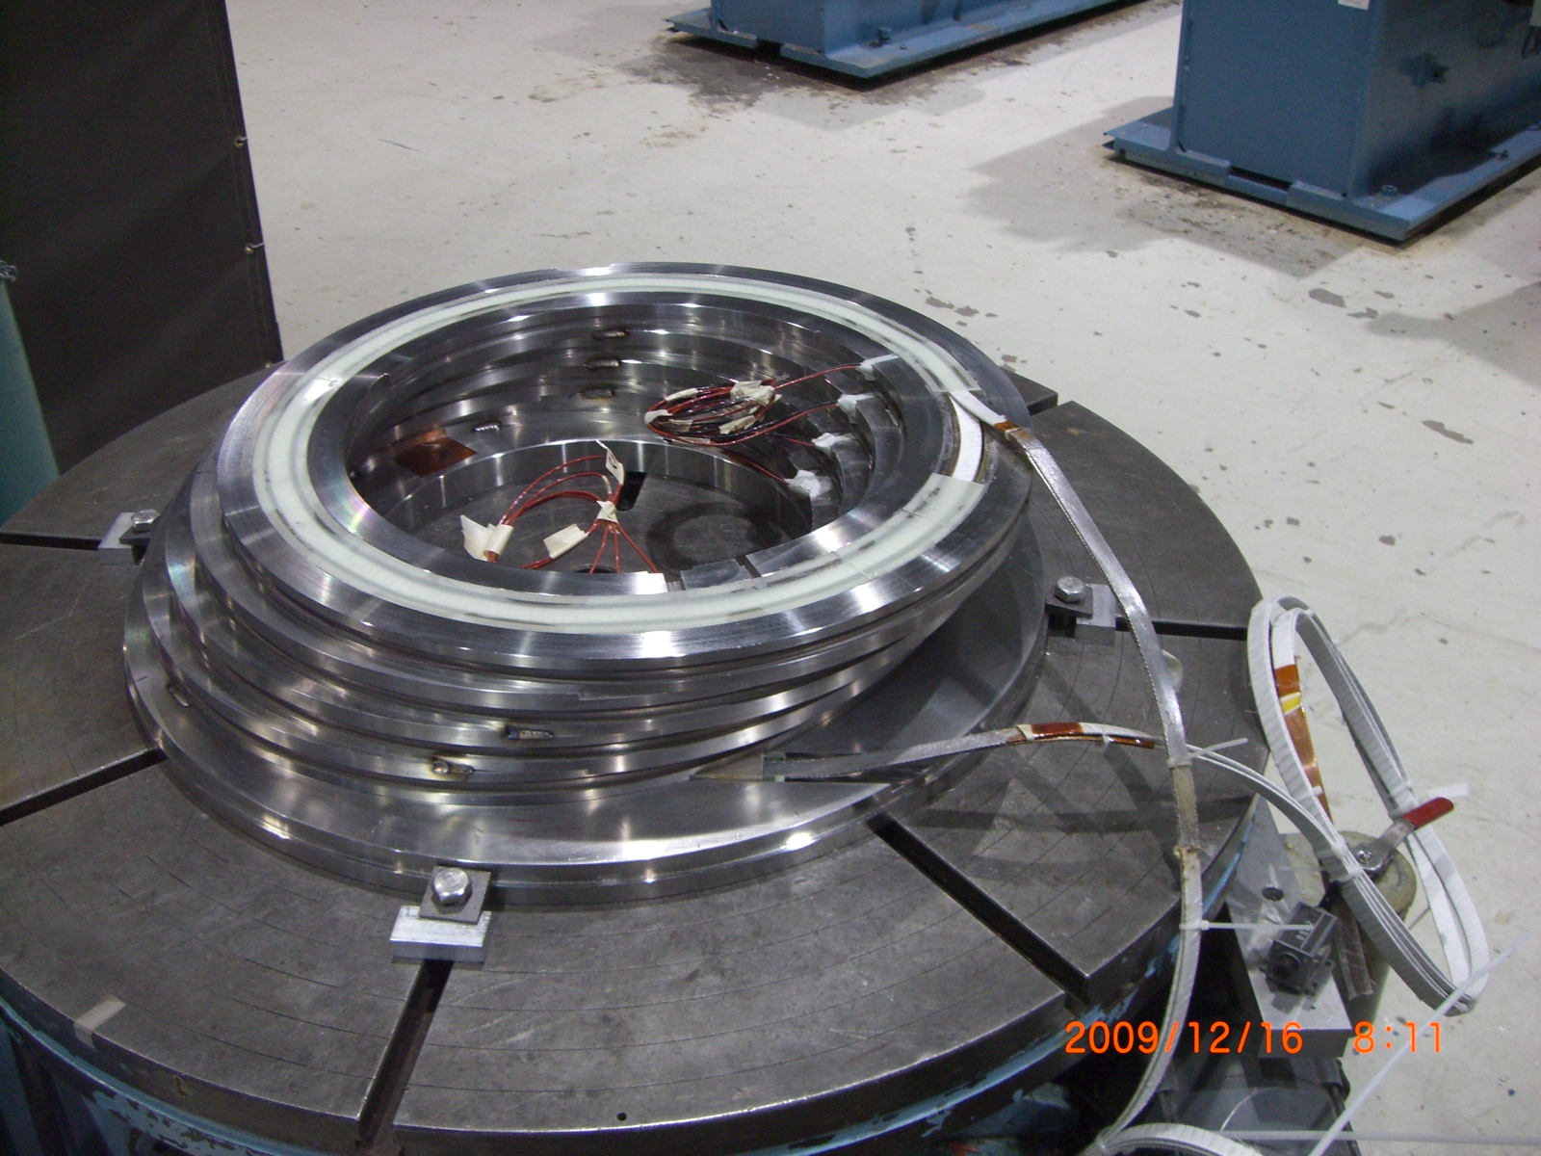
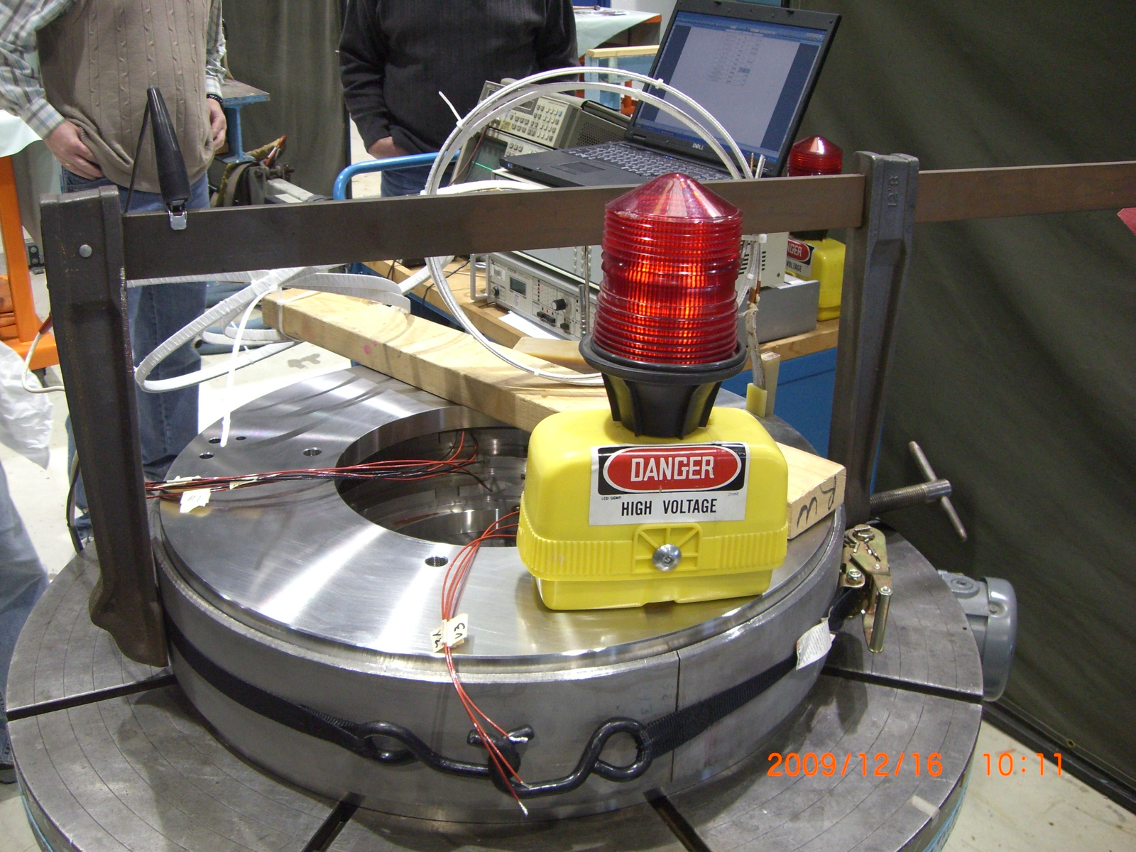
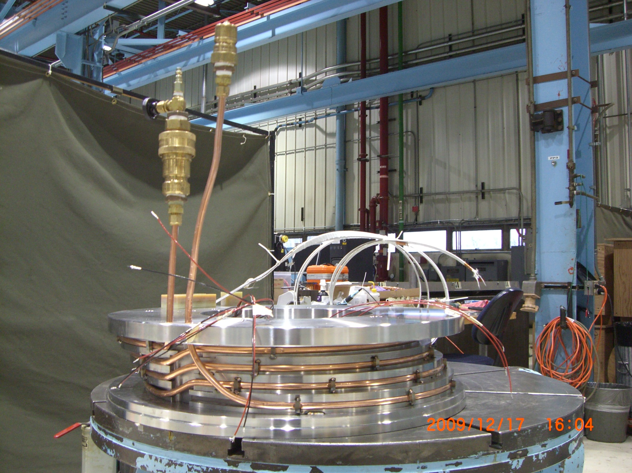
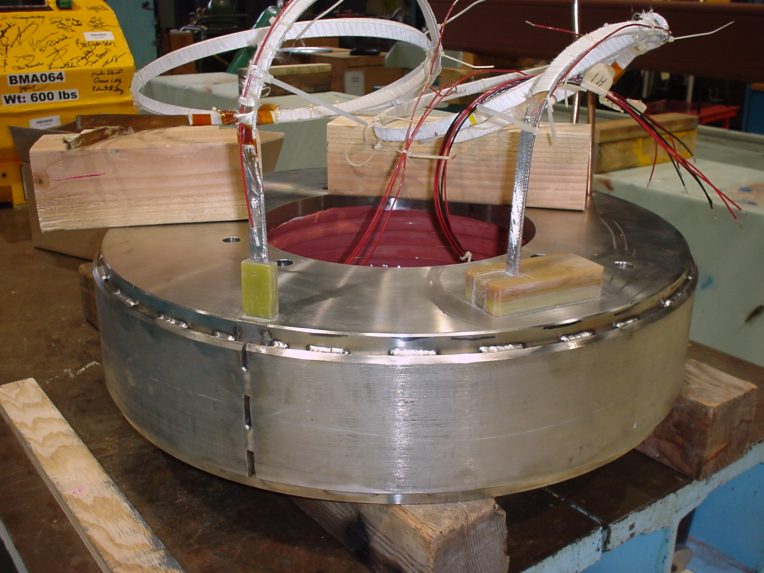
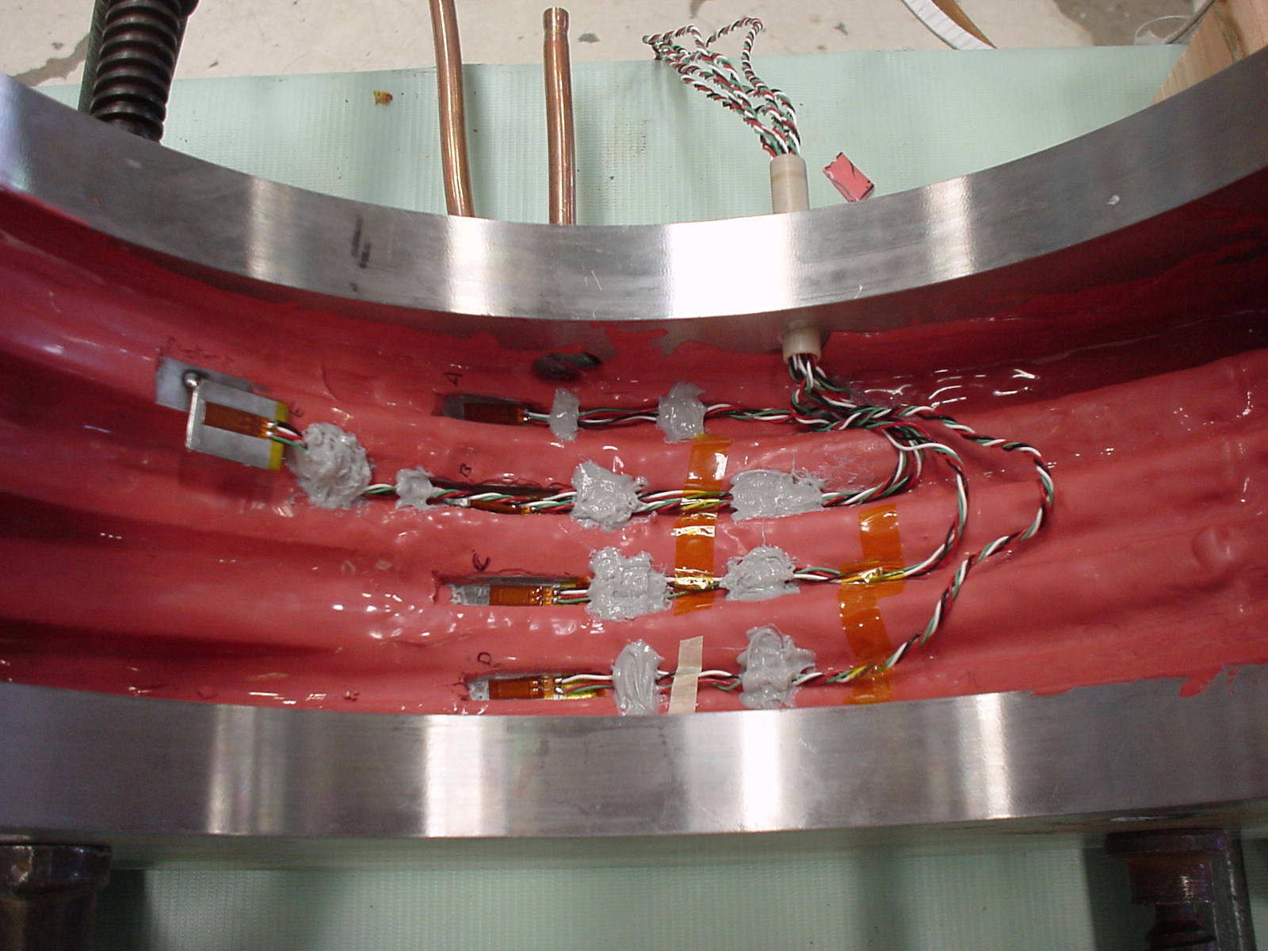
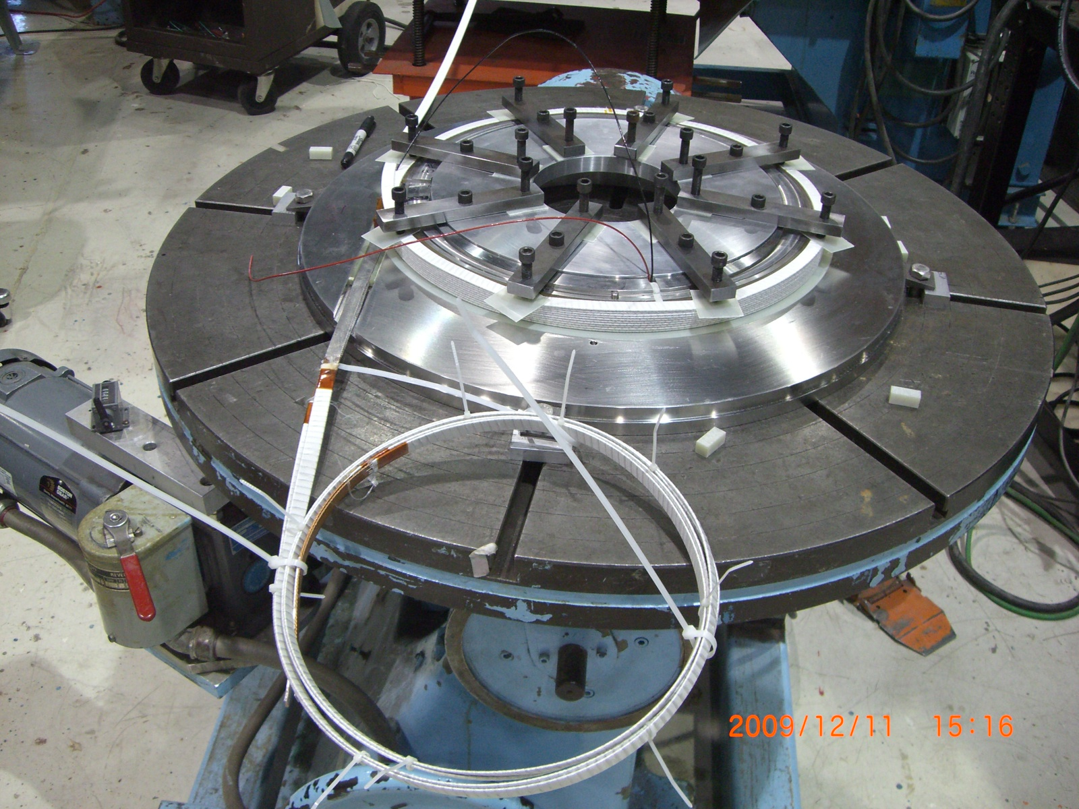
HSM01, HSM02 NbTi Model Magnet Assembly

Slide 9
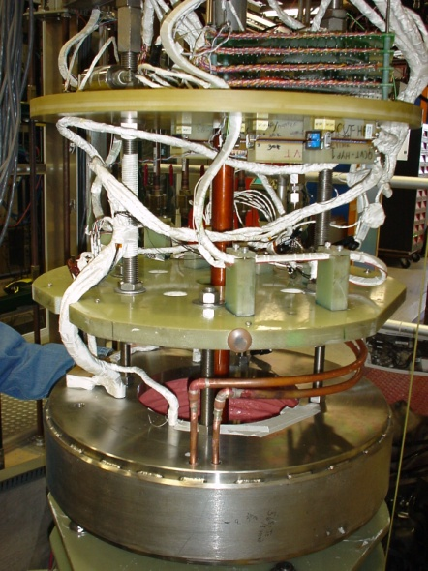
HSM01, HSM02 NbTi Model Magnet Tests
Main Test Goals:
Measure Mech. Stresses
Quench Performance
vs Temperature
vs Ramp Rate
Protection Heater Effic.
Magnetic Field Map
HSM01 tested in Nov/Dec 2008
TD-09-011, PAC’09
Ground Insulation issues
Epoxy voids, packing factor
SC lead support
Coordinate System
HSM02 tested in Nov/Dec 2010
TD-11-012, MT-22
2 thermal cycles
(quench re-training)
LN₂ Conduction cooling study

Slide 10
HSM01, HSM02 NbTi Model Mechanical Stress
Detailed HSM01 mechanical stress analysis made in TD-09-011
FEM analysis of Cool down (.2-.3%); Lorentz Force <.007%) stresses
Transverse (radial), Azimuthal, Longitudinal , compensating (T,B) gauges on coils
Predicted Max On Coils: 13 MPa (T), 10.5 MPa (A), 34.5 MPa (L)
Predicted Max On Links: 116 (T), 101 (A) , 306 (L)
“Acceptable” for 304 S.S., “designed far beyond required even for Nb3Sn”
Hard to measure with any confidence
Imperfect compensation, gauge calibrations? Debonding from surface
measured stresses were < or ~ consistent with calculated
HSM02 has same mechanics
Instrumented with fewer gauges (4 Azimuthal + 1 comp.)
Cool down stress analysis not completed –
inconsistent gauge data (warm/cold) suggests debonding
Lorentz force stresses were <~0.008%

Slide 11
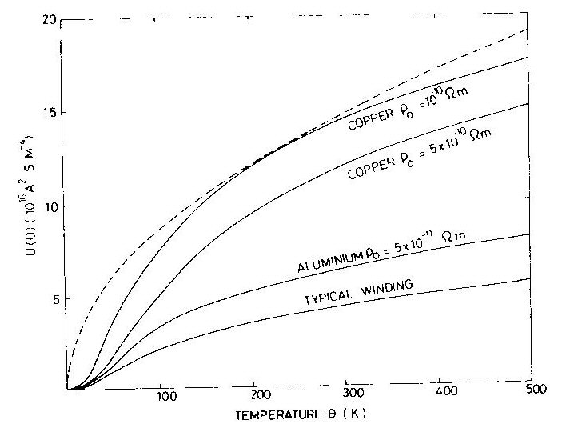
HSM01, HSM02 Test Results Quench Studies
Quench Protection
MIITS calculation (local heat balance), Peak Temperature Rise
LHC Outer cable (30 0.8mm strand NbTi) max. 11 MIITS; data ~3-4
Conductor RRR – Copper stabilizer resistance (higher RRR is better)
HSM01 ~140-155 (same as LQXB) HSM02 ~102 (rather low; why?)
Magnet Description Document
Low Inductance ~200 μΩ, E_{stored}(16kA)~26 kJ
Dump Resistor energy extraction
(t~L/R_{bus+mag}, Vmax=IR_{dump})
R_{d} HSM01 = 10 mΩ, HSM02 = 60 mΩ
Protection Strip Heaters
Study of inducing quenches (for long magnets)

Slide 12
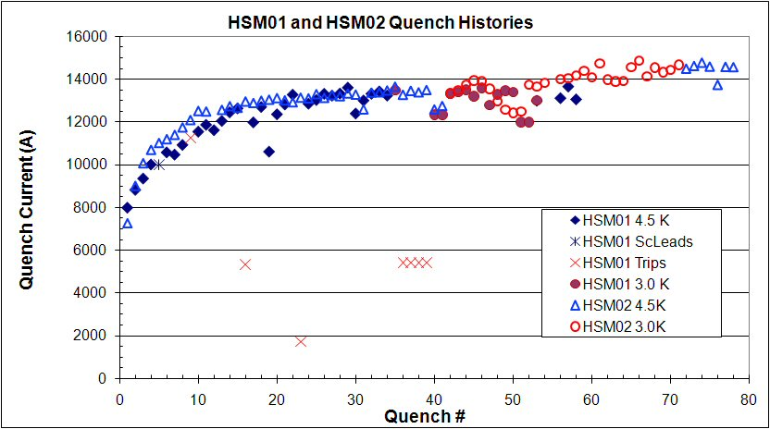
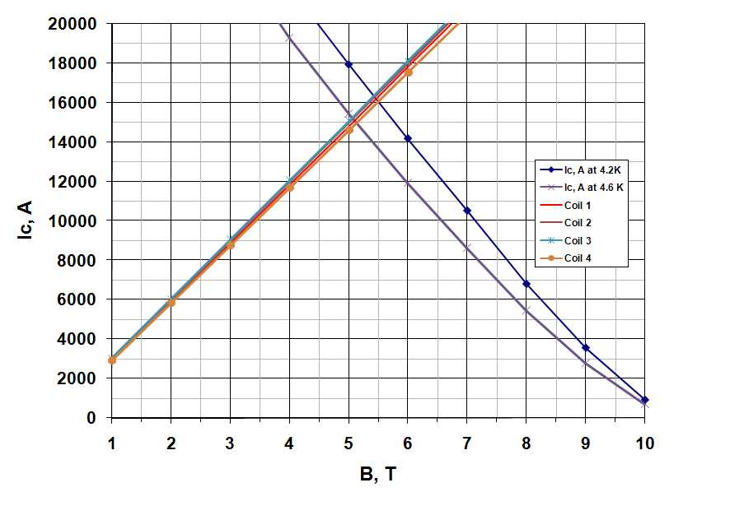
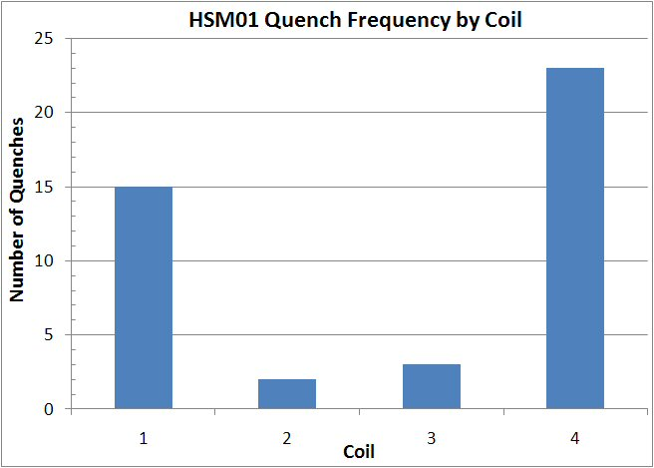
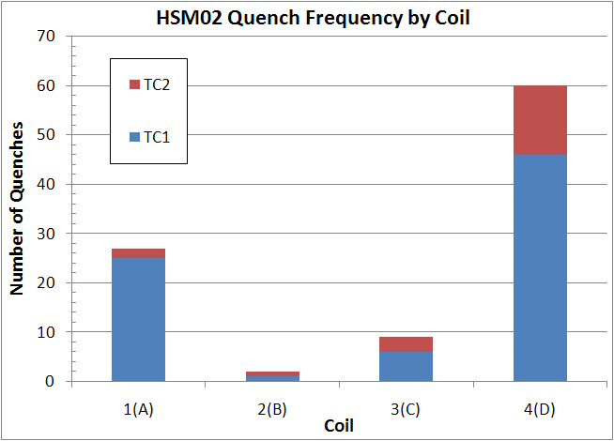
HSM01, HSM02 Test Results Quench Performance
Quench Prediction: at 4.5 K, HSM01~16 kA, HSM02 ~ 15 kA
Magnet Load Line crosses Conductor Critical Current (vs T)
Peak field is slightly higher on end coils
Somewhat slow quench training to plateau
HSM01 (HSM02) reached 85% (100%) of I_{c}
Very similar training curves - slightly erratic
(char. of epoxy-impregnated coils)
Little temperature dependence of training rate (higher Ic, mechanical limitations)
Quenches mostly in end coils for both

Slide 13
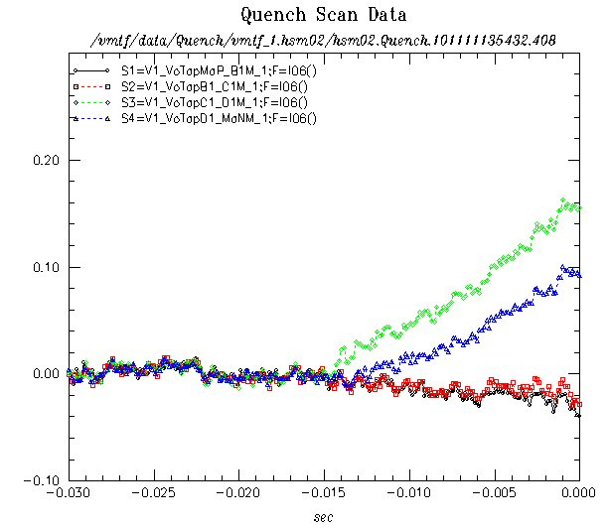
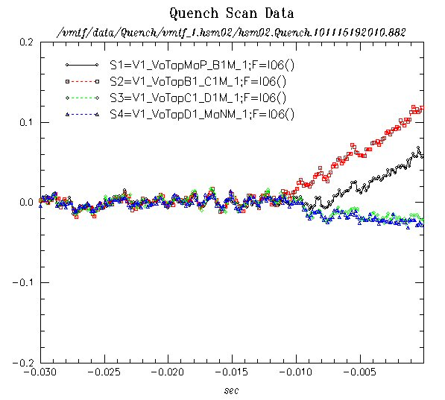
HSM01, HSM02 Test Results Quench Performance
Quench Locations
Generally only know which coil quenched (one voltage segment across each coil)
There has been no detailed analysis of quench velocity
HSM02: Two quenches developed ~ simultaneously in adjacent coils
presumably originating in transition region between coils

Slide 14
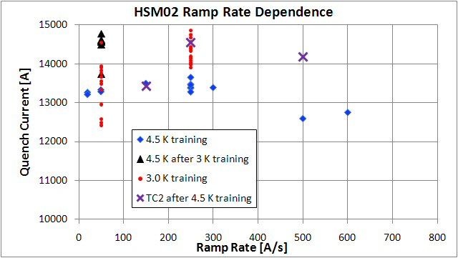
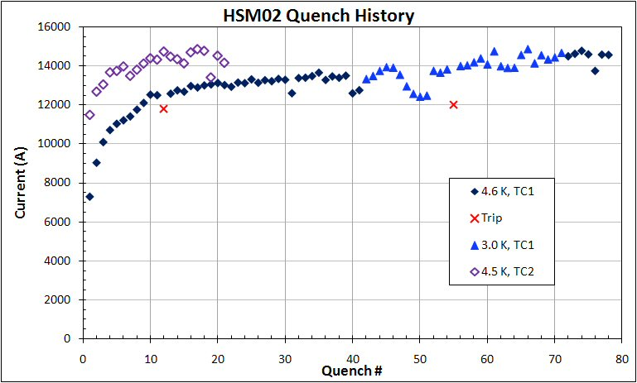
HSM01, HSM02 Test Results Quench Performance
Quench Prediction: at 4.5 K, HSM01~16 kA, HSM02 ~ 15 kA
Design would allow at least 15 % current operating margin
Plateau is “remembered” at 4.5 K after reaching highest current at 3.0 K
Fast Re-training of HSM02 after 300K T-cycle
Virtually no ramp rate dependence (both magnets) to quite high ramp rates (600 A/s) … as expected
Quenches 46-51 Dip at 3K:
Allowed 30 minutes recovery between quenches
Quench 52: waited 1 hour

Slide 15
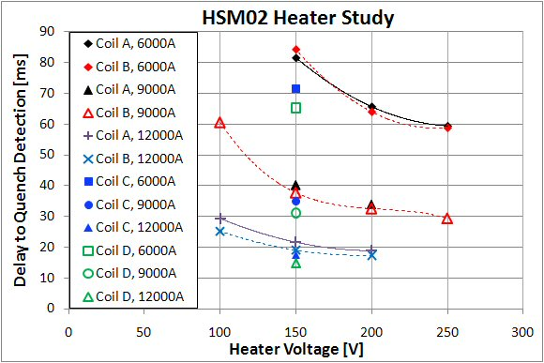
HSM01, HSM02 Test Results Quench Heater Performance
Quench Protection Heaters
HSM01 had S.S. strip heaters on Outer Layer of each Coil
Three were full length, one 6-inch “spot” heater
Time did not allow exploration of heater parameters
only one quench induced, at low heater voltage
HSM02 S.S. strip heaters on mandrel prior to winding of each Coil
All in parallel, with 4W external resistor ; fixed HFU capacitance
(to increase range of parameters given heater voltage limits)
Mapped out Time (heater fired to quench detected) vs {I, Vhfu}
Still needed: calculate heater power density

Slide 16
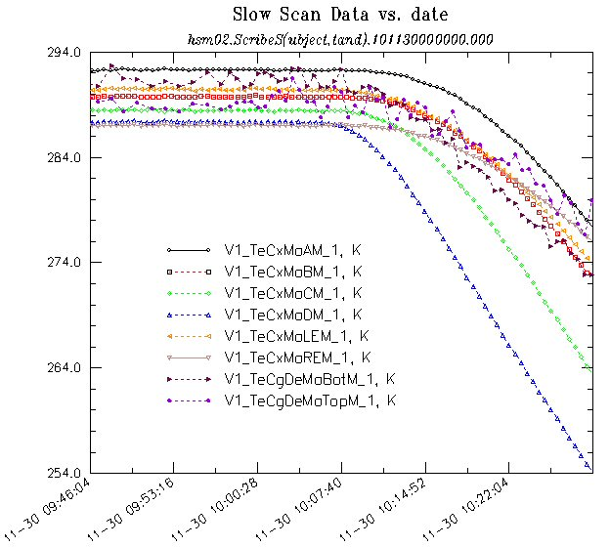
HSM01, HSM02 Test Results Quench Heater Performance
Conduction Cooling Study
We do not have the facilities to test indirectly cooled magnets
Need vacuum vessel for insulation
VMTF is not a good vac. Vessel
No helium supply to cooling tubes
Helium vapor-cooled leads for power testing
We tried a simple thermal test
Pump out VMTF helium space; we achieved <0.1 Torr
Connect LN2 to cooling tubing
Measure T vs time on all four coils with 1 RTD/coil +top, bottom
Not so great: RTD calibrations are sparse at high T (300, 80K)
No one has had time to model expectations, compare with data

Slide 17
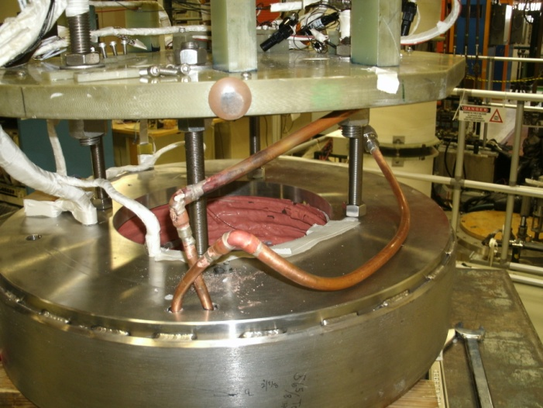
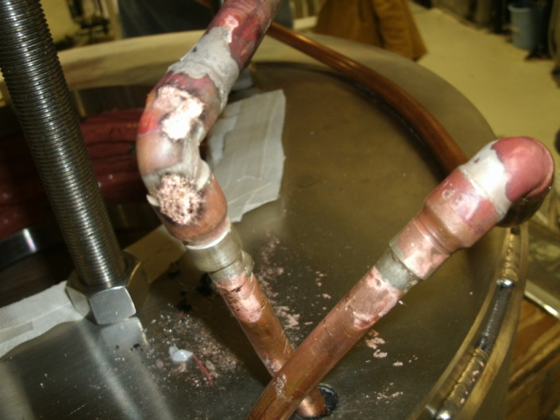
HSM01, HSM02 Test Results Quench Heater Performance
Conduction Cooling Study
We learned one very important Lesson
Copper tubing wrapped around each coil
Makes a beautiful 10:1 transformer!
This is not the right way to design the cooling tube layout

Slide 18
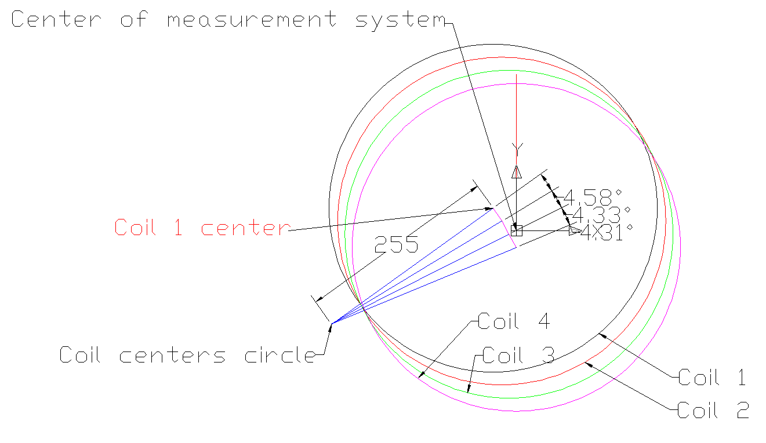
HSM01, HSM02 Test Results Magnetic Field
Magnetic Field Maps: 3D Hall probe scans, vs 3D model prediction
What are the tolerances
On “field quality”
On ring positions ?
These will be measured
Carefully in HSM02
(better attention to alignment/survey features,
Coordinate systems)

Slide 19
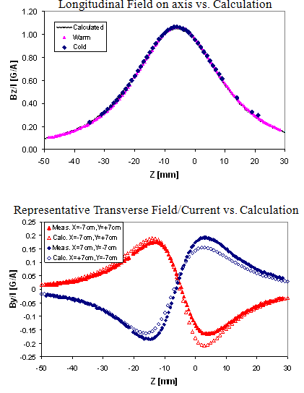
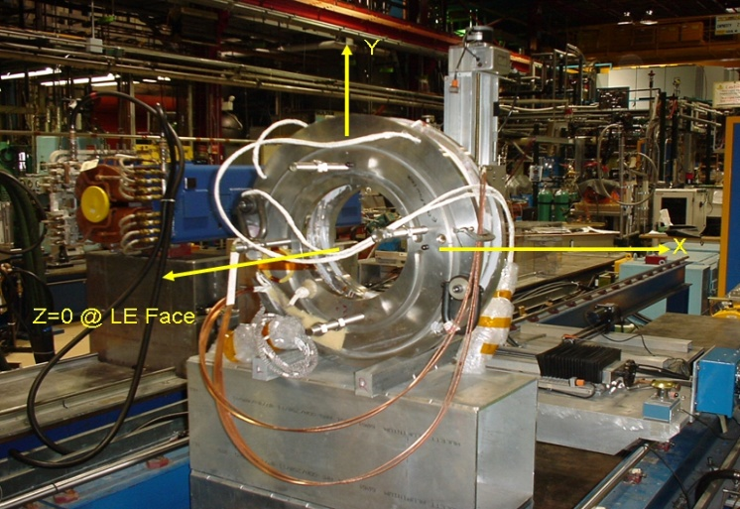
HSM01, HSM02 Test Results Magnetic Field
Magnetic Field Maps: 3D Hall probe scans
HSM01 ±10A at 300 K, 2 kA at 4.5 K (in 1.75” warm bore tube)
HSM02 5 kA at 4.5 K (warm planned)
There is no central axis (offset rings)
Mechanical center is well defined
Fiducial marks allow probe positioning
Make comparison to 3D Model
Cold measurements along a central line
no surprises – Bz/I agrees with warm
Warm measuments
central line along Z (solenoid dir.)
Along Z at {R=4cm, θ}
Off-axis:
Relating {magnet, probe, model} Coordinate Systems needs a bit more attention (done in HSM02)

Slide 20
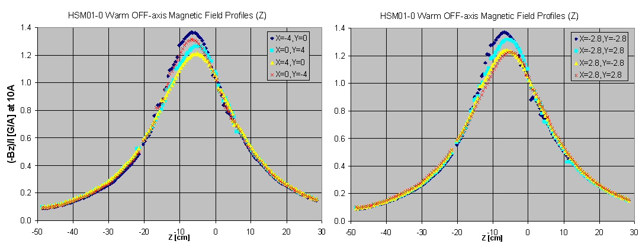
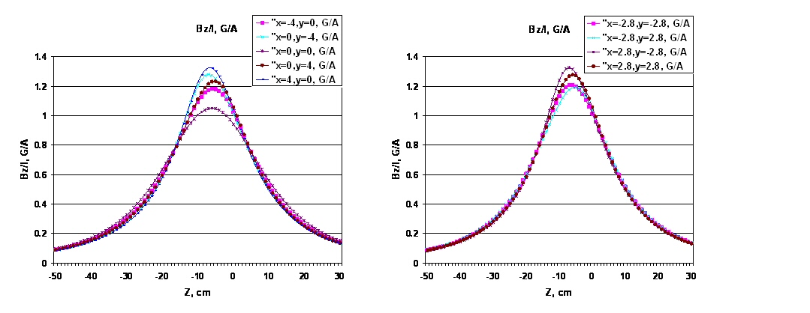
HSM01, HSM02 Test Results Magnetic Field
HSM01

Slide 21
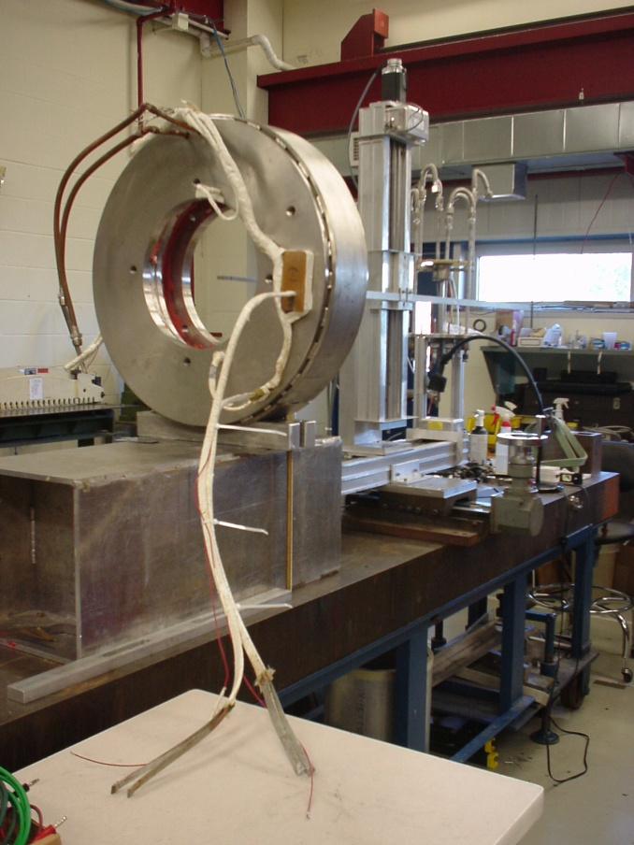
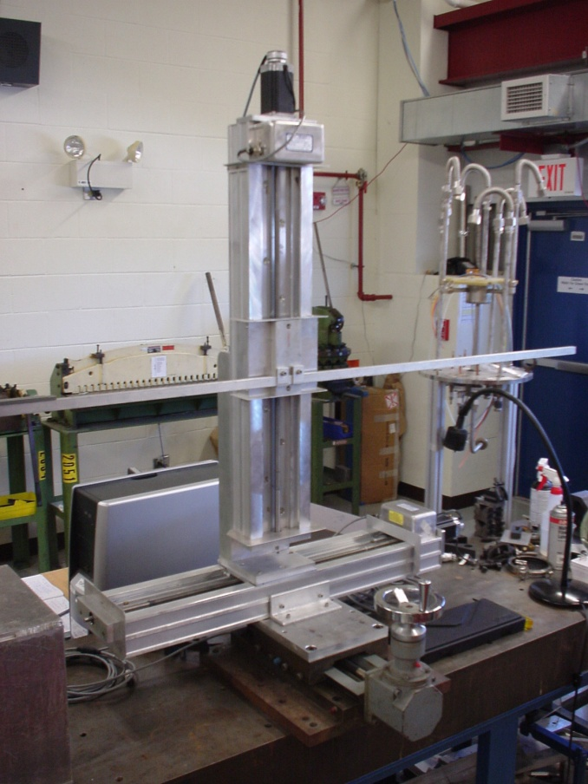
HSM01, HSM02 Test Results Magnetic Field
HSM02: Still setting up to do warm measurements at ±10A
Conventional Test Stand B tied up with Accelerator Support projects
New system development, new 3D Senis Hall probe (vs 3 1D probes)
Minor complication: steel table (mounted high on Al beam)

Slide 22
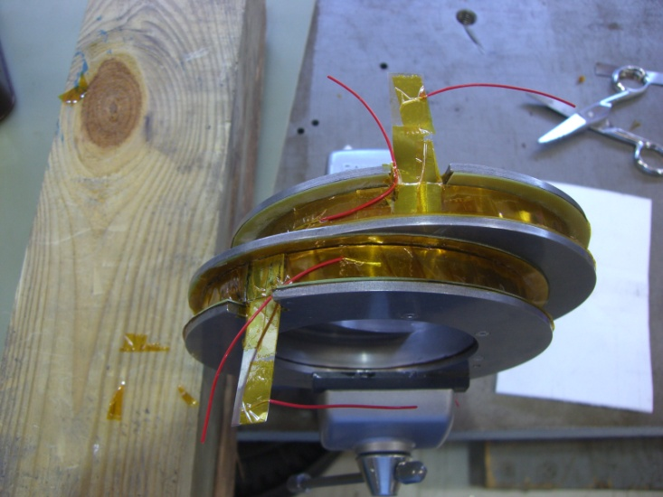
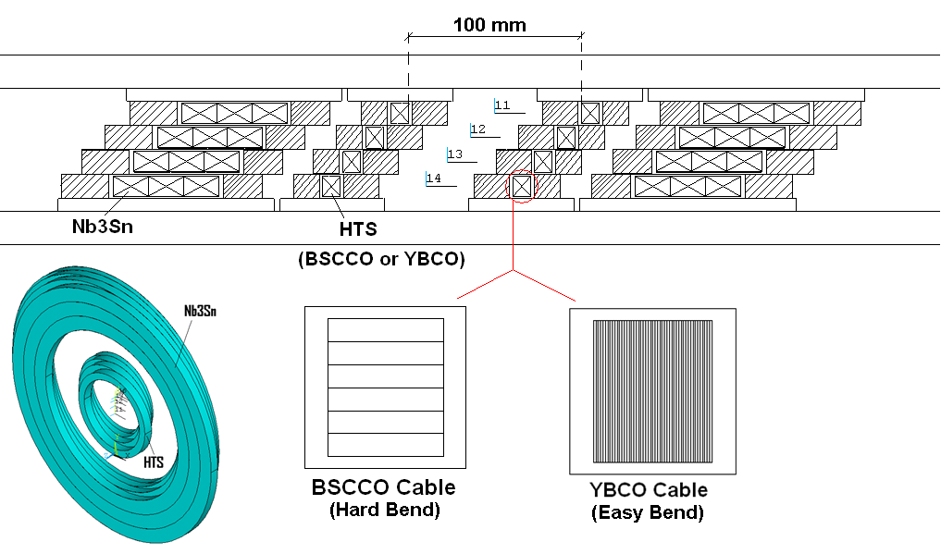
HSM Next Steps Other models in progress, planned
HSM03 – same design but with Aluminum rings for coil pre-stress
HSM04 – Nb₃Sn design
Needed for inserts in higher field cooling regions
Very different technology (small part of larger High Field magnet program)
Helical solenoids using HTS (BSSCO wire or YBCO tape) conductor
Also needed for inserts in higher field regions
New, very different technology –
collaboration with Muons, Inc. to design, build, test first model
First YBCO model has been built and tested –
results for another talk !

