Slide 1
PIP-II coupler activity update
N.Solyak on behalf of coupler team
Nov.18,2020

Slide 2
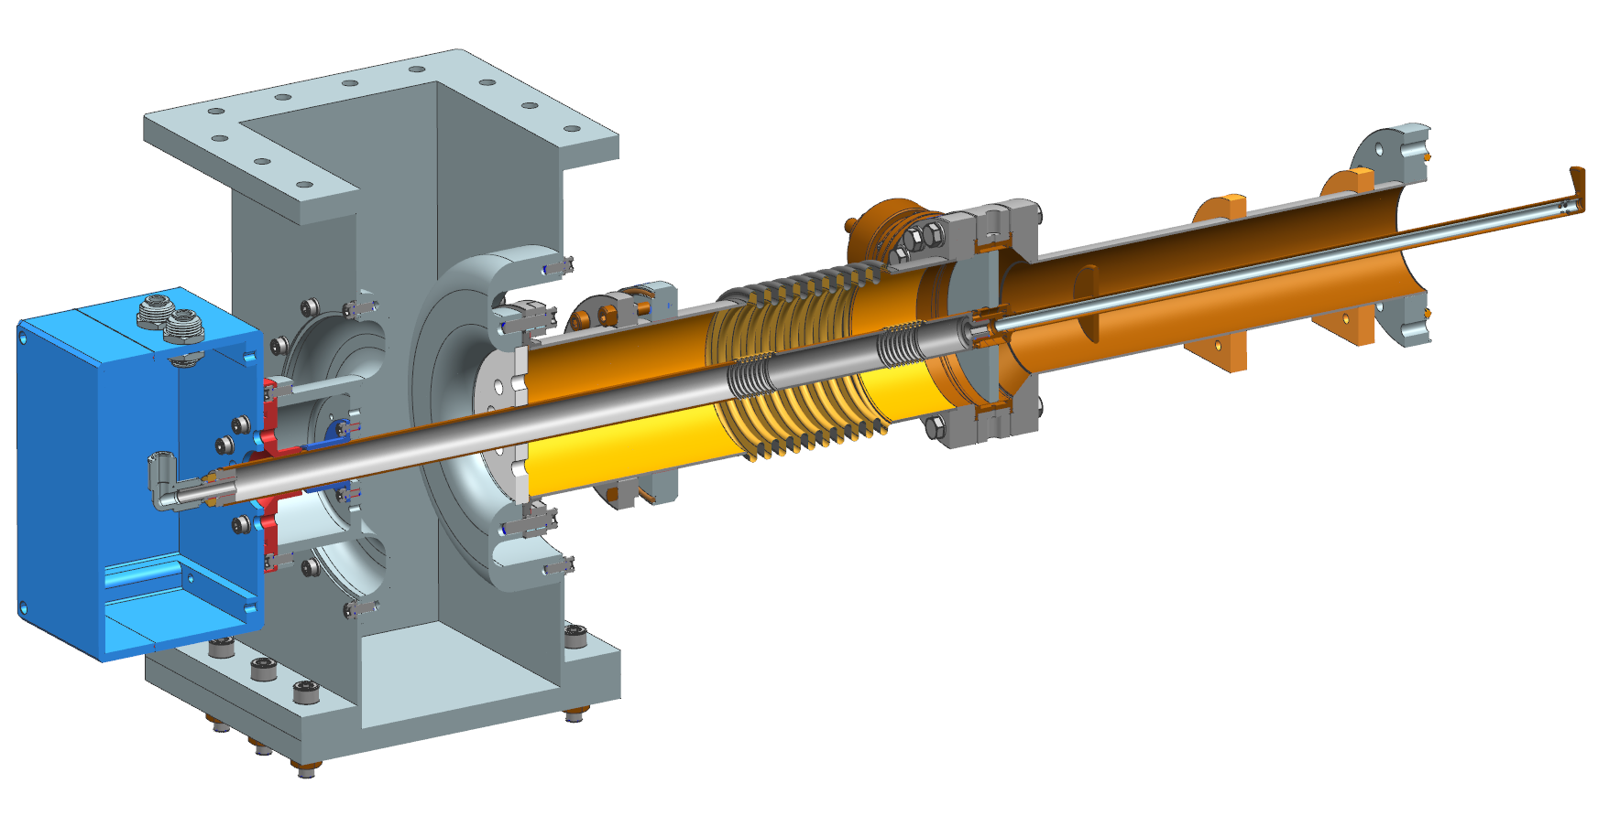
650 MHz Coupler Assembly
F100056895
WR 1150 waveguide assembly
Antenna and ceramic window assembly
Vacuum gauge
Vacuum End Assembly
Inner conductor
Outer conductor
Instrumentation box

Slide 3
Prototype coupler procurement (8 couplers + 3 antenna assembly)
Two proposals received (CPI, Sumitomo/Canon) and evaluated
Awarded to Sumitomo
Negotiation on shorter delivery time in progress

Slide 4
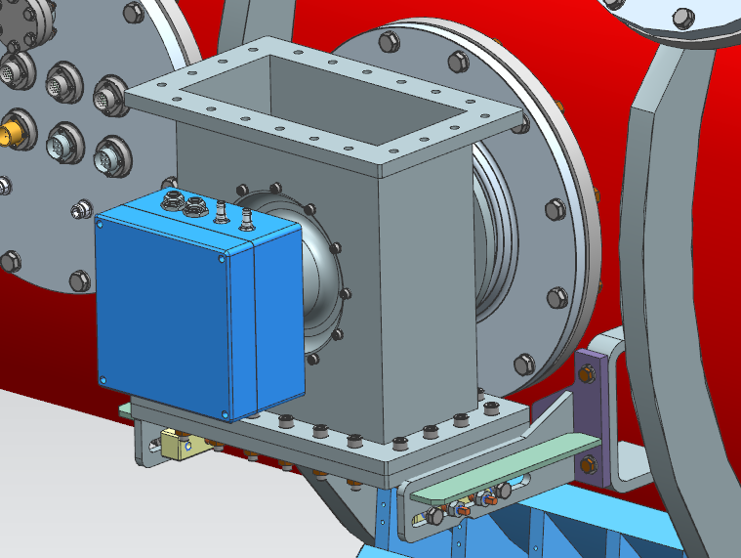
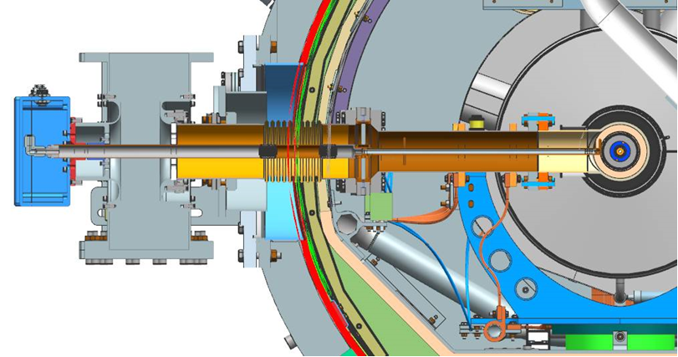
Diagnostics
dry filtered air
HV connections
T, ceramic x2
T, 50K
T, 5K
Ceramic window: heater+
4 straps to ambient
temperature (not shown)
E-probe, and vacuum gauge (not shown)

Slide 5
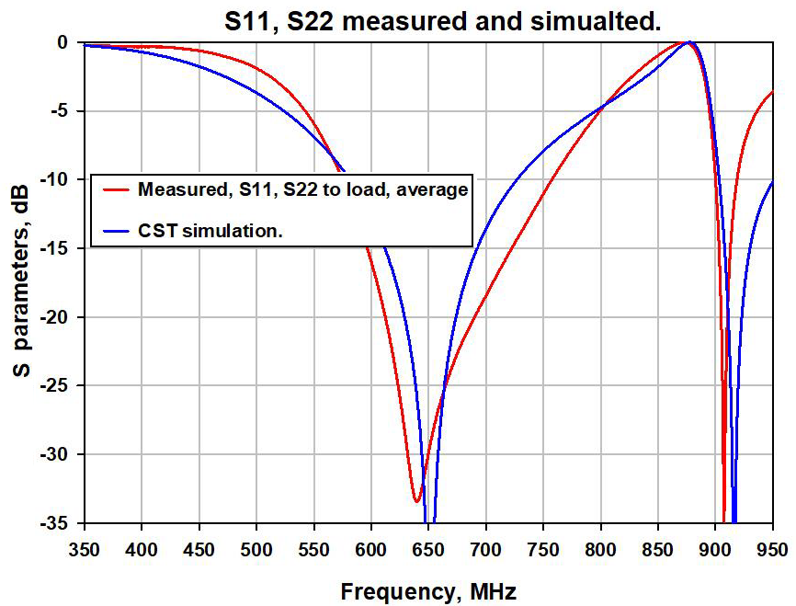
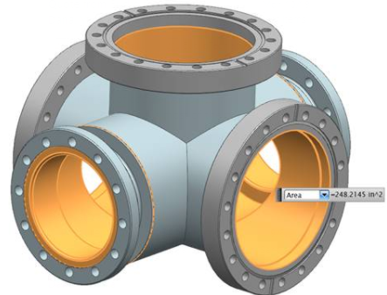
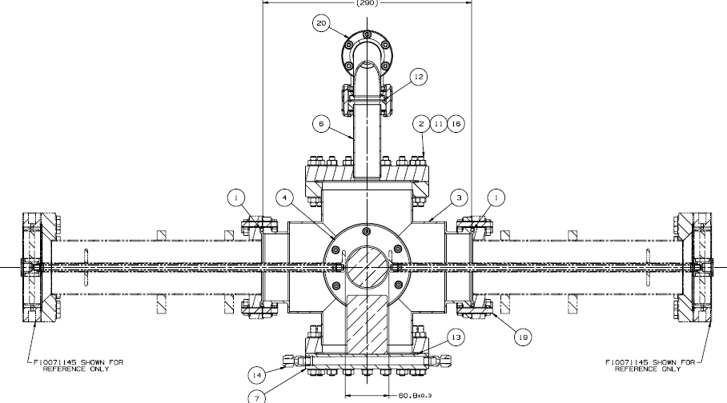
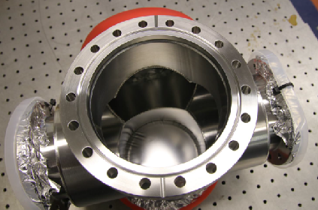
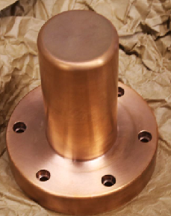
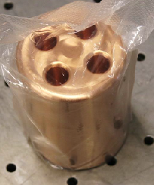
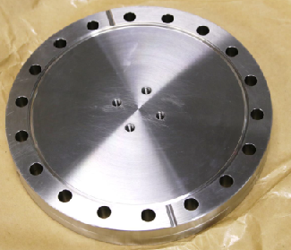
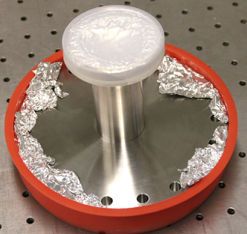
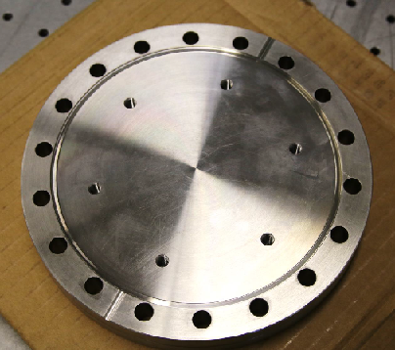
Test stand upgrade: Vacuum chamber for capacitive coupling

Slide 6
Sensitivity to antenna length (gap)
Length of copper antenna ~ 432mm.
Expected temperature rise of antenna is ~ 30C for 50 kW RF power.
Antenna length increasing (capacitive gap length decreasing) ~ 1.7E-5 x 432 x 30 ~ 0.22 mm
Initial gap size is 2.4 mm
Simulations show that gap changing range (-0.6mm, + 0.8mm) keep S11 < -20dB

Slide 7
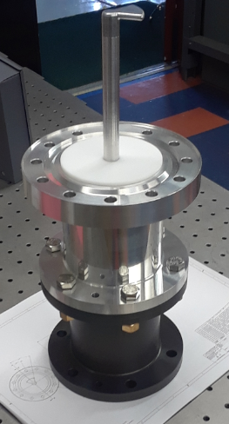
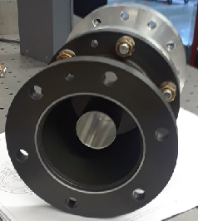
Two dummy couplers
Simplified design, same geometry of antenna
Use to measure coupling (Q_{ext}) of the cavity before final HPR
Used for tuning vacuum chamber (test stand)

Slide 8
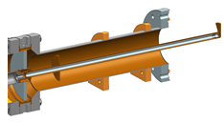
Vibration test (antenna geometry for SSR2/650 similar
Goal: Measure antenna vibration at different air cooling flow rate 0…5 g/s
Design completed (dummy antenna), drawings are released, all under procurement

Slide 9
SSR1 and SSR2 couplers
SSR1 cryomodule under testing at PIP2IT. 4 cavities/couplers are powered (1,2,3,8) and reach design performance (report on Thursday, Nov.19 collaboration meeting)
SSR2 procurement (RFP No 308167-KD)
  four (F10110745) SSR2 Coupler Assemblies and two (F10133762) Ceramic Window – Antenna Assemblies
  One proposal (CPI), awarded
    kick-off meeting with CPI
    ~10 month (proposal)

Slide 10
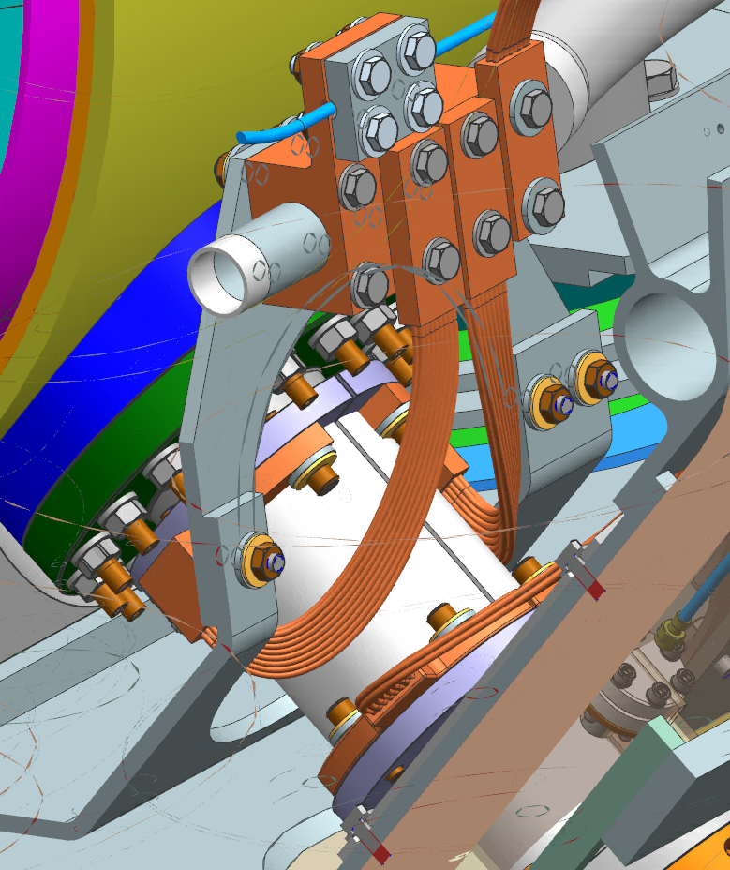
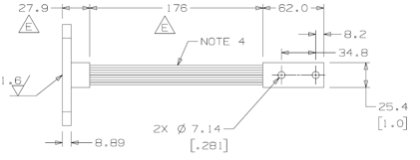
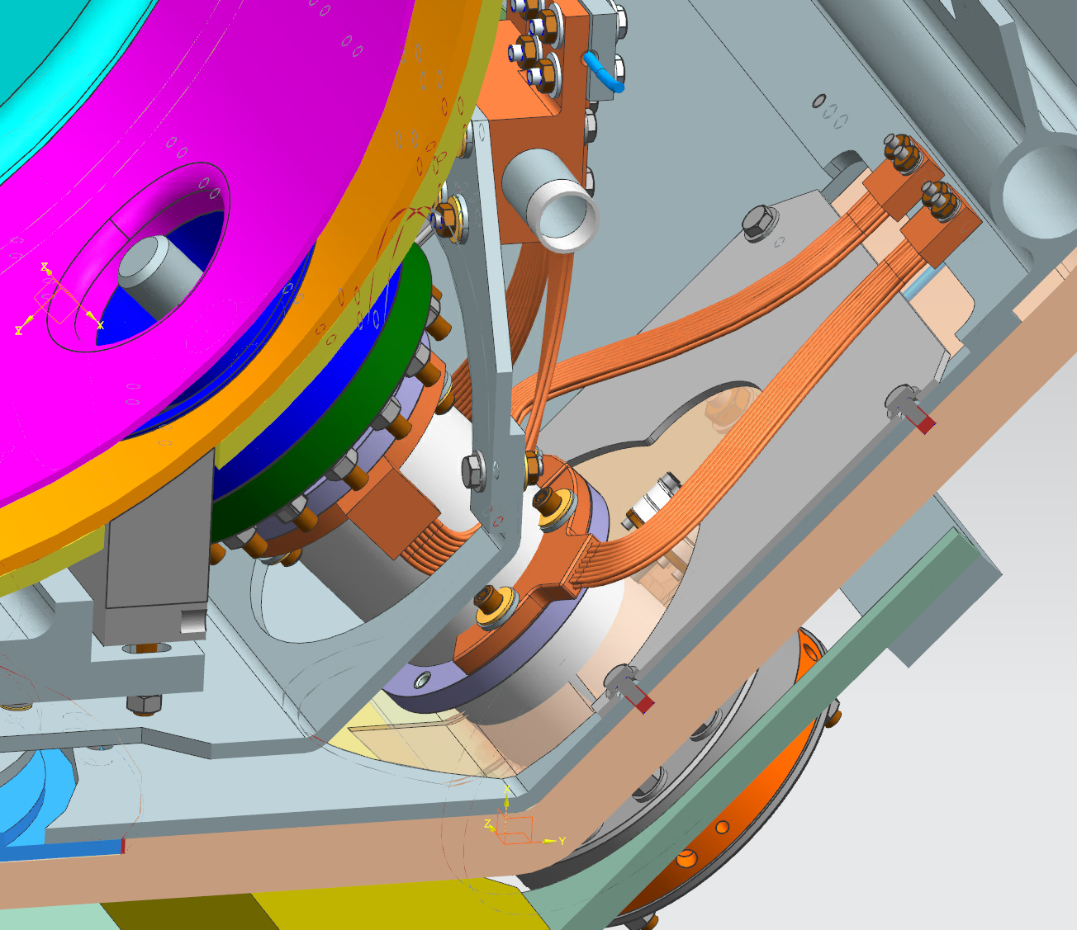
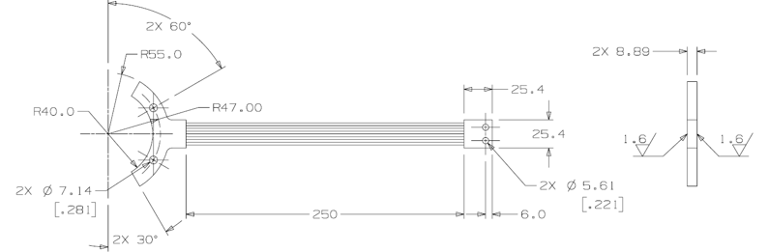
Simulation SSR1 coupler with cryomodule straps.
Copper block around 5K
Thermal straps F1082319
Pipe around 50-110K
Thermal straps F1082037

Slide 11
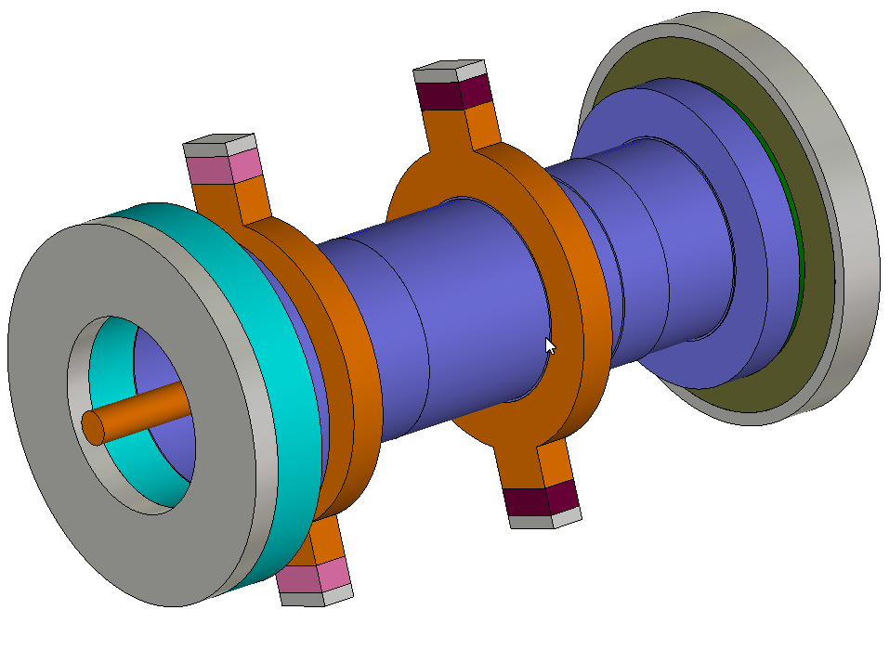
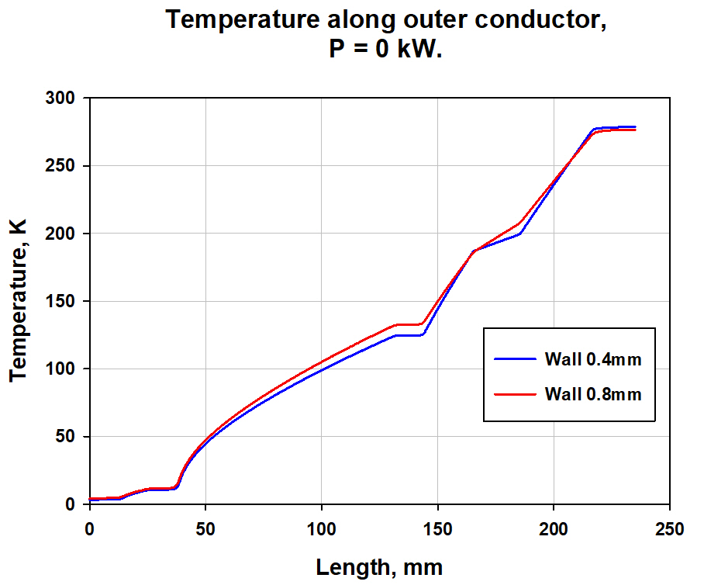
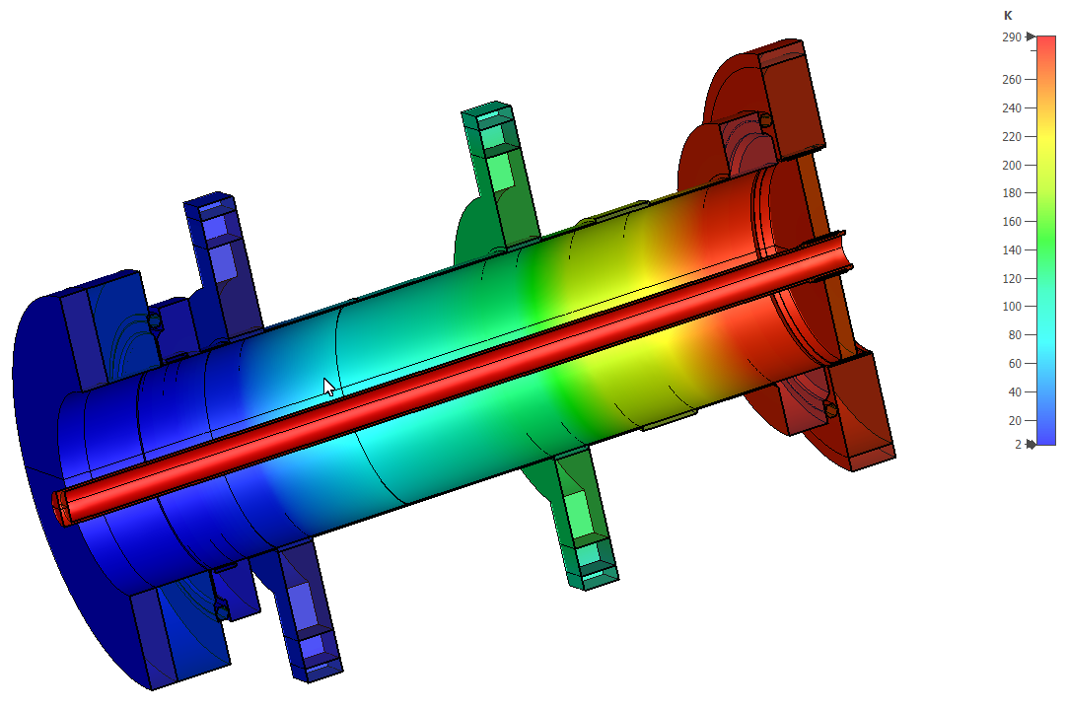
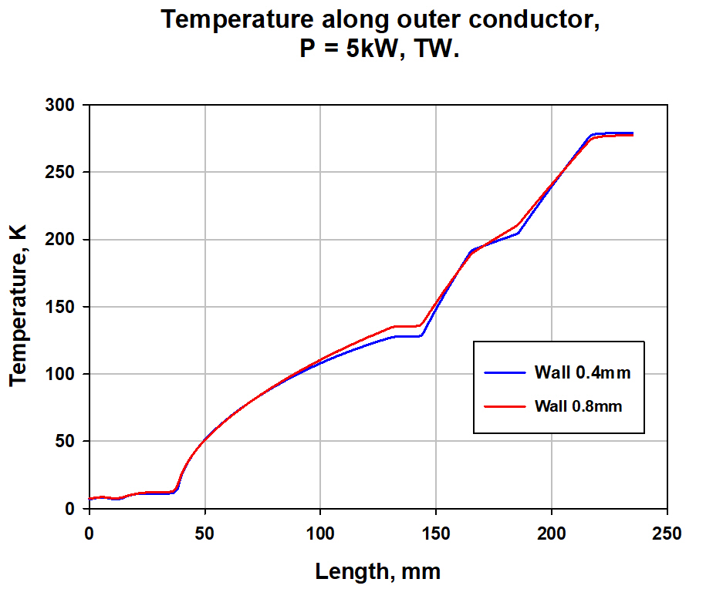
Model:
Temperature distribution:
 | T, 2K | T, 5K | T, 50 | P, “2K”,W | P, “5K”,W | P “50K”,W | P, “RT”,W
0.4mm, 0kW | 3.2 | 10.7 | 124.5 | 0.064+0.5 | 0.72 | 2.4 | -2.0
0.8mm, 0kW | 4.1 | 11.6 | 132.7 | 0.097+0.5 | 1.60 | 3.8 | -4.2
0.4mm, 5kW | 7.3 | 11.2 | 127.7 | 0.24+0.5 | 1.12 | 2.9 | -0.53
0.8mm, 5kW | 7.6 | 12.1 | 135.5 | 0.27+0.5 | 2.04 | 4.2 | -2.7
Will Cross-check with SSR1 cm

Slide 12
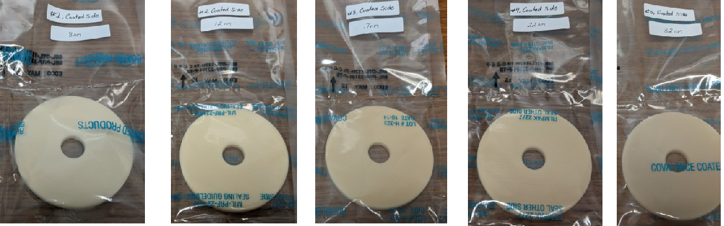

TiN coating studies:
5 disks coated at CPI (8…32nm), using DESY technology (50%TiN + 50% TiO)
Thickness measurements at CPI, cross-check at FNAL/NWU for 1 disk (soon)
RF losses in ceramic before and after TiN coating (vs. thickness) - done
Composition measurements (NWU) in progress
Charging meas. at Euclid Techlab in progress.

Slide 13
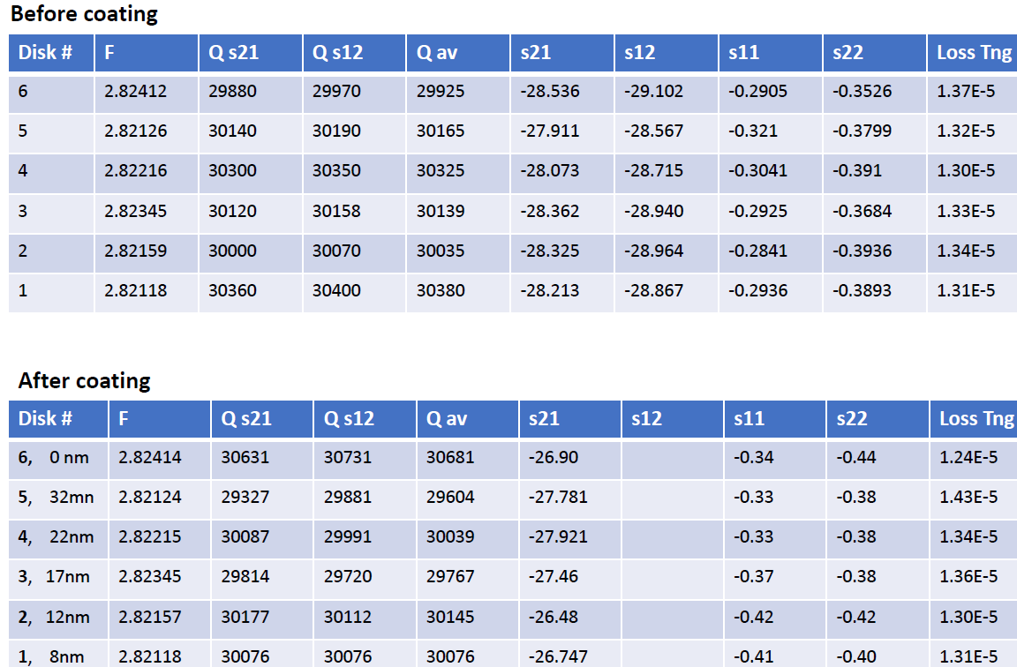
Almost no differences in loss tang

Slide 14
