Slide 1
50% LBNE Concept Design LAr Infrastructure

Slide 2
Mechanical

Slide 3
LAr HVAC
3 x 50% AHU at entrance to cavern
30,000 cfm total airflow (Based on ODH and fire requirements)
Once through system
< 15,000 cfm required for 1 fresh air change per hour
Saving in operation costs with recirculation.
Sidewall ducts within cavern for air distribution.
Exhaust by surface fans
Assumed surface conditions for incoming air (i.e. no spray system)

Slide 4
LAr HVAC
1x 100% air-cooled chiller discharging heat to borehole
Packaged unit including chilled water pumps
Multiple compressors, fans and pumps provide redundancy
Possible single point of failure for electrical
Chilled water piping runs through cavern
AORs air conditioned by local DX units
Revised Veto design not included

Slide 5
LAr HVAC

Slide 6
Plumbing

Slide 7
LAr Plumbing & Fire Protection Services
Industrial water (competing schemes)
Fire fighting water (single fire water supply from Ross).
Drainage
Sewage Removal for the main AOR
No potable water service is provided to the 800L

Slide 8
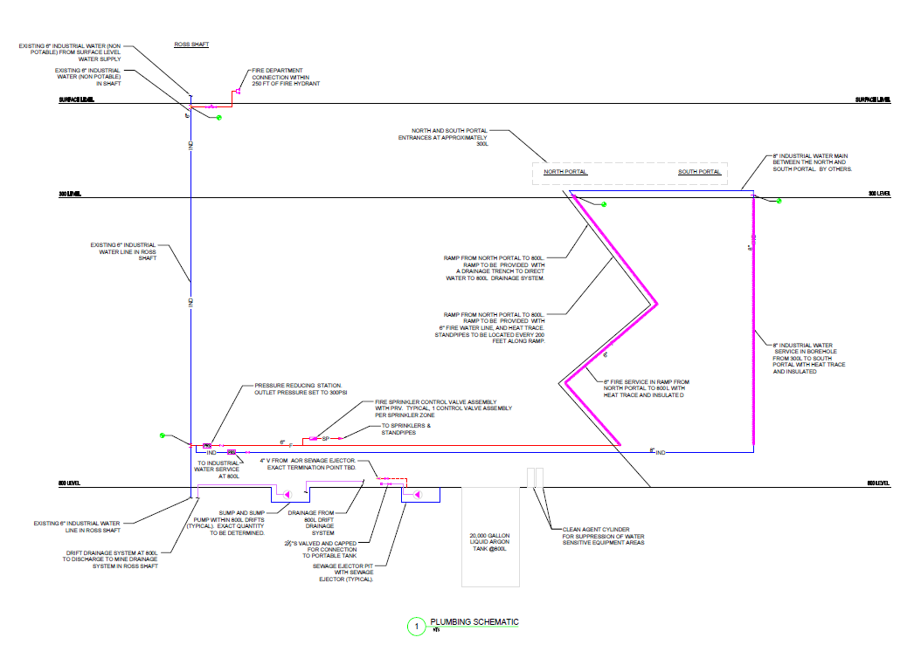
LAr Plumbing Schematic

Slide 9
300L to 800L Ramp
Drainage: The 300-800L ramp will be provided with a drainage trench to direct water to the 800L drainage system.
Fire Fighting: The 300-800L ramp will be provided with a 6” fire line, and class III hose stations every 200 feet. The fire line will be fed from the fire line at 800L and the industrial water at 300L. No Sprinklers will be provided in the ramp.
Ramp AORs: Provided with bottled water for drinking, and chemical toilets.

Slide 10
LAr Cavern AOR
The Main AOR at 800L will be provided with:
A 1000 gallon water tank for hand washing/drinking. Tank will either be elevated, or provided with a pump
Bottled water for drinking
Industrial water for fixture flushing
A vented sewage ejector pit and sewage ejector
Possibility of chemical toilets

Slide 11
Electrical

Slide 12
LAr Detector Electrical Connected Loads
LAr Experiment Electrical Loads
LAr Experiment Infrastructure Electrical Loads
ITEM | ELECTRICAL CONNECTED LOAD | NOTES
Detector – (2) chambers each @ 13.5kVA | 27kW | Based on Facility Underground Electrical Load Table – June 23, 2011
Liquid Argon Pumps – total of (8) pumps each at 15kW | 133kW | Based on Facility Underground Electrical Load Table – June 23, 2011
Heating cables – 70kW per detector | 140kW | Based on Arup estimates using 10w/sq m as a “rule of thumb” and efficiency factor of .75
Purification Skid (heating) | .2kW
Purification Skid (cooling) | 74kW
Purification Skids – (blowers) | 99.2kW
Crane | 6kW | Based on Facility Underground Electrical Load Table – June 23, 2011
Total Estimated Detector Power | 479kW
With 20% Uncertainty factor | 575kW | 20% based on LBNE requirements
ITEM | ELECTRICAL CONNECTED LOAD | NOTES
Detector Lighting – assuming 1w/sq.ft | 58kW | 15-20 fc average at 30” above floor
Drift Lighting – assuming .5w/sq.ft | 6kW | 2.4 fc average at floor level
Ramp Lighting – assuming .5w/sq.ft | 32kW | 2.4 fc average at floor level
Chiller Plant – assuming 100 Tons | 177kW
Air handling Units | 30kW
Sump Pump | 42kW
AORs – total of (3) | 190kW | Based on 100% PDR typical AOR information.
Heat trace cable for 4000’ of sprinkler piping | 32kW | Assuming 8 watts per linear feet for heat trace cable
Electric Humidifiers | 268kW
Electric Heaters | 700kW
Fire Alarm | 2kW
Communications | 15kW
Security (future placeholder) | 15kW
Total Infrastructure Power | 1567kW
20% Spare factor | 1880kW
Total Load – Detector + Infrastructure | 2455kW | Includes 20% spare factor
Total Load assuming .9 power factor | 2728kVA

Slide 13
LAr Emergency/Standby Electrical Load
Item | Emergency/Standby Connected Load
Drift Lighting | 37.5kW
LAr Chamber Egress lighting | 14.5kW
AORs | 152kW
Sump Pump | 4.2kW
LAr Heating Cables | 140kW
Fire Alarm | 1.7kW
Security | 17kW
Heat Trace for Standpipe | 32kW
IT System | 12.5kW
Total Connected Electrical Load | 411kW

Slide 14
LAr Lighting

Slide 15
LAr Drift Lighting

Slide 16
LAr Chamber Lighting

Slide 17
LAr Emergency Power
Notes:
5kv routed from north portal down to 1st substation. Step down to 480v and route to 2nd substation.

Slide 18
LAr Normal Power
Notes:
12kv routed down south portal to first substation. Step down to 480v and route to 2nd substation.

Slide 19
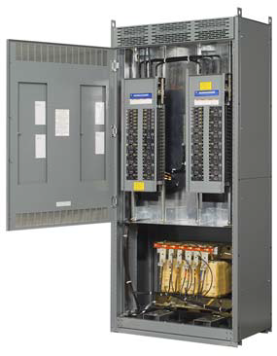
LAr Drift Panels
Notes:
Every 400’ we have a drift panel.

Slide 20
Communications

Slide 21
Scope of Work at LAr
Structured Cabling System
ICT Enclosures and Pathways
Backbone Distribution
Horizontal Distribution
Communications System
Extend existing analog phone system
Extend existing radio system
Extend existing Data Network

Slide 22
LAr Option

Slide 23
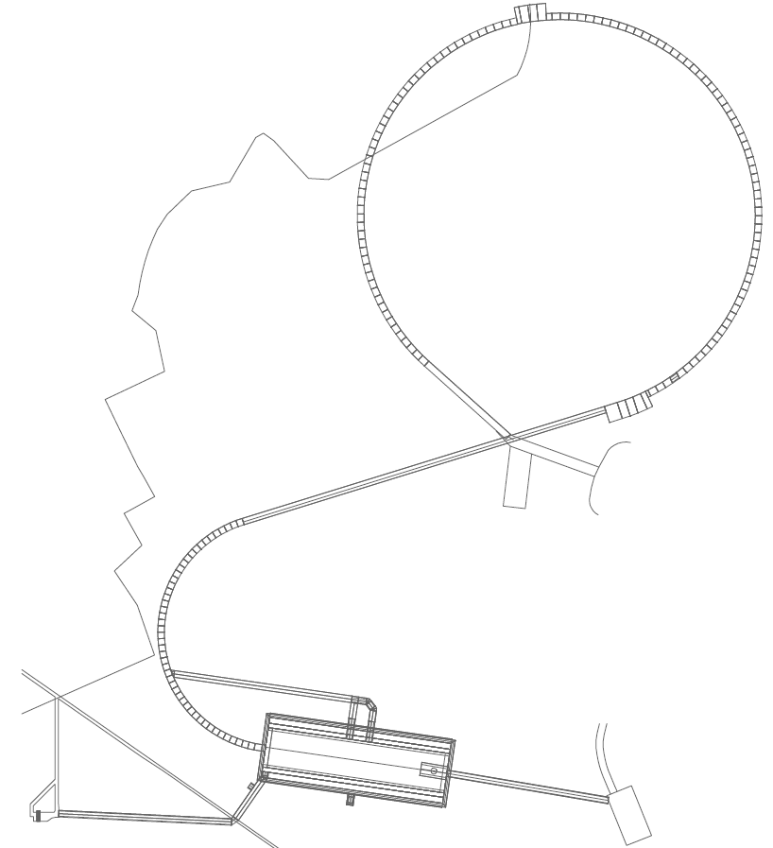
2-Way Radio Coverage
EXISTING LEAKY COAX IN SHAFT REMAINS UNTOUCHED.

Slide 24
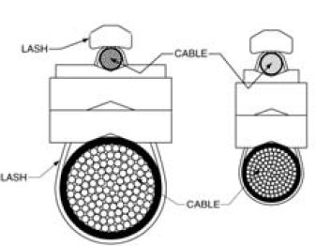
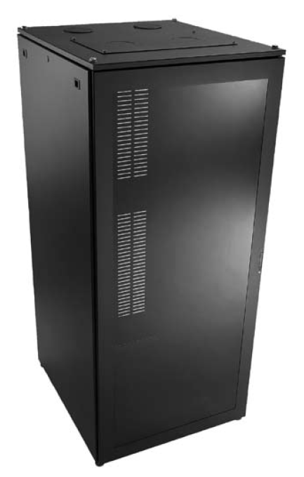
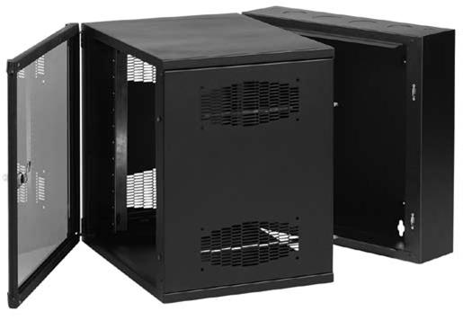
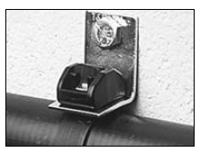
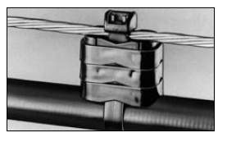
Pathway Supports and Enclosures
Communications Enclosure
Dimensions vary from:
24” x 24” x 36” to
24” x 24” x 60”
Communications Distribution
Enclosure Dimensions:
24” x 24” x 72”

Slide 25
Fire Protection

Slide 26
Life Safety
Codes Standards
IBC 2009
Referenced NFPA Codes and Standards
NFPA 520 – Standard on Subterranean Spaces
Variances
ADA
As per DUSEL ADA Policy July 2010
“…recognizing that DUSEL is a unique facility with special hazards and construction challenges, portions of DUSEL will not be accessible…”
Variances will be necessary

Slide 27
LAr Fire Safety
63 Occupants
Exit via new ramp or Ross Shaft or to AORs
Compartmentation
4 hour barrier to large AOR and experiment cavity
AORs to limit travel distance to 2000 feet
96 hour duration
Cavern AOR sized for 63, others 10

Slide 28
LAr Fire Safety
Suppression
Sprinklers in occupied spaces
Standpipe throughout ramp and occupied spaces
30,000 CFM for smoke control discharged to south portal
Emergency lighting throughout occupied areas
Phones every 400 feet throughout occupied area and up ramp
Fire detection, alarm and ODH detection throughout occupied area

Slide 29
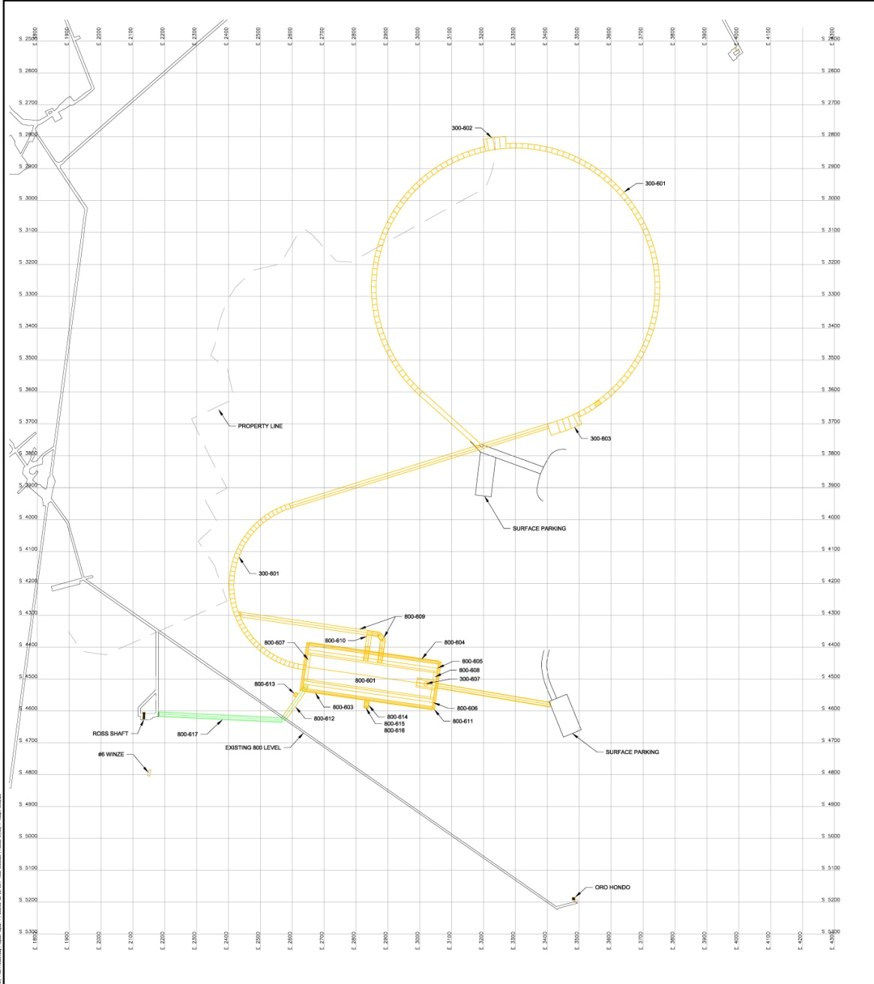
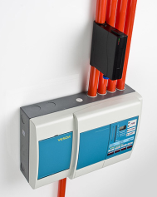
LAr Fire Alarm
Fire Alarm System shall consist of:
Manual Pull stations
Combination speaker/strobe lights
Water flow/tamper switches
Aspirated sampling system with gas monitor modules
Fire fighter phones

Slide 30
Life Safety

Slide 31
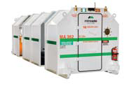
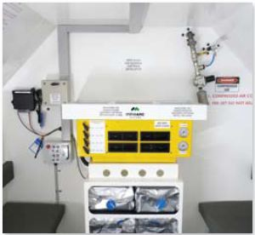
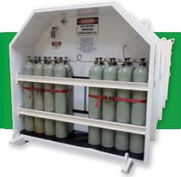
Prefabricated AOR
96 hour duration
Compressed gas module
Airlock Module

