Slide 1
200 kT Water Cherenkov Detector Excavation
50% Conceptual Design Review

Slide 2
Outline
Overview of 200 kT WCD Layout
Generalized Development Sequence
200 kT WCD Excavation Sequence
Ground Support & Stability Modeling
Ventilation
Preliminary Conceptual Cost Estimate
Updates Going Forward
Utility Drift Size
AoRs
Other Excavations

Slide 3
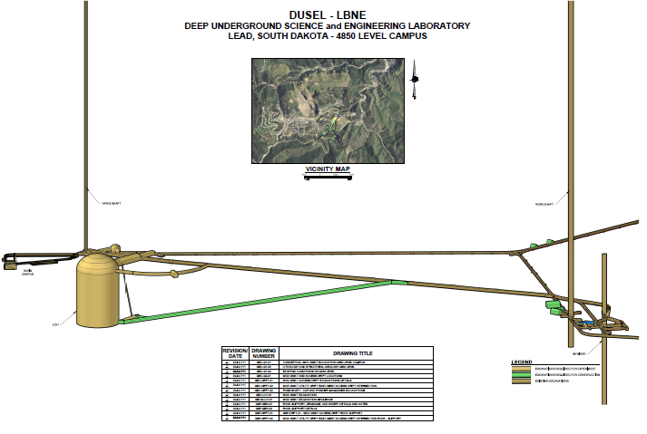
200 kT WCD Layout

Slide 4
200 kT WCD Excavation Sequence
Ramp to dome (exploratory drift)
5117 Ramp & drift to center of WCD
Top level dome excavate/support
Raise bore
Continue down dome
Excavate tank
5 meter benches
Work in sections

Slide 5
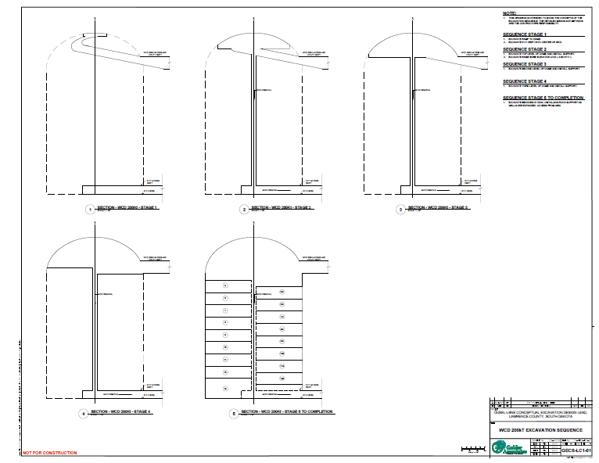
200 kT WCD Excavation Sequence

Slide 6
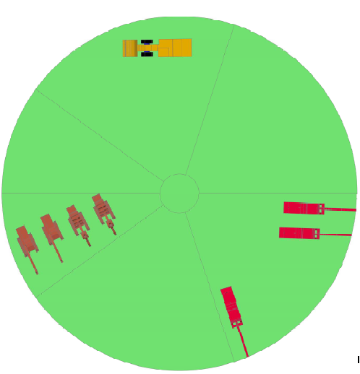
WCD Excavation Cycle
Mucking
Wall Scaling & Cleanup
No-go Zone for Excavator Backup
Blasthole Drilling
Cable & Rock Bolting
Explosive Loading
(Foot Traffic)

Slide 7
Ground Support
WCD Excavation
15m, 50T cable bolts, 2.5m centers
5m, 20T resin bolts, 1.25m centers
100mm mesh
100mm shotcrete
Utility Drift
3m resin bolts, 1.5m centers
75mm shotcrete
Others
1.2m resin bolts, 1.5m centers

Slide 8
Ventilation & Hoisting
Driven by diesel requirements
~125,000 cfm in 5117 Ramp
Volume and velocity in WCD excavation?
~100,000+ cfm at working level in WCD
Crane/Hoist in utility drift, 4T – 8T capacity

Slide 9
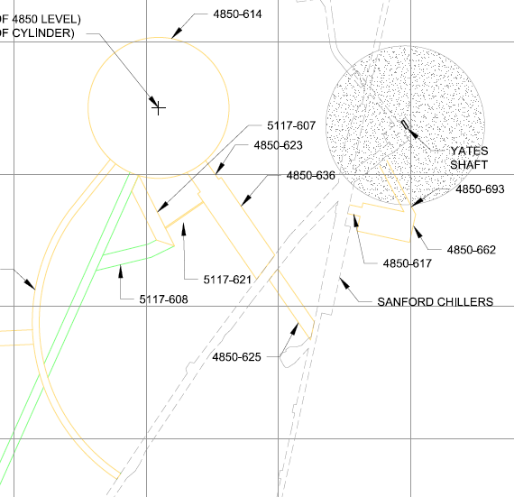
Alternative Utility Drift
950 m²
270 m²

