Slide 1
200 kT Water Cherenkov Detector Vessel Liner
50% Conceptual Design Review

Slide 2
Outline
Vessel Liner Background
CNA Phase 2 Recommendation
Key Concerns
Conceptual Vessel Liner Design
Comparative Leakage Rates
Constructability
Testing

Slide 3
Vessel Liner Background
Initial Options
Free-standing
Rock-supported
Pressure-balanced
Phase 1 Down-select to 2 options:
2A: Rock-supported, cast-in-place concrete vessel
1E: Free-standing steel vessel

Slide 4
CNA Phase 2 Evaluation
Eliminate Option 1E
Add Option 2C: Rock-supported with liner directly on shotcrete
Both have drainage layer(s) behind waterproofing membrane
Experiment water and native groundwater separated

Slide 5
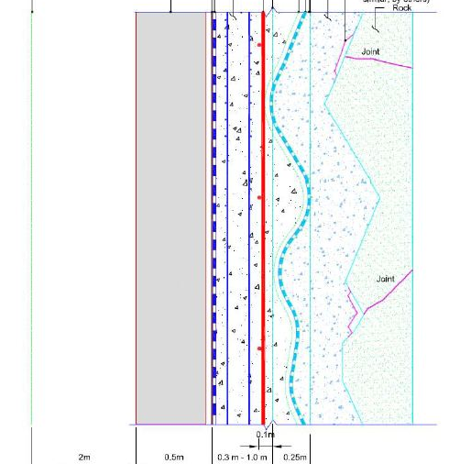
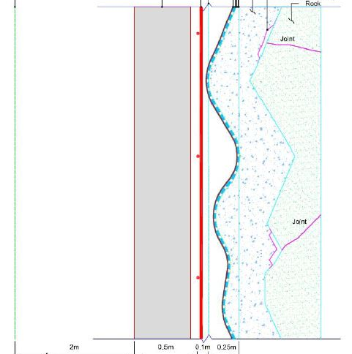
CNA Phase 2 Options
Concept 2A
Concept 2C

Slide 6
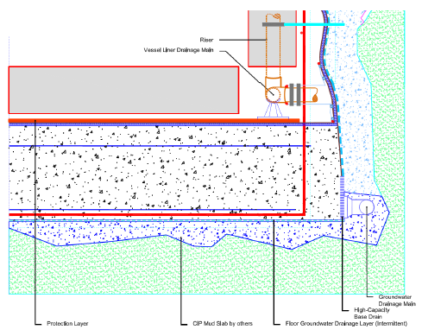
Option 2C Floor Detail

Slide 7
Key Concerns
Drainage Layer Facilitates Leakage
Liner Penetrations
Complexity of Design
CQA

Slide 8
Conceptual Design Tasks
Review previous work
Recalculate for 200 kT WCD
Research alternatives
High head
Leakage control
Seaming
Attachments to vessel
Assume polyethylene in contact with water

Slide 9
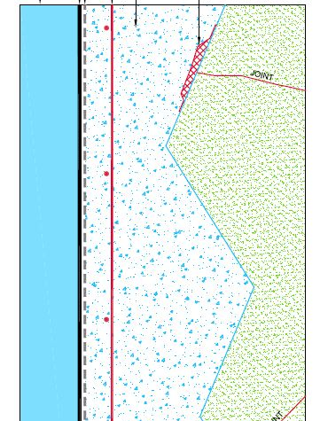
Recommended Conceptual Design A
GW Control
Exp’t Water
Membrane
GCL
Shotcrete
Mag. Coils
Excavation Damage Zone

Slide 10
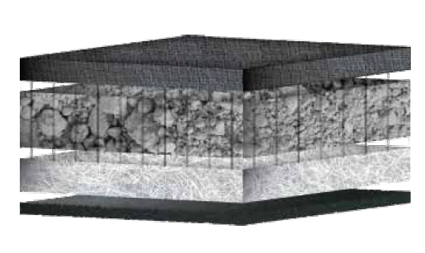
Geosynthetic Clay Liner
Geotextile
Bentonite
Geotextile
HDPE

Slide 11
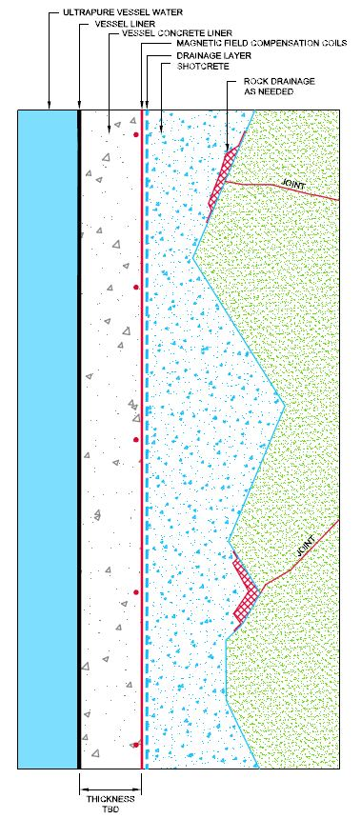
Recommended Conceptual Design B
GW Control
Exp’t Water
Membrane
Concrete
Mag. Coils
Drainage Layer
Shotcrete
Excavation Damage Zone

Slide 12
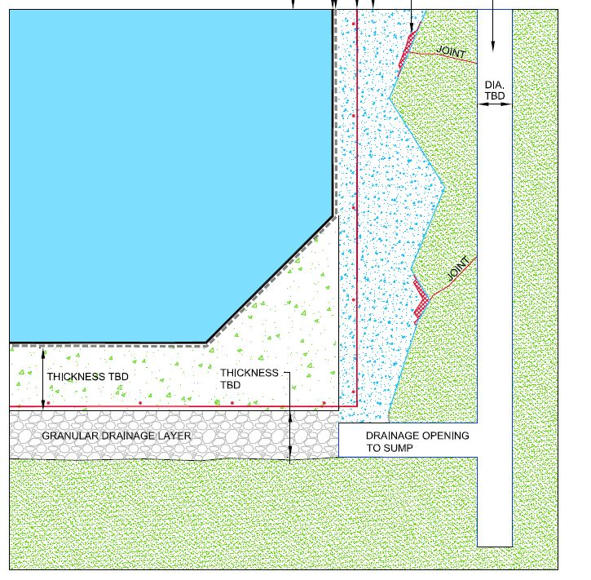
Concept A Floor Detail
Membrane
GCL
Shotcrete
Mag. Coils
Sump
Concrete
Drainage Layer

Slide 13
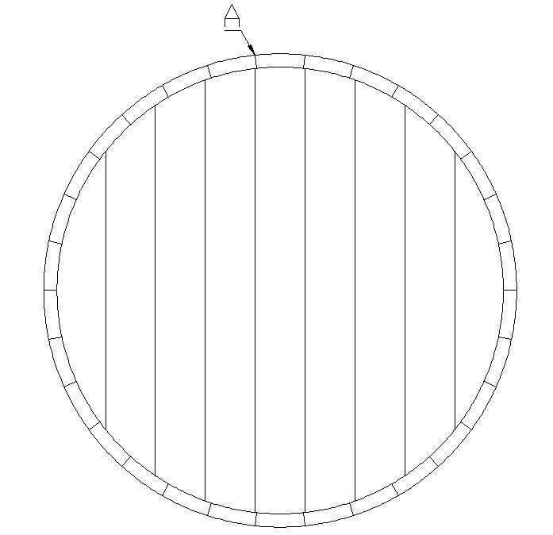
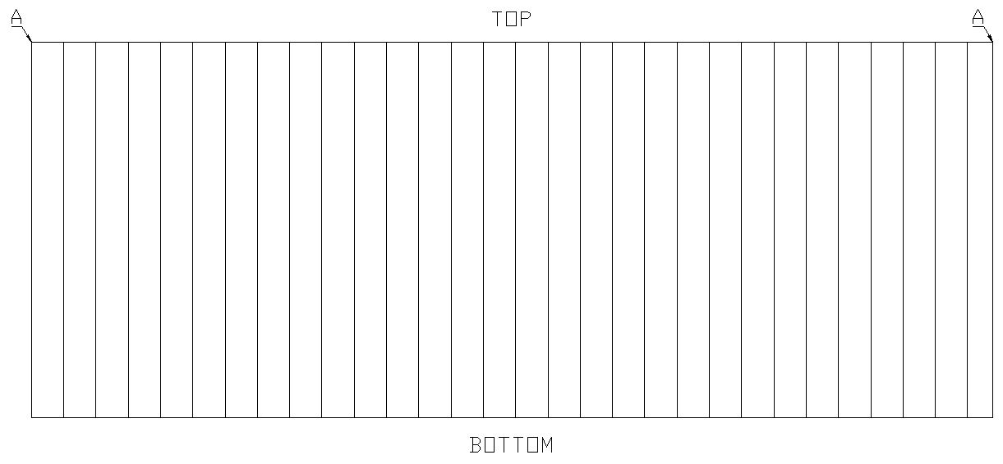
Conceptual Panel Layout
Walls
Floor

Slide 14
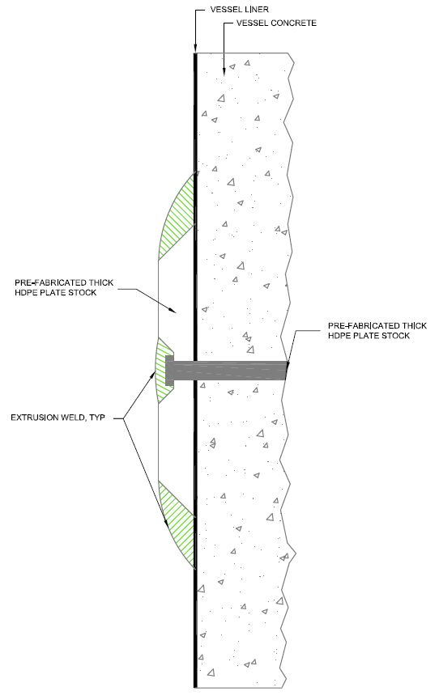
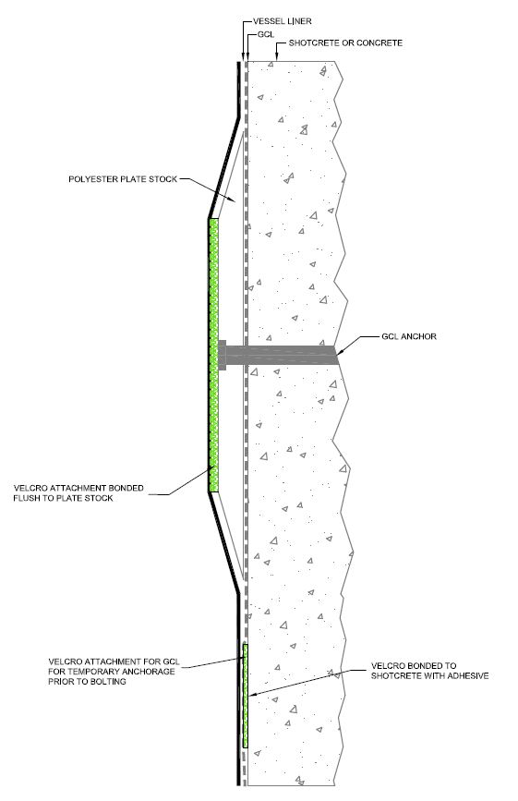
Panel Mounting Options
Polyethylene Plate
“Velcro”

Slide 15
Conceptual Design Features
Leakage minimized 3-6 orders of magnitude
Simplified construction
Minimized penetrations for attachment
Smooth walls to minimize strain on membrane

Slide 16
Testing
Material compatibility
Liner lifetime
Liner creep
Leak testing
Seams
Penetrations
Water interactions

