Slide 1
50% LBNE Concept Design
WCD Infrastructure

Slide 2
Mechanical

Slide 3
WCD HVAC
Large cavity and access drift cooled by 65 F drift air
Once through system
100,000 cfm airflow
Set by smoke extraction requirements
100,000 cfm results in ~10F temperature rise during normal operation
VFD’s may be justified, however there are added costs
No humidity control with once through system

Slide 4
WCD HVAC
2 x 100% exhaust fans for normal and emergency ventilation
Exhaust fans located in 626 drift exhausting to east drift
Davis cavern chilled water system left as is
AORs air conditioned by local DX units
Utility rooms including electrical cooled with drift air
No spray chamber etc.
Chiller by LBNE

Slide 5
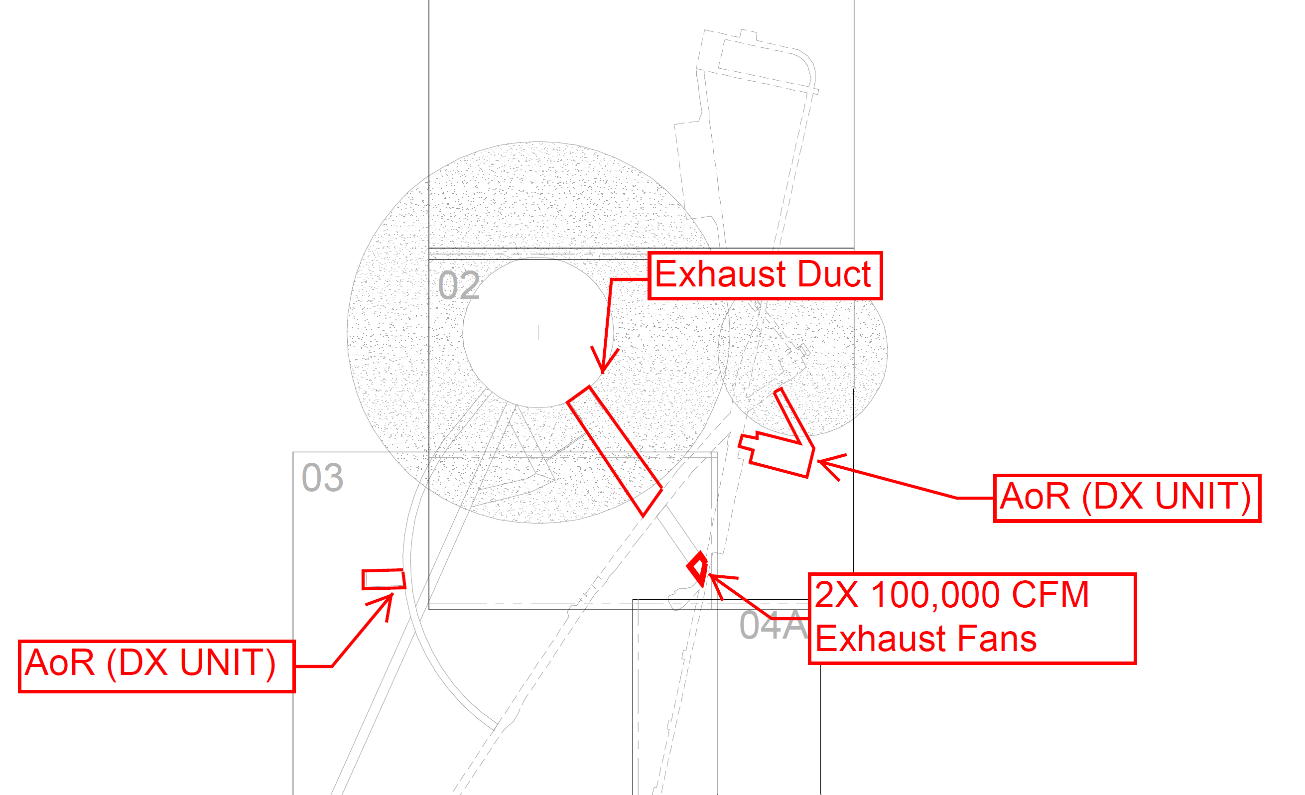
WCD HVAC
Cool
Warm

Slide 6
Plumbing

Slide 7
WCD Plumbing & Fire Protection Services
Potable water
Purified water (50% size 8” per LBNE direction)
Fire fighting water (redundant service from Yates and Ross shafts)
50% design assumes industrial water is currently provided to the 4850L (item for discussion)
Drainage system
Sewage Removal for the main AORs
Valved and capped connection to a water mist system at the WCD.
Compressed air, provided locally in LBNE’s equipment room.

Slide 8
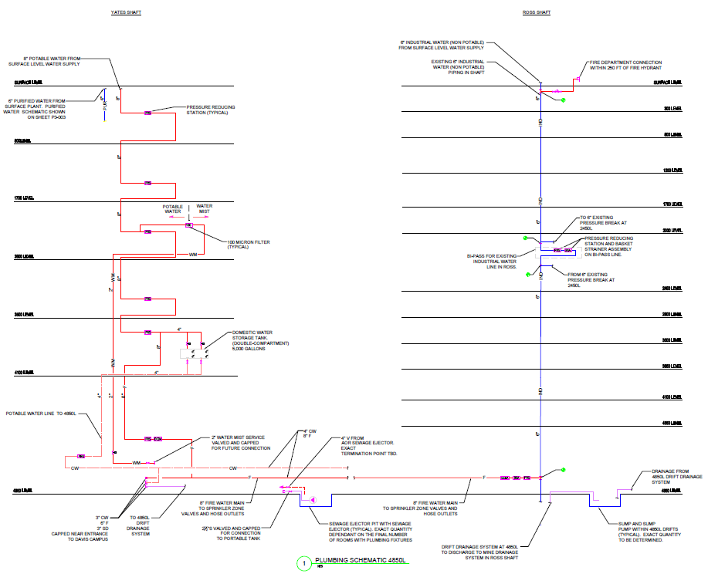
WCD Plumbing Schematic

Slide 9
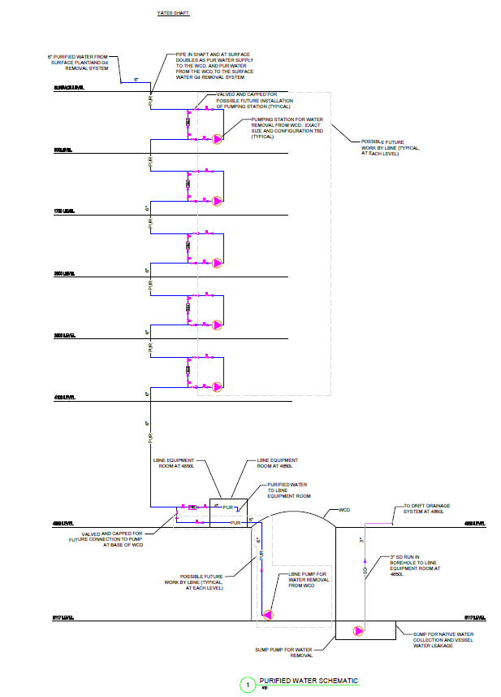
WCD Purified Water Schematic

Slide 10
Electrical

Slide 11
WCD Electrical Connected Loads
WCD Experiment Electrical Loads
WCD Infrastructure Electrical Loads
ITEM | ELECTRICAL CONNECTED LOAD | NOTES
LC Water (PMT-HV) | 3kW | Based on May 13, 2011 RFP Table 1-200
LC-Deck | 100kW | Based on May 13, 2011 RFP Table 1-200
LC-Balcony | 69kW | Based on May 13, 2011 RFP Table 1-200
Crane | 6kW
Total Estimated Detector Power | 178kW
With 20% Uncertainty factor | 214kW | 20% based on LBNE requirements
ITEM | ELECTRICAL CONNECTED LOAD | NOTES
Detector Lighting – assuming 1w/sq.ft | 32kW
Drift Lighting – assuming .5w/sq.ft | 45kW
Chiller Plant – assuming 3 Tons | 5kW | This assumes the 140 Ton chiller electrical requirements by LBNE is already included in Table 1-200 of the May 13, 2011 RFP.
Air handling Units | 30kW
Water System | 431kW | Based on May 13, 2011 RFP Table 1-200
Sump Pump @ 5060 Level for experiment | 254kW | Based on May 13, 2011 RFP Table 1-200
Sump Pump for 4850 level drainage system | 156kW
Utilities in Drift | 75kW | Based on May 13, 2011 RFP Table 1-200
AORs – anticipate total load | 450kW | Based on 100% PDR typical AOR information.
Fire alarm | 2kW
Communication | 12.5kW
Security (future place holder) | 12.5kW
Total Infrastructure Power | 1505kW
20% Spare factor | 1806kW
Total Load – Detector + Infrastructure | 2020kW | Includes 20% spare factor
Total Load assuming .9 Power Factor | 2244kVA

Slide 12
WCD Emergency/Standby Electrical Load
Item | Emergency/Standby Connected Load
Drift Lighting | 45kW
WCD Chamber Egress lighting | 8kW
AORs | 315kW
Sump Pump | 109kW
Fire Alarm | 1.5kW
Security | 15kW
IT System | 11kW
Total Connected Electrical Load | 505kW

Slide 13
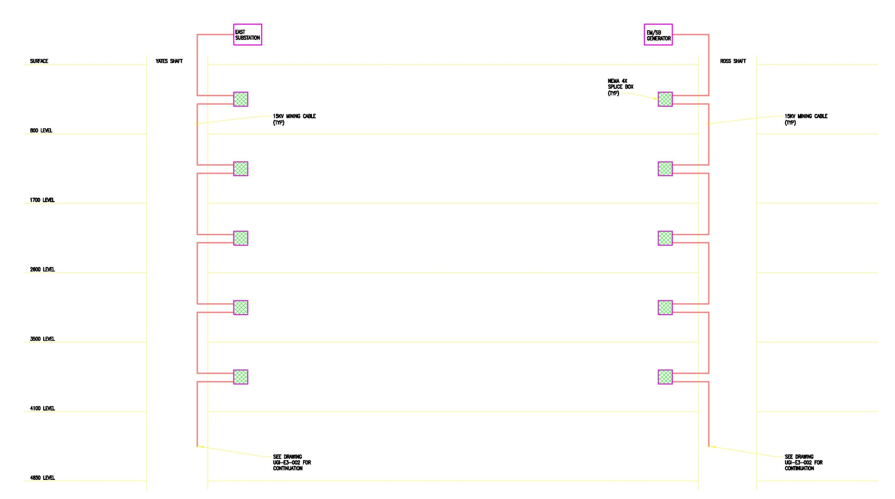
WCD Infrastructure
Other Levels and Ramps (OLRs)

Slide 14
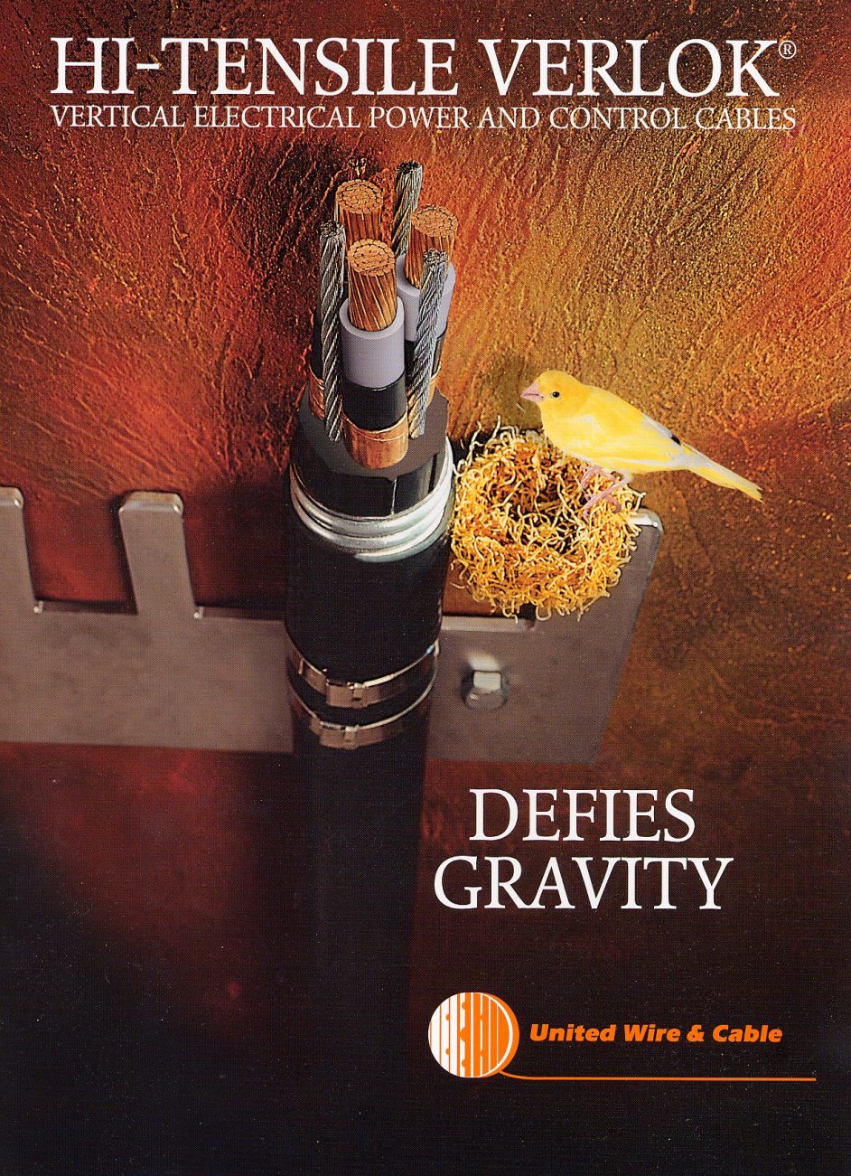
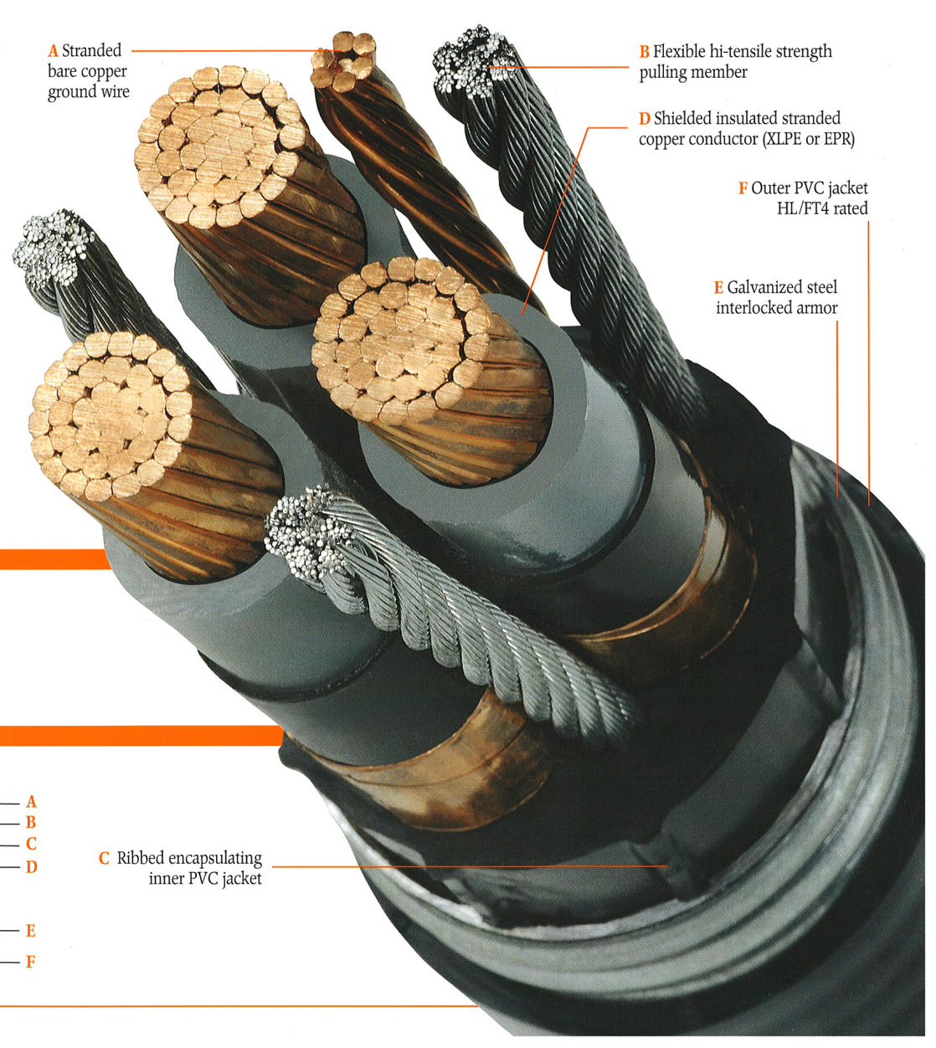
Shaft Cables

Slide 15
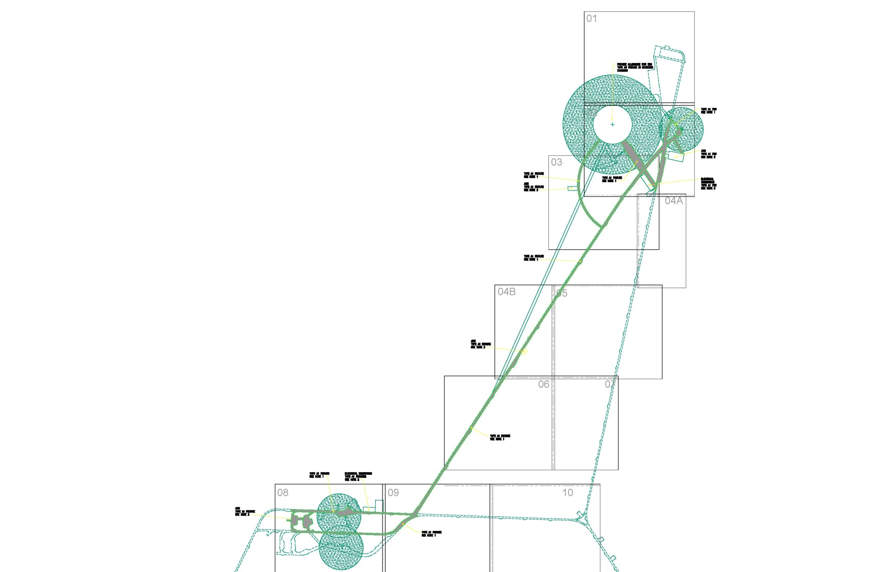
WCD Lighting

Slide 16
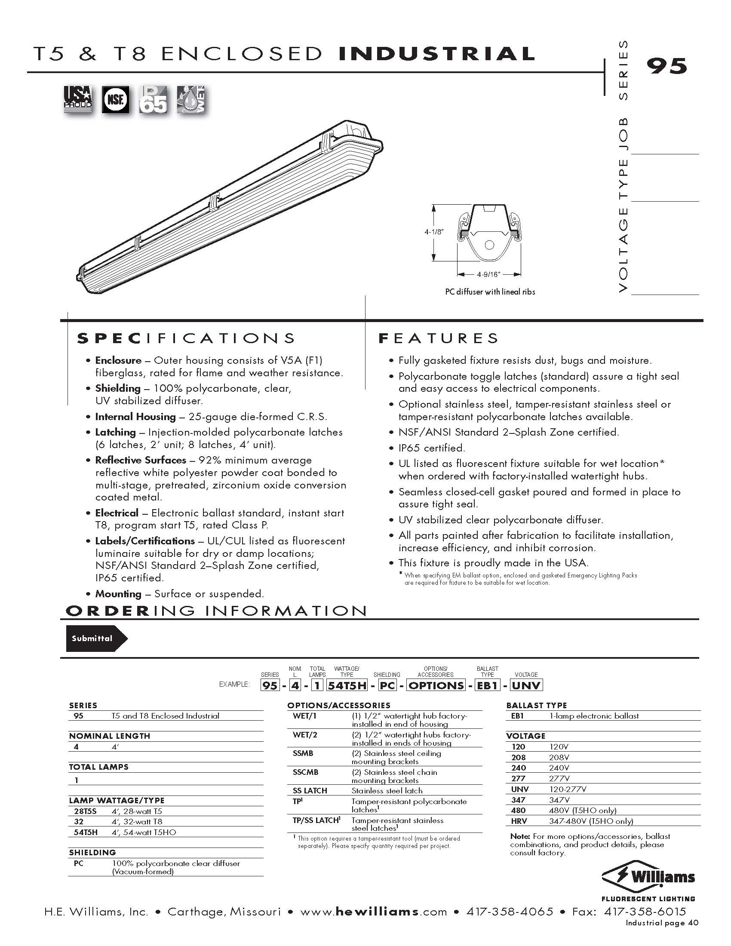
WCD Drift Lighting

Slide 17
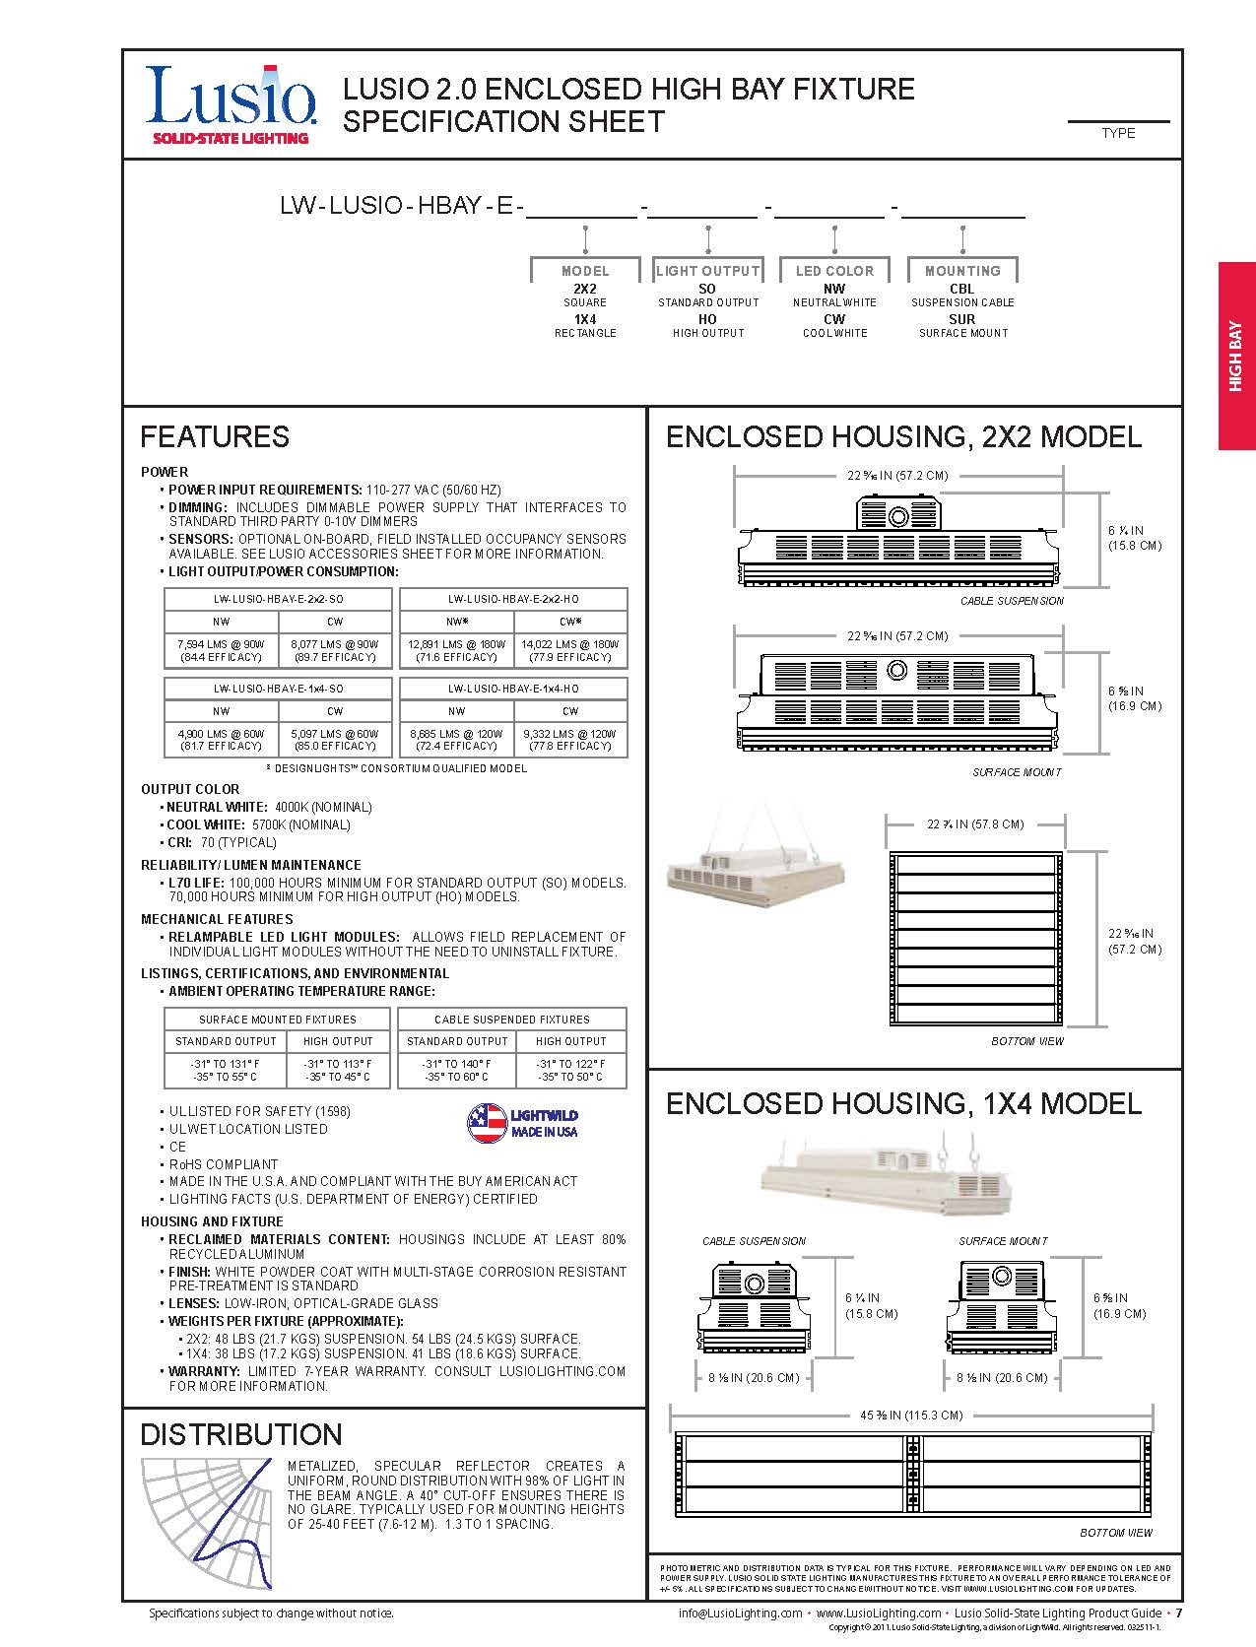
WCD Lighting

Slide 18
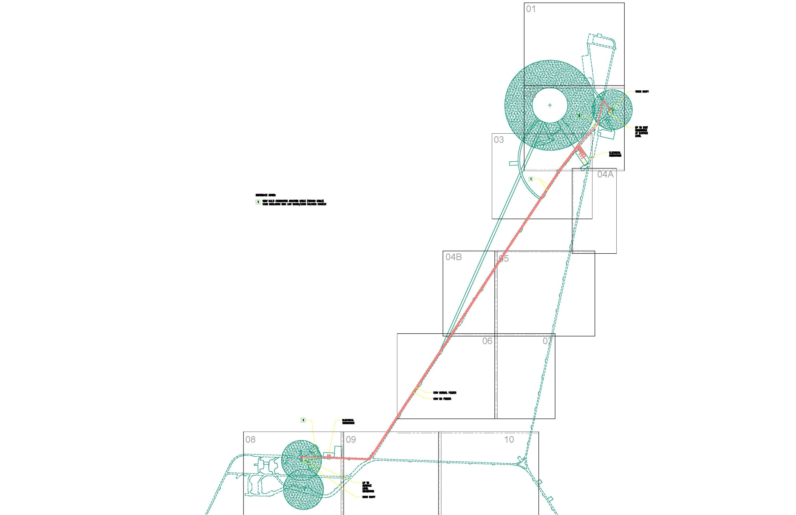
WCD 12kV Electrical Distribution

Slide 19
Communications

Slide 20
Scope of Work at WCD
Structured Cabling System
  ICT Enclosures and Pathways
  Backbone Distribution
  Horizontal Distribution
Communications System
  Extend existing analog phone system
  Extend existing radio system
Extend existing Data Network

Slide 21
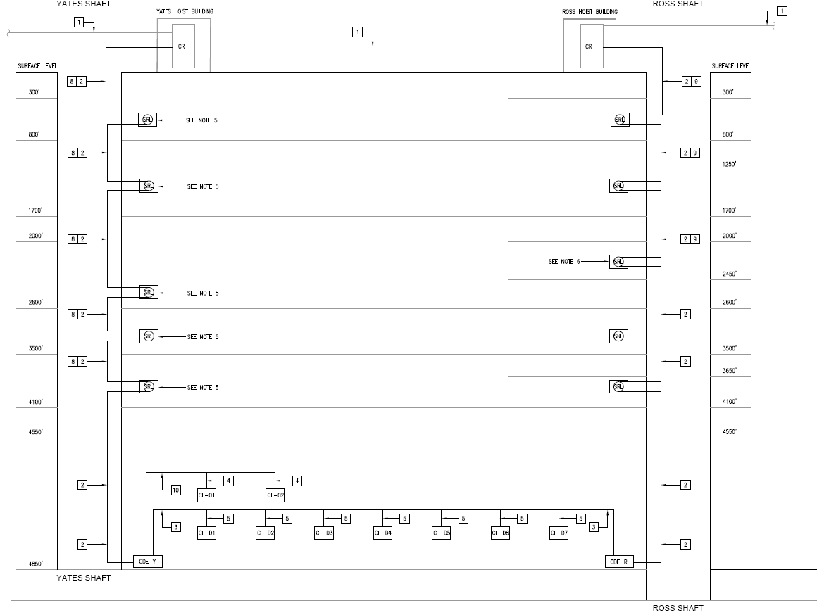
WCD Option
EXISTING COMMUNICATIONS ROOMS AT THE SURFACE
REDUNDANT
BACKBONE
STRAIN RELIEF LOOP
CEs NEAR WCD
CEs IN WEST DRIFT

Slide 22
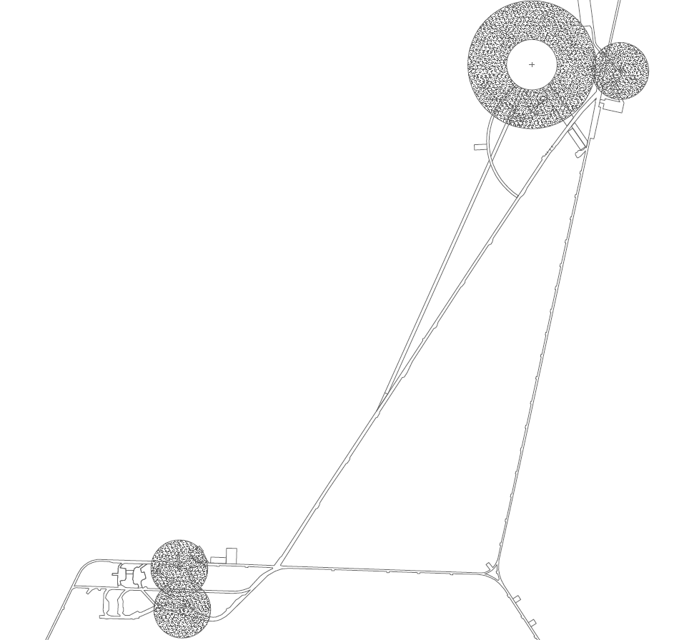
2-Way Radio Coverage

Slide 23
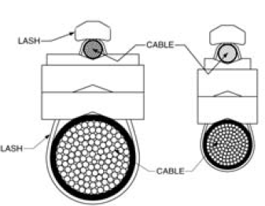
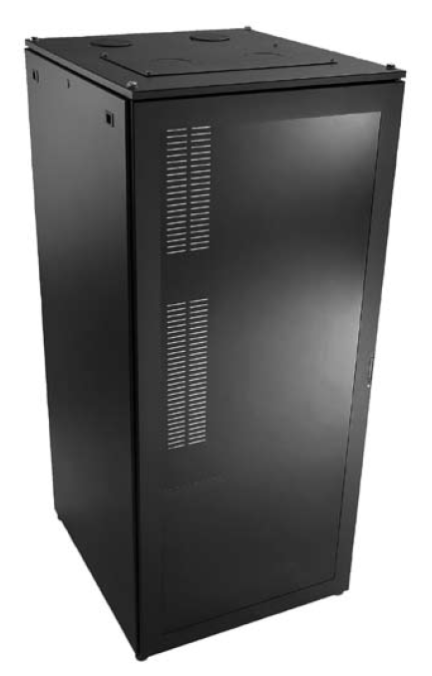
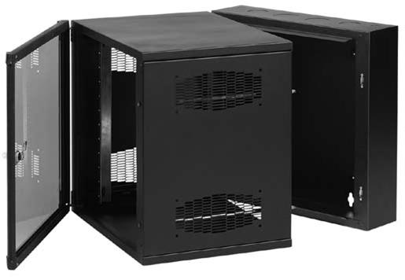
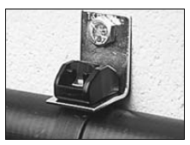
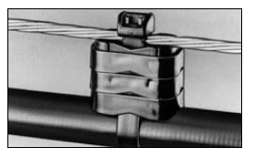
Pathway Supports and Enclosures
Communications Enclosure
Dimensions vary from:
24” x 24” x 36” to
24” x 24” x 60”
Communications Distribution
Enclosure Dimensions:
24” x 24” x 72”

Slide 24
Fire Protection

Slide 25
Life Safety
Codes Standards
  IBC 2009
  Referenced NFPA Codes and Standards
  NFPA 520 – Standard on Subterranean Spaces
  Variances
ADA
  As per DUSEL ADA Policy July 2010
    “…recognizing that DUSEL is a unique facility with special hazards and construction challenges, portions of DUSEL will not be accessible…”
Variances will be necessary

Slide 26
WCD Fire Safety
91 Occupants
Exit via Ross and Yates Shaft or to AORs
Barriers to separate out adjacent mine areas
    4 hour barrier to AOR and experiment cavity
    2 hour any other openings to drift
    2 hour for cross drift
AORs to limit travel distance to 2000 feet
    96 hour duration
    Shaft AORs sized for 91, others 10

Slide 27
WCD Fire Safety
Suppression
    Sprinklers in West drift and occupied spaces
    Standpipe throughout west drift and occupied spaces
    Redundant water supply
100,000 cfm for smoke control discharged to east drift
Emergency lighting throughout occupied areas

Slide 28
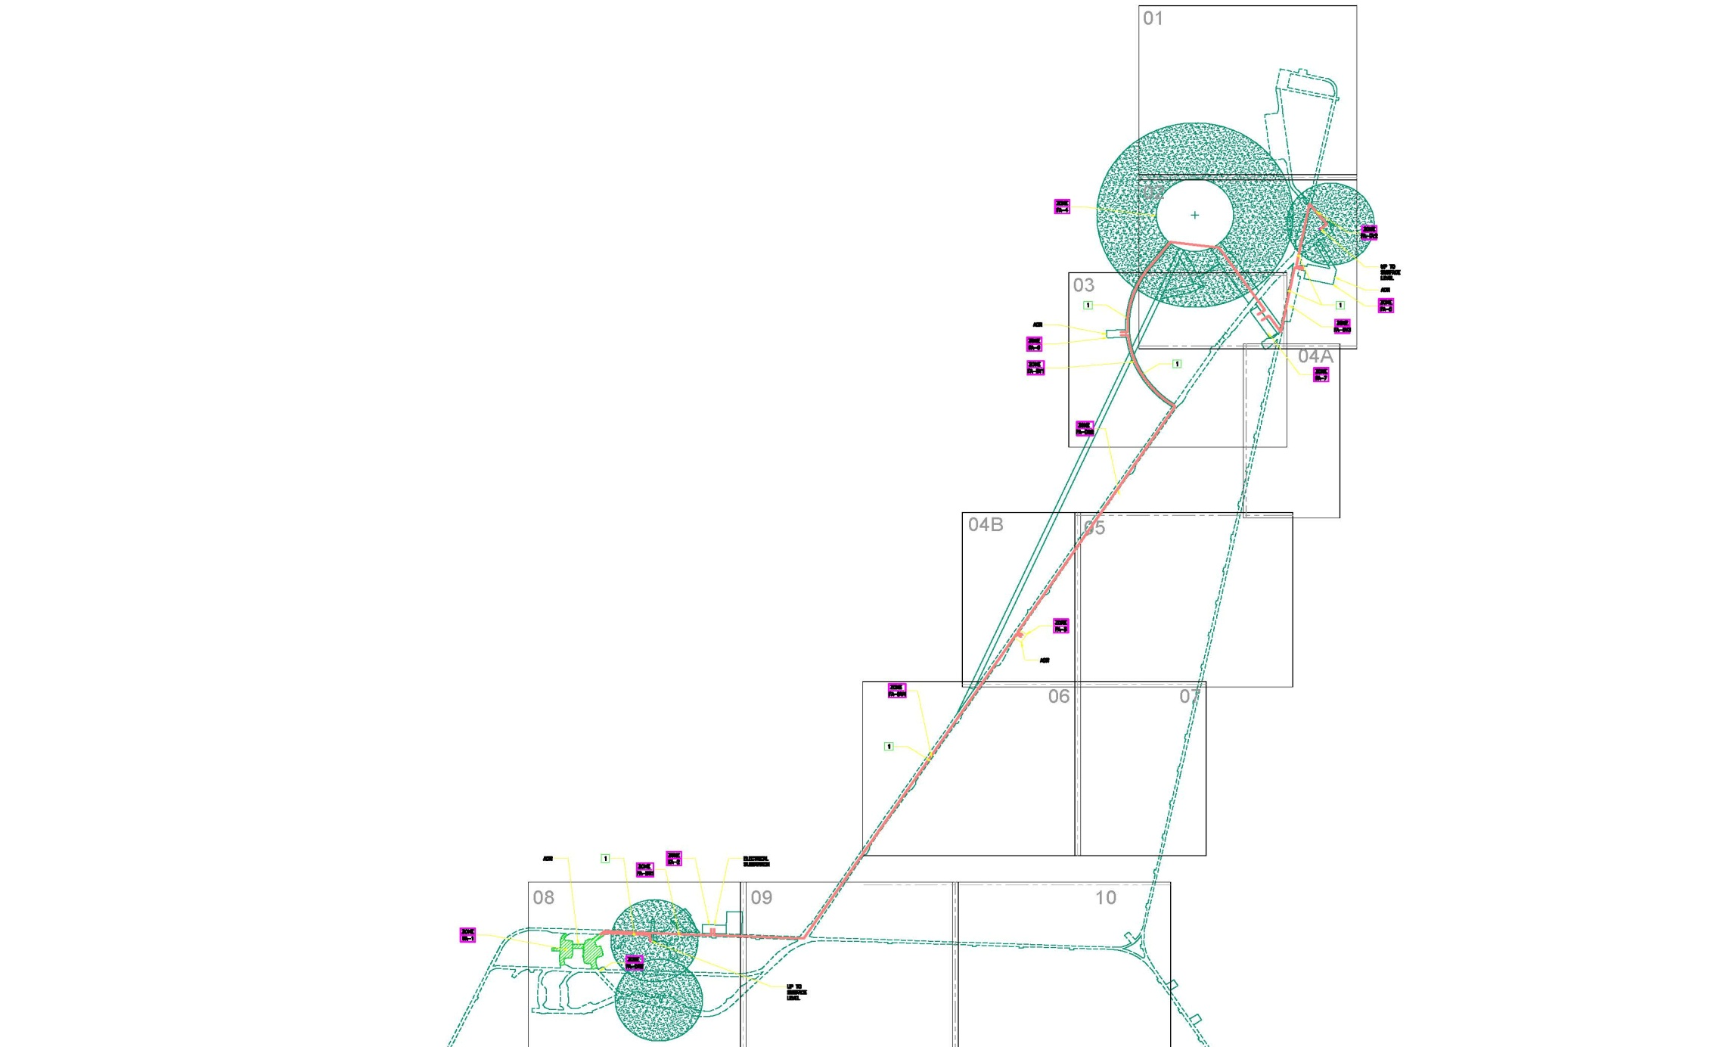
WCD Fire Alarm
Fire Alarm System shall consist of:
  Manual Pull stations
  Combination speaker/strobe lights
  Water flow/tamper switches
  Aspirated Air Sampling with gas monitor modules

Slide 29
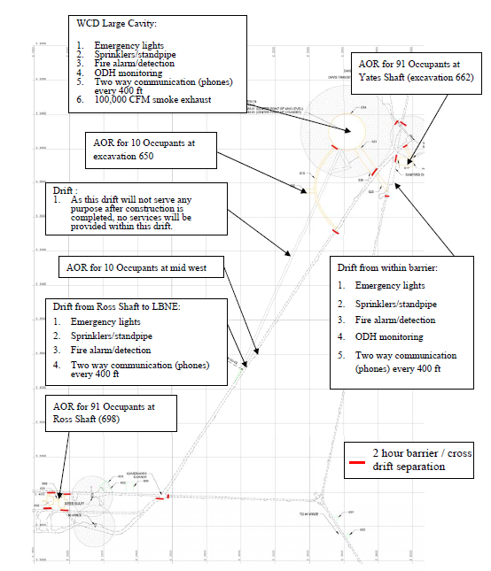
Life Safety

Slide 30
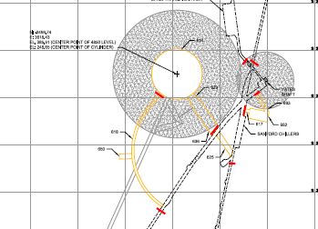
Life Safety
2 hour shaft separation
4 hour separation to WCD cavern
91 person AOR 4 hour separation
4 hour AOR separation
2 hour separation to other unoccupied areas

Slide 31
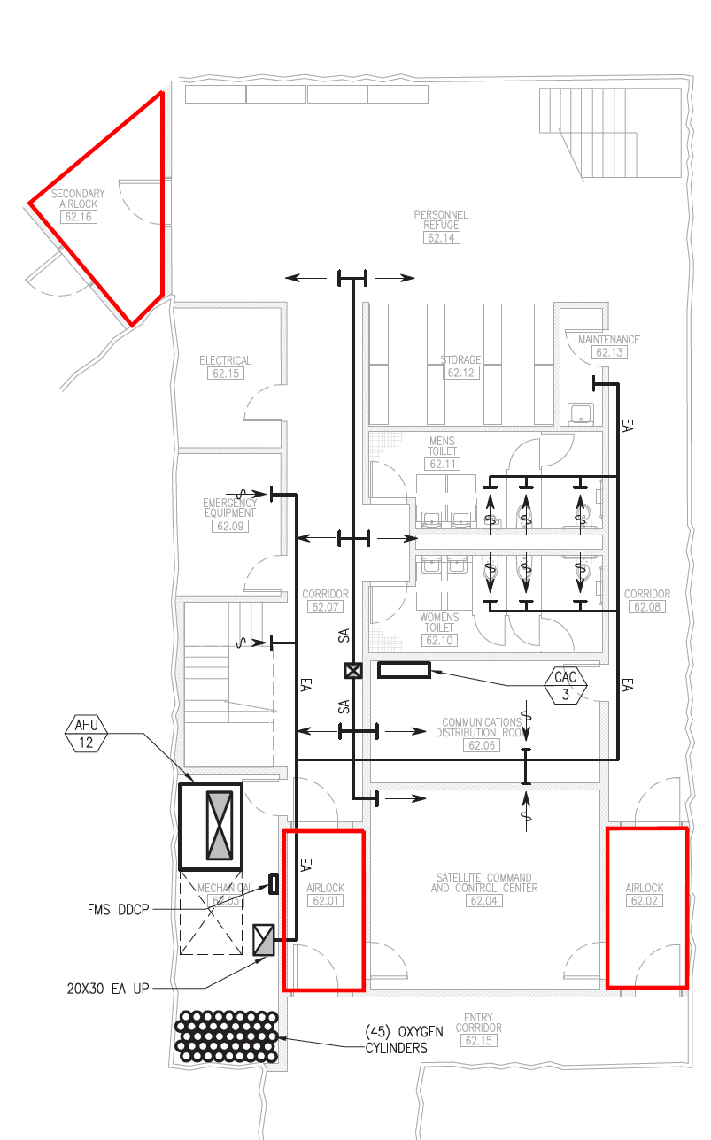
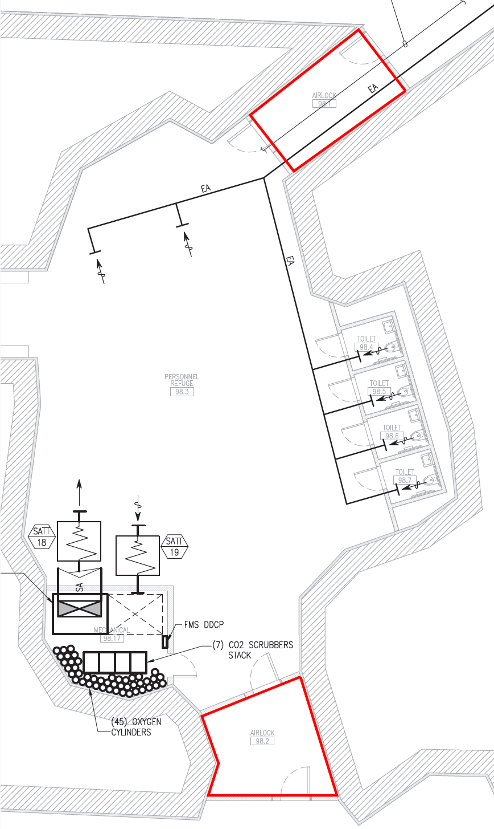
Airlocks

Slide 32
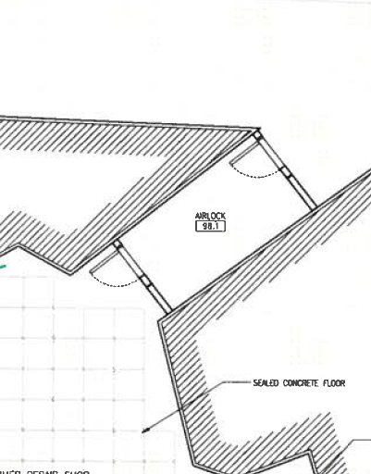
Airlocks

