Slide 1
Study of Dielectric Loaded RF Cavity
MAP meeting - September 23, 2011
Jessica Cenni

Slide 2
CONTENTS
Why a Dielectric Loaded (DL) RF cavity?
Characterization of a dielectric loaded RF cavity
Standard Condition – Simulation
Standard Condition – Test Description
Standard Condition – Data analysis and results
Cryogenic Condition – Simulation
Cryogenic Condition – Test Preparation
High Power (HP) configuration study
What’s next?
Achieved during my
summer program
Jessica Cenni
September 23, 2011
1

Slide 3
Why a Dielectric Loaded RF cavity?
MUON ACCELERATOR
Objective: muons production, beam formation and acceleration within few milliseconds
Possible solution: helical cooling channel (=>RF structure inside a solenoid)
Consequent requirements for RF cavity:
short length
high electric field gradient (>20MV/m)
small radial dimension
first mode of resonance matched with external power source (Fermilab klystrons: 800 MHz)
But:
So:
Standard vacuum cavity DOESN’T work!
Jessica Cenni
September 23, 2011
2

Slide 4
Why a Dielectric Loaded RF cavity? (2)
Insertion of dielectric material same frequency, smaller radius
Pillbox cavity
ε_{r}: relative dielectric permittivity
μ_{r}: relative magnetic permeability
GOAL: large ε_{r}
But also lower quality factor
Cavity completely filled
with dielectric
where:
ε’: real part of
dielectric constant
ε’’: imaginary part of
dielectric constant
GOAL: tgδ<10⁻⁴
Jessica Cenni
September 23, 2011
3

Slide 5
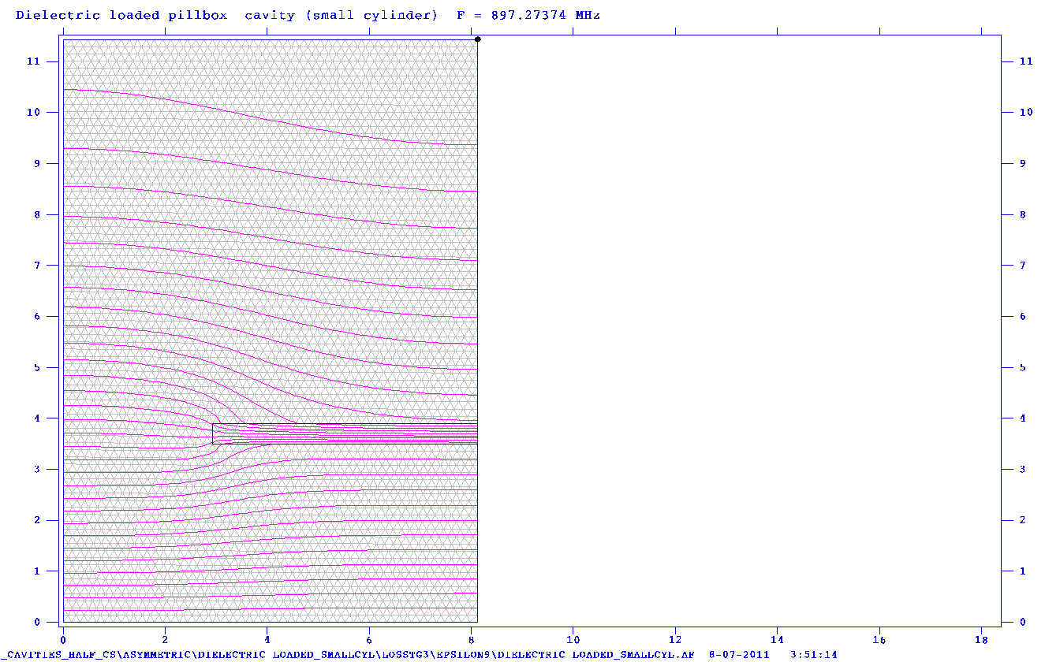
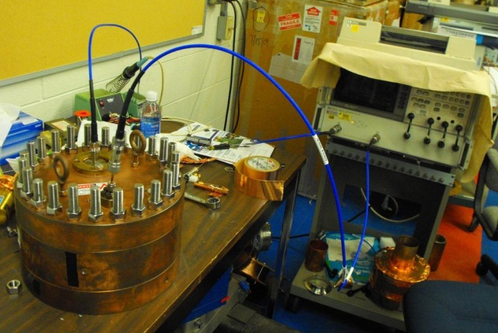
Characterization of a DL RF cavity
Analysis of two main parameters:
Resonance frequency
Quality factor
Conditions considered:
Standard - low power, room temperature
Cryogenic - low power, cryogenic temperature (T=77K)
High power
Means of the analysis:
Simulation in Superfish
Real Tests
Al₂O₃ ring
E field direction
Jessica Cenni
September 23, 2011
4

Slide 6
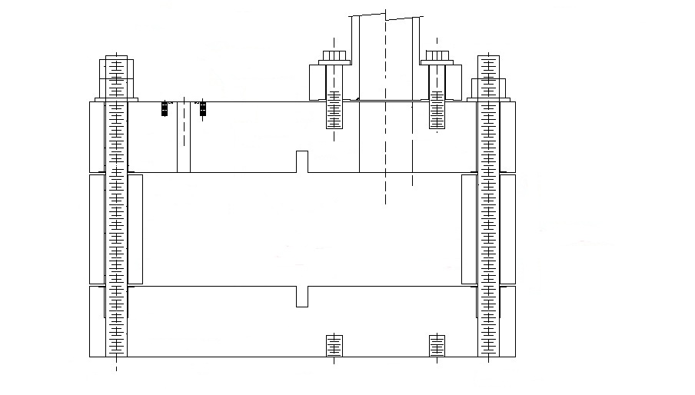
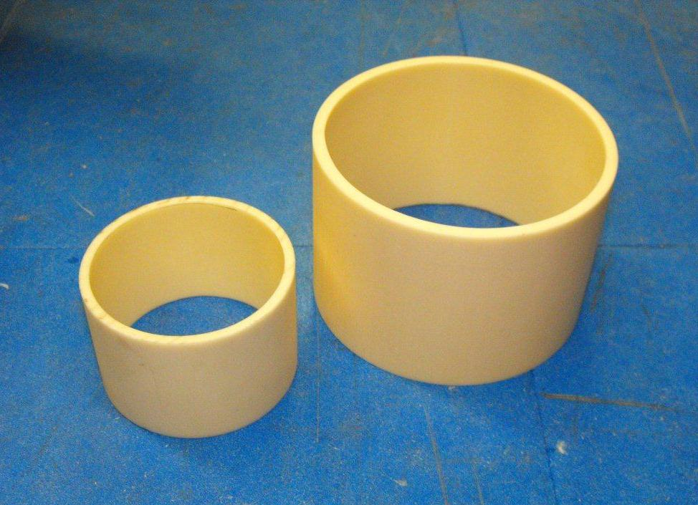
Characterization of a DL RF cavity (2)
For Real Tests
Pillbox cavity
Dielectric rings
Al₂O₃ 99.5%
Stainless steel 316
covered with copper
Rin=5.325cm
Rin=3.5cm
L
=
7.75
cm
D = 22.86 cm
L = 8.128 cm
L
=
5.2
cm
Big cylinder
Small cylinder
Jessica Cenni
September 23, 2011
5

Slide 7
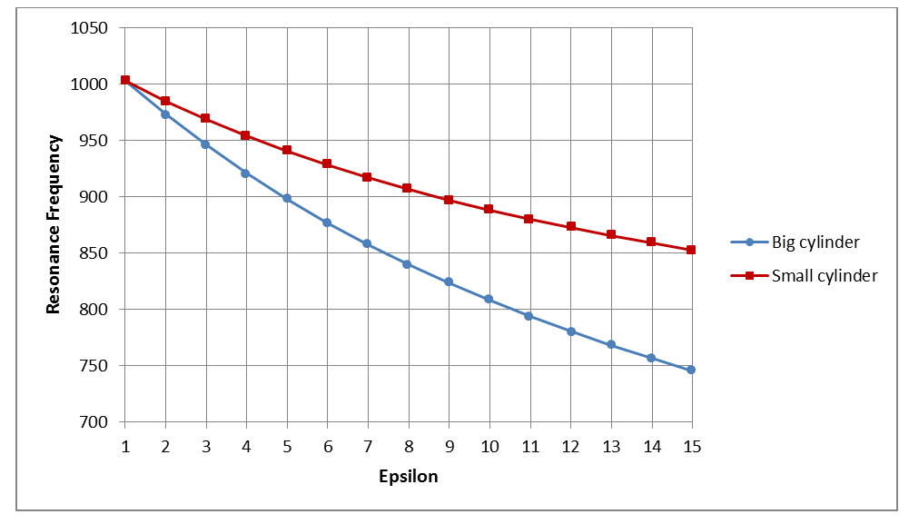
Standard Condition - Simulation
Empty cavity:
f = 1003.87 MHz
Q = 22772.3
Dielectric loaded cavity:
Frequency
897.27MHz
823.53MHz
Jessica Cenni
September 23, 2011
6

Slide 8
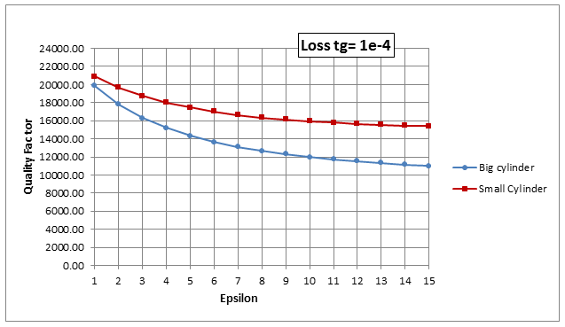
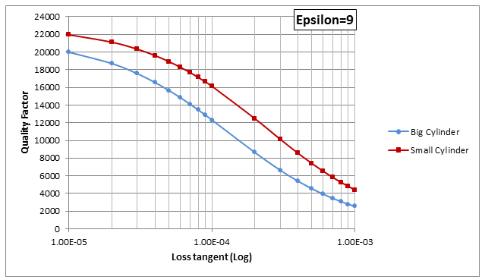
Standard Condition - Simulation (2)
Q_{big} = 12310.1
Quality Factor
Q_{small} = 16123.6
Jessica Cenni
September 23, 2011
7

Slide 9
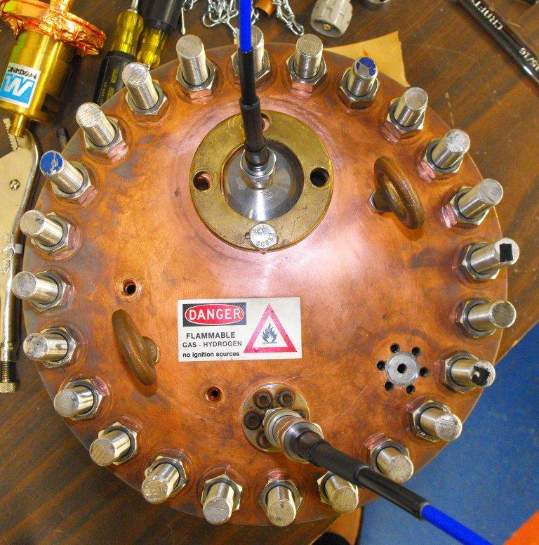
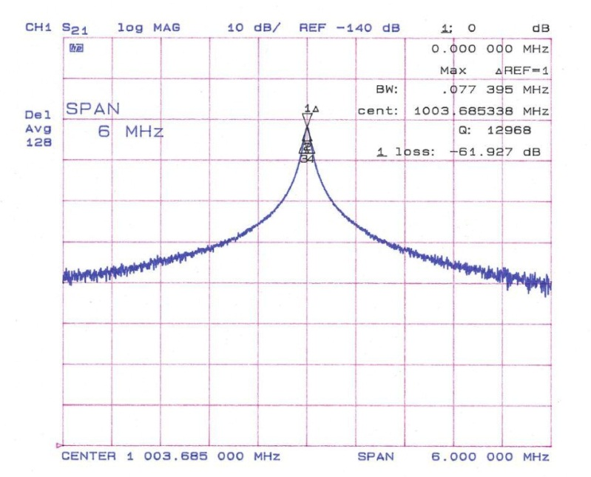
Standard Condition – Test Description
Cavity set up
- Cavity assembled through stainless steel bolts
- Systematic control of locking torque through torque meter
- Measurement through Network Analyzer (loop coupler)
Measurements for each configuration
- resonance frequency
→ good correspondence with simulation
- loaded quality factor (derivation of unloaded quality factor through coupling coefficient)
→ much lower than simulation (30-40% less)
Jessica Cenni
September 23, 2011
8

Slide 10
Std Condition – Data analysis and results
Model used to analyze the data:
- lower Q = higher wall resistivity
→ estimate an equivalent resistivity for the cavity
- Introduce this value in the model for the dielectric loaded cavity
→ extract dielectric properties of the ceramic rings
Final results:
SMALL CYLINDER
BIG CYLINDER
f = 897.96 (±0.97) MHz
Q = 11823.1 (±1037.1)
ε = 8.925 (±0.125)
tgδ = 7.28E-5 (±4.92E-5)
f = 814.30 (±0.81) MHz
Q = 9415.89 (±828.6)
ε = 9.595 (±0.134)
tgδ = 8.17E-5 (±5.52E-5)
Jessica Cenni
September 23, 2011
9

Slide 11
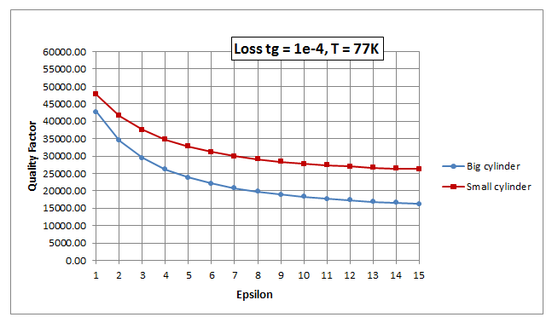
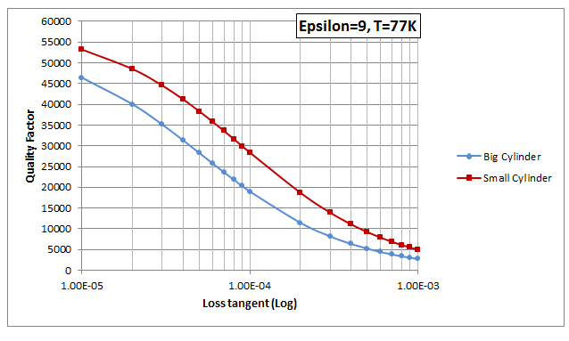
Cryogenic Condition – Simulation
Q_{big} = 18966.9
Quality Factor
Q_{small} = 28361.7
Jessica Cenni
September 23, 2011
10

Slide 12
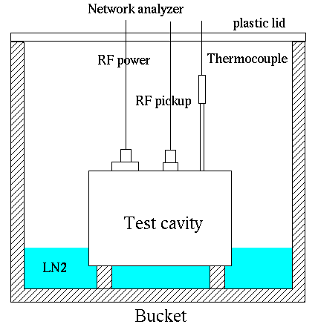
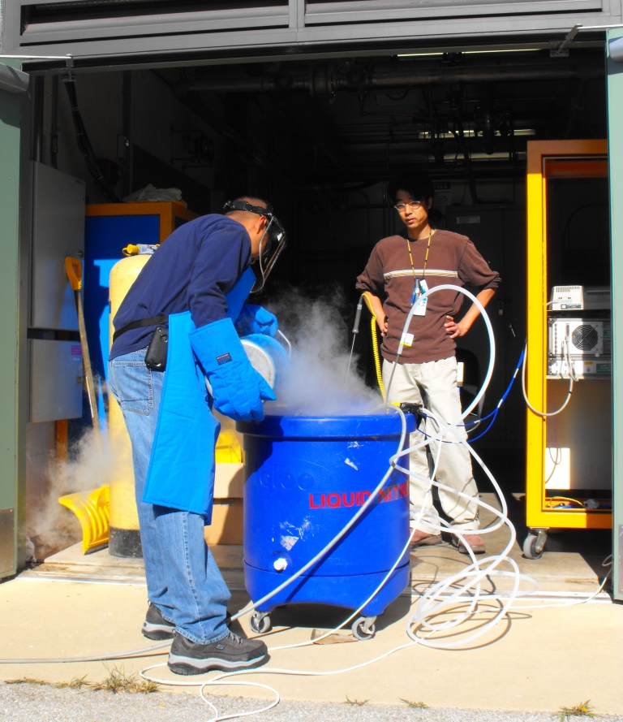
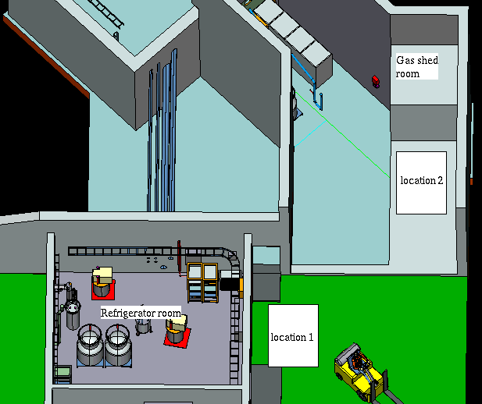
Cryogenic Condition – Test Preparation
System set up:
proper bucket to contain the LN2
temperature sensor
feeding probe for He
TEST
Location choice
ODH requirements
need for power supply
First result:
Q_{empty} = 23774.2
Jessica Cenni
September 23, 2011
11

Slide 13
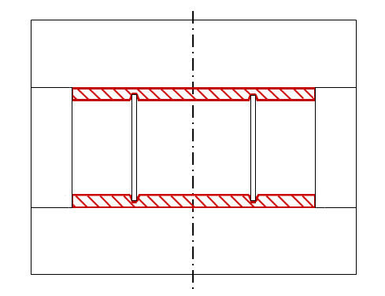
HP condition – Special requirements
Future High Power Tests
Location: MTA
Only big cylinder (for the smaller one the frequency shift is too small)
Teflon holder for the ceramic ring
Cavity filled with gas
Cavity
PTFE
avoid
breakdown
Ceramic ring
GOAL: study the feasibility of using a gas filled dielectric loaded RF cavity at HP
Jessica Cenni
September 23, 2011
12

Slide 14
CONCLUSIONS
Achievements:
LOW POWER ANALYSIS
Description of the behavior of a dielectric loaded RF cavity under different conditions through simulation
At room temperature:
Realization of a complete set of test for the empty cavity
Analysis of the data and extraction of the dielectric properties of the ceramic
→quite good agreement with expected value, provided by the company, both for ε_{r} (exp. ≈ 9) and loss tangent (exp. ≈ 10⁻⁴)
ERROR: mainly due to the sensitivity of the measurements to variation in real resistivity of the cavity
At cryogenic temperature:
Set up of the equipment and definition of the procedure to follow for the test
Realization of test for the empty cavity
HIGH POWER ANALYSIS
Design of Teflon holder for the ceramic ring to use during HP test
Jessica Cenni
September 23, 2011
13

Slide 15
CONCLUSIONS (2)
What’s next?
Complete cryogenic tests and analyze the data to extract how the dielectric properties of the ceramic ring change with temperature and how this affects the behavior of the cavity
Complete the set up of HP configuration and run the test
If all the goals of the study will be achieved
We’ll prove the feasibility of a HPDL RF cavity
Dielectric material:
ε_{r} > 9, tgδ < 10⁻⁴
Electric gradient
> 20MV/m
such a cavity could allow the realization
of a helical cooling channel
AND
it could be applied also to other type
of muon cooling channel
Good resource for muon collider realization
Jessica Cenni
September 23, 2011
14

