Slide 1
Progress of High Pressure RF Cavity Test
K. Yonehara
On behalf of HPRF test group
APC, Fermilab

Slide 2
High pressure RF cavity test program
Demonstrate potential of HPRF cavity for cooling & accelerating a muon beam
Study breakdown in a dense gas with a high RF gradient at a strong magnetic field
Study influence of an intense beam on the cavity
Investigate fast electronegative gases
Study feasibility of gas filled dielectric loaded RF cavity
Make an RF cavity for a real cooling channel

Slide 3
Goal of first beam test
Does the cavity breakdown with an intense beam?
What is the influence of beam on the cavity?
How long does it take to recover RF field?
Study plasma dynamics in a dense gas at a high RF gradient
Search any clues to improve RF system

Slide 4
Collaboration
C. Ankenbrandt, A. Bross, J. Cenni, M. Chung, G. Collura, G. Flanagan,
B. Freemire, P. Hanlet, R. P. Johnson, D. Kaplan, G. Kazakevitch,
A. Kurup, A. Moretti, J. Mukti, M. Neubauer, D. Neuffer,
M. Notani, G. Pauletta, M. Popovic, G. Romanov, A. Tollestrup,
Y. Torun, R. Sah, T. Schwarz,
+ AD external beam division
+ AD mechanical design
+ Machine shop
+ Rad/Hydrogen safety committees
+ Director/Division Heads
+ Operators & Technicians
Supported for many years by the DOE HEP SBIR-STTR program
μ
Muons, Inc.

Slide 5
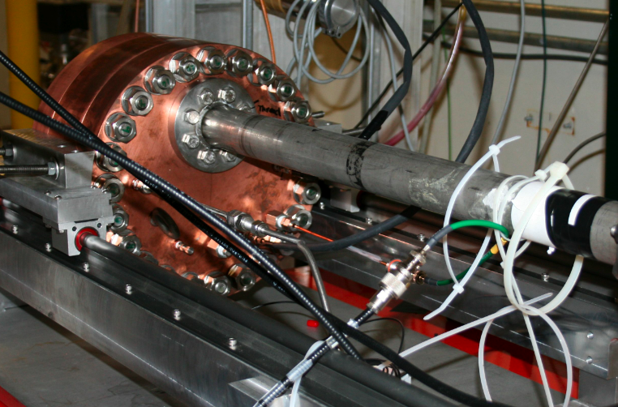
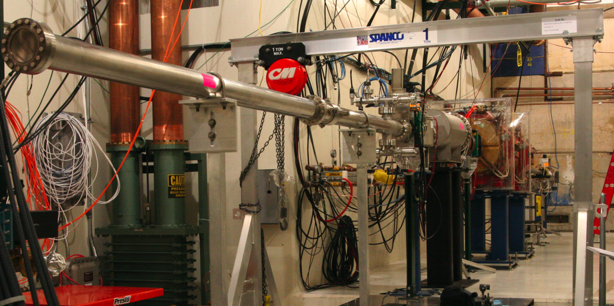
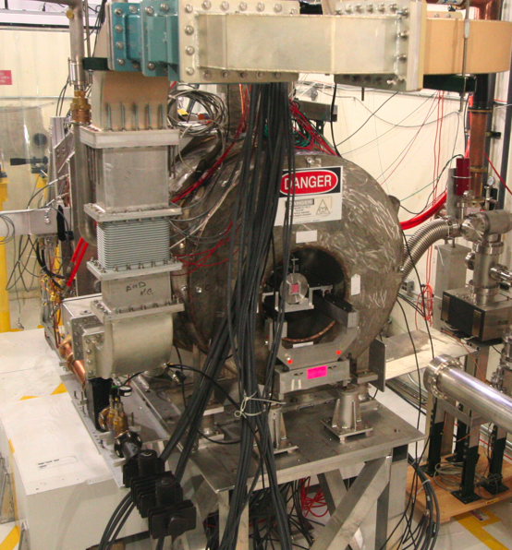
MTA beam line and HPRF cavity
RF cavity
RF power inlet
400 MeV H⁻ beam transport line
Gas inlet
RF cavity
+ collimator
in SC magnet
400 MeV H⁻ beam
Beam pulse length 7.5 μs
5 ns bunch gap
10⁹ H⁻/bunch
20 % of transmission at the collimator system
2 10⁸ protons/bunch passes through the cavity
Circulator
+ RF damper
400 MeV H⁻
beam line

Slide 6
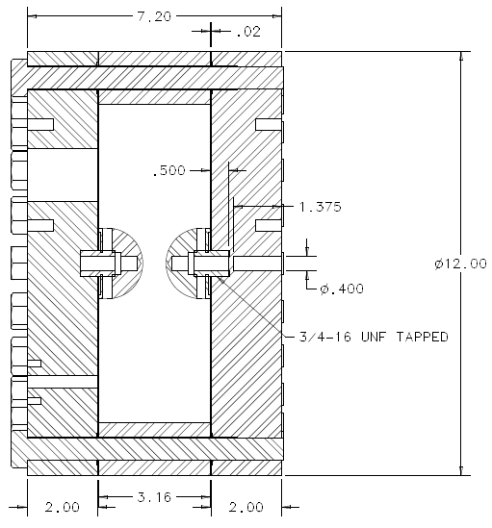
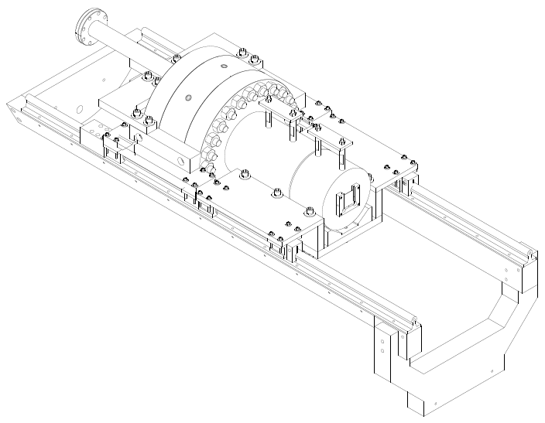
High pressure RF cavity & collimator
RF power coax line
HPRF cell
Collimator
RF
inlet
Phosphor
screen
beam
Gas
inlet
beam
Support rail

Slide 7
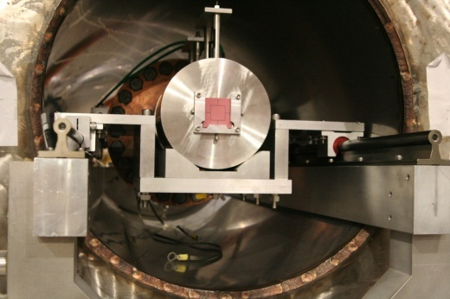
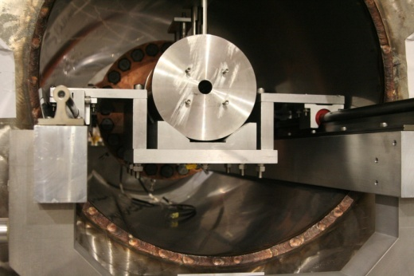
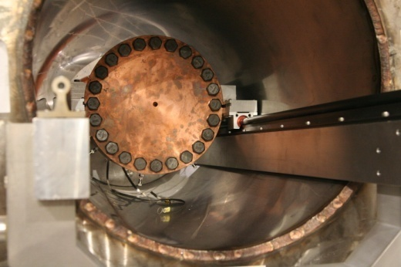
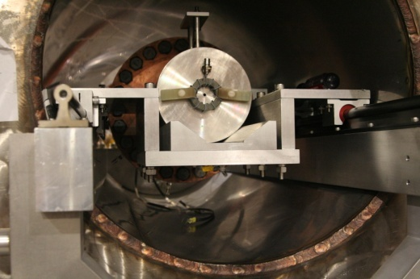
Assemble cavity, collimator, and toroid
1st Collimator & Chromox-6
1st Collimator
HPRFCavity
2nd Collimator + Toroid

Slide 8
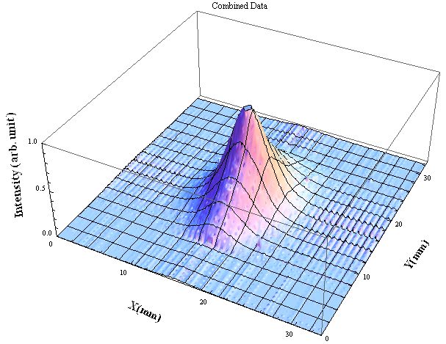
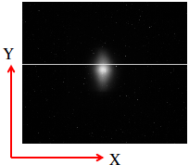
Beam profile monitor
Mukti
σ_{horizontal, x} = 2.6 mm
σ_{vertical, y} = 3.9 mm
CCD image
1st Collimator & Chromox-6

Slide 9
Observed beam intensity
Ben Freemire
8/8/11
Beam intensity is measured by
a handmade toroid pickup coil
Linac toroid 3 (UTR03, commercial)
Maximum transmission efficiency at
the collimator (2mm^{φ}) is 20 %.
Beam intensity per beam pulse
Upstream toroid (handmade)
Downstream toroid (handmade)
By tuning the upstream beam
element, transmission efficiency
goes down to 2 %.
# of beam pulses
Gas filled RF cavity
Collimator
Beam absorber
400 MeV
Proton beam
Linac toroid 3 pickup
(commercial)
Upstream/Downstream
toroid pickups
RF pickup

Slide 10
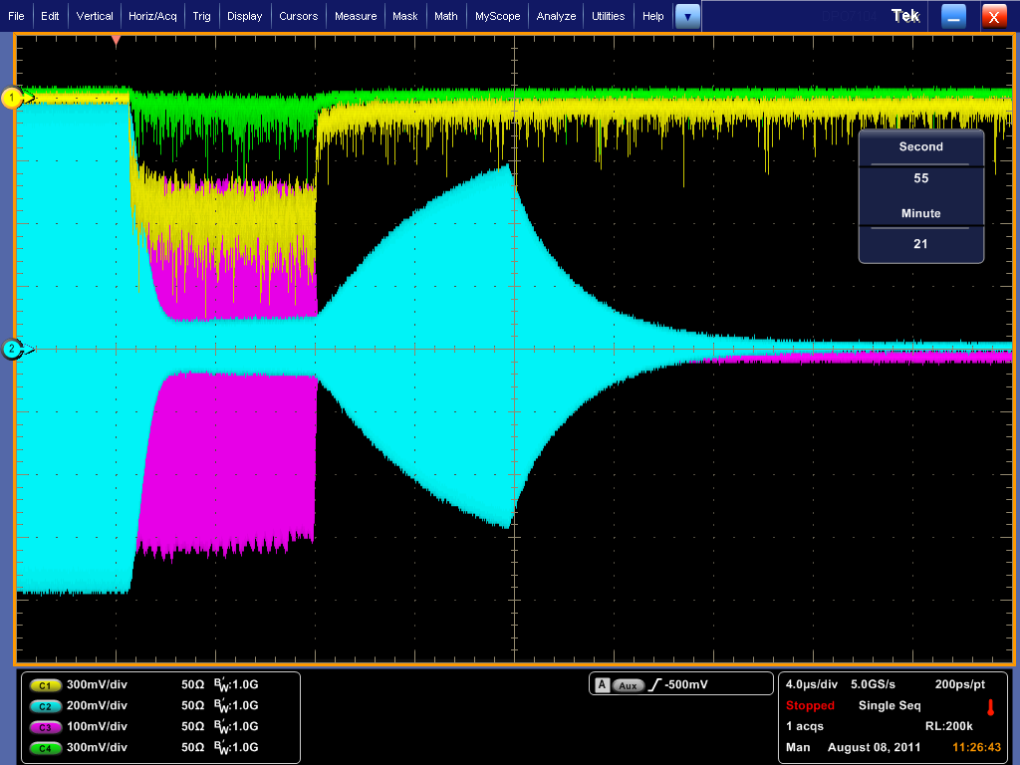
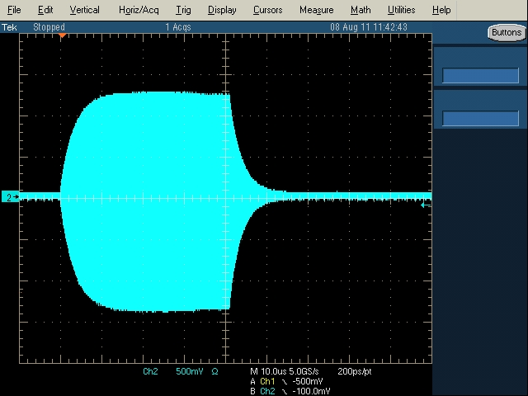
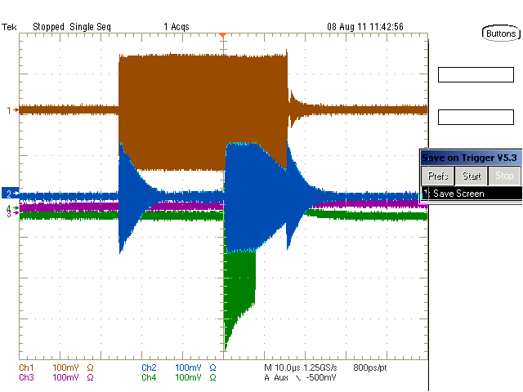
Taken data per pulse
CCD screen shot
Spectroscopic light (656 nm)
White light (656 nm)
Very clean RF signal due to
circulator + damper!
RF pickup
RF pickup after beam (15 Hz)
Downstream toroid
RF forward
RF Refrected
Oscilloscopes are triggered by MTA beam signal
CCD screen shot was taken by hand(!)
We also monitored beam signal from a telescope
counter
Upstream toroid
RF signals are cleaned by
circulator + damper!

Slide 11
Run log
Date | Gas species | Pressure (psi) | Beam intensity^{*1}
7/12 | N2 | 500 | High
7/14 | H2 | 800 | High
7/15 | H2 | 950 | High
7/19^{*2} | H2 | 500 | High
7/22 | H2 | 500 | High
7/25 | H2 | 800 | Low
7/27 | H2 | 500, 800, 950 | Medium
8/08 | H2 H2+N2 H2+SF6 | 950 950^{*3} 500, 800, 950^{*3} | High
*1: “High” = 20 %, “Medium” = 7 %, “Low” = 2 % of transmission efficiency
*2: RF pickup probe was broken
*3: Concentration is 0.01 % at GH2 pressure 950 psi

Slide 12
Study interaction of intense beam with dense H2 in high gradient RF field
ν= 802 MHz
Gas pressure = 950 psi
Beam intensity = 2 10⁸ /bunch
Plasma loading in pure H2 gas
RF power is lost
due to plasma loading
Equilibrium condition
Electron production rate
= Recombination rate
RF power is recovered
when beam is off
RF pulse length
(80 μs)
Beam signal
(7.5 μs)
Ionization process
1,200 e⁻/cm are generated by
incident p @ K = 400 MeV
p + H₂ → p + H₂⁺ + e⁻

Slide 13
Compare with breakdown event
RF power reduction
due to beam
RF power reduction
due to RF breakdown
Beam induced light
RF breakdown light
PMT is saturated
RF pickup and optical signals are quite different from these
at the breakdown event
N_{e} in beam induced plasma = 10¹⁴ electrons/cm³
N_{e} in breakdown plasma = 10¹⁹ electrons/cm³

Slide 14
Model of RF power deposition per ionized electron
Alvin
Electron mobility in GH2
[V/cm/mmHg]
[cm/sec]
Power absorption of electron
For example, E₀ = 20 MV/m, GH2 pressure = 950 psi
[Joules/electron/cycle/cm]

Slide 15
Preliminary estimation of plasma loading effect in HPRF cavity for cooling channel
From RF amplitude reduction rate,
RF power consumption by plasma
can be estimated
ν= 802 MHz
Pure H₂ gas
Gas pressure = 950 psi
Beam intensity = 2 10⁸ /bunch
Joules/RF cycle
@ E = 20 MV/m
electrons@ t = 200 ns
Hence, energy consumption by one
electron is (including with initial beam intensity change)
Joules/RF cycle/e/cm
Both experimental result and model are excellent agreement within 20 %

Slide 16
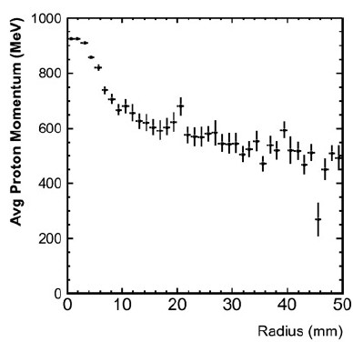
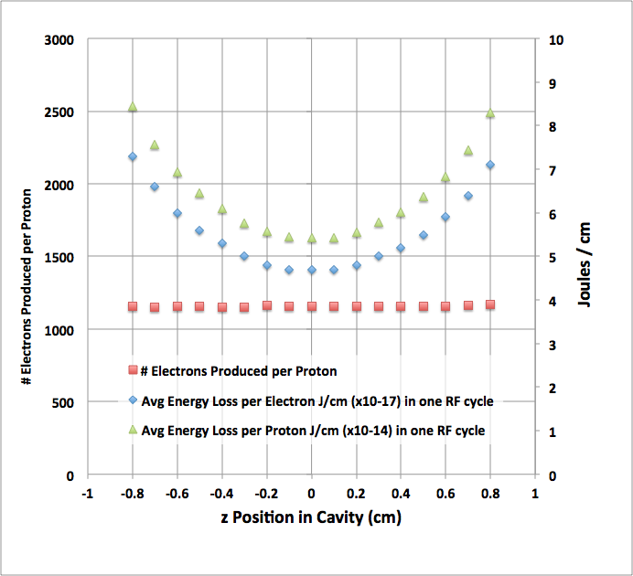
Estimate the number of ionized electron in the cavity from G4beamline simulation
Tom Schwarz
Proton momentum distribution as a function
of radial position in the cavity is taken into
account
Estimated # of ionized electrons per proton ~ 1200 e/cm

Slide 17
Study electronegative gas effect
SF6 removes residual electrons

Slide 18
Electron capture time in dopant
# of yield electrons by proton beam per second
Electron capture rate =
# of electrons in the cavity at equilibrium RF signal
It is NOT a 1/e time constant

Slide 19
Compare with muon beam structure
E/p in helical 6D cooling channel is 1.6 V/cm/mm Hg
Electron capture time is fast enough to hold an E field in the cavity

Slide 20
Radiation length in GH2 with 0.01 % SF6
Based on PDG
In case of SF6
[g/cm²] @ 1 atm
Mixture gas
ω_{j}: fraction by weight
[m]
200 atm GH2 with 0.01 % SF6
10 % shorter than that in a pure GH2
[m]
200 atm GH2

Slide 21
(Near) future plan
Run HPRF cavity with denser gas condition
Presently, the maximum pressure is limited up to 1000 psi
Ramp up the maximum pressure up to 1600 psi
Study more electronegative gas
F2 and O2 are a very attractive electronegative gas
Lowest Flammable Limit of O2 in GH2 is 7 %
It is possible to mix O2 in GH2 with a reliable gas monitor system
Re-take HPRF cavity in a strong magnetic field
E×B force will induce a plasma instability that will break dense plasma condition in the cavity

Slide 22
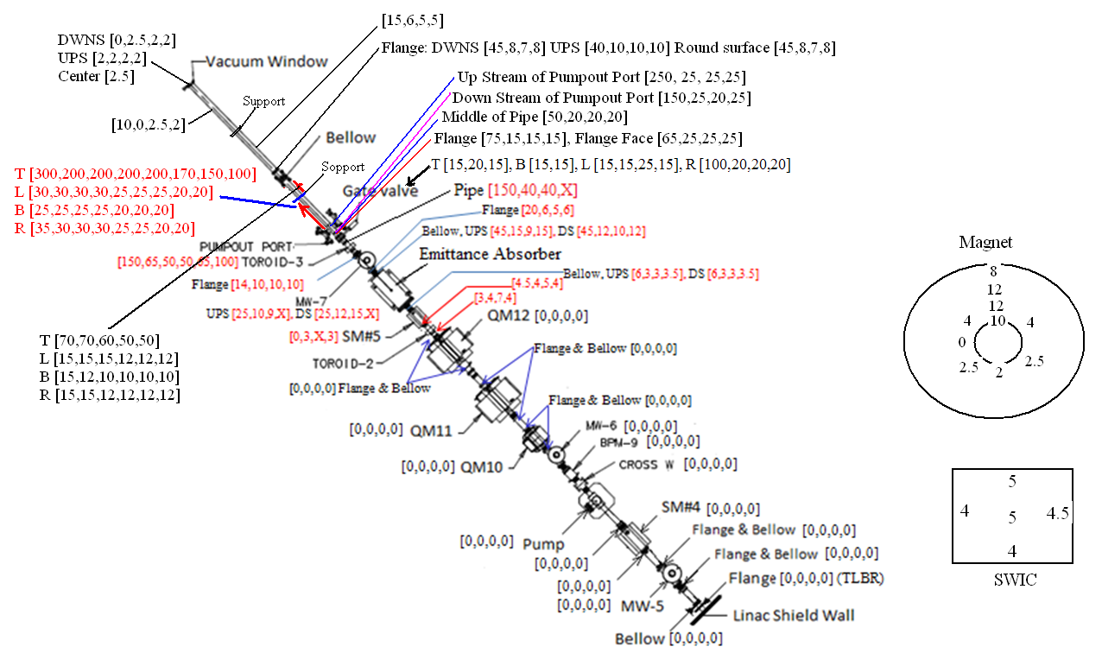
Survey residual radiation dose level
Observed residual dose level at the MTA beam line (on contact)
One day after ~200 beam pulses (beam tuning test at 3/25/11)
Mukti
Note: There was no vertical corrector magnet
Beam went toward upper side of the beam pipe

Slide 23
Conclusion
First beam test has been done
Energy deposition of single electron from RF power is 4.9 10⁻¹⁷ Joules/RF cycle/e/cm at E = 20 MV/m
So far, we do not see any crucial problems (show stopper) of practicality of HPRF cavity for cooling channel
Denser gas makes better RF recovery in pure GH2 condition (analysis is still underway)
Electronegative gas works extremely well
Need to investigate more electronegative gases
Plan to have another beam test
B field effect
Real pillbox cavity

