Slide 1
DUNE-ND cryogenics Interface with PRISM (Energy Chains)
Joaquim CREUS PRATS
DUNE-ND Cryo
20 November 2020

Slide 2
ND-LAr Interface Information
EDMS
2385478
See EDMS document written as interface between LAr and I&I, featuring details on:
Energy Chain pipe sizes and weight per unit length (page 9)
Power distribution for Cryo Equipment (page 9)
Network distribution for Cryo Controls (page 5)
The assumption is the interface specification will be transferred by I&I to PRISM (SLAC/SBU)

Slide 3
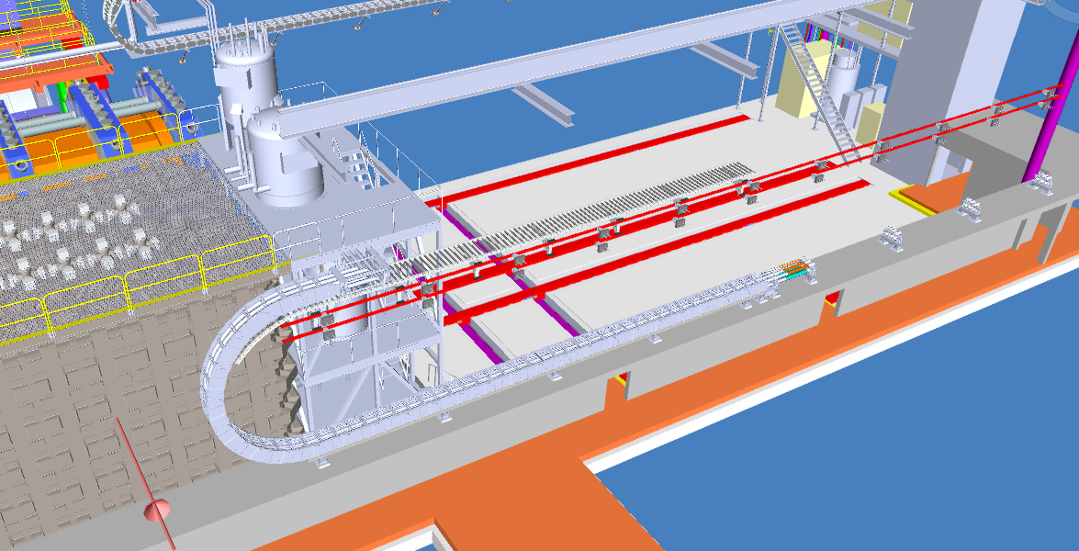
ND-LAr Piping concept
Extract of one line from P&ID schematic (EDMS 2370342 )
Any pipe that uses the energy chain is split in three sections:
Section 1: Rigid part of the pipe going down the shaft and connecting section 2 with external or shaft cryogenics equipment .
Section 2: Flexible section of the line in the energy chain
Section 3: Rigid pipe interconnecting section 2 with valve boxes.
ND-LAr procures and delivers each Section 2 to PRISM (SBU/SLAC) which installs it.
ND-LAr comes later and performs final Section1/2 and Section 2/3 connections
Connection Sections 2/3
Connection Sections 1/2
section 3
section 1
section 2

Slide 4
LHe Interface Information for FSM
Li Wang from Berkeley Lab can provide information if needed.
NS-Cryo would like to find out if the Temporary Muon Spectrometer will have an energy chain sized to host piping for a possible Future Superconducting Magnet.

Slide 5
Other
Energy Chain prototype:
We had communications with employees at LBL about details of the prototype, including testing a flexible line under pressure conditions.
Return of experience from systems similar to PRISM:
We held preliminary design review in July 2020 with reviewers from CERN. They left review comments based on return of experience from ATLAS LAr calorimeter. Concerns of entanglement between cables and pipes inside the energy chain . Image
PRISM movement speed and stroke frequency:
We have expressed our concerns to increase speed and stroke frequency in several ND discussion forums. The flexible vacuum jacketed pipe vendors contacted in Spring 2020 were happy with the application based on low speed ( 1 meter per hour) and low number of cycles during system lifetime (one stroke every month).
Assuming 1 stroke per month and typical flexible line life of 500-1000 cycles, the original requirement would bring 40-80 years of projected lifetime. An increase in movement frequency (up to 1 stroke a week) might lead to preventive replacements every 10 years if we can only pull 500 cycles off of these lines.
The consequences of increased speed are unknown. We assume entanglement would be more likely and wear would accelerate.

Slide 6
Thank you

