Slide 1
LAr Detector Energy Chain Design
Andrew Lawrence ND Mechanical Designer
11 Nov 2020

Slide 2
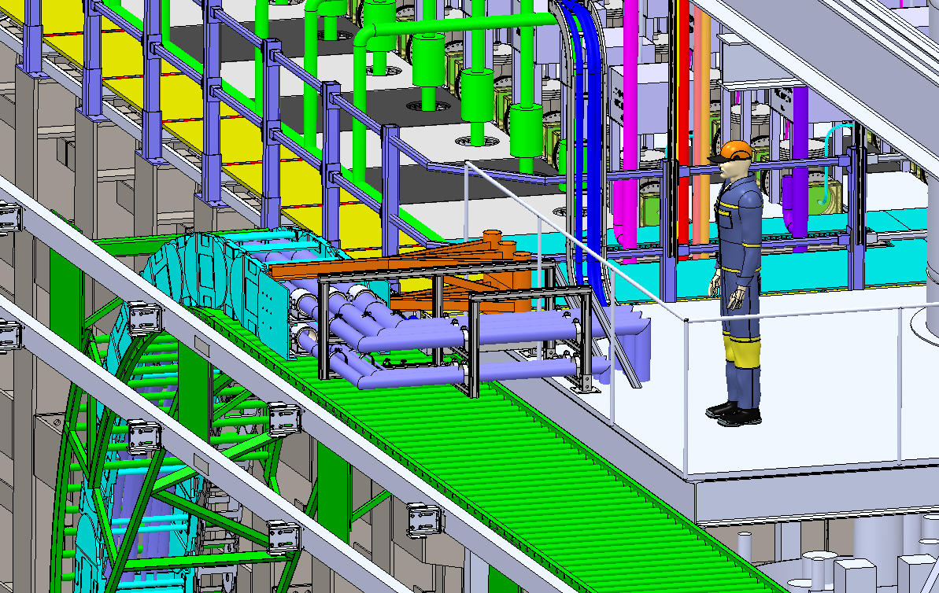
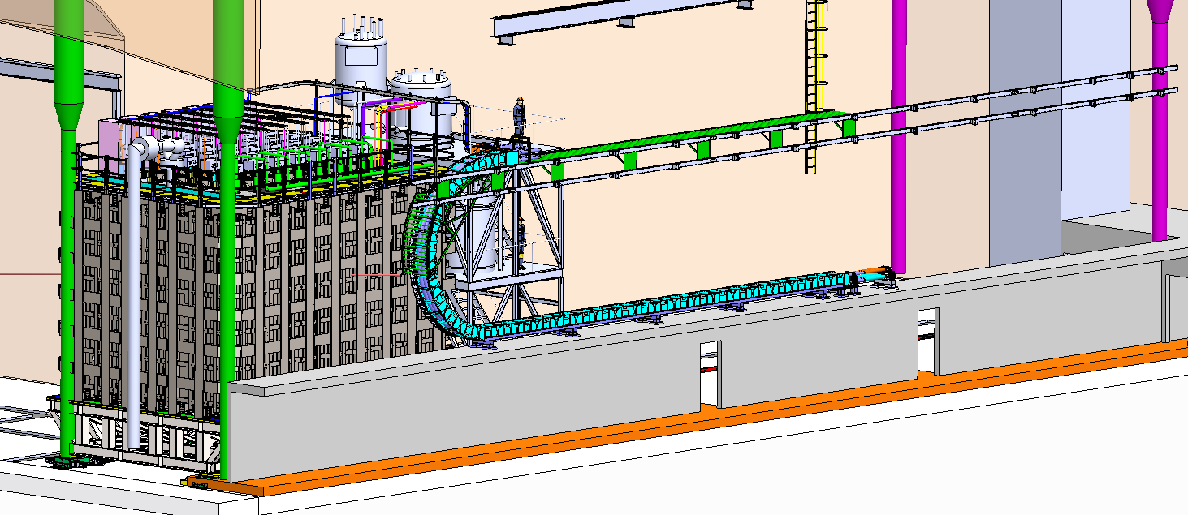
LAr Energy Chain Overview
Two parallel chains will deliver utilities along stride of PRISM System
-LAr Cryogen Supply Chain
-Power Supply/Controls/Data Chain
-Linear Motion Support Conveyor
-PRISM Anchor via Cryogen Mezzanine

Slide 3
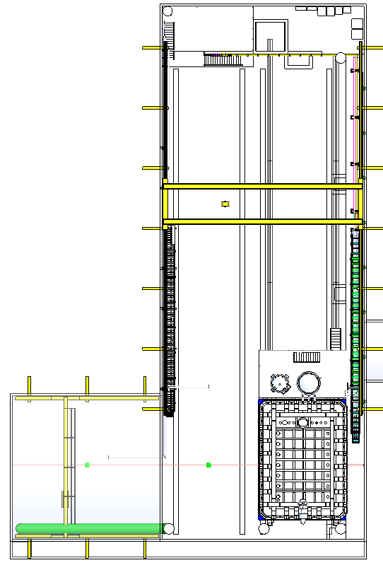
Energy Chain Interface with Cavern
Energy Chain Moving End
Linear Motion Rail System
Energy Chain Fixed End
*Quantity and spacing of mounts will be determined based on method and individual load capacity

Slide 4
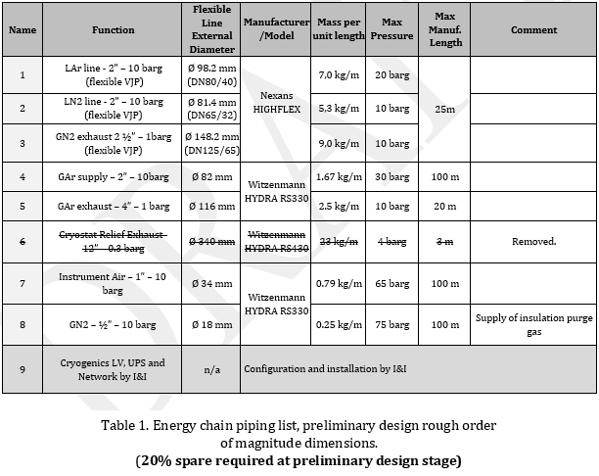
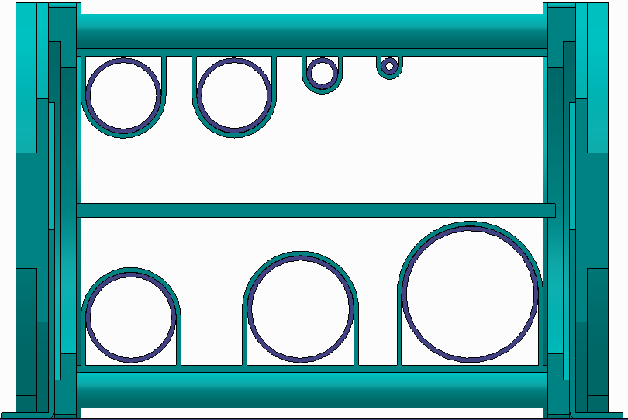
Pipe Sizing and Placement
4
2
7
8
Contingency Space
~25%
1
5
3
Model: IGUS E4-350-500
Internal Width: 350mm
Internal Height: 500mm
Weight: 65.7 kg/m
*Final sizing and layout of lines TBD

Slide 5
Igus Shelving and Proposed Pipe Layout

Slide 6
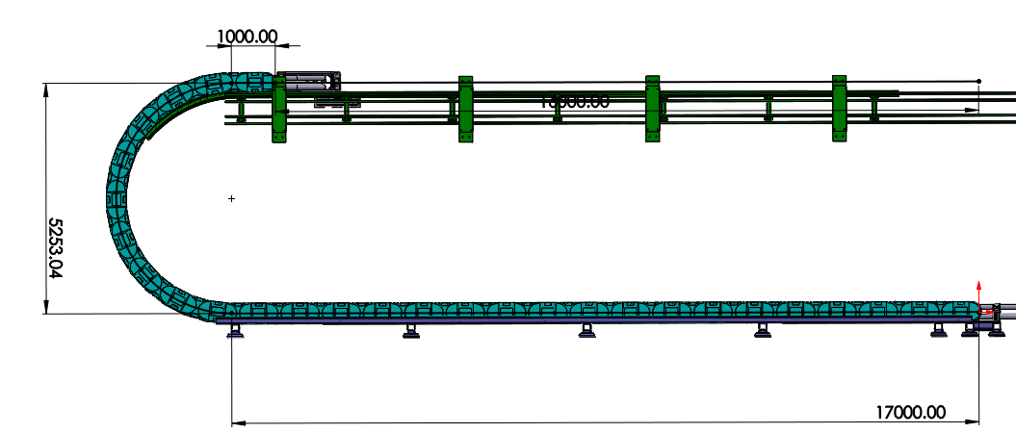
Cryogenic Energy Chain Load Values
Length of energy chain: 26.25 meters
-16 m for necessary travel
-8.25 m in energy chain bend
-1 m relief at both ends
Weight of Energy Chain
Cryogenic Piping(filled): 572.1 kg
Igus Chain(65.7kg/m): 1,724.6 kg
Total Weight: 2,296.7 kg
Line | Volume (m3) | Material Density kg/m | Material Mass kg | Pipe Weight kg | Total Weight kg
L. Argon | 0.05321 | 1430 | 76.08685 | 105 | 181.1
L. Nitrogen | 0.05321 | 804 | 42.77890 | 105 | 147.8
G. Nitrogen | 0.08314 | 1.2 | 0.09976 | 105 | 105.1
G. Argon supply | 0.05321 | 17.8 | 0.94709 | 43.8375 | 44.8
G. Argon exhaust | 0.21283 | 1.65 | 0.35117 | 65.625 | 66.0
Instrument Air | 0.01330 | 1.23 | 0.01636 | 20.7375 | 20.8
G. Nitrogen (purge gas) | 0.00333 | 12.4 | 0.04124 | 6.5625 | 6.6
Total |  |  |  |  | 572.1

Slide 7
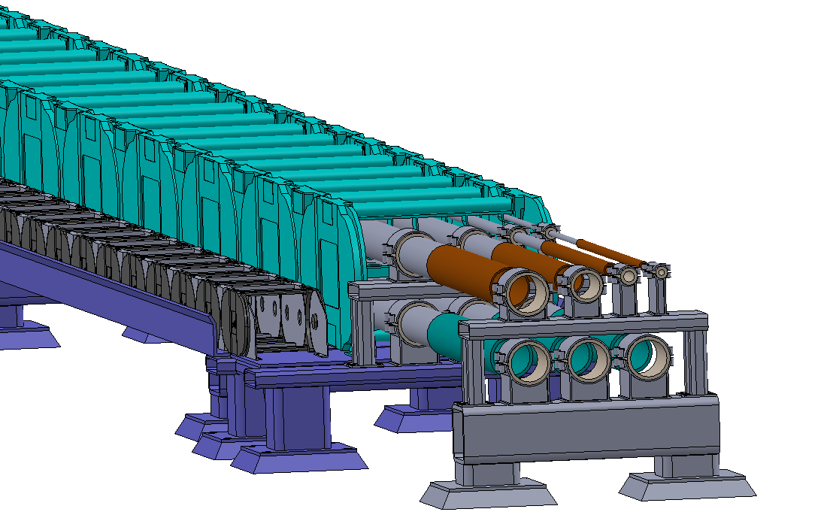
Power Supply Energy Chain
IGUS chain model for power and data
Inner Height: 162mm
Inner Width: 200mm
*chain selection to chain per volume requirements

Slide 8
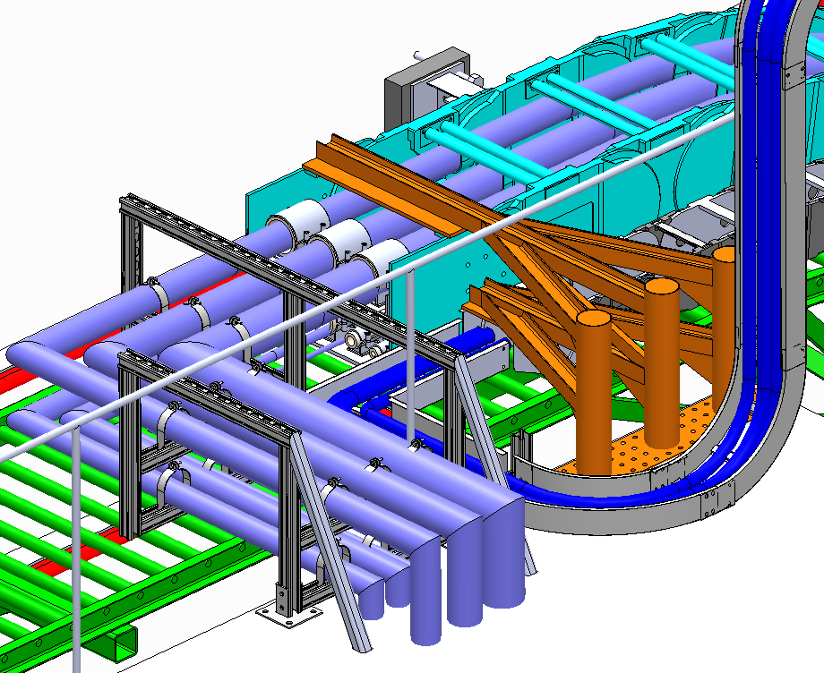
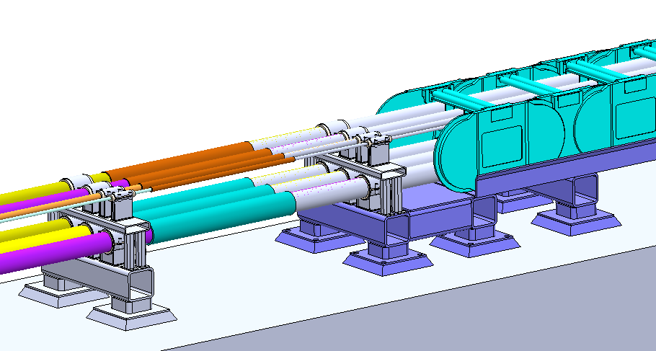
End Connections
Rigid piping from cyroplant and surface transfer lines will connect via welded connections
90 degree turn at end of chain to mate with LAr cryogenic mezzanine
Moving End
Flex Pipe
Welded Joint
Rigid Pipe
Fixed End
Flex Pipe
Welded Joint
Rigid Pipe
Anchor boom

Slide 9
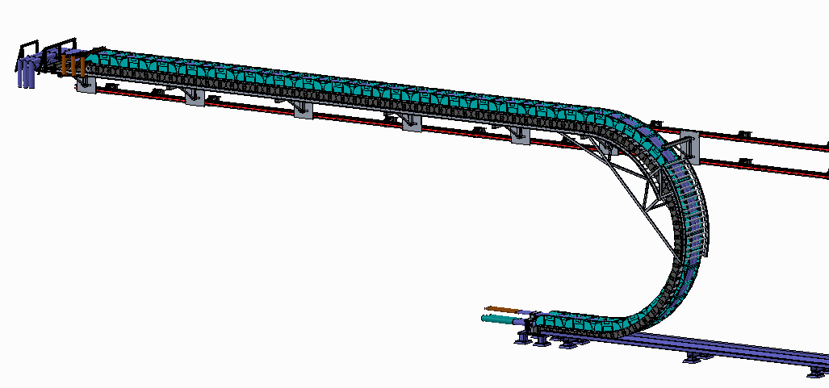
Conveyor Shelf
Energy chain traveling support needs to return with energy chain
Can this be accomplished without another powered motion system?
Added a concentric conveyor to guide travel support back to starting position

Slide 10
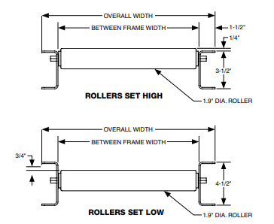
Commercially Available Conveyor
Model RS19U/G-31-6, 10’
Rollers Max Load: 8,757kg
15m(49.21ft) of straight conveyor results in 99 rollers
99x195lb= 19,305lb (8,757kg) max load
Frame max load:
10ft separated supports: 49.21ft x 120lb/ft = 5,905lb(2,678kg)
5ft separated supports: 49.21ft x 660lb/ft = 32,478lb(14,732kg)
*We will have to fabricate custom transfer module at end
Working with custom conveyor vendor CSE for a custom conveyor with wall-mounted rollers

Slide 11
Wall Mounting of Chain Support Conveyor
Travel support conveyor needs linear motion system to span travel distance of cryostat
Load Breakdown on linear motion system
Energy Chains: ~2,405 kg
Cryogenic Chain w/ VJP’s, 24.55m at max travel (16.3m on conveyor, 8.25m in bend): ~2,148 kg
Power Supply Chain: 24.55m at max (10.45kg/m) ~257 kg
Travel Support Conveyor: ~1,085 kg
Conveyor: 987 kg
Support Shelves: 97.12 kg , 12.14 kg per unit
Load on linear bearings(max): ~3,490 kg

Slide 12
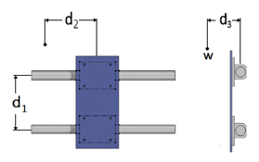
Linear Bearing Selection
Introduced Thomson linear bearings into model.
Two preferred options given for layout:
2 or 4 bearing per mounting pad
Option 1
Option 2

Slide 13
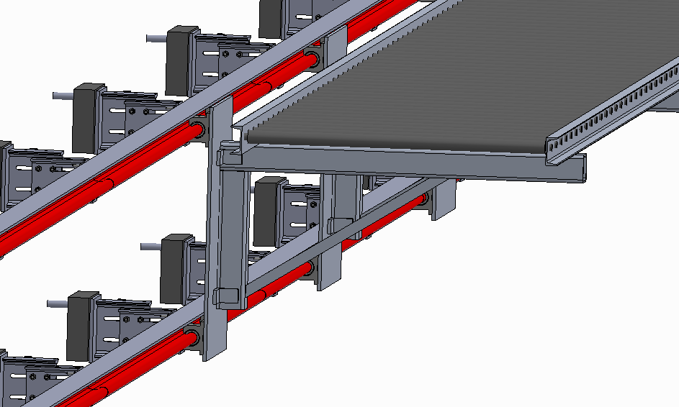
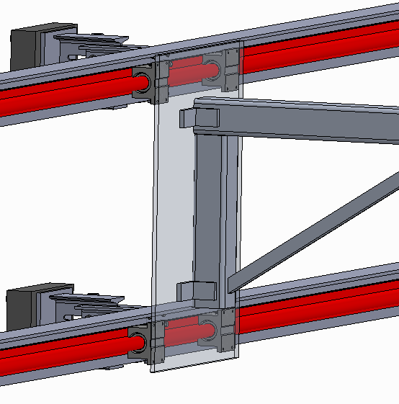
Conveyor Support
Specs:
Rail Diameter: 1.5 inch
Bearing Max Load(per): 7000 lbf, or 3175kg
Max Load per support unit: 12,700 kg
3+ support units mounted along conveyor
Total bearing max load capacity: 38,100 kg

Slide 14
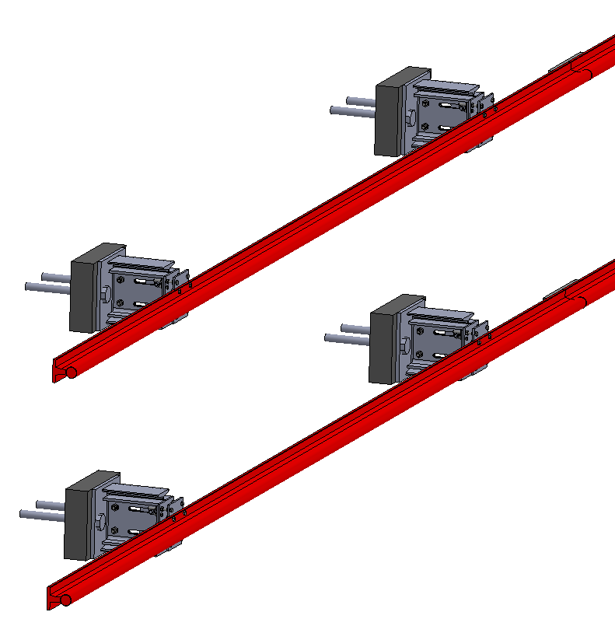
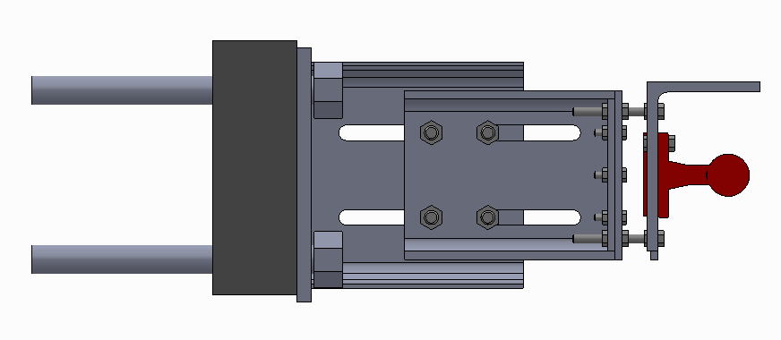
Rail Mounting
Slotted beam mounted to grout pad/shotcrete surface
3” slot + grout pad thickness (0 to 3+ inches) can overcome 6”+ variability in cavern wall surface.

Slide 15
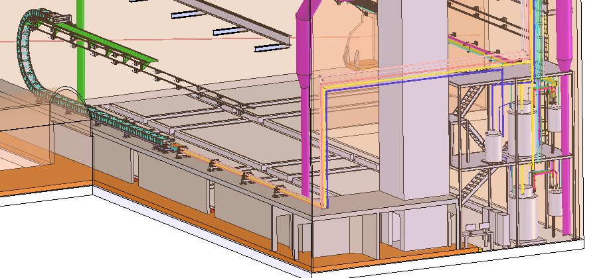
Cryogen Pipe Routing in Cavern
Preliminary routing along rear wall of cavern and down to egress surface.
Concerns: Equipment placement along desired path, Interference with current ventilation model and power distribution equipment

