Slide 1


Particle transport in LAr (not only)
Paola Sala
INFN Milano (Italy)
Alfredo Ferrari
Universitätklinikum Heildelberg (Germany) and
Gangneu-Wonju National University
Gangneung and Wonju, South Korea

Slide 2
Low Energy Neutrons
Low energy neutrons ( E< 20 MeV) are treated in a “special” way by most MC codes
Why?
  Because they are neutral..they can interact at low energies, where protons are deflected by the Coulomb barrier
  Because at these low energies nuclear interaction cross sections are heavily dependent on the detailed structure of the target nuclei
  Because there is plenty of experimental/evaluated data
Neutron cross section datasets available on the web: ENDF, TENDL, JEFF
Very detailed, provide total and partial cross sections, and spectra and angular distributions of emitted particles

Slide 3
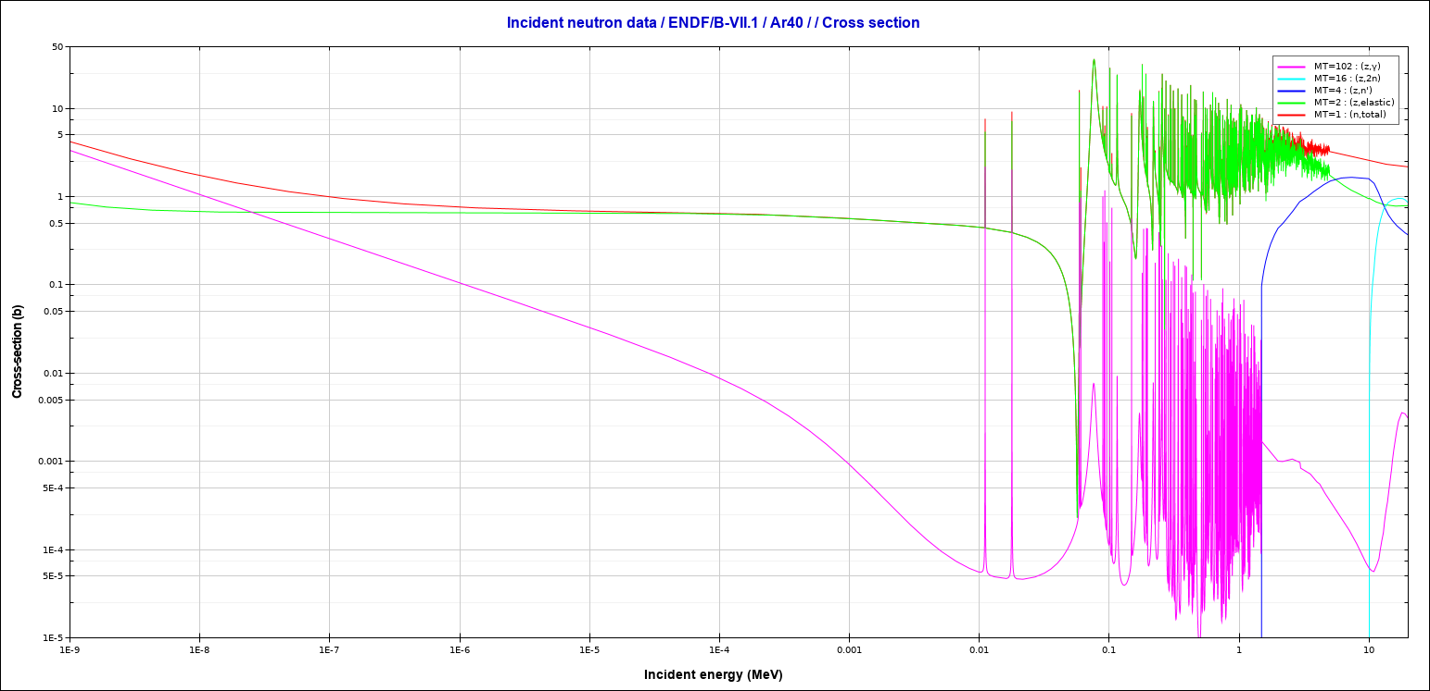
Neutron cross sections in Ar (low energy)
( at high energy, the neutron interaction length in argon is around 80~cm)
n, total
n, elastic
n, n’
n, 2n
1. b ~ 50 cm path
n, γ
Elastic : ΔE≈0.05E
Capture: Q≈6MeV
Inelastic: ΔE>1.4 MeV
1 keV
10 keV
1.4 MeV: Ar 1st excited state

Slide 4
Low Energy Neutrons DataBases -II
DRAWBACK 1) : outgoing particle spectra are inclusive. If sampled as such:
  Single events do not conserve energy (they do on average)
  Interaction products are not correlated
  Example: (n,2n) interaction. We have the spectrum of outgoing neutrons, but we have to sample 2 neutrons from the same spectrum. In a single event, we could have both of them with E=Emax, or both of them with E=Emin. On average, the spectrum is reproduced. On single event, not
  Need work to get correlated, energy conserving events. In FLUKA, this is already done for Ar, C, .. in progress for other isotopes (170 isotopes ready for the next release)
Drawback 2) : Data may be partially missing, or inconsistent between compilations

Slide 5
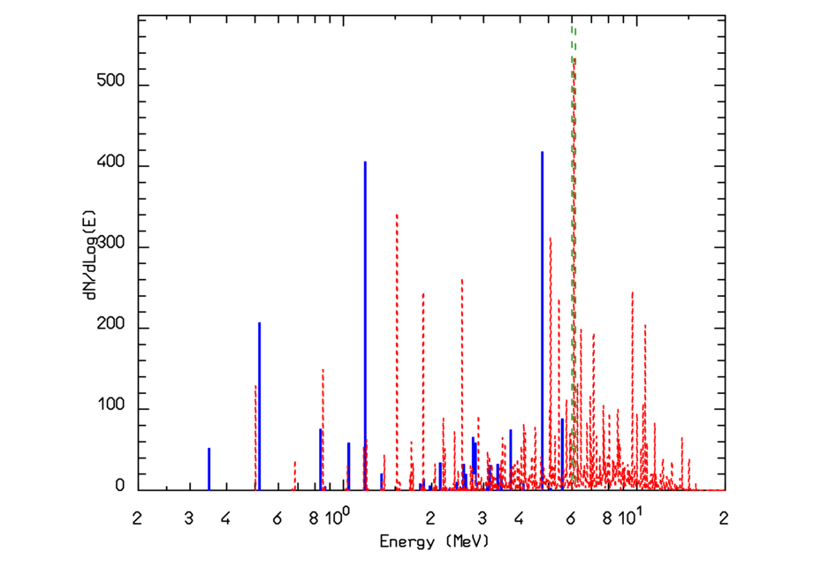
(Un)correlated capture γ cascades: ⁴⁰Ar(n,γ)⁴¹Ar
Thermal n capture: 6.1 MeV excitation energy
Dissipated through cascade of γ Several possibilities for the cascade
In the dataset: gamma energy, average multiplicity and average relative intensity (blue in the plot)
⁴⁰Ar(n,γ)⁴¹Ar:
Capture γ spectrum
Q for corr. cascades (6.10 MeV)
Q distribution for uncorr. cascades

Slide 6
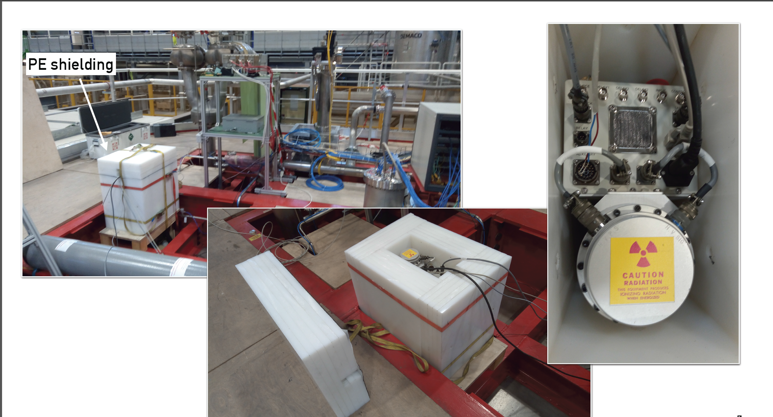
Next check: neutron gun on ProtoDUNE
MC and data analysis in progress, stay tuned!
Pictures from Mattia Fanì, LANL, at DUNE collab. meeting

Slide 7
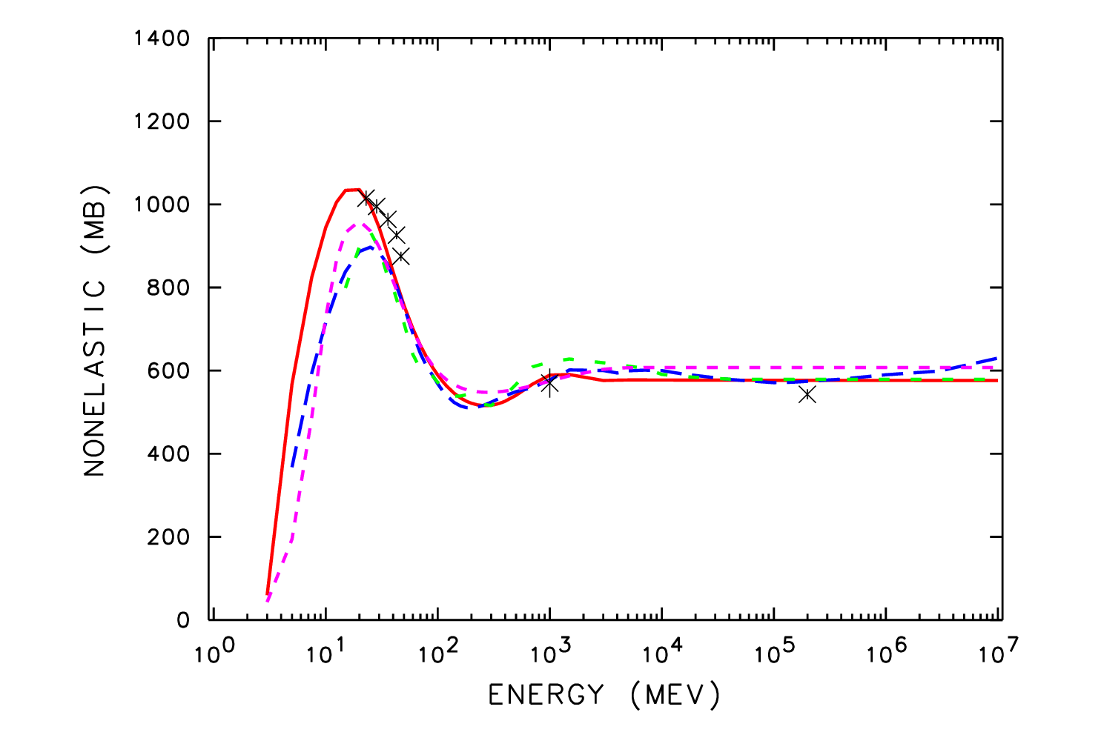
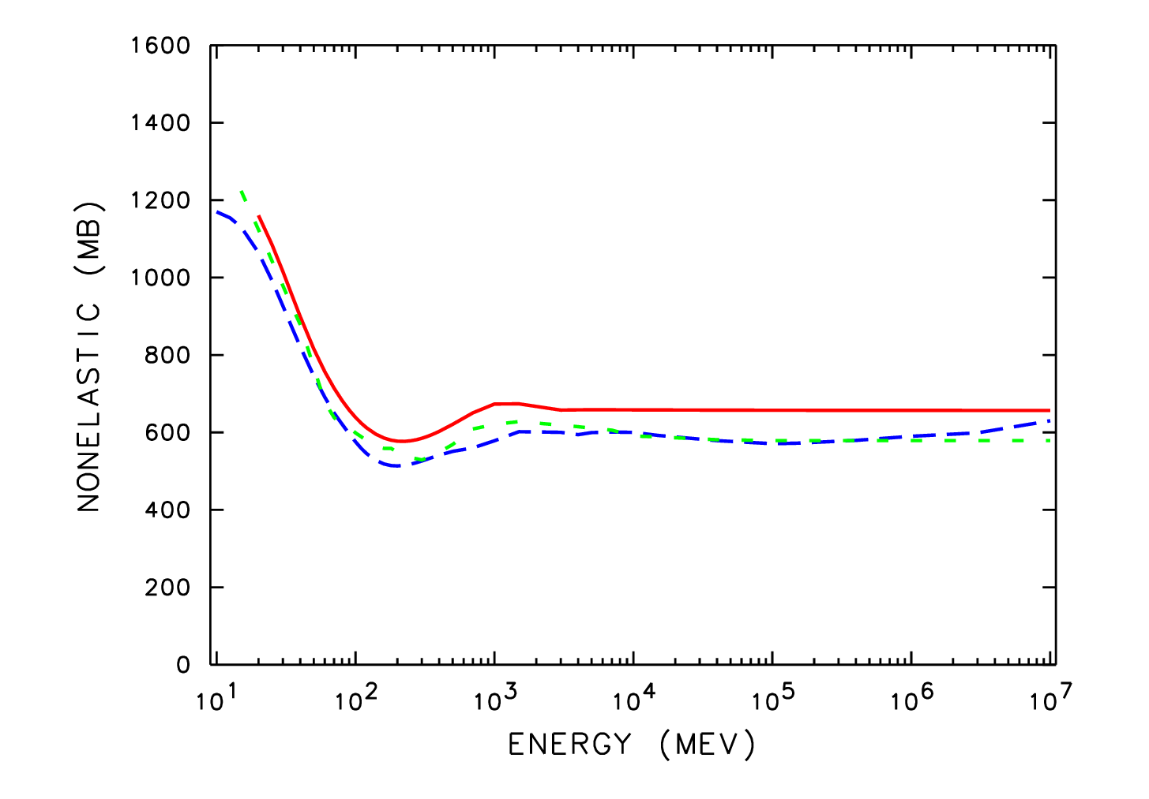
Hadron nucleus cross-sections
Inelastic cross sections:
Several models available in literature. Compared to/ driven by data when available
in FLUKA: Silberberg and Tsao astrophysics journal supplements 51 271 (1983)
Angeli and Csikai NPA170 577 (1971)
Shen INDC(CPR) 020 (1991)
See also : Wilson and Townsend NASA 4053 (1988)
+ specials for low mass
Protons on A=40 Z=18
Neutrons on A=40 Z=18
..no data..no reason to be vastly different from p-Ar above ~100 MeV
Data: symbols
FLUKA: blue long dash

Slide 8
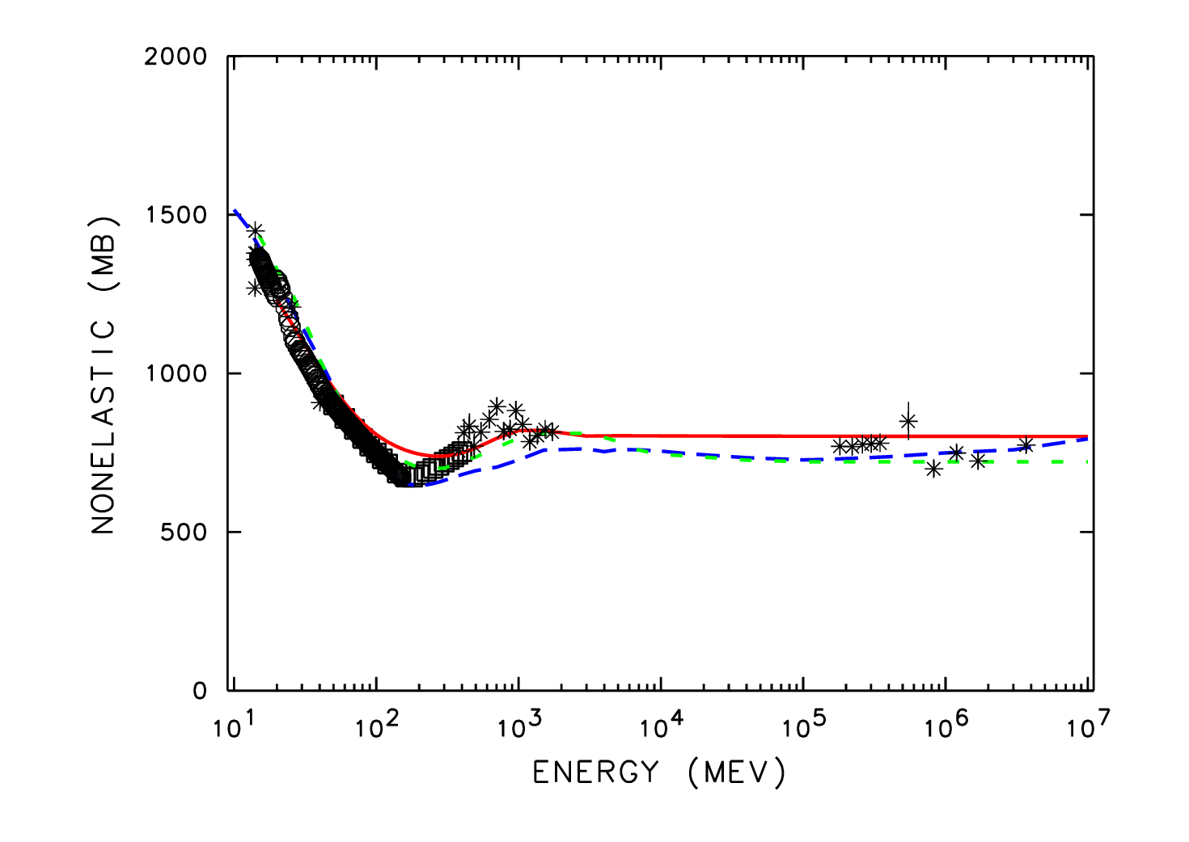
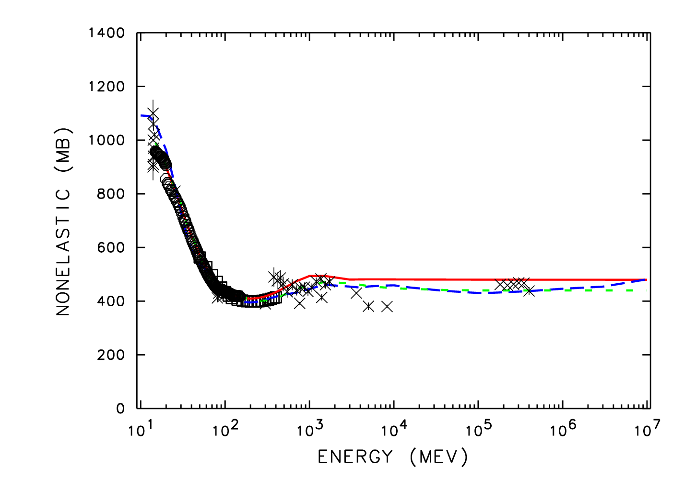
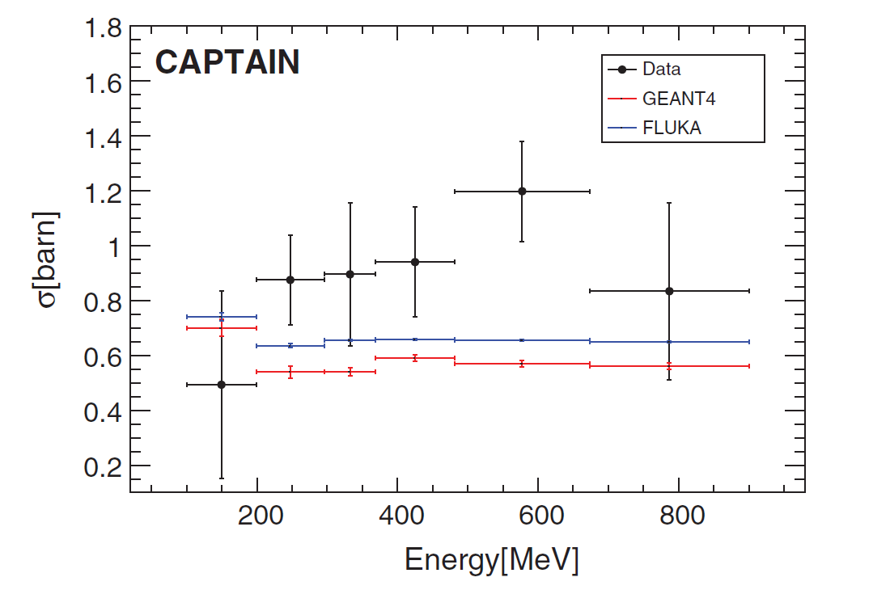
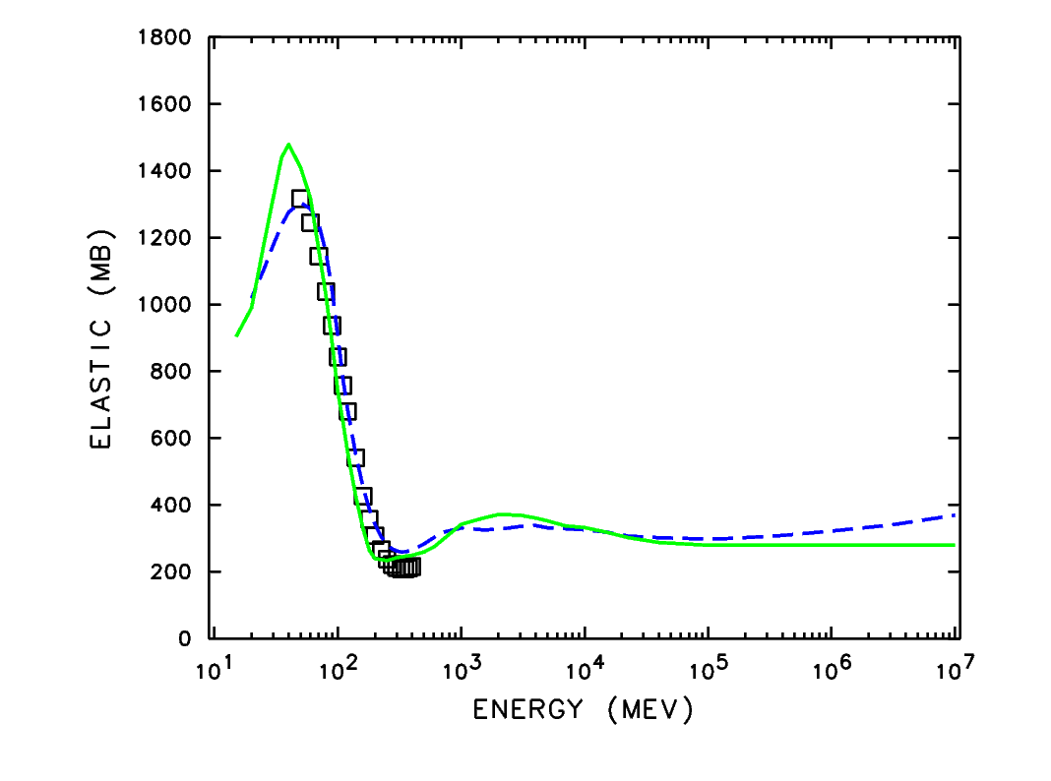
Hadron nucleus cross sections: look nearby
Neutrons on on A=56 Z=26
Shape is approx. the same for all targets, expect rough scaling with A^{1/3}
Neutrons on on A=27 Z=13
Data: symbols
FLUKA: blue long dash
Squares: evaluation
Elastic, neutron on A=40 Z=18
Not negligible

Slide 9
Hadronic interaction Models (here FLUKA)
Hadron-nucleus: PEANUT
Sophisticated
G-Intranuclear Cascade
Gradual onset of Glauber-Gribov multiple interactions (High E)
Preequilibrium
Coalescence
Elastic, exchange
Phase shifts
data, eikonal
P<3-5GeV/c
Resonance prod
and decay
hadron
hadron
low E π,K
Special
High Energy
Strings (DPM)
hadronization
Evaporation/Fission/Fermi break-up
γ deexcitation

Slide 10
Hadron-nucleon interaction models
Particle production interactions: two kinds of models
p-p and p-n cross section
FLUKA and data
Those based on “resonance” production and decays, cover the energy range up to 3–5 GeV: examples
total
N₁ + N₂ → N”₁ + Δ(1232) → N₁’ + N₂’ + π
π + N → Δ(1600) → π’+ Δ(1232) → π’ + π“+ N’
N_{’1}+ N₂ → Δ₁(1232) + Δ₂(1232) → N₁’ + π₁ + N’₂ + π₂
elastic
Those based on quark/parton string models, which provide reliable results up to several tens of TeV
Elastic, charge exchange and strangeness exchange reactions:
• Available phase-shift analysis and/or fits of experimental differential data
• At high energies, standard eikonal approximations are used

Slide 11
Pion production in p-p collisions:
Inclusive cross section for the production of π⁰ (blue), π+ (red), and π⁻ (green)
in p-p collisions as a function of the proton kinetic energy. Lines: simulations, symbols exp. Data.
(figure from AstrPhys81, 21 (2016))

Slide 12
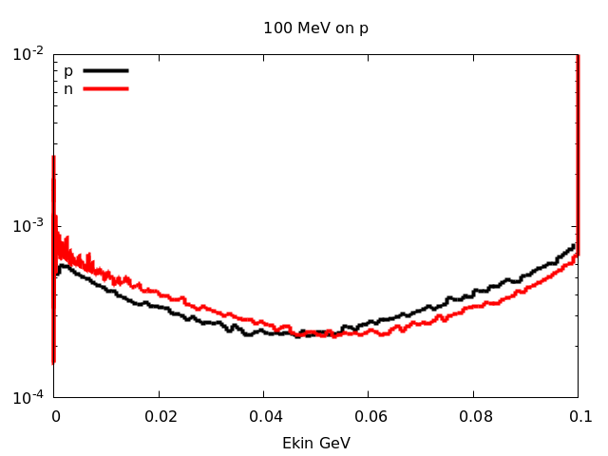
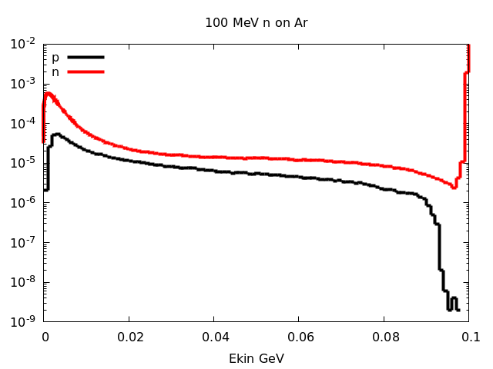
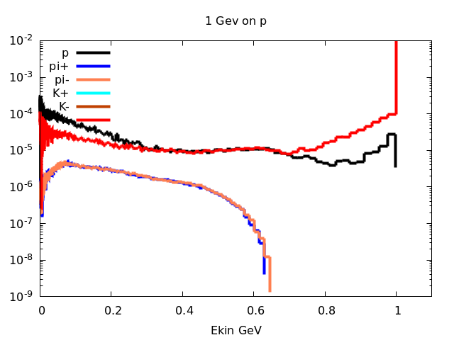
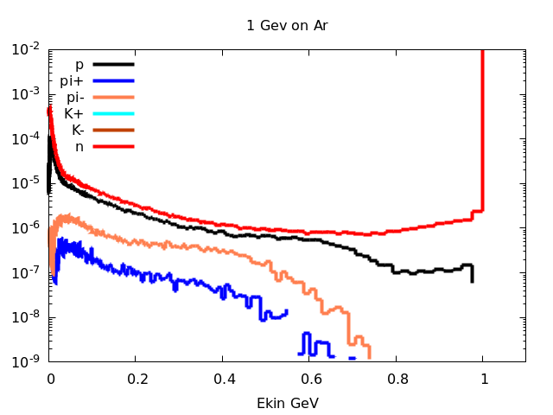
From n-p to n-Ar, 0.1 and 1GeV
Spectra from Interactions
On thin target
100 MeV n on p
100 MeV n on Ar
Not normalized, look at shape:
Decrease of high energy
Huge increase of 0-100 MeV protons/neutrons
1 GeV n on p
1 GeV n on Ar

Slide 13
Sketch* of IntraNuclearCascade (INC):
Fluka uses a modern and much evolved INC model
* E. Gadioli et al., “Pre-Equilibrium Nuclear Reactions”, Oxford Studies in Nuclear Physics 15, 1992.

Slide 14
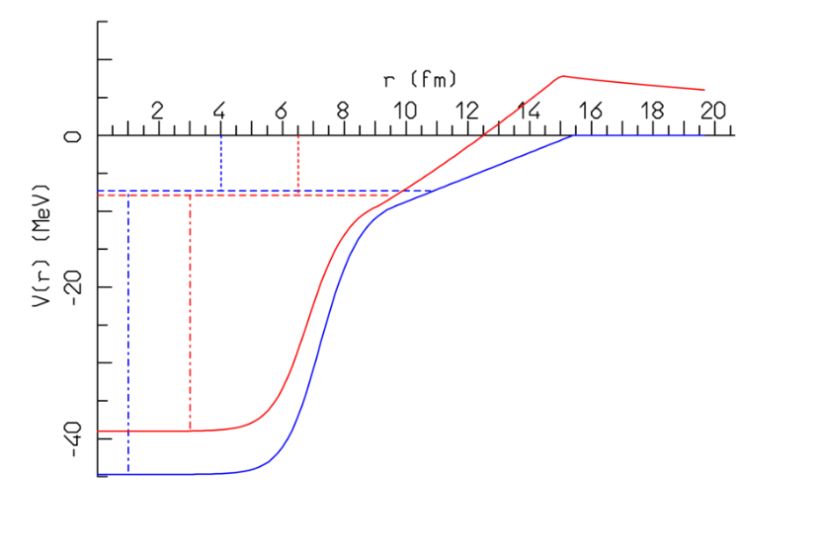
Fermi motion: Nucleon levels inside the nuclear potential
Blue: neutron
Red: proton
S_{n}
S_{p}
Local Fermi momentum, smeared according to uncertainty principle assuming a position uncertainty = √ 2 fm
p/n are grouped on energy levels space according to the shell model (blue lines, shown for neutrons)
The maximum radius for nucleus depends on the occupied level
The potential well depth depends on the nucleon energy (not yet implemented for neutrino and electron interactions)
Hit nucleon must go above Fermi level (Pauli blocking) can stay below separation energy
Trajectories are curved by the nuclear potential
E_{F}^{n}
E_{F}^{p}
ENERGY is conserved

Slide 15
Nuclear potential for pions
For pions, a complex resonant nuclear potential can be defined out of the π-nucleon scattering amplitude to be used in conjunction with the Klein-Gordon equation
In coordinate space (the upper/lower signs refer to π⁺/ π⁻):
Using standard methods to get rid of the non-locality, in momentum space

Slide 16
Nuclear potential for pions: examples
The real part of the pion optical potential for π⁺ on ¹⁶O (left) and π⁻ on ²⁰⁸Pb (right) as a function of radius for various pion energies (MeV)
Depends on pion energy and on nuclear density

Slide 17
Pions: nuclear medium effects
Free π N interactions ⇒ | ⇒ | Non resonant channel
 | ⇒ | P-wave resonant Δ production
π + N → Δ in nuclear medium | ⇒ | decay | ⇒ elastic scattering, charge exchange
 | ⇒ | reinteraction | ⇒ Multibody pion absorption
Assuming for the free resonant σ a Breit-Wigner form with width Γ_{F}
An “in medium” resonant σ (σ^{A}_{res}) can be obtained adding to Γ_{F} the imaginary part of the (extra) width arising from nuclear medium
(Oset et al., NPA 468, 631)
quasielastic scattering, two and three body absorption
The in-nucleus σ_{t}^{A} takes also into account a two-body s-wave absorption σ_{s}^{A} derived from the optical model

Slide 18
Pion absorption:
Emitted proton spectra at different angles, 160 MeV π⁺ on Ni
Phys. Rev. C41,2215 (1990), Phys. Rev. C24,211 (1981)
Proton spectra extend up to 300 MeV!!
Pion absorption cross section on Gold and Bismuth in the Δ resonance region (Black dots: exp data, colored ones: model)
Symbols: exp. Data
Histos: model

Slide 19
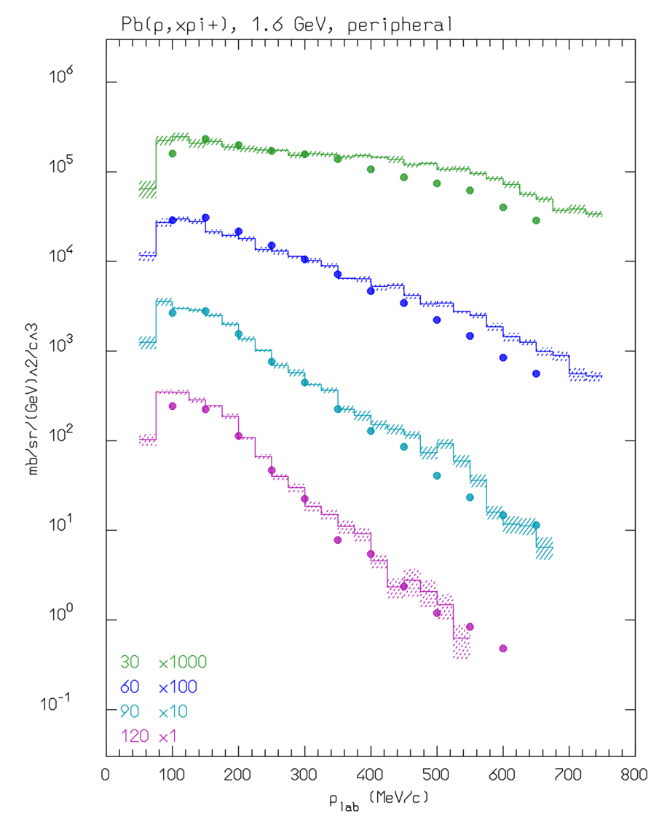
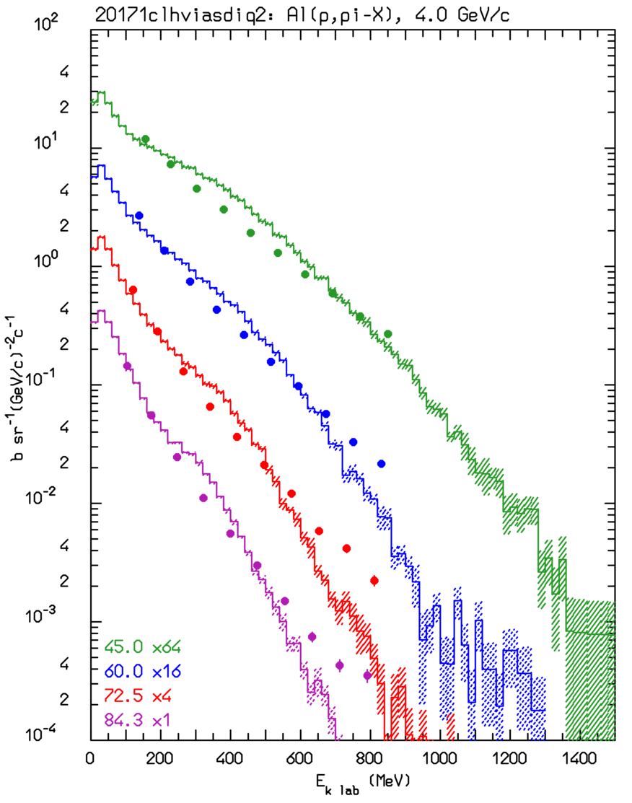
Pion production examples:
p+Pb → π⁺+X (1.6 GeV)
p+Al → π⁻+X (4 GeV/c)
Double differential pion production cross sections d²σ/dEdΩ for 1.6 GeV p on Pb (left), and for 4 GeV/c p on Al (right)
Symbols: exp. data*
Histograms: model
*CEA-N-2670
PLB159, 1 (1985)
PLB159, 1 (1985)

Slide 20
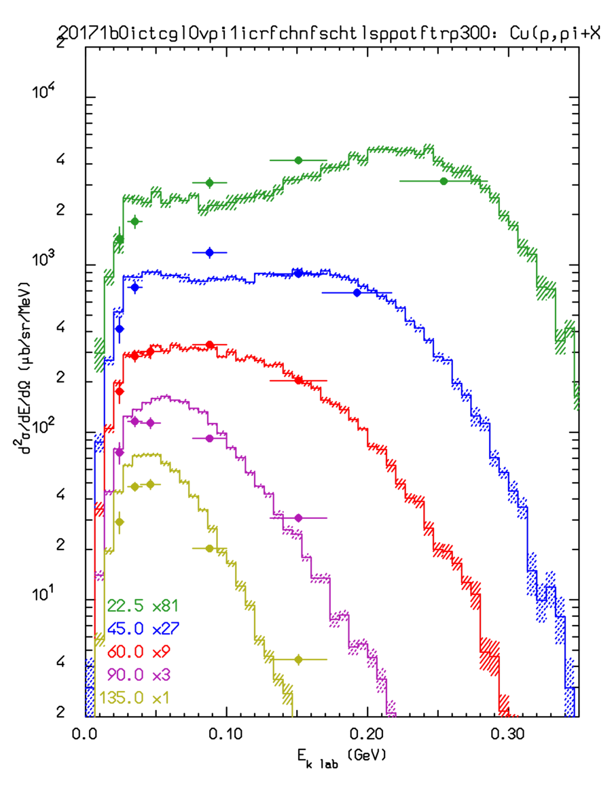
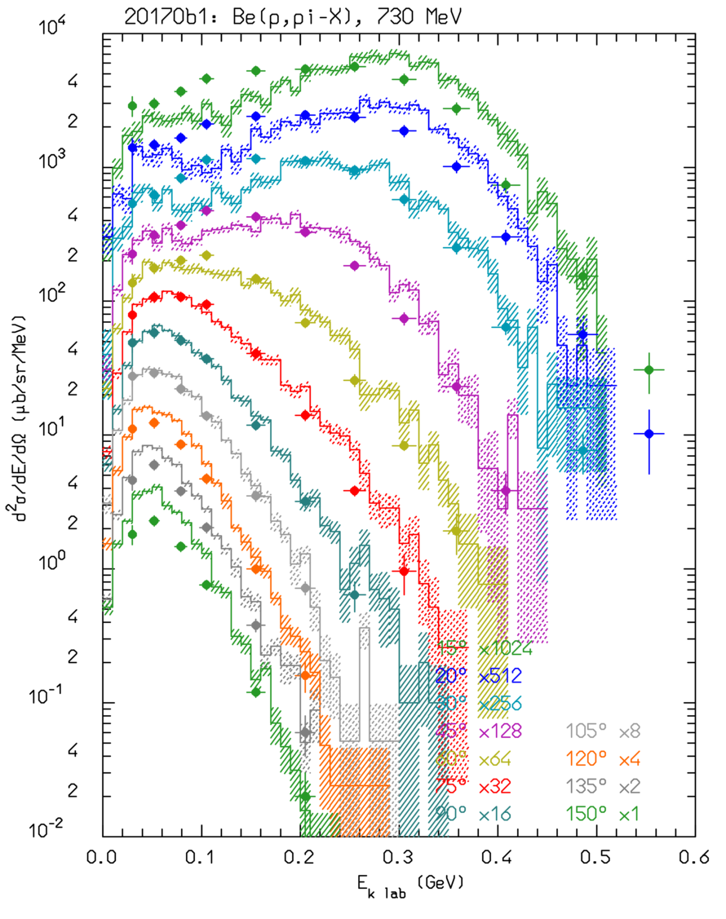
pCu→π⁺X @ 585 MeV and pBe→π⁻X @ 730 MeV
Pion production from proton interactions on Cu (π⁺ 585 MeV) and Be (π⁻, 730 MeV)
Emitted pion spectra at different angles.
Symbols: data, histograms : Fluka

Slide 21
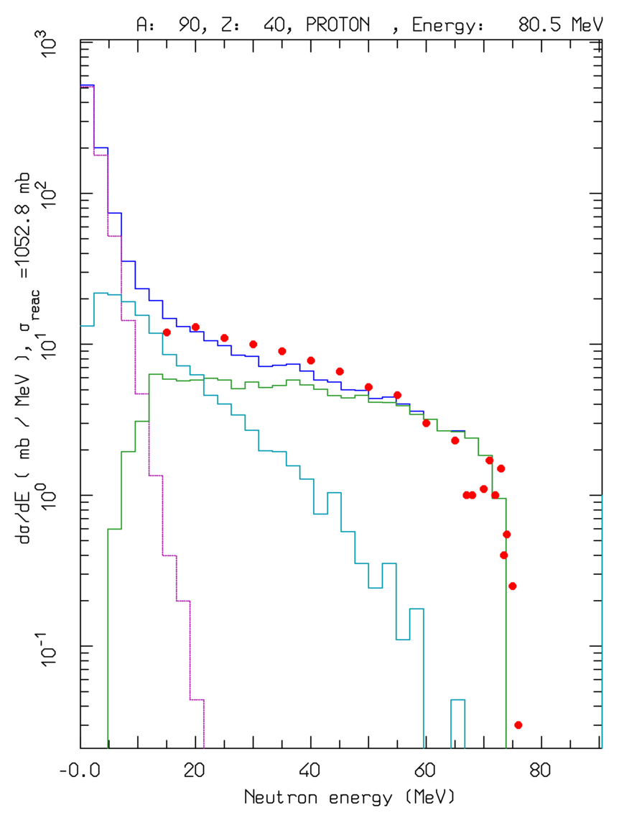
Preequilibrium emission:
For E > π prod. threshold → only (G)INC models. At lower energies INC becomes increasingly inapplicable → preequilibrium models == share the excitation energy among many nucleons/holes
Statistical assumption:
any partition of the excitation energy E* among N, N = N_{h} +N_{p}, excitons has the same probability to occur
Step: nucleon-nucleon collision with N_{n+1}=N_{n}+2 (“never come back approximation”)
Chain end = equilibrium = N_{n} sufficiently high, or excitation energy below threshold
N₁ depends on the reaction type and cascade history
dσ/dE ⁹⁰Zr(p,xn) at 80.5 MeV
Lines: total, INC, preequilibrium, evaporation contributions
Data • :from Phys. Rev. C39, 452
Preeq. in FLUKA: directly for p/n induced reactions below 30-100 MeV, or all remaining nucleons/clusters below 30-100 MeV/n.
In the latter case the initial configuration depends on the previous history.
Emission of p/n/light fragments (up to α’s)

Slide 22
Equilibrium particle emission (evaporation, fission and nuclear break-up)
From statistical considerations and the detailed balance principle, the probabilities for emitting a particle of mass m_{j,} spin S_{j,}ħ and energy E, or of fissioning are given by*:
(i, f for initial/final state, Fiss for fission saddle point)
Probability per unit time of emitting a particle j with energy E
In FLUKA: ~600 possible emitted particles/states (A<25) with an extended (heavy) evaporation/fission/fragmentation formalism
For light nuclei (A<17): enhanced Fermi break up
Probability per unit time of fissioning
*Weisskopf-Ewing approach
ρ’s: nuclear level densities
U’s: excitation energies
V_{j}’s: possible Coulomb barrier for emitting a particle type j
B_{Fiss}: fission barrier
Q_{j}’s: reaction Q for emitting a particle type j
σ_{inv}: cross section for the inverse process
Δ’s: pairing energies
Neutron emission is strongly favoured because of the lack of any barrier
Heavy nuclei generally reach higher excitations because of more intense cascading

Slide 23
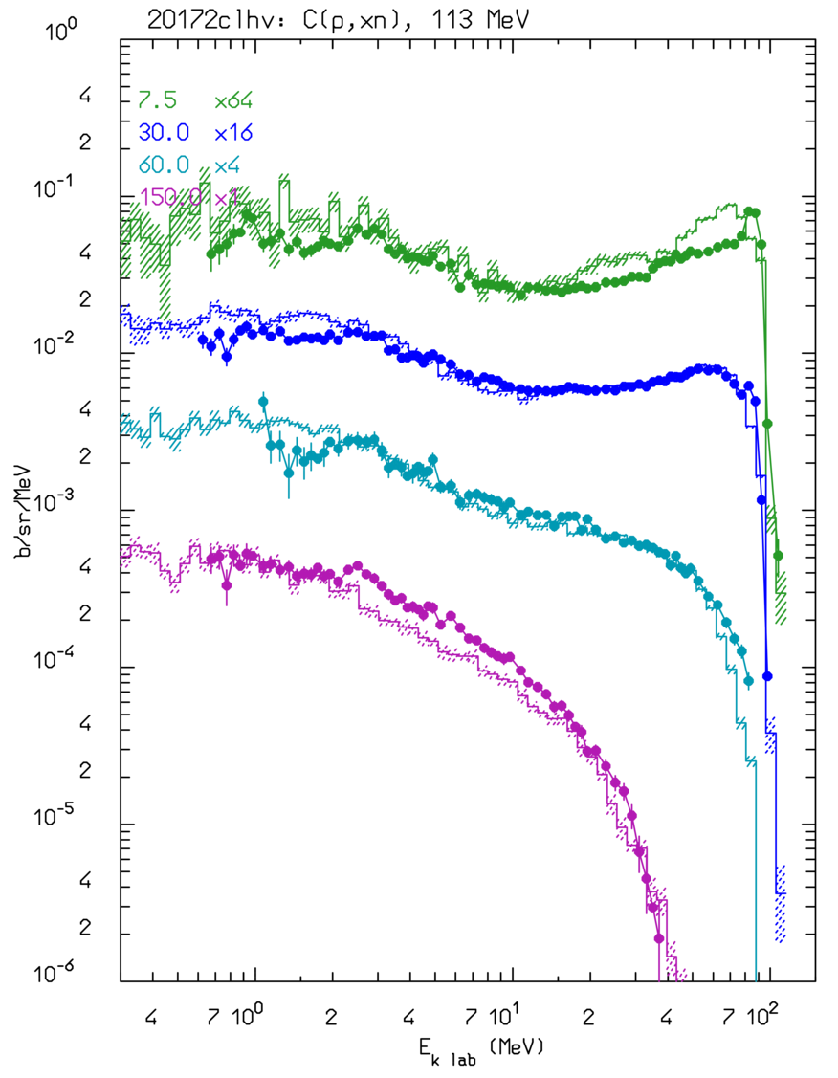
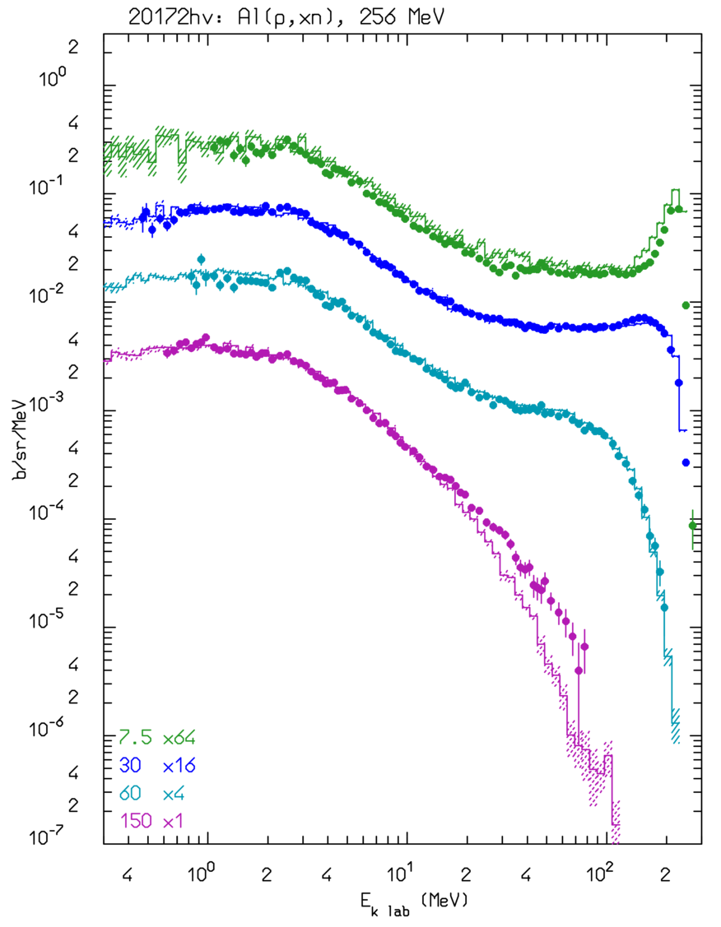
Thin target examples: neutrons
Double differential ← cross section for C(p,xn) @ 113 MeV, thin target
Data: NSE112, 78 (1992)
Cascade, preequilibrium neutrons
Evaporation
neutrons
Double differential cross section for Al(p,xn) @ 256 MeV → thin target
Data: NST32, 827 (1995)

Slide 24
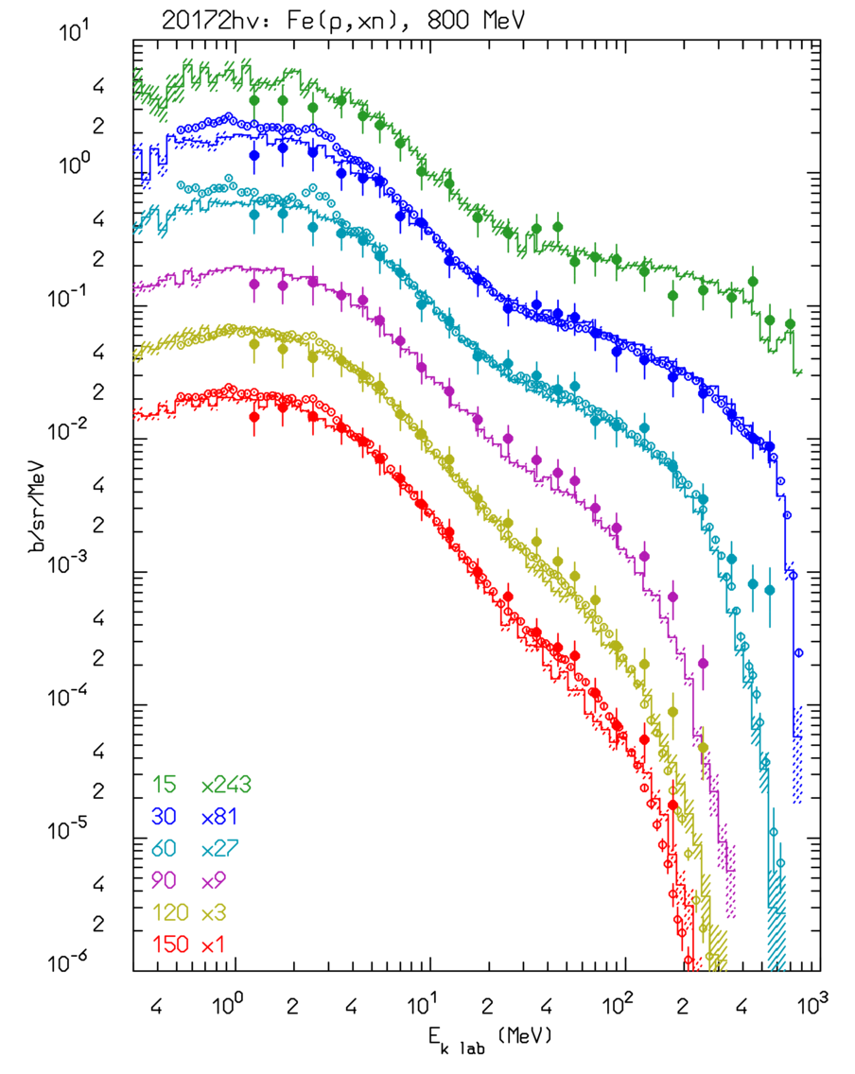
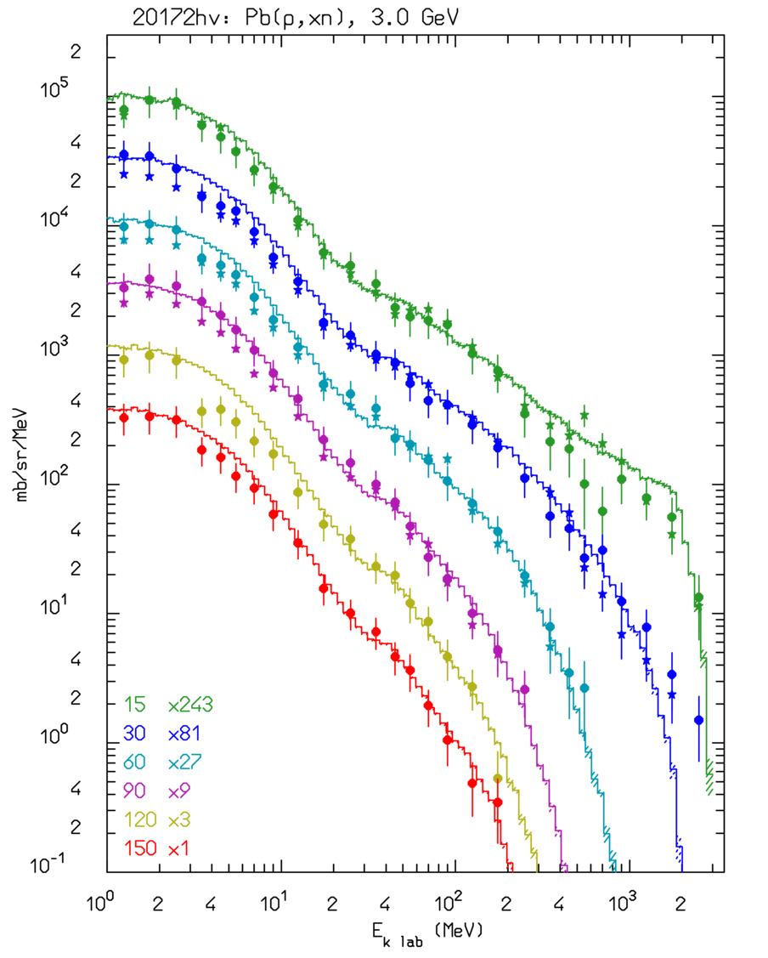
Thin target examples II: neutrons
Double differential ← cross section d²σ/dEdΩ for Fe(p,xn) @ 800 MeV, thin target
Data: NSE112, 78 (1992), NST34, 529 (1997)
Cascade, preequilibrium neutrons
Evaporation
neutrons
Double differential cross section d²σ/dEdΩ for Pb(p,xn) @ 3 GeV → thin target
Data: NST32, 827 (1995)

Slide 25
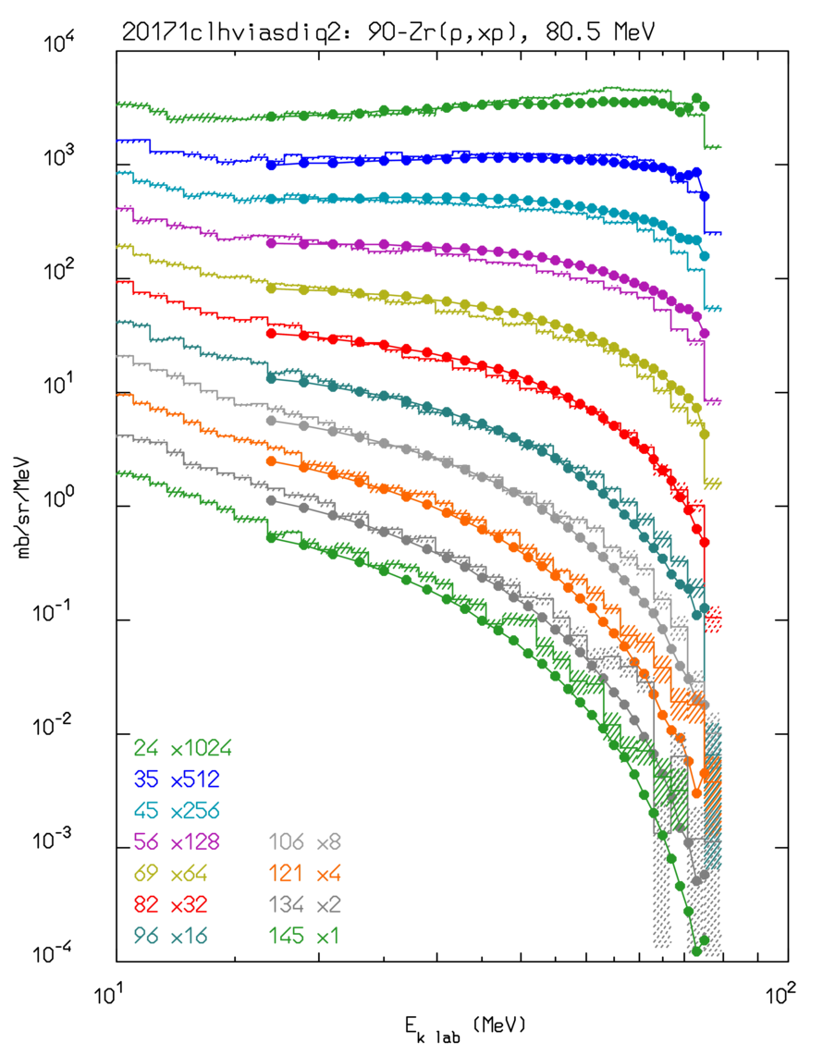
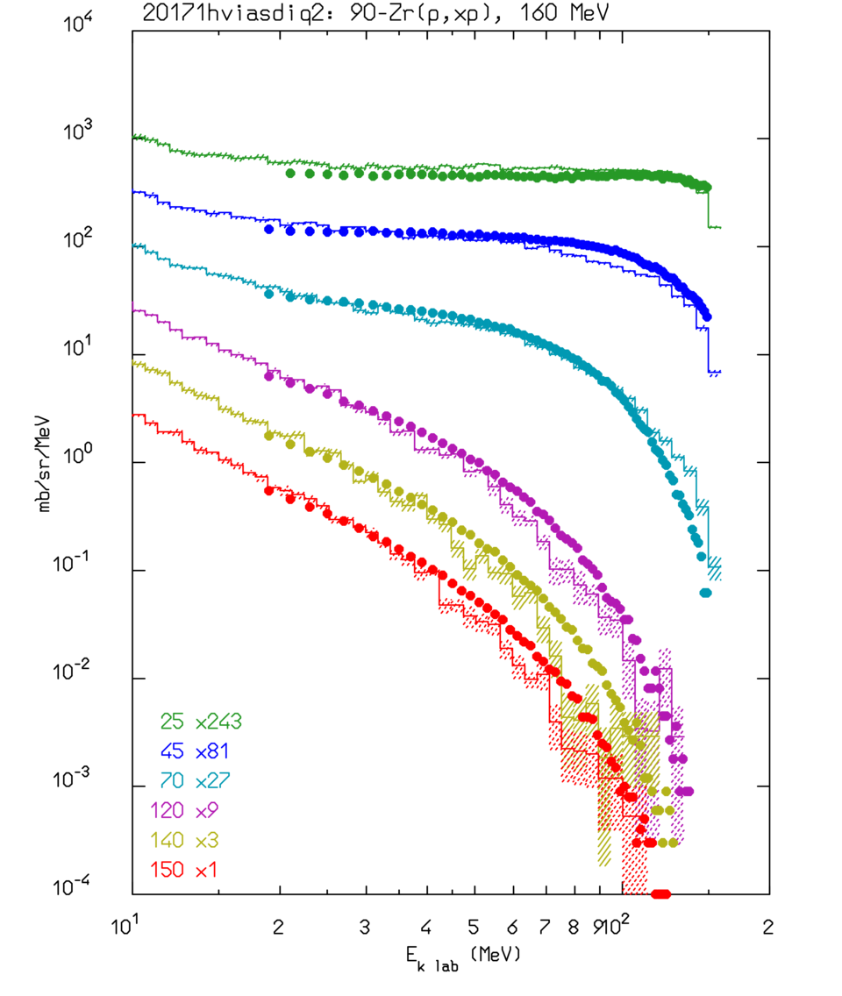
More Thin target examples
p + ⁹⁰Zr → p + X (80 MeV)
p + ⁹⁰Zr → p + X (160 MeV)
Double differential, d²σ/dEdΩ emission spectra for various angles

Slide 26
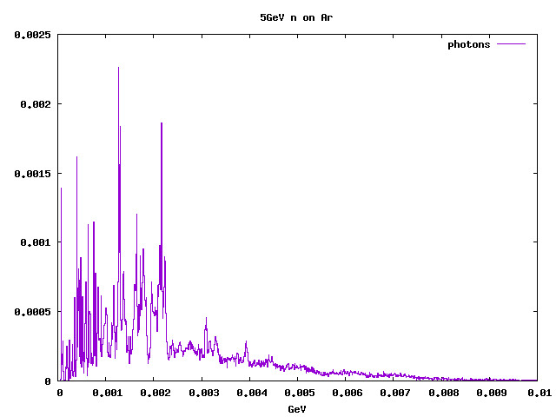
Last step
At excitation energies < separation energy➔ emission of gamma rays (actually also in competition with evaporation) .
Uses atlas of excited levels/transitions whenever available
Simulated gamma rays from 5 GeV neutron interactions in Ar

Slide 27
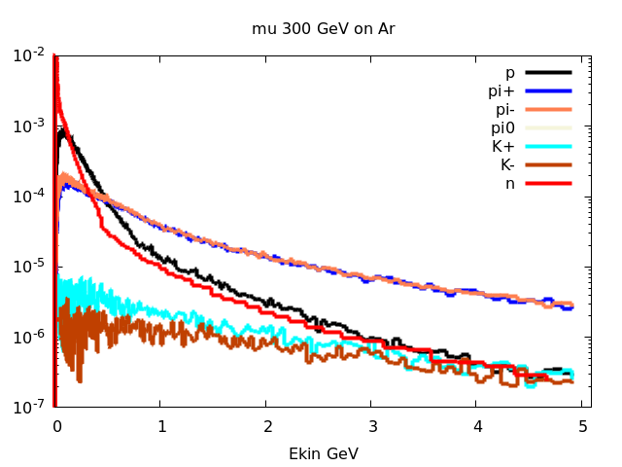
One more source of neutrons, and other particles
Simulated particle spectra from 300 GeV muon interactions in on Ar

Slide 28
Real and Virtual Photonuclear Interactions
Photonuclear reactions
Giant Dipole Resonance interaction (special database)
Quasi-Deuteron effect
Delta Resonance energy region
Vector Meson Dominance at high energies
INC, preequilibrium and evaporation via the PEANUT model
Virtual photon reactions
Muon photonuclear interactions
Electronuclear interactions
Electromagnetic dissociation
Electro(Positro)Fission on ²³⁸U
Lines:FLUKA (E1+E2)
Symbols.: exp. data
Notes:
In not many other existing transport codes photonuclear reactions are simulated over the whole energy range

Slide 29
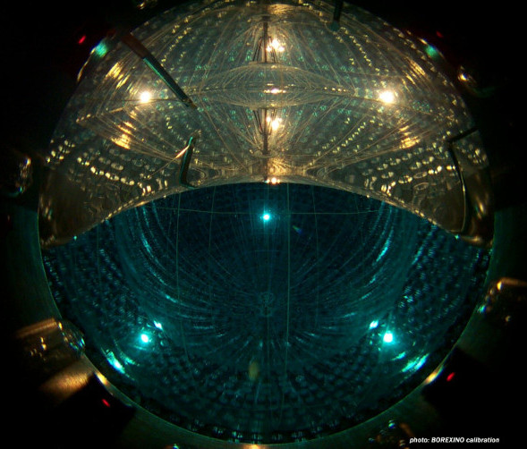
Cosmogenic backgrounds at Gran Sasso
Borexino detector:
~300 tons of liquid scintillator surrounded by 1000 + 2400 tons of Sci/H₂O shielding
Primary physics goal: solar ν’s
Possibility of measuring neutrons and radioactive decays related to passing cosmic muons (average energy of μ’s at Gran Sasso depth ~283 GeV)
Critical test of (μ and γ) photonuclear interactions, as well as of μ atomic physics (dE/dx, e± pair prod., bremss.)

Slide 30
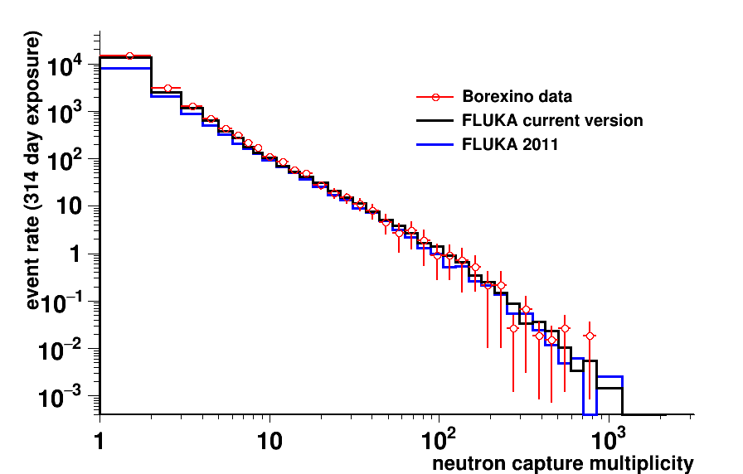
μ Induced neutron multiplicity events @ Borexino*
*A.Empl et al, APCPC,1672,090001
Neutron producing μ event rate
(evt/day @ inner detector)
Borexino: 67±1
Fluka: 62±1
Fluka2011: 42±1

Slide 31
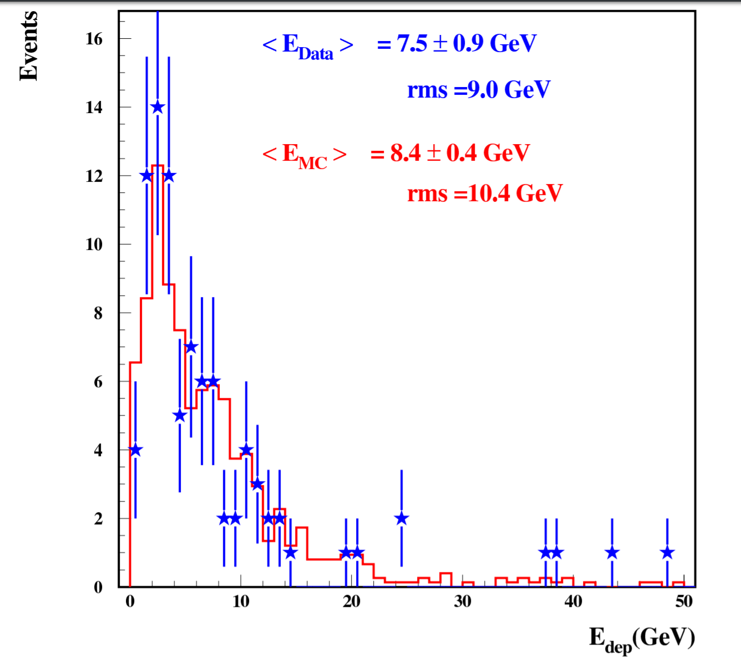
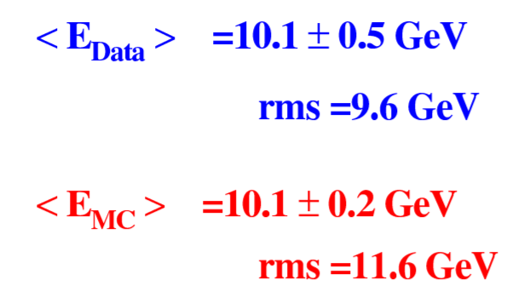
ICARUS@CNGS data (≈20 GeV Eν peak)
Distribution of total deposited energy in the T600 detector
Left:
ν_{µ} CC events
Right:
ν NC events
Same reconstruction in MC (FLUKA) and Data, no tuning.
Neutrino fluxes from FLUKA cngs simulations.
Neutrino interactions by the FLUKA generator
Eur. Phys. J. C (2013) 73:2345
Phys. Lett. B (2014)
Not so bad in LAr!!

Slide 32
END

Slide 33
Backup slides

Slide 34
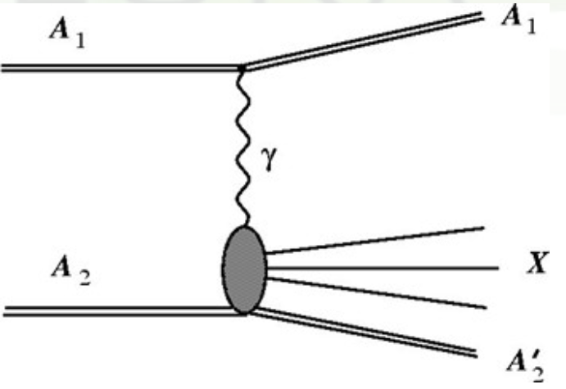
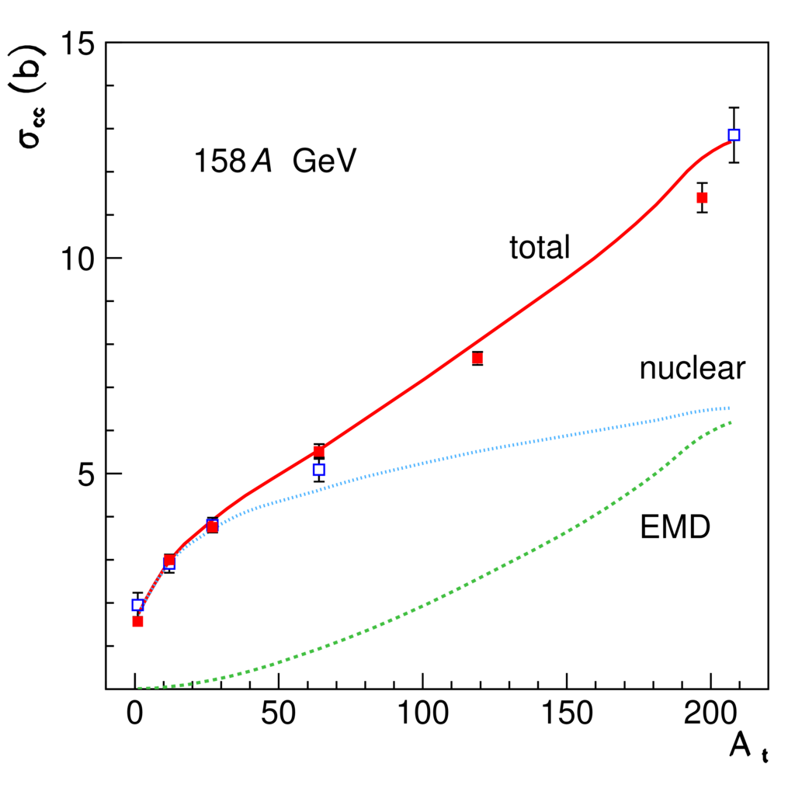
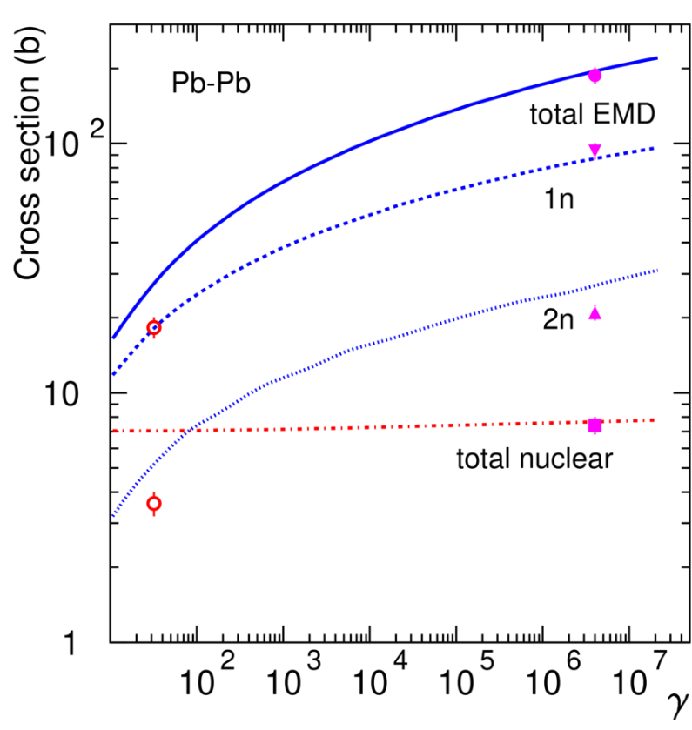
Electromagnetic dissociation
Very peripheral collisions
Break-up of one of the colliding nuclei in the electromagnetic field of the other nucleus
… nuclear and, mostly, ElectroMagneticDissociation collisions on LHC machine elements or at IP’s produce a variety of (excited), possibly radioactive, fragments in flight
Pb ions on various targets
Alice:
√s_{nn}=2.8 TeV
Symbols: exp. data
Lines: Fluka
Total charge changing cross section as a function of atomic mass
Total EMD, 1 n, 2 n, and nuclear cross sections as a function of the effective γ factor

Slide 35
FLUKA (PEANUT) modeling of nuclear interactions
Target nucleus description (density, Fermi motion, etc)
t (s)
10⁻²³
10⁻²²
10⁻²⁰
10⁻¹⁶
Glauber-Gribov cascade with formation zone
(Generalized) IntraNuclear cascade
Preequilibrium stage with current exciton configuration and excitation energy
(all non-nucleons emitted/decayed + all nucleons below 30-100 MeV)
Evaporation/Fragmentation/Fission model
γ deexcitation

Slide 36
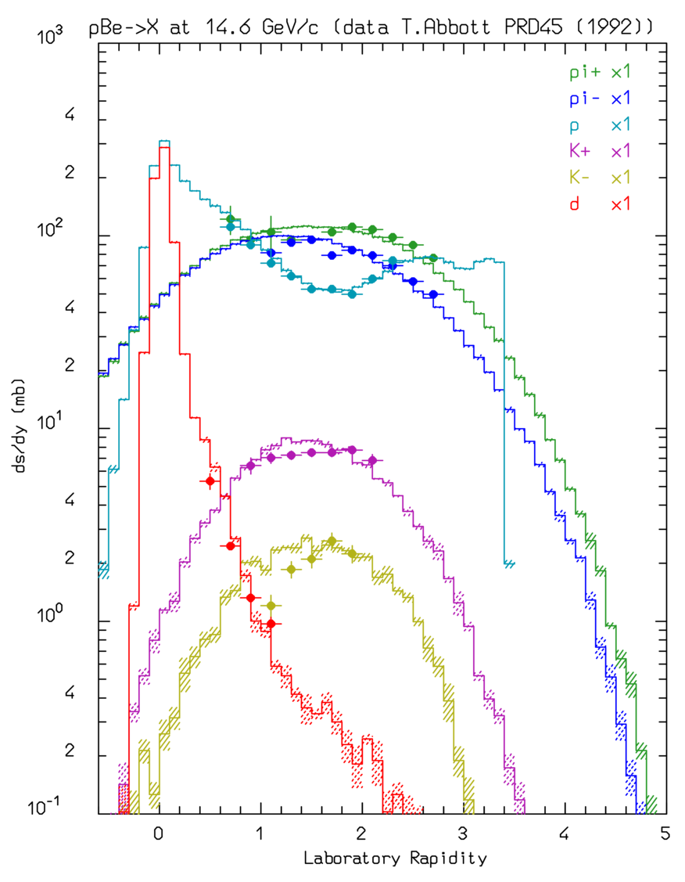
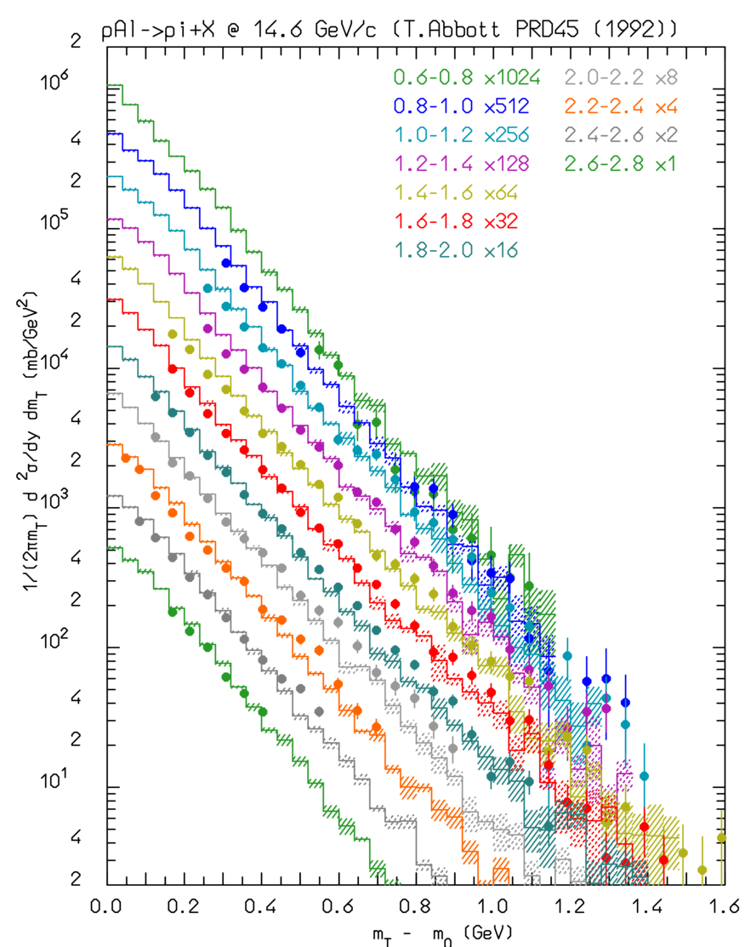
pBe, pAl @ 14.6 GeV/c
π⁺, π⁻, K⁺, K⁻, p, d, rapidity distributions for pBe @ 14.6 GeV/c (left)
π⁺ production double differential cross section for pAl @ 14.6 GeV/c as a function of the transverse mass, for different rapidity intervals
Symbols: exp. data
Histos: FLUKA

Slide 37

Compound nucleus: evaporation
After many collisions and possibly particle emissions, the residual nucleus is left in a highly excited “equilibrated” state
De-excitation can be described by statistical models which resemble the evaporation of “droplets”, actually low energy particles (p, n, d, t, 3He, alphas…) from a “boiling”soup characterized by a “nuclear temperature”
Formation and decay are supposed to be decoupled → residuals with the same A, Z, U (exc. Energy), (and J^{π}) will decay the same regardless of the process which generated them
The process is terminated when all available energy is spent → the leftover nucleus, possibly radioactive, is now “cold”, with typical recoil energies ∼ MeV
For heavy nuclei the excitation energy can be large enough to allow breaking into two major chunks (fission).
Since only neutrons have no barrier to overcome, neutron emission is strongly favoured.
In FLUKA: ~600 possible emitted particles/states (A<25) with an extended (heavy) evaporation/fragmentation formalism
In AA evaporation (of the projectile) is responsible for the leading particle(s) and for the resulting A, Z of the (projectile) remnant(s)

Slide 38
Secondary light fragments: coalescence
Experimental evidence of energetic fragment production
Double differential d (left) and t (right) production from 383 MeV (left) and 542 MeV (right) neutrons on Copper (Nucl. Phys. A510, 774 (1990))

Slide 39
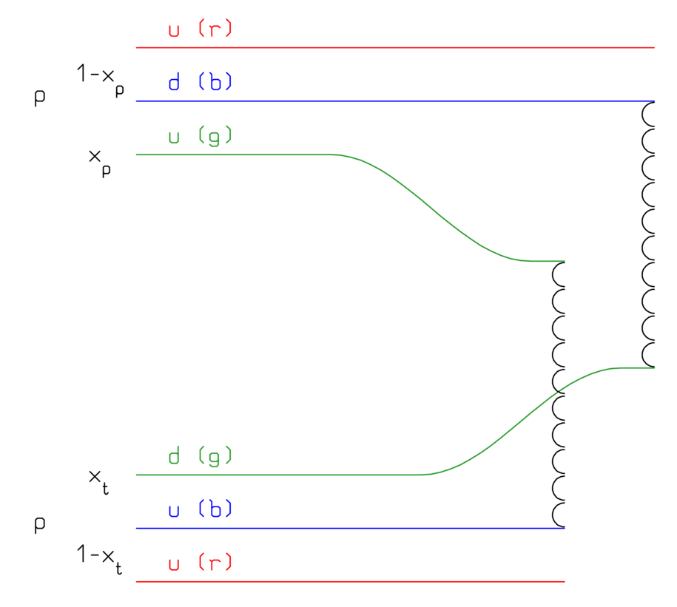
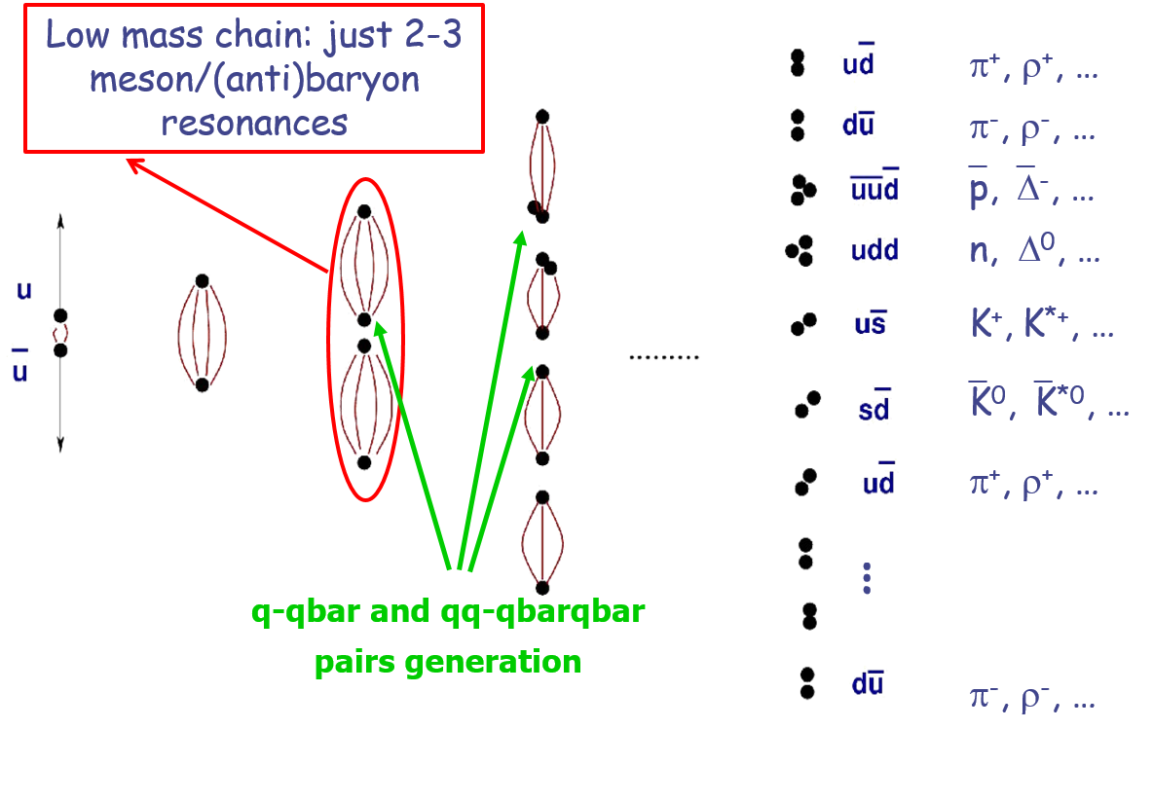
hN collisions at high energy*: “hadronization” of color strings
An example:
Leading two-chain diagram in DPM for p-p scattering. The color (red, blue, and green) and quark combination shown in the figure is just one of the allowed possibilities
*Fluka uses an in-house implementation of the Dual Parton Model + hadronization

Slide 40
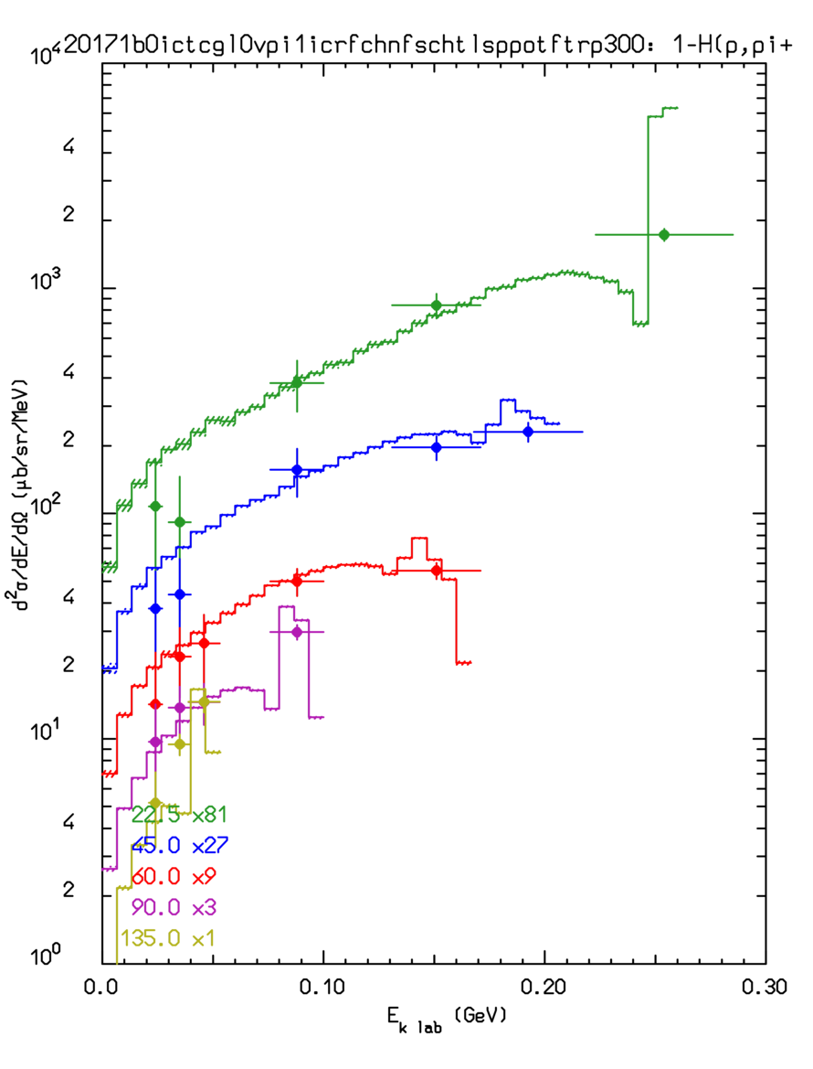
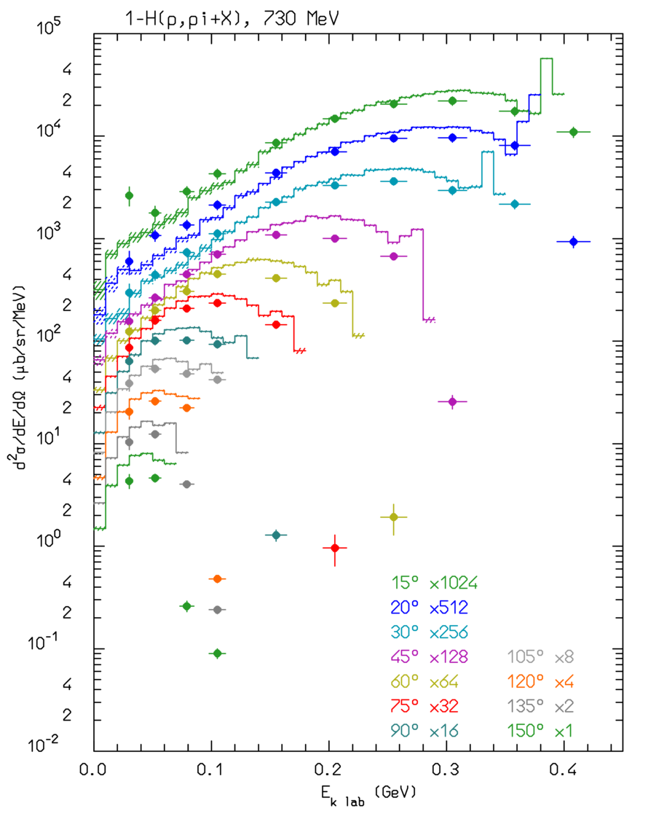
pH→π⁺X @ 585 MeV and 730 MeV:
?
?
π⁺ production from proton interactions on hydrogen at 585 MeV (left) and 730 MeV (right) at different angles.
Symbols: data, histograms: Fluka

Slide 41
FLUKA short description:
FLUKA is a general purpose tool for calculations of particle transport and interactions with matter
All Hadrons (p, n, π, K,pbar, nbar, (anti)hyperons…) [0-10000 TeV]
Nucleus-nucleus [0-10000 TeV/n]
Electromagnetic (γ, e^{+/-}) and μ and ν [1 keV – 10000 TeV]
Low energy neutrons (0-20 MeV, multigroup, ENDF… )
Transport in magnetic field
Combinatorial (boolean) and Voxel geometries
Double capability to run either fully analogue and/or biased calculations
On-line evolution of induced radioactivity and dose
Radiation damage predictions (NIEL, DPA)
User-friendly GUI interface thanks to the Flair interface
√s_{NN}~20 TeV
http://www.fluka.org ~13000 registered users worldwide

Slide 42
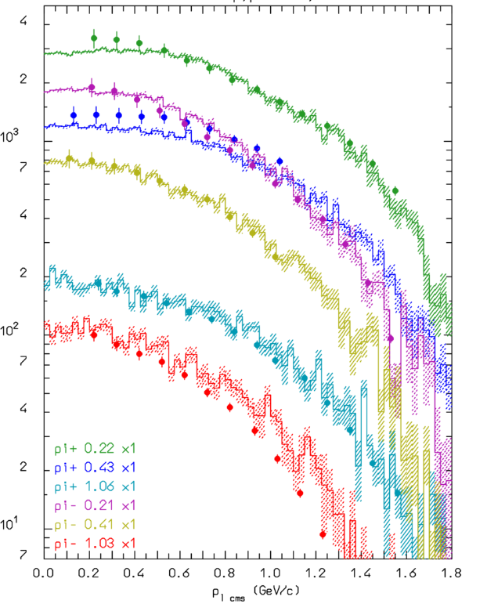
pH→πX @ 585 MeV and12.2 GeV/c
LEFT: π⁺ production from proton – proton interactions at 585 MeV at different angles.
RIGHT: π⁻ emission from proton-proton interactions at 12.2 GeV/c. at different angles
Symbols: data, histograms: Fluka
p_{T}²
E_{k}

Slide 43
Nonelastic hN interactions: (very) short summary
Up to a few GeV’s:
Dominance of the Δ and of the N∗, ρ… resonances
→ isobar model
→ all reactions proceed through an intermediate state containing at least one resonance
N₁ + N₂ → N”₁ + Δ(1232) → N₁’ + N₂’ + π
π + N → Δ(1600) → π’+ Δ(1232) → π’ + π“+ N’
N_{’1}+ N₂ → Δ₁(1232) + Δ₂(1232) → N₁’ + π₁ + N’₂ + π₂
FLUKA: ≈ 60 resonances, and ≈ 100 channels
At energies above a few GeV’s:
Interacting strings (quarks held together by gluons into the form of a string)
Interactions treated in the Reggeon-Pomeron framework (Dual Parton Model, DPM)
Each hadron splits into 2 colored partons
  → combination into 2 colourless chains
  → 2 back-to-back jets
each jet is then hadronized into physical hadrons
Fluka contains its own hadronization model

Slide 44
Preequilibrium emission:
For E > π prod. threshold → only (G)INC models. At lower energies INC becomes increasingly inapplicable → preequilibrium models == share the excitation energy among many nucleons/holes
FLUKA: semiclassical exciton model:
Statistical assumptions
Simple and fast
Suitable for MC
Statistical assumption:
any partition of the excitation energy E* among N, N = N_{h} +N_{p}, excitons has the same probability to occur
Step: nucleon-nucleon collision with N_{n+1}=N_{n}+2 (“never come back approximation”)
Chain end = equilibrium = N_{n} sufficiently high, or excitation energy below threshold
N₁ depends on the reaction type and cascade history

Slide 45
Thick target examples: neutrons
¹⁹⁷Au(p,xn) @ 68 MeV, stopping target
Data: JAERI-C-96-008, 217 (1996)
⁹Be(p,xn) @ 113 MeV, stopping target
Data: NSE110, 299 (1992)

Slide 46
Pion-Nucleus scattering:
Angular distribution for ⁵⁸Ni(π⁺,π⁰X) (charge exchange, left) and ⁵⁸Ni(π⁺,π^{+’}X) (inelastic scattering, right) at 160 MeV. Histos model, symbols exp. data

Slide 47
Example of fission/evaporation
1 A GeV ²⁰⁸Pb + p reactions Nucl. Phys. A 686 (2001) 481-524
Data
Fluka
Fluka after cascade
Fluka after preeq
Quasi-elastic
Spallation
Evaporation
Fission
Deep spallation
Fragmentation

Slide 48
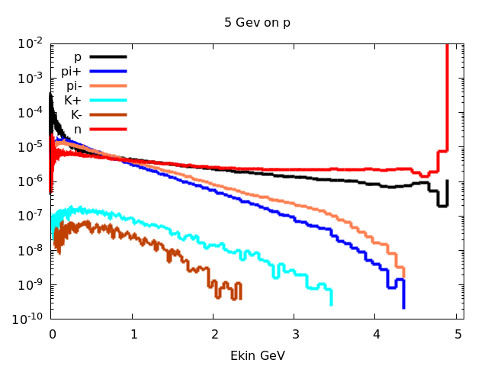
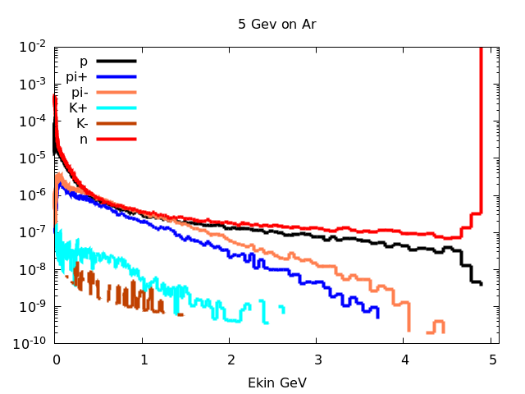
From n-p to n-Ar, 5GeV

Slide 49
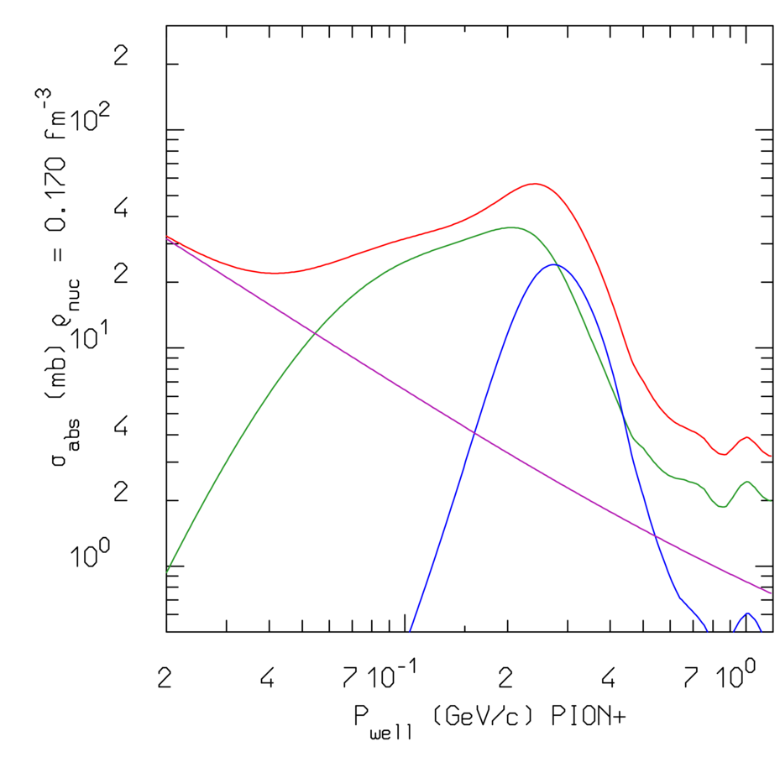
Pion absorption on nuclei:
2-body resonant
3-body
resonant
Total absorption cross section (red curve) for π⁺ on an isoscalar target at central nuclear density. The various contributions, both 2- and 3-body resonant (p-wave ↔ Δ) and 2-body s-wave are also shown
2-body
s-wave

Slide 50
From INC to (G)INC: ⁹⁰Zr(p,xp) @ 80.5 MeV
Plain INC (a la Bertini)
Plain INC plus preequilibrium
GINC calculation with no quantum effect, apart Pauli blocking
Full GINC calculation
d²σ/dEdΩ
Data: connected symbols
Model: “isolated” symbols

Slide 51
Fermi Break-up in FLUKA:
Statistical (evaporation) models are known to work poorly for light nuclei. An alternative, better performing, description of light nuclei de-excitation can be obtained with the Fermi break-up mechanism. The probability of splitting a nucleus A, Z, with excitation U into n fragments of given masses, m_{i}, spins, s_{i}, … is given by:
… however it implicitly assumes that the emission takes place in L=0.
Significant improvement can be obtained when the compound nucleus spin and parity, J^{π}, are known:
The minimum orbital momentum, L_{min}, required to match J^{π} is computed
S_{n} is restricted to the subset of spin combinations compatible with L_{min}
If L_{min} > 0, then E_{Coul} → E_{Coul} + B_{centrifugal}

