Slide 1
Current Understanding of Cavity/Coldmass MAWPs
PIP-II Cryogenic integration workshop
11th February 2021
Vincent Roger

Slide 2
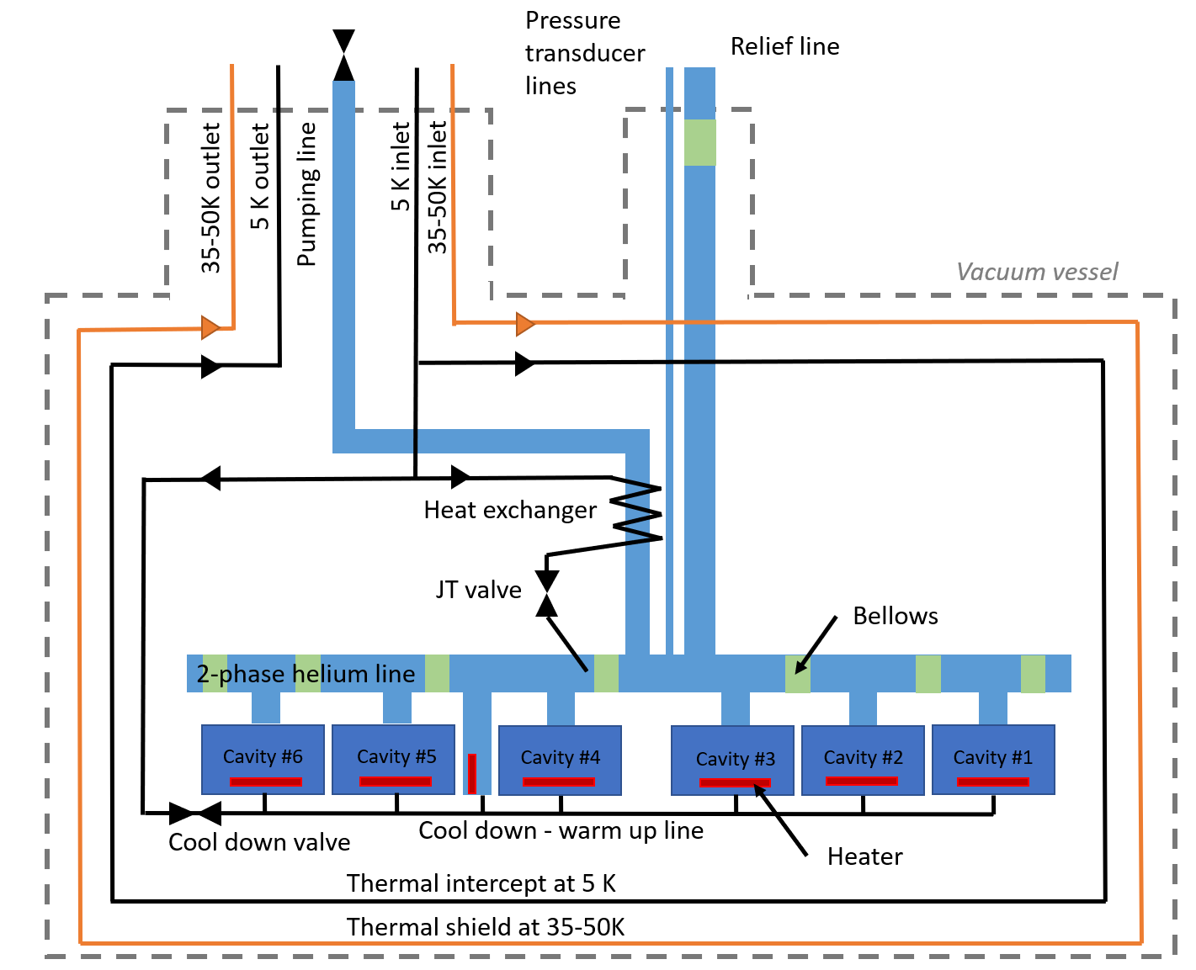
Description of the cryomodule & MAWP
Preliminary P&ID available in Teamcenter F10101087.

Slide 3
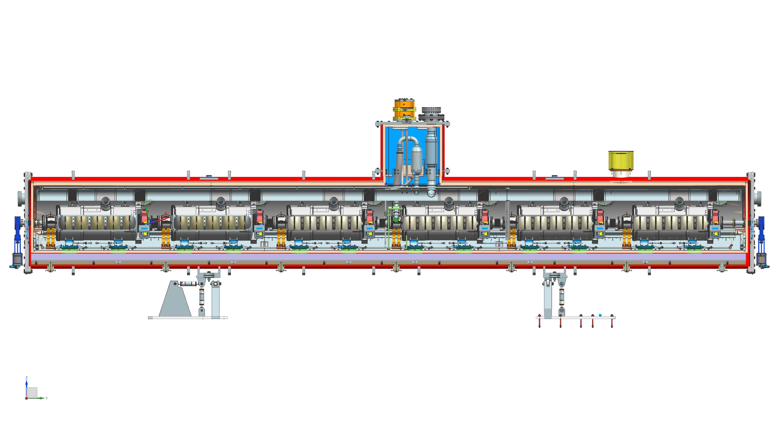
Description of the cryomodule & MAWP

Slide 4
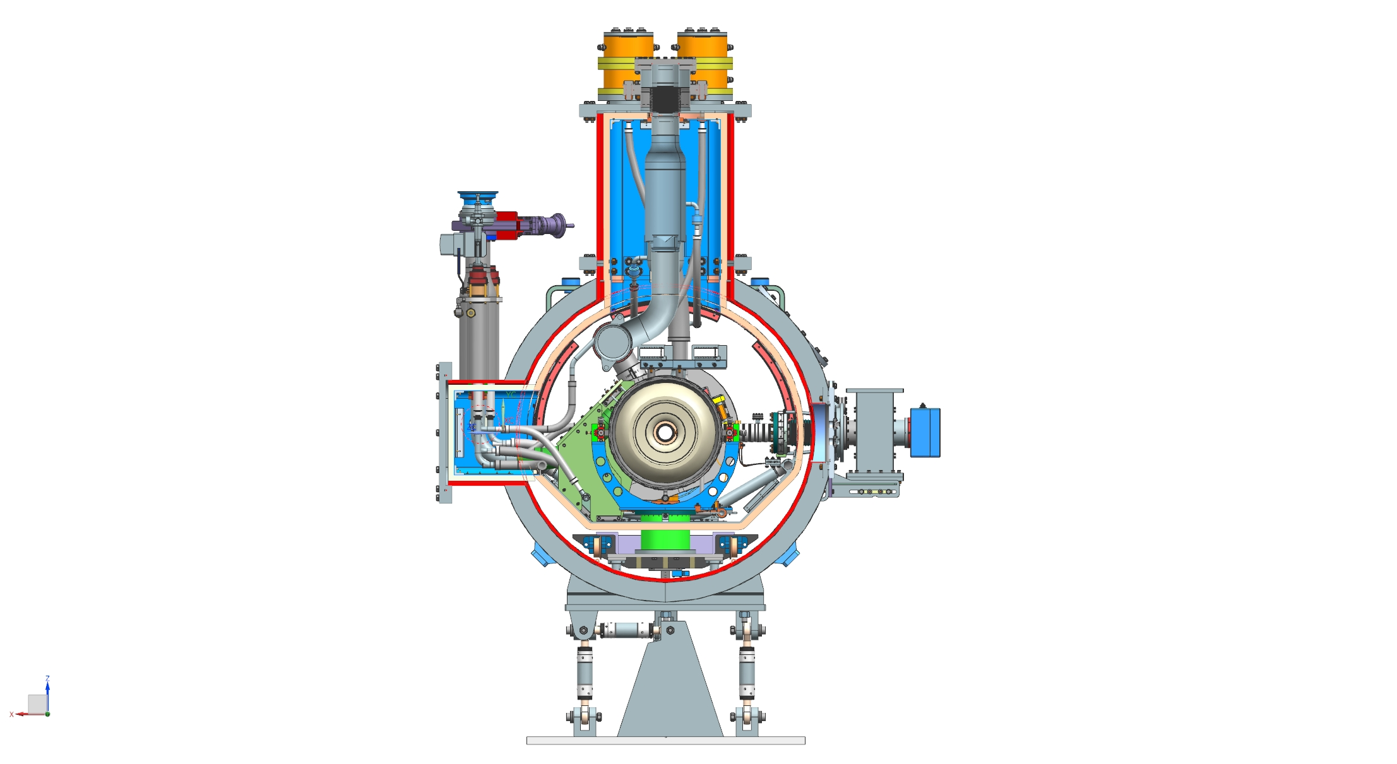
Description of the cryomodule & MAWP
Cryogenic side port
(bayonet and cryogenic valves)
Thermal shield + MLI
C-Clamp
Cavity support post
Coupler
G11 support post
Strong-back
Vacuum vessel
Interface with the cryomodule transport frame
Cryomodule stands

Slide 5
Description of the cryomodule & MAWP
The MAWP of PIP-II cryomodules have been defined based on the experience with LCLS II cryomodules as the following:
Pipe A - 2 K supply
MAWP: 20 bar
Pipe G - 2phase He pipe & Relief line
MAWP: 2.05 bar warm, 4.1 bar cold
Pipe B - Pumping line
MAWP: 2.05 bar warm, 4.1 bar cold
Pipe E & F - 35-50 K line
MAWP: 20 bar
Pipe H - Cool down /
warm up line
MAWP: 20 bar
Pipe C & D - 5 K line
MAWP: 20 bar
Cavity
MAWP: 2.05 bar warm, 4.1 bar cold

Slide 6
Description of the cryomodule & MAWP
Cavities have been designed according to FESHM 5031.6 and the Piping systems according to FESHM 5031.3. A new revision of these chapters is being written to allow the use of these dual MAWP by making reference to the code and to the literature. Discussion are still on going to define these rules.
To summarize, these revisions will be based on the fact that the Niobium and Stainless steel 316L properties are better at cold temperature than at room temperature. Specific welding rods will be used for the weldment.
For the cavities,
The pressure test at room temperature at 2.38 barg (2.05x1.15 barg) will validate all the welds. No XRAYs will be needed.
For the piping,
A pressure test at room temperature at 4.55 barg (4.1x1.1) of the sub-assemblies will be needed when possible. The closure welds will be qualified with a pressure test at 2.27 barg (2.05x1.1 barg), XRAYs won’t be needed.

Slide 7
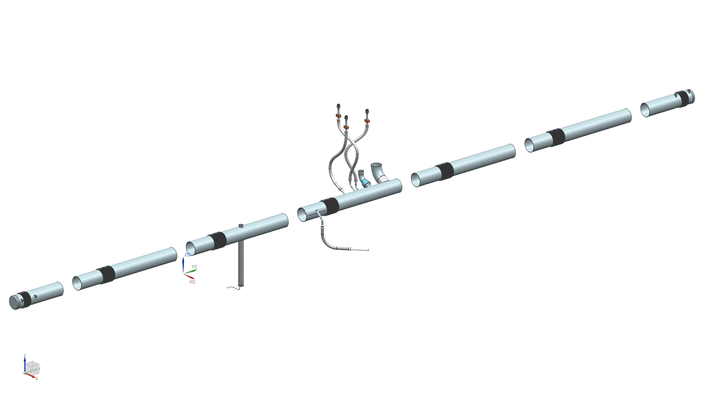
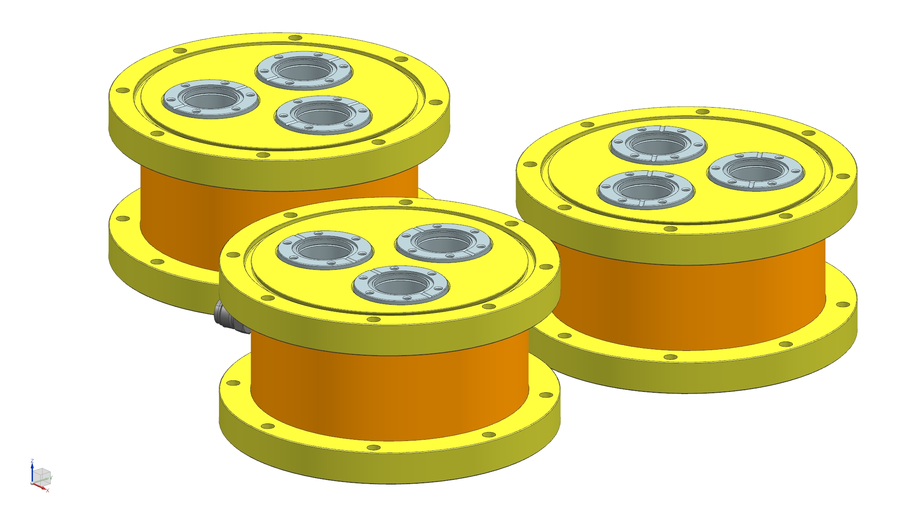
HB650 cryomodule piping
Pressure test at 4.55 barg of the following assemblies:

Slide 8
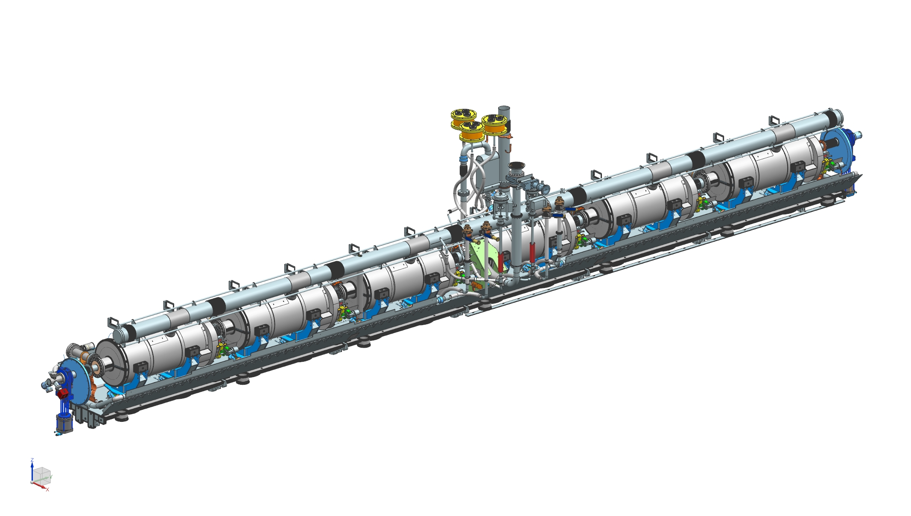
HB650 cryomodule piping
These 36 closure welds will be validated with a room temperature pressure test at 2.27 barg.
No Xrays needed.
Two phase pipe closure welds
Pumping line closure welds
Cool down line closure welds
Relief line closure welds
JT valve closure welds

Slide 9
Conclusion
It seems that we have at Fermilab a path forward in order to qualify the cavities and piping systems with a dual design pressure. Discussion are still on going with the Mechanical Safety Committee.
Discussions are needed with Partners in order to find a way to qualify the Piping systems with a dual MAWP according to PED.

