Slide 1
PIP-II CDS 2K Circuit Relief Design
Bill Soyars, Ram Dhuley/ Fermilab
PIP-II Cryogenic Integrated Workshop
11 February 2021

Slide 2
Outline
Thermodynamic and hydraulic considerations
Schematic of 2K relief system
Design Assumptions, Requirements and Results
Summary of analysis from December 2020 workshop by Ashish Shukla (RRCAT).
CDS 2K relief valve inlet pressure drop check.
Geometry for Cryomodule 2K Rupture Disk vent to atmosphere
Operational relief sizing for Cryomodule
Future work
Mechanical design considerations
Primary relief line
Operational relief line
Vent header supports
Future work

Slide 3
Warm helium supply
Cryomodule relief vent header
Low pressure suction
HTTS Return
HTTS supply
LTTS Return
4.5 K Supply
2 K Return line
CD Return line
Distribution valve box
Bayonet can
Phase
separator
Pressure relief valve
Pressure relief rupture disk
Process control valve
Cryomodule relief line
Turnaround can
Heat load
U-tubes
Heat exchanger
Cryogenic distribution system
Cryomodule
Cavity string

Slide 4
2K relieving assumptions, requirements, and results
Heat flux from air ingress during Loss of Vacuum
CDS: Rupture of ISO 80 pumping port. 79.8 mm dia.
CRYOMODULE
for LOBV: Rupture of coupler window. 60.2 mm dia . Assumes infinite supply of air behind this
For LOIV: Rupture of ISO 100 pumping port. 97.6 mm dia
Relief orifice sizing calculations performed per Code. Used Code EN ISO 4126-1
For CRYOMODULE: analyze last/furthest HB650, worst-case for size and worst-case distance for venting flow
SYSTEM | MAWP[bara] | Temp. relieving [K] | Failure scenario | 2K surf area [m²] | Portion of heat to 2K surface [%] | Heat load [kW] | Required relief rate [kg/s] | Orifice size for relief [mm] | Required relief capacity [std m³/m of air] | Relief type and location
CDS | 4.1 | 6.6 | LOIV | 227 | 45 | 300 | 6.90 each | 60.6 each | 90.2 each | Reclosable, at DB & TC
CRYOMOD | 2.05 | 5.4 | LOBV | 10.8 | 100 | 316 | 18.7 | 140 | 214 | Rupture disk, every CM
CRYOMOD | 2.05 | 5.4 | LOIV | 17.8 | 31 | 256 | 15.1 | - | (Not used for sizing) | -
Pressure Safety references: ANALYSIS & RESULTS ED0008556, CDS FRS ED0008022, CDS TRS ED0008552, CDS ISD ED0007572.
Also, acknowledgement to WUST for very good preliminary design work and report.

Slide 5
CDS 2K Return Relief Valves: Pressure drop for inlet to re-closeable relief valve during event
Circuit |  |  |  | 2 safety valves
 | Relief press | Relief temp. | Max L of CDS | Required flow, each | Assumed Capacity | Excess capacity | Press. drop | % of set pressure
 | [bara] | [K] | [m] | [kg/s] | [kg/s] | [%] | [bara] | -
CDS 2 K Return | 4.1 | 6.6 | 265 | 6.90 | 9.32 | 35 | 0.123 | 3.0%
Goal: Meet provisions in ASME BPVC in non-mandatory Appendix M to minimize “chattering” of reclosable relief valve
Criteria: Pressure drop into valve during relieving is ≤3% of set pressure at rated capacity
Install relief with actual capacity ≤135% of the required capacity

Slide 6
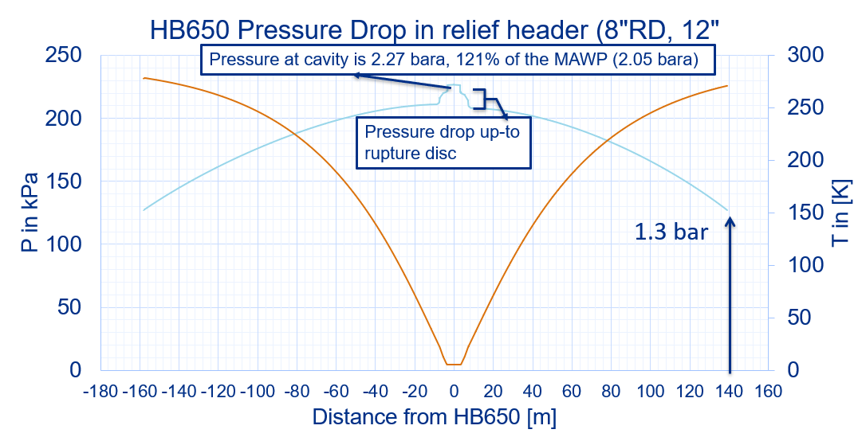
CRYOMODULE relief venting from tunnel to surface
DN 300
Upstream 150.2 m
Downstream 131.3 m
DN 200
HB650 pressure drop in relief header (DN200 RD, DN300 vent)

Slide 7
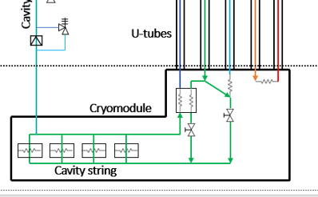
CRYOMODULE Operational relief (check valve) sizing
Assumed 2K operational relief MAWP: 1.65 bara
Flow from the cooldown and JT valves
each DN10 with Cv=3.25
Worst case when fully open and inlet at CDS relieving P & T
No flow through CDS 2K return valve
Flow from warm cryoplant compressor
Using valve sizing formula, calculate C_{V} required
Description | Required vent rate [g/s] | Required Orifice dia [mm] | Required Cv for operational relief
CDS LIV event with open CD and JT valves | 1635 | 62.6 | 147
Maximum flow from Cryoplant warm compressor system | 900 | Not used | Not used

Slide 8
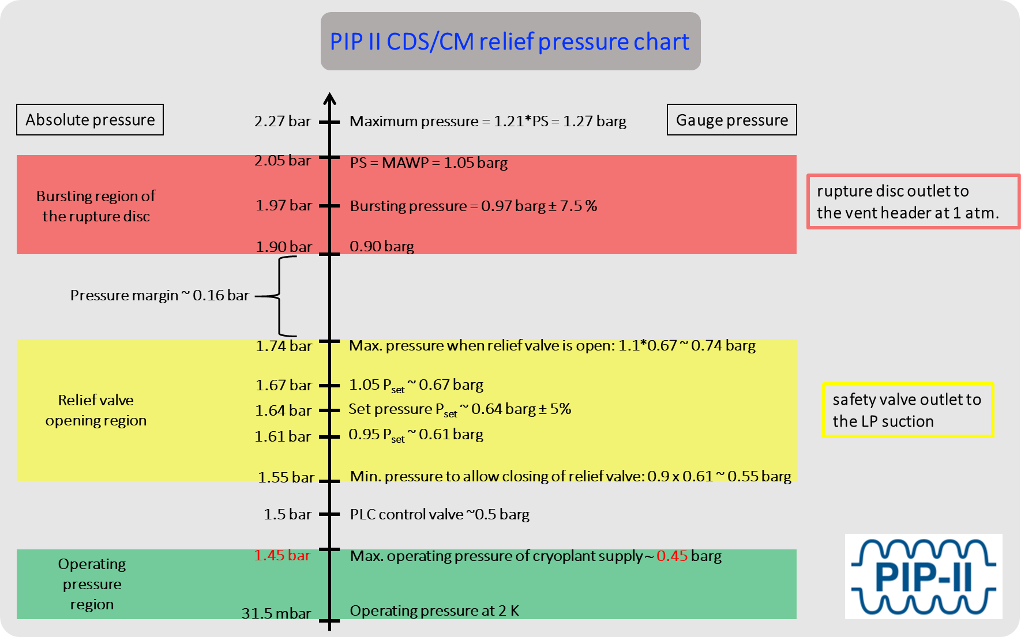

Slide 9
Some questions and next steps
Any CRYOMODULE 2K Volume MAWP changes discussed today?
For relief return to suction, what will be backpressure?
Operational relief (check valve) spring choices?
Investigate reclosable, sub-atmospheric valves for 4 bar relief with capacity range meeting minimum and maximum requirements

Slide 10
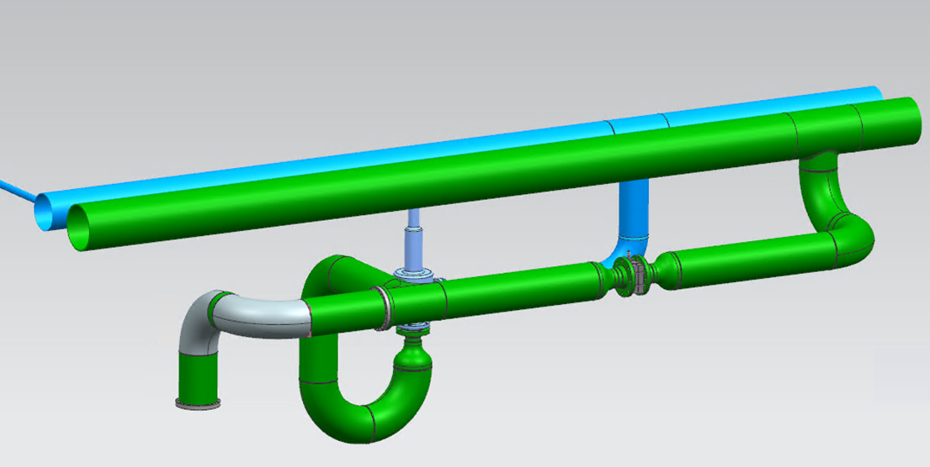
2 K CM relief system design – status at CDS FDR (Aug 2020)
Design based on “dual” MAWP requirement
2 K relief vent header
LP suction header
4 bar relief
(rupture disc)
2 bar relief
(reclosable valve)
Interface to CM 2 K bath

Slide 11
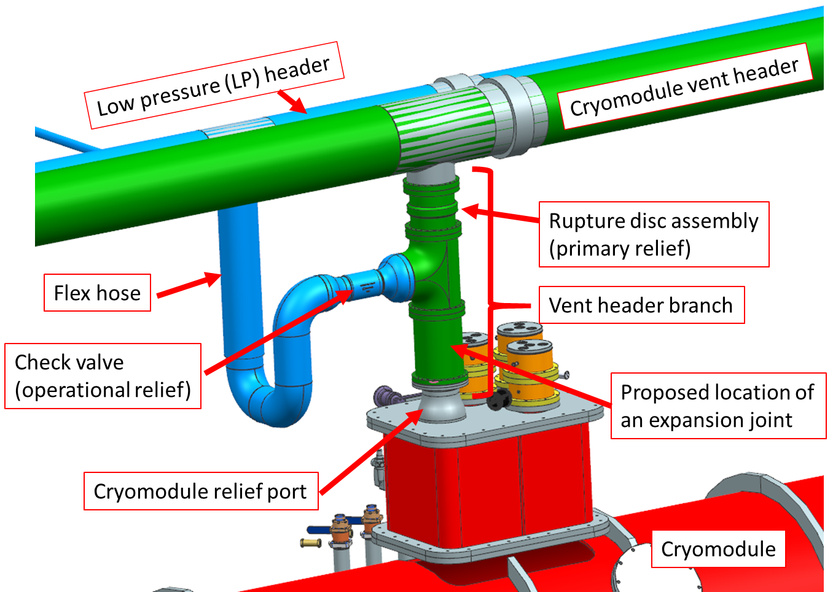
2 K CM relief system design – current status
Design based on “single” 2.05 bar MAWP

Slide 12
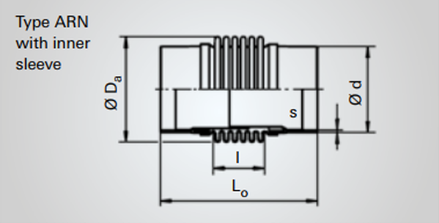
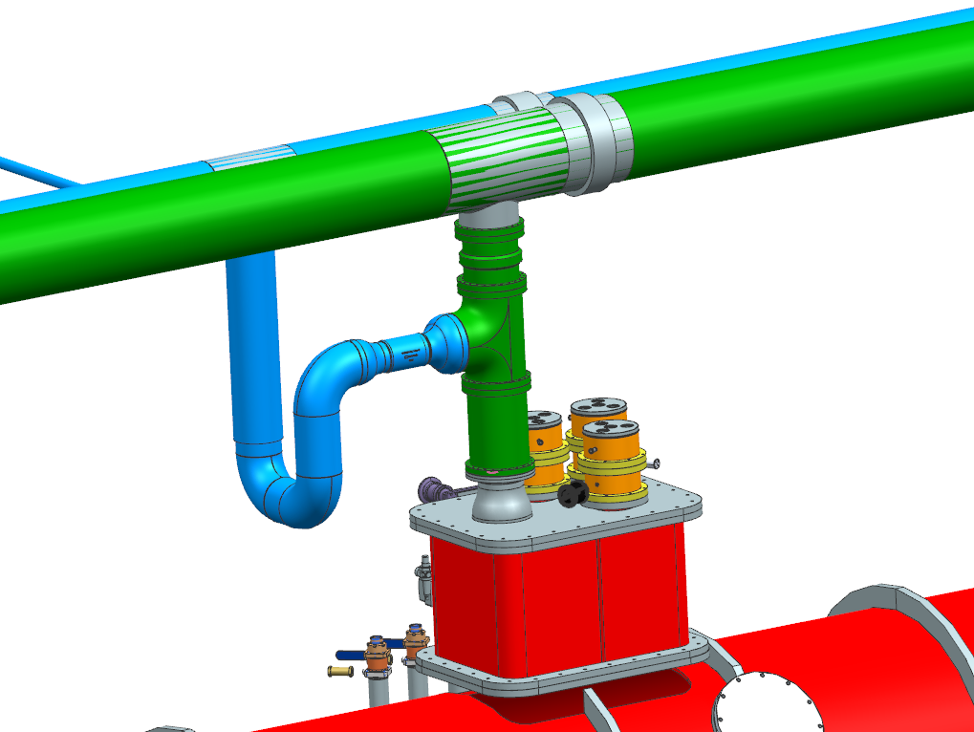
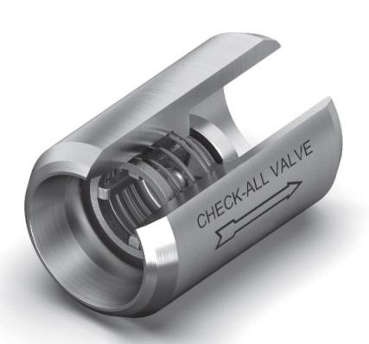
Design of Operational Relief Line
1: Expansion joint on the vent header
Witzenmann axial bellows
Weldable DN200,
Axial movement = 70 mm (expected movement <36 mm)
1
2: Flex hose on the branch
2
Hosemaster Masterflex
Weldable 6”,
Total length = 33” provides lateral movement of 1.5” (sufficient to accommodate thermal
shrinkage in the header and the branch)
3
3: Reclosable valve
CheckAll check valve
4” butt weld
Cv = 144

Slide 13
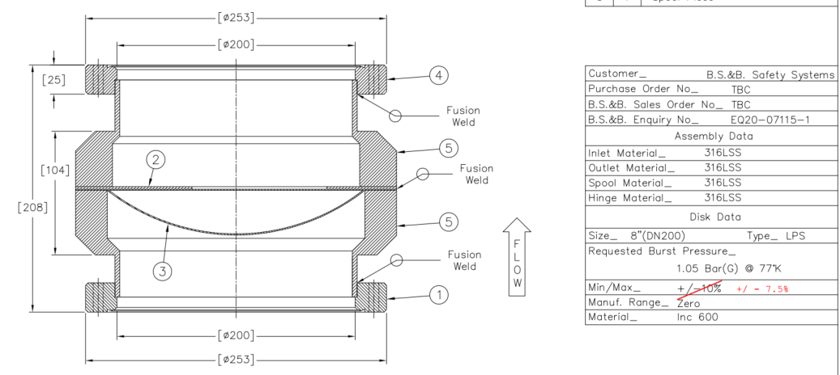
Design of Primary Relief Line
1: Expansion joint on the vent header
Witzenmann axial bellows
Weldable DN300,
Axial movement = 70 mm (expected movement <36 mm)
1
2
2: Rupture disc
BS&B Safety Systems, 8” rupture disc assembly with CF flanges,
burst pressure 1.05 barg ± 7.5%
3

Slide 14
Design of Primary Relief Line
3: Expansion joint on relief vent branch
This can end up being a non-standard item, so we are formulating specifications with help from an expansion joint vendor
1
2
> 4 mm axial flexibility is required to compensate thermal shrinkage after a relief event
3
Lateral flexibility if required to accommodate alignment mismatch between vent header branch and cryomodule relief port
Notes:
Assumes that CDS warm piping will be installed before cryomodules. Cryomodules may not be aligned to the CDS…

Slide 15
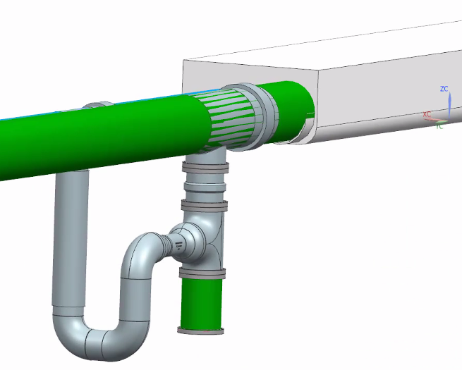
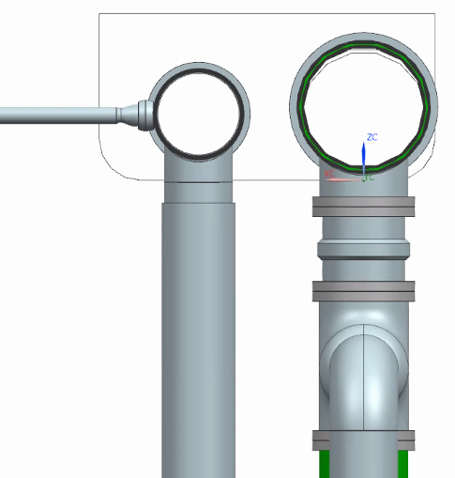
Vent headers and their ceiling envelope
Ceiling envelope for the headers
7.5 mm
DN300 pipe remains within the envelope
DN300 bellows gets out on one edge by 7.5 mm

Slide 16
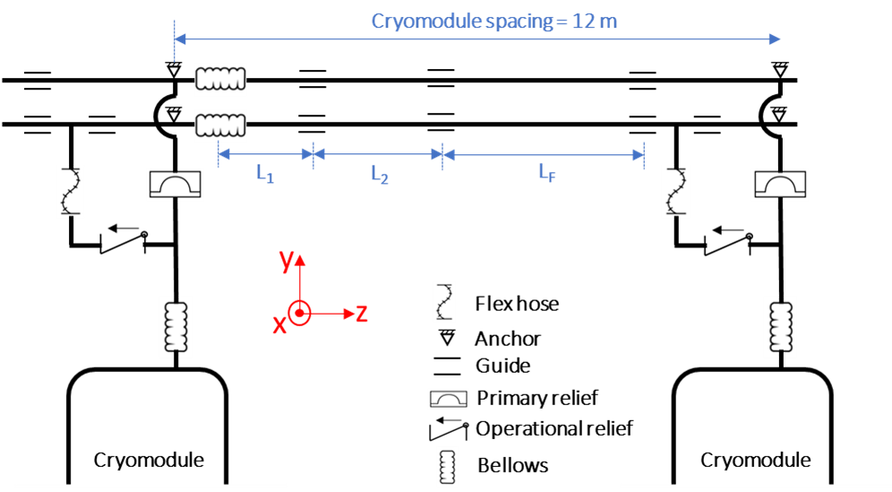
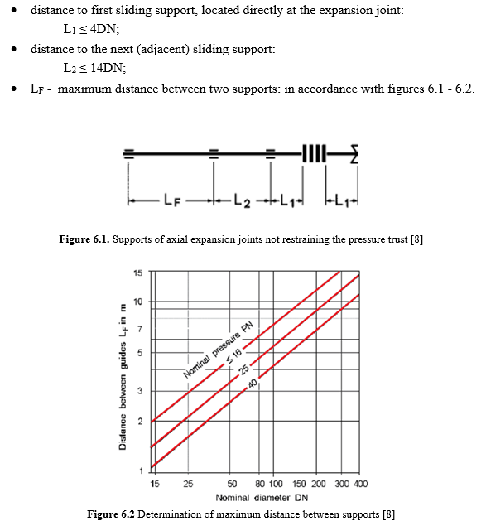
Preliminary analysis of ceiling supports for the vent headers
EN 14917:2009+A1:2012 Metal bellows expansion joints for pressure applications
Pipe | Size | L₁ [m] | L₂ [m] | L_{F} [m]
Primary vent header | DN300 | ≤ 1.2 | ≤ 4.2 | ≤ 15
Operational vent header | DN250 | ≤ 1 | ≤ 3.5 | ≤ 13

Slide 17
Future work
Revise design to incorporate dual MAWP
What can be a reasonable estimate for lateral alignment mismatch between
vent header branch and cryomodule relief port?
This needs to go in the expansion joint specification
Physical design of vent header ceiling hangers – ideas?
Comments/feedback are welcome

