Slide 1
RF Coupler cooling air flow requirements.
S. Kazakov
PIP-II Cryogenic Integrated Workshop
Feb 11, 2021

Slide 2
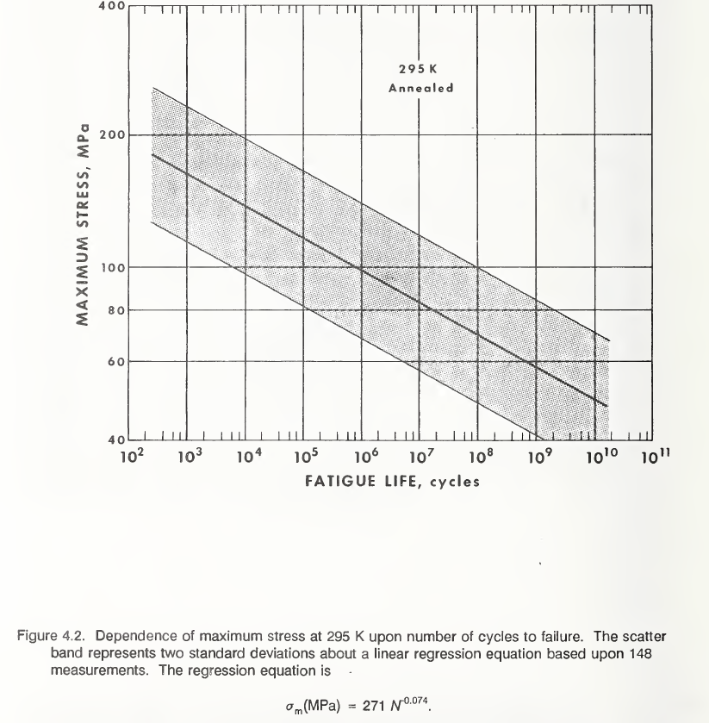
Why we use air in main RF couplers?
Two purposes:
To warm and keep antenna and ceramic window above freezing (and/or condensing) temperature without RF power. Low temperature can cause condensation and ice forming.
To cool antenna and ceramic window during operation and keep ceramic temperature at acceptable level. High temperature of ceramic causes of thermal stresses at ceramic-metal brazed joints. Stresses produces a fatigue and destroys a window after some number of On/Off cycles. We think coupler should withstand ~1E+5 cycles (~30 years x 10 trips per day). Stresses should not exceed 80 MPa. It degerms an air rate flow.

Slide 3
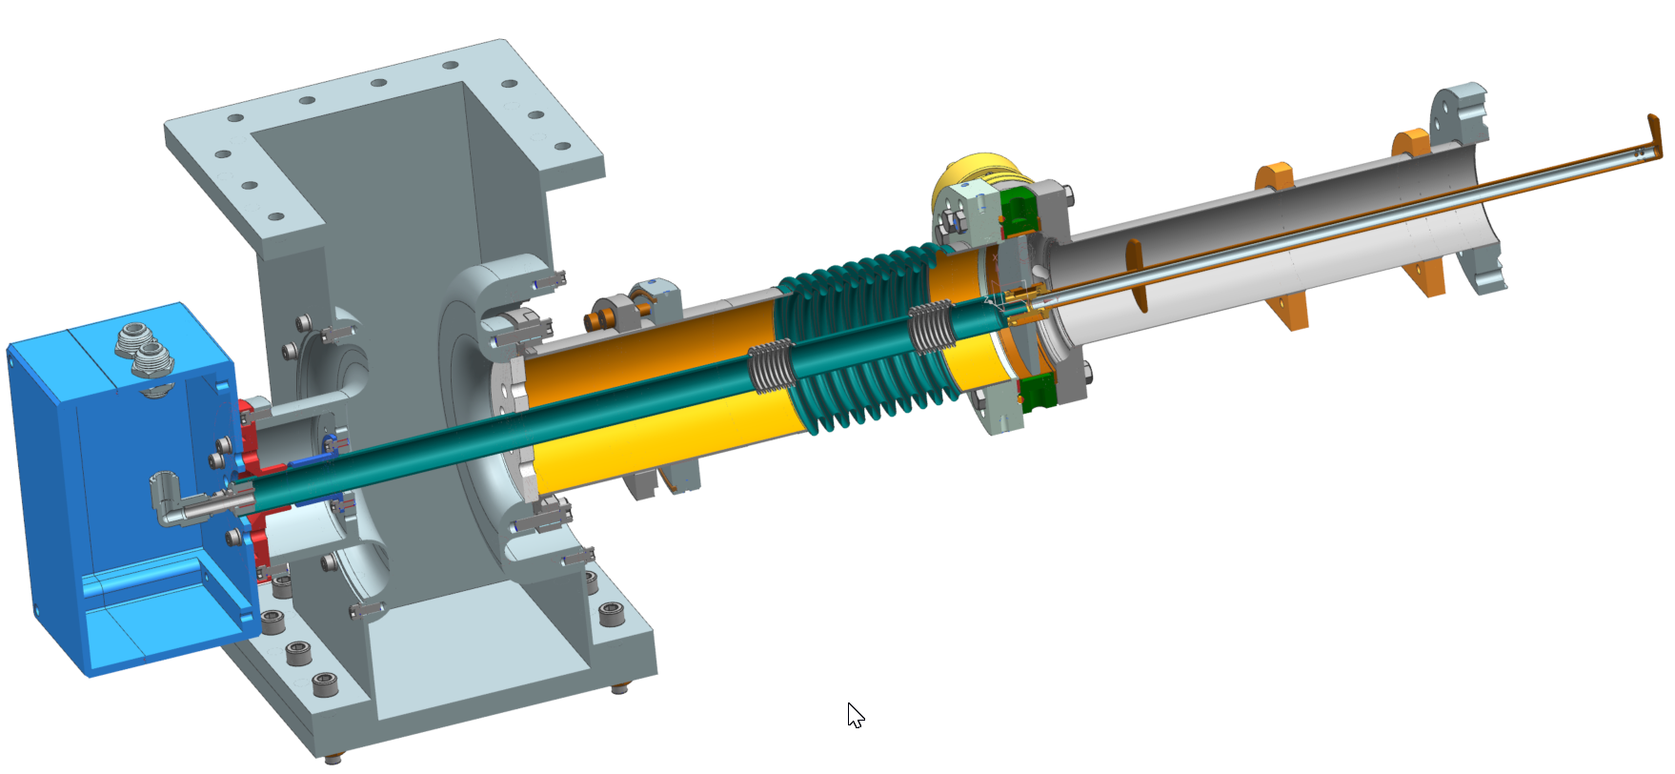
We use two types of coupler, 325 MHz and 650 MHz, for 4 types SC cavities: SSR1, SSR2, LB650, HB650.
Couplers have very similar air-cooling configurations:
325 MHz coupler, air flow scheme:
650 MHz coupler, air flow scheme:

Slide 4
All cavities operate at different level of RF power, coupler requires different air flow rate for operation.
Max power level of cavity operation: SSR1 ~ 5 kW, SSR2 ~ 15 kW, LB650 ~ 30 kW, HB650 ~ 50 kW
We are proposing operating air flows rates with RF power:
SSR1 – 1g/s ( 1.8 SCFM), SSR2 – 2g/s ( 3.5 SCFM)
LB650 – 3g/s (5.3 SCFM), HB650 – 4g/s (7.1 SCFM)
It is good to have safety margin and have possibility to increase air flow rate by ~25% at least at first prototype cryomodules.
Pressure drop.
New 325MHz and 650 MHz couplers have similar air configuration. Pressure drop was measured recently.
Pressure drops for maximum
flows (with 25% margin) :
SSR1 ~0.3 bar SSR2 ~ 0. 4 bar
LB650 ~ 0.8 bar HB650 ~ 1.5 bar

Slide 5
We recommend to have about 0.5g/s per couplers (~ 1 SCFM) to keep antenna above freezing temperature.
Total air consumption (without RFQ and HWR):
Total number of cavities (SSR1…. HB650): 111
SSR1 – 16, SSR2 – 35, LB – 36, HB – 24.
Air flow rate without RF power (keeping antenna warm): ~ 56 g/s ( ~ 98 SCFM)
Air flow rate with RF power: 16 x 1.g/s + 35 x 2g/s + 36 x 3g/s + 24 x 4g/s = 290 g/s (512 SCFM)
Air flow rate with RF power with margin: 290 g/s*1.25 = 363g/s (640 SCFM)
“Power” to push air trough couplers ( P x V/s).
1bar x 1g/s corresponds to ~83.3 W
Power, P = 83.3 x (16 x 1g/s X 0.3 bar + 35 x 2g/s x 0.4bar + 36 x 3g/s x 0.8bar + 24 x 4g/s x 1.5) ~ 22 kW
“Efficiency” of coupler ~ 99.5% (0.5% - losses)
Total RF power ~ 2.3 MW, CW. Total power of loss in couplers ~ 11.5 kW (tunnel heating by couplers).

