Slide 1
Suppressing the Electron Cloud Using a Solenoid
Sarah Pfluger
Fermilab Summer 2011

Slide 2
Electron Cloud Issue
Residual gas ionization, beam loss on pipe
Electrons in the pipe are affected by the beam, pulsate in and out with bunches
Crash into beam pipe, may release more electrons than incident number
Electrons buildup into cloud, potentially interfere with beam
Predict that the higher intensity of Project X will lead to detrimental interactions

Slide 3
Solenoid as a Solution
The magnetic field inside of the solenoid keeps the electrons near the beam pipe and away from the beam
Electrons bend back into the surface with less energy, reduce SEY
I
B
e⁻
e⁻
p⁺
p⁺
e⁻
e⁻
e⁻
e⁻

Slide 4
Progress and Goals
I have created 2 prototypes of the solenoid in the lab and taken some magnetic field measurements
#1: 92 turns, 30.4 cm long
Solenoid start at 10 cm, port 15-20 cm, solenoid end at 41.5cm
#2: 92 turns, 32 cm long
Solenoid start at 1 cm, port 14.5-19 cm, solenoid end at 33 cm
A small group from the larger electron cloud group will install a solenoid into the beam line and collect data
Measure current, energy
Look for e⁻ cloud

Slide 5
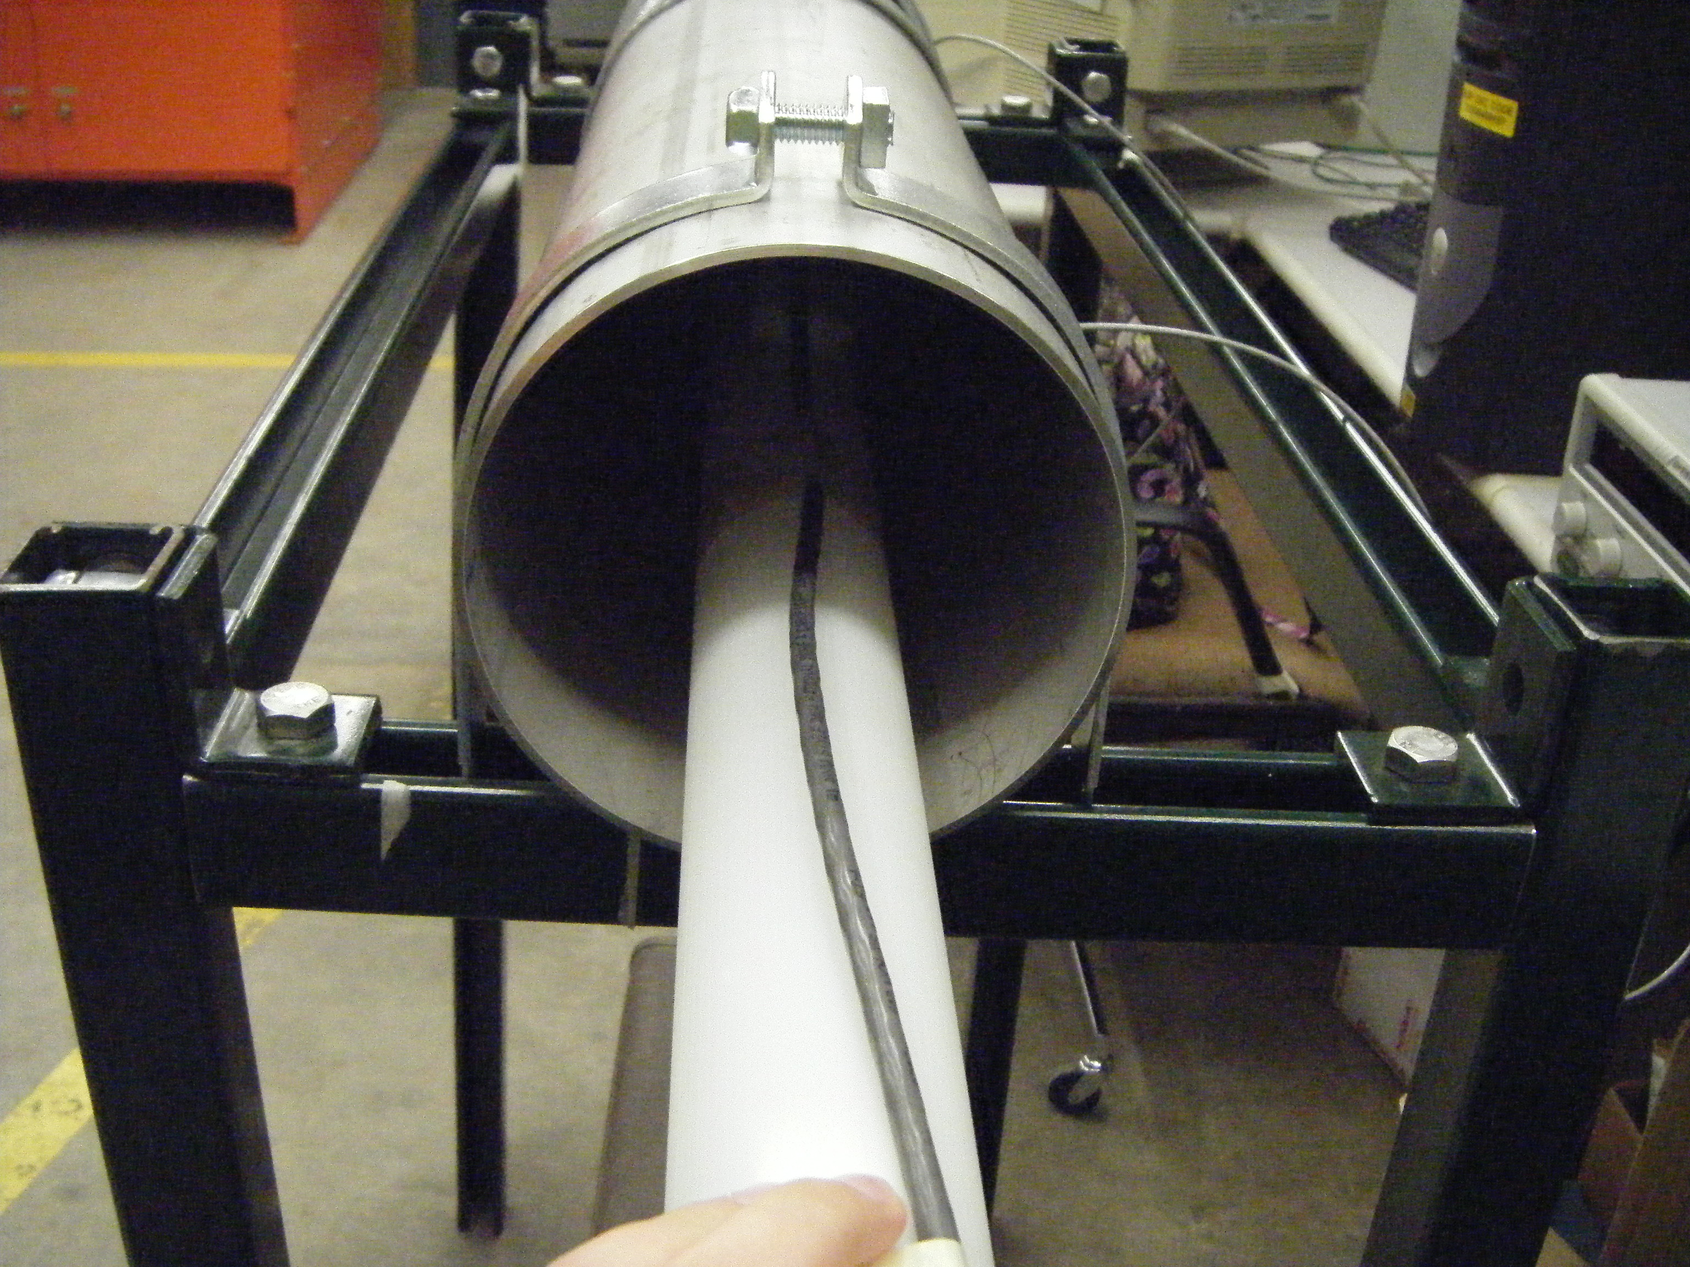
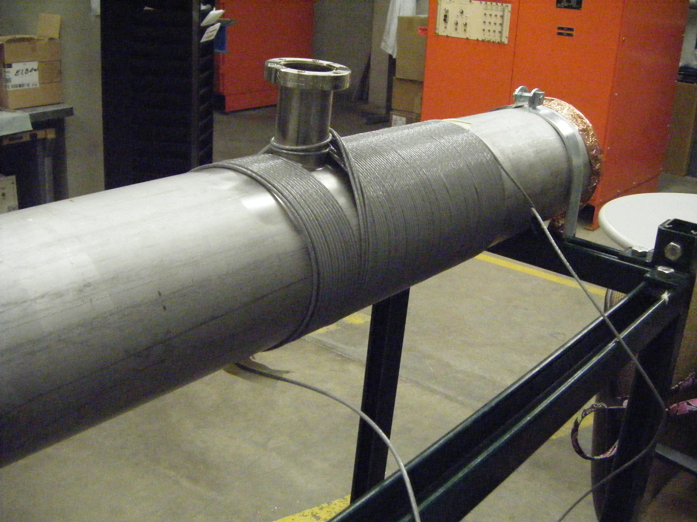

Slide 6
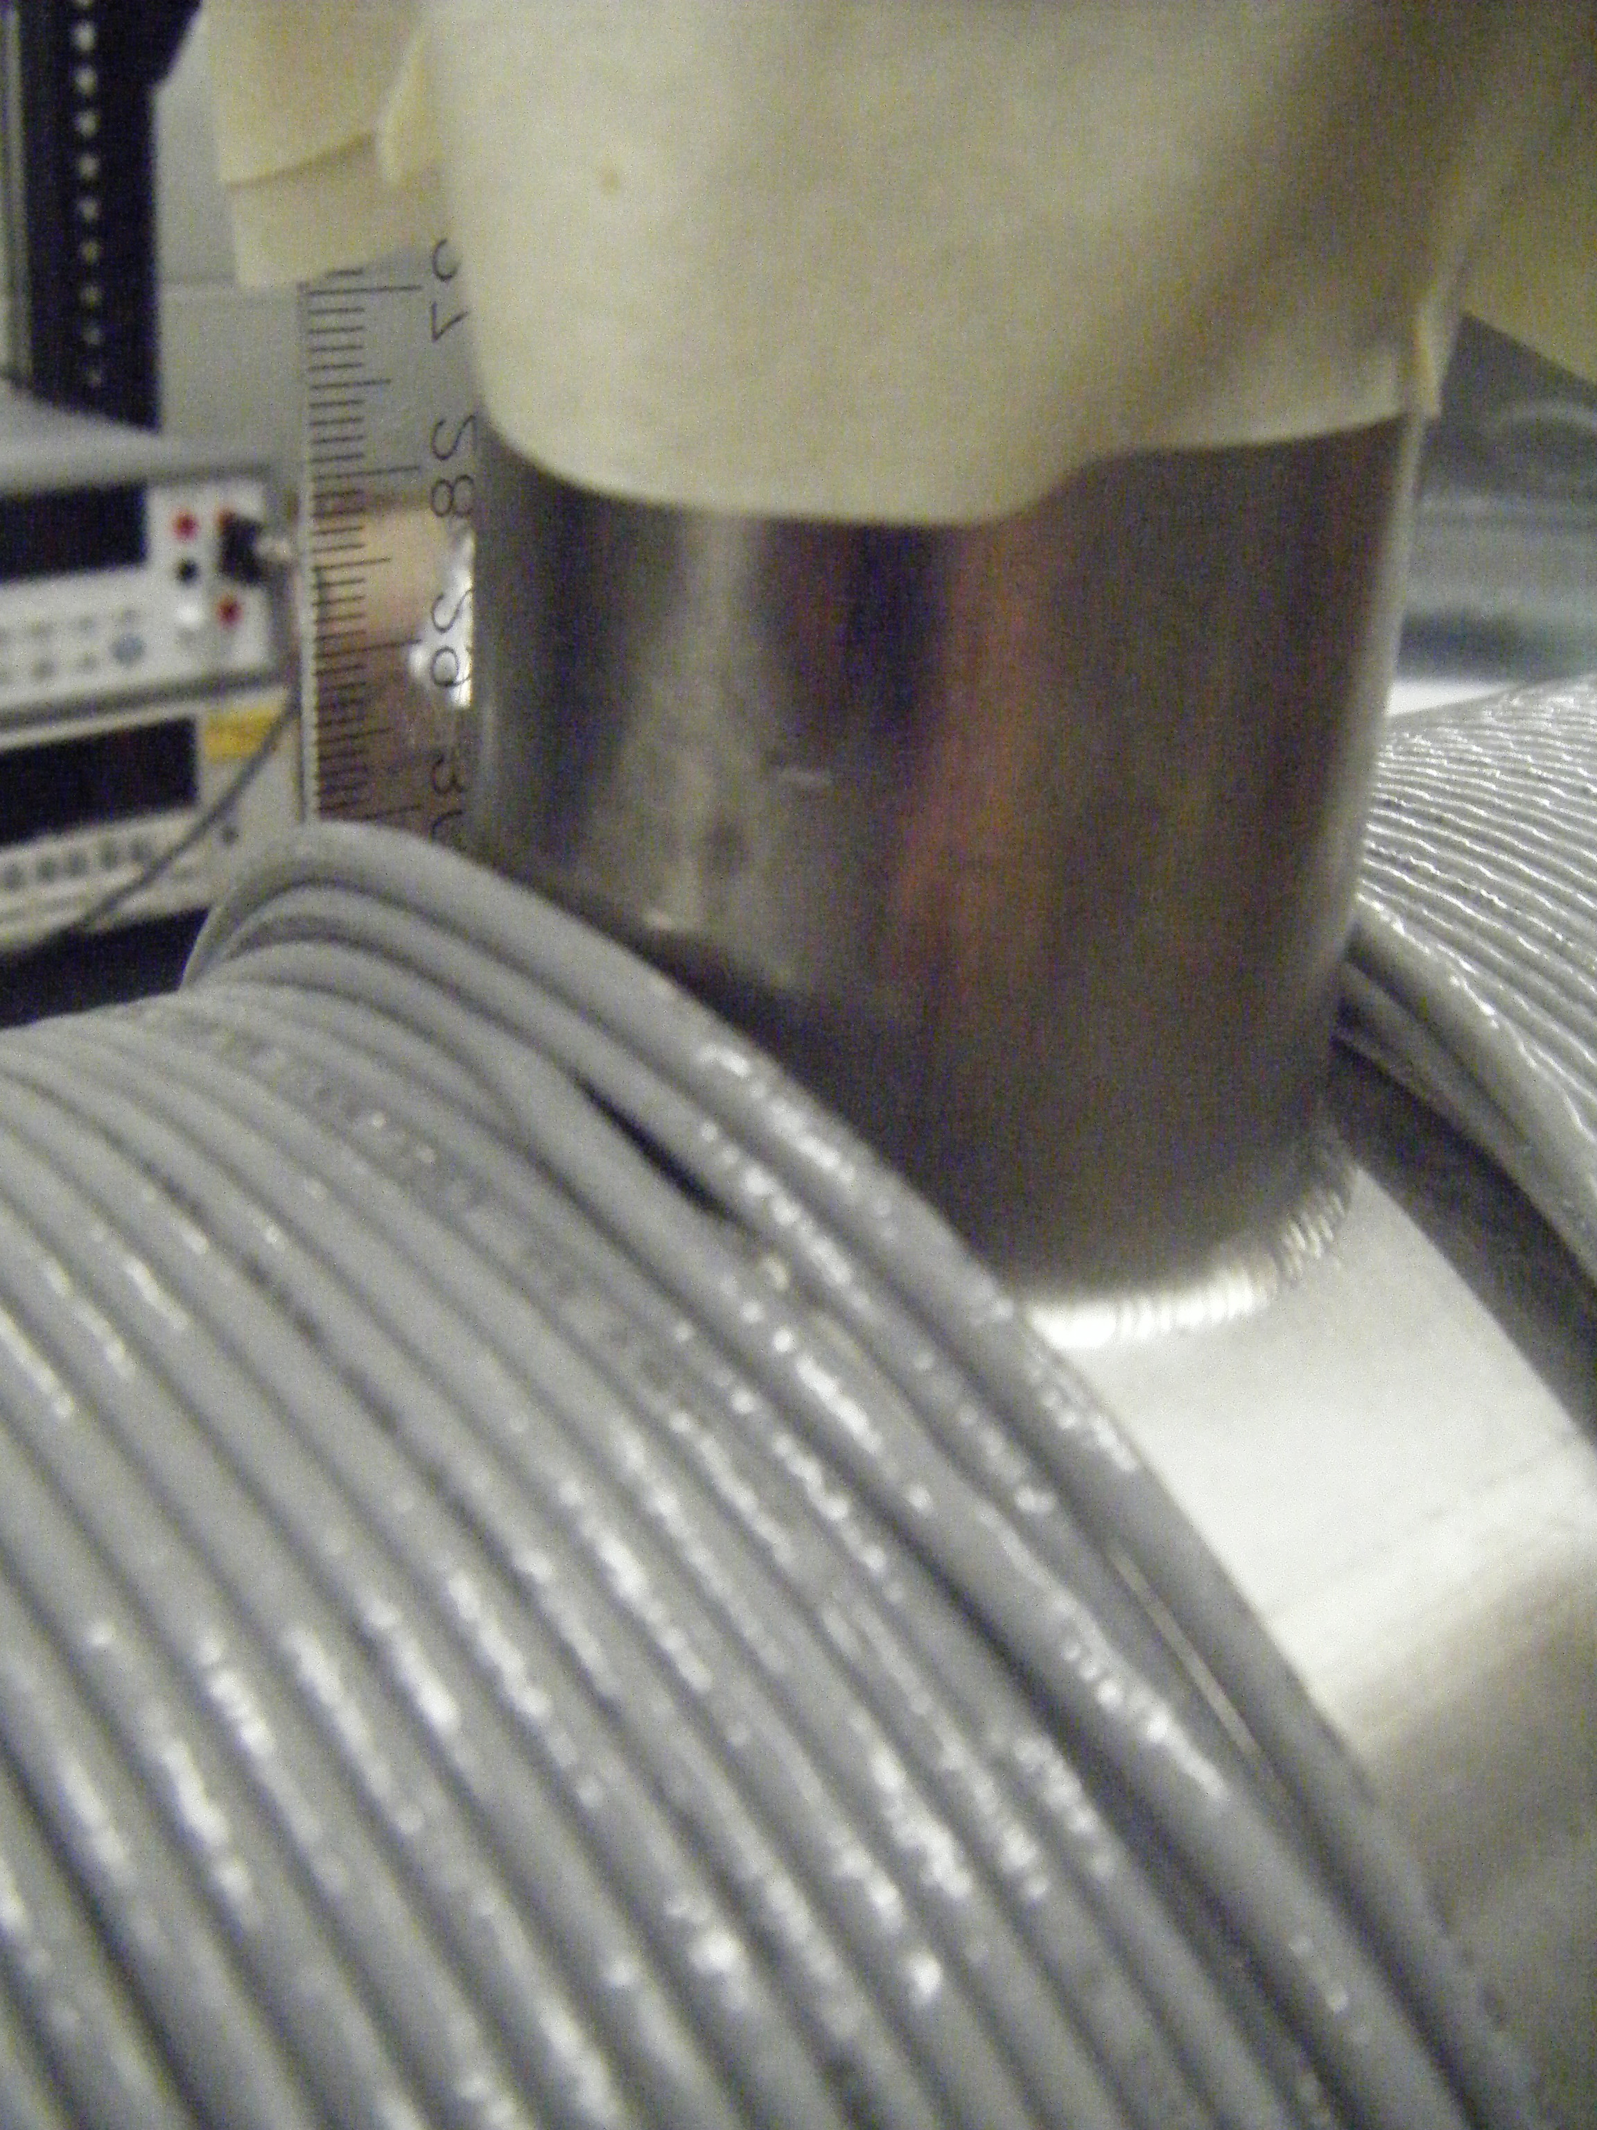
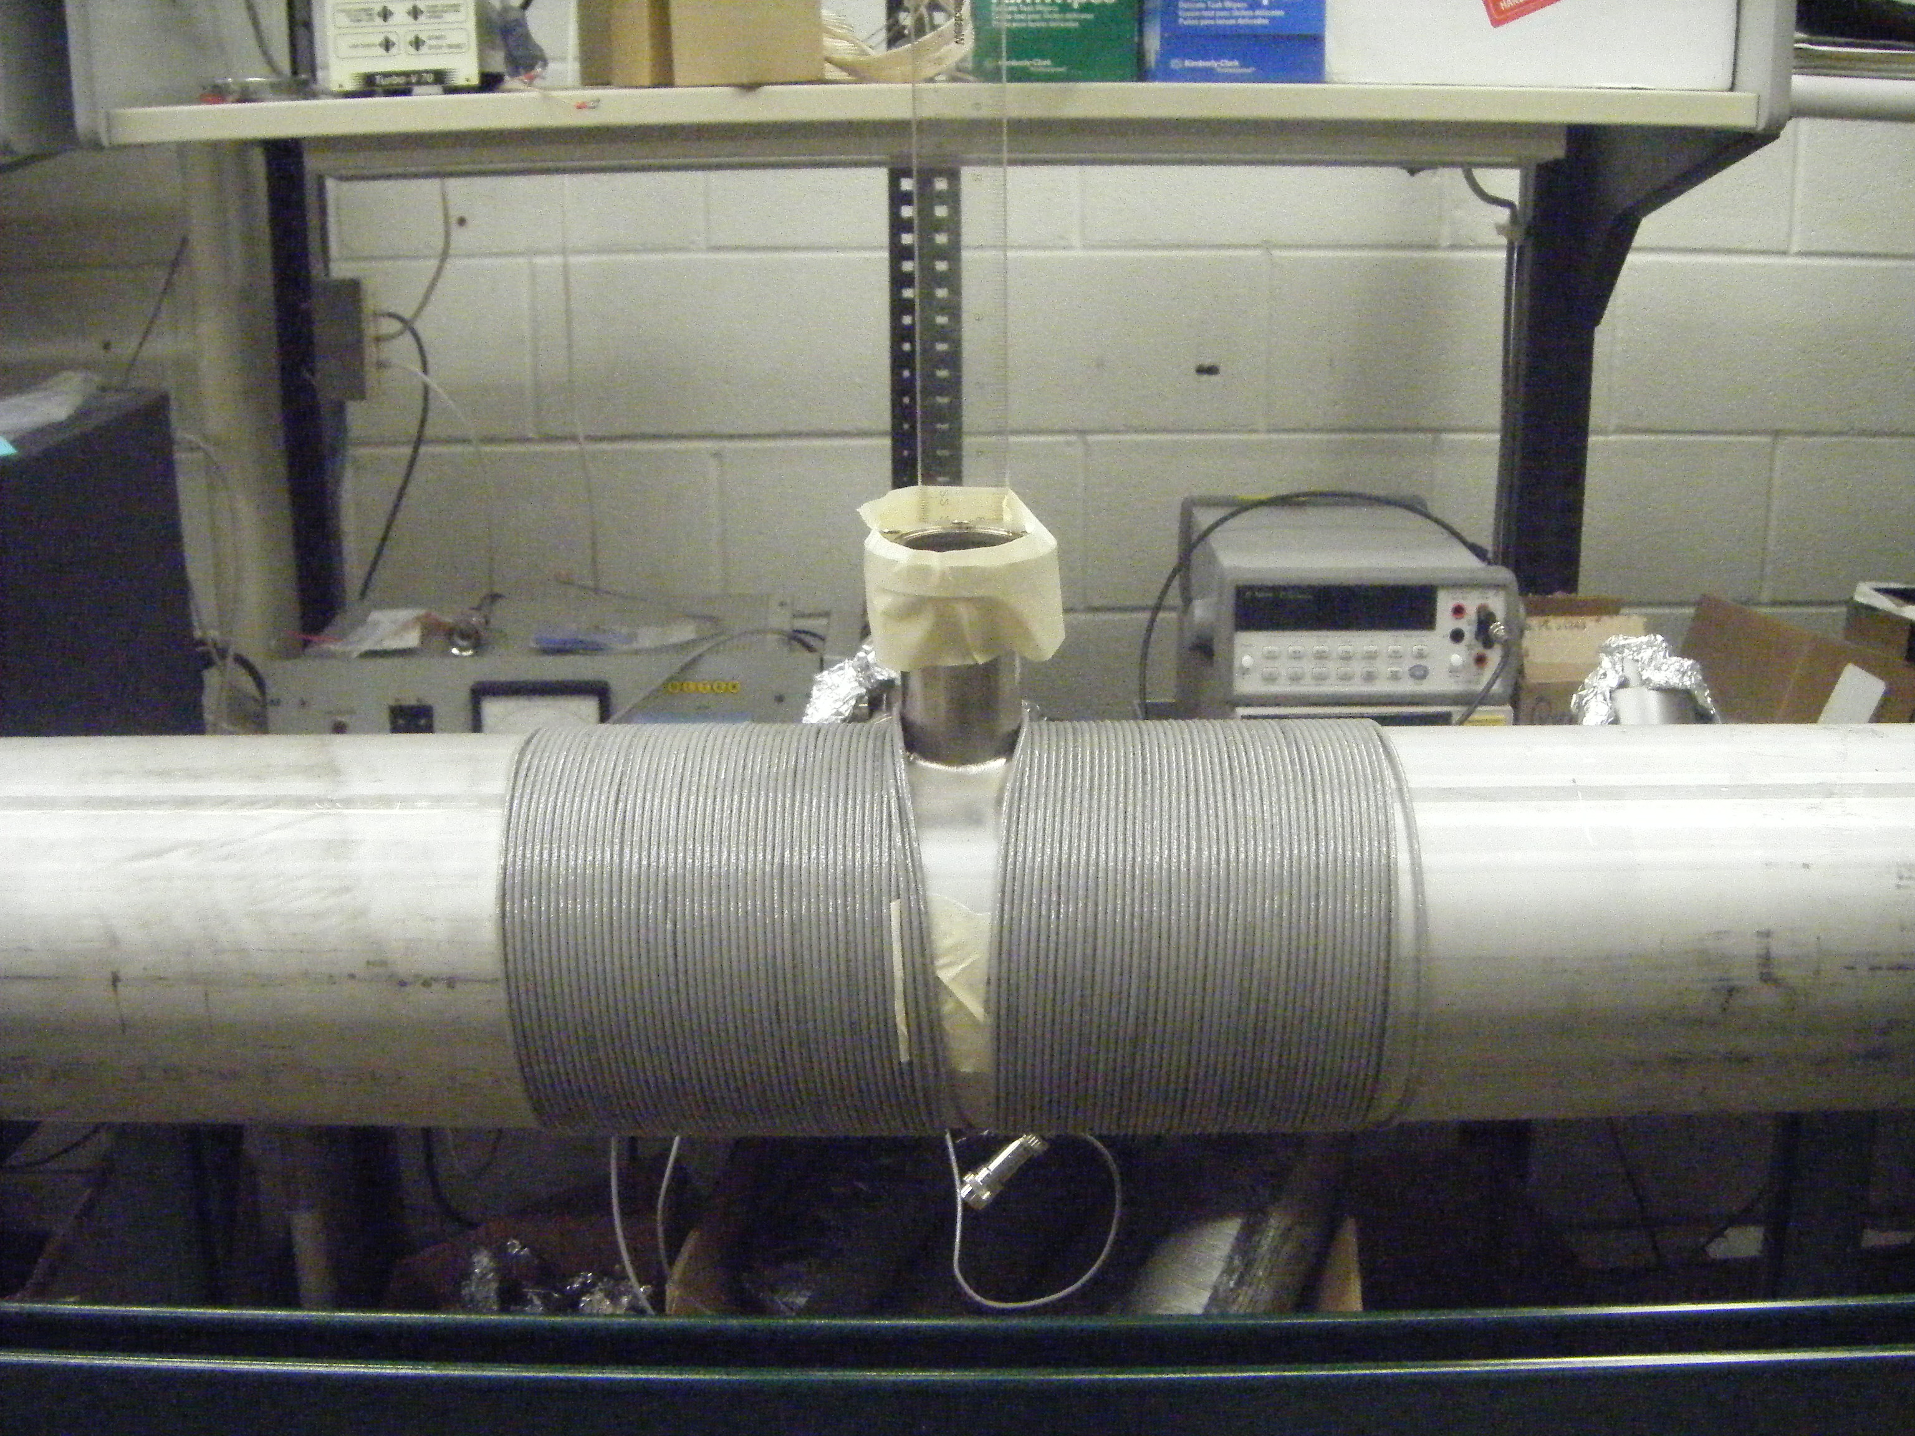

Slide 7
Data

Slide 8
Theoretical Comparison
I used 2 methods for the theory (on axis)
Piecewise from each coil in Excel
Integral

