Slide 1
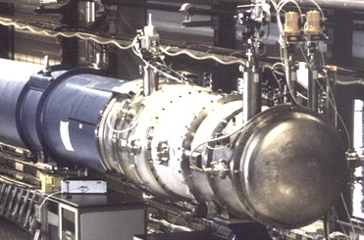
Input data for thermal modeling of Nb₃Sn Superconducting Magnets by Andrew Davies
the most likely cause of death for a superconducting magnet
Find the temperature margin before the magnet quenches.
Provide a compiled data set for future modeling
Transient heat flow remains un-modeled.

Slide 2
Electrical description of thermal systems
For one-dimensional heat flow
Transmission line equation
No direct comparison for inductance and the volume element cannot cool itself, L′=0 and G′=0
Kirchhoff “Two different forms of energy behave identically when the differential equations which describe them have the same form and the initial and boundary conditions are identical”

Slide 4
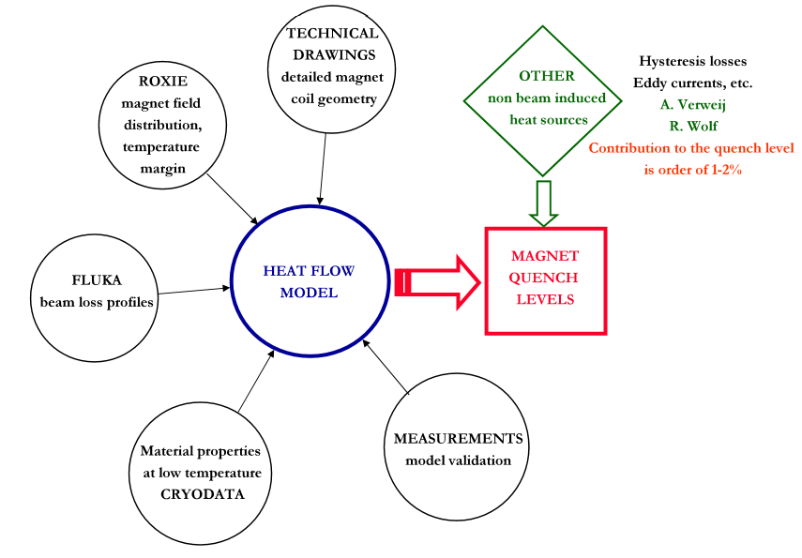
Network Model

Slide 5
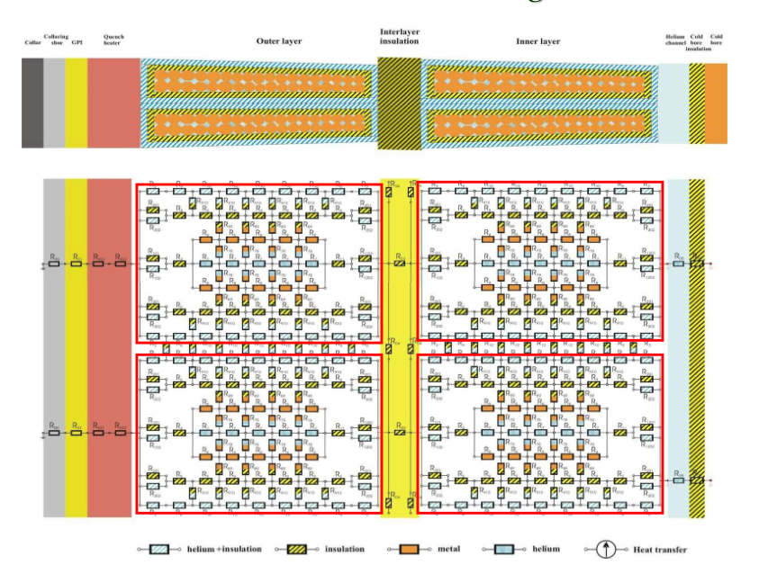

Slide 6
Material data collection and compilation
Temperature range of 1.0K to 300.0K
The compiled dataset will be used as input to the Network model for Nb₃Sn Superconducting Magnets.
Assess the impact of material properties on thermal properties of magnets. (CTD-1002X), (G10)
Heat conductivity and Heat capacity.
Assess the impact of magnetic fields on thermal properties. (copper, NbTi, Nb3Sn)

Slide 7
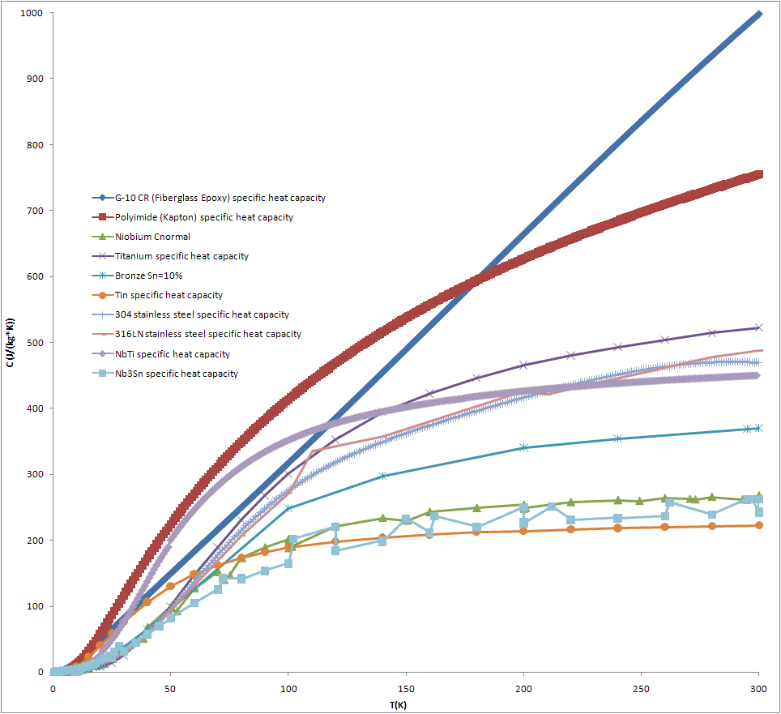

Slide 8
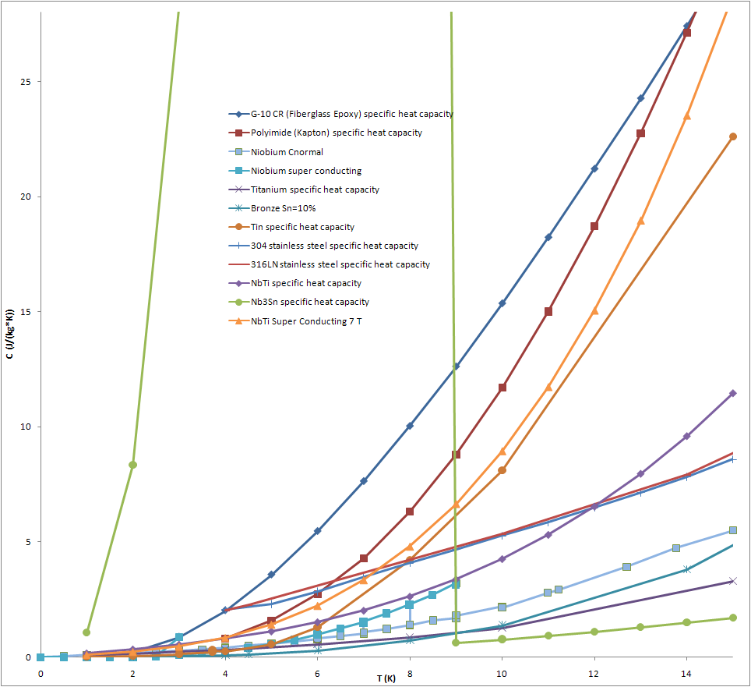

Slide 9
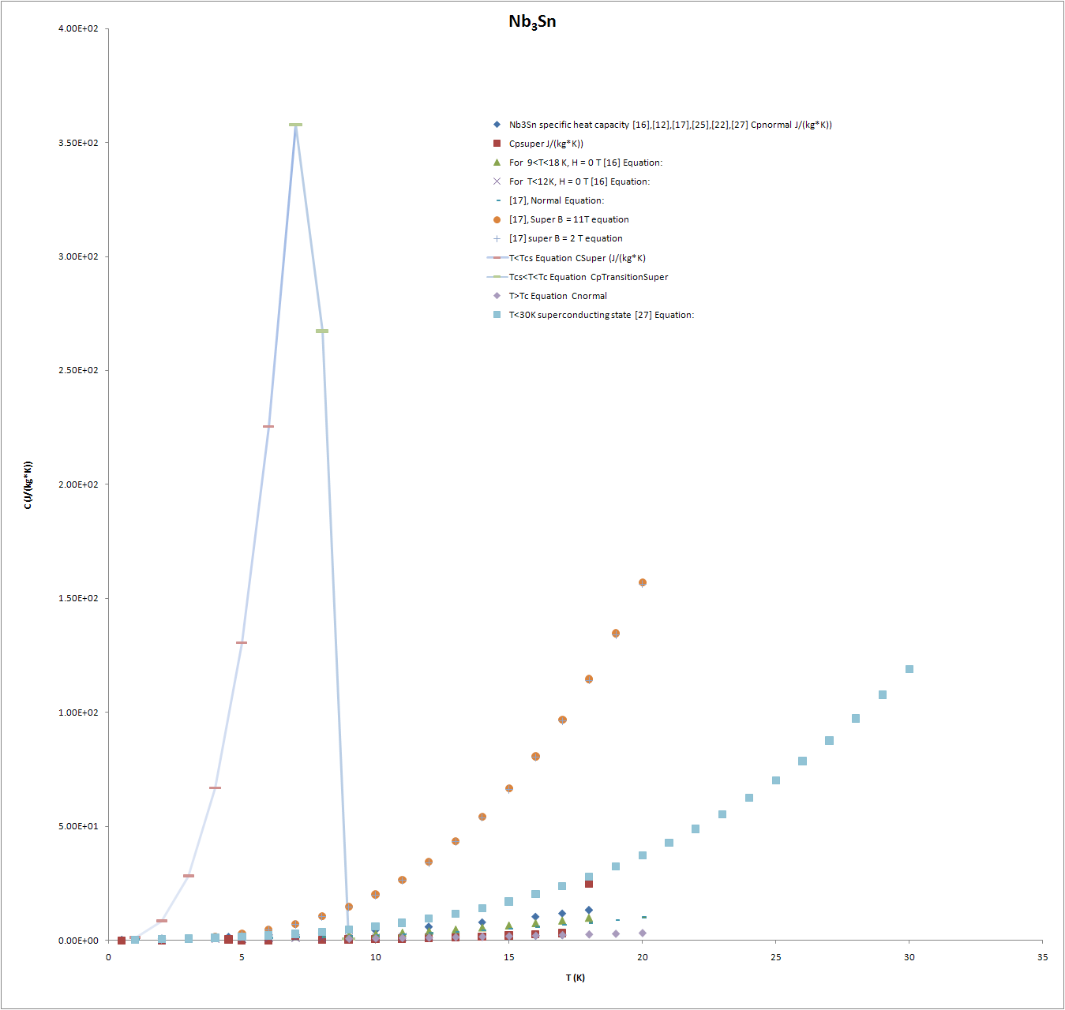

Slide 10
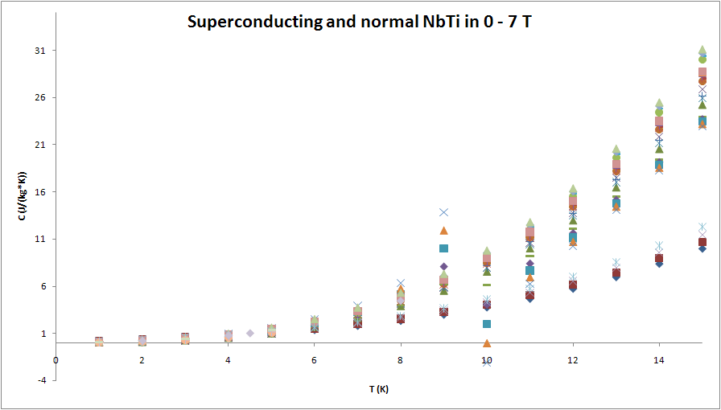
Second order transition in magnetic field

Slide 11
Future Work
Write report on the impact of magnetic fields on the thermal properties.
Build the magnet in Pspice
Steady state
Transient
Program heat capacity into VBA
Numerical simulations with parametric study
Simplify model for coil construction and testing.
Compare to existing measurements

Slide 12
End

Slide 13
Results
Evaluate final results
Propose possible future steps of analysis
Present effects of the input parameters

Slide 17
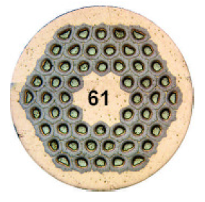
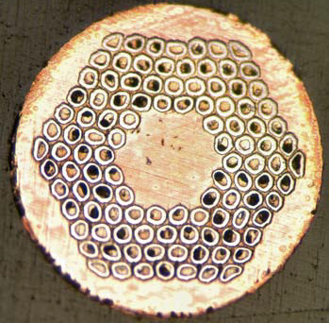

Slide 18
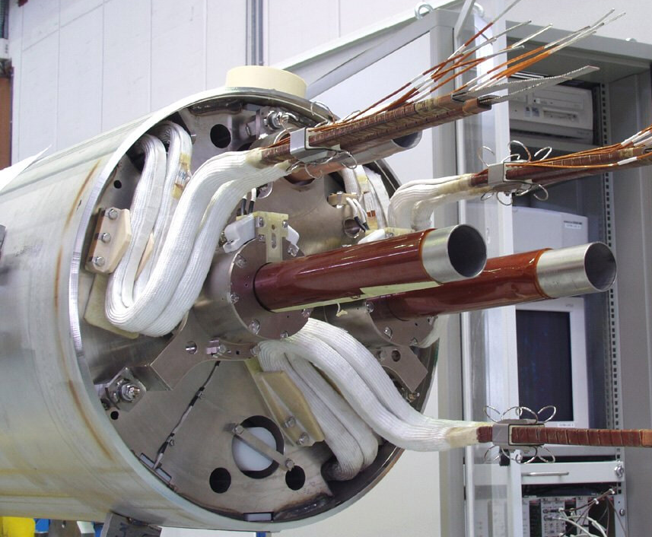
Case study: LHC dipole protection
It's difficult! - the main challenges are:
1) Series connection of many magnets
In each octant, 154 dipoles are connected in series. If one magnet quenches, the combined inductance of the others will try to maintain the current. Result is that the stored energy of all 154 magnets will be fed into the magnet which has quenched ⇒ vaporization of that magnet!.
Solution 1: put cold diodes across the terminals of each magnet. In normal operation, the diodes do not conduct - so that the magnets all track accurately. At quench, the diodes of the quenched magnet conduct so that the octant current by-passes that magnet.
Solution 2: open a circuit breaker onto a dump resistor (several tonnes) so that the current in the octant is reduced to zero in ~ 100 secs.
2) High current density, high stored energy and long length
As a result of these factors, the individual magnets are not self protecting. If they were to quench alone or with the by-pass diode, they would still burn out.
Solution 3: Quench heaters on top and bottom halves of every magnet.

