Slide 1
The Necessity of DUNE Intranuclear $ℬ−ℒ$-Violating Searches for a World-Leading, Complementary Physics Program
This presentation is based upon work that is supported by the Visiting Scholars Award Program of the Universities Research Association. Any opinions, findings, and conclusions or recommendations expressed in this material are those of the author(s) and do not necessarily reflect the views of the Universities Research Association, Inc.
by J. L. Barrow
Snowmass Early Career Neutrino Frontier
December 2nd, 2020
Please see the associated Letter of Interest, and references therein

Slide 2
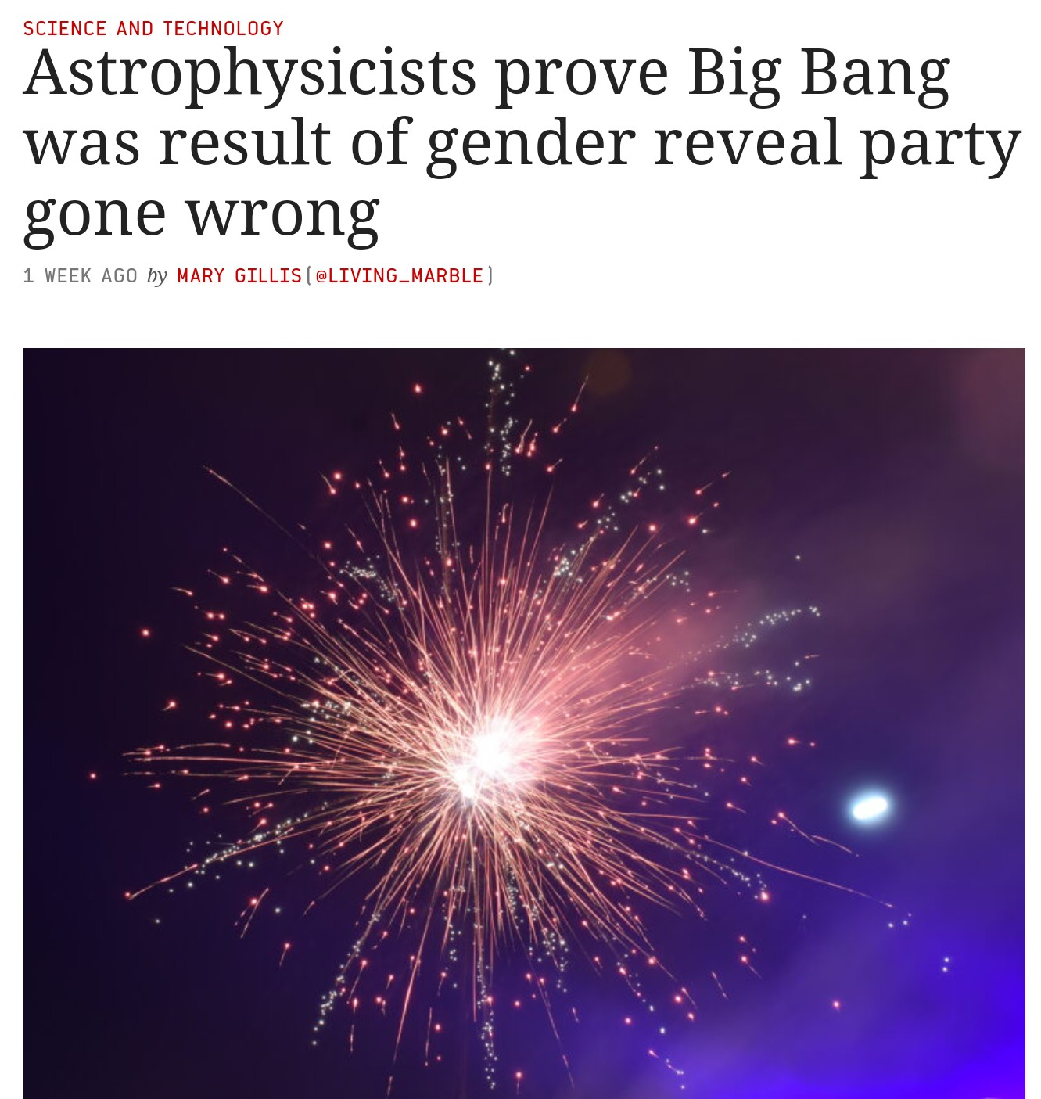
Theoretical Points
Why $ℬ−ℒ$ Violation?
How do we understand baryogenesis?

Slide 3
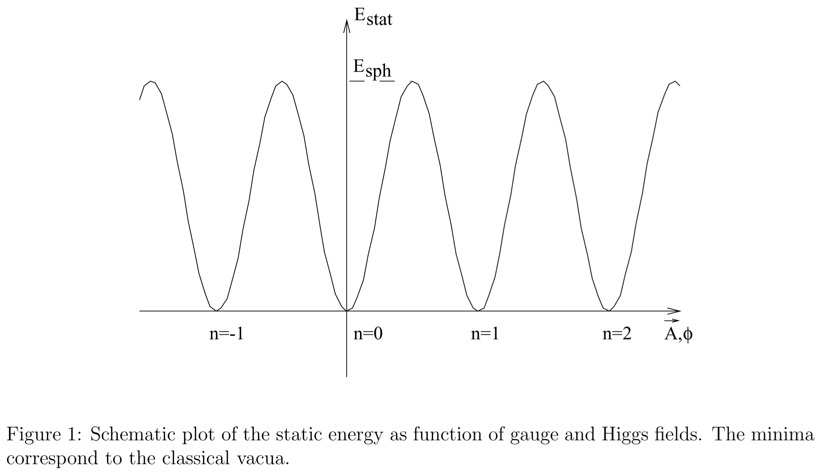
Can $ΔB=ΔL$ Remedy the Baryon Asymmetry?
Baryon ($B$) and lepton number ($L$) are violated infinitesimally in the SM due to anomalies
The SM nonperturbatively conserves $B−L$ (t’Hooft 1976)
$$⟹ΔB=ΔL$$
It turns out that no theory that operates within the SM has produced a proper baryon abundance yet, fully and consistently—EWBG???
Topological tunneling is completely inadequate
The sphaleron mechanism still washes out any asymmetry we would see today if when they are generated they conserve $B−L$
The short answer?
NO!
Proceed by contradiction…
SHOULD
$$B−L$$
BE VIOLATED???
Maybe…
But let’s be more conservative, and focus on observing processes with
$$ΔB≠0$$
$$α\left(\frac{4π}{g^{2}}\right)M_{w}≿100 TeV$$
$${\sim 10}^{−170}$$
A. D. Dolgov, Baryogenesis, 30 Years Later
M. E. Shaposhnikov et al 1993 and 1998

Slide 4
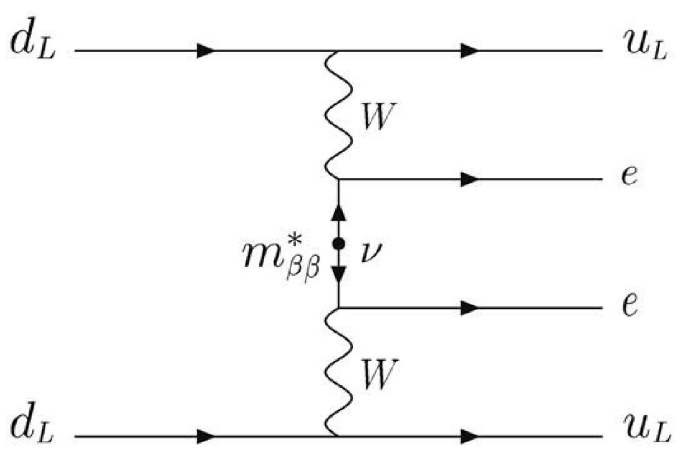
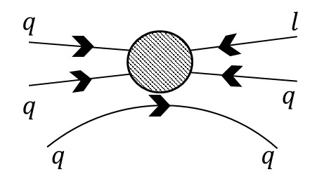
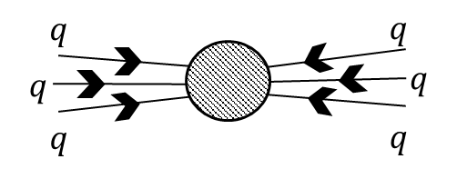
Going Beyond the Standard Model
$$𝒪_{p}^{6}\sim λ_{p}\frac{qq\overline{q}l}{M_{GUT}^{2}}$$
What else do we need to add?
Proton decay? $∝qqql⟹B−L$ conserving
Important to some BSM GUT SUSY theories
No experimental evidence in large volume detectors
LHC has turned up no persistent signs of SUSY
Some other kinds of $ΔB≠0$ or $ΔL≠0$?
$ΔB=2$ operators?
$ΔL=2⟹$leptogenesis?
Why some over others?
Can they properly generate the baryon asymmetry of the universe?
At what energy scales can these theoretically produce the correct value?
$$𝒪_{2N}^{9}\sim λ\frac{qqq\overline{q}\overline{q}\overline{q}}{M_{\sim EWPT}^{5}}$$

Slide 5
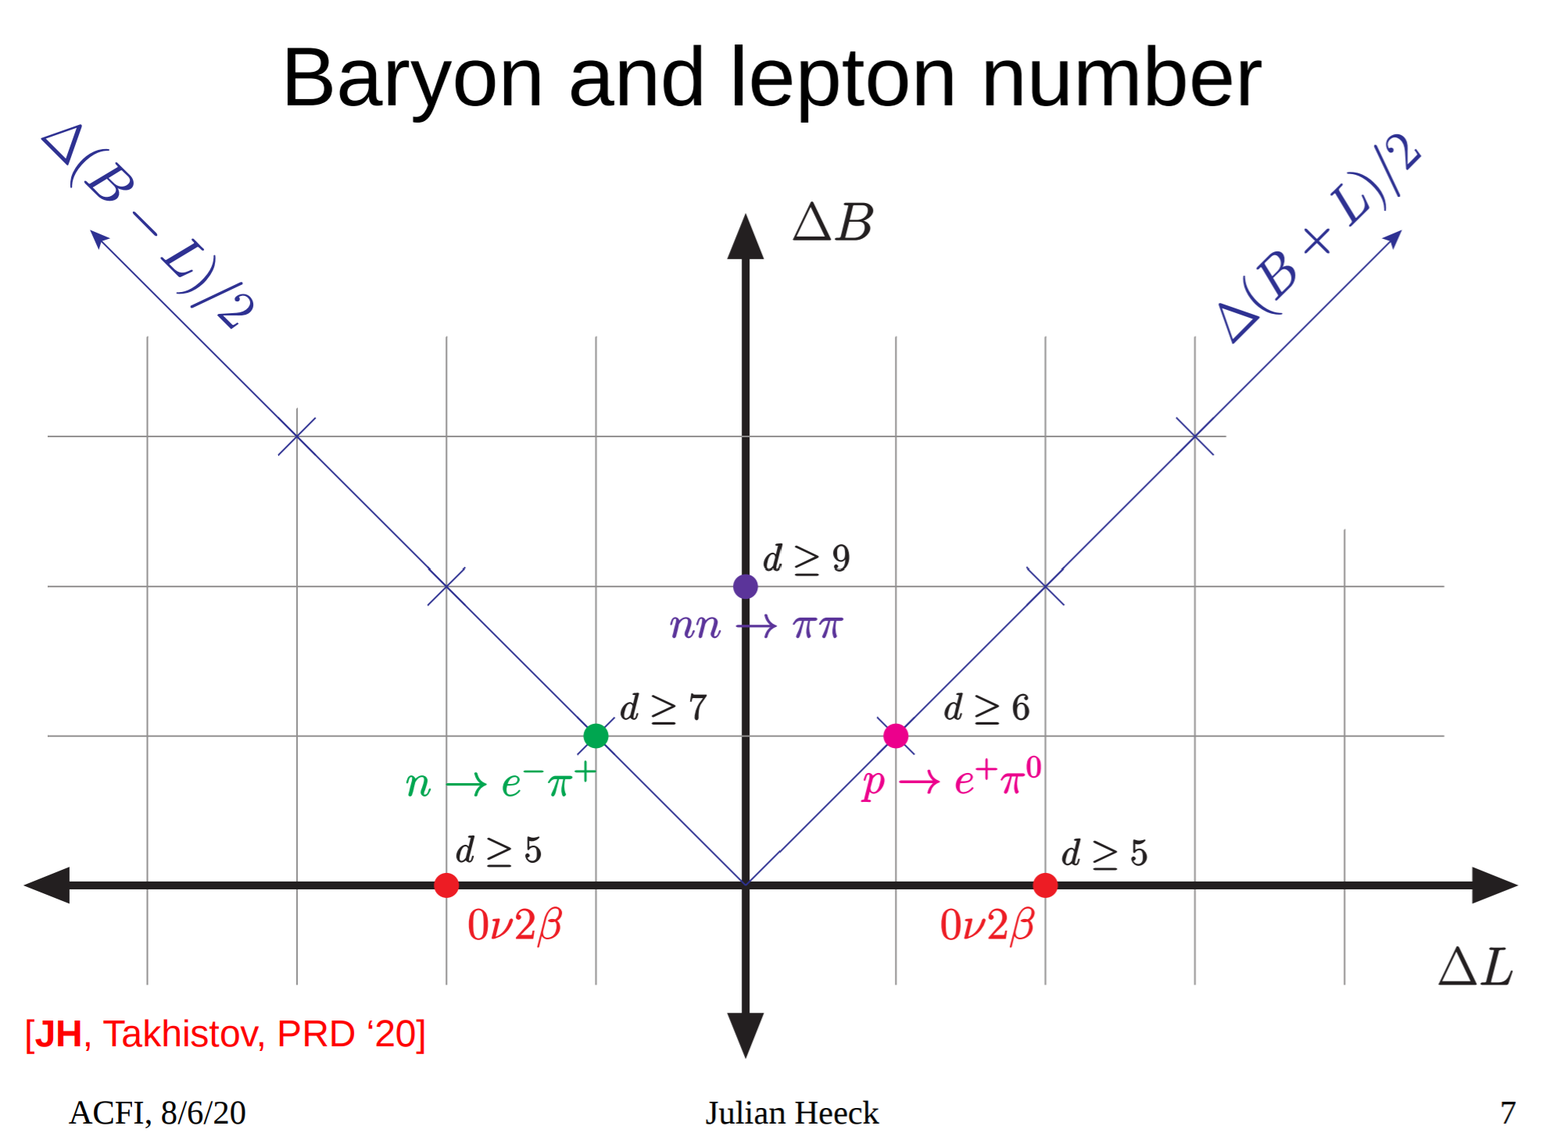
Julian Heeck ACFI Presentation

Slide 6
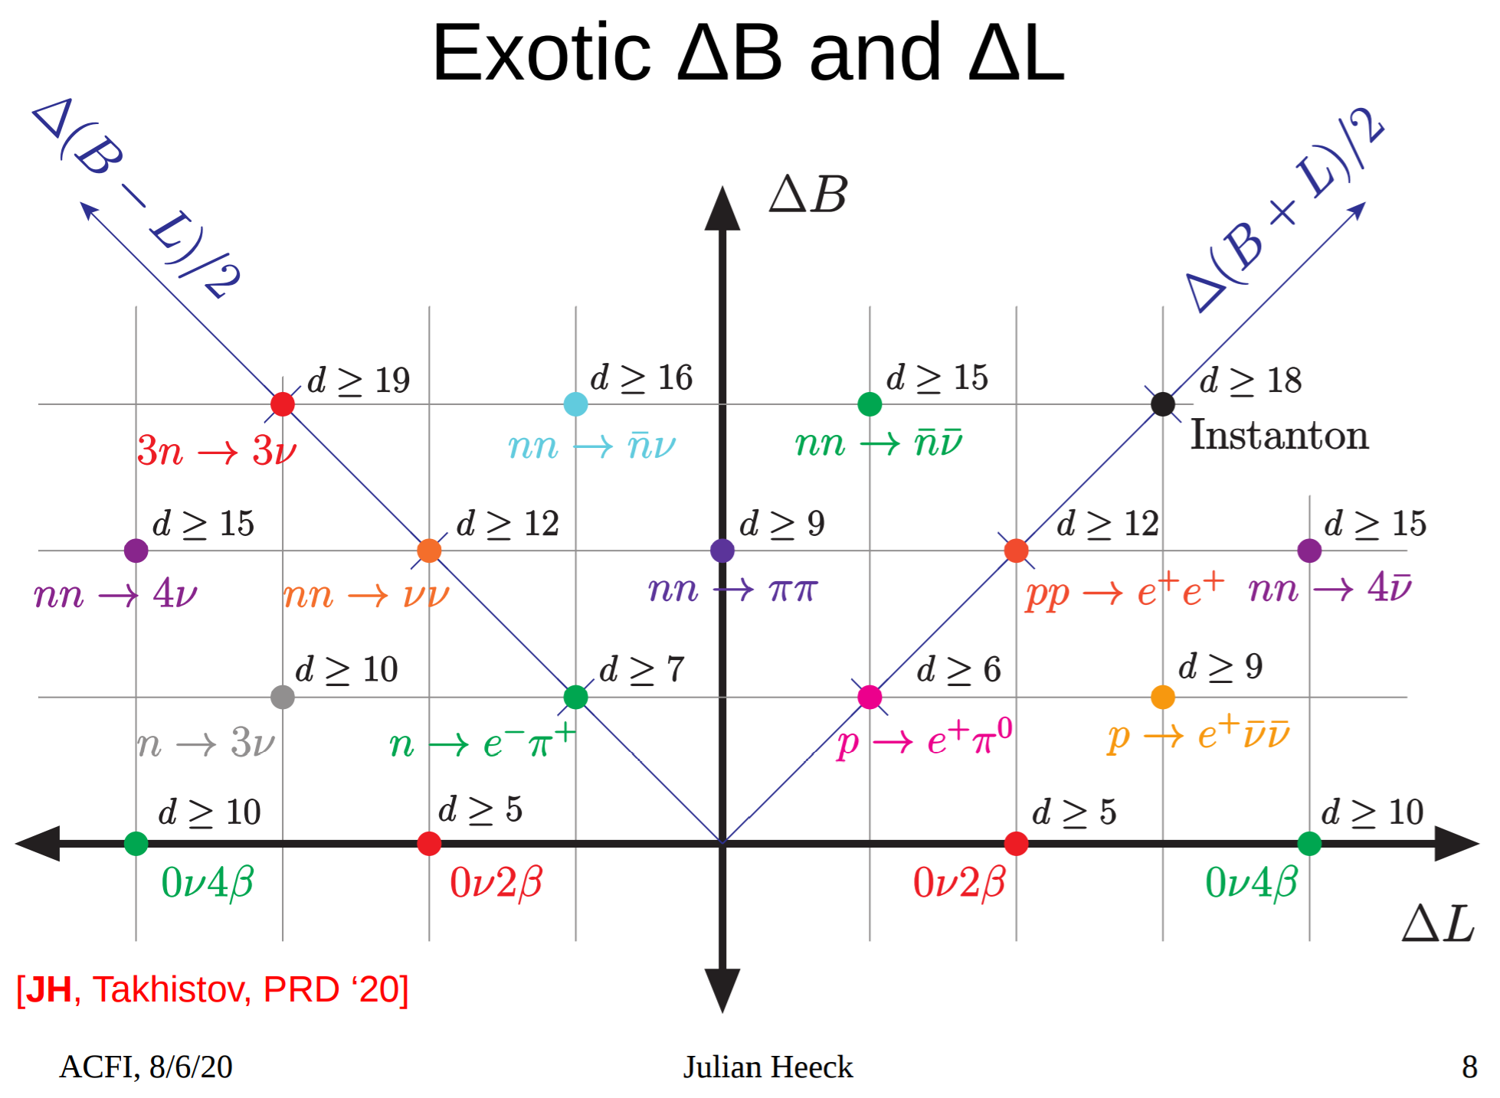
Julian Heeck ACFI Presentation

Slide 7
A Few (MC Truth) Considerations
Toward the Future
Consider $ℬ−ℒ$-violating $n→\overline{n}$
Understanding Modeling Systematics Beyond Previous Ad-hoc Assumptions
December 2nd, 2020
Snowmass Early Career Neutrino Frontier Meeting
7

Slide 8
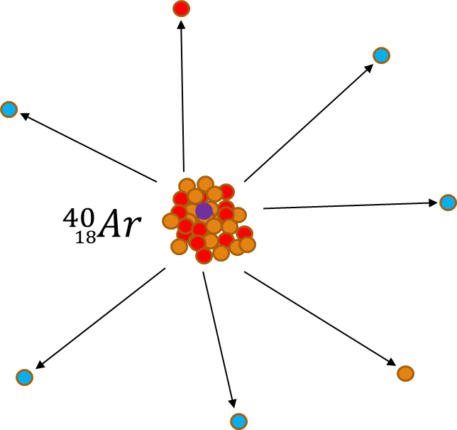
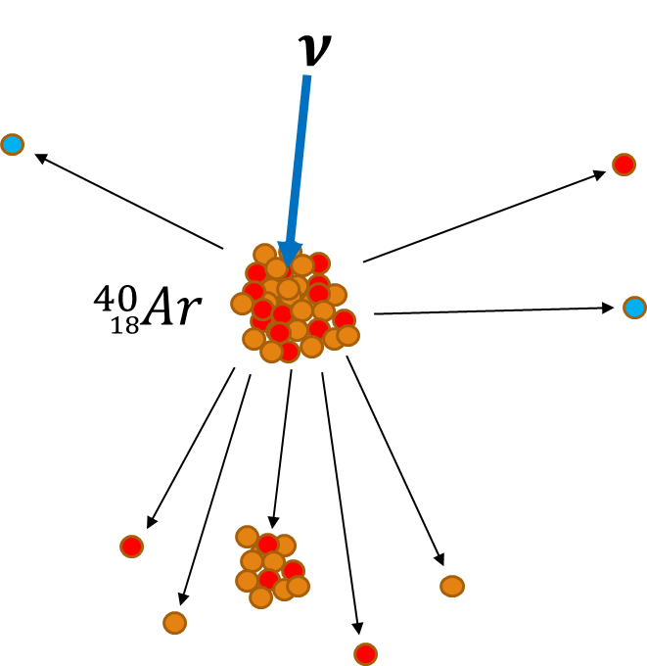
Dover, Gal, and Richard 1983, 1985, and 1996
$\sim$Golubeva and Kondratyuk, 1997
Kopeliovich et al 2018
Golubeva, JB, Ladd 2019
JB, Golubeva, Richard, Paryev 2020
Signal Comparison $n→\overline{n}$ vs. Backgrounds (ex: Atmospheric Neutrino, $ν$)
$n→\overline{n}$ Annihilation and Knockouts
Neutral Current Atmospheric $ν$
Continuous energy spectrum
Generally a ~correlated topology
Large range of total momentum
~Noncontinuous energy spectrum
Generally a ~spherical topology
~Low momentum due only to Fermi motion
$$π$$
$$π$$
$$π$$
$$π$$
$$π$$
$$π$$
$$π$$
- Antineutron
“pion star”
- Neutron
- Proton
- Pion

Slide 9
Goals of Ongoing Studies
Utilize realistic models of rare process signals and associated backgrounds
Integration of the newest nuclear model configurations available in GENIE and other $n→\overline{n}$ generators from Golubeva et al. into full DUNE reconstruction chain underway
Fully oscillated atmospheric neutrino fluxes/spectra; expected counts complete
Proper $ν_{τ}$ CC-interactions and subsequent $τ$ decays underway (issues with GEANT)
Approximate uncertainties in signal and background topologies
Iterate across many nuclear model configurations and generators as possible
Automate analysis techniques to extract expected lower limits of many rare processes
Generate many different samples for many different signals over many different nuclear model configurations, producing outputs from many individually trained CNN/BDTs

Slide 10
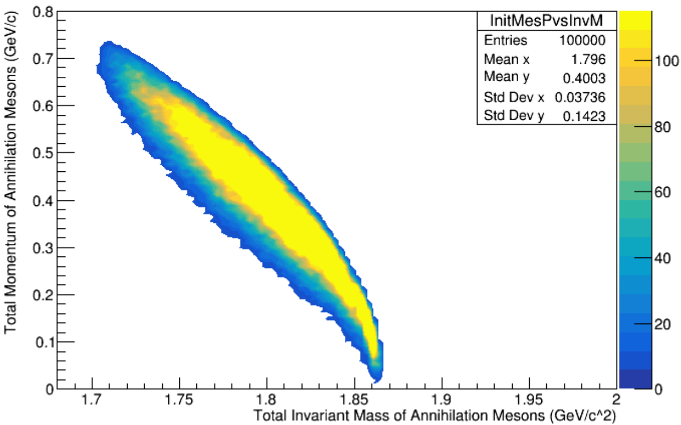
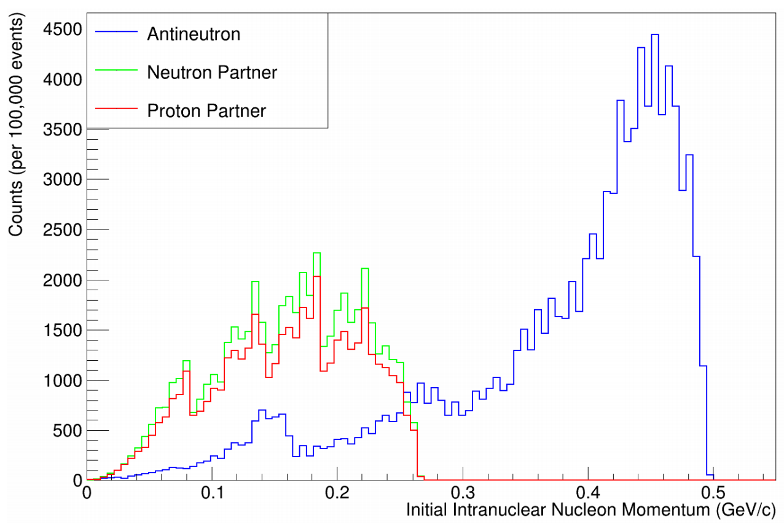
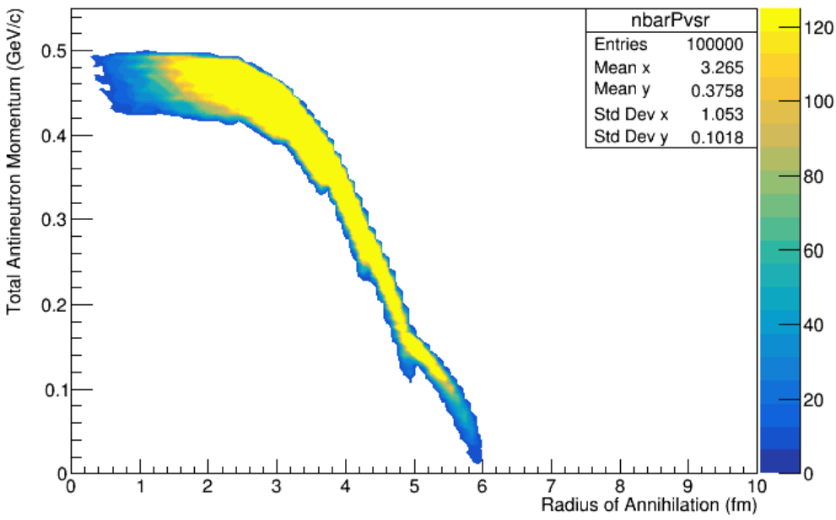
The Importance of Some Initial Physical Correlations
Consider a local Fermi gas nuclear model of Fermi momentum (initial state)
$$p$$
$$\overline{n}$$
$$n$$
$$p$$
$$n$$
The correlation of radius and momentum has been previously ignored for all $n→\overline{n}$ simulations in all experiments
High radii lead to…
Fewer FSIs, more meson emission
Lower total momentum (near ideal case)
Paryev’s distribution

Slide 11
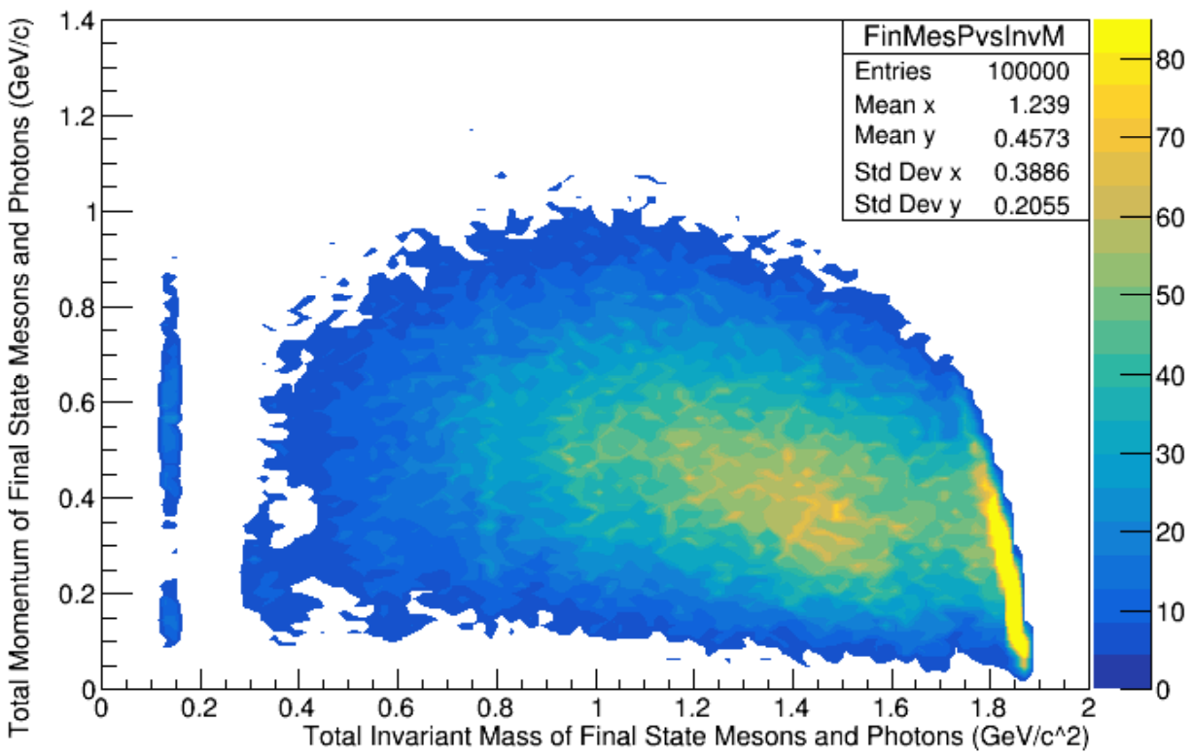
Final State

Slide 12
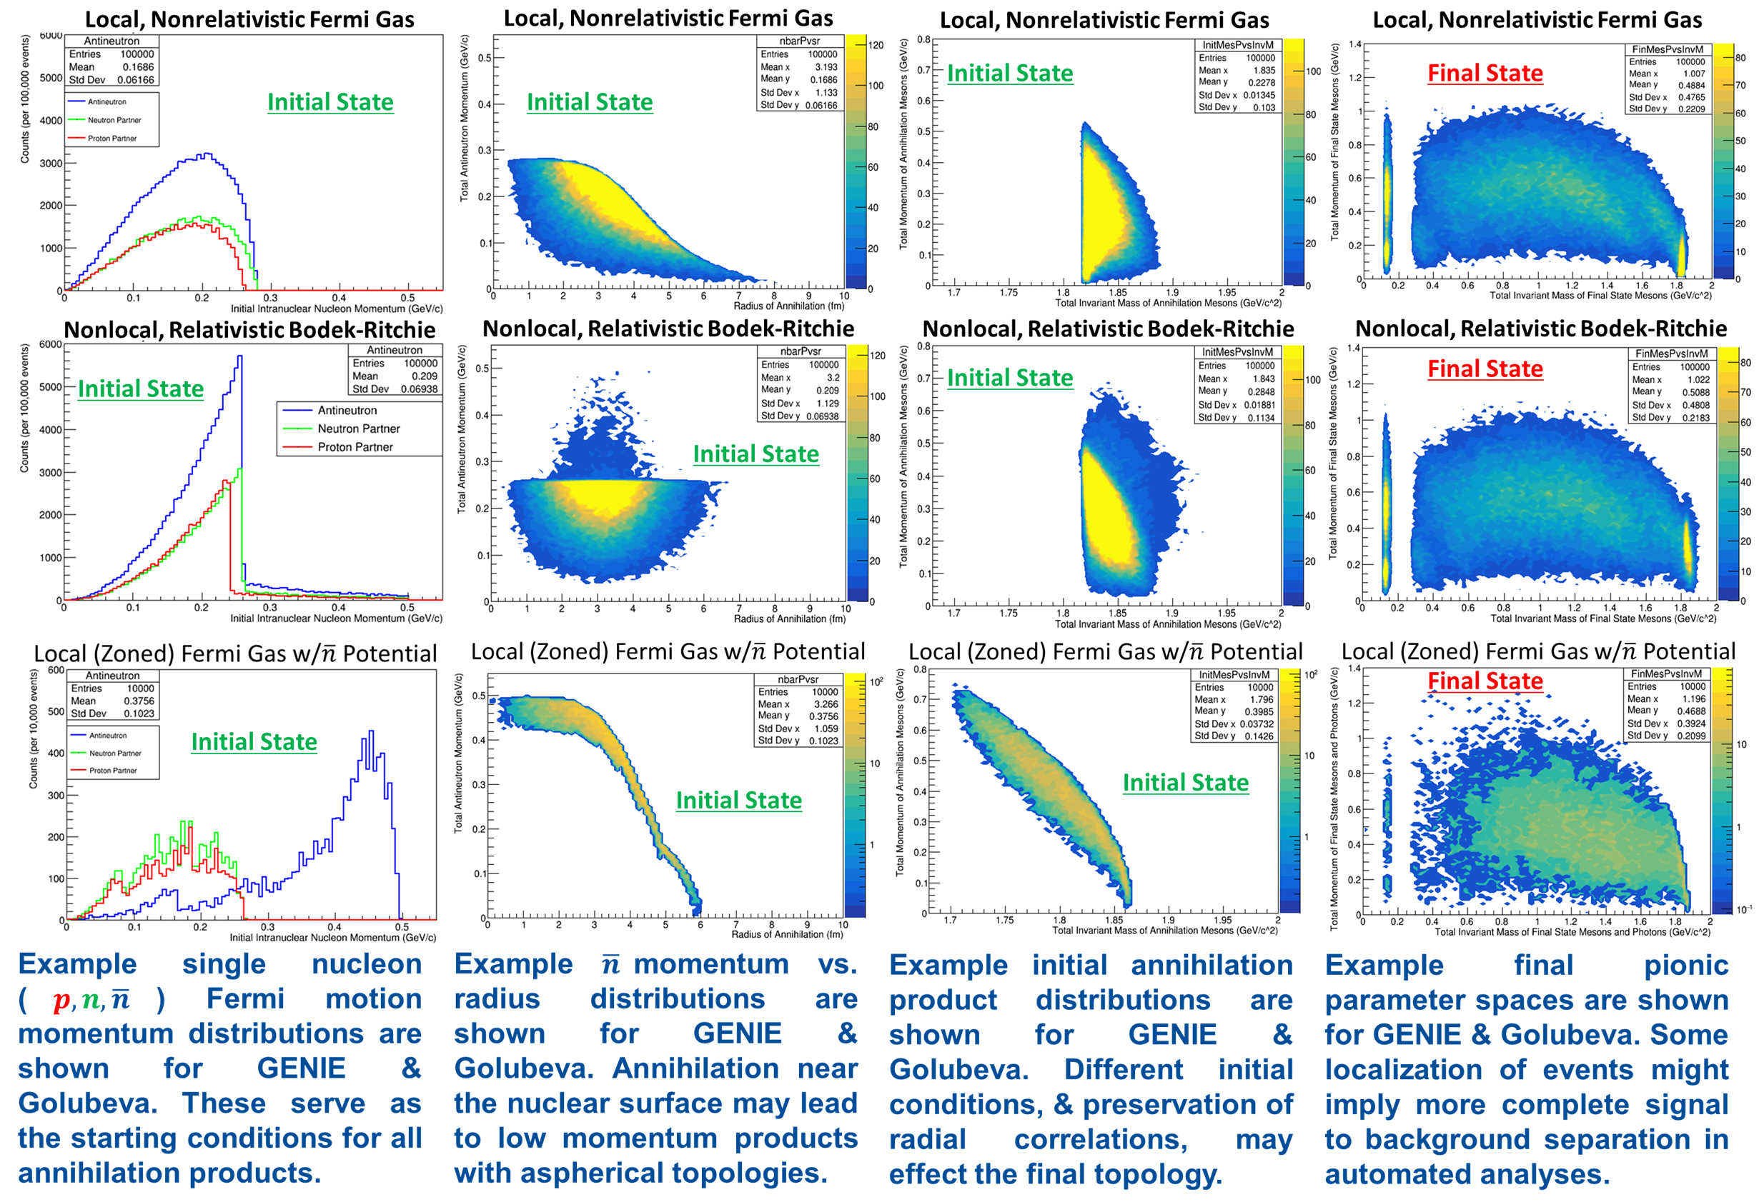
Model Dependencies in Final State Topologies are Being Investigated
Final State
First foray into this study detailed in our recent PRD
Compares many GENIE models to our generator work with E. S. Golubeva
Initial State
Initial State
Initial State

Slide 13
Summary and Conclusions
DUNE shows potential to reach $τ_{n\overline{n}}≥5.58×{10}^{8}s$ lower limit
Improvements are sought via…
Better reconstruction can hopefully lead to better ROI selection
BDT input of CNN PID for better cuts against background
Iteration over nuclear model configurations underway
Will allow us to test stability of CNN/BDT response to various topological differences
Effectively determine model systematics
Will $S:B$ remain the same independent of the nuclear model configuration?

Slide 14
ACFI Workshop on $Δℬ=2$
Theoretical Innovations for Future Experiments Regarding Baryon Number Violation, Part 1
Associated Letter of Interest
Associated Book of Abstracts (Short Proceedings)
$\left|Δℬ\right|=2:$ A State of the Field, and Looking Forward
A brief status report of theoretical and experimental physics opportunities
$Δℬ=2:$ A state of the Field, and Looking Forward

