Slide 1
Accelerator Operations
Proton PMG Meeting
December 3, 2020

Slide 2
New RunCo
RunCo’s have taken over
First Rotation Will be John Kuharik (3 Week Rotation ends December 7th)
Email: AD_Runco@fnal.gov (Goes to all members of the RunCo Team)
Personnel email: kuharik@fnal.gov
Ext: x3769
Second Rotation Adam Watts
Email: AD_Runco@fnal.gov (Goes to all members of the RunCo Team)
Personnel email: awatts@fnal.gov
Ext: x5127
RunCo Rotation
https://www-bd.fnal.gov/hq/consCal.html

Slide 3
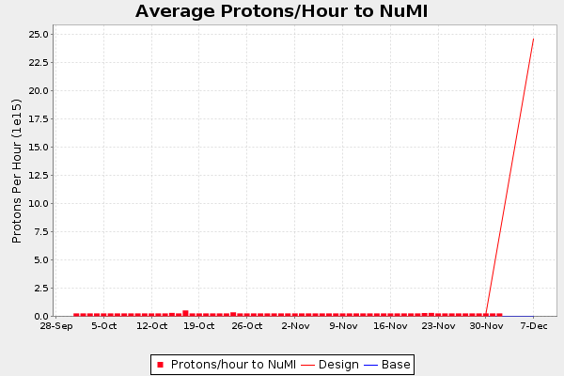
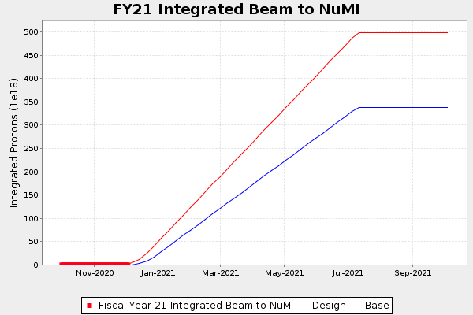
NuMI

Slide 4
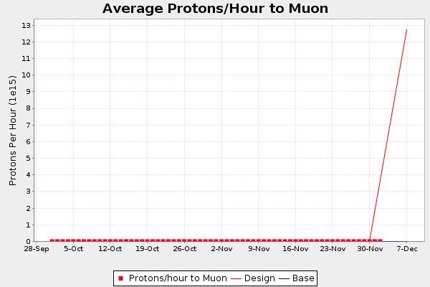
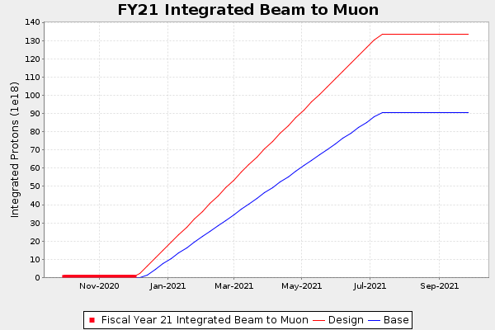
Muon

Slide 5
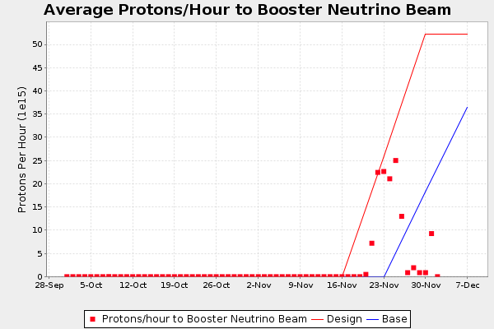
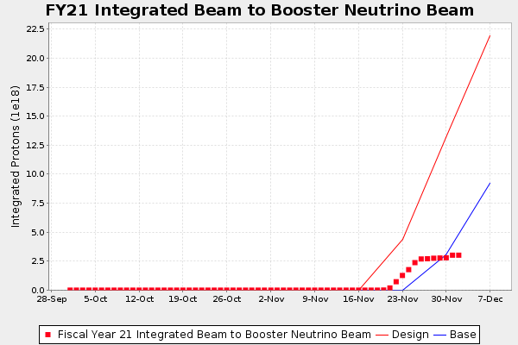
BNB

Slide 6
Machine Status
NuMI
Ground fault developed after horn beam scans.
Need to fix the ground fault and then do horn scan and target scan.
Numi report has more details.
Muon
Ready for 1 Booster batch, low intensity beam to g-2, 1e12
Booster, Recycler, and Muon tuning required for increased intensity.
Switchyard
Need additional power supply work and safety system testing before being beam ready. PIP II berm work not yet completed. Still on track for beam week of the 14th
BNB
Ready for beam to users, tested up to 3 Hz, 2.5e12
Target scans done and being analyzed for best positions and angle.
Additional scans might be needed.
MTA
Commissioning beam.

Slide 7
Main Injector Kautz Rd Power Station Outstanding Issue
There is an issue at Kautz Rd. that developed this week that prevents the normal turn on of the Main Injector power.
The problem is a dead HMI display that communicates with the PLCs that are responsible for controlling the breakers at Kautz Rd.
There is not a viable replacement on hand, replacement parts have been rush ordered and should arrive in the next day or two.
This device must be fixed to turn on Main Injector.
Impacts Numi, Muon, and SY beam

Slide 8
Berm Horizontal Boring Impacts SY Beam
A24 Gate
A1 Service building
Work to be completed the week of Dec 7th
Waiting on parts domestic water line
COVID-19 event that halted work for the Middle two weeks of November.
The ACUC installation of the communication line across the beam line and associated wall penetration into the Transfer Gallery is planned to be completed the week of Dec 7th.

Slide 9
Outstanding Issues and Plans Moving Forward
DNS (Domain Name Service) is the network service that translates computer names like www-bd.fnal.gov into numbers like 131.225.121.145 that computers actually use to talk to each other.
The appliances in Accelerator Division, which are managed for us by Computing Division will be end of support on December 31st
They have the replacement hardware already physically installed in our computer room, but the switchover will take about 90 minutes.
During the switchover, name lookups will still work as systems will fail over to the alternate name server appliance, but this failover takes 20 seconds, so many network operations will see 20 second delays during that 90 minutes.
Not scheduled yet.

