Slide 1
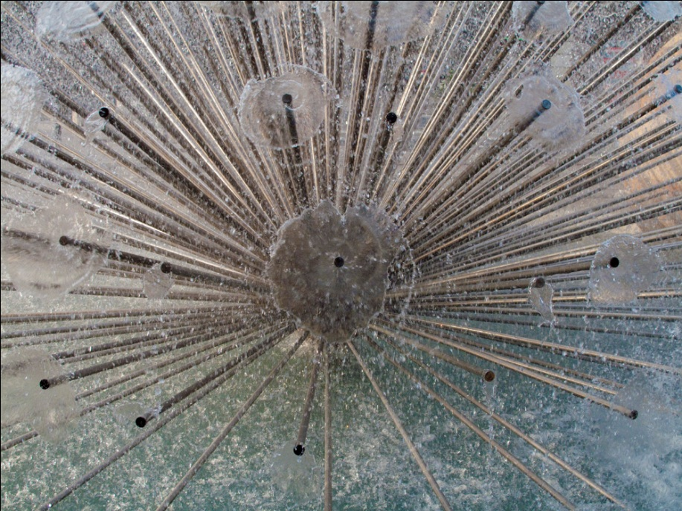
The Search for the Higgs Recent developments in the search for the “God” particle Encuentro Científico Internacional, Lima Peru P. Oddone, August 5th, 2011
Photo: fountain in the city of Grenoble where the latest results were presenteed at EPS-HEP2011

Slide 2
Outline
Background: the state of particle physics
The Higgs Boson: how do we make it?
The Higgs Boson: when made, what does it do?
The Higgs Boson: how do we “see” it?
Recent results: EPS-HEP2011, Grenoble
If there is no Higgs: then what?

Slide 3
The state of knowledge
The present theory is a remarkable intellectual construction
Every particle experiment ever done fits in the framework
But we know it is incomplete: there are hidden sectors yet to be discovered

Slide 4
What we do not know
The sense of mystery has never been more acute and evident. With our increasing knowledge we also have learned how much we do not understand
Where does mass come from?
Are there extra dimensions of space?
Why only three families of quarks and lepton?
Why is matter dominant?
What are the neutrino masses and what do they say?
Where are the heavy neutrino partners?
Does nature use supersymmetry?
Do the forces unify?
What is dark matter?
What is dark energy?
Higgs Boson?

Slide 5
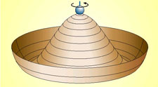
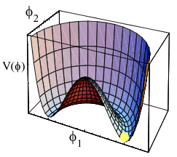
Higgs analogy
Mystery two: what gives mass to elementary particles?
Mass of composite particles understood E=mc².
But the theory has zero masses for quarks and leptons. What breaks the symmetry?

Slide 6
How do we make it?
Need to invest enough energy in the collision to create the particle. No more than E = mc²
e⁺
Z*
Z
e⁻
H
E (e+,e-) > m (Z+H)

Slide 7
How do we make it?
The LEP machine with 200 GeV of top energy established that there was no Higgs Boson up to a mass of 115 GeV. It was an electron-positron collider and it is very hard to go to higher energies with these machines
The party then moved to the Tevatron where with 2,000 GeV it can explore Higgs Bosons masses up to about 200 GeV
Now the party moves to the LHC where with 7,000 GeV of total energy it can explore up to Higgs Boson masses of about 600 GeV

Slide 8
How do we make it?
The effective energy available in the Tevatron (proton-antiproton collisions) and the LHC (proton-proton collisions) is about 10% of the total collision energy because protons are not simple, they are made of quarks and gluons rattling around inside

Slide 9
How do we make it?
We look for energetic collisions of elementary components (the partons).
that throw a lot of energy transverse to the beam indicating an energetic collision

Slide 10
How do we make it?
Typical collisions to produce the Higgs Boson
gluon
quark
Z*
Z
H
antiquark
H
gluon

Slide 11
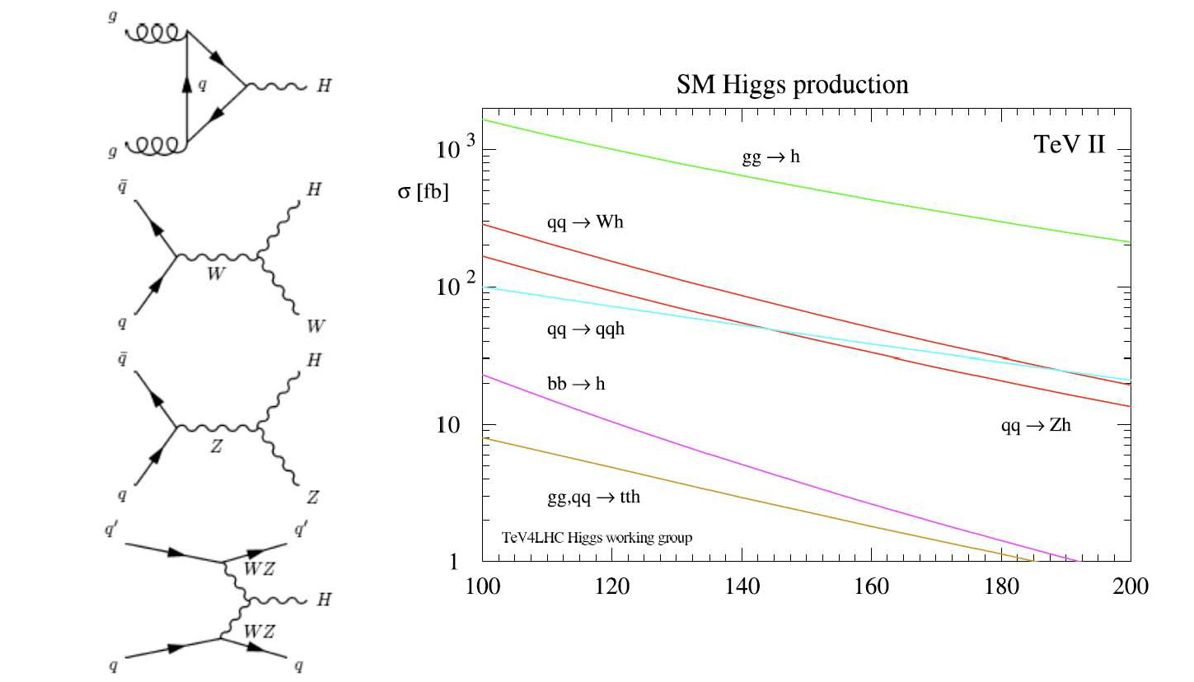
How do we make it?
Higgs production at the Tevatron

Slide 12
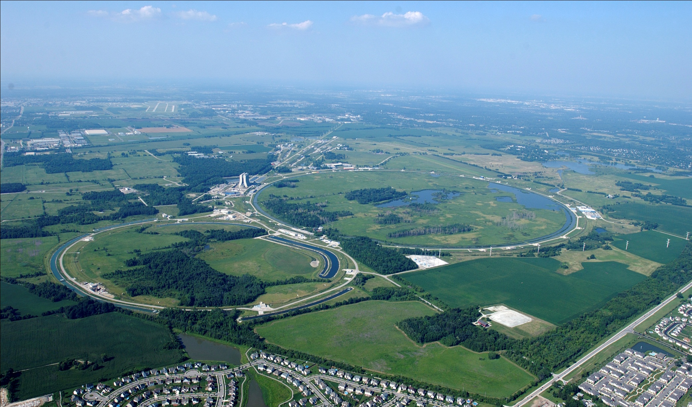
How do we make it?: Tevatron

Slide 13
The Tevatron: a legendary machine
First large superconducting accelerator: established the technology → HERA, RHIC and LHC
New detector technologies (e.g. silicon vertex detectors at hadron colliders); sophisticated triggers and new analysis techniques
Many important results: top quark discovery, B_{s} mixing, precision measurements of M_{W} and M_{Top}, di-boson production, single top production, many searches, delimited range of Higgs masses
Recent record luminosity 4.16 10³² sec⁻¹ cm^{-2….}and it is not done yet……

Slide 14
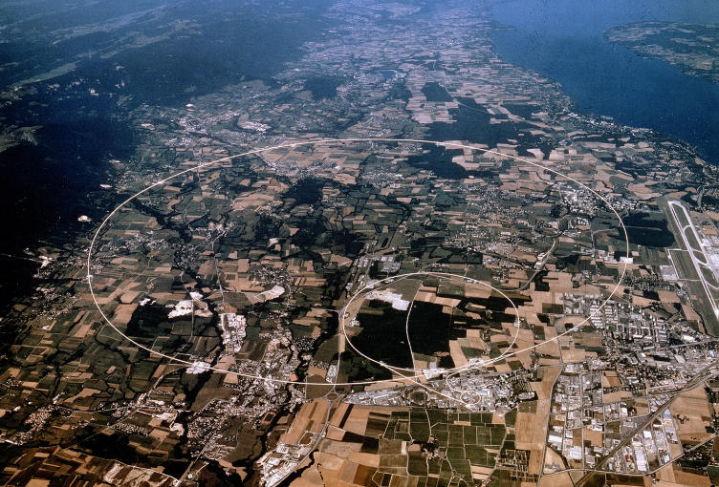
How do we make it?: LHC

Slide 15
When made, what does it do?
The Higgs instantly decays into either bosons (WW, ZZ, gg, γγ), leptons (ee, μμ, ττ) or quarks (any pair of quarks). It prefers to go to the highest mass channel available
For instance at “low” Higgs mass:
Jet of ordinary particles
b
H
b
Jet of ordinary particles

Slide 16
When made, what does it do?
For instance at “high” Higgs mass:
μ+
Final state is four charged leptons: we measure the mass with great resolution
Z
μ-
H
e+
Z
e-
e+
Final state is two leptons and two neutrinos (not detected): poor mass resolution
W⁺
ν
H
ν
W⁻
μ-

Slide 17
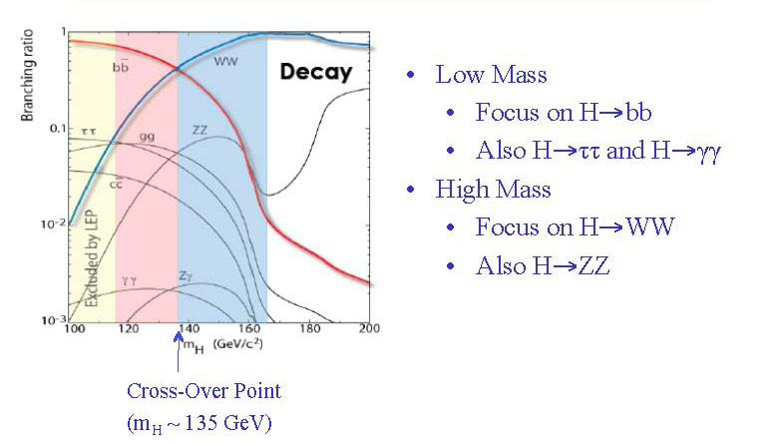
When made, what does it do?
μ-

Slide 18
How do we see it?
Vertex detector
electron
charged
hadron
Tracking
gamma
neutron
EM calorimeter
muon
neutrino
Hadron calorimeter

Slide 19
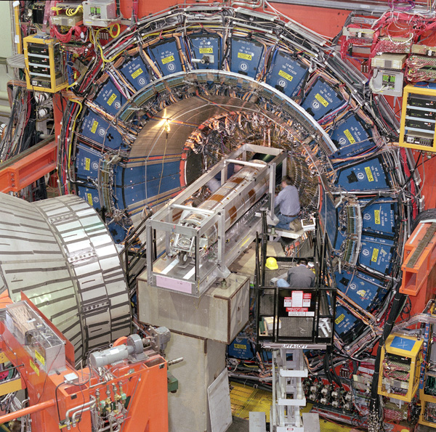
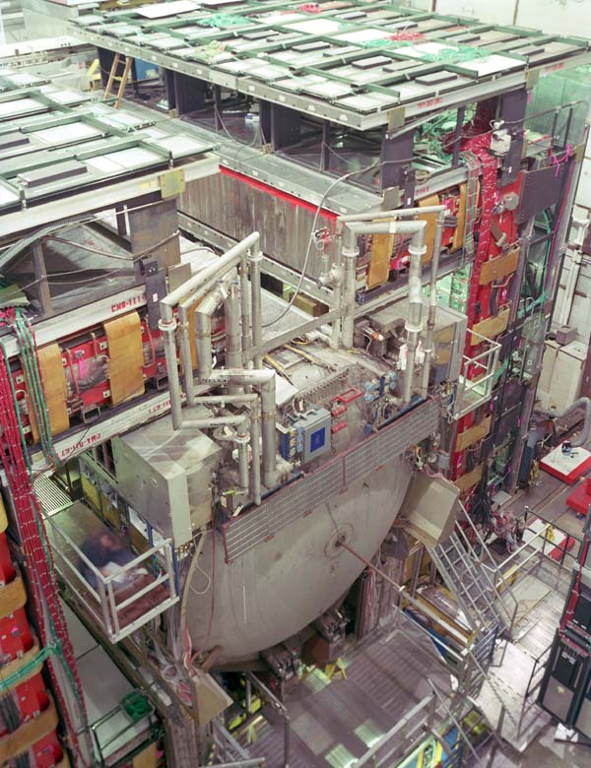
How do we see it?: CDF and DZERO
~10 fb⁻¹ recorded to tapes by each detector

Slide 21
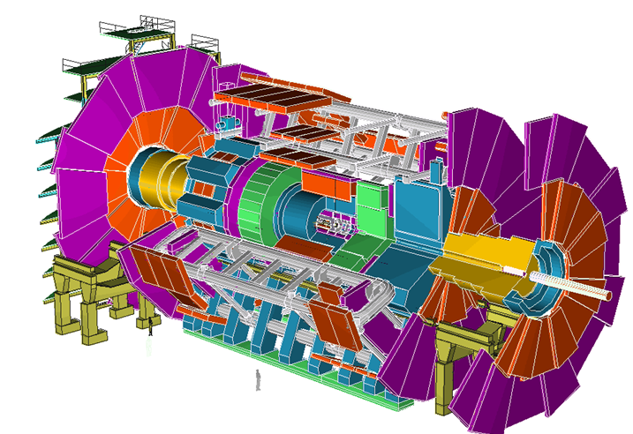
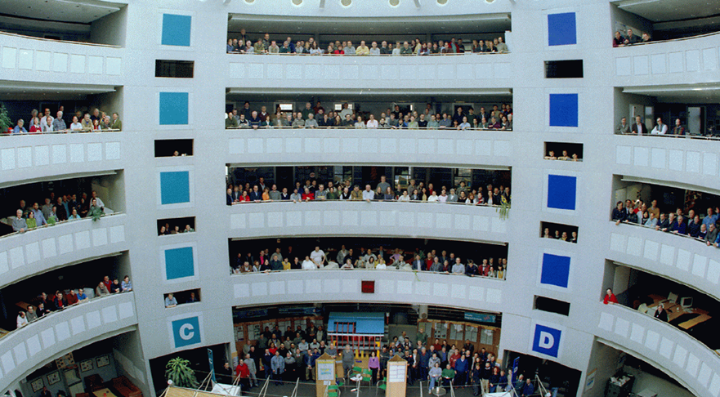
How do we see it?: ATLAS
ATLAS detector
and collaboration

Slide 22
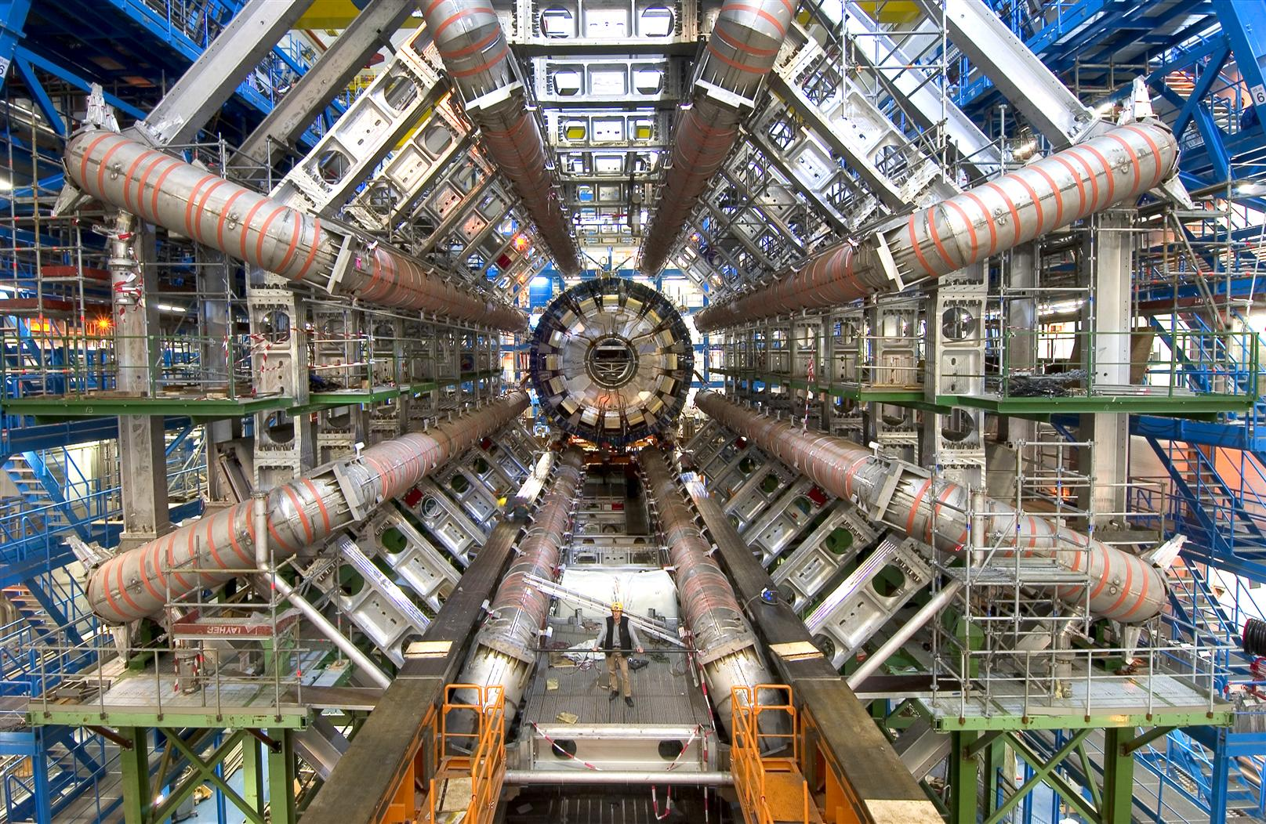
ATLAS detector toroid

Slide 23
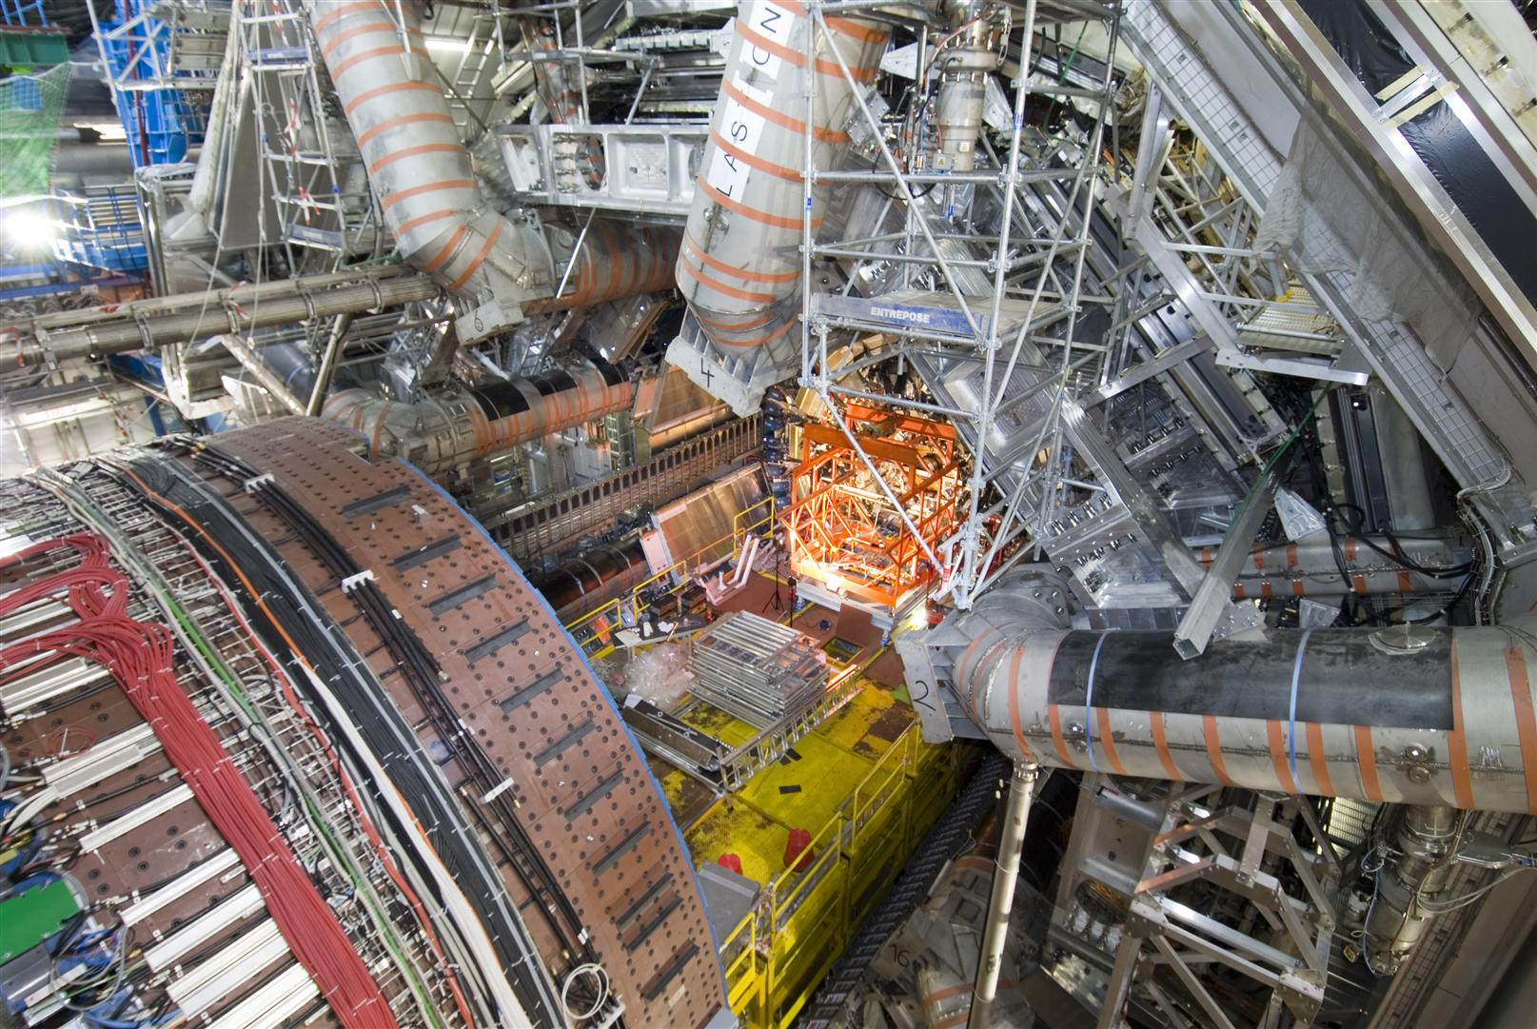
ATLAS assemby

Slide 25
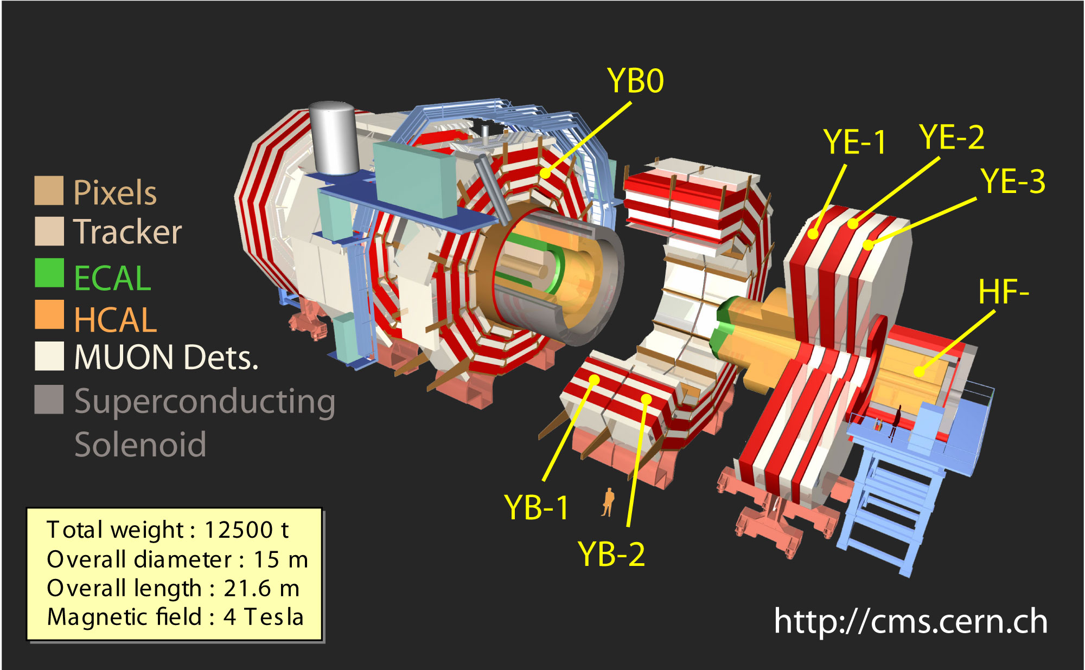
How do we see it?: CMS Detector
>2500 scientists/engineers from 38 countries

Slide 26
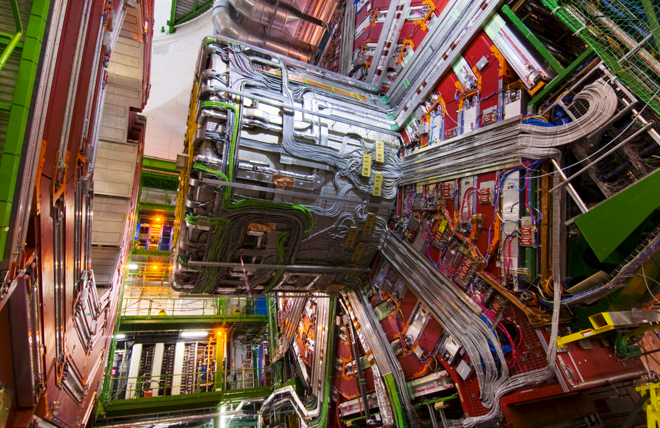
CMS Detector

Slide 27
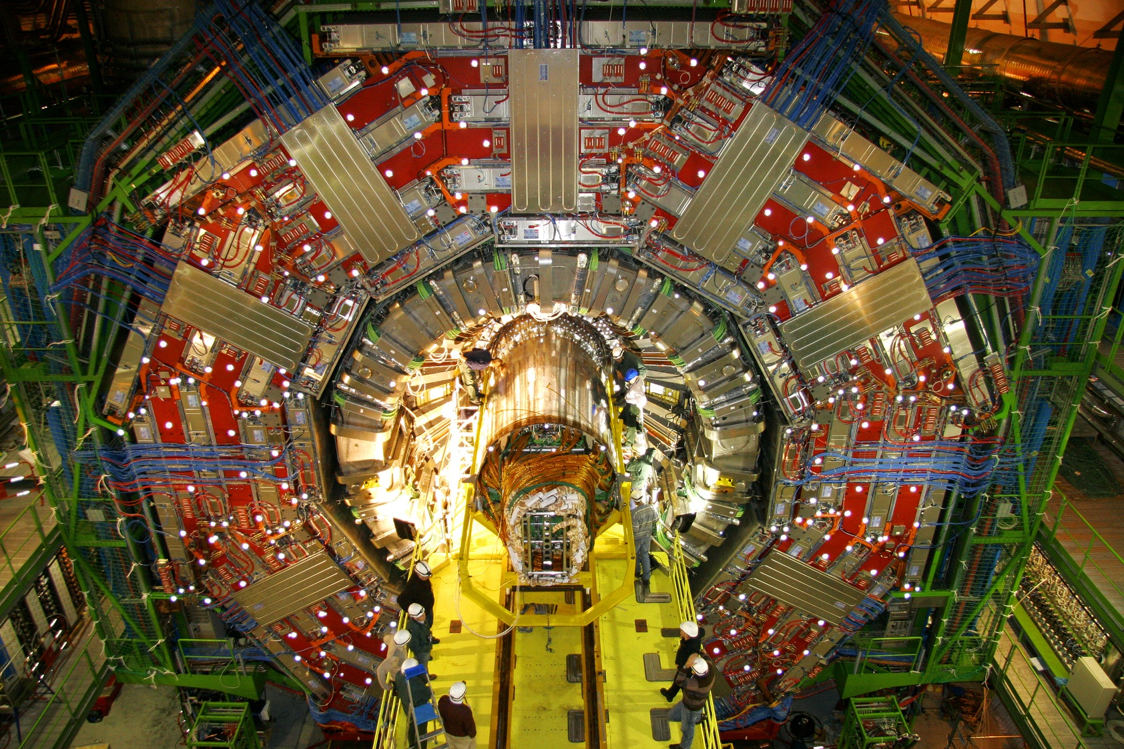
CMS Detector
Tracker Insertion: Dec’07

Slide 28
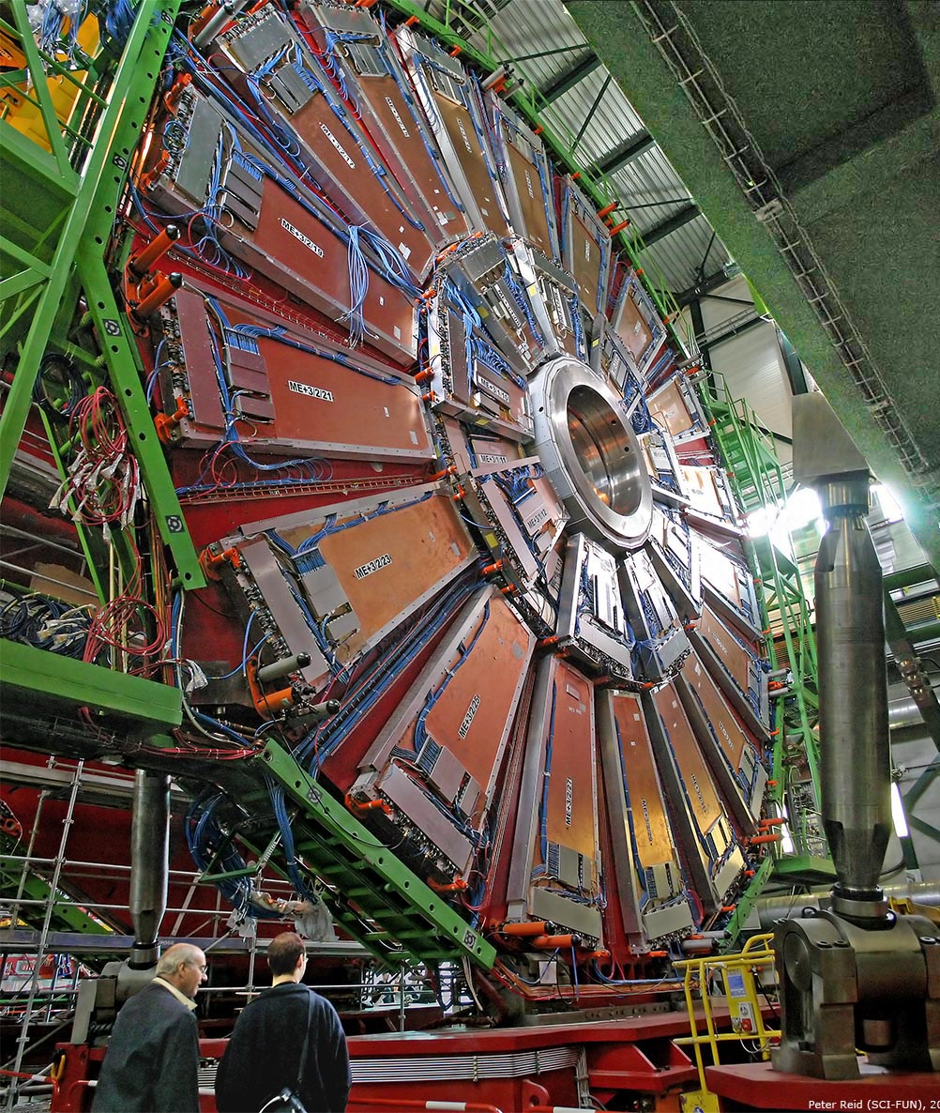
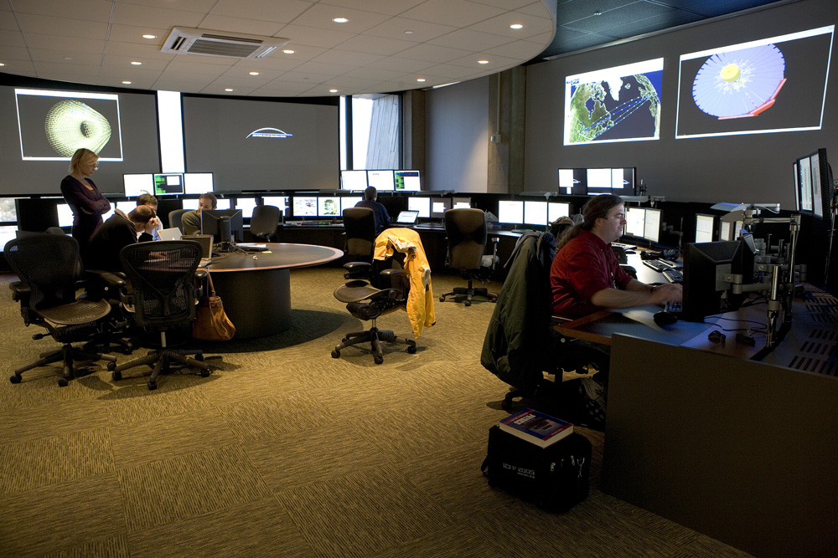
How do we see it?
Remote Operation Center (ROC) at Fermilab

Slide 29
How do we see it? Backgrounds!
per 1 fb⁻¹
1.4 x 10¹⁴
1 x 10¹¹
σ
Tevatron Total Inelastic
mb -
jets (qq, qg, gg)
-
bb
μb -
W
Z
3 x 10⁷
1 x 10⁷
nb -
-
WZ
Single Top
ZZ
tt
14,000
8,000-3,000
pb -
Higgs
Low Mass SUSY
WH,ZH
2000 ~ 200
200 ~ 20
fb -
-
-
-
-
100 120 140 160 180 200
Higgs Mass [GeV/c²]

Slide 30
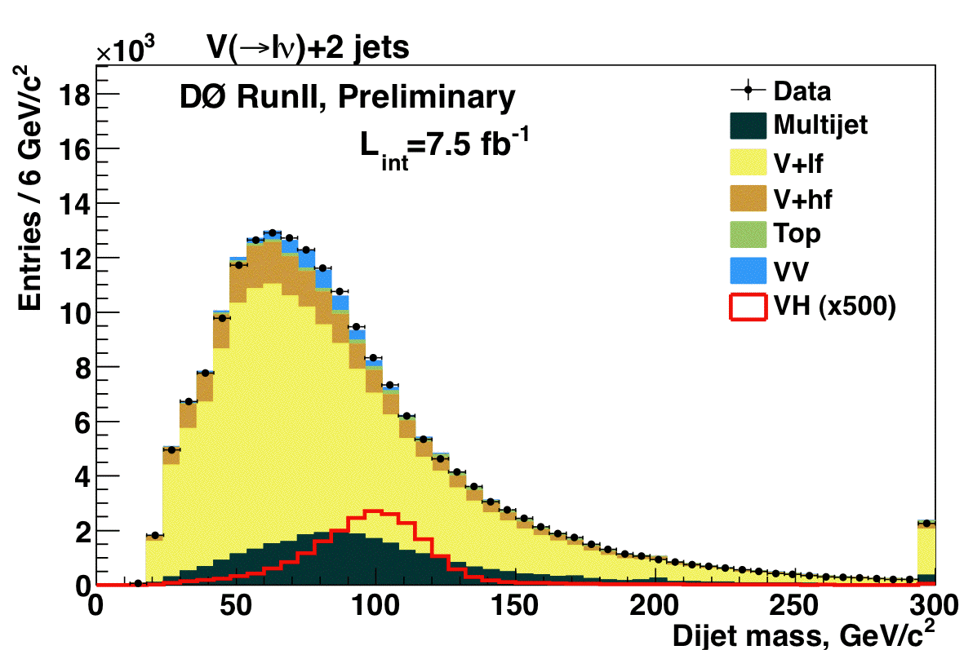
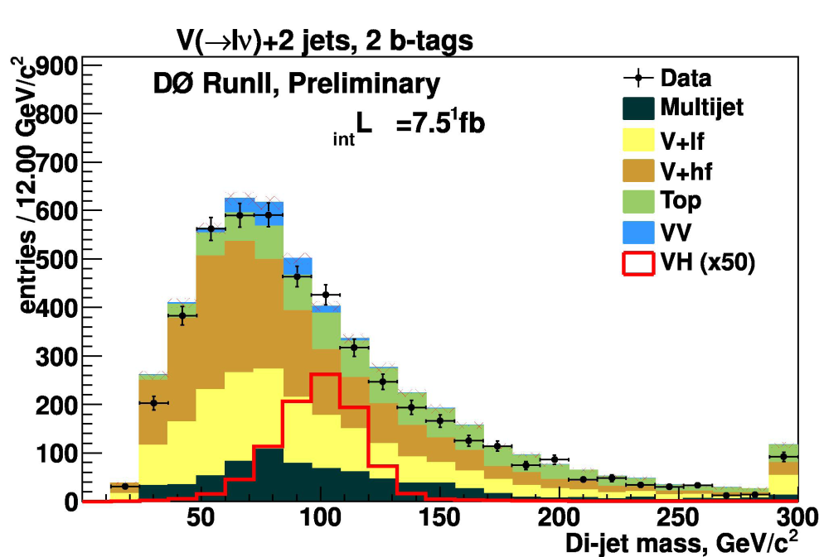
How do we see it? Backgrounds
Requiring b-quarks

Slide 31
How do we see it? Backgrounds
The key to observe the Higgs is to distinguish it from the many orders of magnitude more events produced in the collision
No channel is free of background
Maximize sensitivity through discrimination methods such as neural networks that use the full kinematic information
It can be even more complicated. Pile-up of events at LHC is significant: bunches cross every 50 nsec and each collision has close to ten events – event rate more than 100 MHz!!

Slide 33
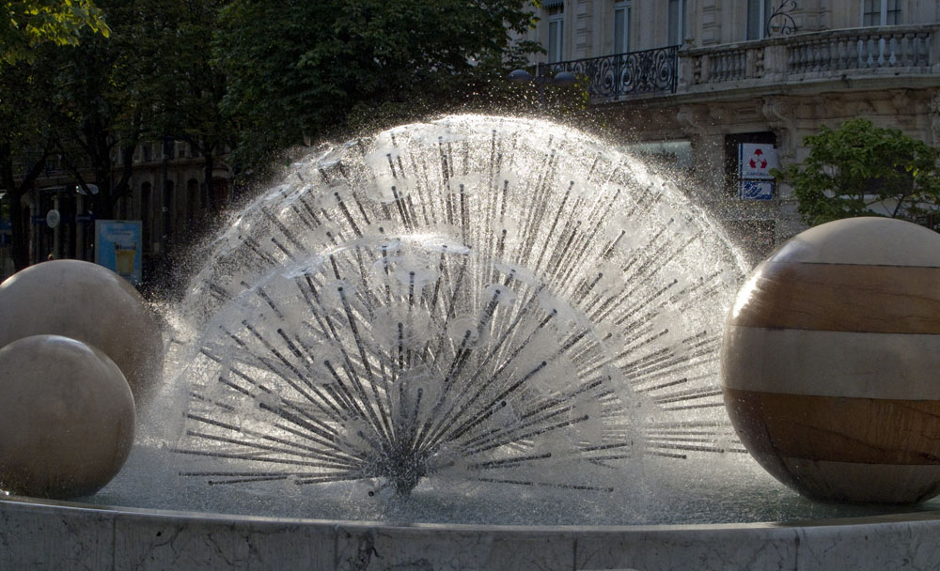
Recent results from EPS-HEP2011
Boulevard Gambetta, Grenoble, France

Slide 34
Eric James, EPS-HEP2011

Slide 35
Eric James, EPS-HEP2011

Slide 37
Recent results: conclusions
Tevatron does not see any significant evidence for the Higgs
Both CMS and ATLAS have hints in the H→WW channel at about 130-160 GeV. Very poor mass resolution because of missing neutrinos. Backgrounds need to be model precisely. Both experiments are correlated in this regard. No definitive claim made
If the excess seen in ATLAS and CMS is real, LHC will find the Higgs in the H→ZZ→4 charged leptons mode
The Tevatron is still relevant at very low masses where the SM Higgs is expected to be. It is likely to have strongest exclusion for the next year

Slide 38
What if there is no Higgs?
The hope of particle physicists was to find super symmetry quickly, then the Higgs and the dark matter particle as the lowest lying super symmetric particle
There is no sign so far of super symmetry. If the Higgs does not exist, then we expect some sort of new strong dynamics to come in and play the role of the Higgs in symmetry breaking.
However, this new strong dynamics may be at considerably higher energies and may take a long time to find. The LHC should find it.

