Slide 1
A2D2 Operational Meeting
Michael Geelhoed

Slide 2
Work and Samples on the horizon
Stonybrook Containers (SUNY CRADA)
EERE 3M Containers (3MEE CRADA)
Stonybrook High Dose (SUNY CRADA)
Stonybrook Low Dose (SUNY CRADA)
MWRD (~ weeks)
FDA (CRADA/RCA)
APS-TD Nb Cavity (Internal)
GWRC Ballast Water (CRADA)
Regher Solar (SPP)
PPD CMS Detector Boards (Internal)
APTIM Leachrate (CRADA/SOW pending)
MWRD (~ months)
SRNL

Slide 3
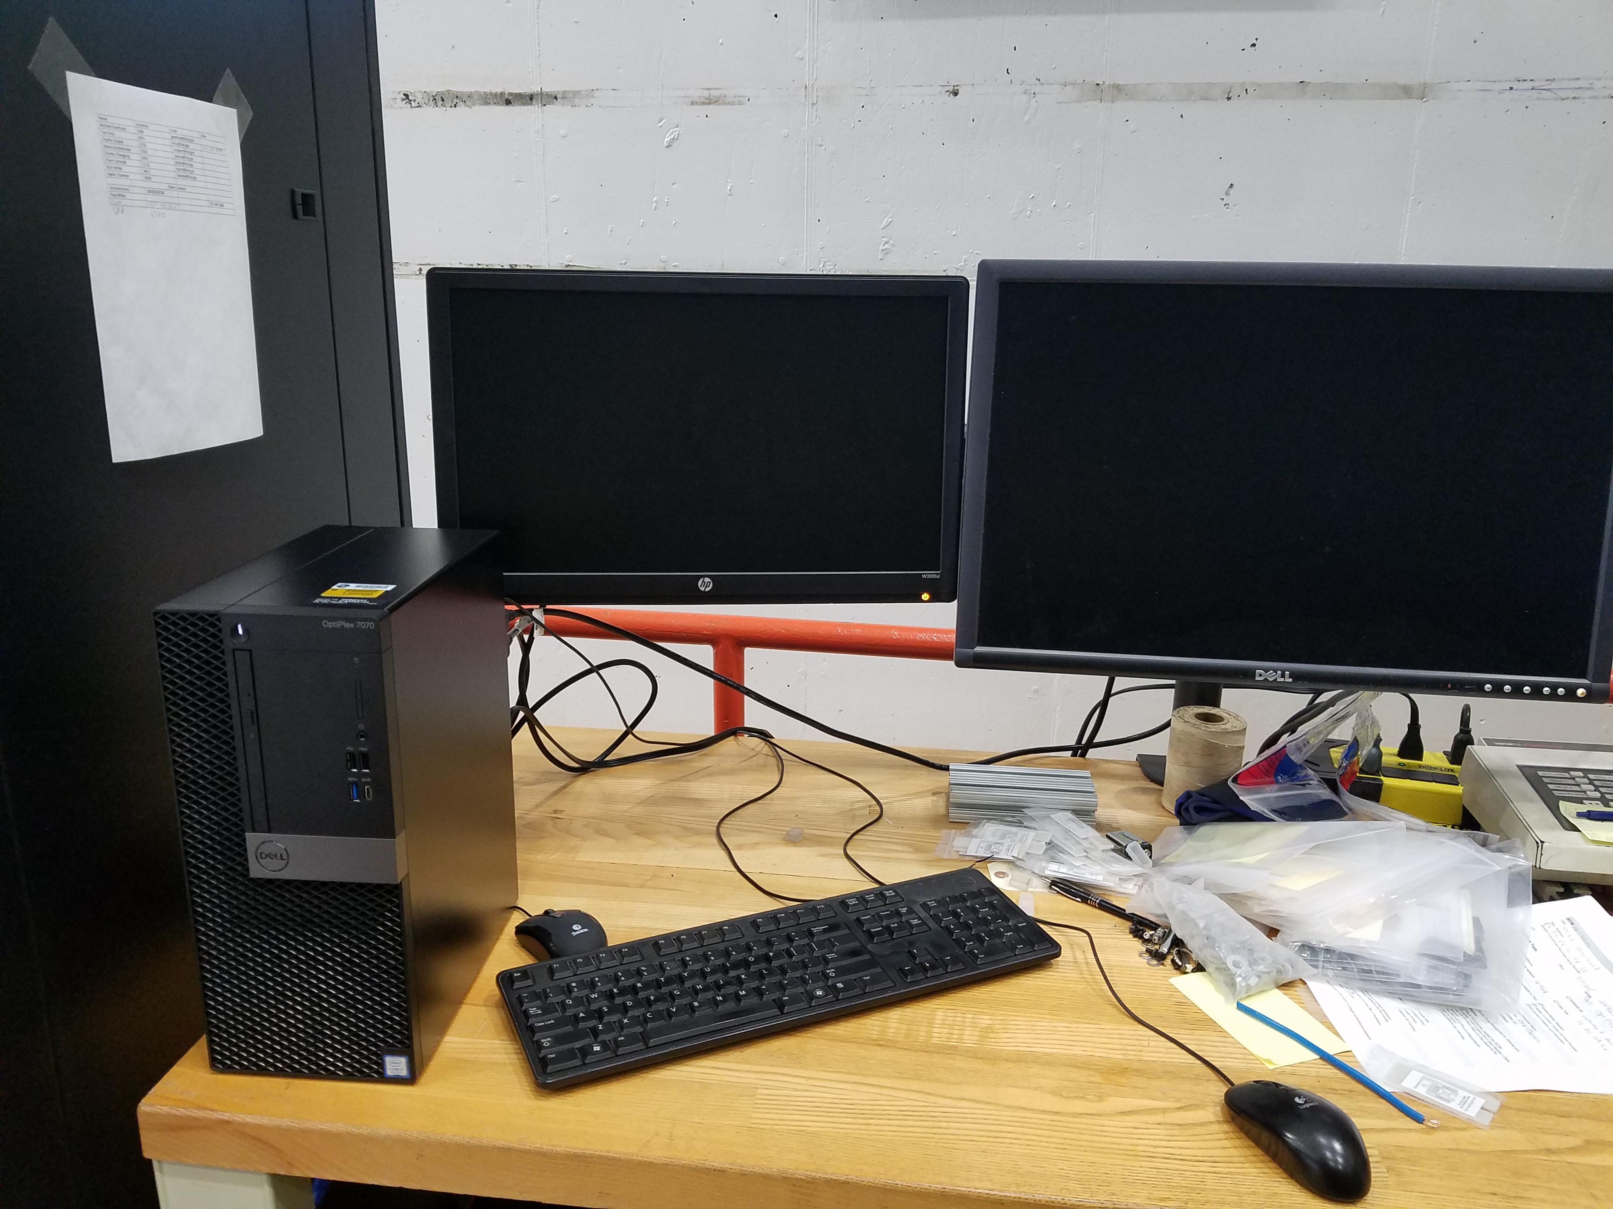
Upgrade and Status
DCO are back on
Procurements
Low Dose Films Pur Req #311174 (NIST)
J. Graves and I talked last week
PO 672237
Labview renewed
10-10.20.09.02
Chris Jacobson is aware

Slide 4
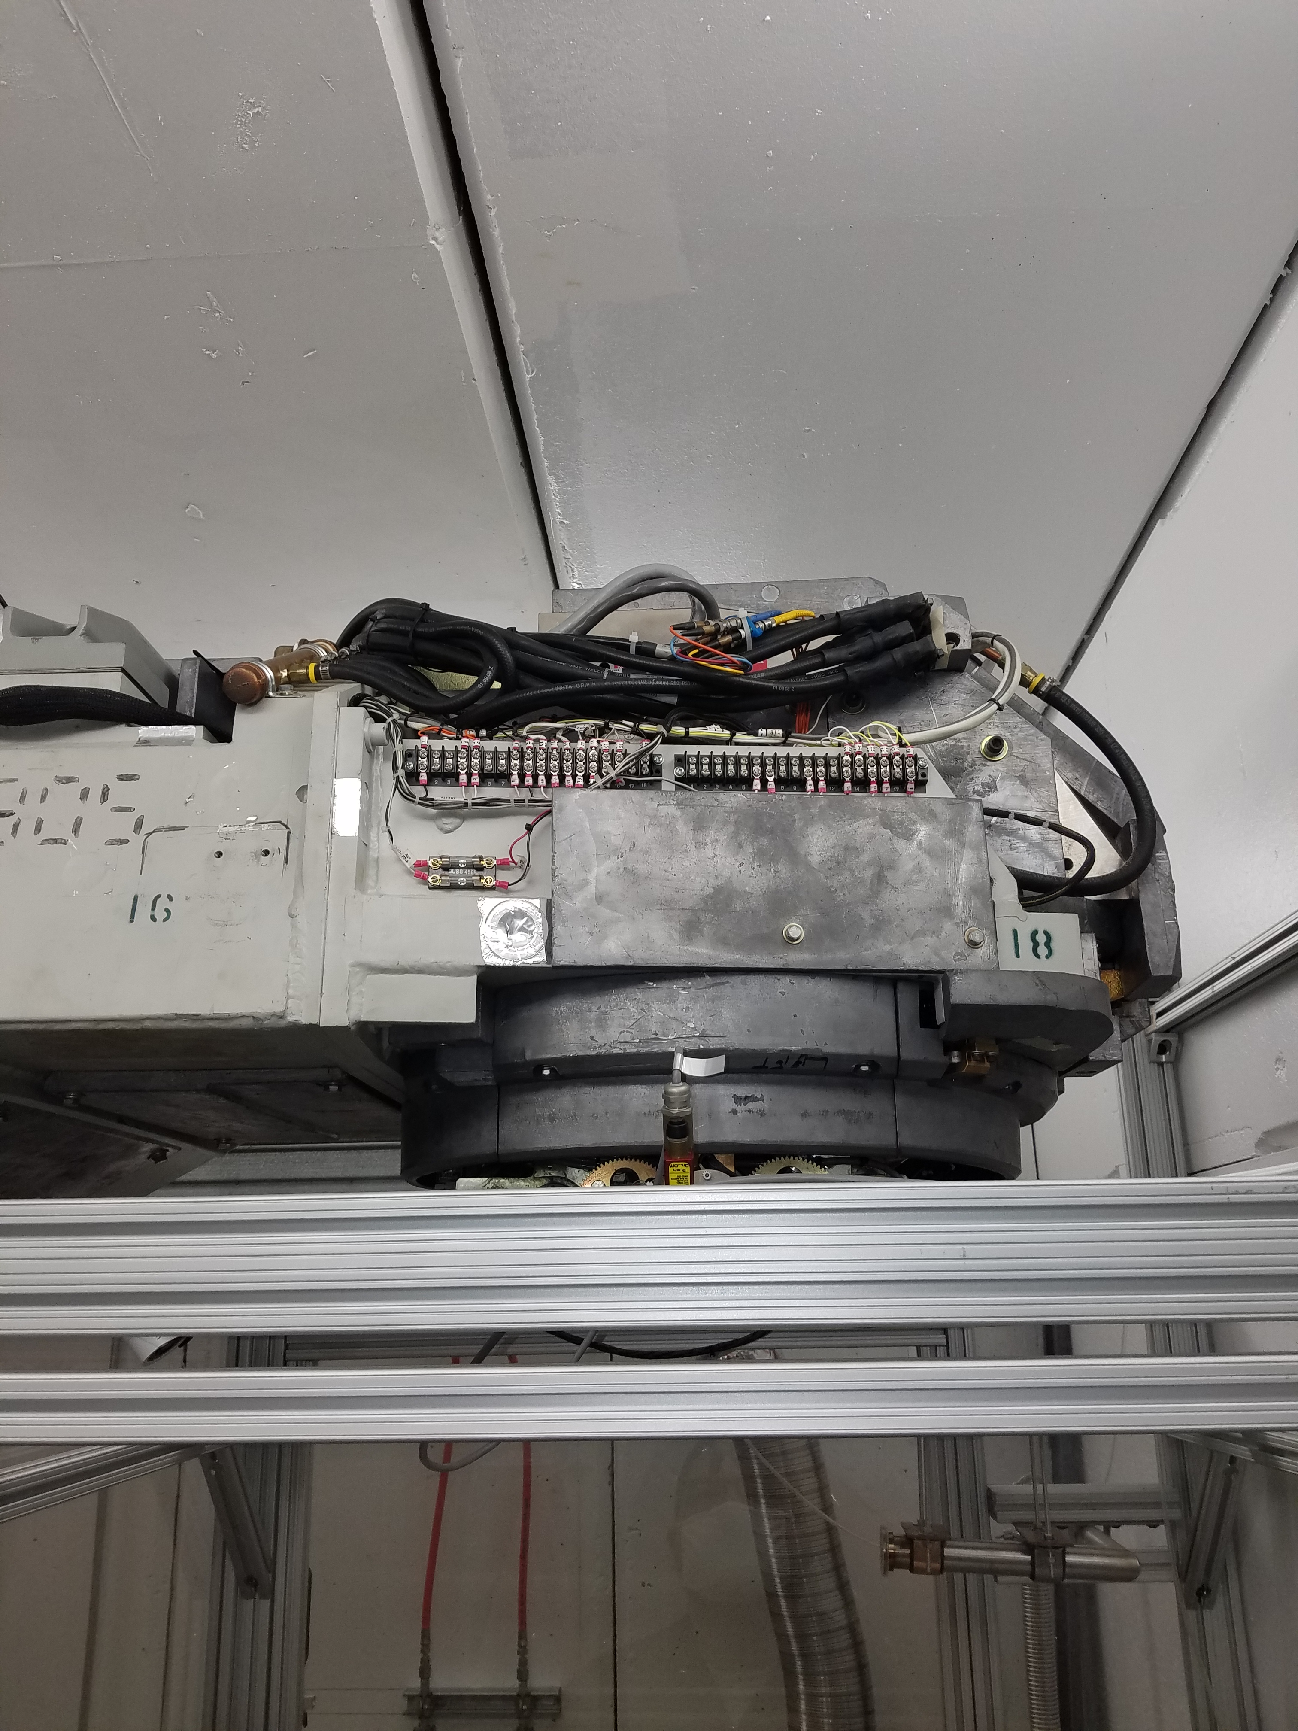
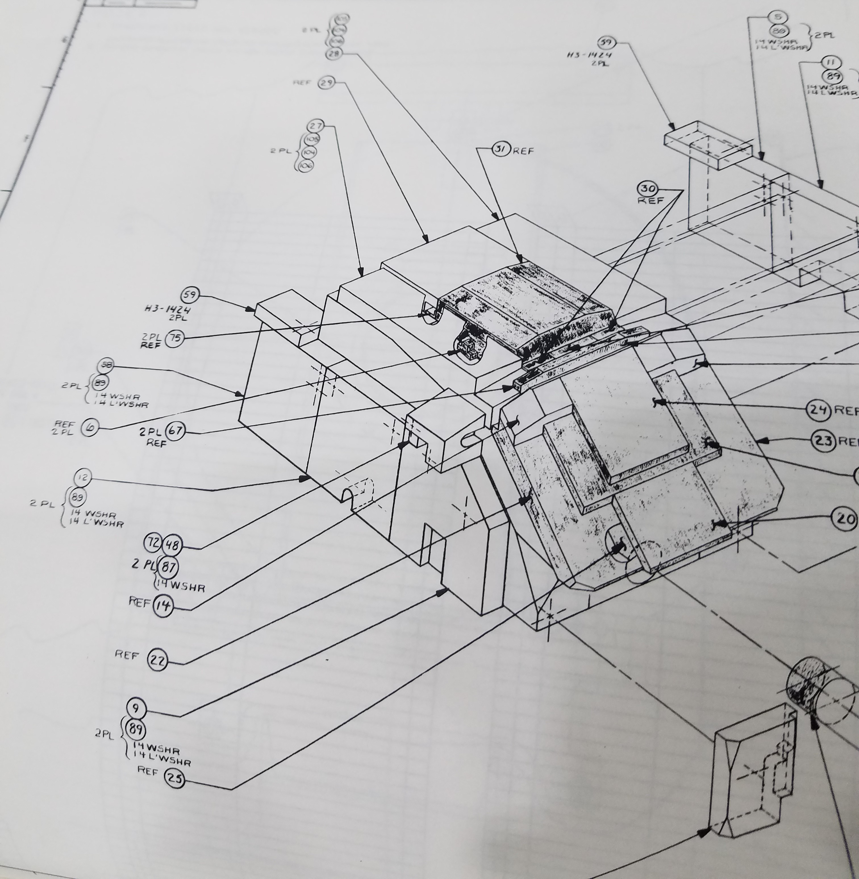
A2D2 Air Leak

Slide 5
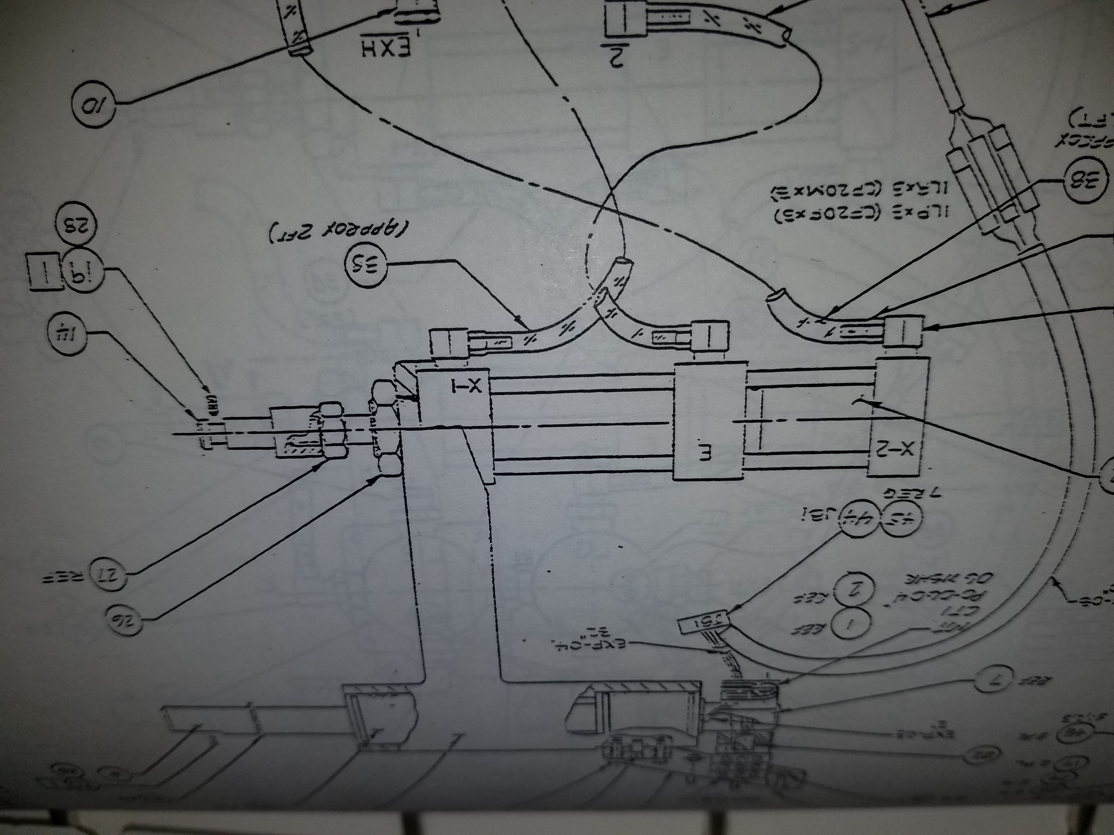
A2D2 Air Leak

Slide 6
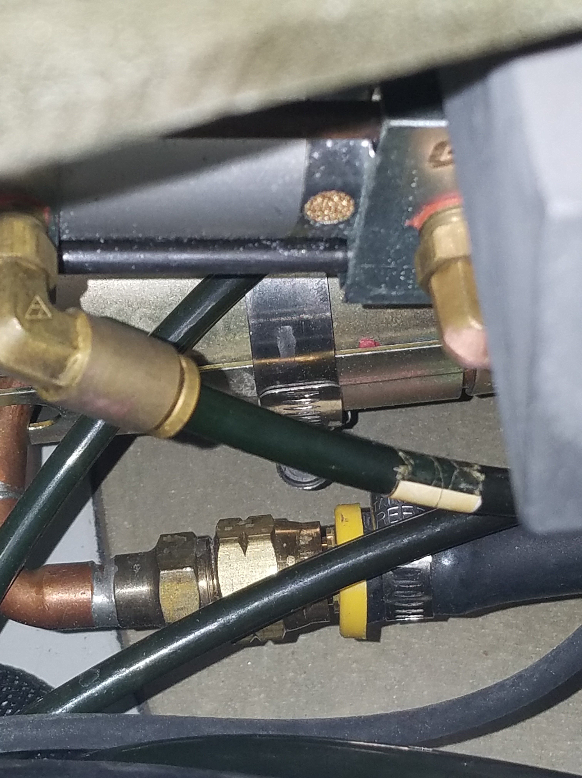
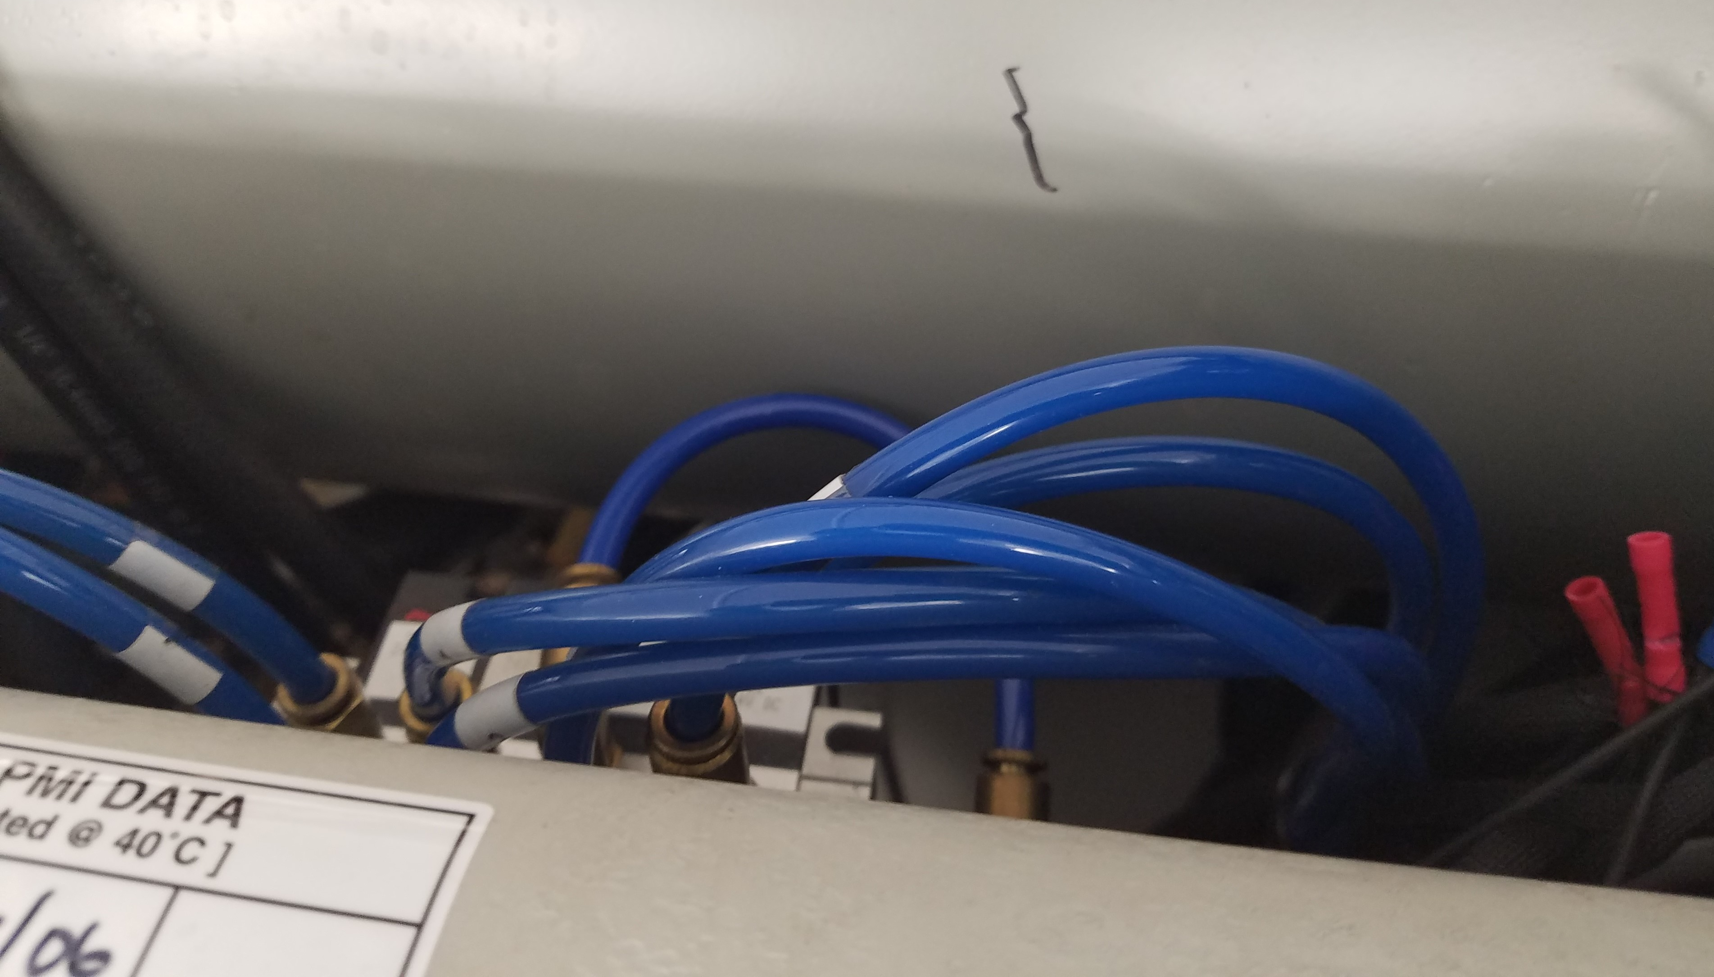
A2D2 Air Leak

Slide 7
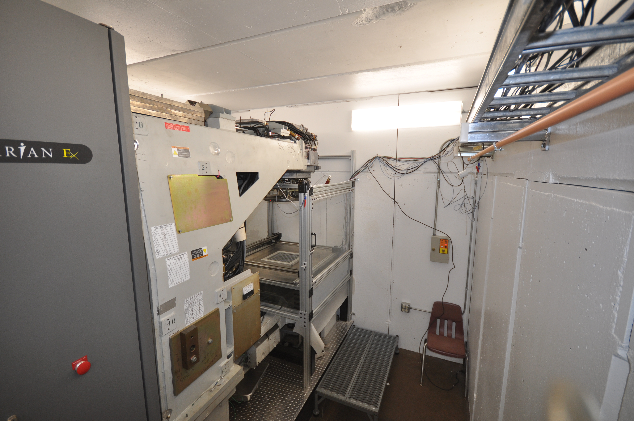
A2D2 Air Leak

Slide 8
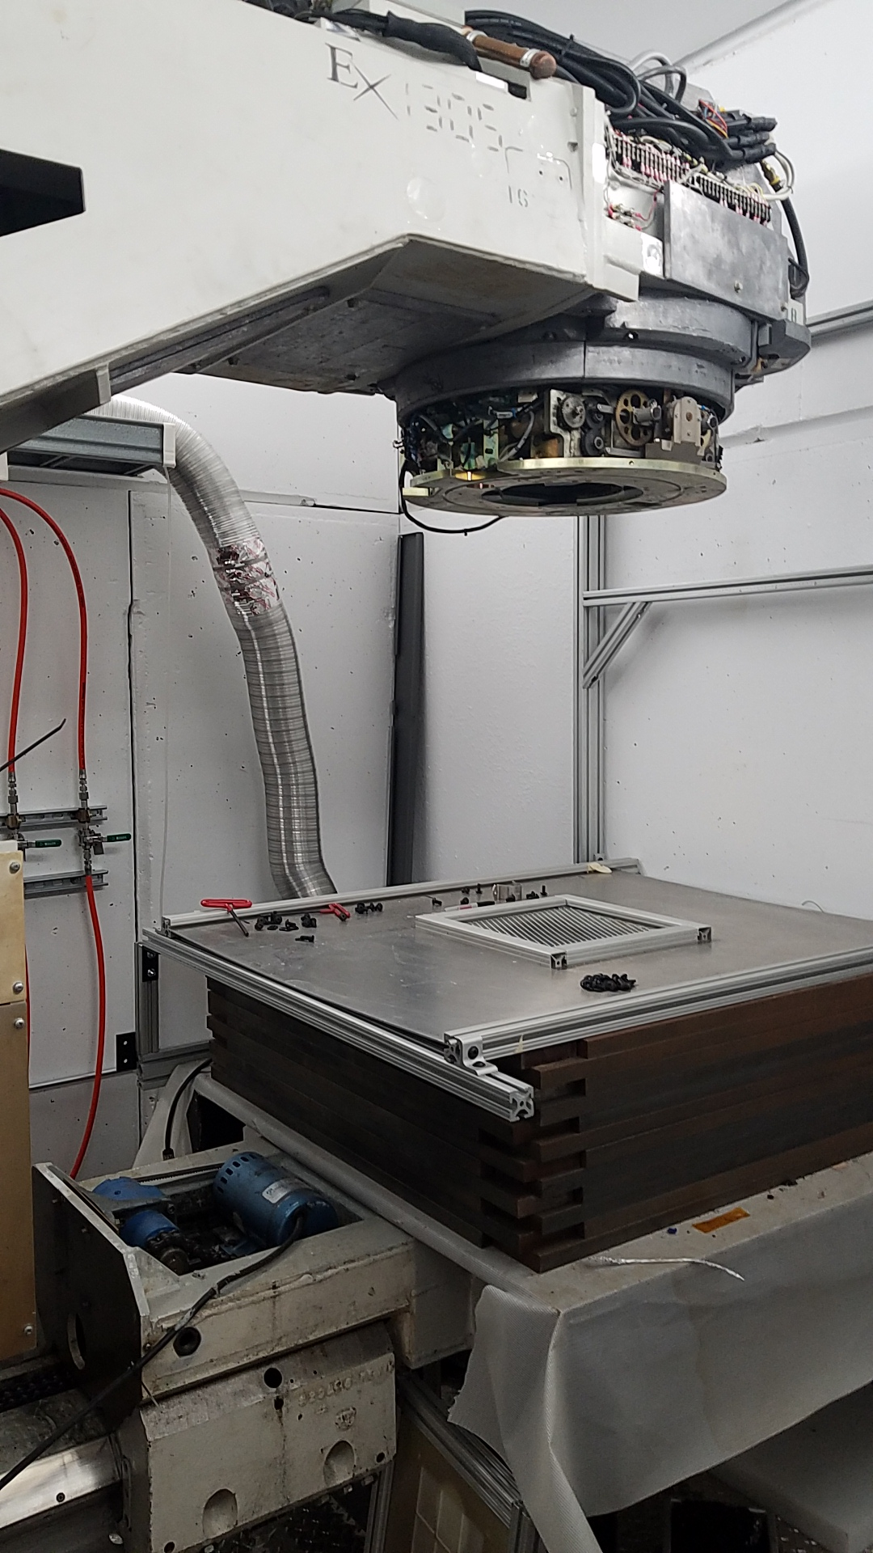
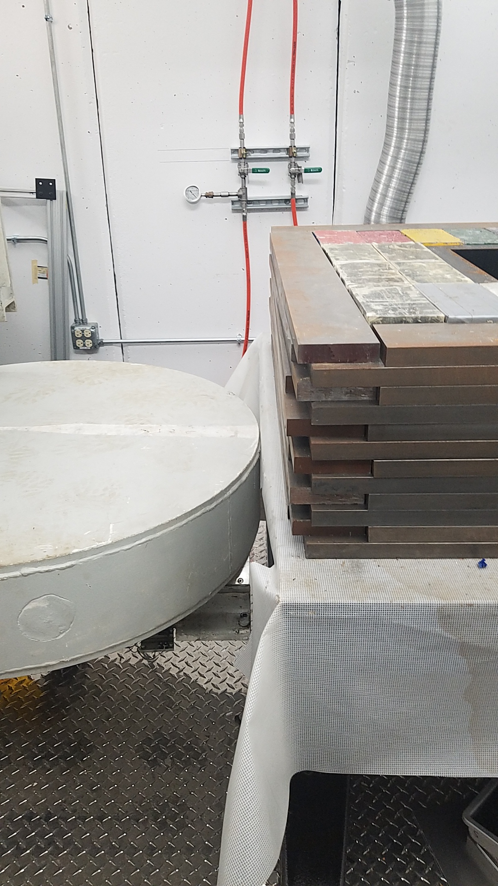
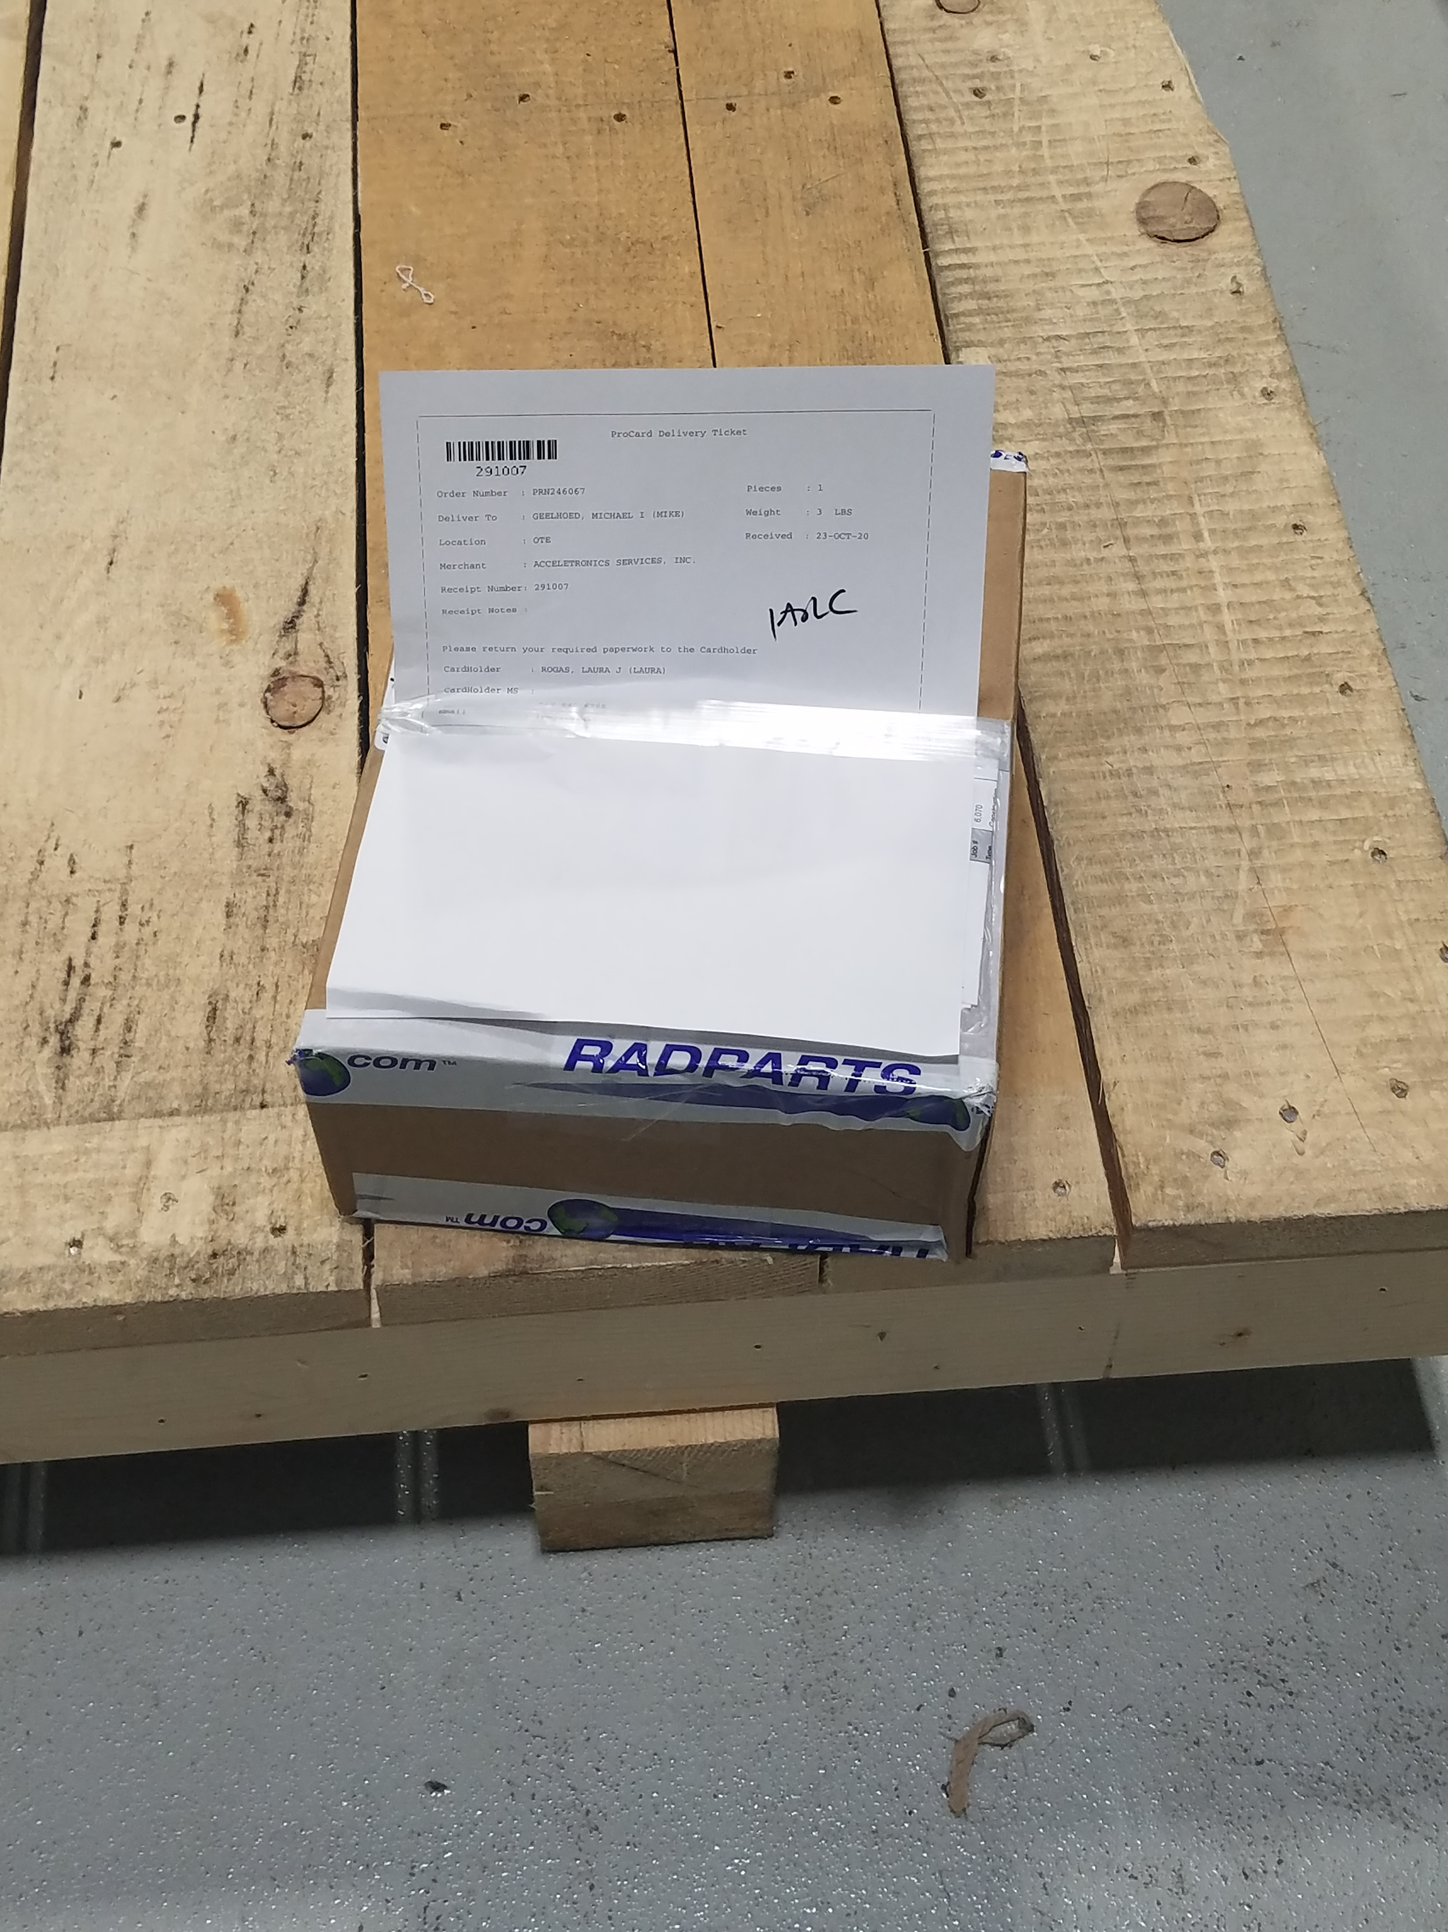
A2D2 Air Leak Solution Ready

Slide 9
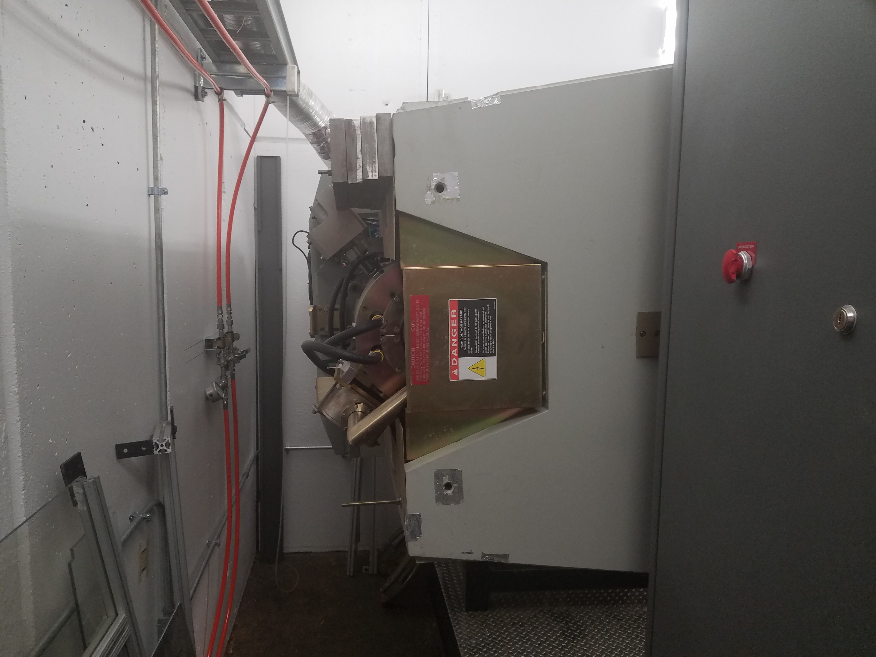
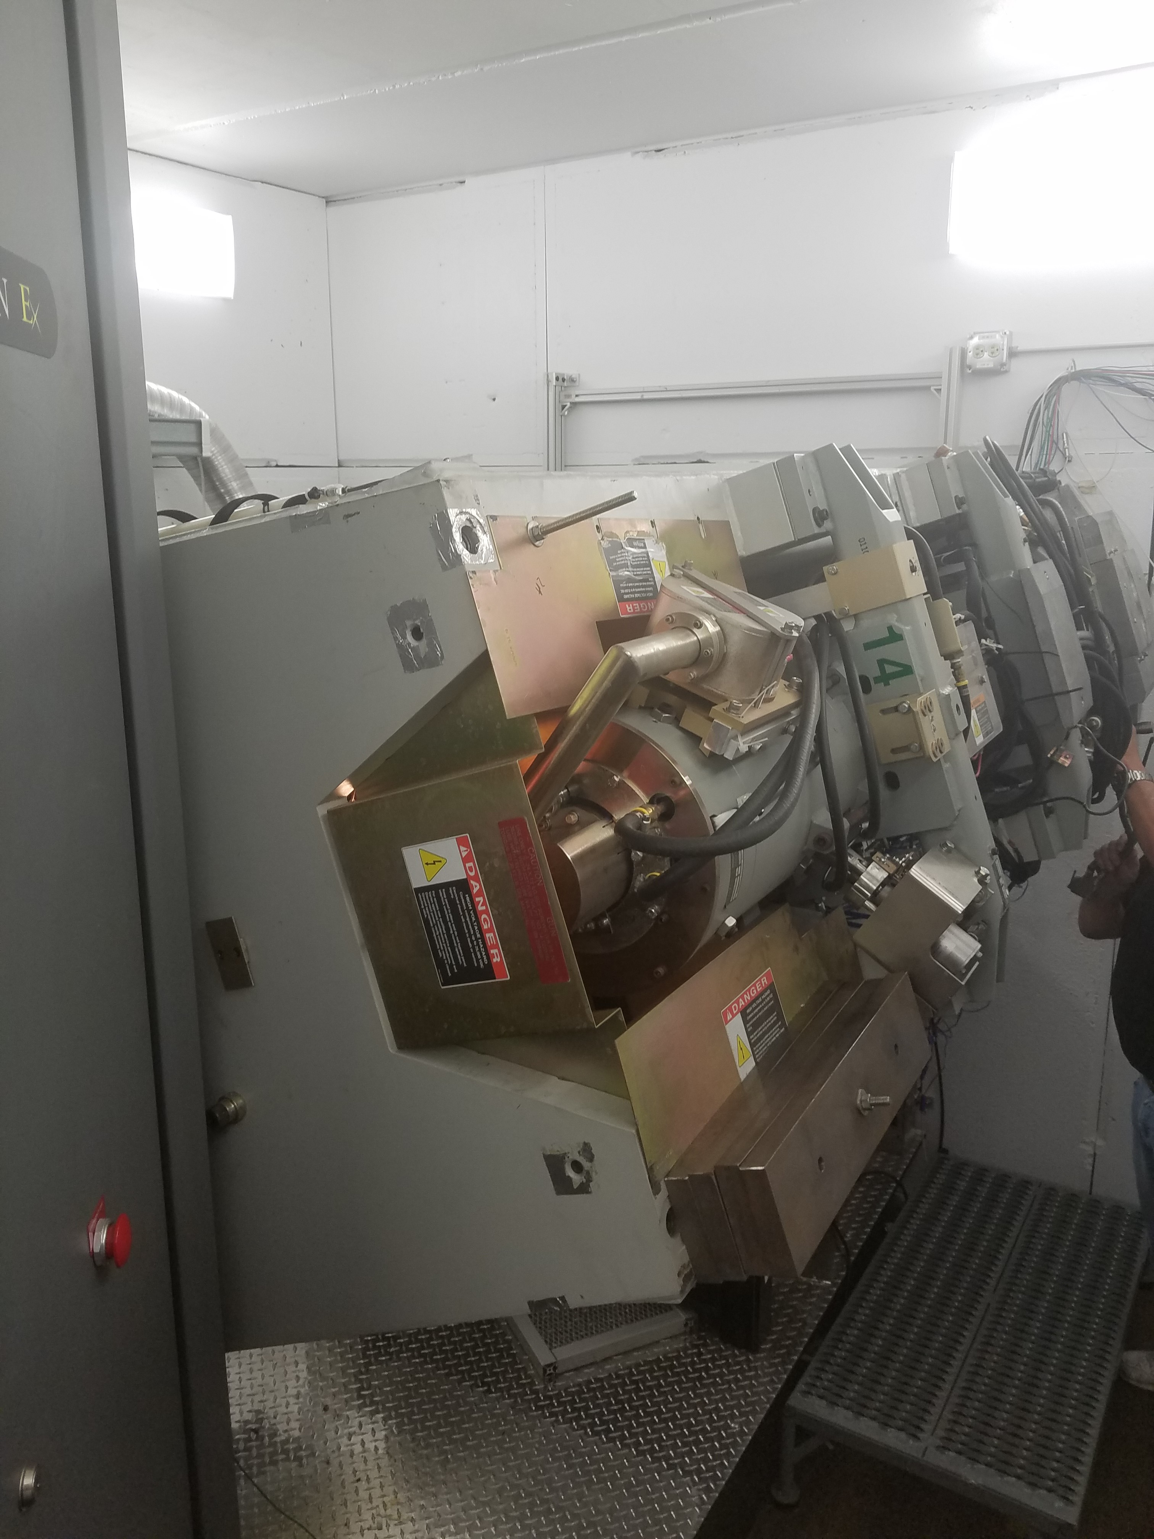
A2D2 Rotated to fix air leak

Slide 10
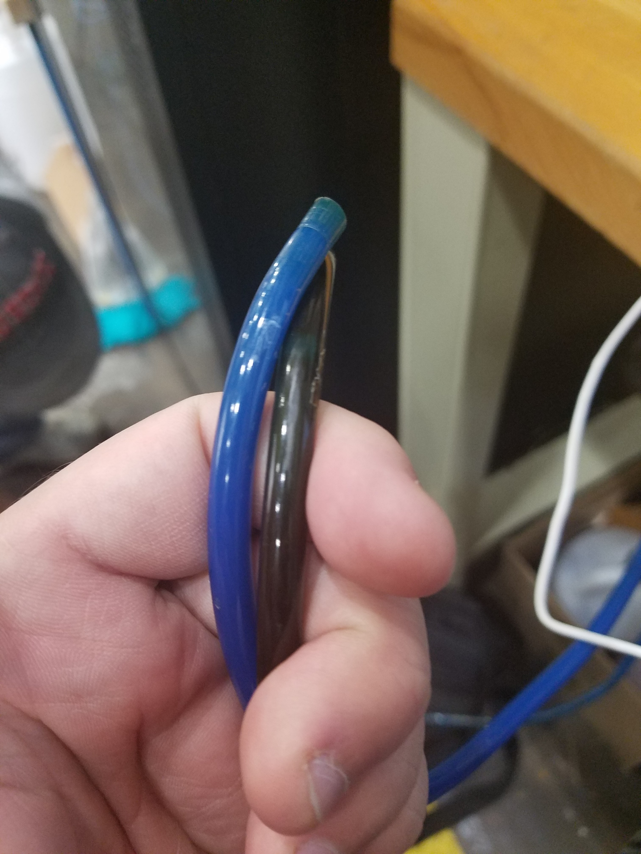
A2D2 Air Leak Fixed

