Slide 1
AF Implementation Task Force
Thomas Roser for the Implementation Task Force
Meetings with AF groups
December 2020

Slide 2
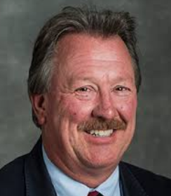
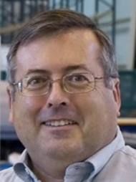
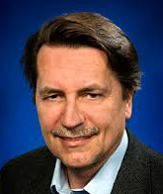
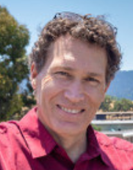
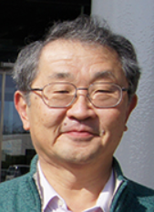
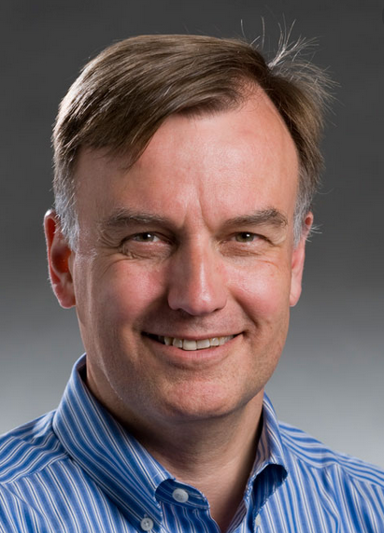
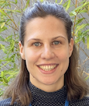
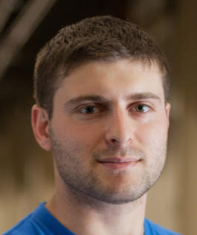
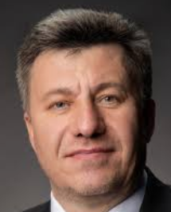
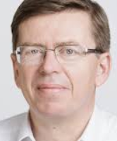
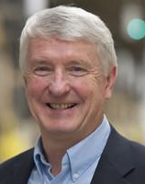
AF Implementation Task Force
Key question for Snowmass’21 Accelerator Frontier to address: “…What are the time and cost scales of the R&D and associated test facilities as well as the time and cost scale of the facility?”
A large number of possible accelerator projects: ILC, Muon Collider, gamma-gamma and ERL options, a large circumference electron ring, and a large circumference hadron ring amongst others.
Comparison of the expected costs (using different accounting rules), schedule, and R&D status for the projects.
The Accelerator Implementation Task Force is charged with developing metrics and processes to facilitate a comparison between projects.
Steve Gourlay (LBNL)
Philippe Lebrun (CERN)
Thomas Roser (BNL, Chair)
Tor Raubenheimer (SLAC)
Katsunobu Oide (KEK)
Jim Strait
(FNAL)
Marlene Turner (LBNL)
Spencer Gessner (SLAC)
Vladimir Shiltsev (FNAL)
Reinhard Brinkmann
(DESY)
John Seeman
(SLAC)

Slide 3
Charge items
Develop the metrics to compare projects’ cost, schedule/timeline, technical risks (readiness), operating cost and environmental impact, and R&D status and plans;
Select the accelerator projects to be evaluated (provided by the AF topical groups);
Work with the proponents of the selected accelerator projects to evaluate them against the metrics
from item 1;
Consider the ultimate limits of various types of colliders: e+/e-, p/p, mu+/mu-;
Consider limits and timescales due to accelerator technology for various types of colliders:
e+/e-, p/p, mu+/mu-;
Lead the evaluation of the different HEP accelerator proposals and inform and communicate with the Snowmass’21 AF, EF, NF and TF;
Document the metrics, processes, and conclusions for the Snowmass'21 meeting in the Summer 2021; write and submit a corresponding White Paper.

Slide 4
LHC example

Slide 5
LHC example

Slide 6
LHC example

Slide 7
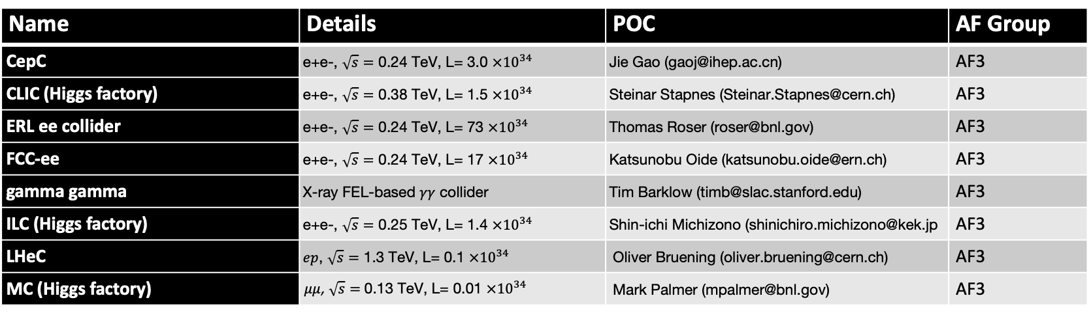
Higgs factory concepts / proposals (8)
Name | Details | POC | AF Group
CepC | e+e-, $\sqrt{s}=$ 0.24 TeV, L= 3.0 $×{10}^{34}$ | Jie Gao (gaoj@ihep.ac.cn) | AF3
CLIC (Higgs factory) | e+e-, $\sqrt{s}=$ 0.38 TeV, L= 1.5 $×{10}^{34}$ | Steinar Stapnes (Steinar.Stapnes@cern.ch) | AF3
ERL ee collider | e+e-, $\sqrt{s}=$ 0.24 TeV, L= 73 $×{10}^{34}$ | Thomas Roser (roser@bnl.gov) | AF3
FCC-ee | e+e-, $\sqrt{s}=$ 0.24 TeV, L= 17 $×{10}^{34}$ | Katsunobu Oide (katsunobu.oide@ern.ch) | AF3
gamma gamma | X-ray FEL-based $γγ$ collider | Tim Barklow (timb@slac.stanford.edu) | AF3
ILC (Higgs factory) | e+e-, $\sqrt{s}=$ 0.25 TeV, L= 1.4 $×{10}^{34}$ | Shin-ichi Michizono (shinichiro.michizono@kek.jp | AF3
LHeC | $ep$, $\sqrt{s}=$ 1.3 TeV, L= 0.1 $×{10}^{34}$ | Oliver Bruening (oliver.bruening@cern.ch) | AF3
MC (Higgs factory) | $μμ$, $\sqrt{s}=$ 0.13 TeV, L= 0.01 $×{10}^{34}$ | Mark Palmer (mpalmer@bnl.gov) | AF3

Slide 8
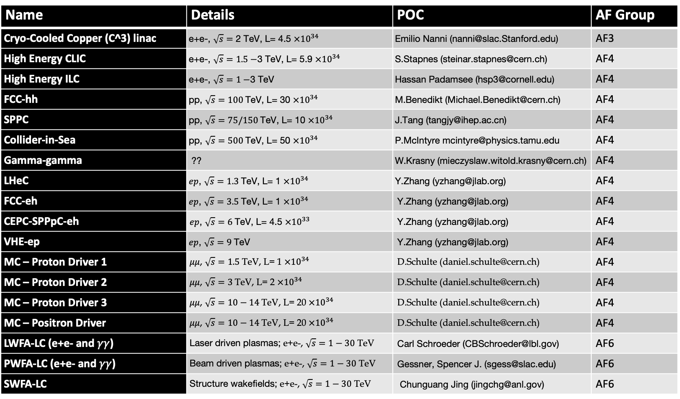
High energy concepts / proposals (18)
Name | Details | POC | AF Group
Cryo-Cooled Copper (C^3) linac | e+e-, $\sqrt{s}=$ 2 TeV, L= 4.5 $×{10}^{34}$ | Emilio Nanni (nanni@slac.Stanford.edu) | AF3
High Energy CLIC | e+e-, $\sqrt{s}=1.5−$3 TeV, L= 5.9 $×{10}^{34}$ | S.Stapnes (steinar.stapnes@cern.ch) | AF4
High Energy ILC | e+e-, $\sqrt{s}=1−$3 TeV | Hassan Padamsee (hsp3@cornell.edu) | AF4
FCC-hh | pp, $\sqrt{s}=100$TeV, L= 30 $×{10}^{34}$ | M.Benedikt (Michael.Benedikt@cern.ch) | AF4
SPPC | pp, $\sqrt{s}=75/150$TeV, L= 10 $×{10}^{34}$ | J.Tang (tangjy@ihep.ac.cn) | AF4
Collider-in-Sea | pp, $\sqrt{s}=500$TeV, L= 50 $×{10}^{34}$ | P.McIntyre mcintyre@physics.tamu.edu | AF4
Gamma-gamma | ?? | W.Krasny (mieczyslaw.witold.krasny@cern.ch) | AF4
LHeC | $ep$, $\sqrt{s}=1.3$TeV, L= 1 $×{10}^{34}$ | Y.Zhang (yzhang@jlab.org) | AF4
FCC-eh | $ep$, $\sqrt{s}=3.5$TeV, L= 1 $×{10}^{34}$ | Y.Zhang (yzhang@jlab.org) | AF4
CEPC-SPPpC-eh | $ep$, $\sqrt{s}=6$TeV, L= 4.5 $×{10}^{33}$ | Y.Zhang (yzhang@jlab.org) | AF4
VHE-ep | $ep$, $\sqrt{s}=9$TeV | Y.Zhang (yzhang@jlab.org) | AF4
MC – Proton Driver 1 | $μμ$, $\sqrt{s}=1.5$TeV, L= 1 $×{10}^{34}$ | D.Schulte (daniel.schulte@cern.ch) | AF4
MC – Proton Driver 2 | $μμ$, $\sqrt{s}=3$TeV, L= 2 $×{10}^{34}$ | D.Schulte (daniel.schulte@cern.ch) | AF4
MC – Proton Driver 3 | $μμ$, $\sqrt{s}=10−14$TeV, L= 20 $×{10}^{34}$ | D.Schulte (daniel.schulte@cern.ch) | AF4
MC – Positron Driver | $μμ$, $\sqrt{s}=10−14$TeV, L= 20 $×{10}^{34}$ | D.Schulte (daniel.schulte@cern.ch) | AF4
LWFA-LC (e+e- and $γγ$) | Laser driven plasmas; e+e-, $\sqrt{s}=1−30$ TeV | Carl Schroeder (CBSchroeder@lbl.gov) | AF6
PWFA-LC (e+e- and $γγ$) | Beam driven plasmas; e+e-, $\sqrt{s}=1−30$ TeV | Gessner, Spencer J. (sgess@slac.edu) | AF6
SWFA-LC | Structure wakefields; e+e-, $\sqrt{s}=1−30$ TeV | Chunguang Jing (jingchg@anl.gov) | AF6

Slide 9
Status
ITF is focusing on collider facilities.
AF topical groups (AF3,4,6) have provided initial lists of proposals and concepts for evaluation to the ITF.
Proposal for four categories:
  Existing facilities for references (Tevatron, RHIC, LEP, LHC, Super KEKB, XFEL, LCLS II ...) [Existing]
  Proposals with TDR and/or CDR [CDR/TDR]
  Proposal without TDR or CDR but reasonably well thought through and mostly based on existing technologies. An estimate for component counts exists. [Concept]
  Future concepts and ideas [Future concepts]
The ITF developed a set of metrics that will be used to evaluate the proposals and concepts. A spreadsheet to be filled out by the proponents of proposals and concepts will be distributed soon.
ITF will assemble and evaluate all this information and prepare an overall comparison of all the proposals and concepts. This will be presented to the AF topical groups at a workshop, probably during spring 2021, for comments and feedback.
ITF will prepare a White Paper with the metrics, processes and conclusions for Snowmass’21 in summer 2021.

