Slide 1
Status of hadronic calorimetry in GEANT4
Hans Wenzel, Adam Para, Sunanda Banerjee, Julia Yarba
Fermilab
CPAD Instrumentation Frontier Workshop
18-22 March 2021, Stony Brook, NY

Slide 2
Outline
Motivation
Geant4 hadronic physics
Validation
Thin target tests
Calorimeter setups
The Geant4 validation portal
Geant4 as a predictive tool
Identifying particles of interest
utilizing the time structure of hadronic showers
Dual readout total absorption Calorimetry: hadron shower development
Conclusions

Slide 3
Motivation
Proposed Lepton collider projects: ILC, CLIC, FCCee, CEPC, muon Collider for different energy regimes: 91 GeV (Z-factory), 250 GeV (Higgs-factory), and multi TeV for linear/muon colliders.
Precision frontier: measurement of Higgs couplings, W, Z and top properties, searches for BSM physics.
Many of the physics channels of interest involve hadronic jets in the final state → hadronic calorimetry paramount for extracting the physics!
Typical benchmark: to distinguish di-jets from W and Z decaying into hadrons → Goal: 3-4% jet energy resolution requiring much better hadron calorimeters.
Many ideas and concepts to improve the performance of hadronic calorimeters. Exploring this ideas requires more than just modeling of global observables in hadron calorimeters (response, resolution, longitudinal center of gravity, shower radius etc.). We will rely on the Simulation to make predictions and to identify the most relevant contributions on calorimeter performance.
This ideas include:
dual readout calorimetry¹: uses Cerenkov light produced by light relativistic particles (β>1/n) in the shower to correct energy response. This requires good description of particle content of hadronic showers, good description of the velocity distribution of produced particles to predict the amount of Cerenkov light.
Temporal structure of hadronic showers: this requires the detailed knowledge of the spatial and temporal development of hadronic showers and requires the detailed treatment of neutrons.
Particle flow algorithms²: combines tracking of charged particles with imaging, highly segmented calorimeters (CALICE). It relies on the possibility to disentangle contributions from particles within jets and identify the sub structure of showers.
1) see e.g.: M. Demarteau: “Total Absorption Calorimetry, a path to superior jet energy resolution ”, this conference.
2) see e.g.: S. Chekanov: “Calorimeter performance studies using Monte Carlo simulations for future collider detectors”, this conference.

Slide 4
Geant4 hadronic physics
https://groups.lal.in2p3.fr/ED-geant4/

Slide 5
Factories allow to customize physics
Reference physics list:
FTFP_BERT
FTFP_BERT_HP
FTFP_BERT_TRV
FTFP_BERT_ATL
FTFP_INCLXX
FTFP_INCLXX_HP
FTF_BIC
QGSP_BERT
QGSP_BERT_HP
QGSP_BIC
QGSP_BIC_HP
QGS_BIC
QGSP_INCLXX
QGSP_INCLXX_HP
QBBC
Shielding(M)
ShieldingLEND
NuBeam
Em Option:
””
_EMV
_EMX
_EMY
_EMZ
_LIV
_PEN
__GS
__SS
_EM0
_WVI
__LE
Physics Constructor:
G4OpticalPhysics
G4NeutronTrackingCut
G4StepLimiterPhysics
…
Achieve higher precision when and where you need it. Speed up processing time when less precision is sufficient.
Be aware of transition regions between models.
Be aware model might not apply to particle of interest.
Useful:
C++: phys->DumpList();
Will list all models attached to particles and energy ranges.
+ you can register your own custom physics list!

Slide 6
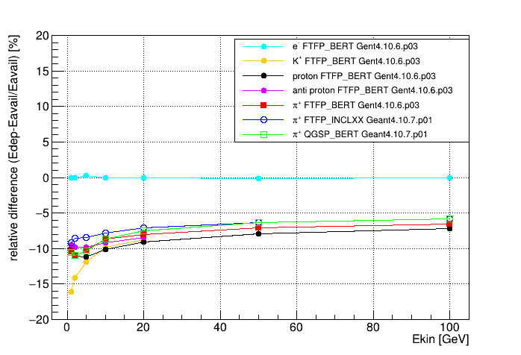
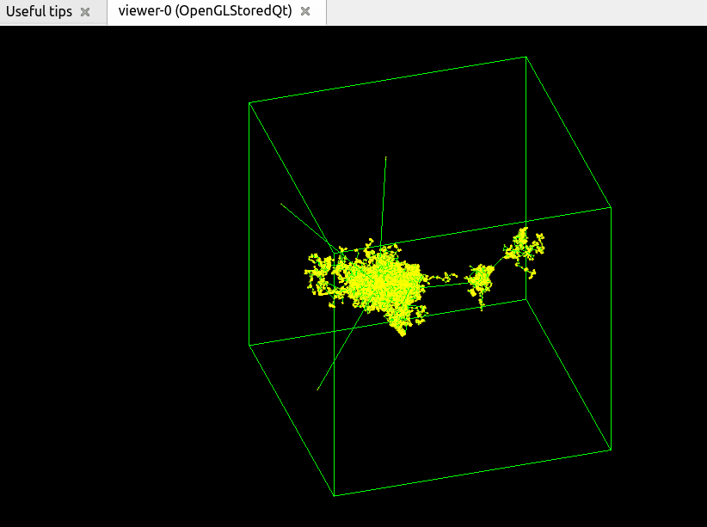
Energy response for various particles and physics lists
Available Energy Eavail:
e⁻, p : Ekin
π⁺ : Ekin + mπ⁺
K⁺ : Ekin + mK⁺
pbar : Ekin + 2 x mp
Very simple geometry: 5 x 5 x 5 m³ cube of PbWO
Particle Gun located inside the volume
Below is the shower created by a π⁺ with 20 GeV kinetic Energy

Slide 7
Validation
It’s a continuous effort leading to continuous improvement of models and providing of alternative models.
There are mainly two types of validation tests:
Simple benchmarks: typical thin-target setups with simple Geometry. They test a single interaction and a specific physics model. (often limited by the availability and quality of experimental data). But experimentalists should feel some responsibility to identify particles and processes of interest, do their own tests and provide feed back to the Geant4 collaboration (so put your students to work ☺).
Full Calorimeter setups: e.g. test-beams. The observables are the convolution of many effects and interactions. Mostly performed by the experiments.
A subset of test results are collected in the Geant4 Validation Portal (https://geant-val.cern.ch/). This is an active development. New tests and experimental data are added continuously (labor intense process).
Regression testing: keep track of changes.
Regular validation work shops: see e.g.: https://indico.cern.ch/event/964486
Publications see: https://geant4.web.cern.ch/publications

Slide 8
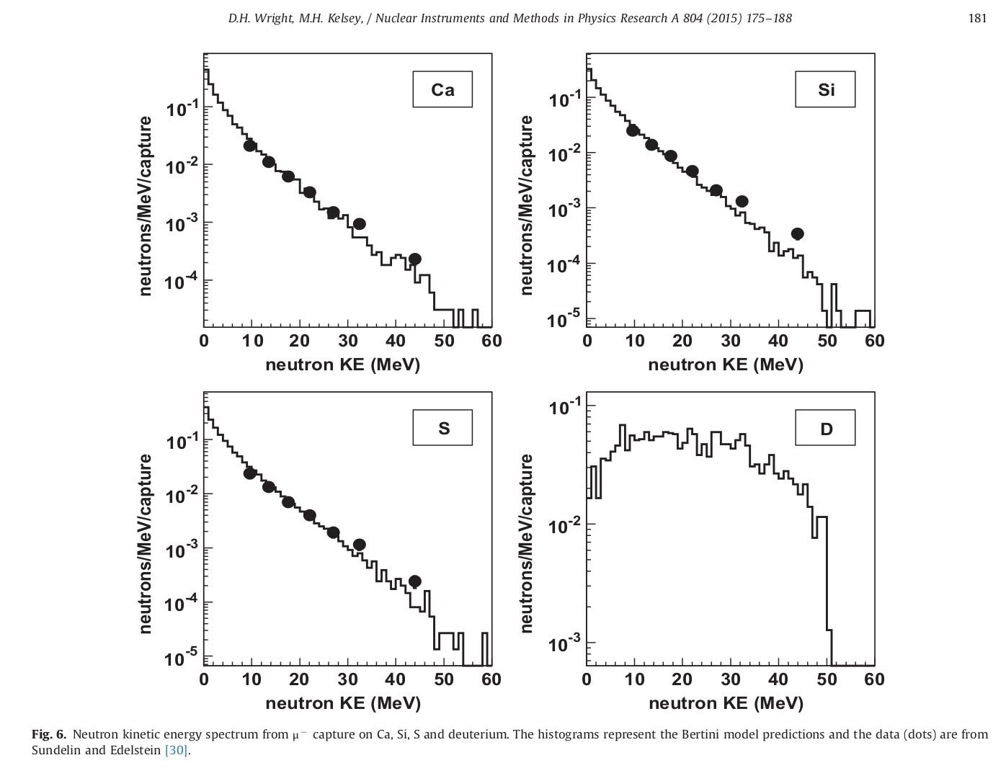
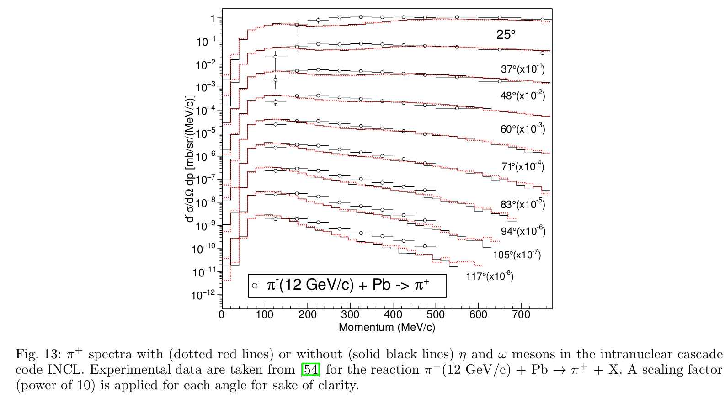
Example of thin-target validation:
Bertini:
INCLXX:
D.H. Wright and M.H. Kelsey,
Nucl. Instrum. Meth. 1 804 (2015) 175-188
J.-C. David et al., Eur. Phys. J. Plus (2018) 133: 253

Slide 9
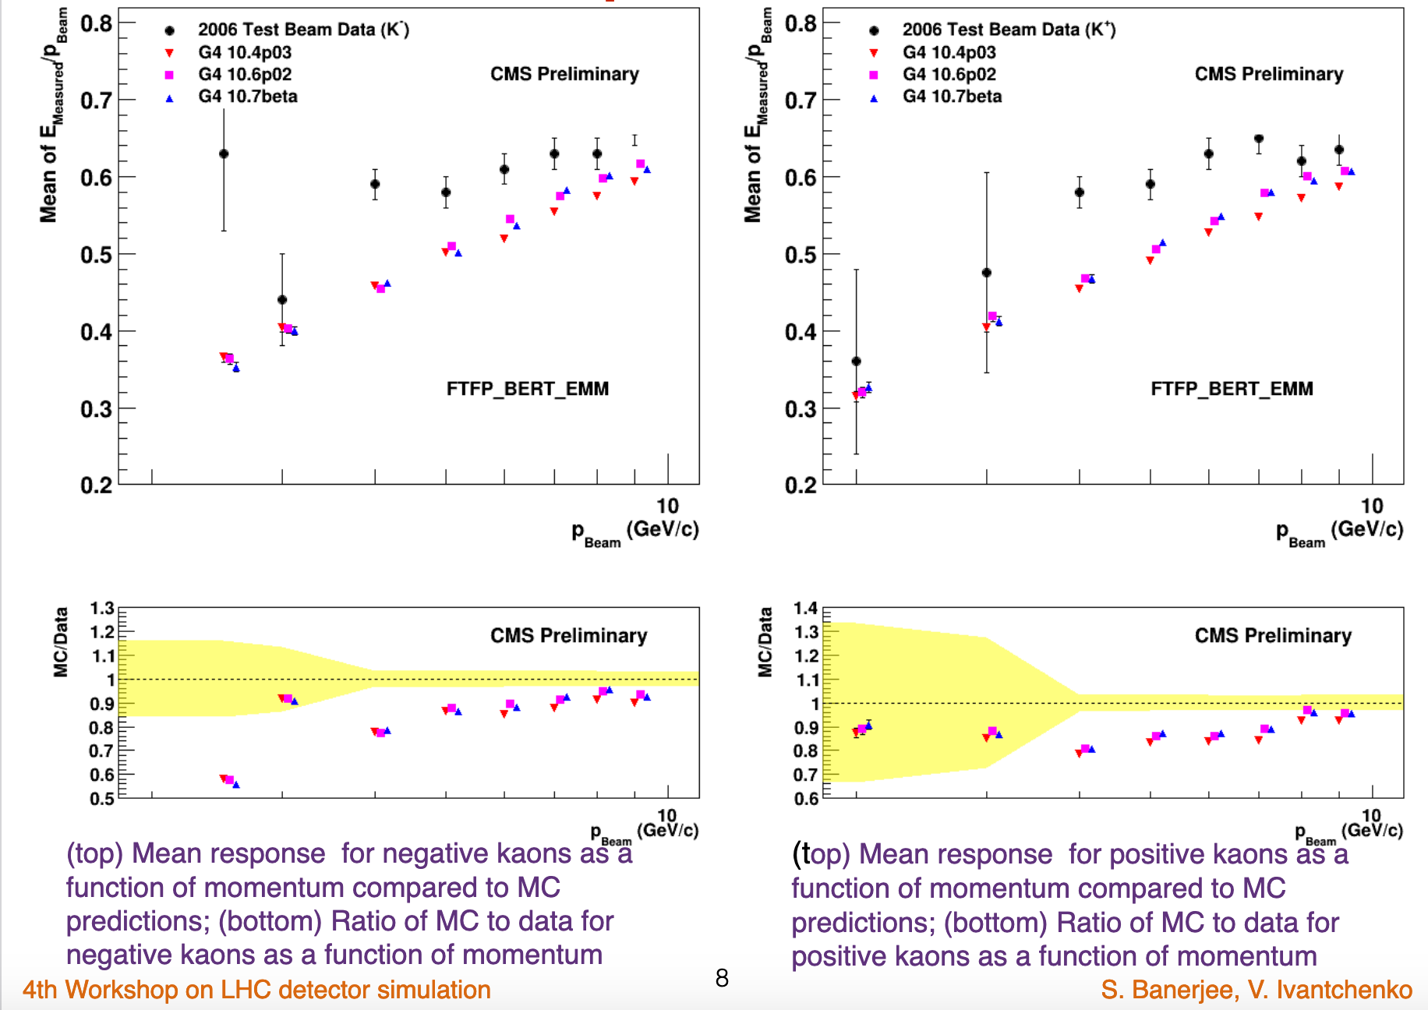
Full Calorimeter setups: e.g. CMS Test beam:
Π⁺⁻: Good agreement
K⁺⁻ : underestimation of the response
4th LPCC Detector Simulation Workshop, CERN (Geneva), 2-3 November 2020. https://indico.cern.ch/event/964486

Slide 10
Geant4 Validation Portal: https://geant-val.cern.ch/
See: https://doi.org/10.1051/epjconf/201921405002

Slide 11
Geant4 as a predictive tool
Very powerful and flexible tool to
identify the most important contributions, variables and particle types,
develop and test new concepts and ideas and make predictions with high confidence,
Identify observables that can be tested in small experimental test setups,
learn and teach physics ☺.

Slide 12
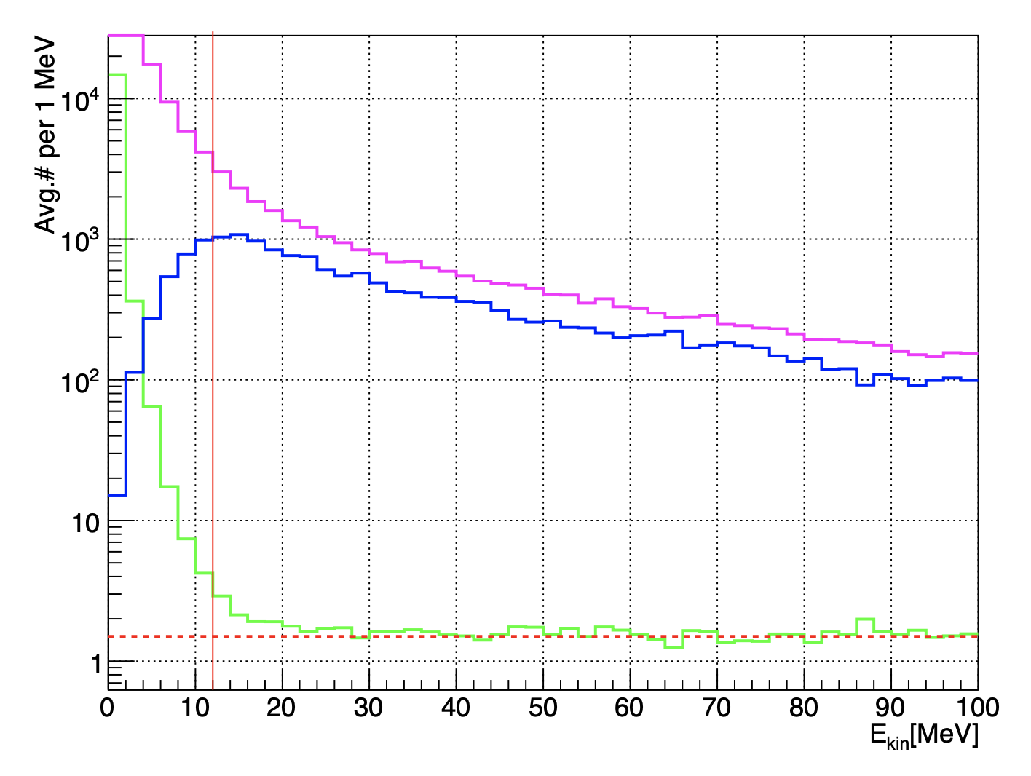
Particles of interest: neutrons and protons
Neutrons:
Neutrons are abundantly produced they are typically the 3rd most produced particle (after electrons and gammas)
Mostly “soft” neutrons, produced by the de-excitation of nuclei.
Before a neutron “disappears” via an inelastic interactions (or decays or exits the world volume), it can have many elastic scatterings with nuclei, and eventually can “thermalize” in the environment.
Assuming a long integration time (> 10μs) for a 5 GeV π⁻ shower in a dual readout total absorption PbF calorimeter one observes that ≈ 17% of the Scintillation signal and ≈ 23% the Cerenkov signal are due to γ’s from neutron capture.
For typical high-energy applications very often a simple treatment is enough. But as we will see neutrons are critical to get the details (e. g. temporal development) in hadronic calorimetry right.
Kinetic Energy of neutrons (magenta) and protons(blue) created in Pb²⁰⁸208 and the ratio 82 thereof (green) as predicted by Geant4 (Bertini Cascade). The vertical line represents the energy of the Coulomb barrier (≈ 12MeV ). The horizontal line represents the ratio in which neutrons and protons are present in the target nucleus (≈ 1.54).
(H. Wenzel CHEF2013)
Topics to discuss with students: nuclear binding forces, nuclear potential, difference for n and p, Coulomb barrier, tunneling ….

Slide 13
Particles of interest: neutrons and protons (cont.)
For low energy neutrons kinetic energies Ekin < 20 MeV down to thermal energies a high precision, data-driven and isotope-specific treatment is available. NEUTRON_HP is based on evaluated neutron scattering data libraries. It includes 4 types of interactions: elastic scattering, radiative capture, fission, inelastic scattering. It is precise, but slow (expensive)!
Concerning calorimetry energy conservation needs special attention!
protons:
Range of spallation protons is very short (~ 1 mm).
in a sampling calorimeter these energies are not observable (part of the ‘nuclear effects’).
In a total absorption dual read out calorimeter these protons contribute significantly to the observed ionization signal (~23% for 5 GeV π⁺⁻ showers).
These protons don’t contribute to Cerenkov signal.
Physics list | sec/evt (20GeV π+)
QGSP_BERT | 1.8
FTFP_BERT | 4.2
FTFP_INCLXX | 15.4
FTFP_BERT_HP | 24.8

Slide 14
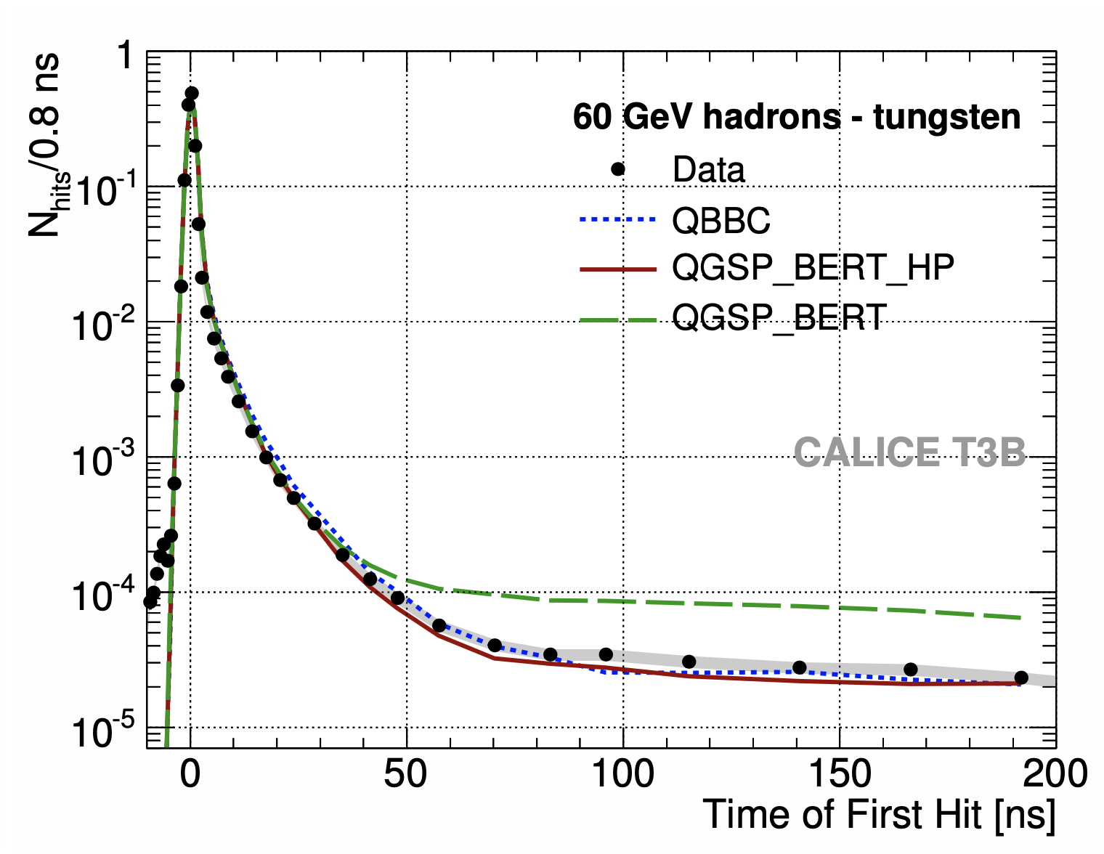
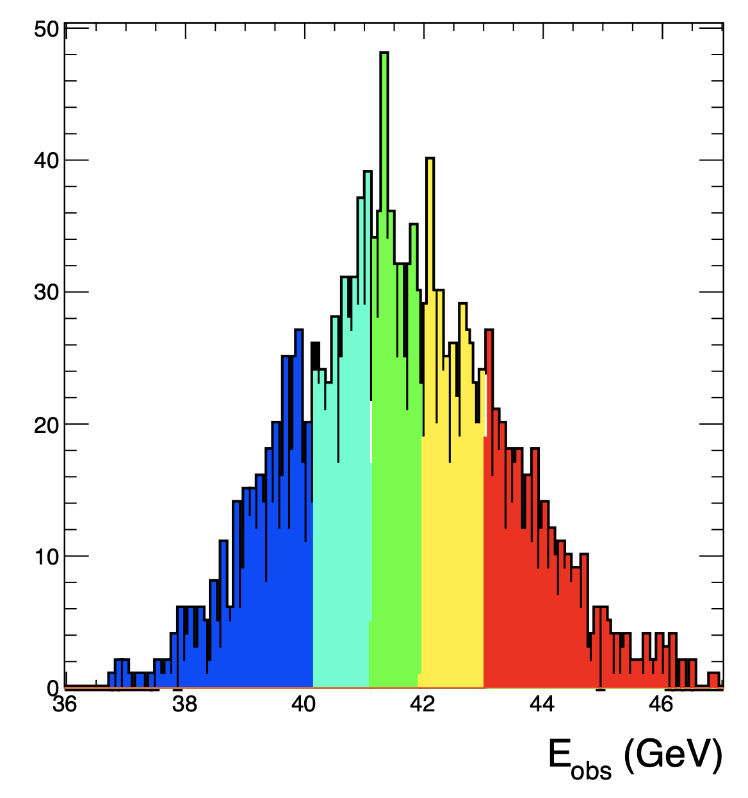
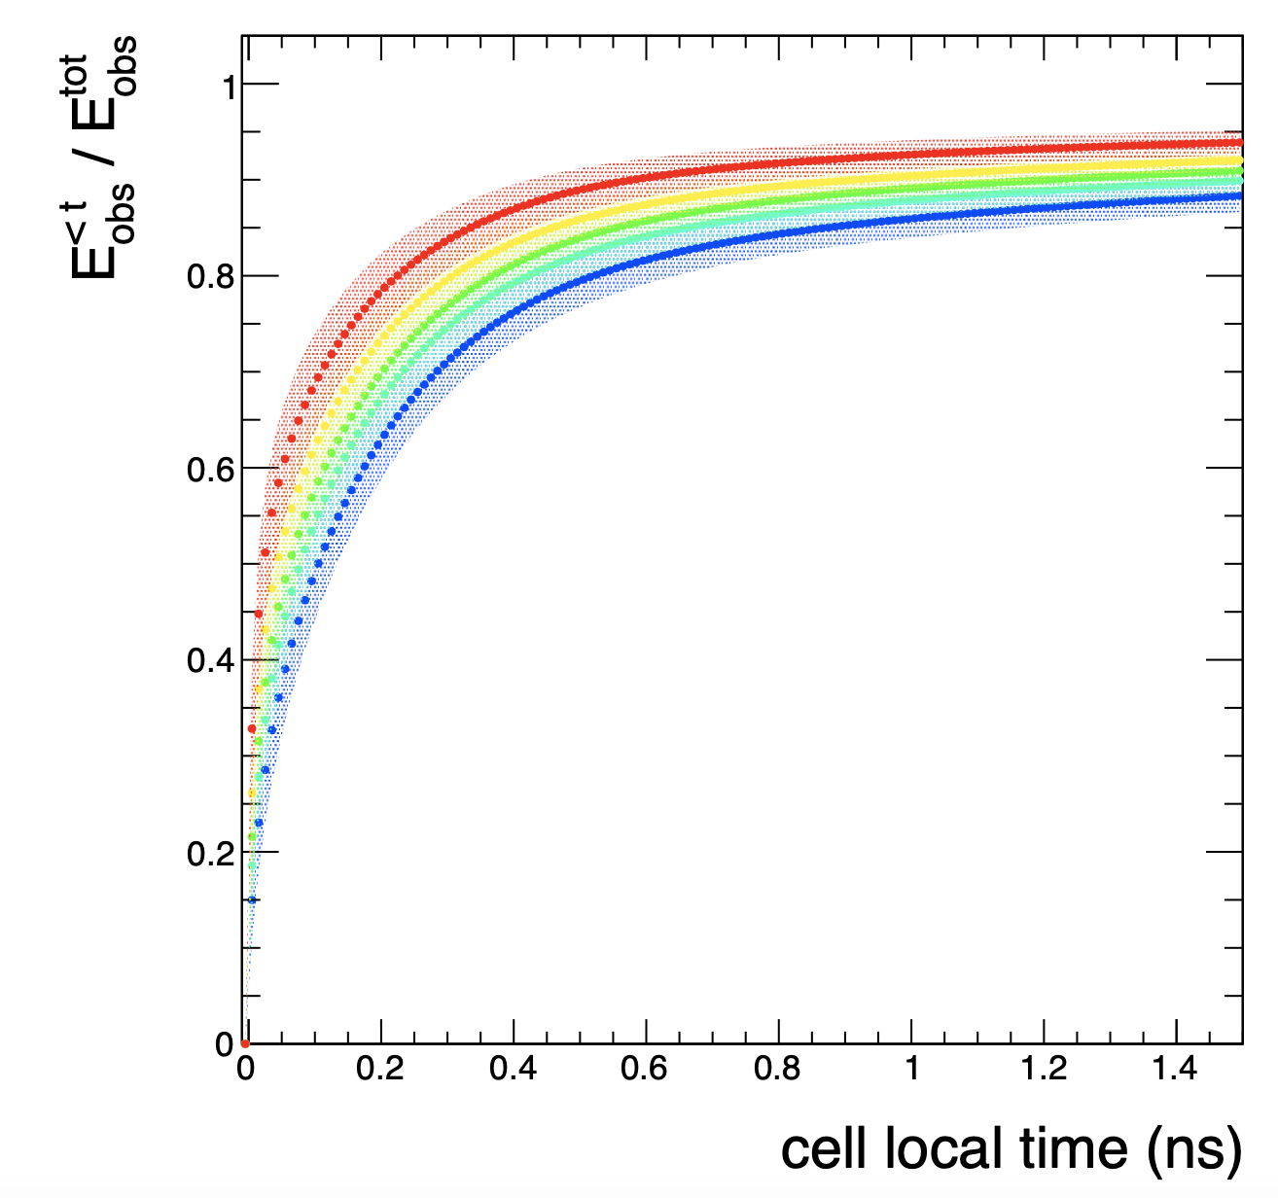
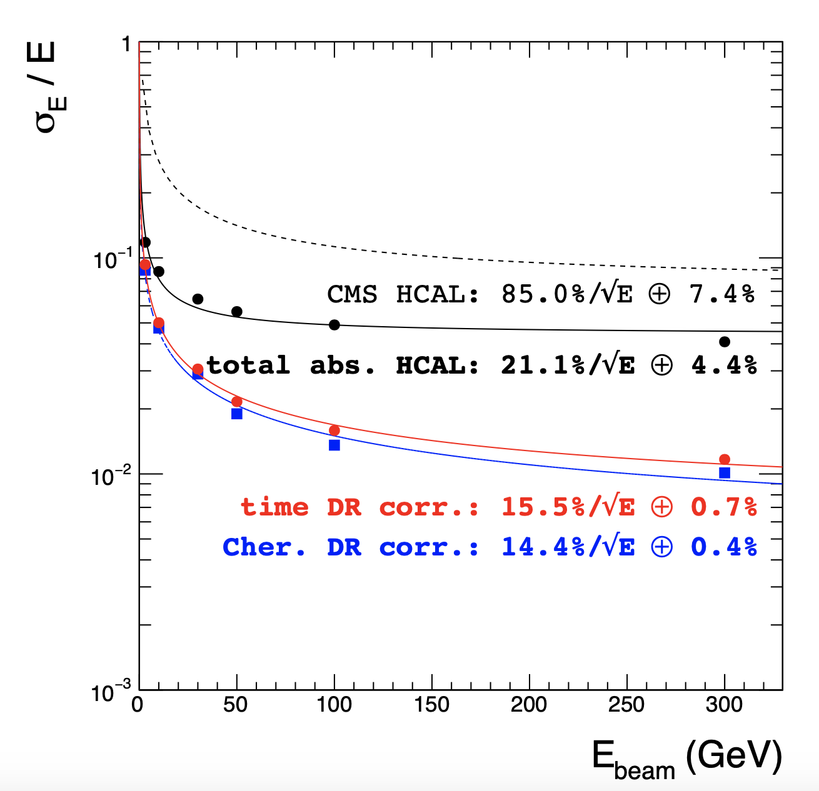
utilizing the time structure of hadronic showers
CALICE: JINST, 9, P07022, 2014
requires the detailed knowledge of spatial and temporal development of hadronic showers and specifically requires the precise treatment of neutrons (QBBC, _HP).
Monte Carlo study (FERMILAB-PUB-16-407-CD)
GEANT4 10.1.p01,
Physics list: QGSP_BERT_HP,
Geometry: 3000 x 1m x 1m x 1mm Iron

Slide 15
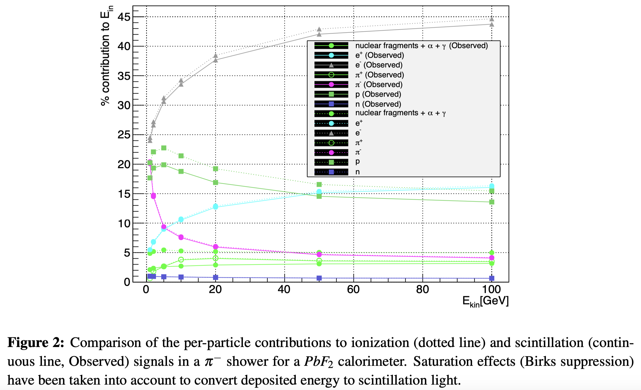
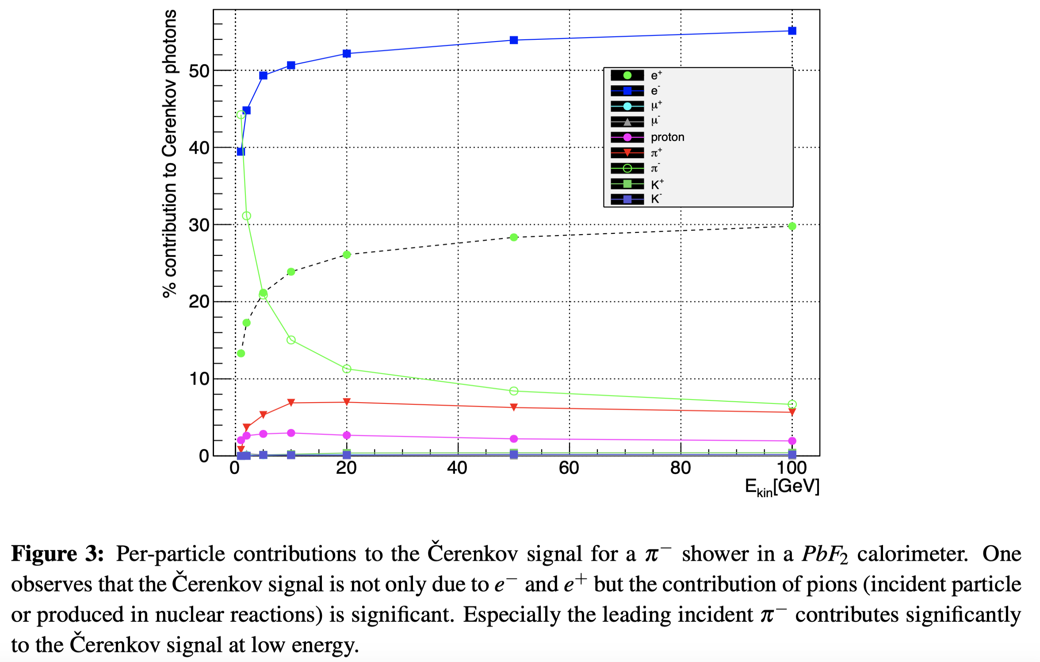
Dual readout total absorption Calorimetry: hadron shower development
Scintillation response: requires good understanding of particle content and momentum distribution of hadronic showers.
Cerenkov response: requires good understanding of the velocity distribution of produced particles.
Full simulation of the creation and tracing of optical photons is critical to address:
how the directionality of Cerenkov light affects the response,
how to separate Cerenkov from Scintillation light
→ great application for G4Opticks (see: https://doi.org/10.1051/epjconf/201921402027) which offloads the creation and tracing of optical photons to GPU’s.
from
H. Wenzel CHEF2013

Slide 16
Conclusion
Many ways to configure and customize Geant4 physics to meet your requirements.
Validation is a continuous effort.
Geant4 under active development, it’s continuously being improved.
Geant4 is very well documented, open source, provides many excellent examples and tutorials and has very active user community.
Very good tool to learn and teach physics ☺.
Geant4 needs user feed back to identify shortcomings and bugs.
We need a program to systematically study the dynamics of hadronic showers. Geant4 is a very powerful predictive tool that allows to:
Identify the most important contributions, variables and particle types,
Develop and test new concepts and ideas and make predictions with high confidence,
Identify observables that can be tested in small experimental test setups.
…
Simulation is important. The US community needs to stay actively involved (funded).

Slide 17
Resources
Tutorials
Ecole Geant4 de l’IN2P3 et PHENIICS, 23 – 27 November 2020 https://groups.lal.in2p3.fr/ED-geant4/
Geant4 Advanced Course @ CERN, 28 September - 2 October 2020. https://indico.cern.ch/event/866056/
Workshops and Conferences
4th LPCC Detector Simulation Workshop, CERN (Geneva), 2-3 November 2020. https://indico.cern.ch/event/964486
Simulation of total absorption dual readout calorimetry - INSPIRE-HEP https://old.inspirehep.net/record/1846890
Geant4 main web page:
https://geant4.web.cern.ch/node/1
LXR source code browser:
https://geant4.kek.jp/LXR/
Geant4 examples:
https://geant4.kek.jp/lxr/source/examples/
Physics Reference Manual:
https://geant4-userdoc.web.cern.ch/UsersGuides/PhysicsReferenceManual/html/index.html
Guide for Physics Lists:
https://geant4-userdoc.web.cern.ch/UsersGuides/PhysicsListGuide/html/index.html
Geant4 on-line forum:
https://geant4-forum.web.cern.ch/
Geant4 technical forum:
https://geant4.web.cern.ch/collaboration/technical_forum
Geant4 validation portal
https://geant-val.cern.ch/

Slide 18
Backup Slides

