Slide 1

Recent results from pixel-based accelerated aging of Large Area Picosecond Photodetectors (LAPPDTM)
V. A. Chirayath, A. Brandt, N. W. Clifton
Department of Physics, The University of Texas at Arlington, Arlington, Texas – 76019
M. J. Aviles, S. Butler, T. Cremer, M. R. Foley, C. J. Hamel, A. Lyashenko, M. J. Minot, M. A. Popecki, M. E. Stochaj, C. Walne
Incom Inc., Charlton, MA – 01507
CPAD Instrumentation Frontier Workshop 2021
Virtual event @ Stony Brook, March 18-22, 2021

Slide 2
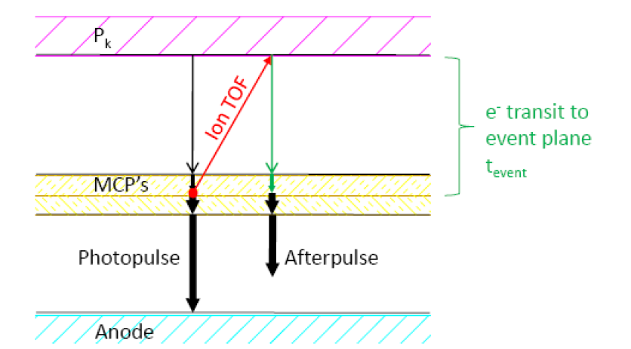

Lifetime of Microchannel Plate Photomultiplier Tubes (MCP-PMT)
$$hθ$$
Incoming photons are converted to photo-electron (PE) by the photocathode (P_{k}).
The charge is multiplied by the collision of the incoming PE with the walls of the MCP. Amplified charge is collected at Anode.
Collision can sometime lead to ionization of the residual gas/desorption of positive ions from the MCP surface: Ion feedback
Ions can react with or even sputter the P_{k} material – Degradation of Quantum efficiency
MCP Gain can also be affected by the desorption of ions from MCP surfaces.

Slide 3
Lifetime of Microchannel Plate Photomultiplier Tubes (MCP-PMT)
$$hθ$$
Blocking the ions from reaching the photocathode once they are created (active or passive ion barriers).
Suppress the release of positive ions through Atomic Layer Deposition (ALD) of additional layers of Al₂O₃ or MgO in the inner surfaces of MCP micropores. Main challenge is optimizing the coating process to get the desired lifetime.

Slide 4

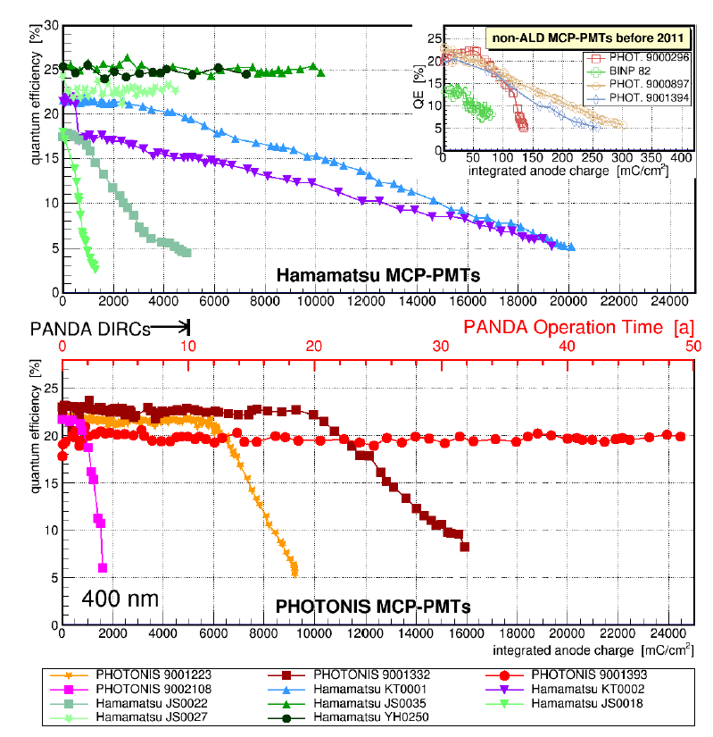
Investigation of Aging of MCPs with Enhanced Lifetime
Pioneering work in simultaneously comparing the aging behavior of different kinds of MCPs by Lehmann et al [1]
Diffuse 460 nm LED to homogeneously illuminate the whole MCP at single PE rate. The LED pulsed at 1 MHz.
Photonis MCP PMT with two ALD coating showed lifetime exceeding 26 C/cm².
Ongoing experiment for several years to achieve integrated anode charge.
10 C/cm²
26 C/cm²
Fig. 1 . Results from the Lifetime testing conducted by Lehmann et al., NIMA (2020) [1]. The Quantum efficiency as a function of integrated anode charge for ALD coated MCP-PMTs. The inset in top panel for non-ALD MCP-PMTS.
1. Lehmann et al., Nuclear Inst. and Methods in Physics Research, A 958 (2020) 162357.

Slide 5
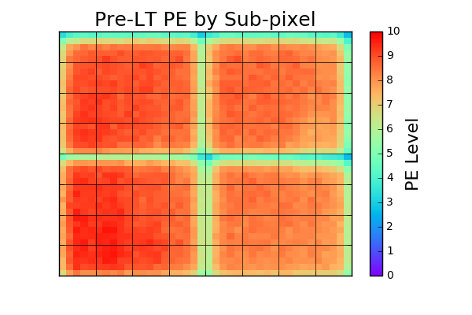
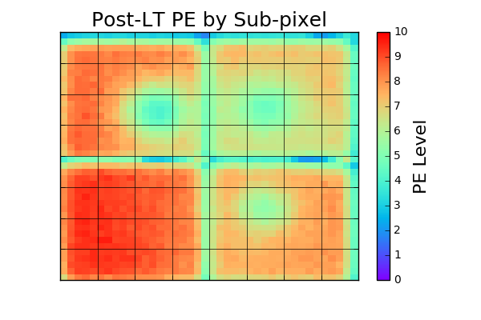
Pixel-based Lifetime testing
The pixel-based lifetime time testing method: Exposes a pixel of the MCP-PMT to high photon rate.
Damage is primarily a local phenomenon.
Key advantages:
The MCP-PMT can be reused after testing.
Multiple lifetime tests can be performed on a single device.
5 cm
Figure: PE scan of a 5 cm x 5cm Photonis MCP-PMT. Comparison of the estimated photo electrons (PE) before (Pre-LT) and after (Post-LT) the lifetime test for same incoming light intensity.
Notes:
Reduce the number of words!!

Slide 6
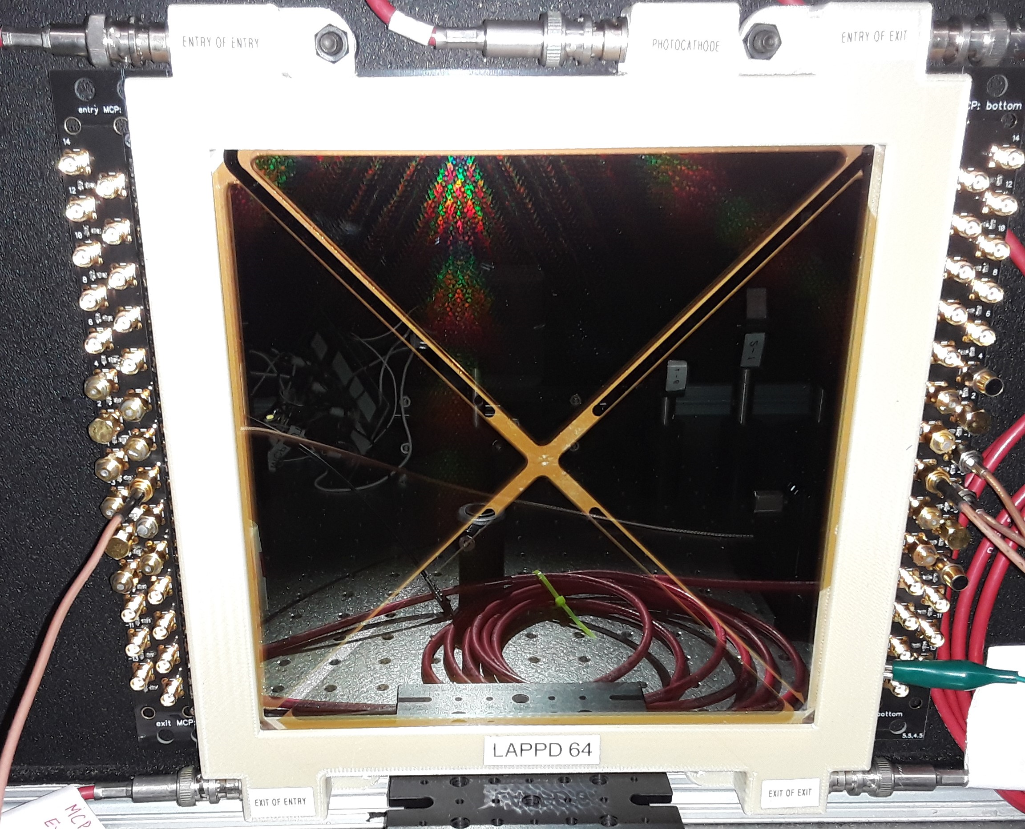
20 cm x 20 cm LAPPDTM from Incom Inc.
Feature | Parameter
Seal Date | 02/04/2020/LAPPD-64
Photodetector Material | Borosilicate glass lower tile assembly Interior stripline anode
Photocathode Material | Alkali metal
Wavelength – Maximum Sensitivity (nm) | ≤ 365 nm
Anode Data Strip Configuration | 28 silver strips, Width = 5.2 mm, Nominal 50 ‎Ω Impedance
MCP Substrate | Incom C14/C5 Glass
Resistive and Emissive Coatings | Chem 1, Applied via Atomic Layer Deposition (ALD)
Secondary Emission (SEE) Layer Material | MgO
MCP resistance (Entry/Exit) | 13.1 / 4.1 MΩ at 925 V ^{A}
5 cm

Slide 7
Pre-Lifetime Characterization : Dark box with Pulsed LASER
Device characterization using pulsed LASER (405 nm). The exposure arrangement is equivalent to that in Lifetime test box with LED.
Main Tests
Single PE pulse height distribution
Transit Time Spread
Behavior under high-rate exposure
After pulse characterization
MCP-PMT
Fiber Holders
Mirrors
ND Filters
LASER
Lifetime Testing of the MCP-PMT is performed in a dedicated dark box with LED

Slide 8
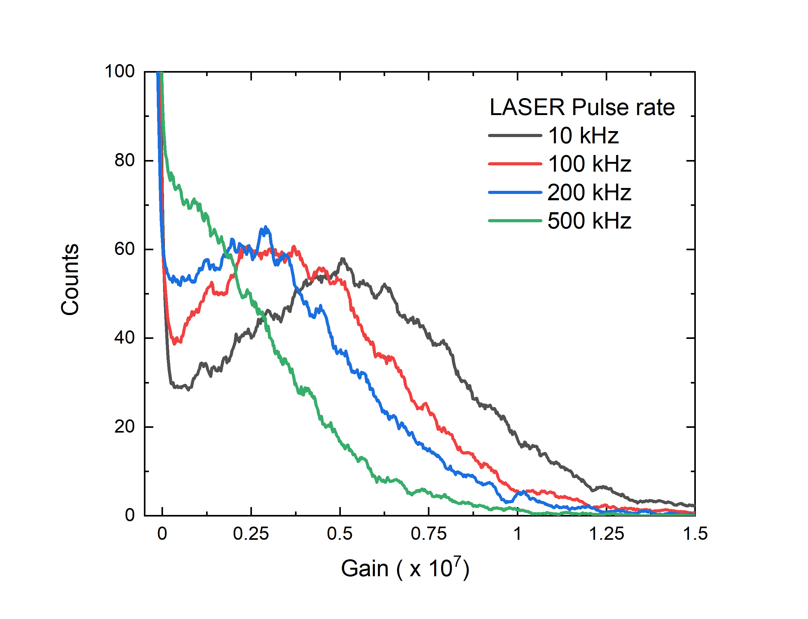
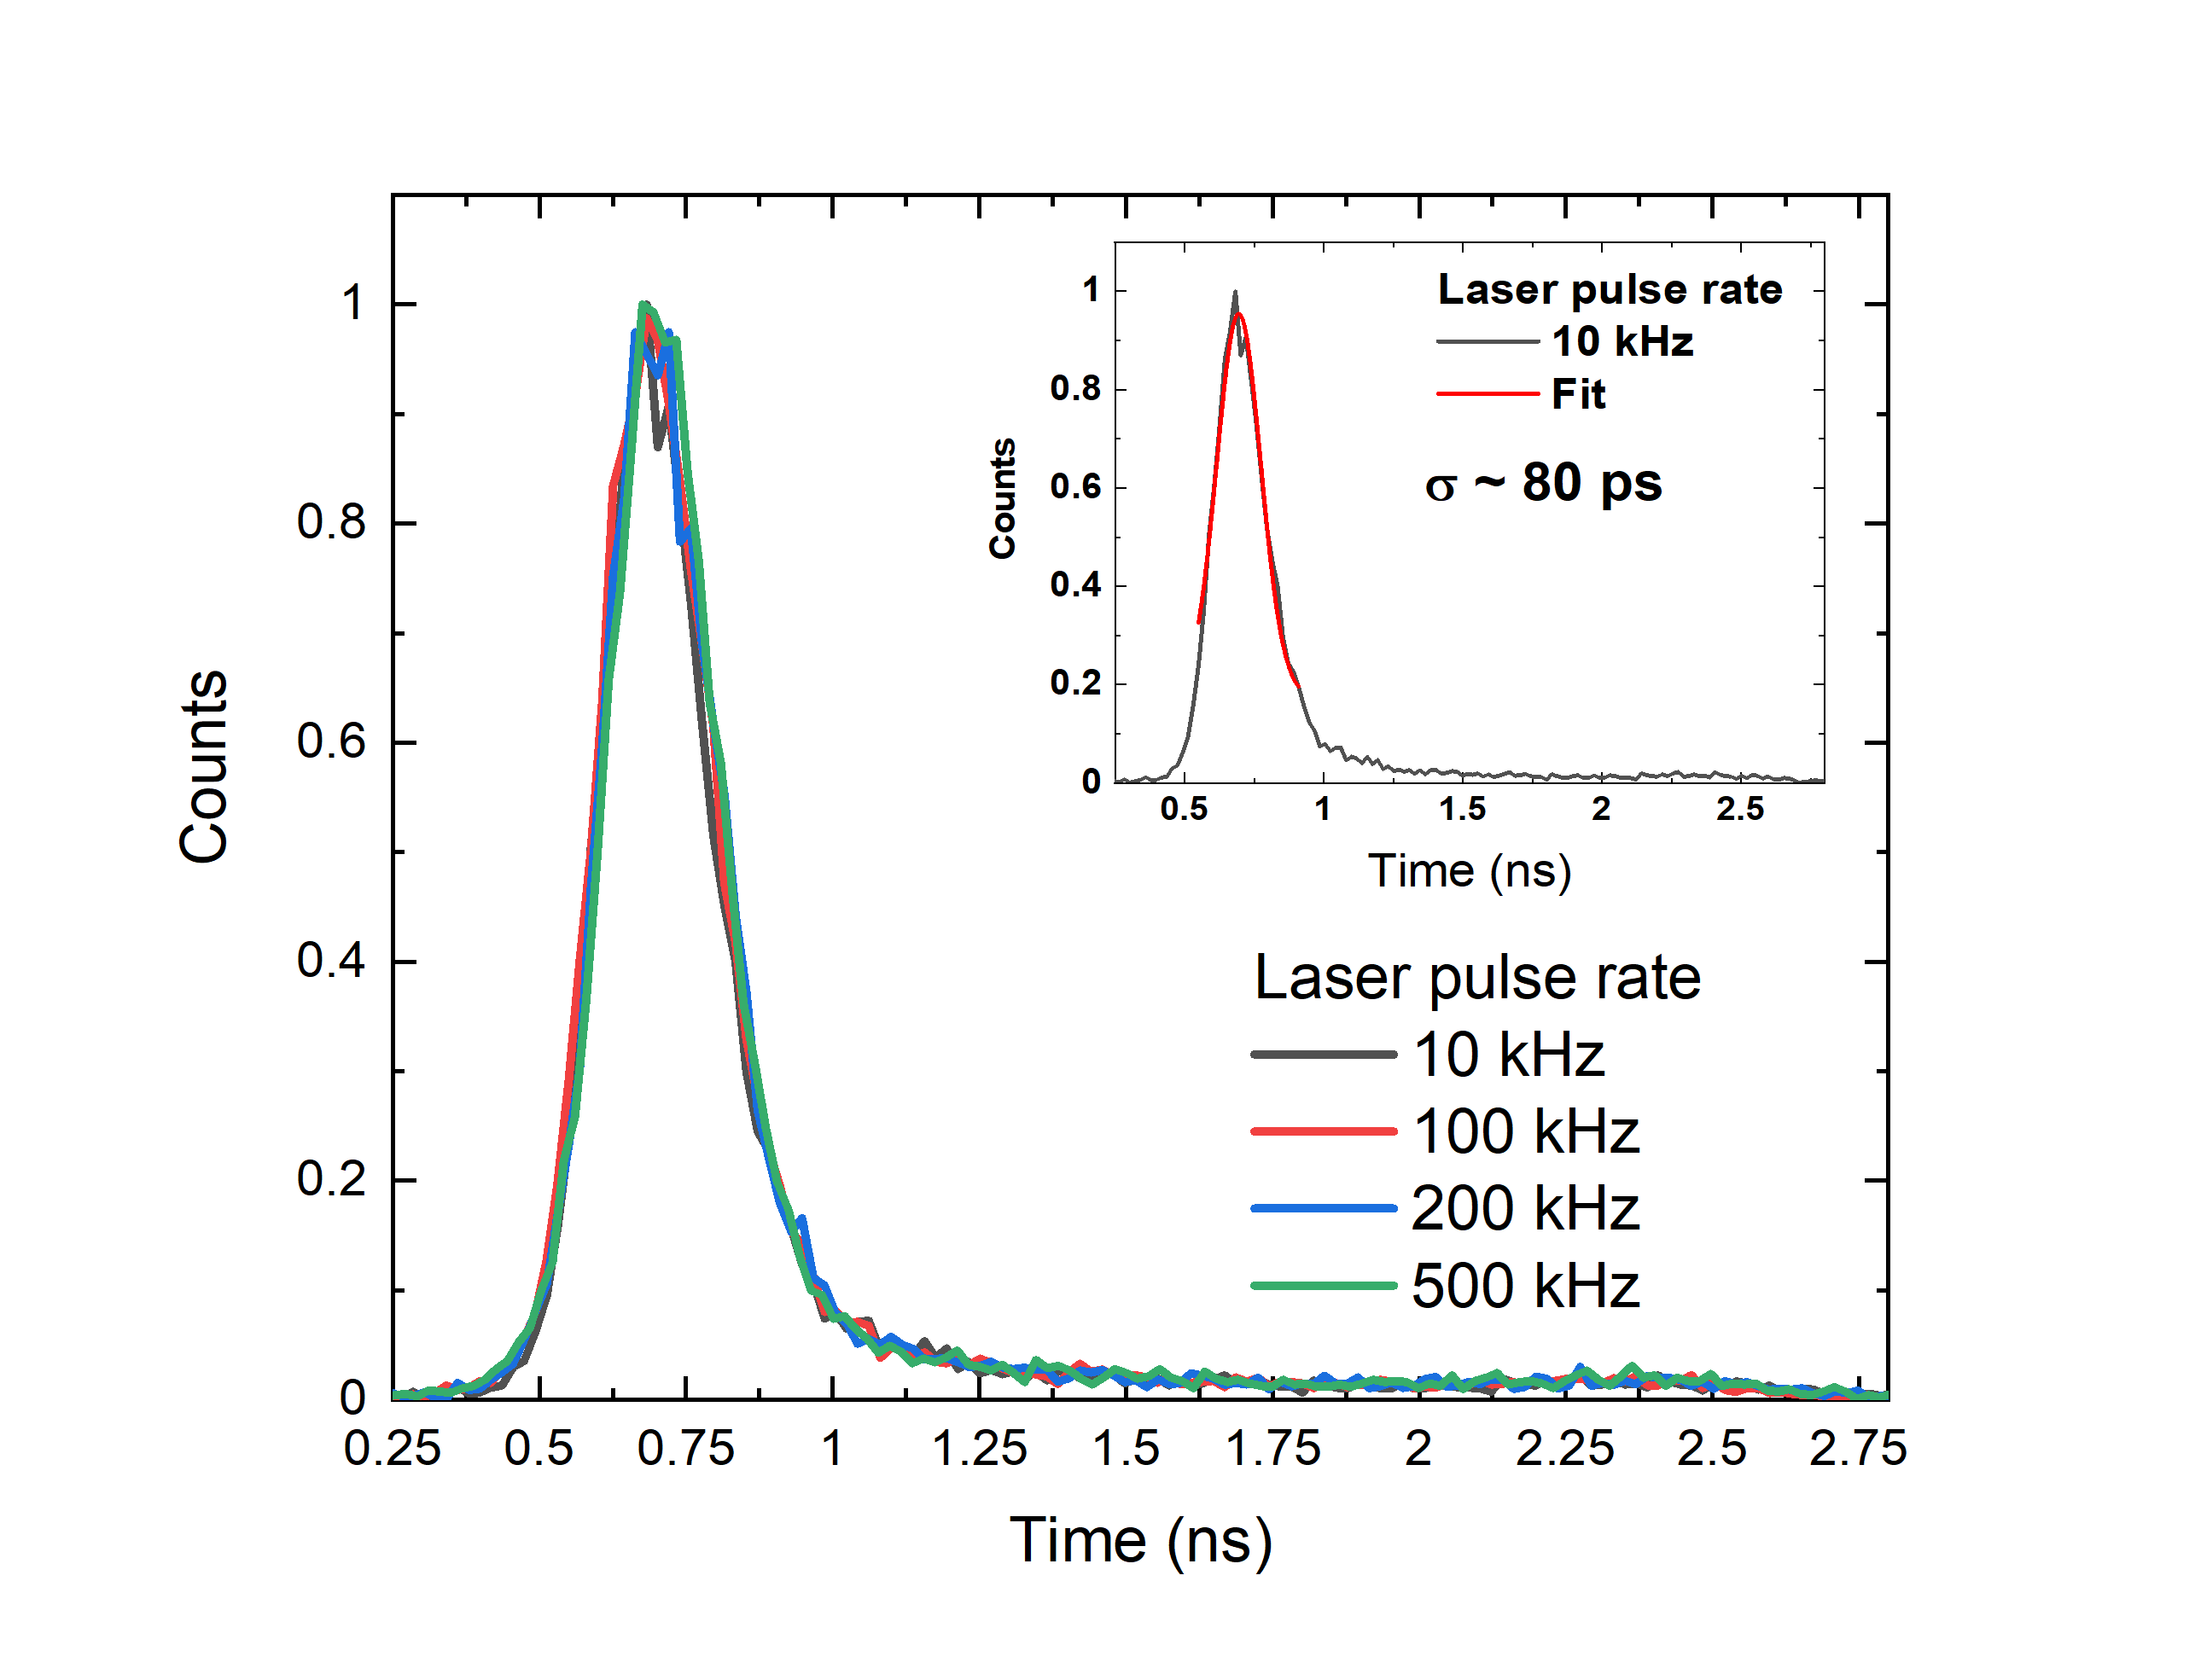
Gain Distribution and Transit Time Spread
(a)
(b)
Figure: (a) Gain and (b) Transit time spread as a function of rate. Performance measurements were carried using fiber arrangement which leads to ~ 4.6 mm beam spot. Saturation happens ~ at 500 kHz for a beam spot of diameter 4.6 mm. Measurements performed with 925 V across the MCPs, 100 V on Photocathode.

Slide 9
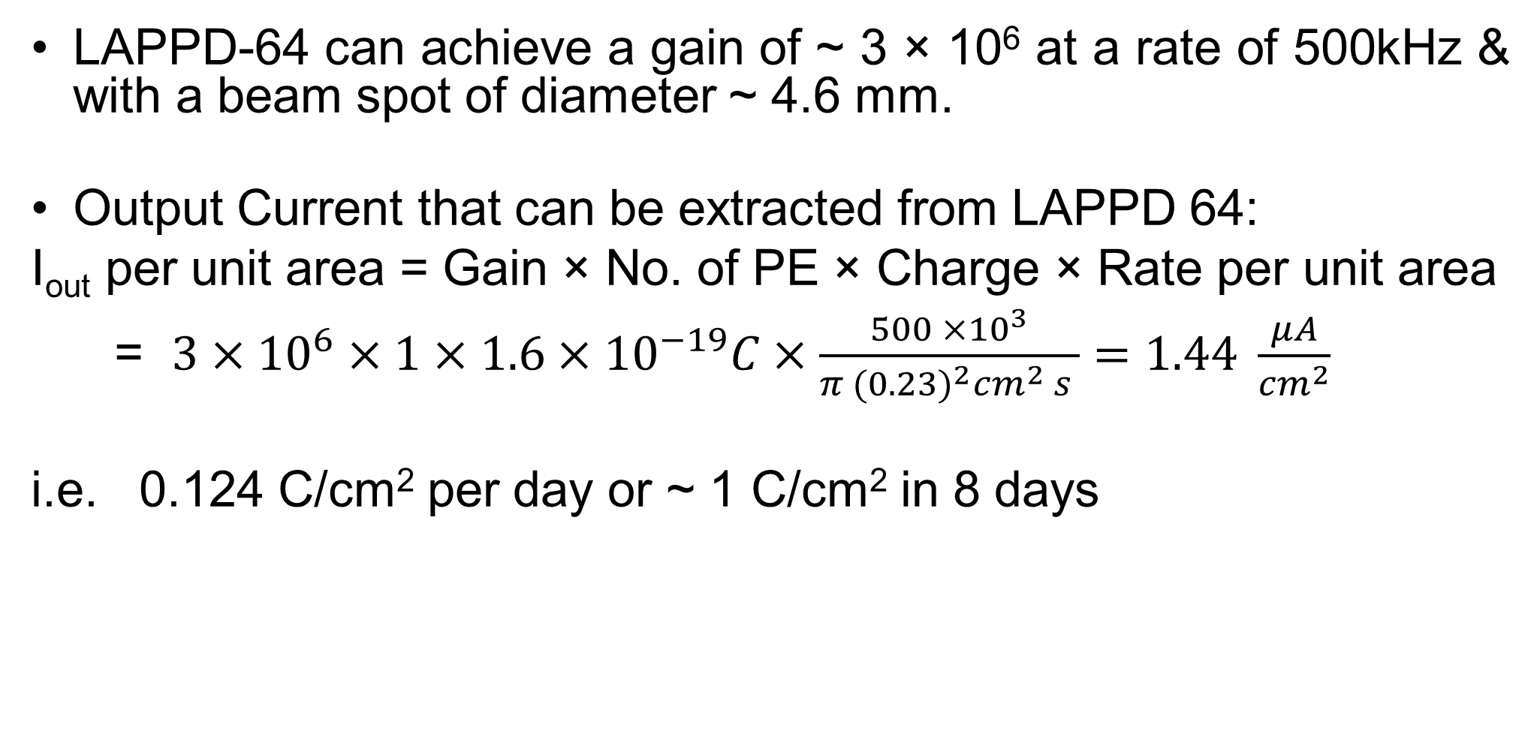
Lifetime Testing Rate
LAPPD-64 can achieve a gain of ~ 3 × 10⁶ at a rate of 500kHz & with a beam spot of diameter ~ 4.6 mm.
Output Current that can be extracted from LAPPD 64:
I_{out} per unit area = Gain × No. of PE × Charge × Rate per unit area
= $3×{10}^{6}×1×1.6×{10}^{−19}C×\frac{500 ×{10}^{3}}{π {(0.23)}^{2}{cm}^{2} s }=1.44 \frac{μA}{{cm}^{2}}$
i.e. 0.124 C/cm² per day or ~ 1 C/cm² in 8 days

Slide 10
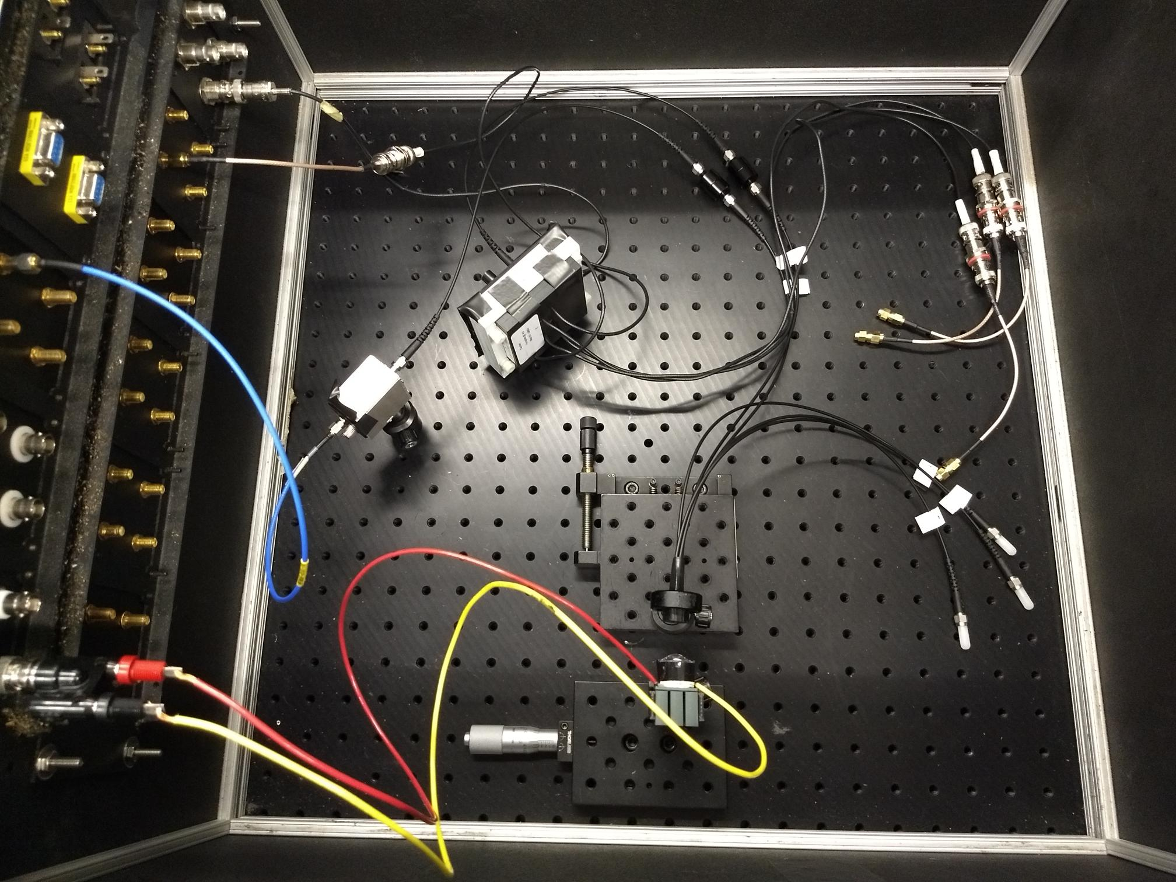
Pixel based Lifetime Testing setup
LED is operated in continuous mode (CW) for irradiation and pulsed mode (PW) for evaluation.
LED illuminates 4 fiber bundle
Allows pixelized exposure of up to 4 devices with inline neutral density (ND) filters to control the light intensity to each device.
A Si Photodiode for independent monitoring of light intensity
Inline ND filter
Tube under test
Si Photodiode
Fiber bunch
ND filter
LED

Slide 11
Pixel-Based Lifetime Testing Algorithm
Measure the pulse Height distribution at single PE level in the LED box at non saturation level (200 Hz) before the test.
Irradiate a small region of 4.6 mm diameter with MCP-PMT close to saturation.
Measure the pulse height distribution at single PE level in the LED box at 200 Hz at regular intervals by stopping the irradiation.

Slide 12
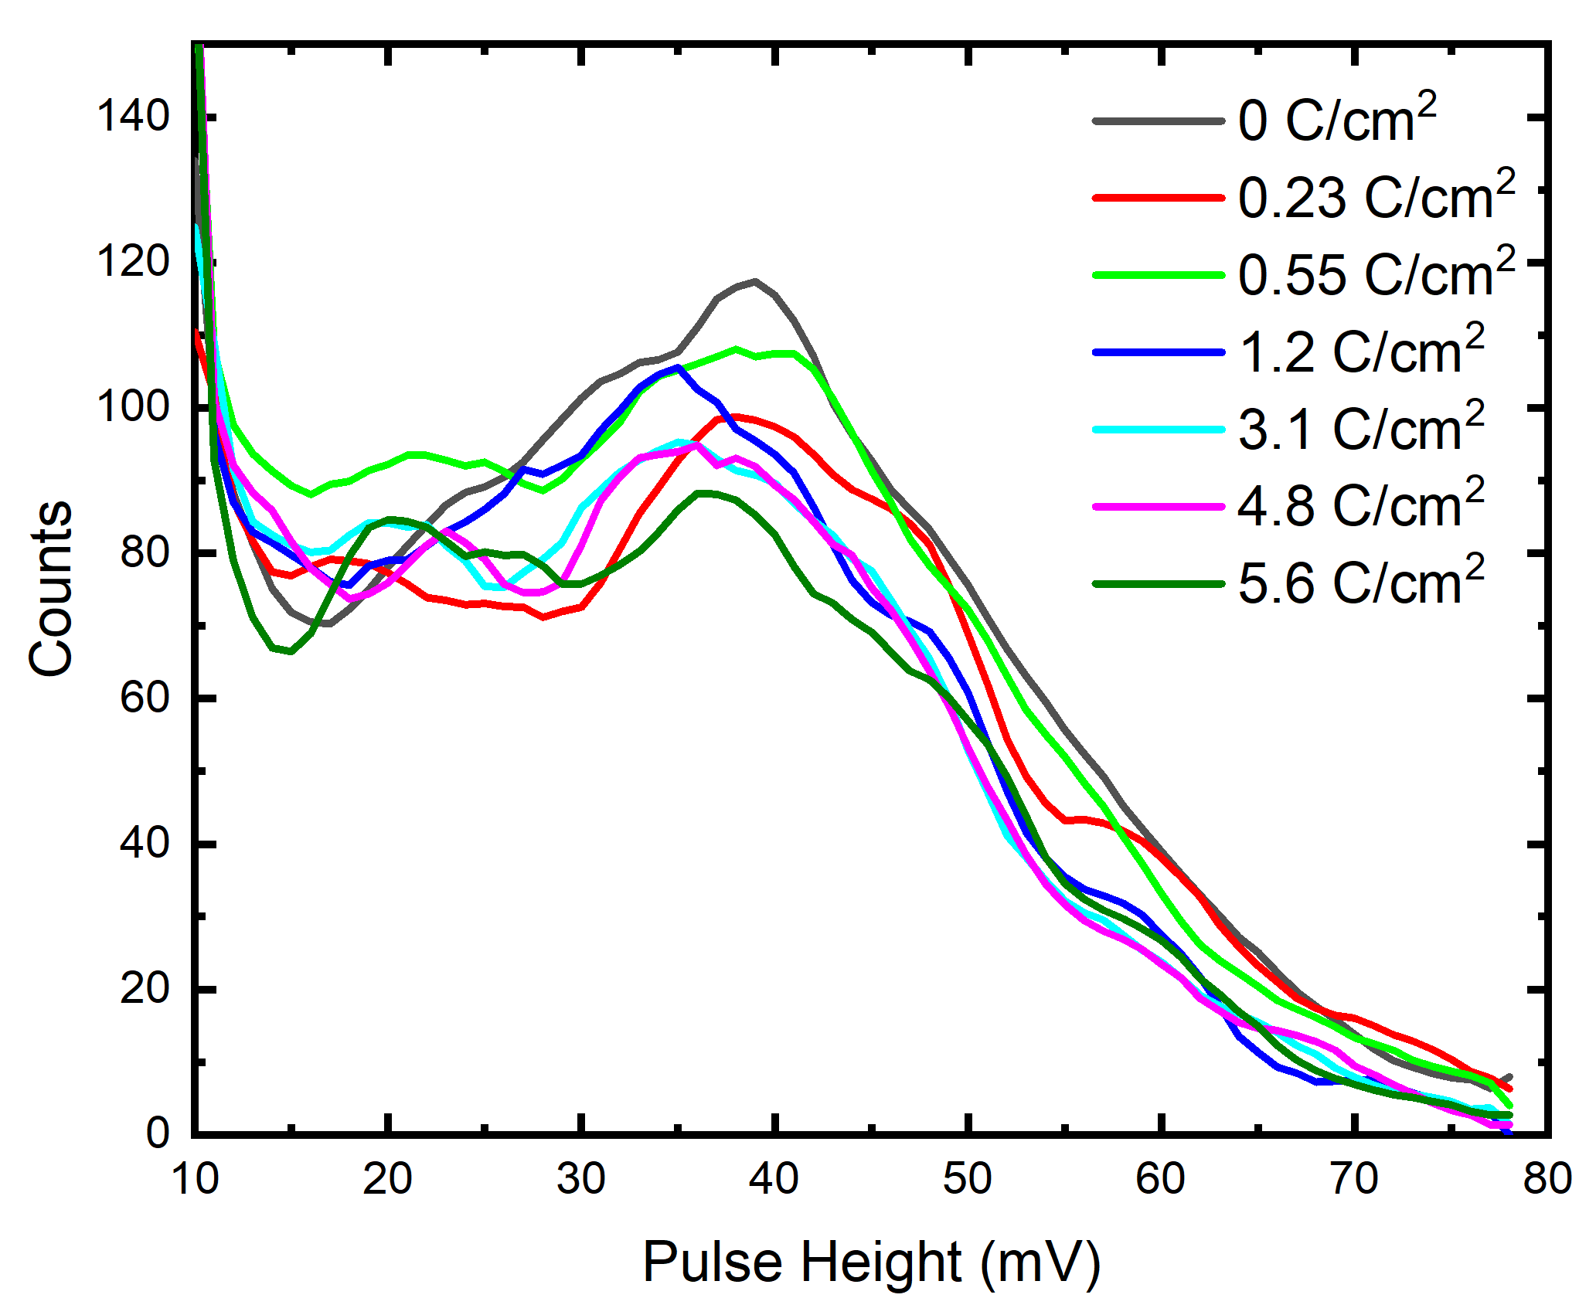
Pulse Height distribution as a function of collected charge
Figure: Pulse height distribution as a function of the charge collected at the anode.

Slide 13
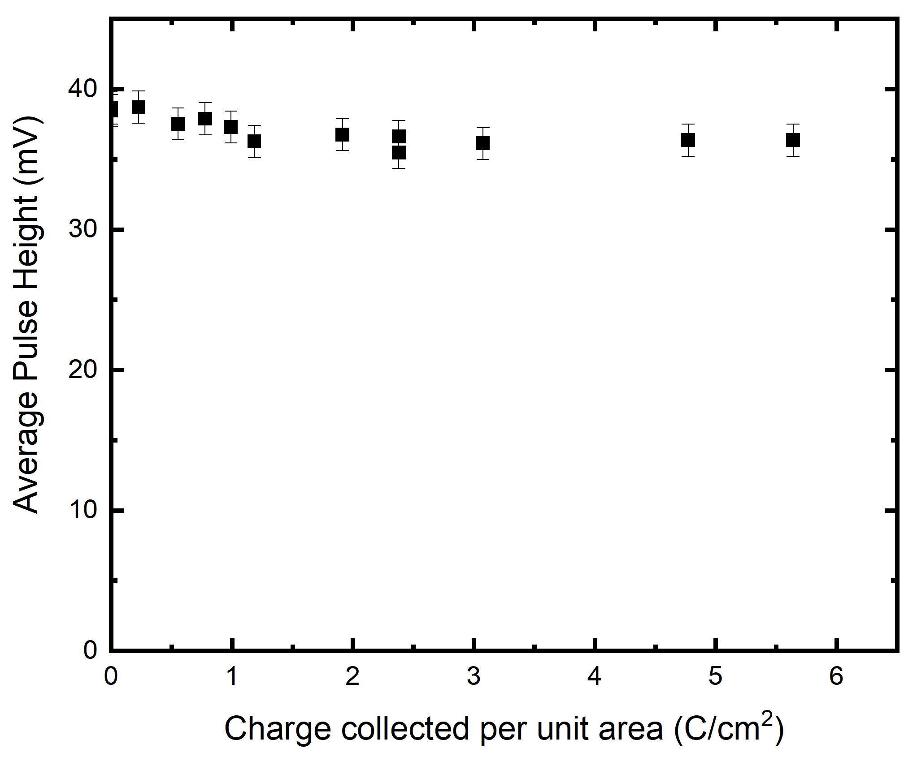
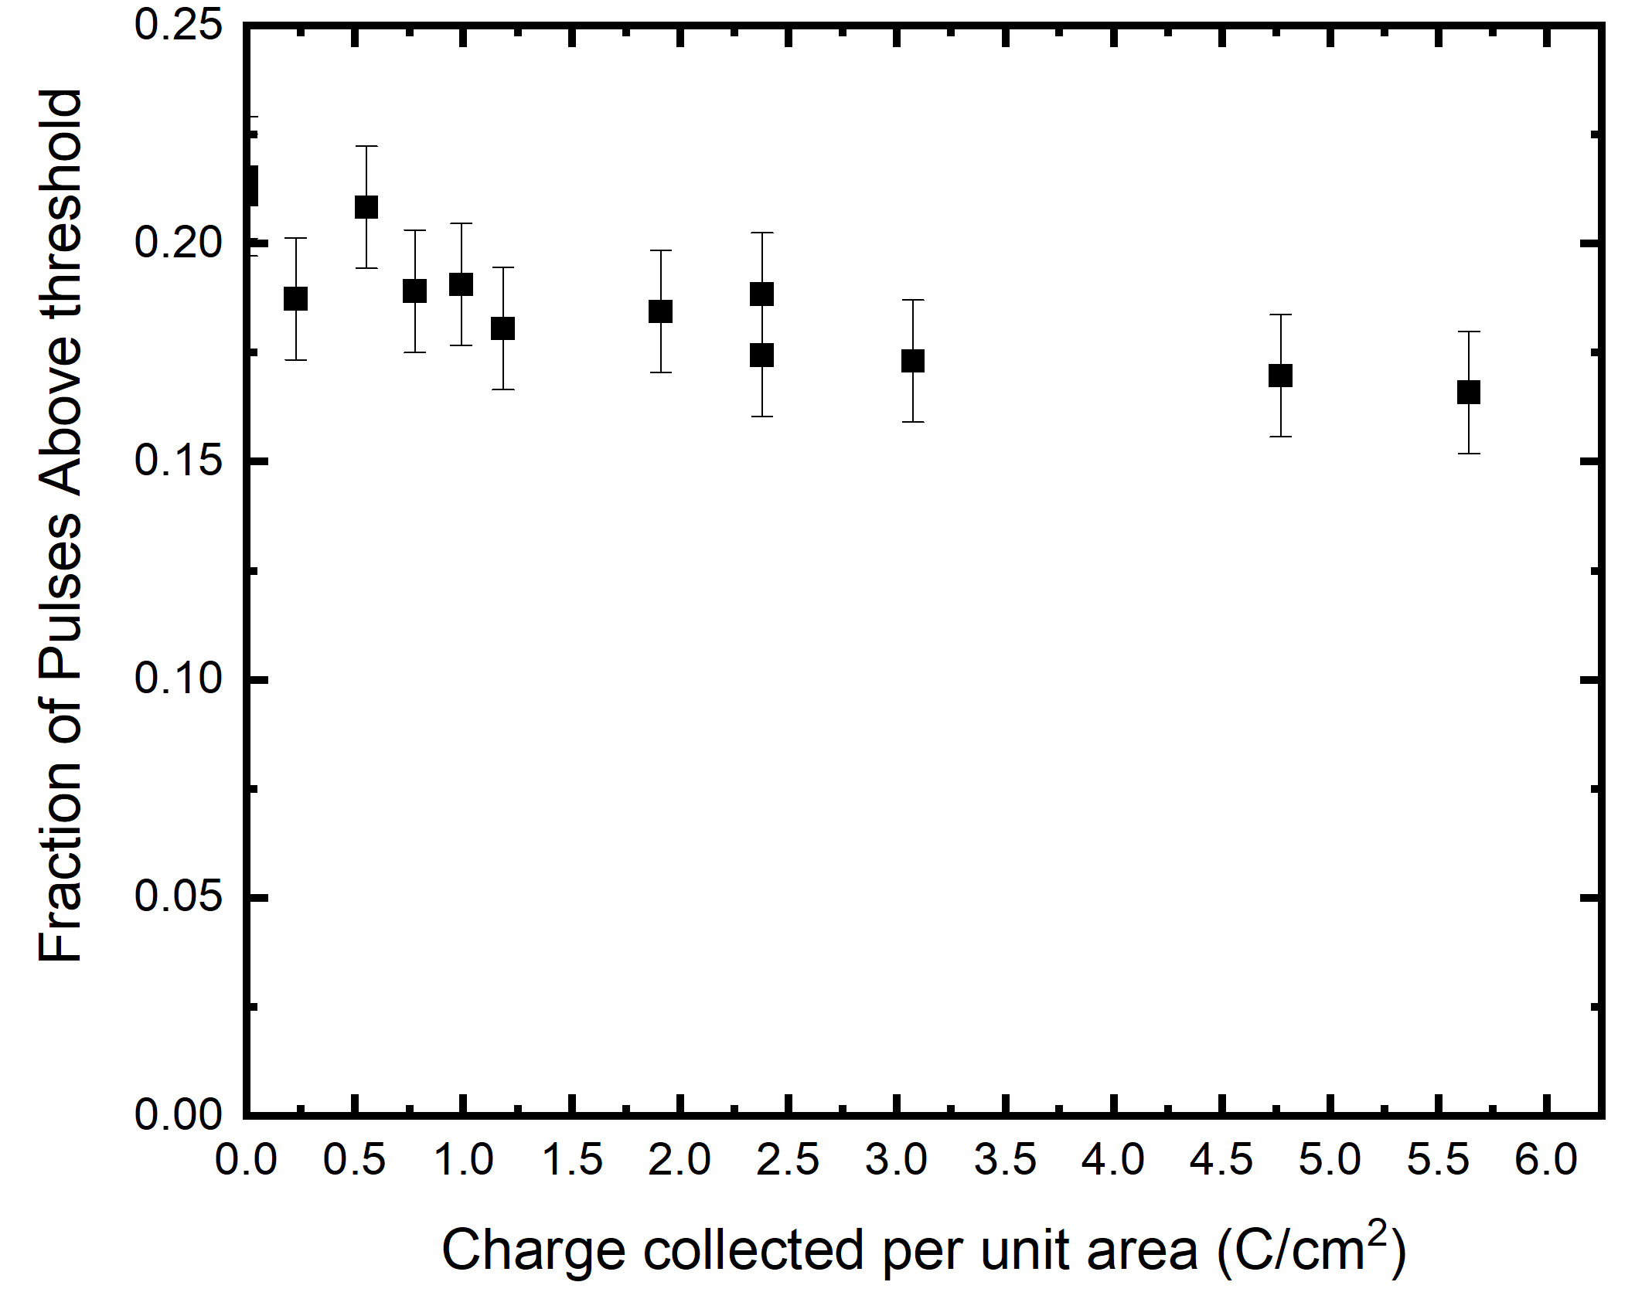
MCP-PMT performance as a function of collected charge
Figure: Average pulse height calculated for pulses above threshold (15 mV). Sensitive to Gain variations.
Figure: Fraction of pulses above threshold (15 mV). Sensitive to QE variations.

Slide 14
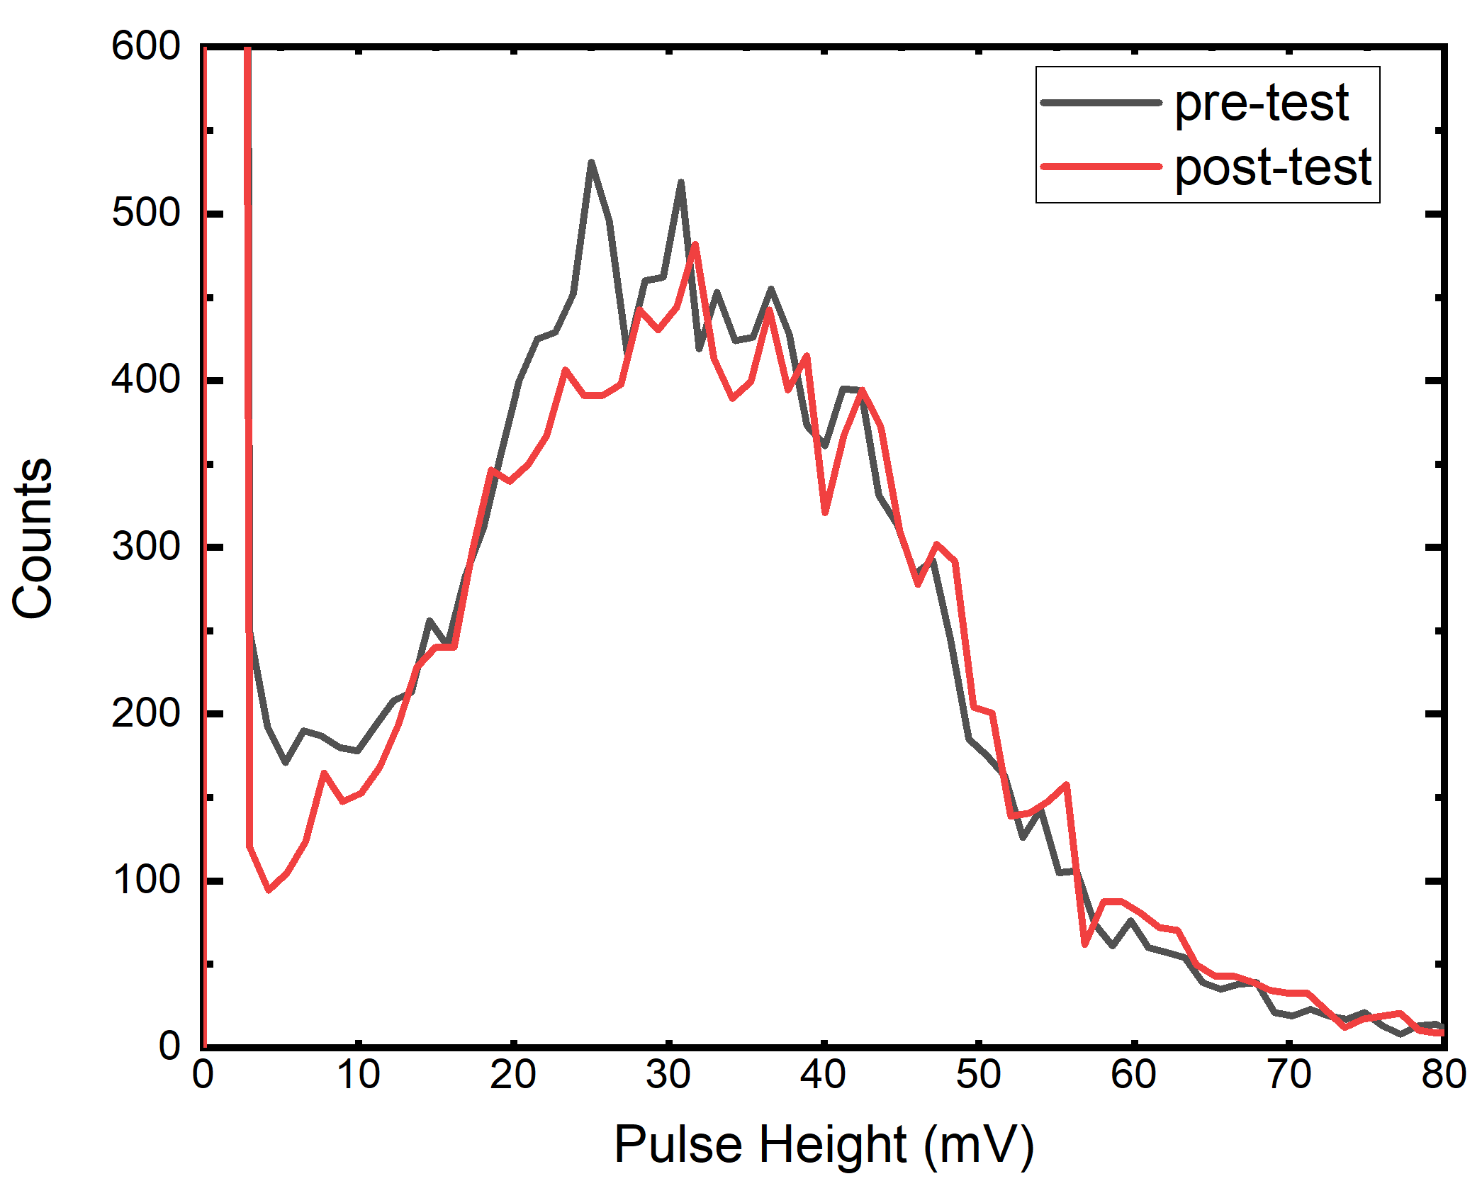
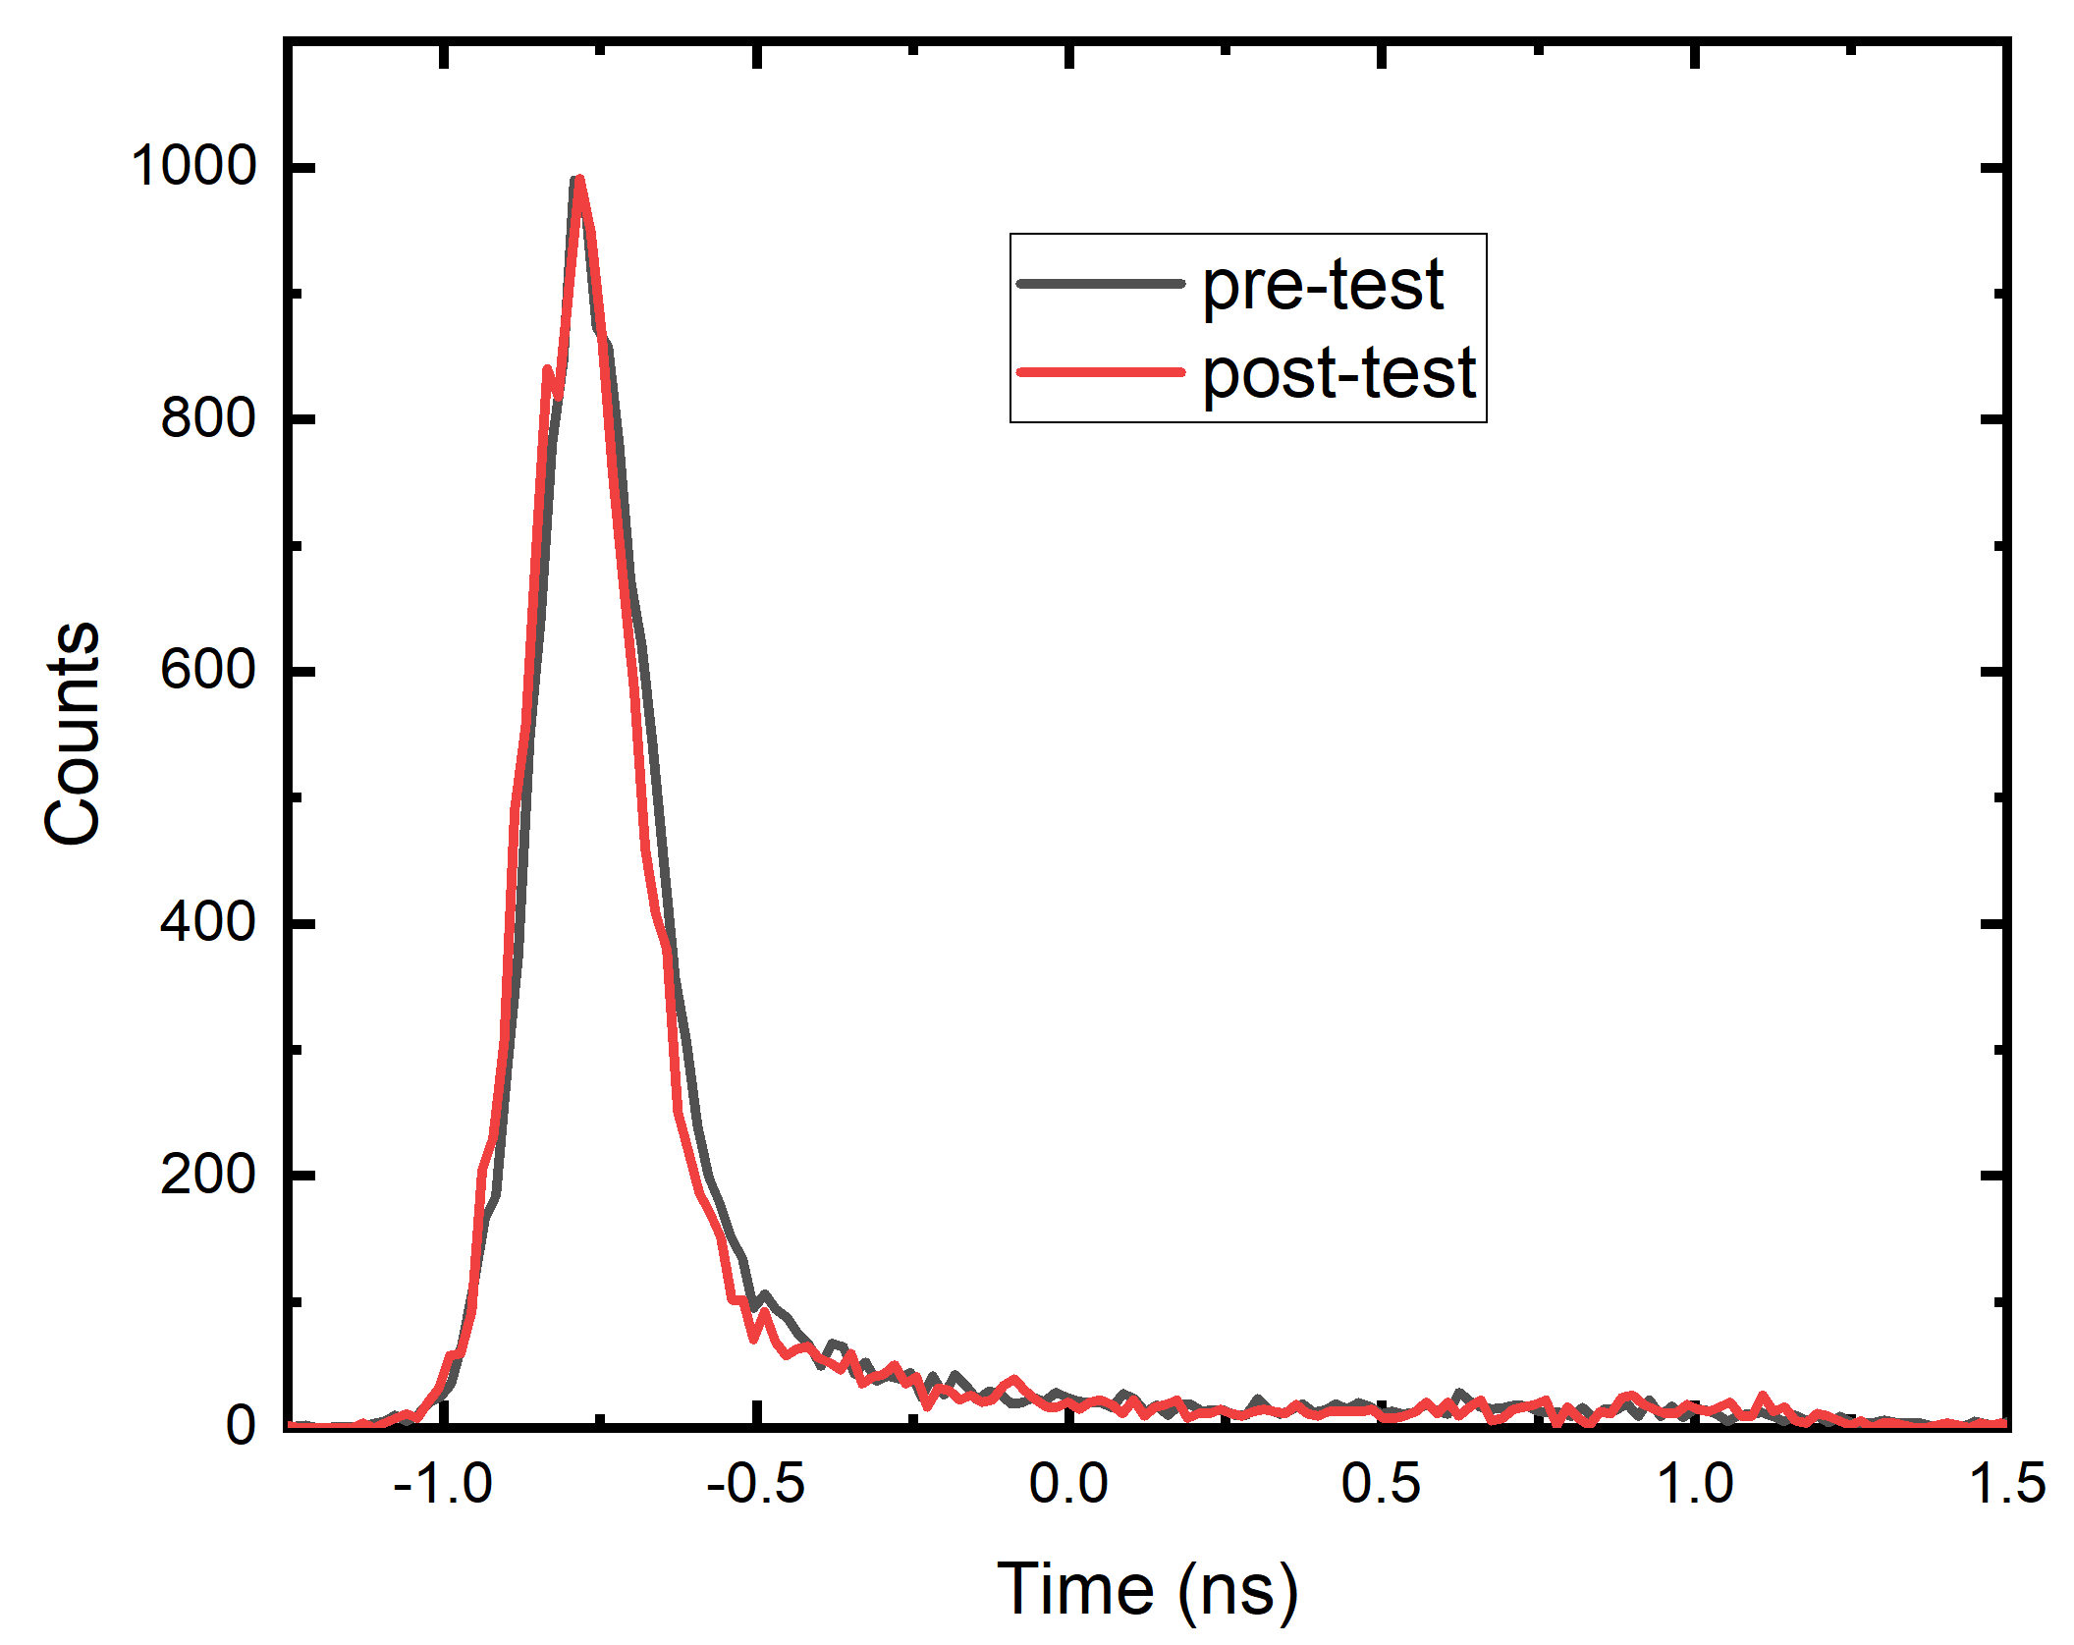
Comparison of pre and post test performance using pulsed LASER

Slide 15
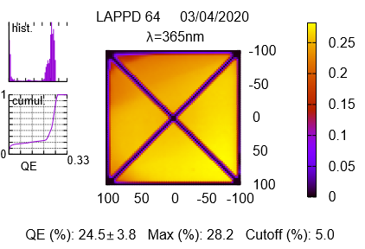
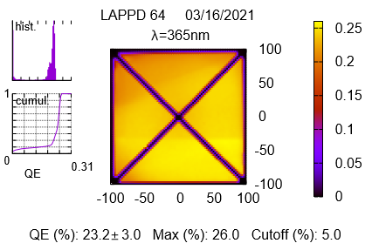
Comparison of pre and post test performance QE Scan @ Incom Inc.
QE Scan : Before shipping to UTA. Blue square shows the irradiation spot. Spot size is to scale.
QE Scan : After receiving the tile from UTA

Slide 16
Conclusions and Future work
LAPPD-64 is a high gain MCP-PMT with good timing resolution and the lifetime tests has shown little degradation in performance till 5.6 C/cm²
The time for aging depends on the current that can be extracted from the MCP-PMT. A lower resistance MCP-PMT can significantly increase the lifetime testing rate.
A low resistance (four times lower) MCP-PMT (LAPPD-89) is next in line for testing.

Slide 17

Thank You
DOE Grant DE-SC0011686

Slide 18
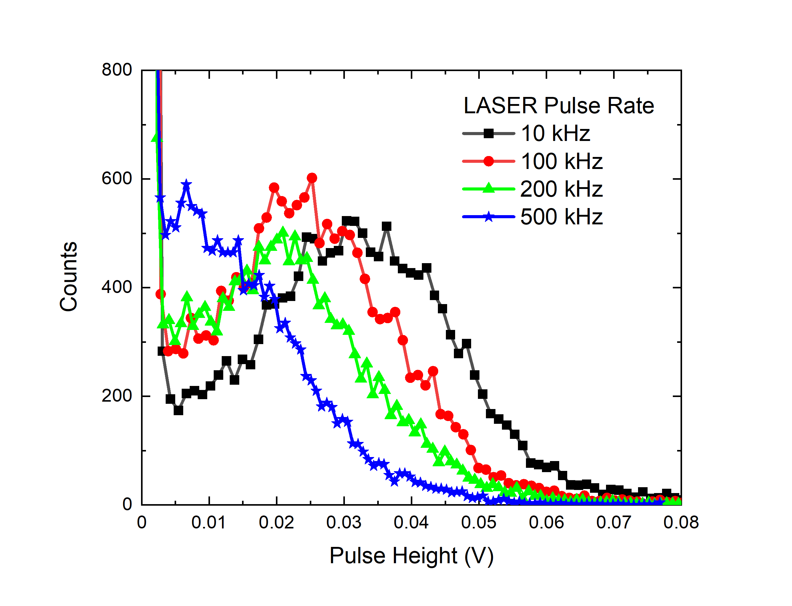
Gain, Pulse Height Distribution and TTS
925 V across the MCPs, 100 V on Photocathode
(b)
(a)
(c)
Figure: (a) Gain (b) Pulse height distribution and (c) Transit time spread as a function of rate. Performance measurements were carried using fiber arrangement which leads to ~ 4.6 mm beam spot. Saturation according to UTA measurements at 30 kHz/mm².

Slide 19
HV Distribution for LAPPDTM
Light source
CAEN0 N1470 NIM HV supply
LAPPD window
- 2150 V
CAEN0 N1470 NIM HV supply
-1275V
CAEN1 N1470 NIM HV supply
MCPs
5.0 M, 0.5 W
-1075 V
CAEN2 N1470 NIM HV supply
Anode
0.5 M, 0.1 W
-200 V
CAEN3 N1470 NIM HV supply

Slide 20
Strip -2
4.8 cm

Slide 21
LASER measurements for finding effective area
Fig. Rate measurements with a beam diameter of (a) 4.8 mm (b) 3.2 mm and (c) fiber arrangement
Fig. Pulse height variation with LASER rate with different beam spots on the LAPPD. Based on the variation at 200 kHz, we deduced that the beam spot due to our fiber is ~ 4.6 mm.

Slide 22
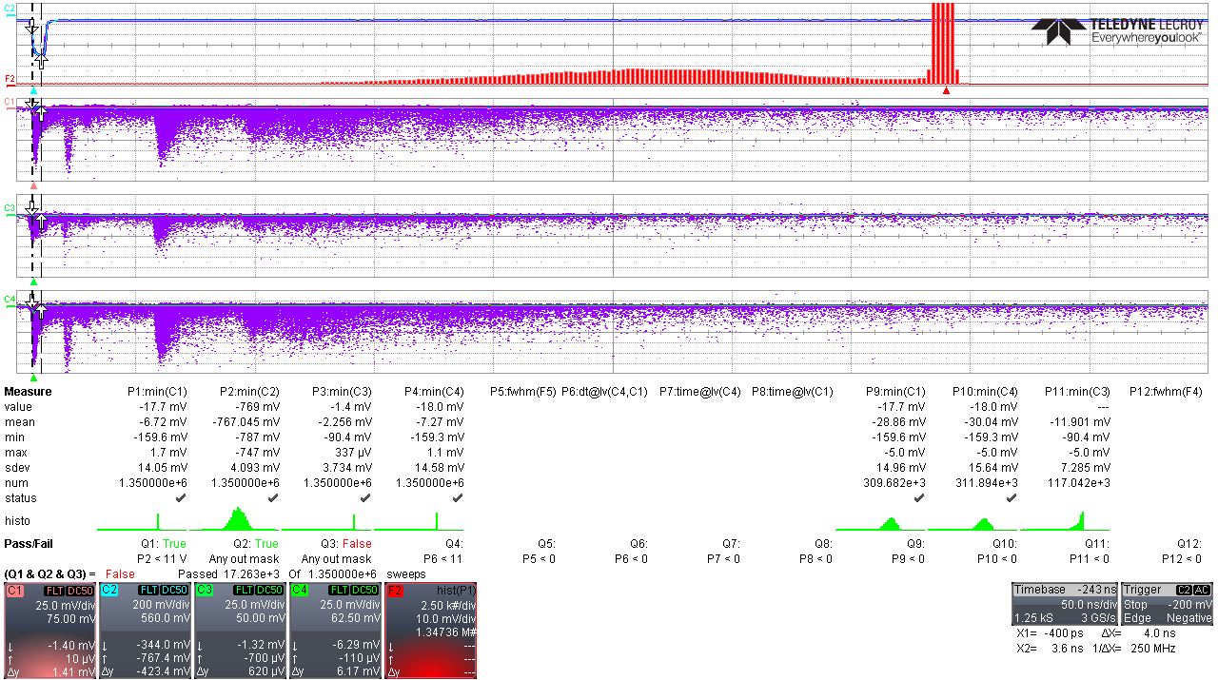
LAPPD Electrode Arrangement
LASER Pulse
Pulse Height Distribution of Main Pulse
PC
100 V
MCP1
925
Ch1: One end of strip
200 V
MCP2
925
Anode
Main Pulse
Ch3: Unirradiated strip
After Pulses
Ch4: Other end of strip
Spectra of After pulses
when only one after pulse occurs in coincidence with main pulse and LASER.
After Pulse measurement settings
At a gain of 1x10⁷, the tube has an after-pulse rate of 5%

