Slide 1
Gas-filled Neutron Imager Operating in Ionization Mode
J. Fried, G. Mahler, N. Schaknowski, G. Smith, B. Yu,
Brookhaven National Laboratory
Doumas
Merchant Marine Academy
Outline
• Thermal neutron interaction with ³He
• Technology for anode pad readout
• Installation of system at OPAL, ANSTO
• Observation of recoil nuclei from fast neutrons

Slide 2
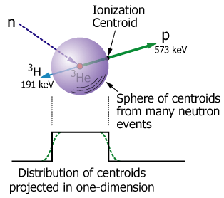
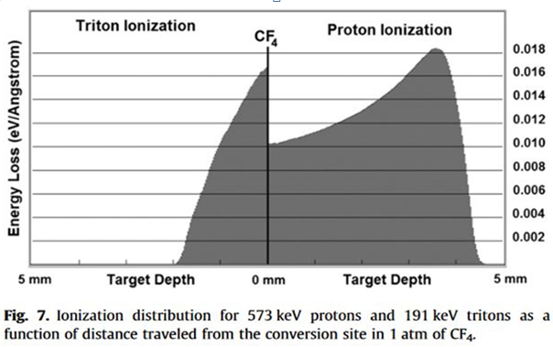
Thermal Neutron Detection in ³He
n + ³He → p + ³H + 764 keV
( ~ 25-30k electrons, 4.5 fC )
Simulation using SRIM
Total range of proton & triton in 1 atm CF₄ is 6mm (N.B. less than 10mm)
Range is inversely proportional to CF₄ partial pressure
• ³He has minimal stopping power for p and ³H compared to CF₄

Slide 3
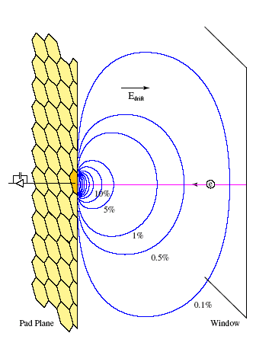
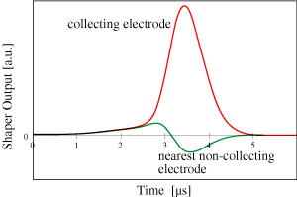
Pad Detector Operating in Ionization Mode
Neutrons enter conversion region, depth d, from the right and create a “line charge” of ∼ 30k electrons. Diagram shows contour plot of the weighting potentials (blue curves) for d /a ∼ 8, where a = pad pitch. The induced charge on a pad is given by the difference in the weighting potentials between any two positions of the moving charge. Require d/a > 1.
Every anode has signal shaping electronics
Cathode is a continuous conducting plane
Anodes are at ground. Cathode is -ve
E_{drift} ∼ several 100 V/cm
Drift velocity of electrons ∼ 10 mm μs⁻¹
a = 5mm, d = 40mm, therefore d / a = 8
Weighting potentials
Cathode (window)
Anode pads
Computed Waveforms
Neutrons
(Orange Pad)
To shaping amplifier
and ADC
(6 bits)
a
0
0
d

Slide 4
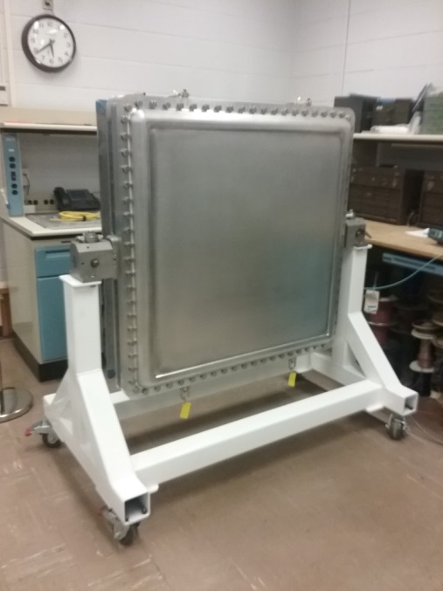
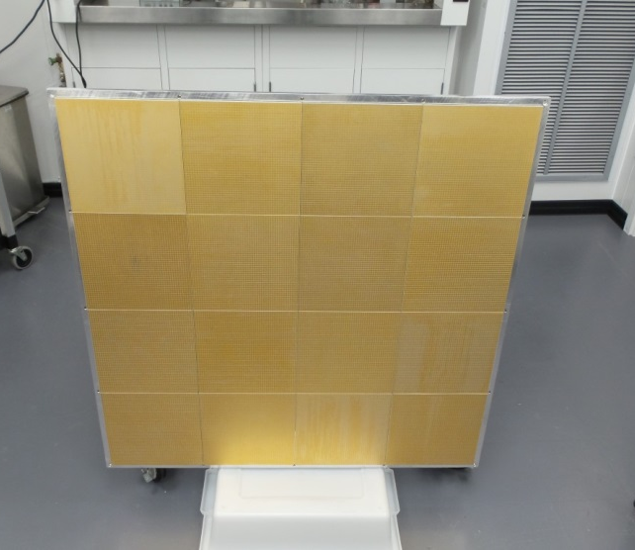
Anode pad board, ASIC readout, detector assembly
5mm x 5mm pads
48 x 48 pads
2304 pads total
36 x 64 channel ASICs
2304 channels
24 cm
96 cm
1m x 1m
detector
4 x 4 pad boards
36,864 pads total

Slide 5
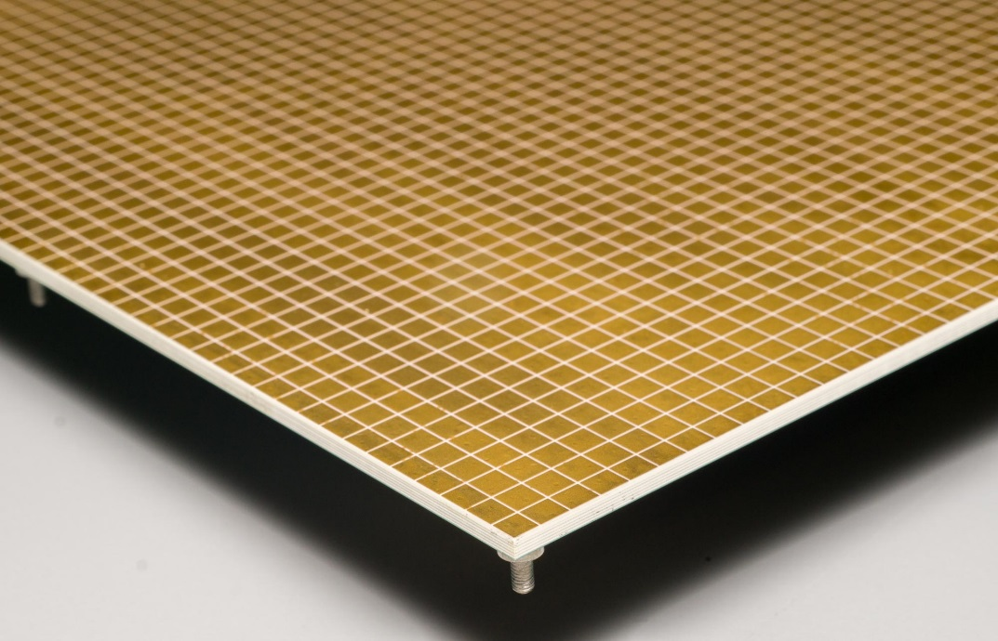
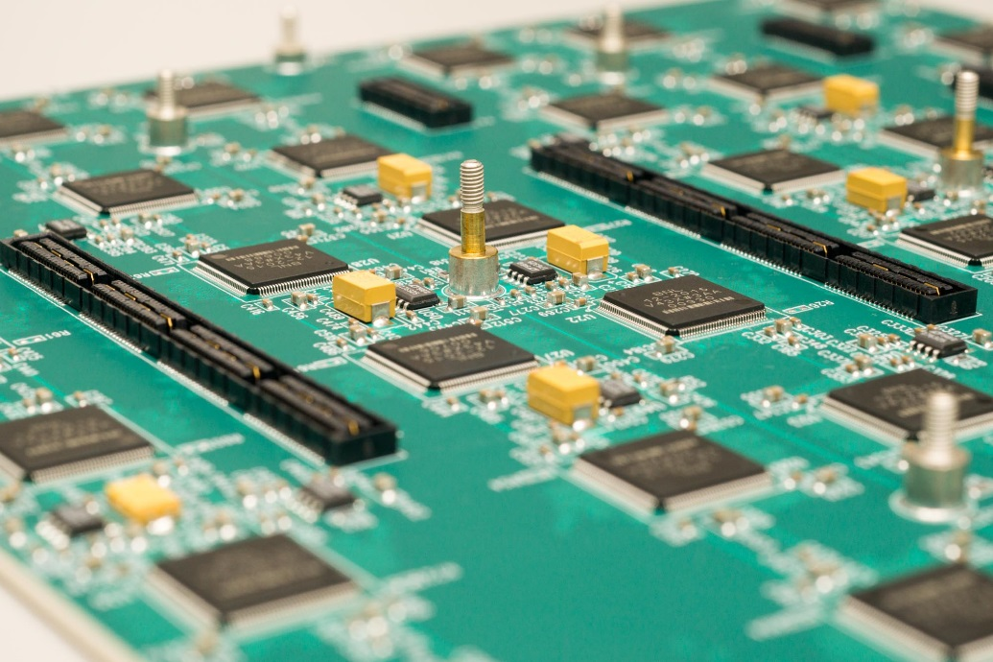
Inside the Detector – the Pad Board
Top side
Bottom side
Red outline shows group of 8 x 8 pads
Each ASIC has 64 channels (inputs for 8 x 8 pads

Slide 6
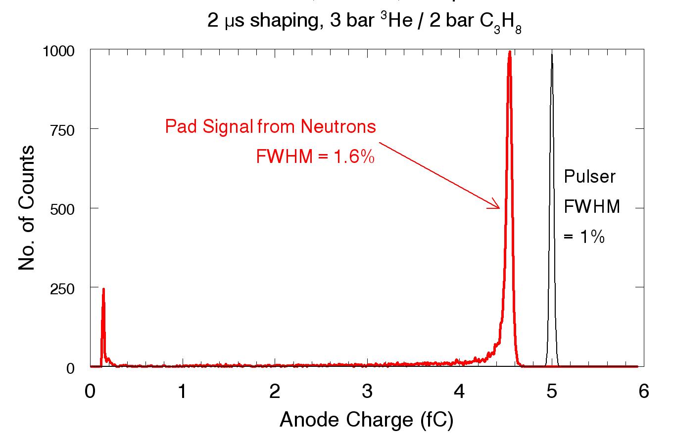
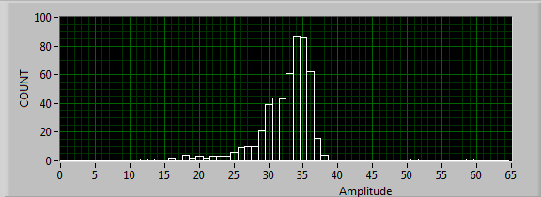
Position Sensitive Neutron Detector in Ionization Mode
1mm x 1mm thermal neutron beam directed at center of pad
All 30k electrons collected by this one pad
Red is pulse height distribution from thermal neutrons
Black is system response to 5 fC from pulse generator
Summed anode signals from 6 bit ADCs
Average amplitude is 35

Slide 7
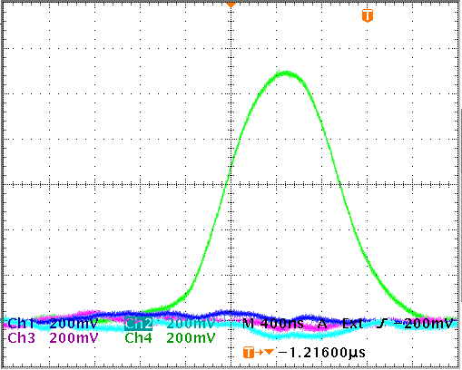
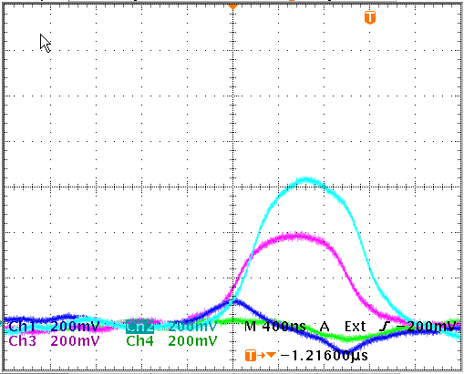
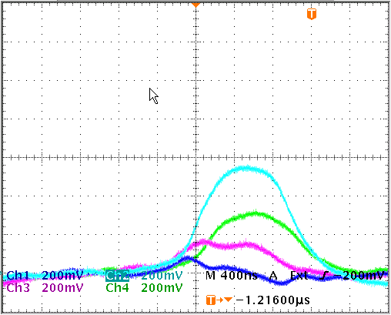
Collection of ionization by array of anode pads.
5 mm
Measured Waveforms
A
5 mm
Full electron collection on one pad
A
C
B
B
Electron collection on two adjacent pads
C
Proton/triton tracks in ³He and 1 bar CF₄
Electron collection on three adjacent pads

Slide 8
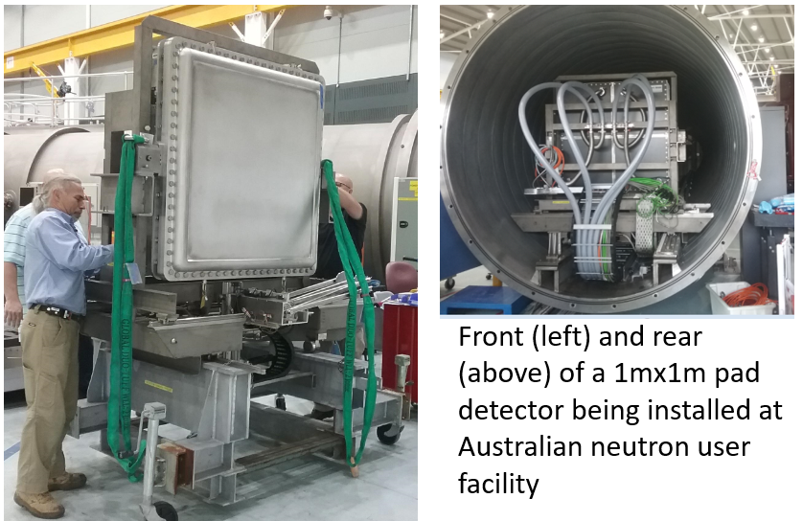

Slide 9
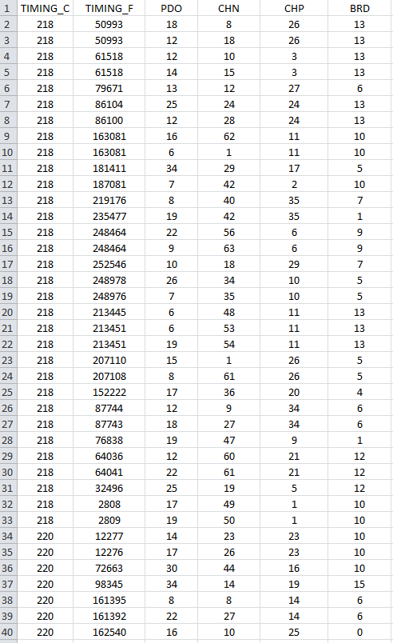
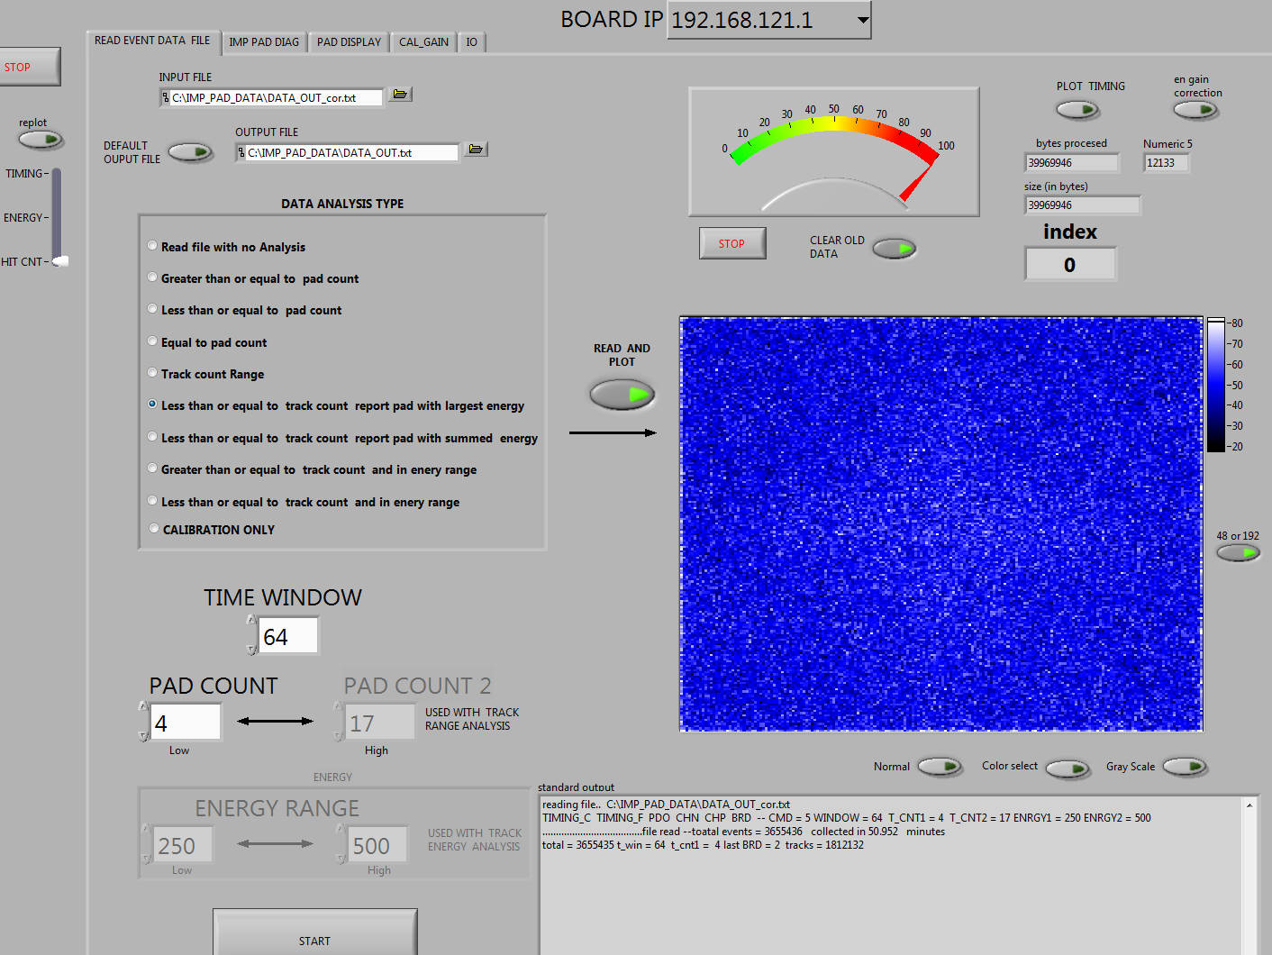
Timing Coarse Fine | Peak Detect | Channel # | Chip # | Board#
Uniform Illumination with neutrons
≤ 4 pads with charge. Report pad with largest energy. Hit Count.
Tracks 1,812,132 ∼ 300 cts s⁻¹ m⁻²

Slide 10
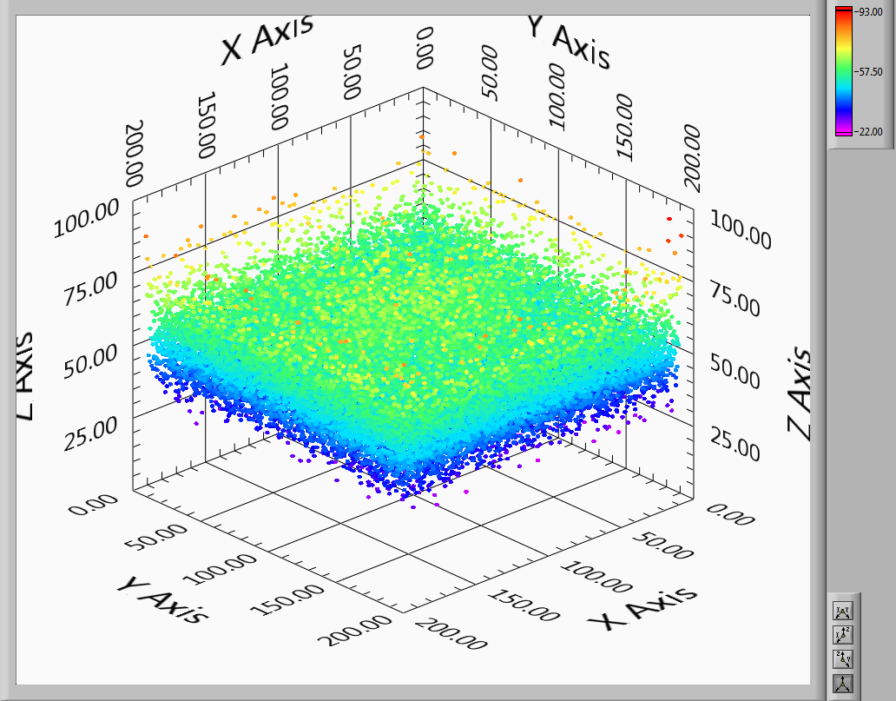
Uniform Illumination with neutrons
≤ 4 pads with charge. Report pad with largest energy.
Hit Count.
Tracks 1,812,132
∼ 300 cts s⁻¹ m⁻²
Note average count per pixel is ∼ 50

Slide 11
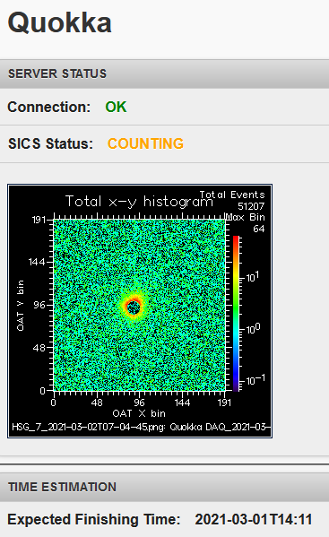
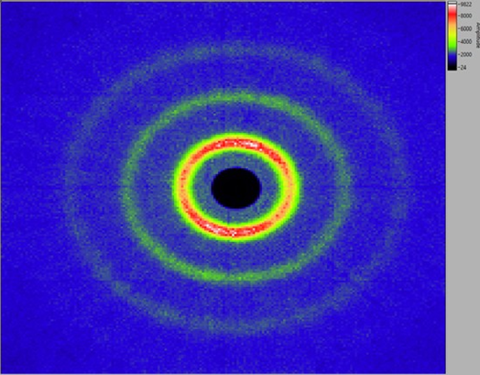
Results from Quokka
SANS image from silver behenate (a standard for small angle scattering), showing multiple diffraction rings. Global rate~ 510 kHz
https://www.nbi.ansto.gov.au/quokka/status/mobile.html

Slide 12
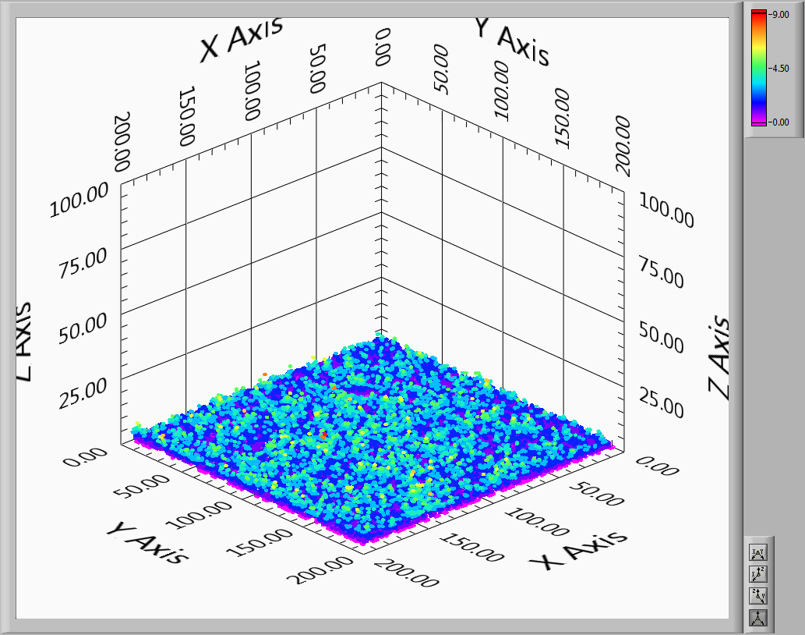
≥ 5 pads with charge.
Hit count.
Tracks: 6318
Total energy in ADC counts ranges from ∼55 to ∼390

Slide 13
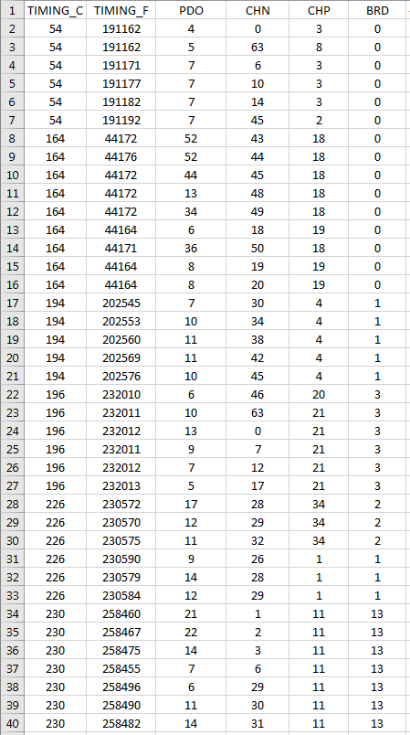
Timing Coarse Fine | Peak Detect | Channel# | Chip# | Board#

Slide 14
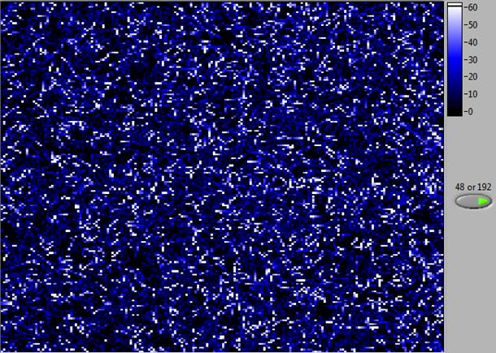
ADC (Energy) scale
≥ 5 pads per event
Tracks = 6318
∼ 1 ct s⁻¹ m⁻²

Slide 15
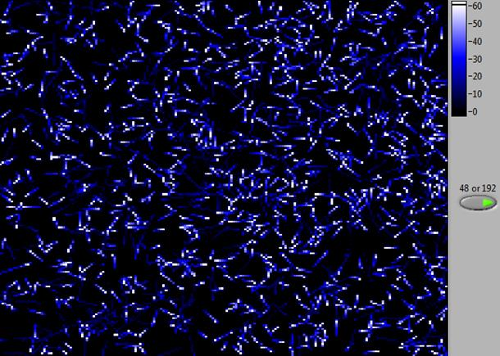
ADC (Energy) scale
≥ 10 pads
Tracks = 1208
∼ 0.2 ct s⁻¹ m⁻²

Slide 16
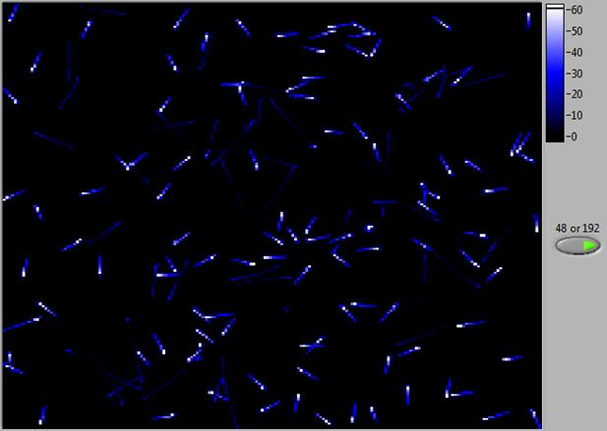
ADC (Energy) scale
≥ 15 pads
Tracks = 146
∼ 0.02 ct s⁻¹ m⁻²

Slide 17
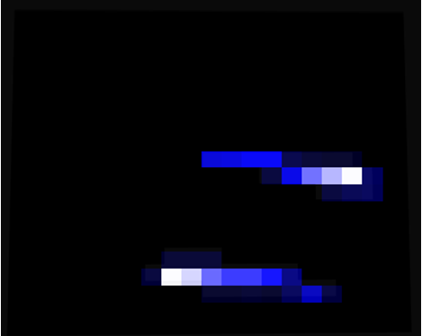
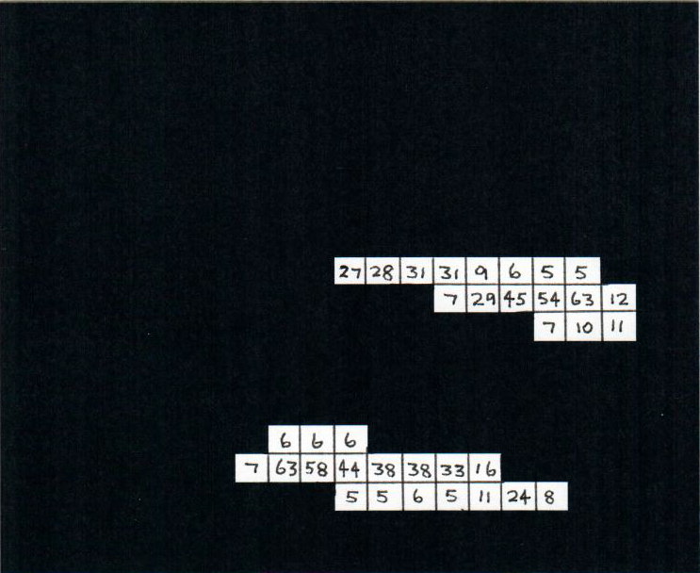
Zoom into two tracks from last slide
a) Each square represents charge from one pad (5mm x 5mm)
Amplitude of each pad signal from 6-bit ADC
b) ADC value from each pad, above
Sum = 380
Total charge in each track is TEN times that from a thermal neutron
Sum = 379

Slide 18
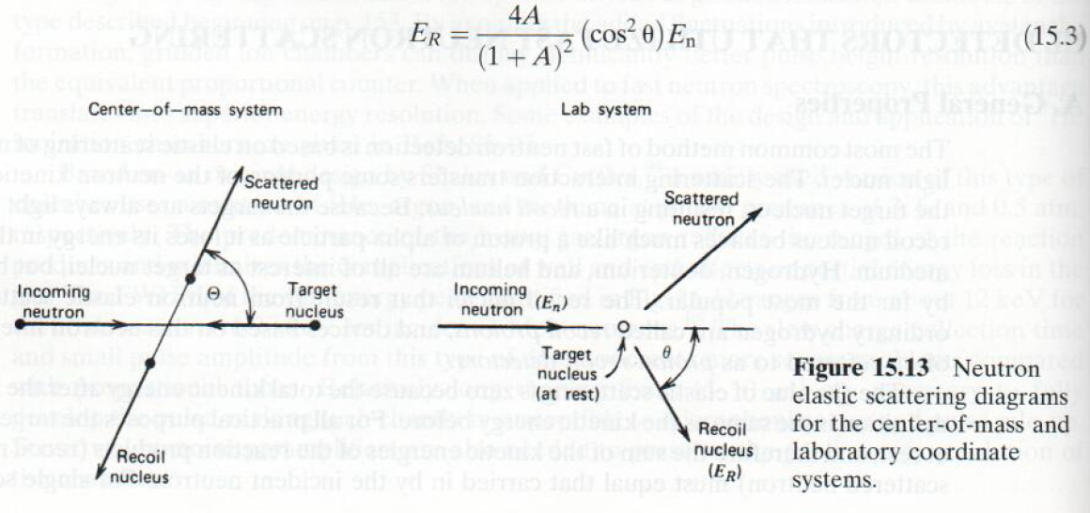
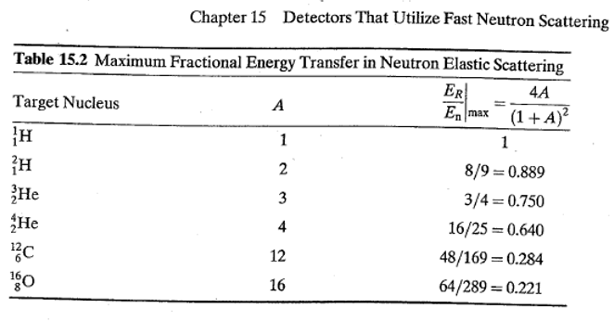
Neutron Elastic Scattering
Radiation Detection and Measurement
by Glenn Knoll
4th Edition, Chapter 15

Slide 19
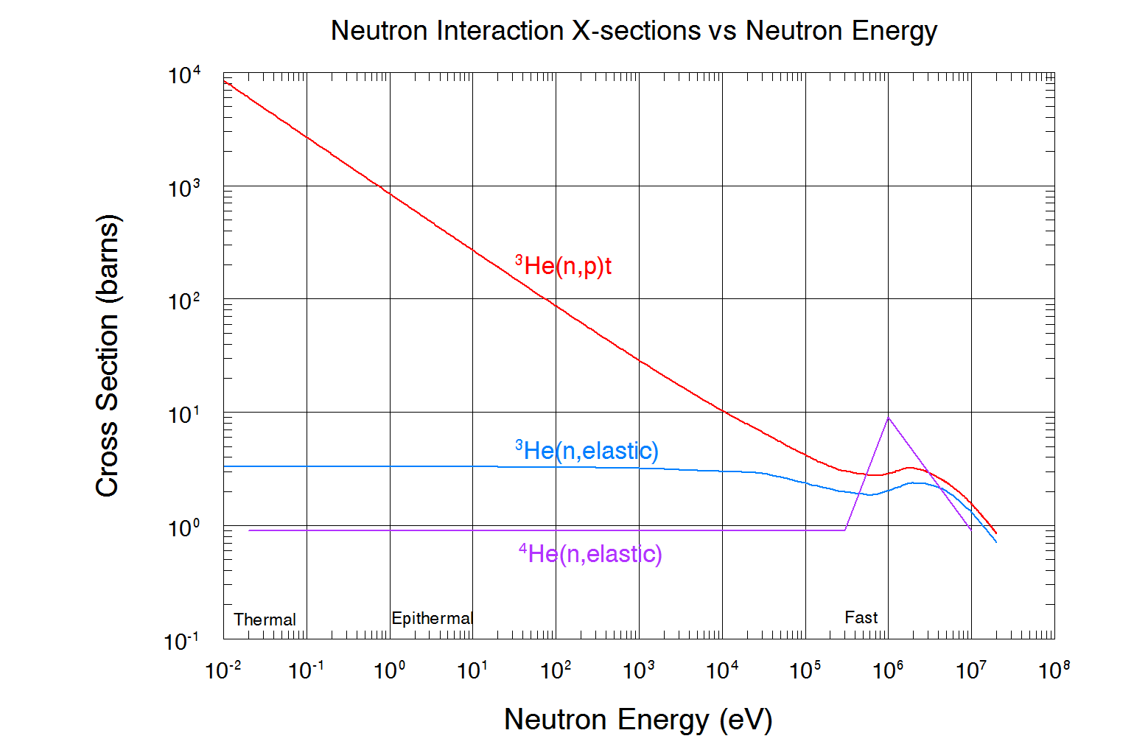

Slide 20
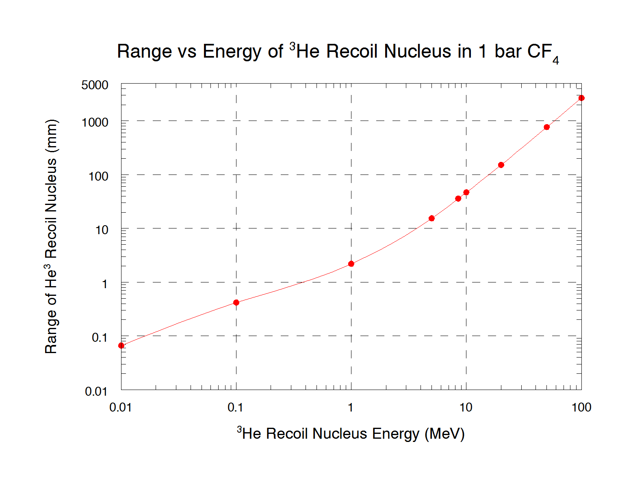

Slide 21
SUMMARY
1m x 1m detector for SANS installed at ANSTO’s OPAL reactor
Ability to distinguish thermal neutron from fast neutrons
Flexibility in pad geometry – for example one axis better position resolution than the other
System integration and operation much easier – all components inside – only services going into detector are GB ethernet and HV and low voltage power
Count rate capability one to two orders of magnitude greater than achievable with existing neutron sensors
Operation in ionization mode – long term stability. Not possible without ASICs.
Best energy resolution comes from ionization mode – note 6 bits is limiting
Potential to have thermal and fast neutron detection in a common sensor, diluting gas mixture with He4 for fast neutrons to reduce cost
Sensitivity to cosmic neutrons is not, but ability to distinguish is.
Single pad board version already proven successful in the field
Quasi 3D track visualization demonstrated
With addition of scintillation light detection, true 3D tracks would be generated

Slide 22
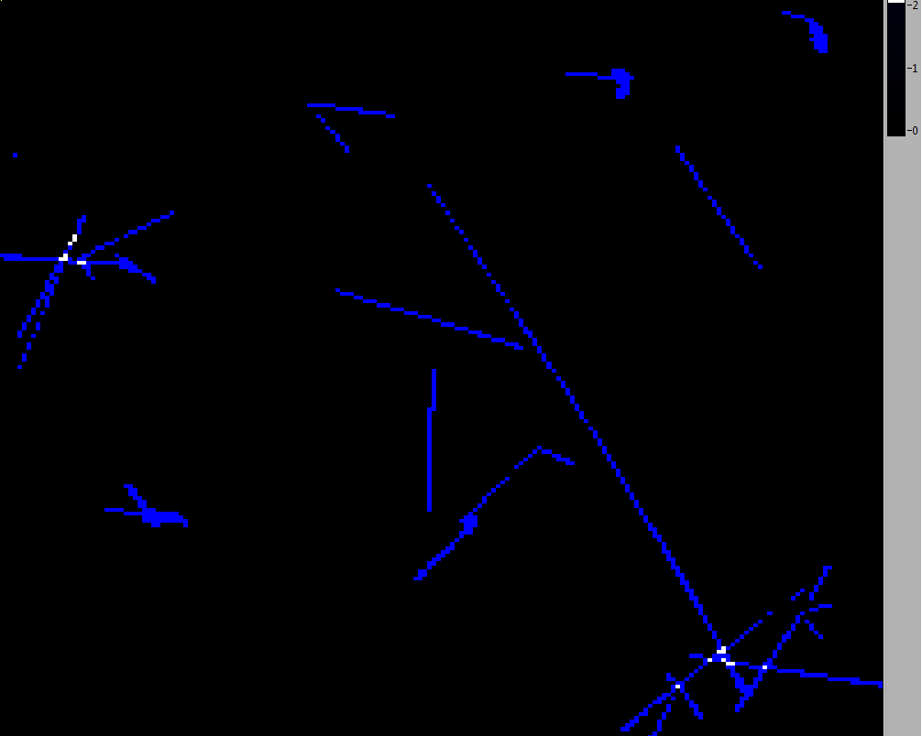
142 pads, cumulative 1576 ADC counts, or close to 40MeV total energy

