Slide 1
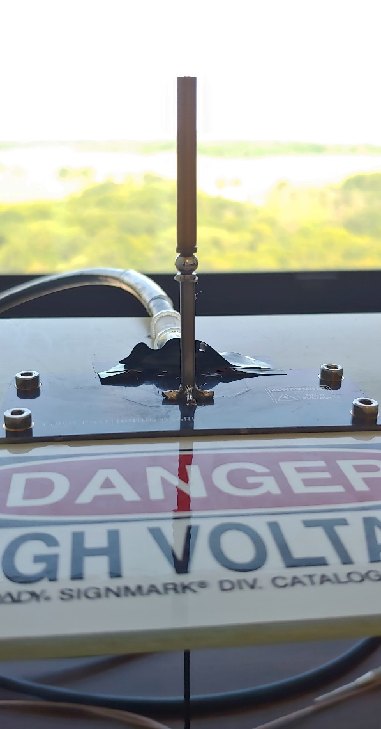
Developing Small-Pitch Optical Fiber Positioners for Massively Parallel Spectroscopy
DES/LSST will need new telescopes and instruments to attain sufficient amounts of spectroscopic follow-up.
A limitation on the number of spectra that can be simultaneously acquired is the size of the Fiber Positioner. Currently used technologies permit ~ 1 cm distance between them.
Our LDRD Goal is to build 5 to 6 mm pitch optical fiber positions for massively parallel spectroscopy.
Prototype Tilting Spine @ FNAL
Summer 2019

