Slide 1
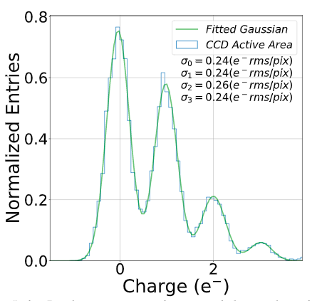
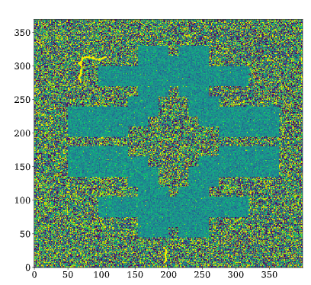
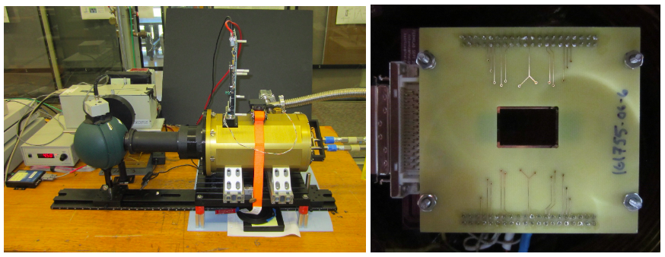
Skipper CCDs for Cosmic Surveys
Reducing noise to ~0.5e- rms/pix can lead to a ~50% increase in survey speed for some applications
Selecting regions of the detector can further improve survey speed and efficiency
Target a future spectroscopic survey (there are ~4 facility concepts being proposed to Snowmass)

