Slide 1
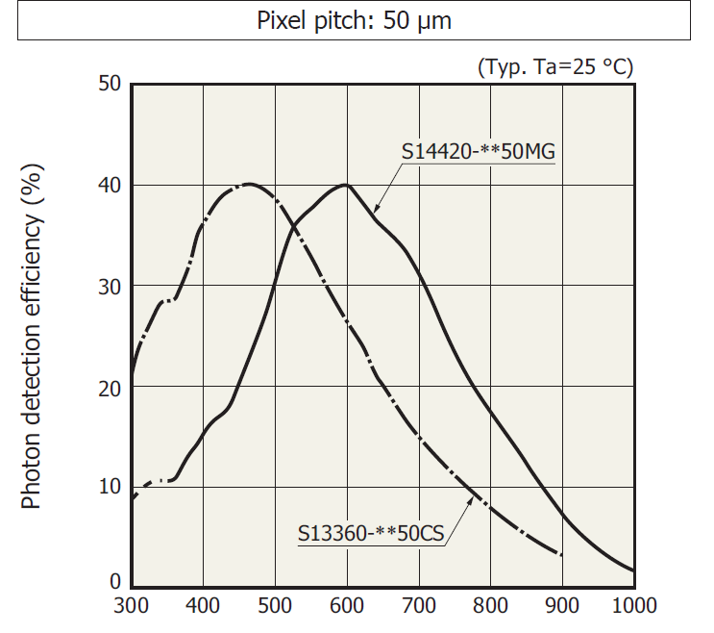
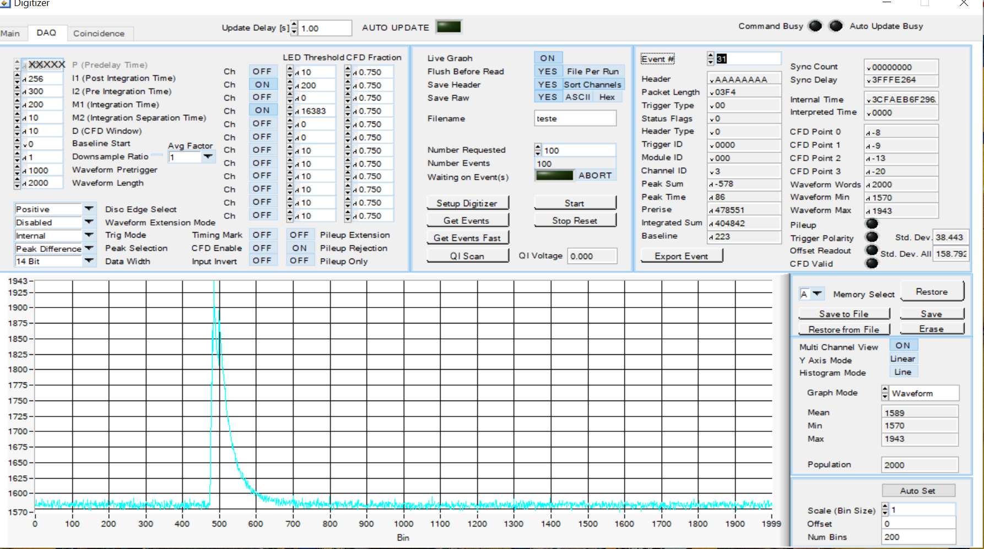
NIR in LAR
Carlos O. Escobar – Fermilab
In collaboration with Adam Para and Paul Rubinov
Currently running an experiment in TallBo: one VUV & one IR SiPMs + alpha source.
First look at the data shows encouraging results. Taking data in both LAr and GAr
Typical waveform for NIR SiPMs (bottom right).
Currently limited by pde of the IR SiPM for λ > 900 nm
Support needed for a NIR detector that could reach beyond 900 nm
There are candidate detectors:
InGaAs SPADs from Princeton Light Waves in the US and MPD in Italy
FERMILAB SAC strategic planning working group: Detectors 12/2020

