Slide 1
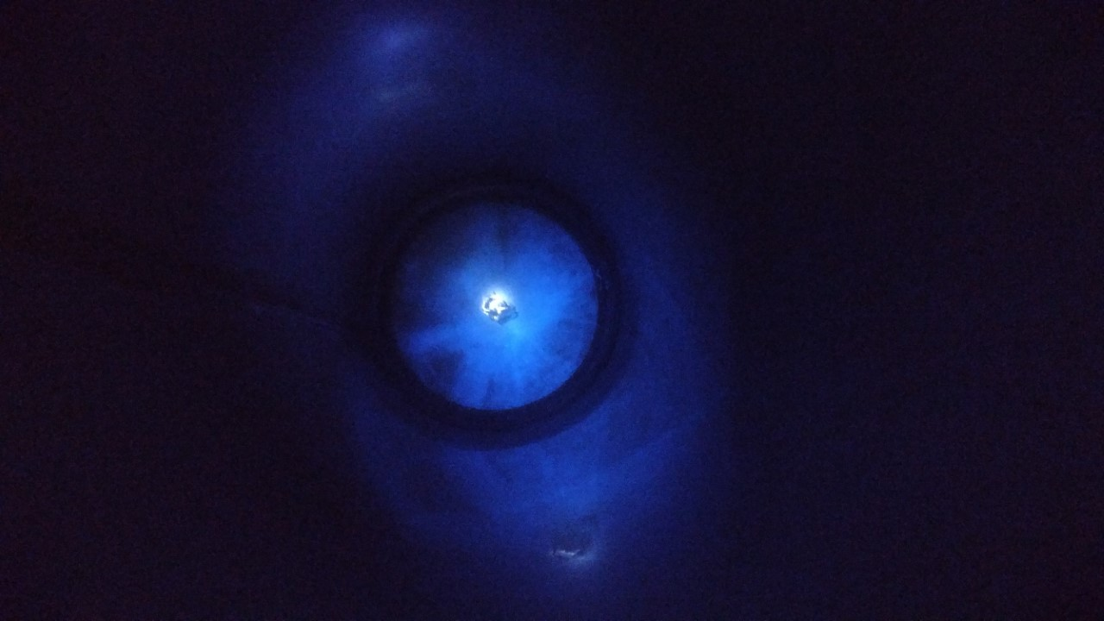
Doping of LAr
Carlos O. Escobar
Mounting evidence of loss of wavelength shifters (WLS) in LAr.
All cryostats at PAB which have used WLS coated elements show the existence of residues inside after being emptied: ICEBERG and TallBo the most notable.
Pictures below show evidence of either TPB or pTp residues inside TallBo after it was last used in the fall of 2017. Three years after and despite thoroughly cleaned it exhibits spots on the wall, shining under UV light, typical of WLS.
Need support to perform rigorous investigation of the solubility of several WLS in LAr and LXe.
Need to get accurate solubilities (mole fraction) as well as determining the rates of solubility, important for long term use of WLS coated elements in large LAr/Lxe detectors
Preliminary studies using semi-empirical Preston-Prausnitz method suggest mole fraction solubilities of the order 10 ppb
FERMILAB SAC Detectors 12/2020

