Slide 1
PoF for use in HV/LAr

Slide 2
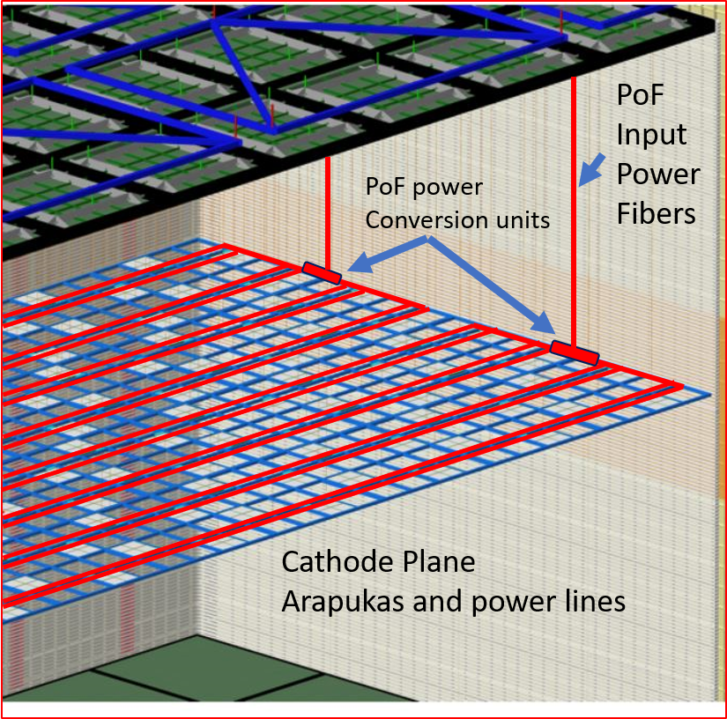
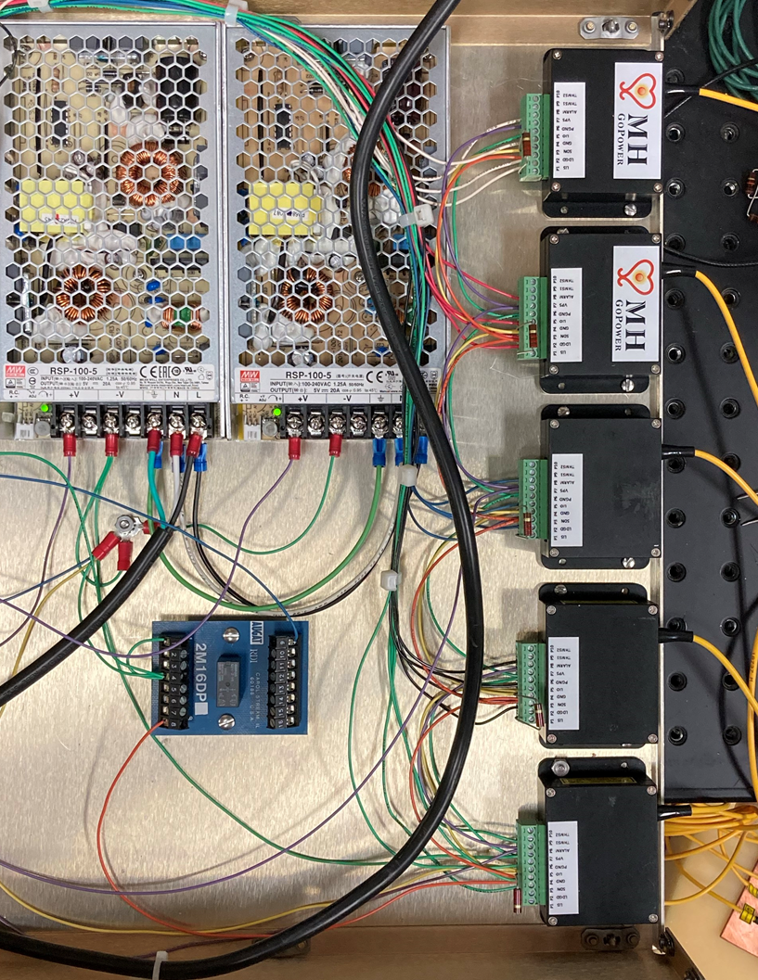
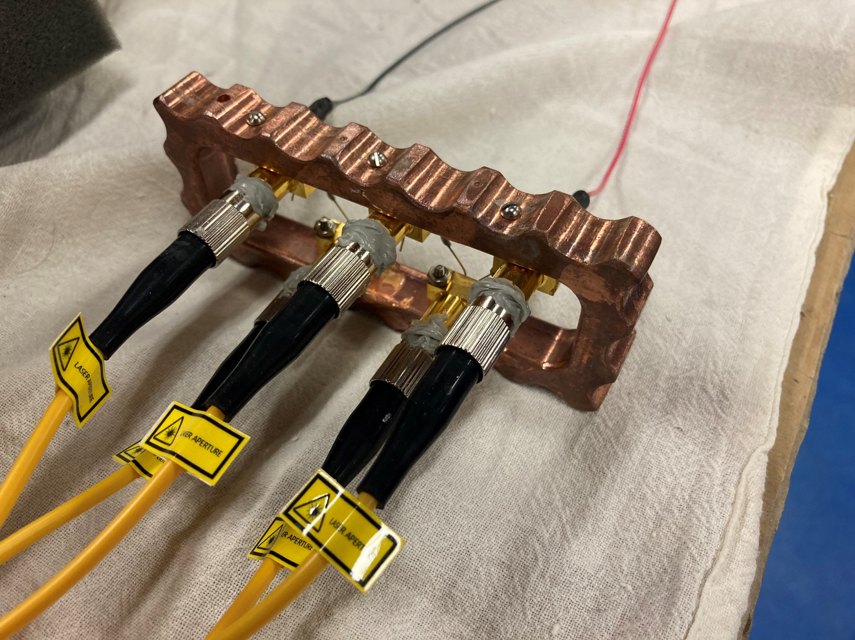
PoF for use in HV/LAr
Larger liquid argon volume detectors require expanded PD capabilities.
A solution is to place additional PD on the HV surfaces – such as cathode and FC.
To do this this requires the use of isolated power source: power over fiber PoF
Recent success on a prototype PoF system has shown this as a promising tech.
PoF has modular capability that can be adapted to suit a need.
PoF cathode SiPM
A test is underway to verify the capability of powering electronics on a HV plane in LAr.
+
=

