Slide 1
Detectors
Working Group Leaders:
Juan Estrada, Angela Fava, Zoltan Gecse, Vadim Rusu

Slide 2
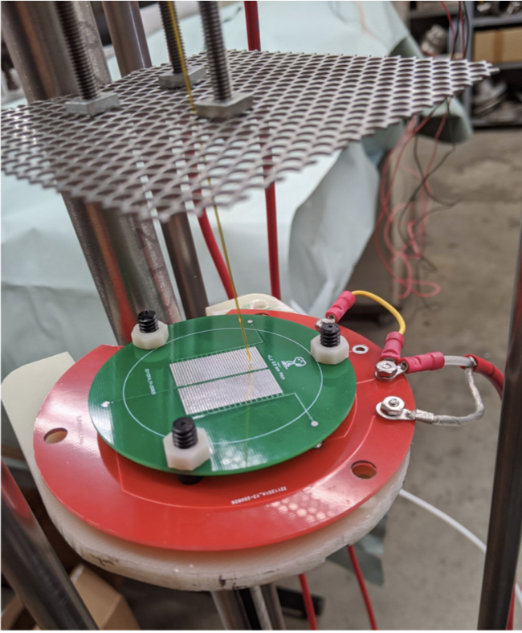
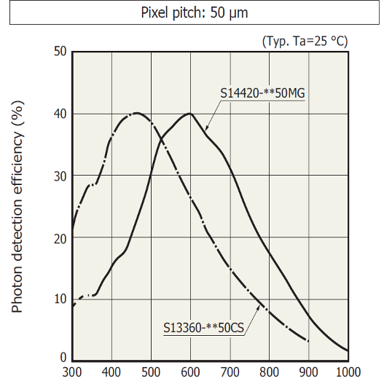
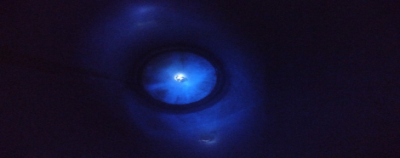
Neutrino Frontier Detectors
LILAr: Light Imaging w/ Liquid Argon (E. Gramellini, J. Asaadi)
In collaboration with UTA theorists: Developed a first simulation based on density functional theory for optical properties. First papers on their way
Successful vacuum tests on first prototypes (performed at UTA): we saw signal!
FNAL Vacuum setup is close to be completed: ORC in preparation
Exploring options of A-Se deposition at the Lab: next step cryo stress tests
NIR in Lar (C. O. Escobar, A. Para, P. Rubinov)
Currently running an experiment in TallBo: one VUV & one IR SiPM + alpha source
First look at the data shows encouraging results, taking data in both LAr and GAr
Currently limited by pde of the IR SiPM for λ> 900 nm
Doping in Lar (C. O. Escobar)
Mounting evidence of dissolution of wavelength shifters (WLS) in LAr.
All cryostats at PAB which have used WLS coated elements show the existence of residues inside after being emptied: ICEBERG and TallBo the most notable.
Found evidence of either TPB or pTp residues inside TallBo after it was last used in the fall of 2017. Three years after and despite thoroughly cleaned it exhibits spots on the wall, shining under UV light, typical of WLS.
Directionality measurement of nuclear recoil (D. Caratelli, A. Fava, R. Harnik, P. Machado, Y. Perez Gonzales, J. Raaf, J. Zettlemoyer)
LOIs submitted on drift electron amplification in LAr-TPC and tracking of nuclear recoils in high-pressure GAr-TPC, both aiming at ~10s KeV energy threshold for detection of nuclear recoils mainly from CEvNS and WIMP DM
Intent to enlarge the scope in view of a white paper, to directional detection of nuclear recoil in TPC’s, to engage other experimental groups involved in synergistic efforts (several identified during the Magnificent CEvNS 2020 Workshop).
Focus: directional tracking in gaseous TPCs for all gases (FNAL: argon, possibly with the addition of dopants)

Slide 3
Cosmic Frontier Detectors
Particle Dark Matter:
FNAL has leading roles in the development of low threshold dark matter detectors with new materials, superconductor detectors , skipper-CCDs and Scintillating Bubble Chamber.
WP in preparation include next generation experiments, sensor developments, readout systems and material studies
Kurinsky coordinating CF-1 Low-Threshold Landscape white paper
Wavelike Dark Matter:
FNAL was involved in ~11 LOIs
Now focusing in 2 WP:
Resonant cavity experiments : Summary of US and international efforts.
Discovering GHz-THz axion dark matter to be led by Fermilab (axion discovery with broadband detectors.
Cosmic Surveys (VIS-IR):
A white paper that brings together roughly a dozen cosmic survey instrumentation LOIs:
Detector technology: fully depleted CCDs, skipper CCDs, germanium CCDs, non-destructive CMOS, MKIDS
“Photon Systems”: fiber positioners, photonics, ultra-high-resolution interferometers, multi-photon interferometers
Development and Testing Facilities: detector fabrication facilities, calibration facilities, astronomical testing facilities
CMB:
Several WP covering:
CMB-HD: An Ultra-Deep, High-Resolution Millimeter-Wave Survey Over Half the Sky
Millimeter-Wave Line Intensity Mapping (Physics and Facilities)

Slide 4
Precision and Energy Frontier Detectors, Facilities
Straw tracker R&D
We currently have made 8 micron wall thickness, spirally wound, Mylar straws. These are being tested for mechanical properties over the next couple months. Long term tension tests will be started and monitored.
Will use FastSim to test effects of differing tracker geometry and tracking technology. Comparison of momentum sensitivity for different geometry, material and tracking technology.
Fast Machine Learning
Develop real-time ML tools and algorithms for current and future HEP experiments, applications include hardware trigger systems as well as coprocessors for data reconstruction
Organized “Fast ML for Science” workshop: https://indico.cern.ch/event/924283/overview
High Speed Links
Fermilab is collaborating with Freedom Photonics (FP), UCSB, and LBNL on a system to demonstrate Ring Resonant Modulators (RRMs) for use in Wavelength Division Multiplexing links for detector readout
FP has submitted a new design and will be testing these devices soon, this is supported by an SBIR Phase I award
High Intensity Proton Irradiation Facility
The need for a high-rate proton irradiation facility has been identified for the HEP community
No similar proposal has been put forward during the Snowmass process so far
We have support from the DOE program manager
Fermilab is the best place to realize such a facility
New Test Beam at Fermilab
Current Test beam is very successful, but also often oversubscribed
Users have also requested different beam energies and capabilities
We’re looking to take advantage of the PIP-II and the new BR
Multiple beam lines, upgraded facility instruments, well understood beam is key
Help is welcome with simulations, placement, etc.

