Slide 1


Magnets 302.2.02 and 03 –
Strand Procurement and Testing
Cable Fabrication
Lance Cooley – NHMFL/ASC (302.2.02 L3)
Vito Lombardo – FNAL (302.2.02 CAM)
Ian Pong – LBNL (302.2.03 L3 and CAM)
Elizabeth Lee – LBNL (302.2.03 CAM deputy)
Mike Naus – LBNL (302.2.03 L3 Deputy)
Jonathan Lee – LBNL Intern Student
HL-LHC AUP MQXFA07 Coil Acceptance Review – 17 Dec 2020

Slide 2
Outline
Cable Summary
Wire Summary
Cable Details – x4
  Discrepancy Reports (if any)
  Cable Mechanical QC Summary
Summary

Slide 3
Cable Summary
Coil | Cable
QXFA114 | P43OL1097
QXFA124 | P43OL1131
QXFA212 | P43OL1124
QXFA214 | P43OL1127
All cables are 2nd generation QXF cables with 108/127 RRP® strands procured under LARP
All are AUP cables

Slide 4
Wire Summary
All ordered per “HiLumi” specification
  Procured by LARP under:
    FNAL PO 632982 C – Spec 0
    FNAL PO 624035 C1 – Spec 0
    FNAL PO 624035 D – Spec 0
  Procured by AUP under:
    FNAL PO 646116 Shipment A – Spec 0
    FNAL PO 646116 SA1 Shipment A – Spec 0
    FNAL PO 646116 Shipment B – Spec 0
    LBNL PO 7428700 Shipment A – Spec 0
    LBNL PO 7428700 Shipment B – Spec 0
0.85 mm, Ti-doped, reduced Sn
LARP procurement spec was US-HiLumi-Doc-40
  Modification to HT was applied to PO 632982, changing the final stage from 665°C for 75 h to 665°C for 50 h.
    → IC was higher, but RRR was lower

Slide 5
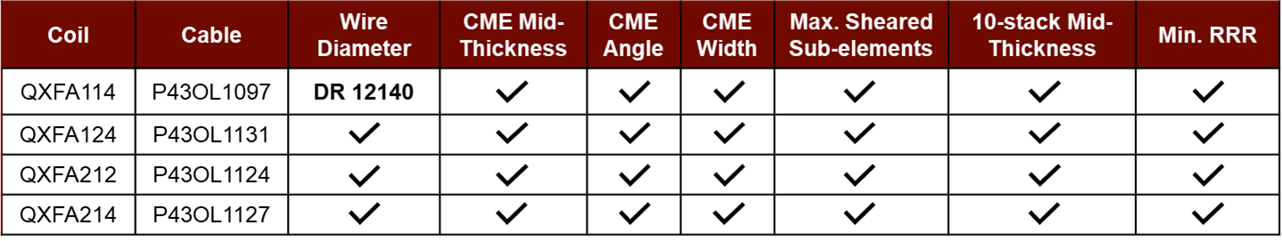
Overall Cable QC Summary
All cables passed required quality control testing per US-HiLumi-Doc. 74
One non-critical DR reported for P43OL1097/QXFA114
  Minor wire diameter non-conformity
ü = Pass

Slide 6
QXFA-114 / P43OL1097

Slide 7
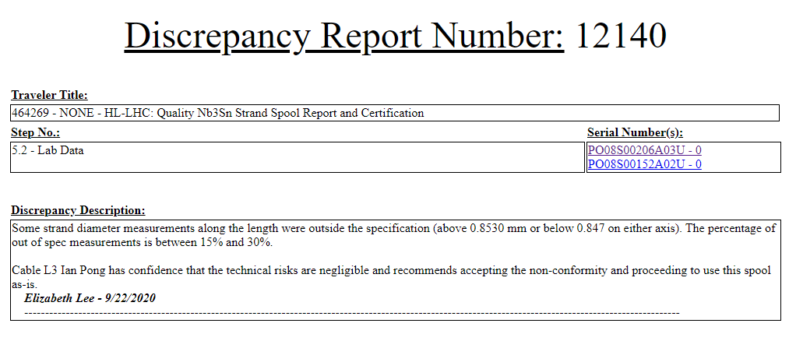
Discrepancy Report #12140
Some strand diameter measurements along the spool length of PO08S00206A03U were outside specification
Should not impact cable readiness

Slide 8
Present strand production data (20 Nov 2020)
114
124
212
214

Slide 9
P43OL1097/QXFA-114 – Cable QC Summary
CME:
Residual Twist: 110°
10-stack:
  Qualification: 1.534 mm
  Production tail end: 1.529 mm
 | Pressure (MPa) | Angle (°) | Width (mm) | Thickness (mm)
Maximum | 17.1 | 0.457 | 18.180 | 1.531
Average | 17.0 | 0.438 | 18.158 | 1.524
Minimum | 17.0 | 0.414 | 18.147 | 1.518
Sigma | 0.01 | 0.006 | 0.006 | 0.002

Slide 10
Summary – coil 114
Margin along load line at 16230 A | 26.7%
Current and field at 100% SSL | 22.1 kA, 15.1 T
Current margin | 62.0%
Current capacity at operating field | 42.8 kA
Temperature margin | 5.4 K
Temperature where scaled SSL crosses I_{op} | 7.3 K
Temperature where scaled SSL crosses I_{ult} | 6.4 K

Slide 11
QXFA-124 / P43OL1131

Slide 12
P43OL1131/QXFA-124 – Cable QC Summary
CME:
Residual Twist: 130°
10-stack:
  Qualification: 1.527 mm
  Production tail end: 1.526 mm
 | Pressure (MPa) | Angle (°) | Width (mm) | Thickness (mm)
Maximum | 17.0 | 0.423 | 18.169 | 1.530
Average | 17.0 | 0.402 | 18.156 | 1.525
Minimum | 17.0 | 0.374 | 18.152 | 1.521
Sigma | 0.01 | 0.007 | 0.002 | 0.002

Slide 13
Summary – coil 124
Margin along load line at 16230 A | 27.0%
Current and field at 100% SSL | 22.2 kA, 15.1 T
Current margin | 63.1%
Current capacity at operating field | 44.0 kA
Temperature margin | 5.4 K
Temperature where scaled SSL crosses I_{op} | 7.3 K
Temperature where scaled SSL crosses I_{ult} | 6.4 K

Slide 14
QXFA-212 / P43OL1124

Slide 15
P43OL1124 /QXFA-212 – Cable QC Summary
CME:
Residual Twist: 120°
10-stack:
  Qualification: 1.537mm
  Production tail end: 1.525 mm
 | Pressure (MPa) | Angle (°) | Width (mm) | Thickness (mm)
Maximum | 17.1 | 0.425 | 18.183 | 1.535
Average | 17.1 | 0.404 | 18.150 | 1.527
Minimum | 17.0 | 0.375 | 18.144 | 1.522
Sigma | 0.01 | 0.008 | 0.004 | 0.002

Slide 16
Summary – coil 212
Margin along load line at 16230 A | 27.9%
Current and field at 100% SSL | 22.5 kA, 15.3 T
Current margin | 63.8%
Current capacity at operating field | 44.9 kA
Temperature margin | 5.6 K
Temperature where scaled SSL crosses I_{op} | 7.5 K
Temperature where scaled SSL crosses I_{ult} | 6.6 K

Slide 17
QXFA-214 / P43OL1127

Slide 18
P43OL1127/QXFA-214 – Cable QC Summary
CME:
Residual Twist: 150°
10-stack:
  Qualification: 1.530 mm
  Production tail end: 1.527 mm
 | Pressure (MPa) | Angle (°) | Width (mm) | Thickness (mm)
Maximum | 17.1 | 0.422 | 18.191 | 1.534
Average | 17.0 | 0.400 | 18.152 | 1.528
Minimum | 17.0 | 0.368 | 18.147 | 1.522
Sigma | 0.01 | 0.009 | 0.003 | 0.002

Slide 19
Summary – coil 214
Margin along load line at 16230 A | 28.8%
Current and field at 100% SSL | 22.8 kA, 15.5 T
Current margin | 65.1%
Current capacity at operating field | 46.5 kA
Temperature margin | 5.7 K
Temperature where scaled SSL crosses I_{op} | 7.6 K
Temperature where scaled SSL crosses I_{ult} | 6.7 K

Slide 20
END
[Back-Up Slides Below]

Slide 21
Present strand production data (20 Nov 2020)
Both 665°C/75h
S: 665°C/50h
V: 665°/75h
Both 665°C/50h
2015
2016
2017
2018
2019
2020
114
124
212
214

Slide 22
Present strand production data (20 Nov 2020)
Both 665°C/75h
S: 665°C/50h
V: 665°/75h
Both 665°C/50h
2015
2016
2017
2018
2019
2020
114
124
212
214

Slide 23
Present strand production data (20 Nov 2020)
Data for 15% rolled strand predicts the RRR at cable sharp bend
Lab: IEC method, Supplier: 20K method
Inter-lab comparisons have validated approaches (see QP)
2015
2016
2017
2018
2019
2020
114
124
212
214

Slide 24
P43OL1097/QXFA-114 – Cable Date, Lengths
Cable Manufacture Date
  2018 02 16 (Production run)
Cable Length:
  463 m (LBNL, fabricated, including LBNL samples)
  ### m (Measured by FNAL)

Slide 25
P43OL1097/QXFA-114 – Strand and SS Core ID
Spool:
  PO08S00076A01U x 1 ULs,
  PO08S00110A02U x 11 ULs,
  PO08S00189A01U x 1 ULs,
  PO08S00189A05U x 1 ULs,
  PO08S00189A06U x 1 ULs,
  PO08S00191A04U x 2 ULs,
  PO08S00204A03U x 1 ULs.
  PO08S00205A01U x 9 ULs,
  PO08S00206A03U x 11 ULs,
  PO08S00208A03U x 2 ULs,
Core:
  120L48A7322313
    Core width: 12.0 mm; material: 316L;
    Heat: 844979; Lot: 16-597;
    Chemical Properties CoT/CoC 172660-1: 0.14 wt% Co
From 8 billets

Slide 26
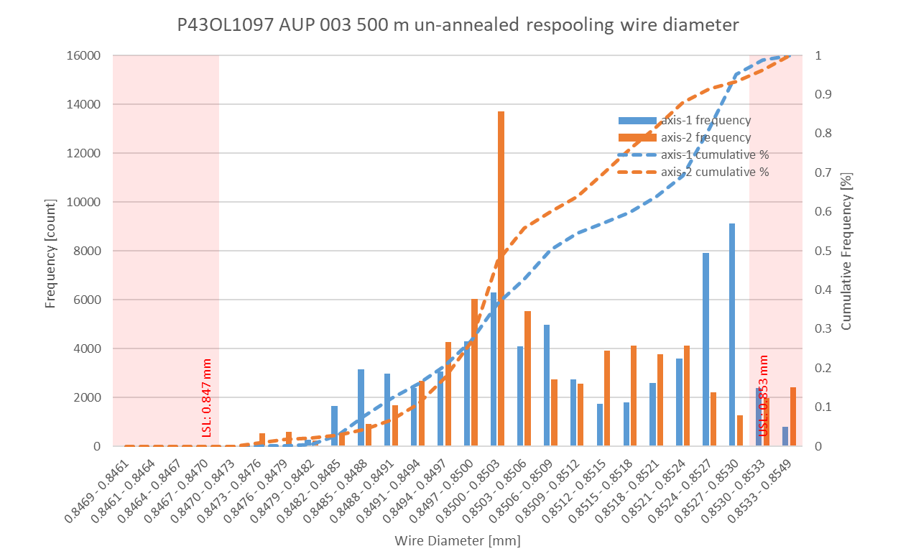
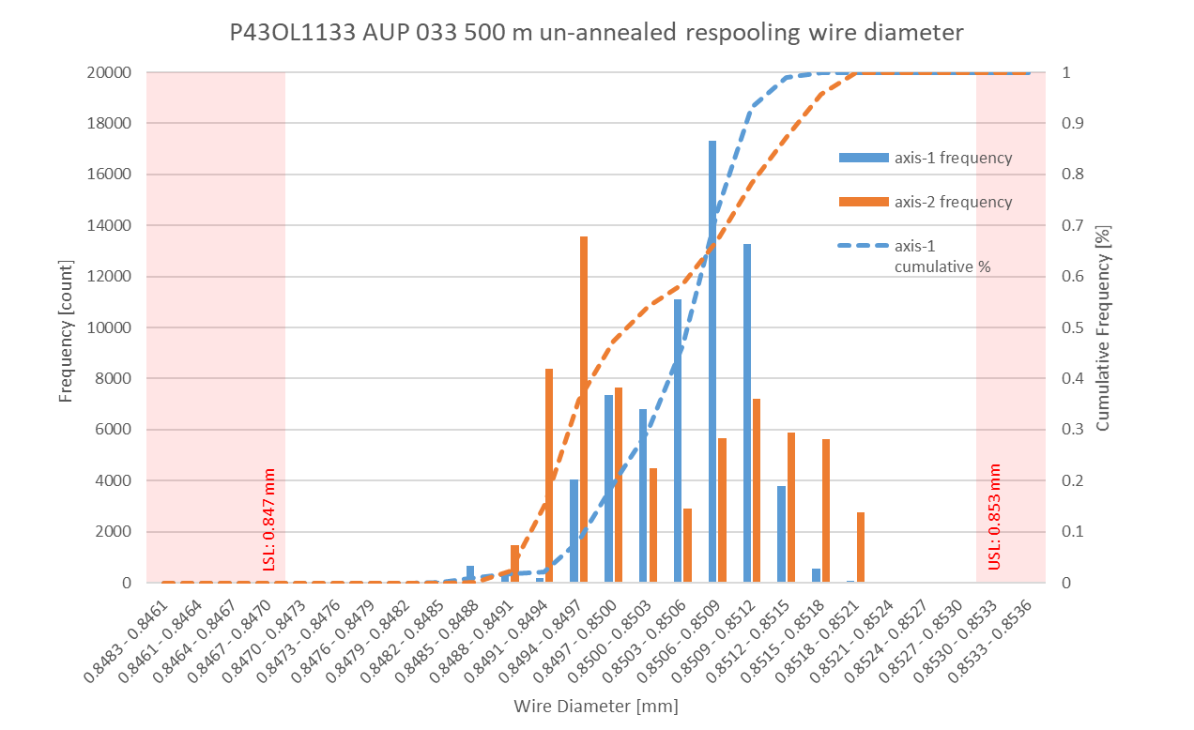
P43OL1097/QXFA-114 Respooling Wire Diameter
Below LSL: 0.00%
Above USL: 2.46%

Slide 27
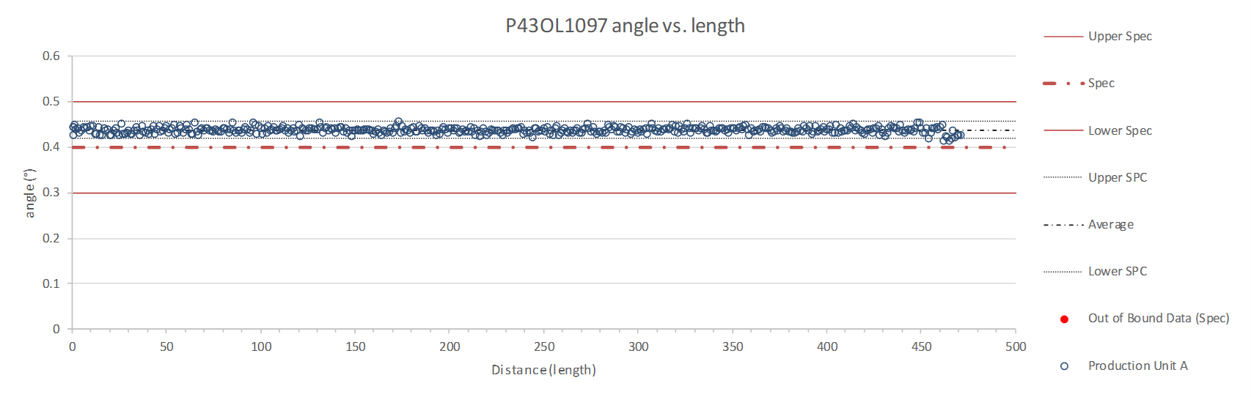
Rollers: P-91 (2017-12-08) and P-92 (2017-12-08)

Slide 28
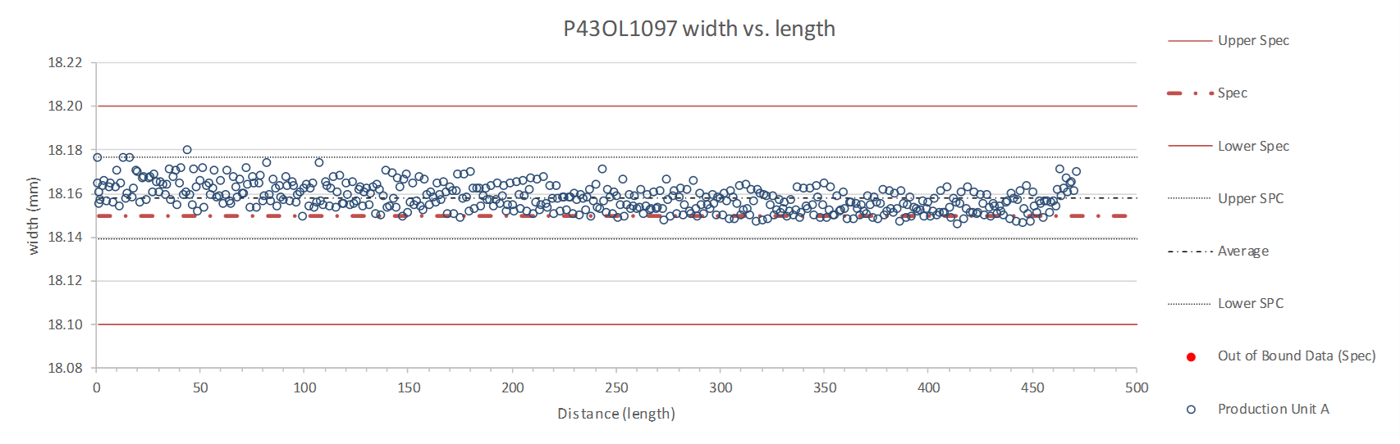
Rollers: P-91 (2017-12-08) and P-92 (2017-12-08)

Slide 29
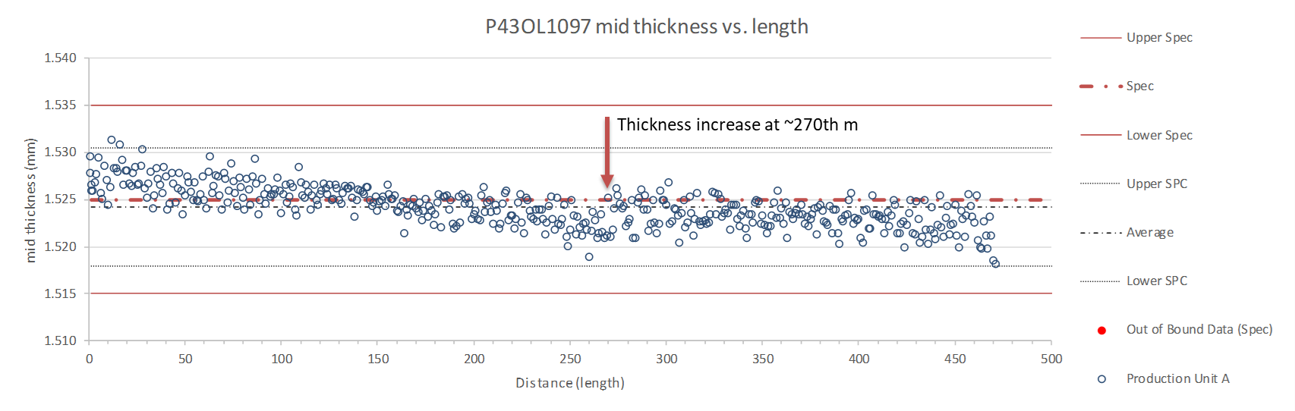
Rollers: P-91 (2017-12-08) and P-92 (2017-12-08)

Slide 30
P43OL1097/QXFA-114 – Braiding
Fiberglass Lot #s: 91309, 100104
P/I: 18.0
Spool tension: 10 lbs. (payoff); 12 lbs. (takeup)
Bobbin payoff tension: 0.125 lbs. (min), 0.250 lbs. (max)
NEWT 10-stack QC:
  Cycle #1) 0.148 mm; #2) 0.145 mm; #3) 0.143 mm;
  Mean 0.145 mm
LBNL 10-stack verification QC:
  Cycle #1) 0.146 mm; #2) 0.143 mm; #3) 0.142 mm;
  Mean 0.144 mm
Vector #464342

Slide 31
P43OL1097/QXFA-114 – Wire Parameters
Properties | Inspected Average
Wire Diameter | 0.8509 ± 0.0014 mm (LBNL)¹
Cu ratio ª | 53.7% (OST)
Strand twist pitch ª | 18.6mm (OST)
RRR (RW) ª | 335 (OST)
RRR (15% rolled) ª | 211 (OST)
I_{C} (4.2 K, 15 T) ª | 372 A (OST)
I_{C} (4.2 K, 14 T) ª | 465 A (OST)
I_{C} (4.2 K, 13 T) ª | 571 A (OST)
I_{C} (4.2 K, 12 T) ª | 692 A (OST)
ª First billet averaged, then weighted average according
to the spool distribution in the cable
¹ As-received, all LBNL respooling data; mean ± 1 sigma

Slide 32
P43OL1097/QXFA-114 – Extracted Strand RRR
 | Cable ID | No. of Units from Billet (spool) | HT/sample ID | Major edge RRR | Minor edge RRR | Straight section 1 RRR | Straight section 2 RRR
ID #1 | P43OL1097AE05E PO08S00110A02U | 11 (11) | LRLK180509ALC3 | 264 | 206 | 322 | 301
ID #2 | P43OL1097AE24E PO08S00205A01U | 9 (9) | LRLK180509ALC3 | 375 | 323 | 383 | 436
ID #3 | P43OL1097AE33E PO08S00205A01U | 9 (9) | LRLK180509ALC3 | 409 | 317 | 426 | 404
ID #4 | P43OL1097AE37E PO08S00206A03U | 11 (11) | LRLK180509ALC3 | 276 | 212 | 308 | 329
ID #5 | P43OL1097AE47E PO08S00206A03U | 11 (11) | LRLK180509ALC3 | 282 | 212 | 315 | 353
Vector #464342

Slide 33
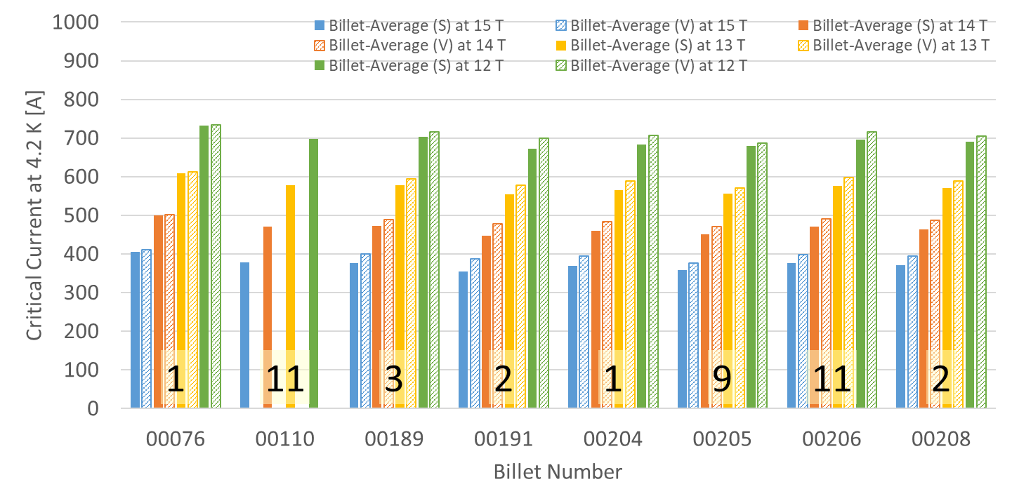
P43OL1097/QXFA-114 – Wire Parameters
Supplier (S) and Verification (V) I_{C} Data
Number of spools from that billet used in the cable

Slide 34
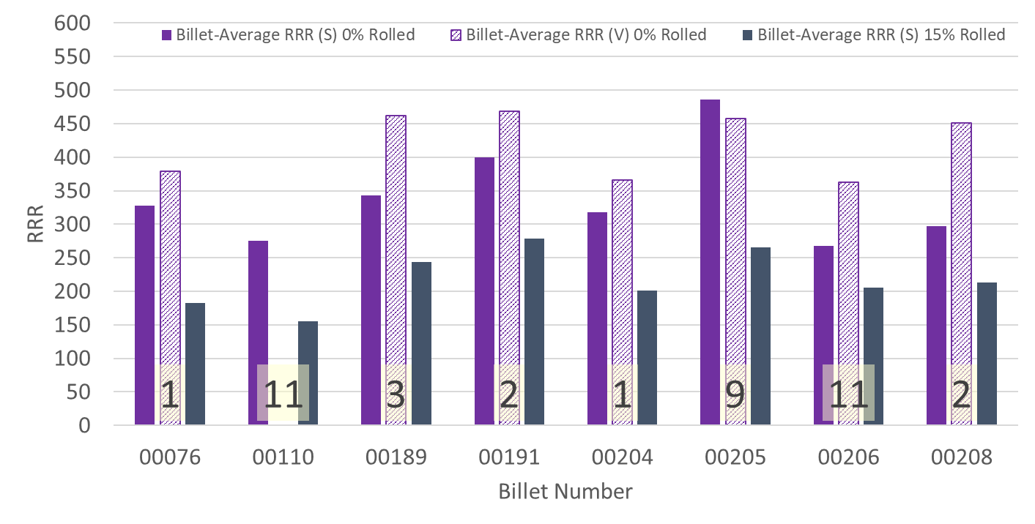
P43OL1097/QXFA-114 – Wire Parameters
Supplier (S) and Verification (V) RRR Data
Number of spools from that billet used in the cable

Slide 35
Coil 114 - SSL and load line information
New version 2.4 of ECE spreadsheet (Rev. M. Turenne 7Dec2020

Slide 36
P43OL1131/QXFA-124 – Cable Date, Lengths
Cable Manufacture Date
  2019 06 04 (Production run)
Cable Length:
  470 m (LBNL, fabricated, including LBNL samples)
  ### m (Measured by FNAL)

Slide 37
P43OL1131/QXFA-124 – Strand and SS Core ID
Spool:
  PO08S00371A01U x 3 ULs,
  PO08S00376A03U x 4 ULs,
  PO08S00412A01U x 19 ULs,
  PO08S00371A02U x 12 ULs,
  PO08S00417A03U x 2 ULs,
Core:
  120L20A7322313
    Core width: 12.0 mm; material: 316L;
    Heat: 844979; Lot: 16-597;
    Chemical Properties CoT/CoC 172660-1: 0.14 wt% Co
From 4 billets

Slide 38
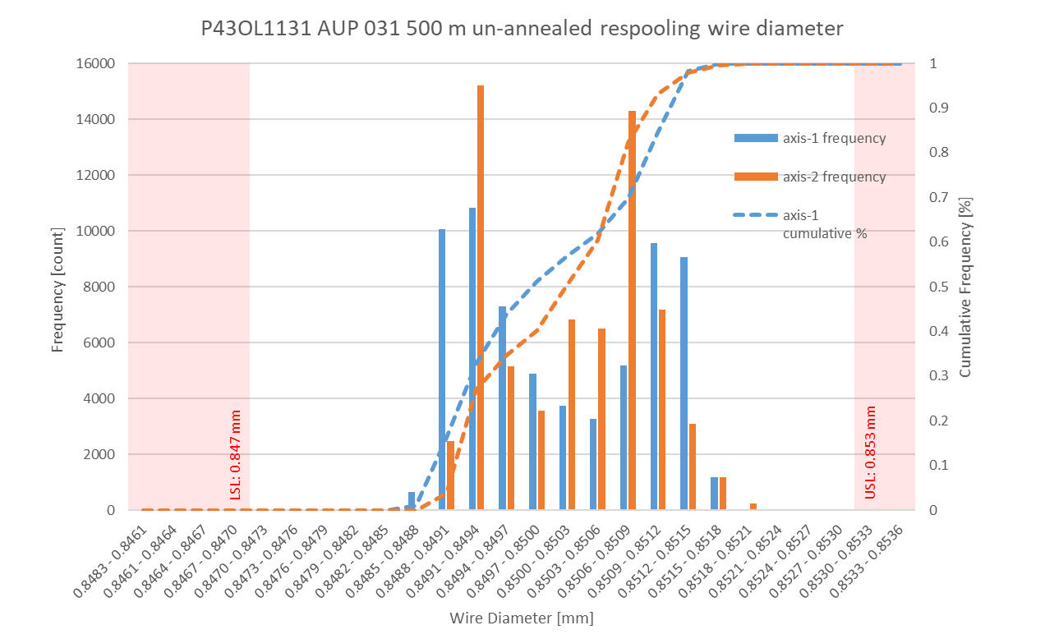
P43OL1131/QXFA-124 Respooling Wire Diameter
Below LSL: 0.00%
Above USL: 0.01%

Slide 39
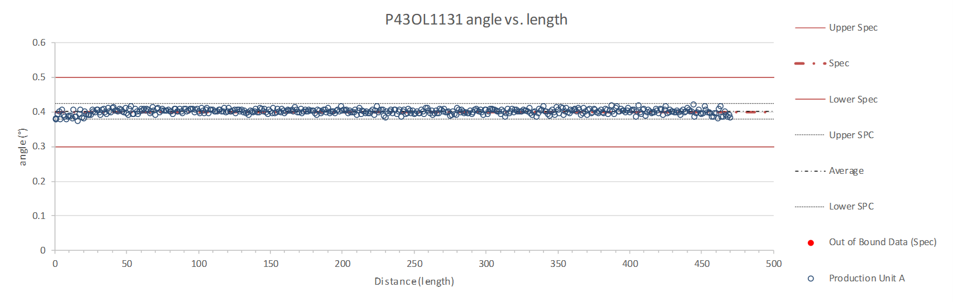
Rollers: P-91 (2017-12-08) and P-92 (2017-12-08)

Slide 40
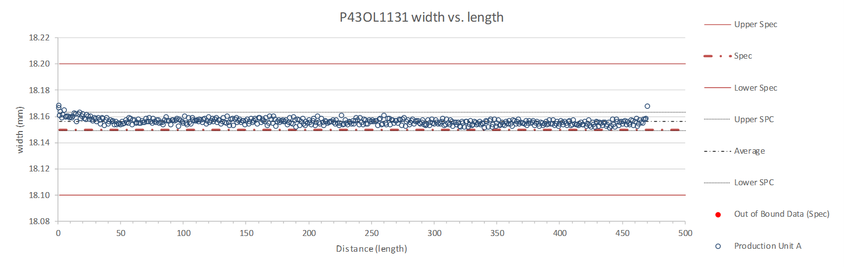
Rollers: P-91 (2017-12-08) and P-92 (2017-12-08)

Slide 41
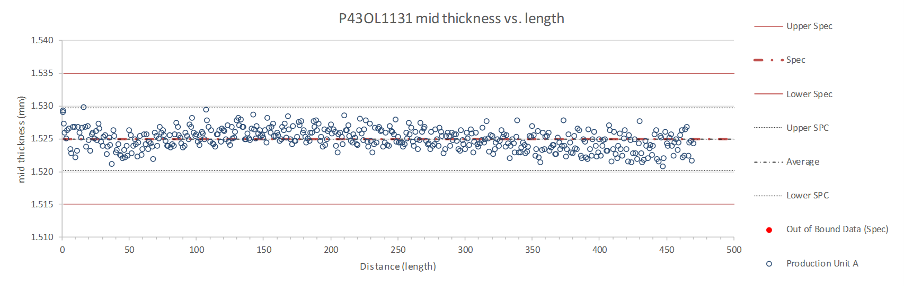
Rollers: P-91 (2017-12-08) and P-92 (2017-12-08)

Slide 42
P43OL1131/QXFA-124 – Braiding
Fiberglass Lot #100858
P/I: 18.9
Spool tension: 10 lbs. (payoff); 20 lbs. (takeup)
Bobbin payoff tension: 0.125 lbs. (min), 0.250 lbs. (max)
NEWT 10-stack QC:
  Cycle #1) 0.151 mm; #2) 0.149 mm; #3) 0.148 mm;
  Mean 0.149 mm
LBNL 10-stack verification QC:
  Cycle #1) 0.151 mm; #2) 0.149 mm; #3) 0.148 mm;
  Mean 0.149 mm
Vector #464342

Slide 43
P43OL1131/QXFA-124 – Wire Parameters
Properties | Inspected Average
Wire Diameter | 0.850 ± 0.001 mm (LBNL)¹
Cu ratio ª | 53.3% (OST)
Strand twist pitch ª | 19.3mm (OST)
RRR (RW) ª | 363 (OST)
RRR (15% rolled) ª | 239 (OST)
I_{C} (4.2 K, 15 T) ª | 376 A (OST)
I_{C} (4.2 K, 14 T) ª | 473 A (OST)
I_{C} (4.2 K, 13 T) ª | 580 A (OST)
I_{C} (4.2 K, 12 T) ª | 702 A (OST)
ª First billet averaged, then weighted average according
to the spool distribution in the cable
¹ As-received, all LBNL respooling data; mean ± 1 sigma

Slide 44
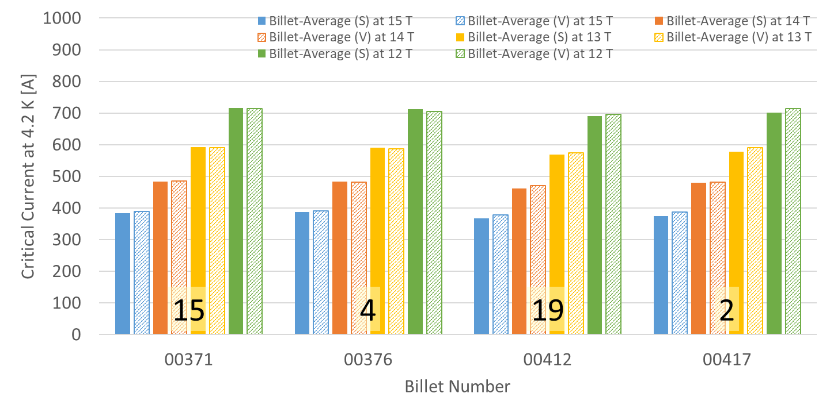
P43OL1131/QXFA-124 – Wire Parameters
Supplier (S) and Verification (V) I_{C} Data
Number of spools from that billet used in the cable

Slide 45
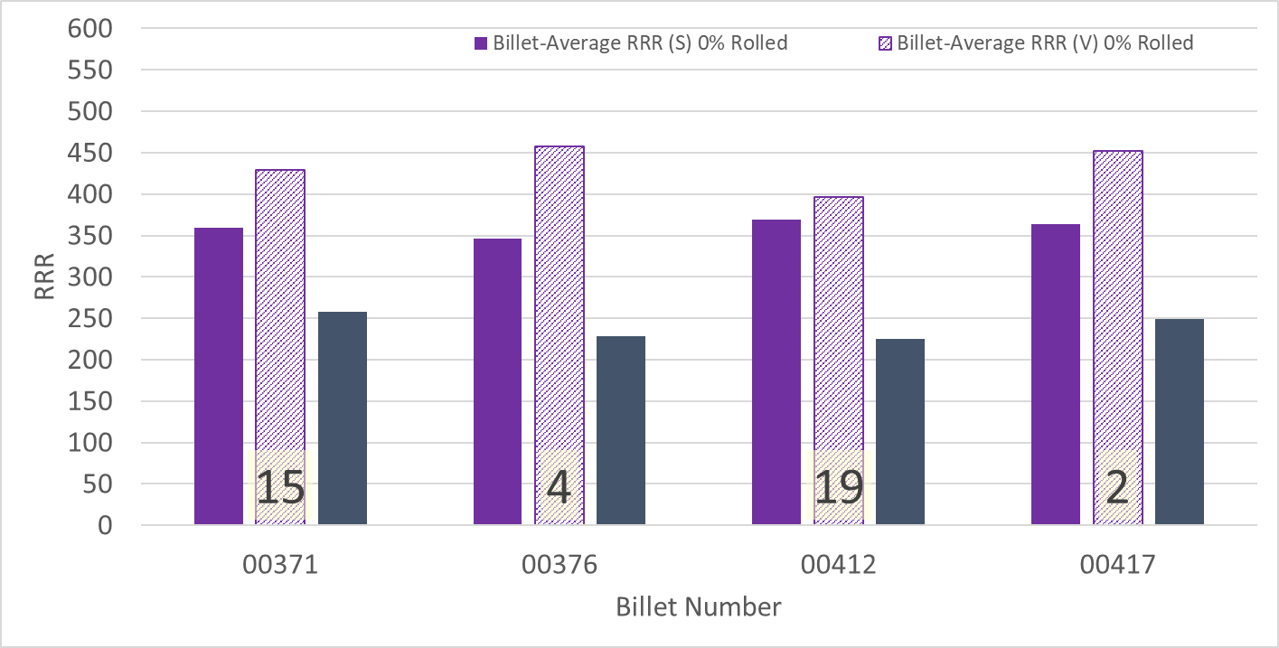
P43OL1131/QXFA-124 – Wire Parameters
Supplier (S) and Verification (V) RRR Data
Number of spools from that billet used in the cable

Slide 46
P43OL1131/QXFA-124 – Extracted Strand RRR
 | Cable ID | No. of Units from Billet (spool) | HT/sample ID | Major edge RRR | Minor edge RRR | Straight section 1 RRR | Straight section 2 RRR
ID #1 | P43OL1131AE06E PO08S00376A03U | 4 (4) | LRLK191212ALC1 | 338 | 301 | 407 | 401
ID #2 | P43OL1131AE42E PO08S00371A02U | 15 (12) | LRLK191212ALC1 | 377 | 304 | 400 | 393
ID #3 | P43OL1131AE41E PO08S00371A02U | 15 (12) | LRLK191212ALC1 | 353 | 280 | 366 | 380
ID #4 | P43OL1131AE13E PO08S00412A01U | 19 (19) | LRLK191212ALC1 | 313 | 222 | 328 | 336
ID #5 | P43OL1131AE12E PO08S00412A01U | 19 (19) | LRLK191212ALC1 | 287 | 219 | 318 | 315
Vector #464342

Slide 47
Coil 124 - SSL and load line information
New version 2.4 of ECE spreadsheet (Rev. M. Turenne 7Dec2020

Slide 48
P43OL1124/QXFA-212 – Cable Date, Lengths
Cable Manufacture Date
  2019 03 13 (Production run)
Cable Length:
  468 m (LBNL, fabricated, including LBNL samples)
  ### m (Measured by FNAL)

Slide 49
P43OL1124/QXFA-212 – Strand and SS Core ID
Spool:
  PO08S00367A03U x 7 ULs,
  PO08S00376A04U x 12 ULs,
  PO08S00366A04U x 4 ULs,
  PO08S00364A01U x 17 ULs,
Core:
  120L27A7322313
    Core width: 12.0 mm; material: 316L;
    Heat: 844979; Lot: 16-597;
    Chemical Properties CoT/CoC 172660-1: 0.14 wt% Co
From 4 billets

Slide 50
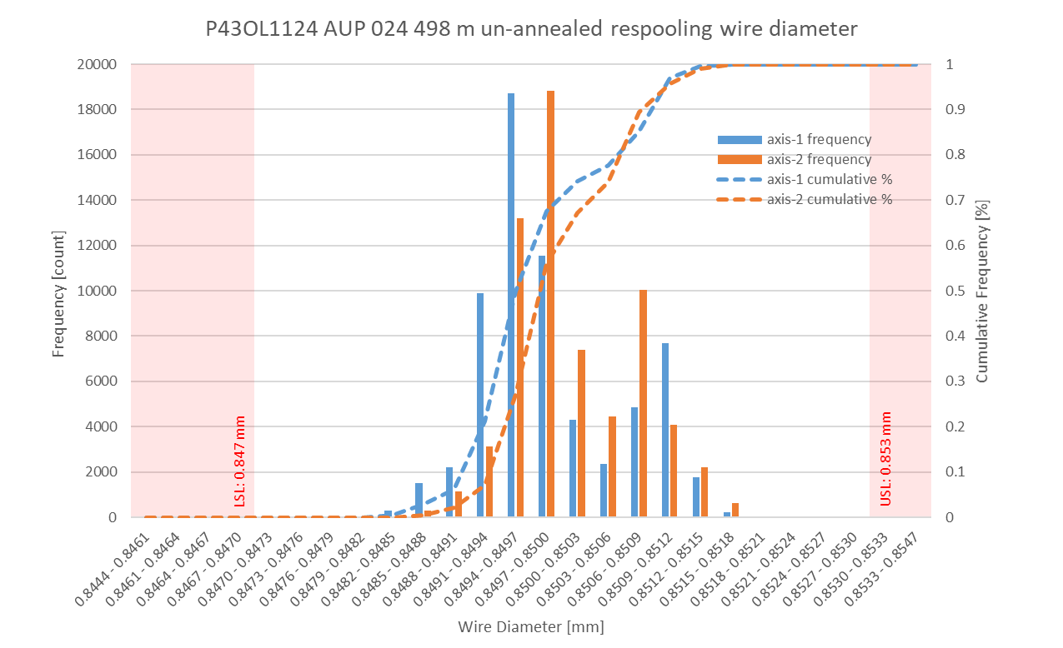
P43OL1124/QXFA-212 Respooling Wire Diameter
Below LSL: 0.00%
Above USL: 0.00%

Slide 51
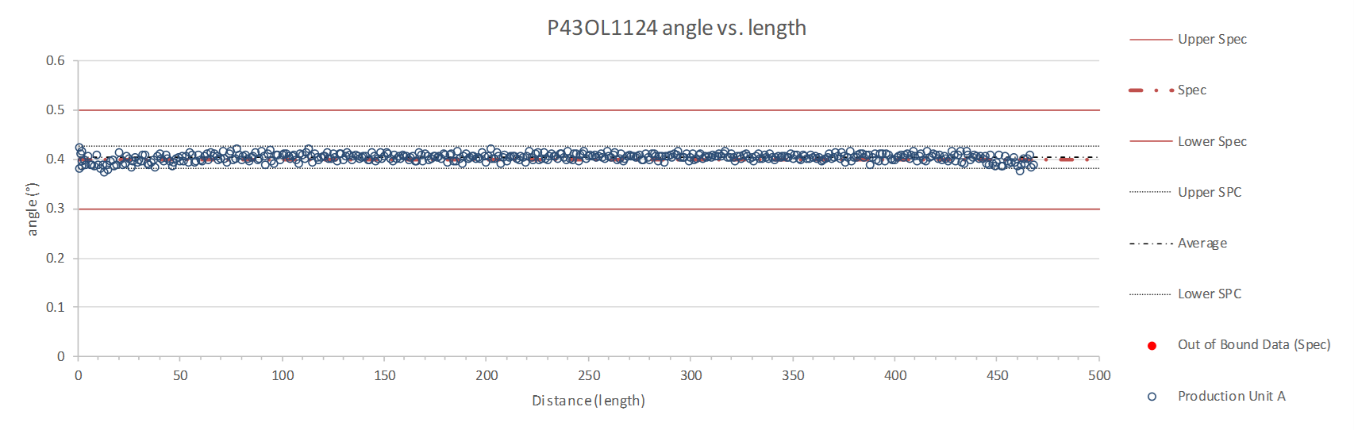
Rollers: P-91 (2017-12-08) and P-92 (2017-12-08)

Slide 52
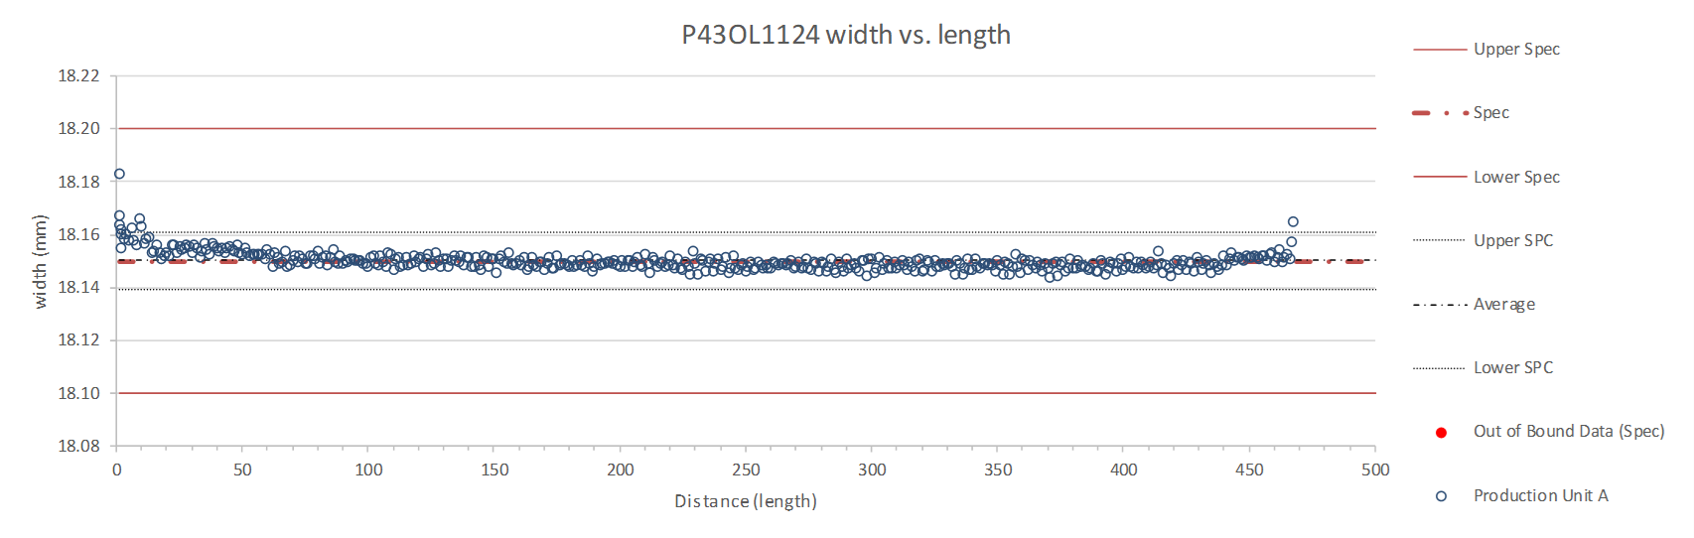
Rollers: P-91 (2017-12-08) and P-92 (2017-12-08)

Slide 53
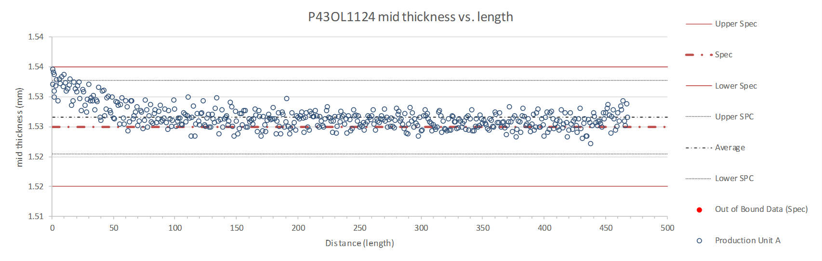
Rollers: P-91 (2017-12-08) and P-92 (2017-12-08)

Slide 54
P43OL1124/QXFA-212 – Braiding
Fiberglass Lot #100858
P/I: 18.9
Spool tension: 10 lbs. (payoff); 20 lbs. (takeup)
Bobbin payoff tension: 0.125 lbs. (min), 0.250 lbs. (max)
NEWT 10-stack QC:
  Cycle #1) 0.151 mm; #2) 0.148 mm; #3) 0.147 mm;
  Mean 0.149 mm
LBNL 10-stack verification QC:
  Cycle #1) 0.149 mm; #2) 0.147 mm; #3) 0.145 mm;
  Mean 0.147 mm
Vector #464342

Slide 55
P43OL1124/QXFA-212 – Wire Parameters
Properties | Inspected Average
Wire Diameter | 0.850 ± 0.001 mm (LBNL)¹
Cu ratio ª | 54.5% (OST)
Strand twist pitch ª | 19.1 mm (OST)
RRR (RW) ª | 340 (OST)
RRR (15% rolled) ª | 231 (OST)
I_{C} (4.2 K, 15 T) ª | 393 A (OST)
I_{C} (4.2 K, 14 T) ª | 488 A (OST)
I_{C} (4.2 K, 13 T) ª | 596 A (OST)
I_{C} (4.2 K, 12 T) ª | 718 A (OST)
ª First billet averaged, then weighted average according
to the spool distribution in the cable
¹ As-received, all LBNL respooling data; mean ± 1 sigma

Slide 56
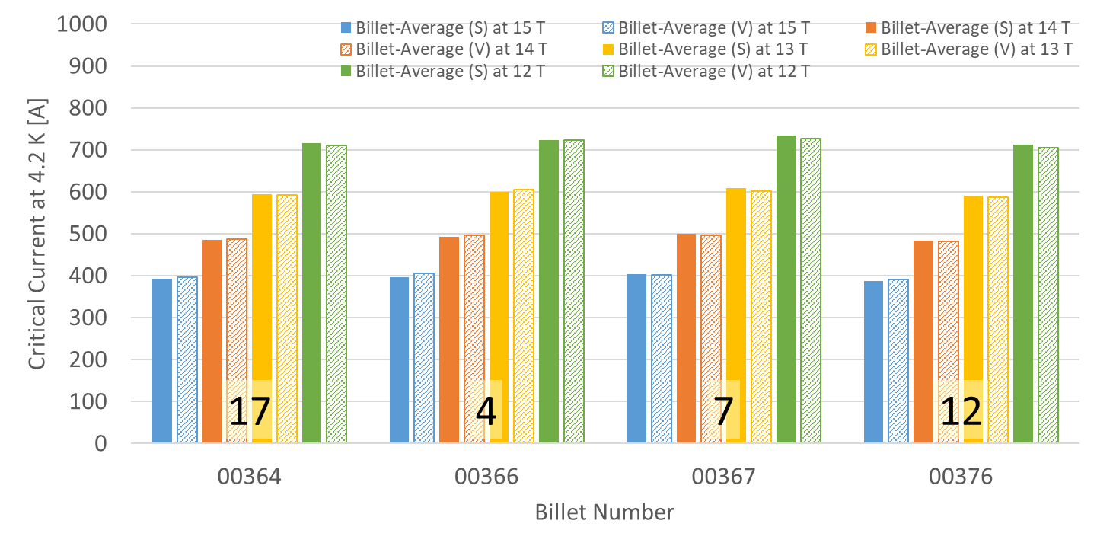
P43OL1124/QXFA-212 – Wire Parameters
Supplier (S) and Verification (V) I_{C} Data
Number of spools from that billet used in the cable

Slide 57
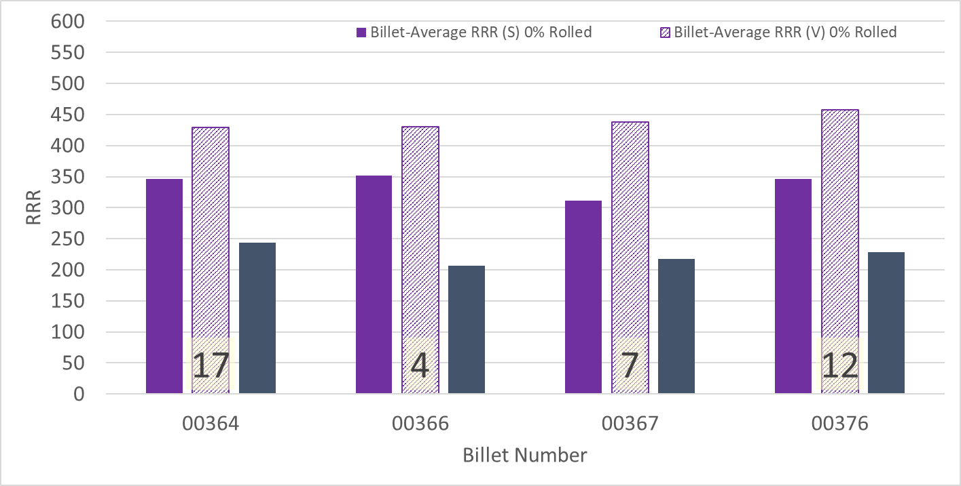
P43OL1124/QXFA-212 – Wire Parameters
Supplier (S) and Verification (V) RRR Data
Number of spools from that billet used in the cable

Slide 58
P43OL1124/QXFA-212 – Extracted Strand RRR
 | Cable ID | No. of Units from Billet (spool) | HT/sample ID | Major edge RRR | Minor edge RRR | Straight section 1 RRR | Straight section 2 RRR
ID #1 | P43OL1124AE05E PO08S00367A03U | 7 (7) | LRLK190404ALC2 | 342 | 331 | 400 | 395
ID #2 | P43OL1124AE36E PO08S00364A01U | 17 (17) | LRLK190404ALC1 | 343 | 291 | 413 | 445
ID #3 | P43OL1124AE37E PO08S00364A01U | 17 (17) | LRLK190404ALC2 | 321 | 315 | 390 | 407
ID #4 | P43OL1124AE12E PO08S00376A04U | 7 (7) | LRLK190404ALC2 | 383 | 332 | 399 | 411
ID #5 | P43OL1124AE13E PO08S00376A04U | 12 (12) | LRLK190404ALC2 | 345 | 303 | 399 | 414
Vector #464342

Slide 59
Coil 212 - SSL and load line information
New version 2.4 of ECE spreadsheet (Rev. M. Turenne 7Dec2020

Slide 60
P43OL1127/QXFA-214 – Cable Date, Lengths
Cable Manufacture Date
  2019 04 30 (Production run)
Cable Length:
  468 m (LBNL, fabricated, including LBNL samples)
  ### m (Measured by FNAL)

Slide 61
P43OL1127/QXFA-214 – Strand and SS Core ID
Spool:
  PO08S00348A01U x 2 ULs,
  PO08S00357A08U x 2 ULs,
  PO08S00347A01U x 3 ULs,
  PO08S00357A04U x 6 ULs,
  PO08S00380A03U x 11 ULs,
  PO08S00365A02U x 16 ULs,
Core:
  120L24A7322313
    Core width: 12.0 mm; material: 316L;
    Heat: 844979; Lot: 16-597;
    Chemical Properties CoT/CoC 172660-1: 0.14 wt% Co
From 5 billets

Slide 62
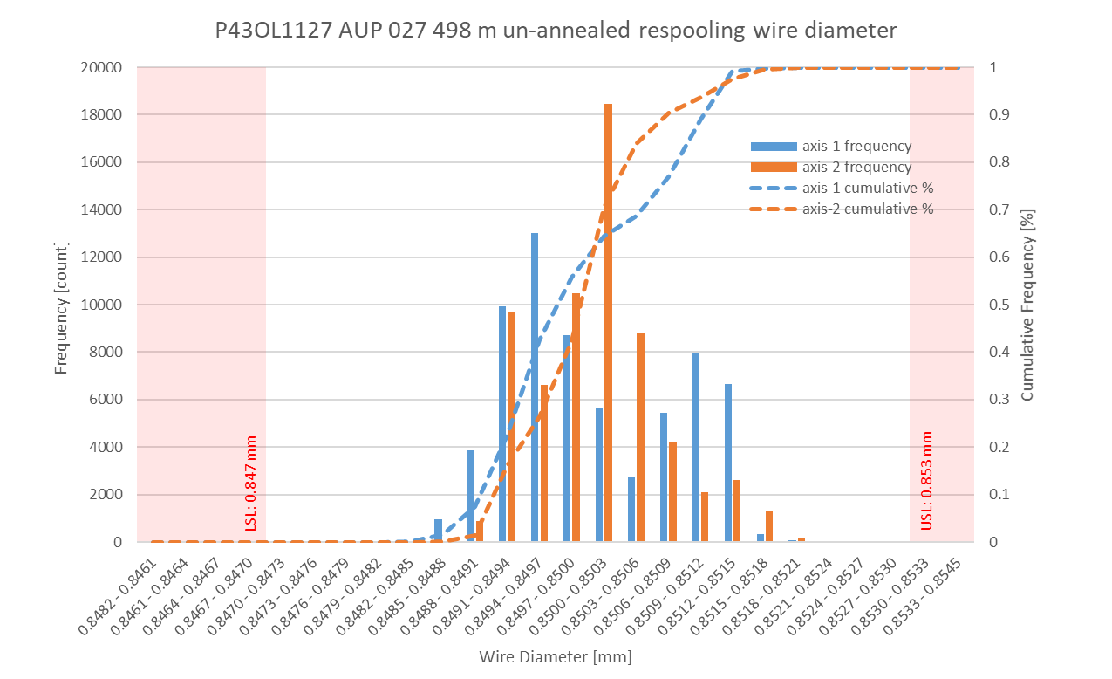
P43OL1127/QXFA-214 Respooling Wire Diameter
Below LSL: 0.00%
Above USL: 0.00%

Slide 63
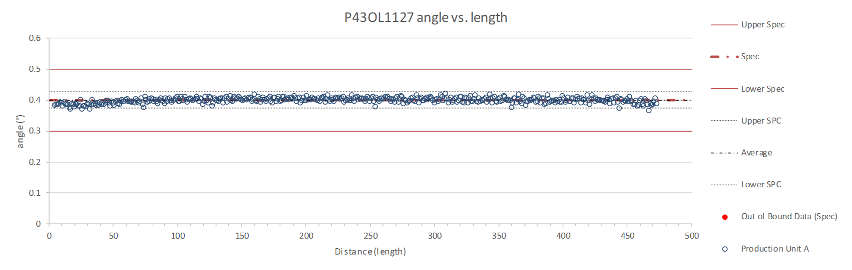
Rollers: P-91 (2017-12-08) and P-92 (2017-12-08)

Slide 64
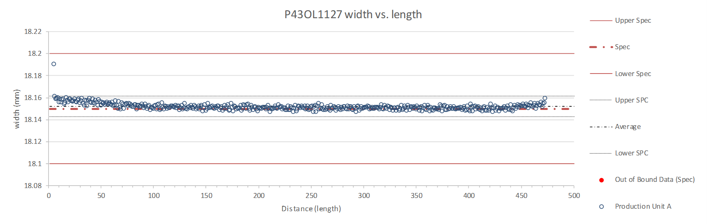
Rollers: P-91 (2017-12-08) and P-92 (2017-12-08)

Slide 65
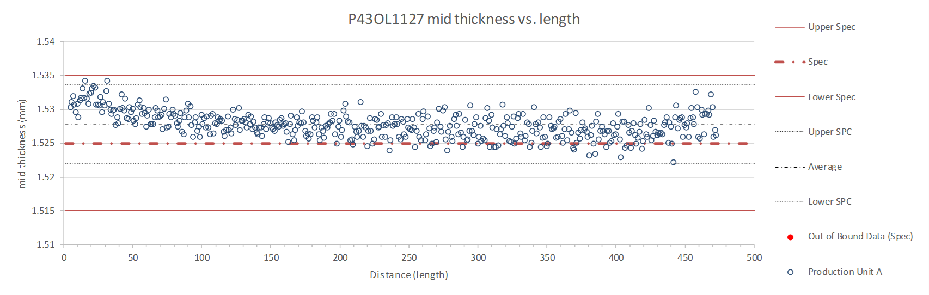
Rollers: P-91 (2017-12-08) and P-92 (2017-12-08)

Slide 66
P43OL1127/QXFA-214 – Braiding
Fiberglass Lot #100858
P/I: 18.9
Spool tension: 10 lbs. (payoff); 20 lbs. (takeup)
Bobbin payoff tension: 0.125 lbs. (min), 0.250 lbs. (max)
NEWT 10-stack QC:
  Cycle #1) 0.148 mm; #2) 0.146 mm; #3) 0.145 mm;
  Mean 0.146 mm
LBNL 10-stack verification QC:
  Cycle #1) 0.150 mm; #2) 0.145 mm; #3) 0.144 mm;
  Mean 0.146 mm
Vector #464342

Slide 67
P43OL1127/QXFA-214 – Wire Parameters
Properties | Inspected Average
Wire Diameter | 0.850 ± 0.000 mm (LBNL)¹
Cu ratio ª | 53.9% (OST)
Strand twist pitch ª | 18.9 mm (OST)
RRR (RW) ª | 349 (OST)
RRR (15% rolled) ª | 248 (OST)
I_{C} (4.2 K, 15 T) ª | 389 A (OST)
I_{C} (4.2 K, 14 T) ª | 486 A (OST)
I_{C} (4.2 K, 13 T) ª | 594 A (OST)
I_{C} (4.2 K, 12 T) ª | 717 A (OST)
ª First billet averaged, then weighted average according
to the spool distribution in the cable
¹ As-received, all LBNL respooling data; mean ± 1 sigma

Slide 68
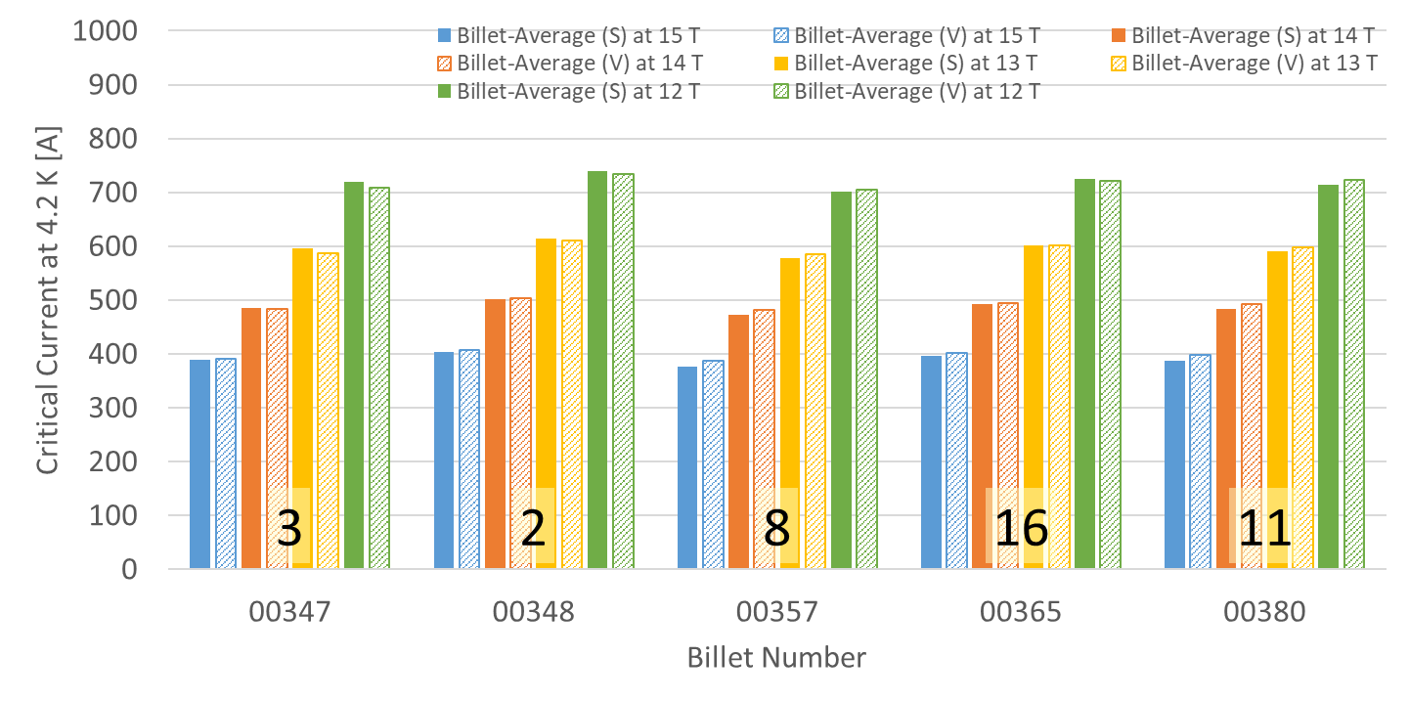
P43OL1127/QXFA-214 – Wire Parameters
Supplier (S) and Verification (V) I_{C} Data
Number of spools from that billet used in the cable

Slide 69
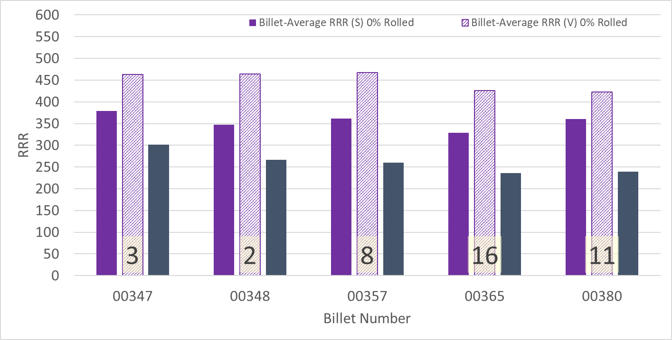
P43OL1127/QXFA-214 – Wire Parameters
Supplier (S) and Verification (V) RRR Data
Number of spools from that billet used in the cable

Slide 70
P43OL1127/QXFA-214 – Extracted Strand RRR
 | Cable ID | No. of Units from Billet (spool) | HT/sample ID | Major edge RRR | Minor edge RRR | Straight section 1 RRR | Straight section 2 RRR
ID #1 | P43OL1127AE21E PO08S00380A03U | 11(11) | LRLK190524ALC2 | 317 | 288 | 383 | 375
ID #2 | P43OL1127AE39E PO08S00365A02U | 16 (16) | LRLK190524ALC2 | 320 | 251 | 344 | 372
ID #3 | P43OL1127AE37E PO08S00365A02U | 16 (16) | LRLK190524ALC2 | 315 | 284 | 367 | 372
ID #4 | P43OL1127AE07E PO08S00347A01U | 3 (3) | LRLK190524ALC2 | 319 | 337 | 435 | 448
ID #5 | P43OL1127AE12E PO08S00357A04U | 8 (6) | LRLK190524ALC2 | 317 | 324 | 430 | 417
Vector #464342

Slide 71
Coil 214 - SSL and load line information
New version 2.4 of ECE spreadsheet (Rev. M. Turenne 7Dec2020

