Slide 1
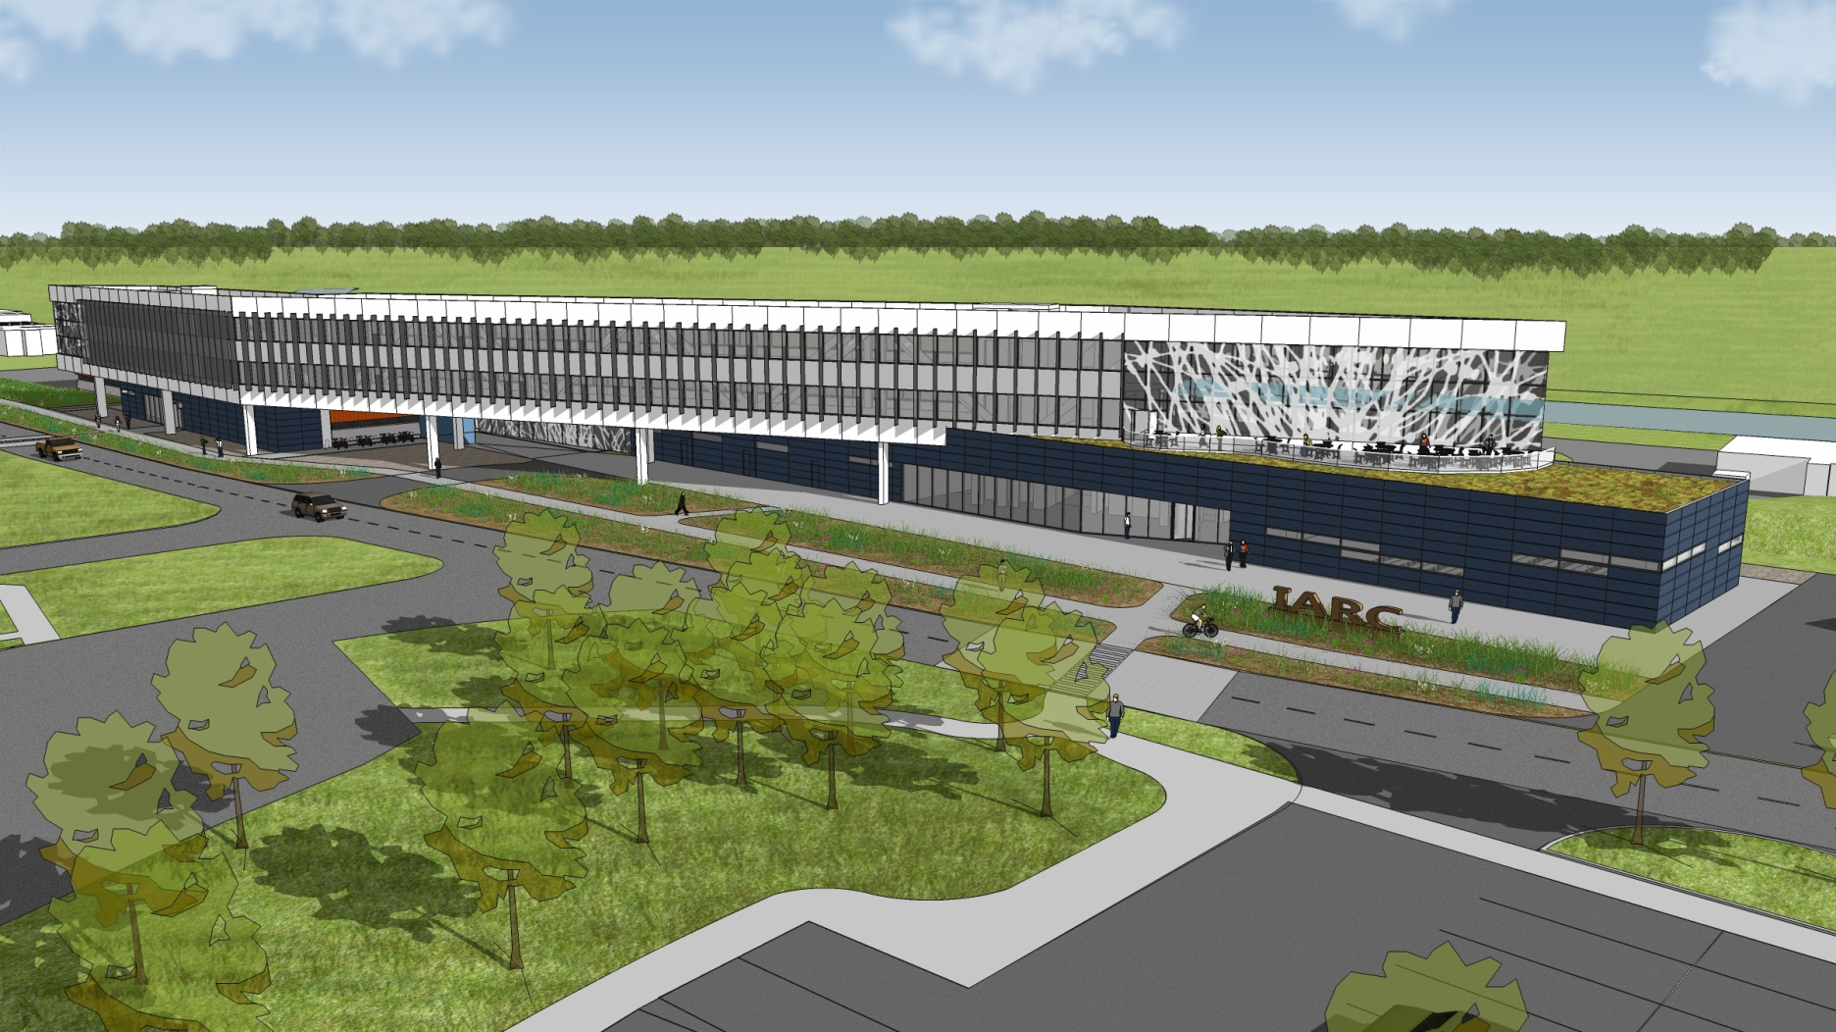
OTE Building PMG Report 08/05/2011
Rhonda Merchut

Slide 2
Agenda
Project Status
Background
Where we are
Plan to move forward

Slide 3
Project Status:
HOK (A/E) re-submittal of Pre-Final (95%) documents rec’d this week:
Construction documents
Calculations
Catalog cuts
Cost estimate
LEED/Guiding Principles
Outline schedule
Review is underway
Extension of design coordinator’s (RBA) P.O. req’d

Slide 4
Background
Original Pre-Final Submittal rec’d 6/7 through 7/16 was not complete due to:
incomplete construction documents,
missing doc’s -i.e. calculations, catalog cuts
resource loaded schedule not provided,
insufficient detail of cost estimate,
inadequate LEED documentation
Tom Powers, project Senior PA, has actively engaged in a series of meetings with HOK to obtain required documents – the documents received this week.

Slide 5
Project Plan Schedule
Final Design was scheduled to be complete for bidding 7/21/11.
Pre Final was schedule for 5/23/11.

Slide 6
Going Forward – Best Case
If Documents rec’d this week are complete for a 95% submittal, we’ll have lost approximately 2 months. We would anticipate starting procurement o/a 9/21/11.
Resource loaded schedule issue has not been resolved.
Because we must also refurbish the CDF building for IARC after D&D, a couple months of delay is not critical for the IARC program.

Slide 7
Going Forward – Most Likely
If Documents rec’d this week are somewhat short of a 95% submittal, manage the risk with selective work to be completed by others.
Continue working with BSS to get completion of construction documents (drawings & spec’s) from HOK.
AND:
Engage others to support bid documents:
Resource loaded const. schedule (based on DCEO reqmt’s).
Detailed cost estimate.
LEED Gold supporting documents (may require some detail design to be corrected by amendment).
Advise/drawing support on amendments to clarify bidding doc’s.
Value Engineering

Slide 8
Financial Impact
Resource loaded construction schedule | $15K
Detailed cost estimate | $20K
LEED Gold supporting documents | $10K
Advise/drawing support on amendments | $15K
Value Engineering | $30K*
*plus costs for HOK to implement

Slide 9
Summary
Working with HOK has been very challenging.
The project is at least 2 months behind schedule.
A 2-3 month delay in the schedule is not critical.
BSS & FESS are working closely to obtain improved performance from HOK
Going forward: HOK complete construction doc’s, others to provide support such as independent cost estimate, resource loaded schedule, value engineering, LEED & amendment support.

