Slide 1
Massively Parallel RF
Power for Low-Cost
Next-Gen Colliders
Snowmass AF7 Seminar
Brandon Weatherford and Sami Tantawi
Alyson Gold, Mark Kemp, Erik Jongewaard, Xueying Lu, Julian Merrick, Emilio Nanni, Chris Nantista, Alex Nguyen, Jeffrey Neilson, Muhammed Shumail, and Ann Sy
Dec. 17, 2020

Slide 2
Overview
Challenge of low-cost RF power & our R&D philosophy
Compact, mass-producible modulators
Multi-array multi-beam klystrons (MA-MBK)
Spinoff programs with commercial use
Fundamental R&D in electron sources, focusing schemes, and additive manufacturing
RF source topologies with multidimensional beams
Advanced simulation code for rapid RF source development using Lagrangian classical field theory
Summary

Slide 3
RF power is the main driver of next-generation accelerator construction costs
Total accelerator system cost (C) can be expressed as:
  C ≈ x*L + yG(I + G/R_{s})*L + aux systems cost (e.g. injector)
Length
Beam
Power
Power Dissipated
Structure
x = $100-150k per meter for tunnel + structure
  Based on ILC estimate
Total RF power cost: $2-3M per meter
  Beam Power: 100 MW/m (for 1 A beam, 100 MV/m gradient)
  Structure Losses: up to 75 MW/m (133 MΩ/m R_{s} for NCRF)
  State of the art klystron + modulator: y = $20/kW for RF power
RF power is > 90% of length-based capital costs
Order of magnitude reduction is needed
Notes:
COMPARE x and y

Slide 4
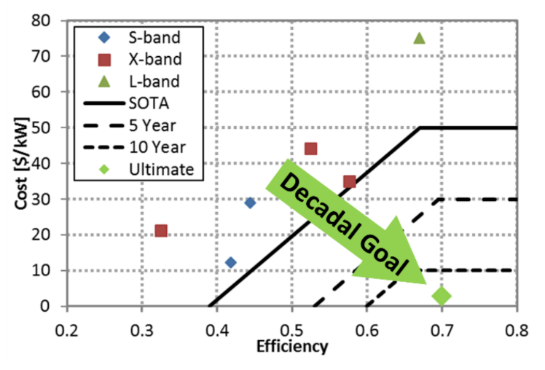
Reducing the cost of RF power
RF power is the main cost driver for any advanced accelerator facility
The invention of pulse compressors, superconducting structures, and two-beam accelerators were all motivated by the need to reduce RF power costs
DOE/HEP set a decadal goal of 70% DC-to-RF efficiency at $2/kW – an extremely difficult challenge at any frequency
*Radiofrequency Accelerator R&D Strategy Report

Slide 5
Optimization of the entire system – accelerator structure, modulator, and RF amplifier – is crucial
 | Efficiency | $/kW_{peak}
Commercial Modulator | 90% | $10/kW
SLAC ILC Marx | 88% | $40/kW
SLAC XL-4 Klystron | 40% | $20/kW
Common Household Cooker Magnetron | 65% | $13/kW
S-band Medical Klystron | 45% | $8/kW
Total System Goal* | 70% | $2/kW
RF Source
Modulators
RF Amplifiers
Research Thrusts
@ SLAC
Research Objectives
Must increase total efficiency from 40% up to 70%, while decreasing cost by 10x
RF and Beam Physics
Low-Cost Systems
Novel Topologies
High Efficiency
Systems
Fabrication
Methodologies
*System goals come from the 2017 DOE RF Accelerator R&D Strategy Report

Slide 6
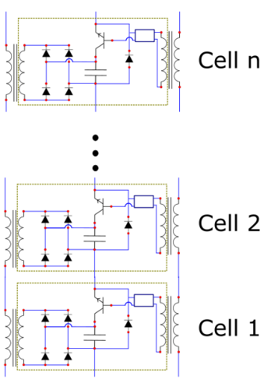
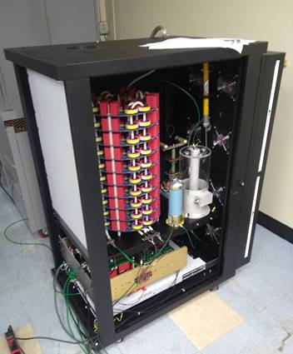
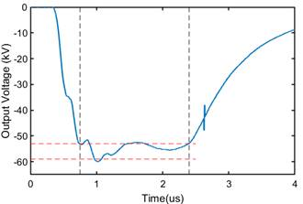
The 60 kV Marx Modulator Topology Embodies Low-Cost Fabrication Techniques
Low-voltage RF power system enables mass-produced modulators
Only off-the-shelf, low-voltage components
>90% of fabrication accomplished with extremely high-throughput methodologies
Testing and assembly can be automated
Complete Marx modulator assembly w/ DC supply, controls, diagnostics
Voltage | 60 kV
Peak Power | 2.5 MW
Rep Rate | 1 kHz
Pulse Width | 1.5 µs
Cells | 80
Average Power | 3.8 kW
$8/kW achieved with first prototype @ SLAC
$2/kW well within reach for qty > 1
<100 ns rise time
<5% ripple
Kemp, Nguyen

Slide 7
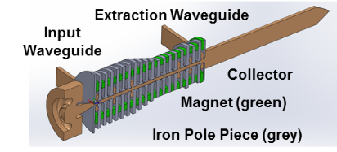
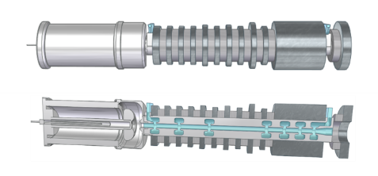
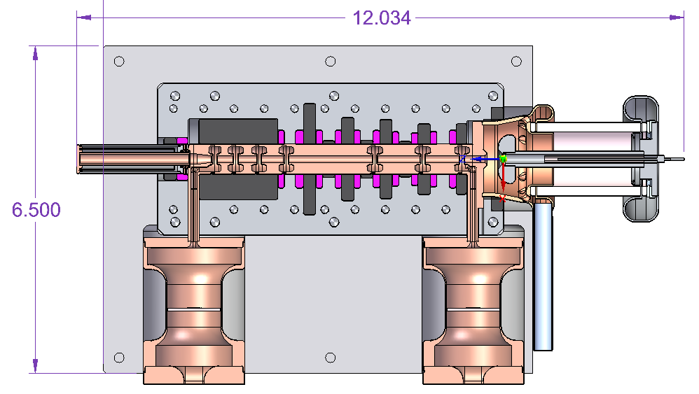
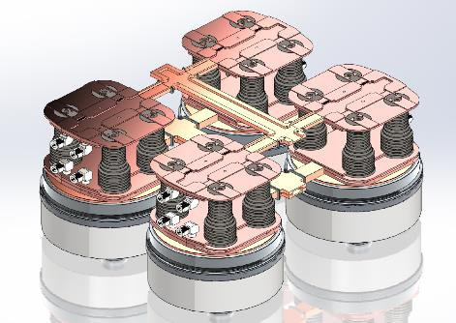
The Modular Array Multi-Beam Klystron (MA-MBK) – High volume RF sources with several uses
Compact, low-voltage “klystrinos” – one RF source topology for many situations:
  Stand-alone RF sources for low power, compact and portable systems
  High volume, distributed linac feeding
  Passive combining for higher peak power
Integrated Pole Pieces/
Long Period Halbach Arrays
Floquet output combiner
A. Jensen, “A Modular 5 MW X-Band Multi-Beam Klystron”, SLAC-PUB-15877.
16 Klystrinos
Franzi, Gamzina, Jensen, Kowalczyk, Tantawi
7

Slide 8
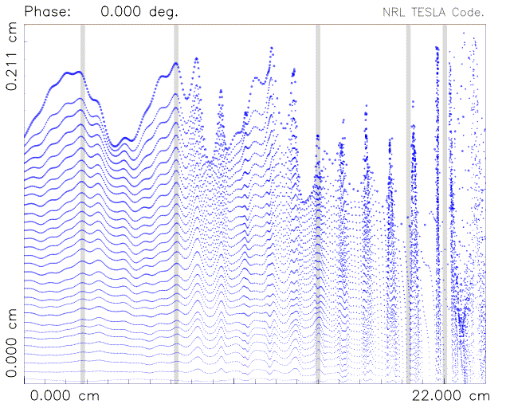
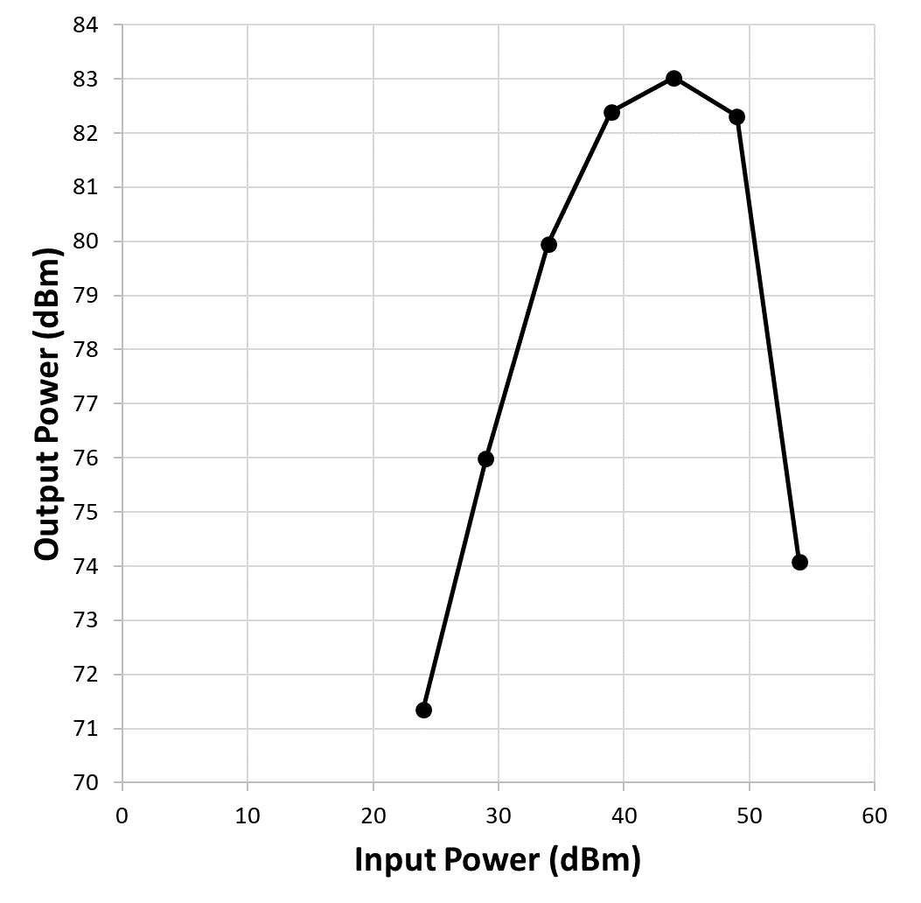
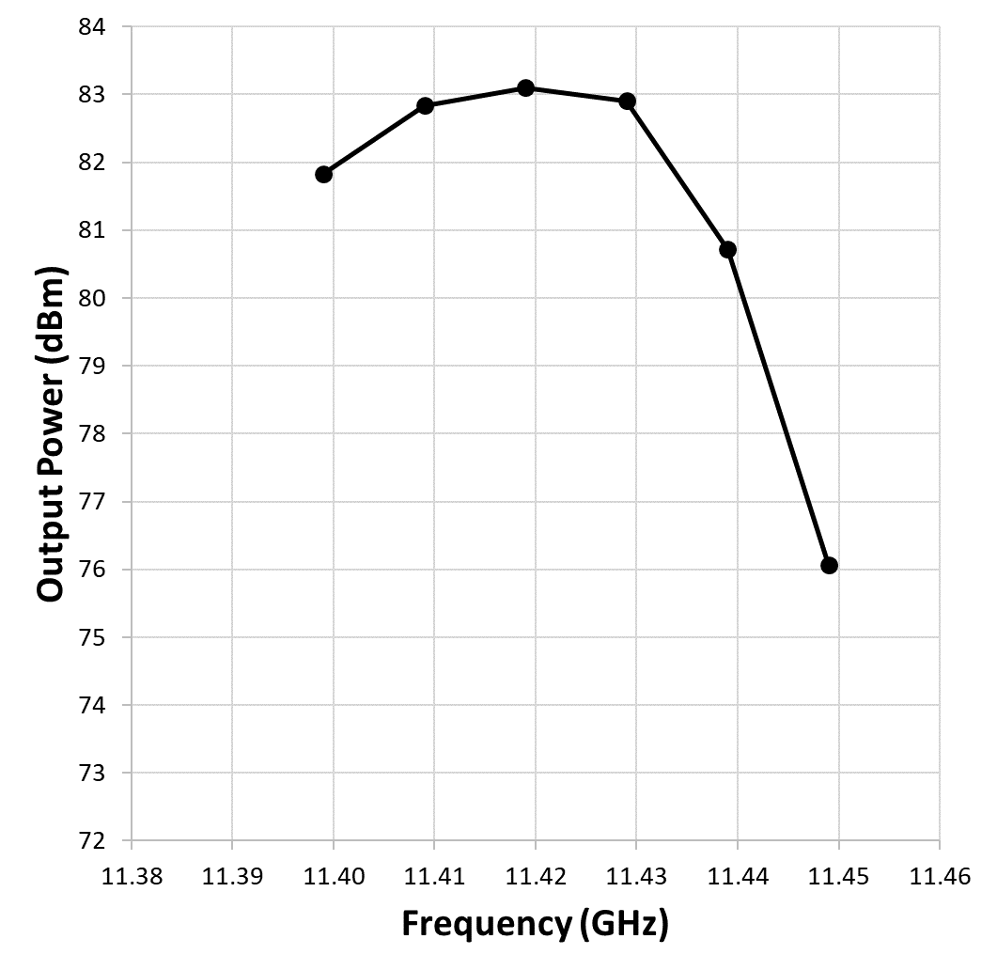
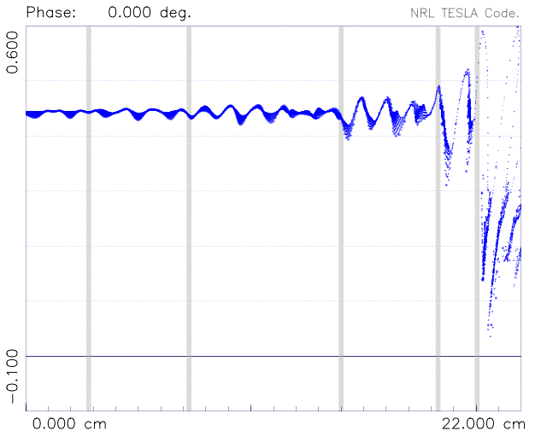


High efficiency X-band klystrinos under construction
60 kV klystrino designs are being built
  High-duty design @ 300 kW (solenoid focused for first prototype)
  SmCo-focused, lightweight, 65% efficient design @ 200 kW
Beam trajectory
Transfer curve
@ 11.424 GHz
RF Bandwidth @ fixed drive
e⁻ velocity vs. z

Slide 9
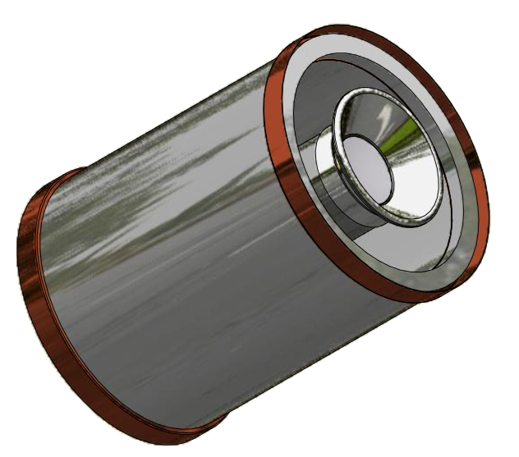
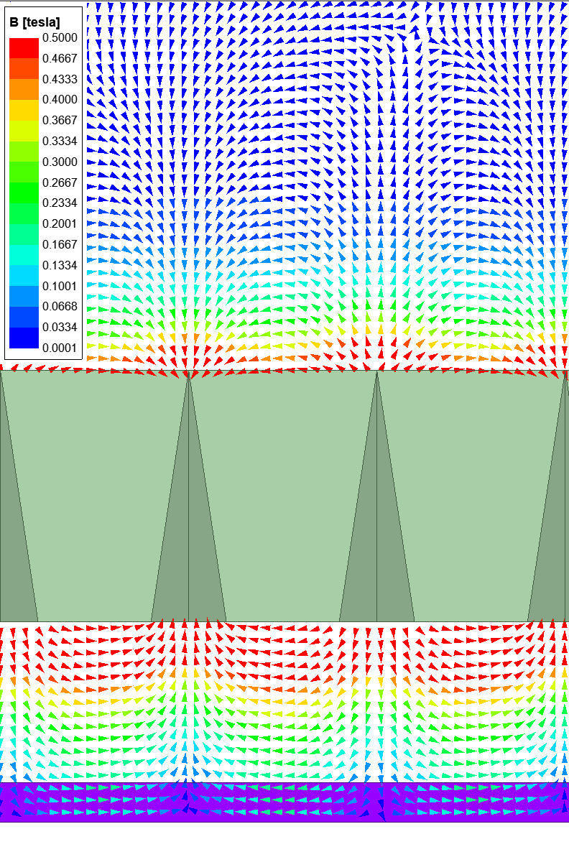
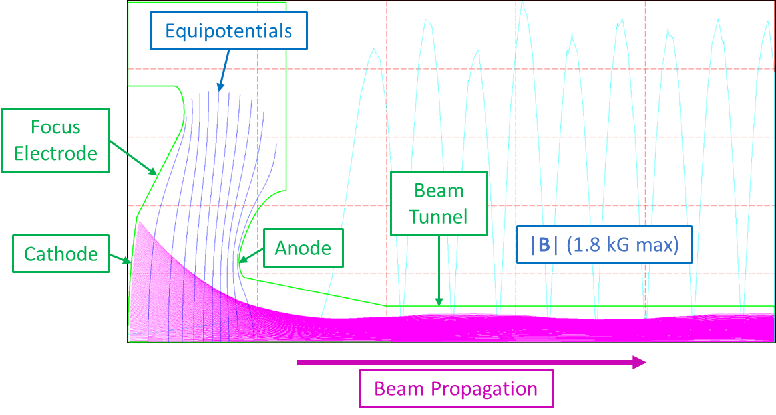
Challenge of high power at low voltage: drives innovation in RF source designs
Multi-period tapered PPM focusing:
Tapered pole pieces & long period increase focusing field by ~30%
Inexpensive low-voltage electron gun development w/ commercial partners
Magnet
Pole Piece
Beam

Slide 10
The demand problem for RF sources
MW-class RF sources are custom-designed, hand-built, and expensive
  There are few commercially viable uses for high power klystrons in 2020
  The key is to develop a scalable, “dual-use” topology for RF power
    SLAC drives applications for RF sources in commercial, medical, defense
    Industry invests in mass production & cost reduction to meet demand
    $2/kW target achieved by industry, enabling funding of the next machine
Wants: Collider and future HEP facilities
Wants:
$
Opposing Motivations
Funding Agencies
Industry
Gridlock
Needs: Minimum cost
Needs: Guaranteed market opportunity

Slide 11
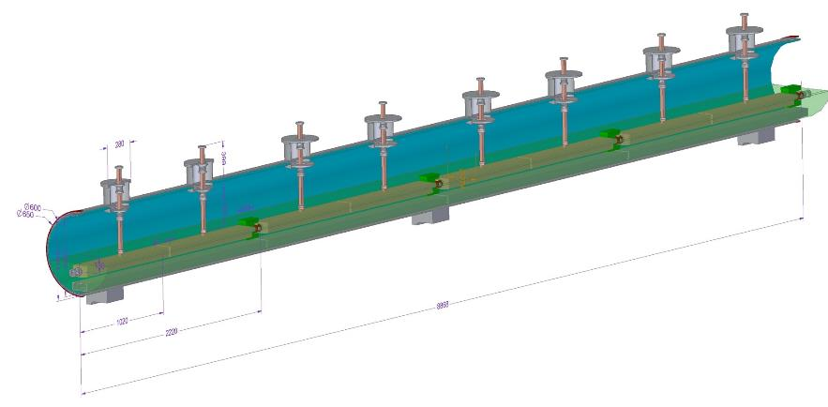
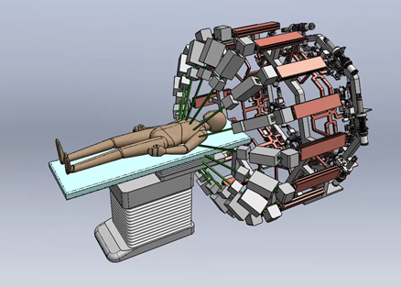
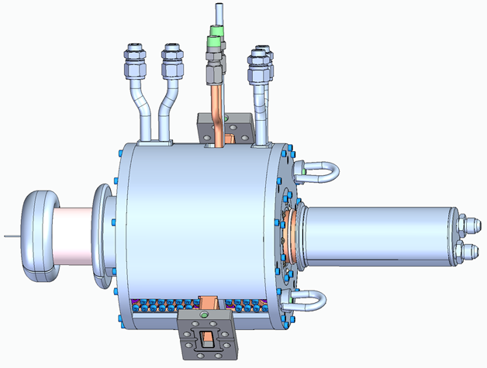
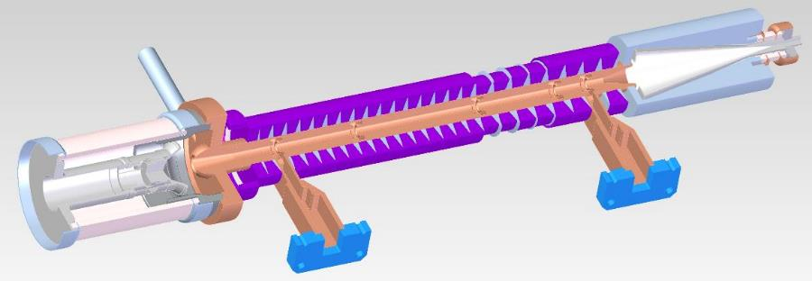
Spinoff programs using modular RF power:
New science & commercially viable applications
Cool Copper Collider (C³) – Liquid N₂-cooled C-band distributed coupling linac
Next-generation radiation therapy
16 klystrinos per system
Compact PPM-focused klystrinos –
Portable radiography for emergency response
High duty klystrino for cargo scanning

Slide 12
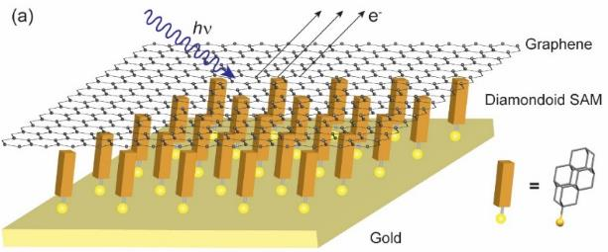
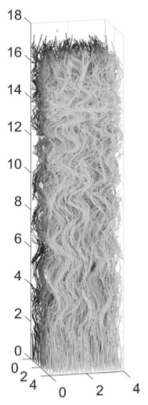
Fundamental R&D – Electron Sources & Focusing
Cheap amplifiers require research into more economical RF source components and processes
Cost driver #1 – Thermionic e-guns:
Field emitter arrays (Diamondoid, carbon nanotube)
RF-driven thermionic emission
Microfabricated spark guns
Multi-aperture plasma cathodes
Yan, Shen & Melosh, Nano Lett. 2018
Cost driver #2 – Magnets for beam focusing:
Multi-stage amplifiers
Ion focusing
Electrostatic focusing circuits
Multi-dimensional beams
Carbon nanotube velvet for field emitter arrays

Slide 13
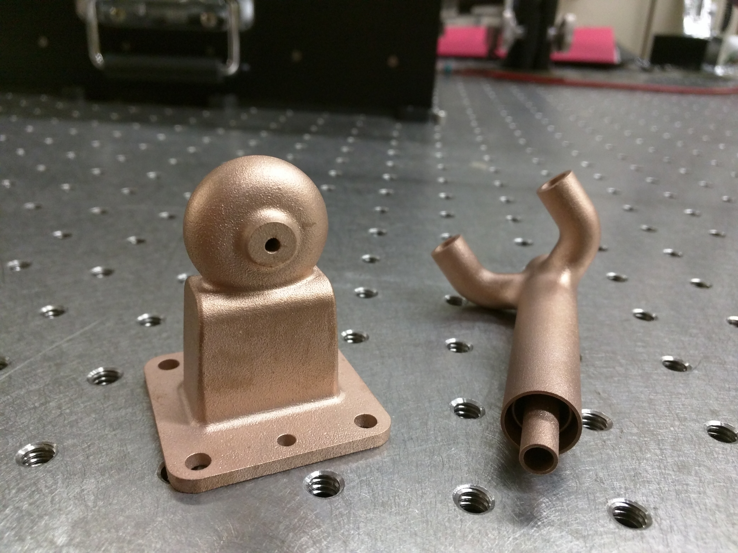
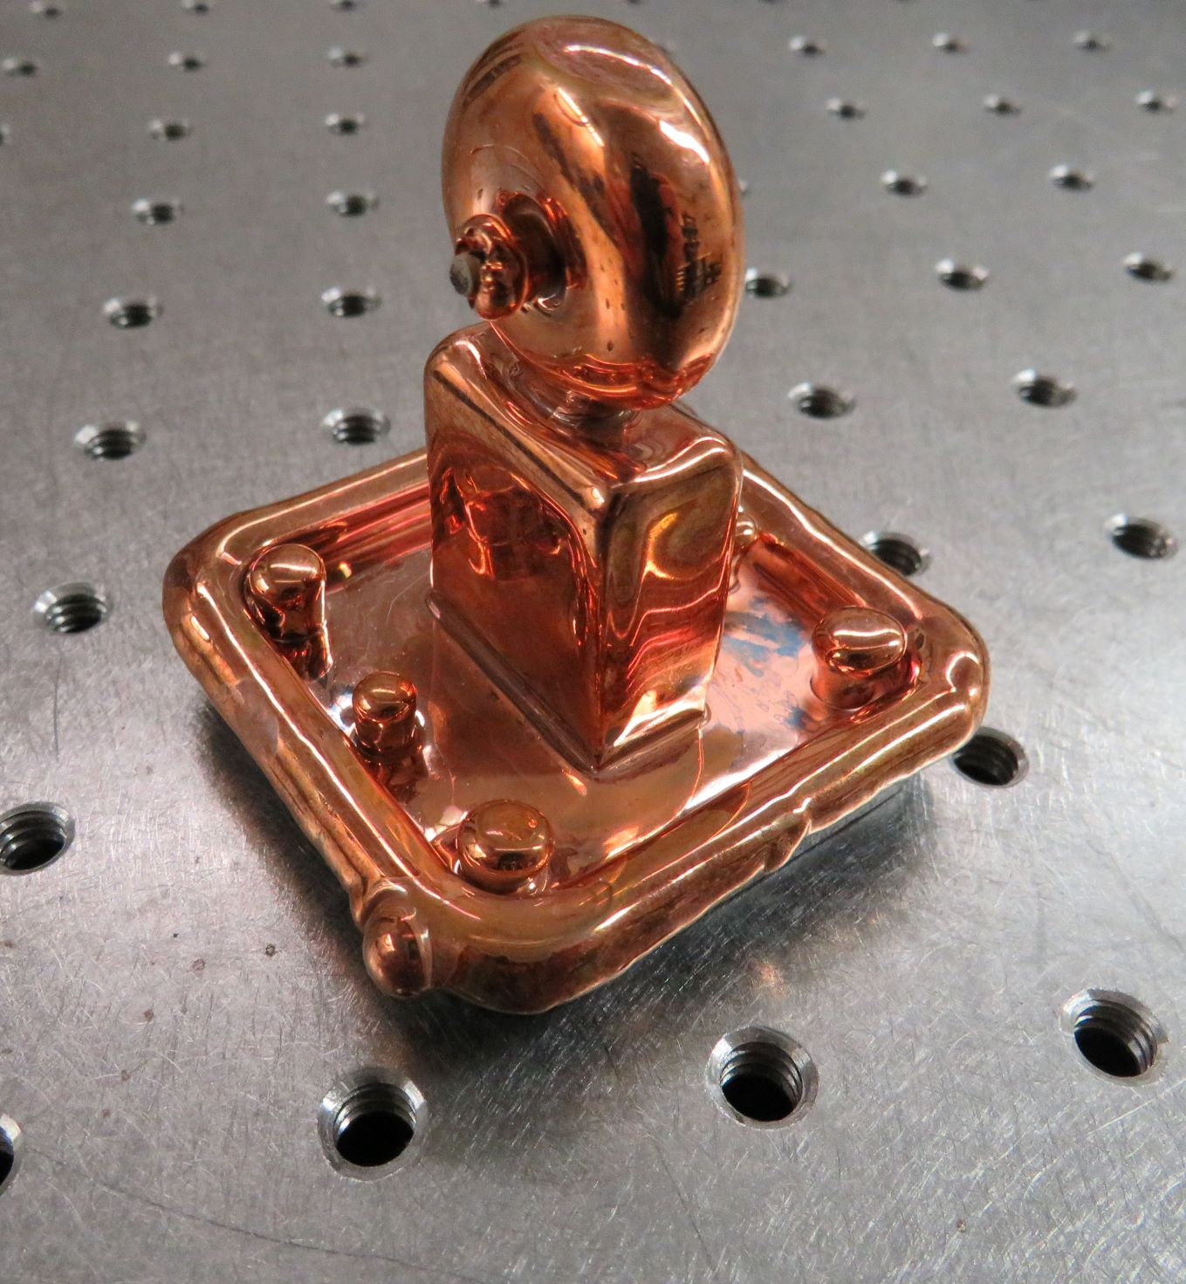
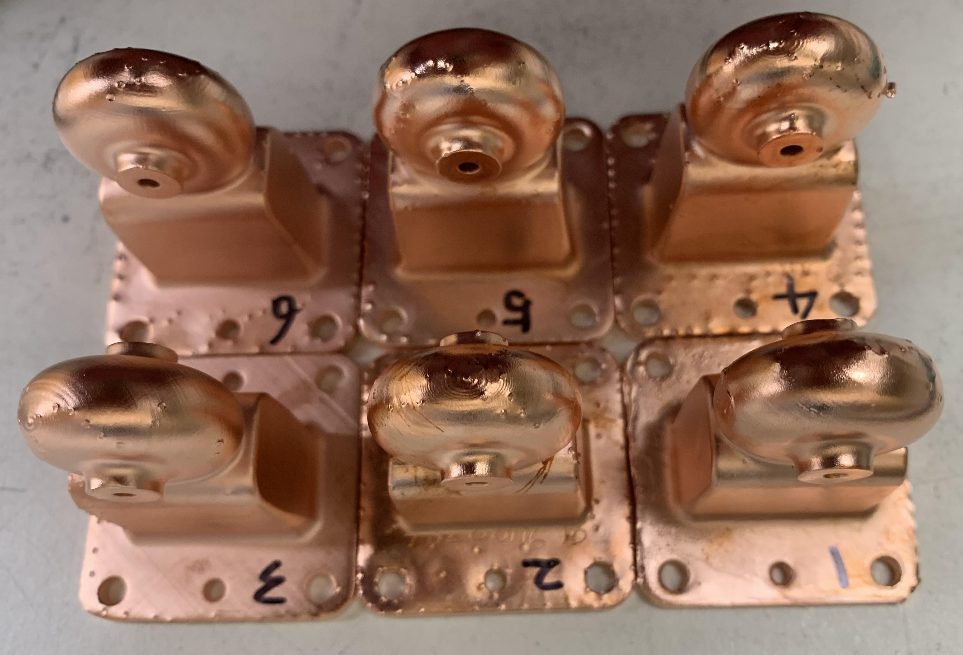
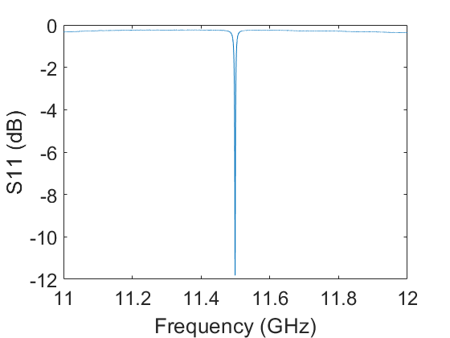
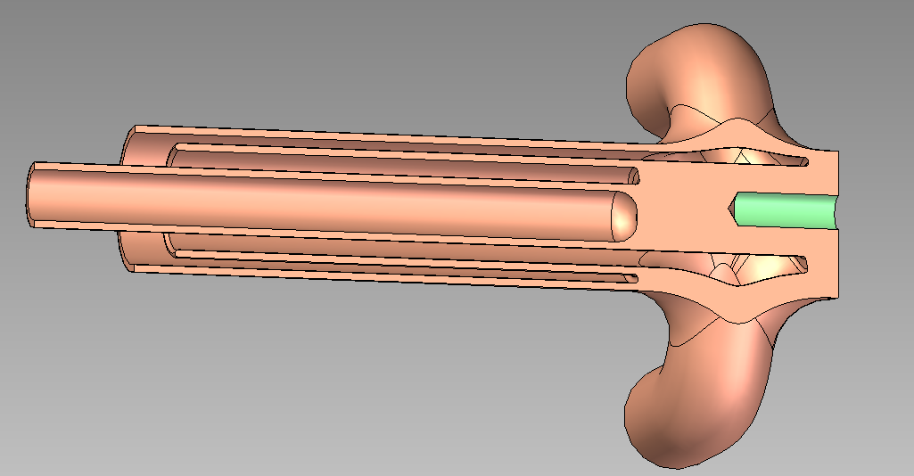
Fundamental R&D – Additive Manufacturing
Cost driver #3 – Hand-built copper RF circuits, collectors, cooling manifolds, etc.
Additive manufacturing is ideal for complex assemblies, but there are challenges:
RF wall losses
Porosity / vacuum compatibility
Brazing and welding
X-Band Resonant Cavities
Q_{o} > 3400
$200 / cavity
DMLS Copper Alloy
Electroformed Copper
Copper on Plastic
Laser-Sintered Copper Alloy Collector
Replaces six machined parts

Slide 14
Acknowledgements
Thank you! Questions?
You can also contact us at:
brweathe@slac.stanford.edu (Brandon)
tantawi@slac.stanford.edu (Sami)
This work was supported by the following agencies:
US Dept. of Energy – Office of Science, HEP - General Accelerator R&D Program (DE-AC02-76SF00515)
US Dept. of Energy – NNSA / NA-22 (FY18-NA-PD3Jc)
US Dept. of Homeland Security (IAA HSHQDC18ITR0004)
Stanford School of Medicine, Dept. of Radiation Oncology

