Slide 1
Novel RF Source
Topologies and
Advanced Modeling
Snowmass AF7 Seminar
Sami Tantawi and Brandon Weatherford
Alyson Gold, Mark Kemp, Erik Jongewaard, Xueying Lu, Julian Merrick, Emilio Nanni, Chris Nantista, Alex Nguyen, Jeffrey Neilson, Muhammed Shumail, and Ann Sy
Dec. 17, 2020

Slide 2
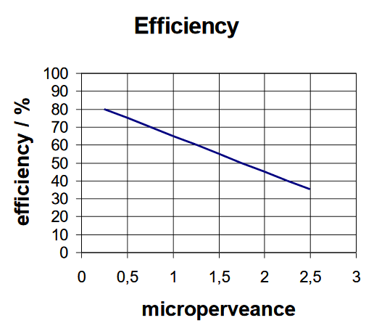
The Main Tradeoff – Efficiency Versus Power Density
In conventional klystrons, efficiency decreases almost linearly with perveance
  At fixed voltage, efficiency ~ 1/power density
  Efficiency decreases due to space charge de-bunching & energy spread in beam
For orders of magnitude improvement in $/kW, we have to break this scaling
S. Simrock & M. Grecki, 5th LC School, Switzerland, 2010, LLRF & HPRF
New RF sources are needed for high perveance AND high efficiency
  Multi-beam arrays: power combining for higher total perveance
  Radial beams: lower charge density w/ minimal focusing
  Trajectory modulation: mono-energetic beams for high efficiency

Slide 3
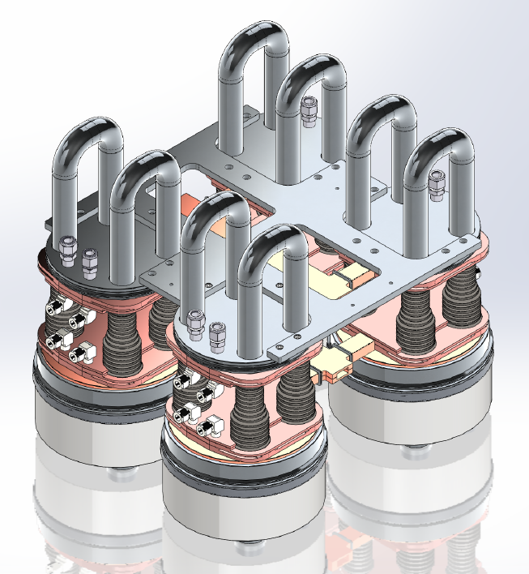
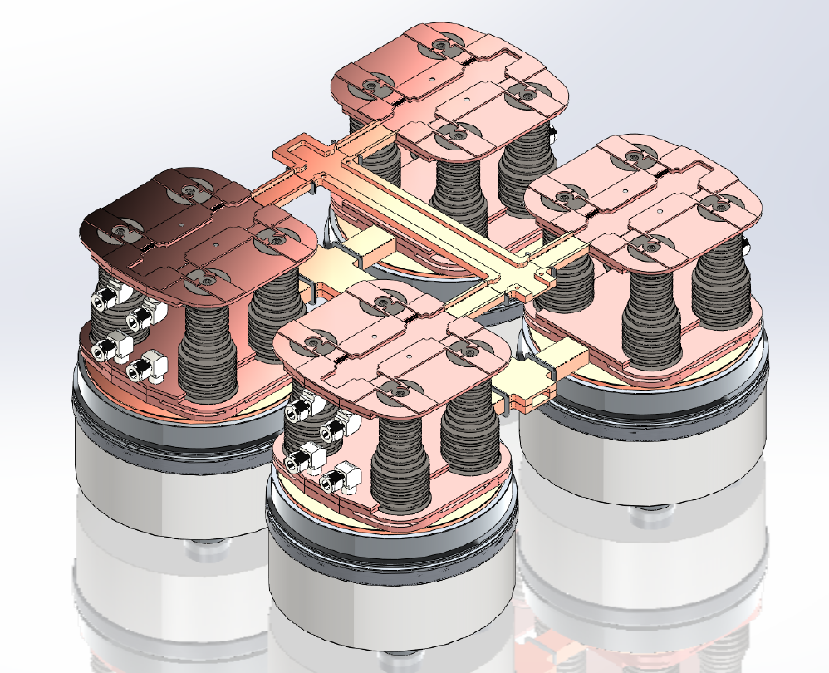
Multi-beam Klystrino Arrays with Floquet Combiner
Scaling to MW-levels is achieved using power combined klystrino subassembly arrays
  Passive power combining via 16-power waveguide matrix
  Single vacuum envelope for several beams
  Shared high voltage insulators
  Common beam dump and cooling
Floquet output combiner
16 Klystrinos

Slide 4
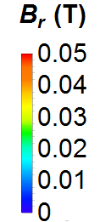
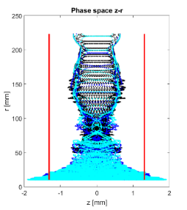
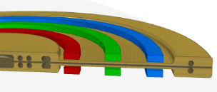
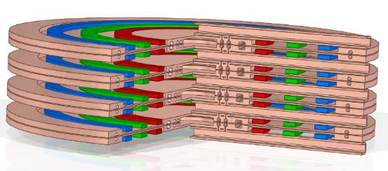
The Radial Beam Klystron Concept Has High Beam Power In a Compact Array
Simulations show that the radial klystron is a naturally stable device
0.05 T peak on axis field
  Minimal focusing required due to low current density
  Order of magnitude less axial field than a typical RF device
Low profile configuration ideal for compact, high power arrays
Phasespace
Graded PPM Focusing
magnets
250
200
150
100
50
0
R (mm)
-2 -1 0 1 2
On-axis radial magnetic field
Z (mm)
RBK module
Extraction waveguide(s)
1
2
3...
n
6”
Output combined using similar technology as MBK
M. Dal Forno,et. al, “Design of a radial klystron”, IPAC 2015.
Forno, M. Dal, S. G. Tantawi, R. D. Ruth, and A. Jensen, “Progress on Design of Radial Klystrons,” IVEC, 2016
Franzi, Tantawi, Dal Forno, Gold

Slide 5
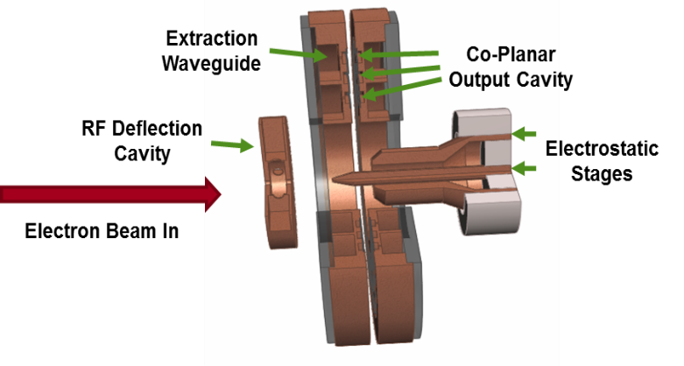
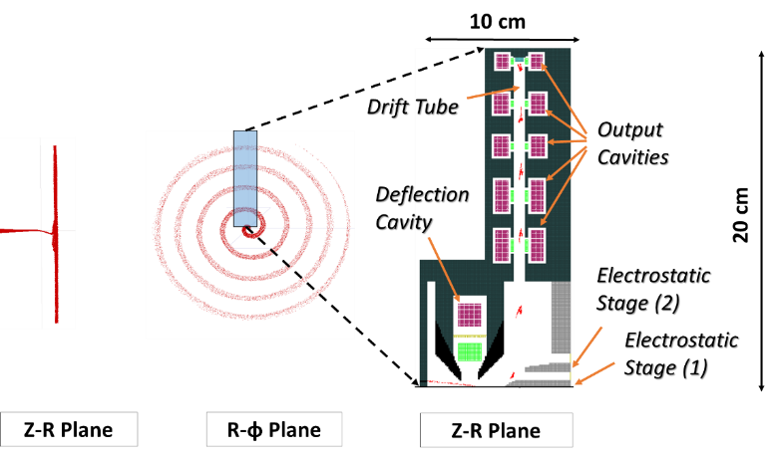
The Deflected Beam Amplifier Will Achieve High Efficiencies By Circumventing Traditional Bunching Schemes
Multi-cell output structure
Aberration correction with an electrostatic deflector
Very high efficiency (>85%)
  No traditional bunching required
Low thermal loading
  <5 % power in spent beam
CL
Franzi, Matt, Aaron Jensen, Sami Tantawi, Filippos Toufexis, and Alysson Vrielink, “The Distributed Bunch Amplifier,” IPAC, 2016

Slide 6
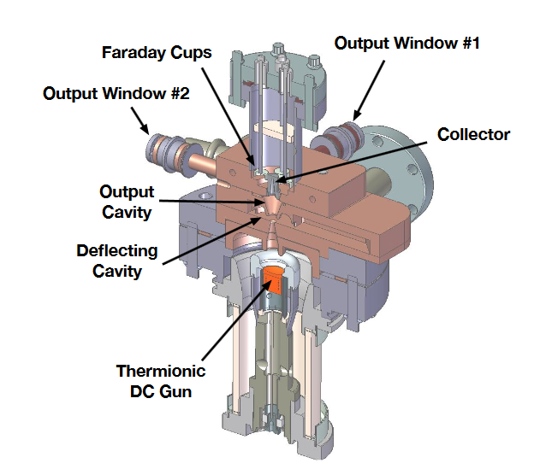
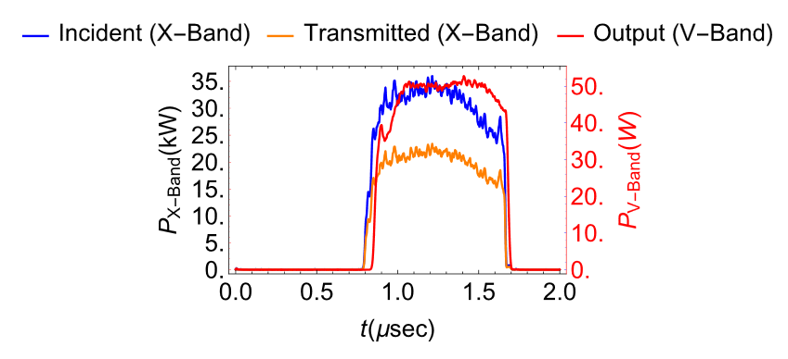
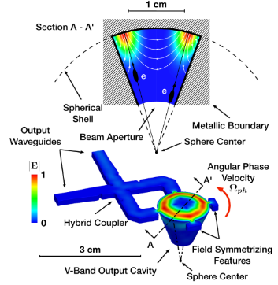
Deflected Beam Frequency Multiplier Provides a Path Towards mm-Wave/ THz Frequencies
Phase synchronous deflected beam interaction with harmonic whispering gallery mode
Electron beam continuously interacts with decelerating phase of RF
  No traditional “bunching” of beam
  Successful LDRD technology that has advanced to the GARD portfolio
Low beam voltage and low cavity voltage allow for higher frequency operation
Toufexis, et al Applied Physics Letters 110.26 (2017): 263507.
Toufexis, PhD Dissertation (2018)
Toufexis, Tantawi

Slide 7
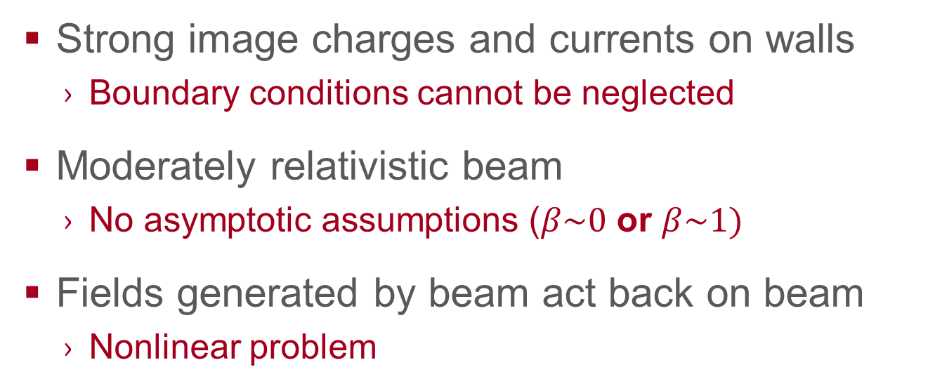
Modeling Requirements for RF Source Development
  Novel RF sources present a formidable modeling challenge.
  Strong image charges and currents on walls
    Boundary conditions cannot be neglected
  Moderately relativistic beam
    No asymptotic assumptions ($β\sim 0$ or $β\sim 1)$
  Fields generated by beam act back on beam
    Nonlinear problem

Slide 8

Accurate Modeling of Exotic RF Sources is Impossible with Existing Simulation Tools
  Without generalized codes that can model complex topologies, we need to “assume a spherical cow”

Slide 9
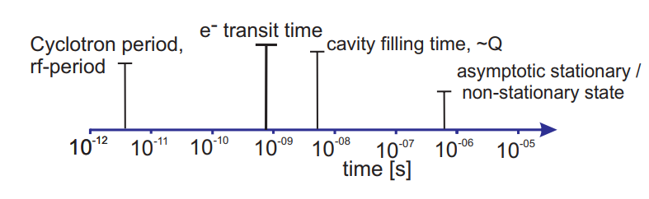
Multi-scale Simulations are Slow and Costly
Transient Solvers: The Wrong Tool at Steady-State
  RF sources are multi-scale (spatially and temporally)
  Simulations can take days to run, even on high performance clusters
Example of time-scales relevant to gyrotron operation (Thesis, Braunmuller 2016)

Slide 10
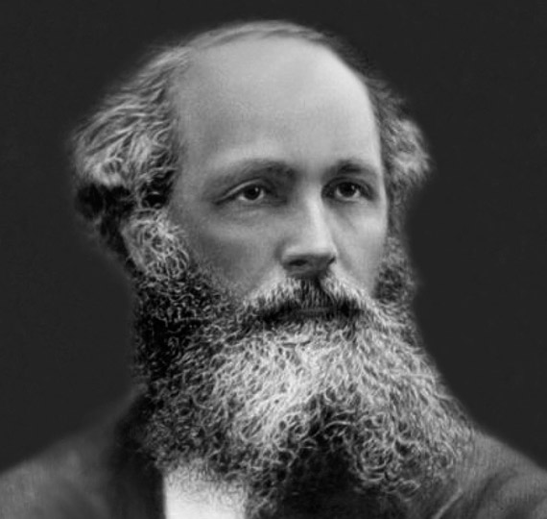
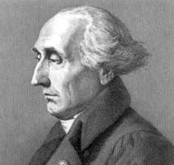
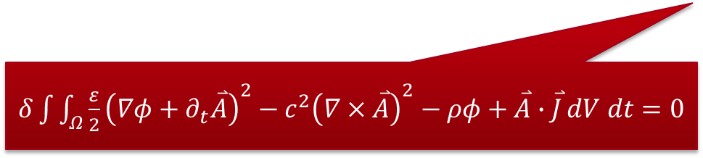


Lagrangian Field Theory
  Reformulation of Maxwell’s equations
$∇∙\overset{⃑}{E}=\frac{ρ}{ε}$
$∇×\overset{⃑}{E}=−∂_{t}\overset{⃑}{B}$
$∇∙\overset{⃑}{B}=0$
$∇×\overset{⃑}{B}=\frac{1}{c^{2}}∂_{t}\overset{⃑}{E}+μ\overset{⃑}{J}$
$δ\int{\int_{Ω}^{ }{\frac{ε}{2}{\left(∇φ+∂_{t}\overset{⃑}{A}\right)}^{2}−c^{2}{\left(∇×\overset{⃑}{A}\right)}^{2}−ρφ+\overset{⃑}{A}∙\overset{⃑}{J}}dV dt=0}$

Slide 11

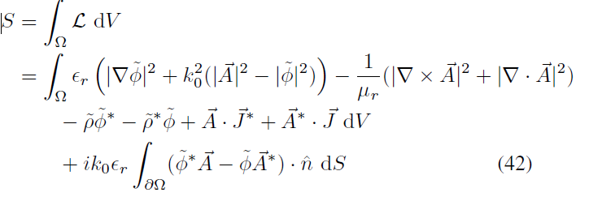
Lagrangian EM Solver Theory
Lorentz-independent Gauge fixing term
Addition of the Gauge fixing term →
Splitting of ϕ, A in the Lagrangian →
Problem can be described with nodal
(instead of vector) basis functions
This approach yields a simpler solution and very fast code for simulations, including beam loading and space charge effects

Slide 12



Lagrangian EM Solver Theory, cont’d.
$$α=e^{iφ^{+}}\sqrt{\frac{P_{in}}{(1−\overline{X}) p_{b}}}$$
$ω−ω_{i}^{′}≅\frac{ω_{i}^{′}}{2Q_{i}}\overline{Y}$ , $1−β_{c}=\overline{X}$
$$T=e^{\sum_{n=1}^{∞}{\frac{ε^{n}}{n!}{D_{L}}_{n}}}=e^{\sum_{n=1}^{∞}{\left.\frac{ε^{n}}{n!}[,L_{n}\right]}}$$
$\frac{〈Δγ_{2}^{c}〉}{(γ_{0}−1)}=\overline{X}−i\overline{Y}$
Treatment of particles & fields using the same Lagrangian, with higher order perturbations accomplished through Lie Transformations
This approach leads to new, accurate expressions for beam loading / detuning in klystron cavities
We are developing a fast, accurate, flexible, and realistic simulation tool for RF sources, enabling rapid automated design and optimization

Slide 13
For More Information on Modeling Work
The basics of our modeling work was published recently in:
  Alysson Gold, and Sami Tantawi, “A Classical Field Theory Formulation for the Numerical Solution of Time Harmonic Electromagnetic Fields,” Member, IEEE Journal on Multiscale and Multiphysics Computational Techniques, vol. 4,Dec. 2019
  Alysson Gold, and Sami Tantawi, “Efficient dual space source interpolation method for the numerical solution of self-consistent static beam-wave interactions” Phys. Rev. Accel. Beams 21, 114403 –November 2018

Slide 14
RF Sources at SLAC: Producing A Significant Impact for HEP
Guided by recent DOE workshops, the broad benefits to HEP of investing in RF sources research are clear
The challenge is substantial: both dramatic improvements in efficiency and a 10x improvement in cost
  Support for fundamental R&D is insufficient (both in funds and people) for the scale, and payoff, of solving this problem
SLAC is taking a holistic approach to optimize full RF power chain, driving performance and cost-capability improvements
Diverse R&D approach includes full system optimization, high voltage power, RF amplifiers, components, and processes
Advanced modeling tools being built at SLAC will be a faster alternative to EM/PIC codes – essential for advancing the state of the art
Thriving spinoff programs with other sponsors broaden the customer base for RF power and make $2/kW an achievable goal
Notes:
UPDATE

Slide 15
Acknowledgements
Thank you! Questions?
You can also contact us at:
tantawi@slac.stanford.edu (Sami)
brweathe@slac.stanford.edu (Brandon)
This work was supported by the following agencies:
US Dept. of Energy – Office of Science, HEP - General Accelerator R&D Program (DE-AC02-76SF00515)

