Slide 1
High Efficiency RF Source Development
Lawrence Ives,
Calabazas Creek Research, San Mateo, CA. USA
100 kW, 1.3 GHz Magnetron w/ Phase and amplitude control
Magnetron frequency/phase control with varactors
100 kW, High efficiency, L-Band klystron
350 – 700 MHz, 200 kW Power Grid Tube RF sources
700 MHz Multiple Beam IOT
.

Slide 2

A 100 kW, 1.3 GHz Amplitude and Phase Controlled Magnetron for Accelerators
Michael Read¹, R. Lawrence Ives¹, Brian Chase², John Reid², Chris Walker³ and Jeff Conant³
[1] Calabazas Creek Research Inc., San Mateo, CA 94404
[2] Fermi National Accelerator Laboratory Batavia IL 60510-5011
[3] Communications and Power Industries LLC, Beverly, MA, USA 01915
Funded by the US Department of Energy under SBIR grant DE-SC0011229

Slide 3
Program
Develop 100 kW, 1.3 GHz magnetron with fast amplitude and phase control
Specifically for high Q (superconducting) cavities
Fast amplitude control by phase modulating the locking signal to shift power to side bands
  Side bands are rejected by high Q cavity
  Power into the cavity = Magnetron power less side band power

Slide 4
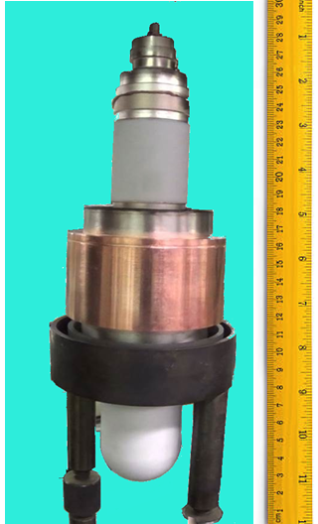
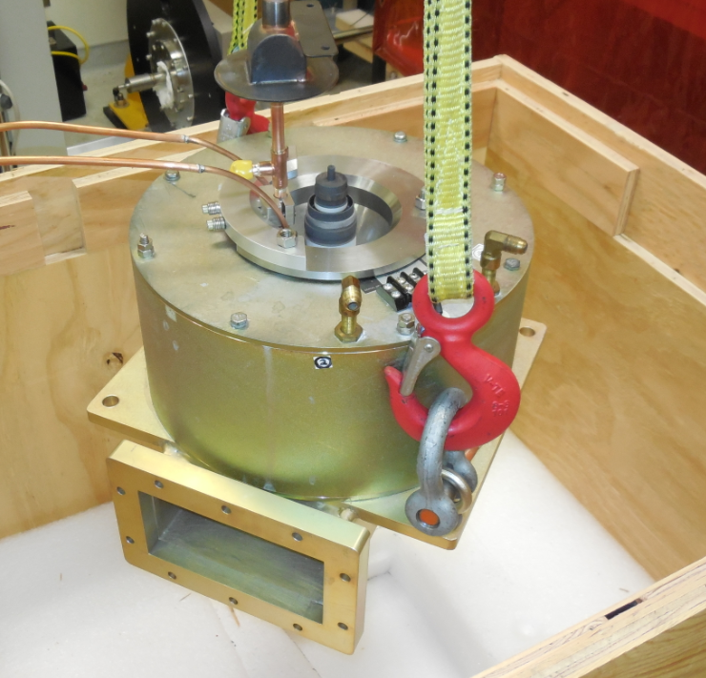
CPI Magnetron
1.30 GHz
100 kW peak
10 kW average

Slide 5
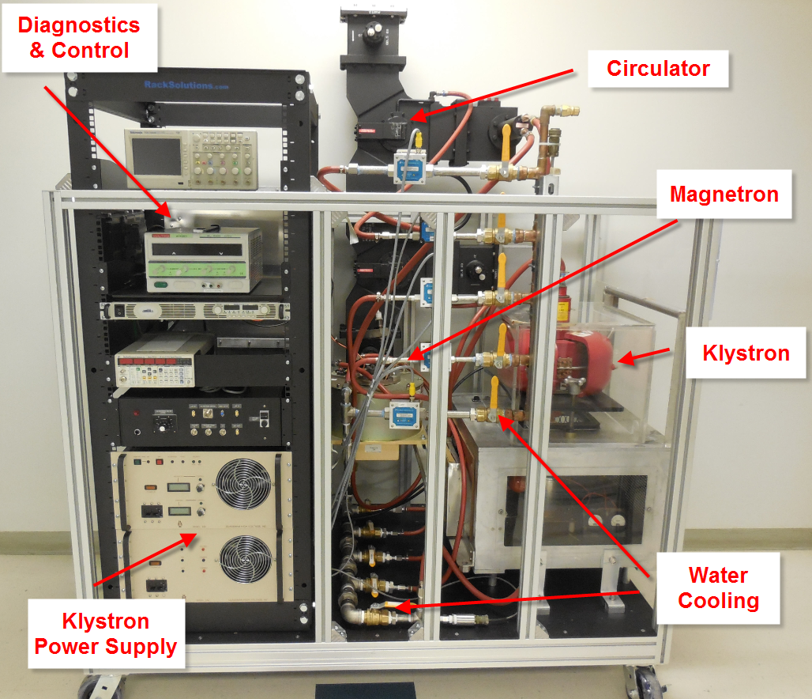
Packaged Magnetron System

Slide 6
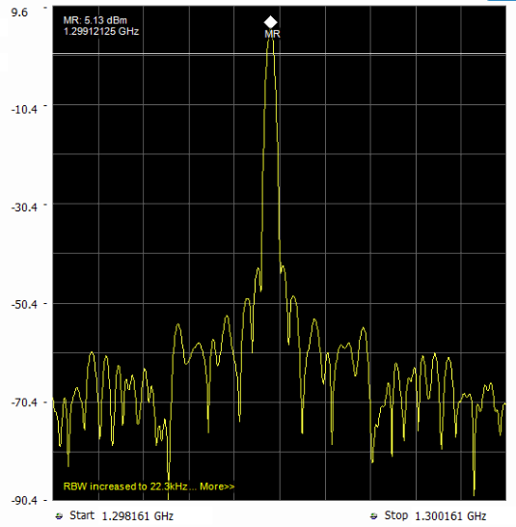
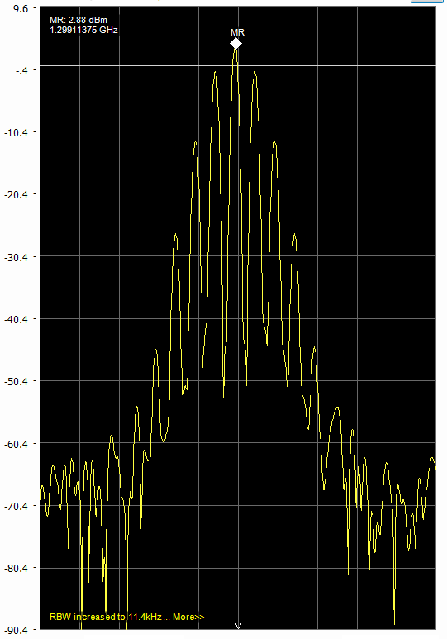
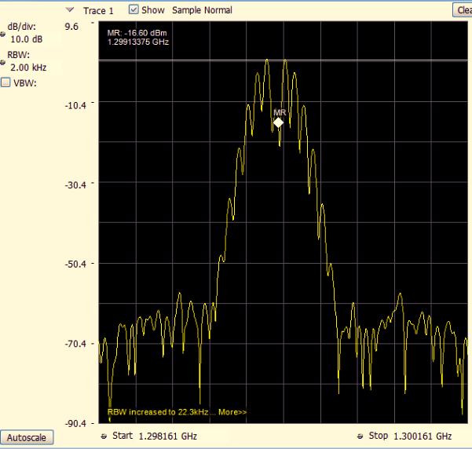
Phase Modulation
50 MHz Phase Modulation
2 MHz
1 MHz
2 MHz
No Modulation
60° Modulation
122° Modulation

Slide 7
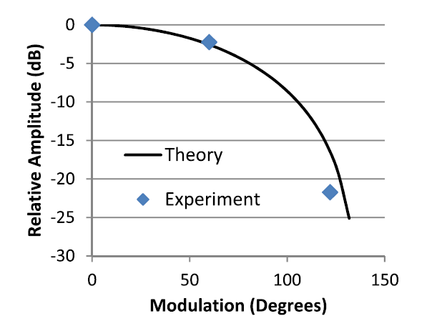
Amplitude Control
Required 316 W of drive power to lock

Slide 8
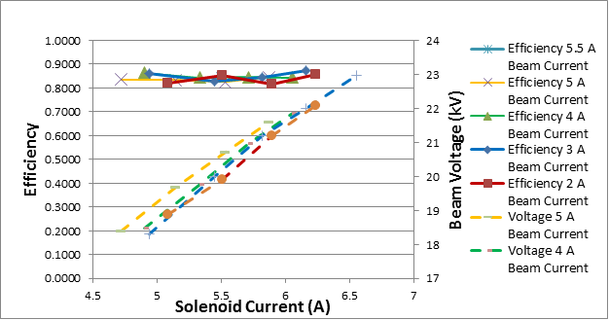
Efficiency
Efficiency varied between 81% and 87%, depending on parameters

Slide 9
Cost for 100 kW System
(Exclusive of high voltage supply)
Magnetron | $40,000
500 W SS amplifier | $17,000
Circulator w waveguide | $20,000
Controls | $10,000
Packaging | $10,000
Total | $97,000
Magnetron System Cost ~ $1/Watt
(Klystron cost ~ $4/Watt)

Slide 10
Compact and Efficient Magnetron Source with
Fast Phase and Frequency Control
Michael Read
^{Calabazas Creek Research, Inc.}
^{Lili Ma, Joseph Frisch}
SLAC National Accelerator Laboratory
^{Chris Walker}
Communications & Power Industries – Beverley
Funded by US Navy Contract N6833520C0822

Slide 11
Goals
Develop S-Band, 5 kW magnetron with frequency and phase control
Minimize weight and power
Eliminate requirement for circulator

Slide 12
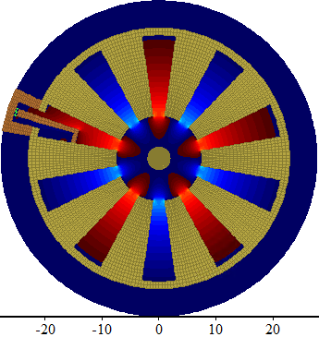
Approach
3D MAGIC Simulation PI Mode Fields
Capacitor
Varactor tuning of magnetron by changing capacitance
0.5 pF swing 5 MHz shift
(mm)
Simulated Performance

Slide 13
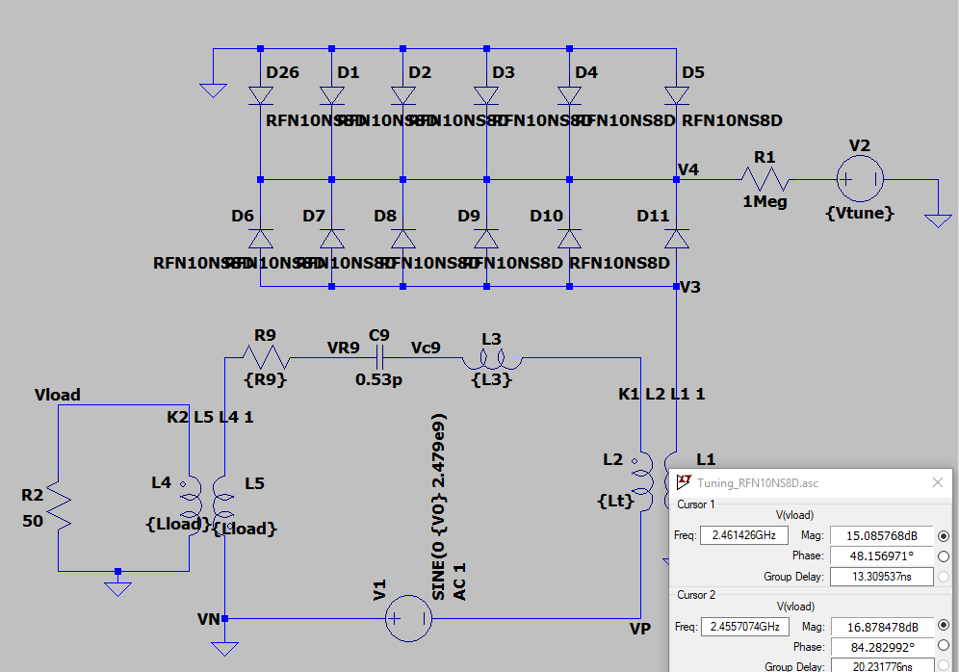
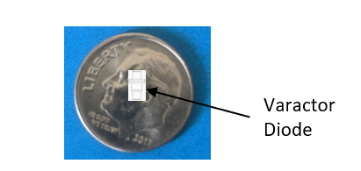
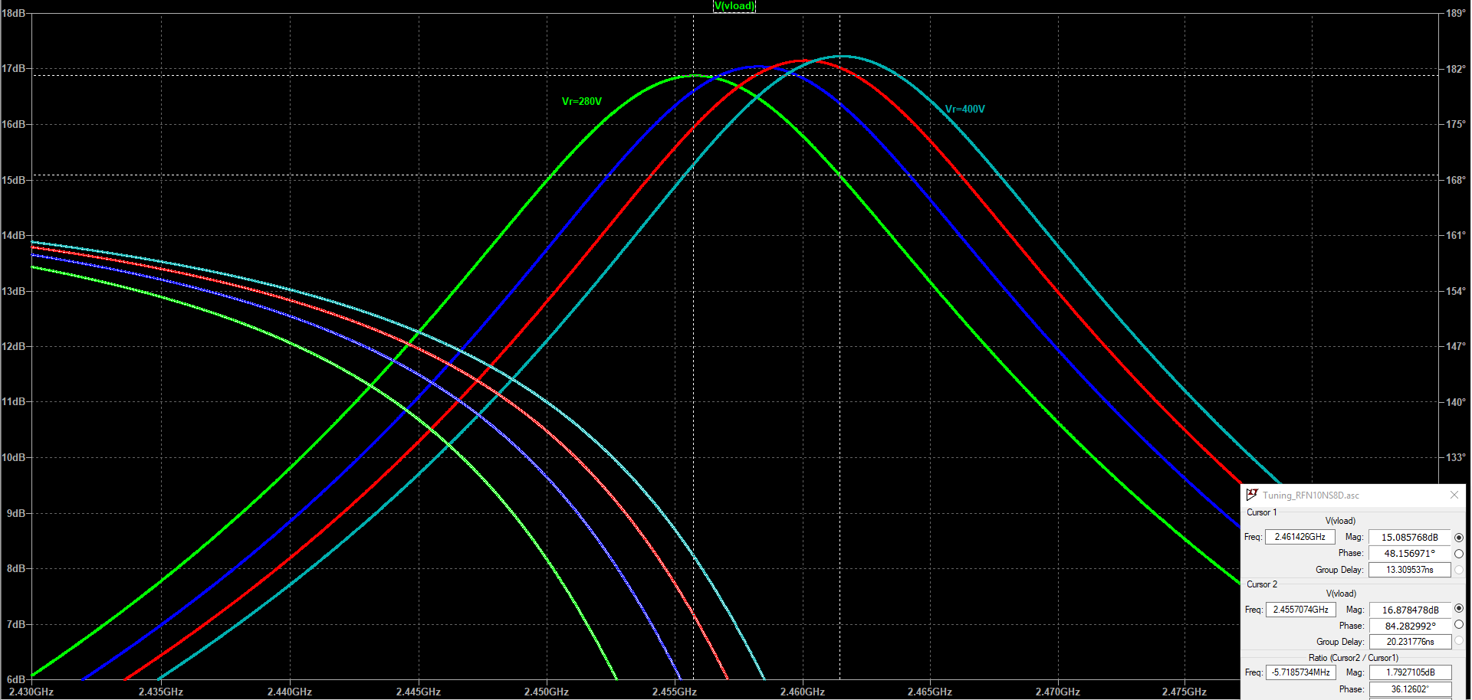
Spice Simulations Determined Diode Requirements
Microsemi GC1712
200 V
400 V
  20 diodes in series C = 0.2pF - 1.5pF
  Bias voltage 13V – 38V
  Frequency Shift 6 MHz
5 MHz

Slide 14
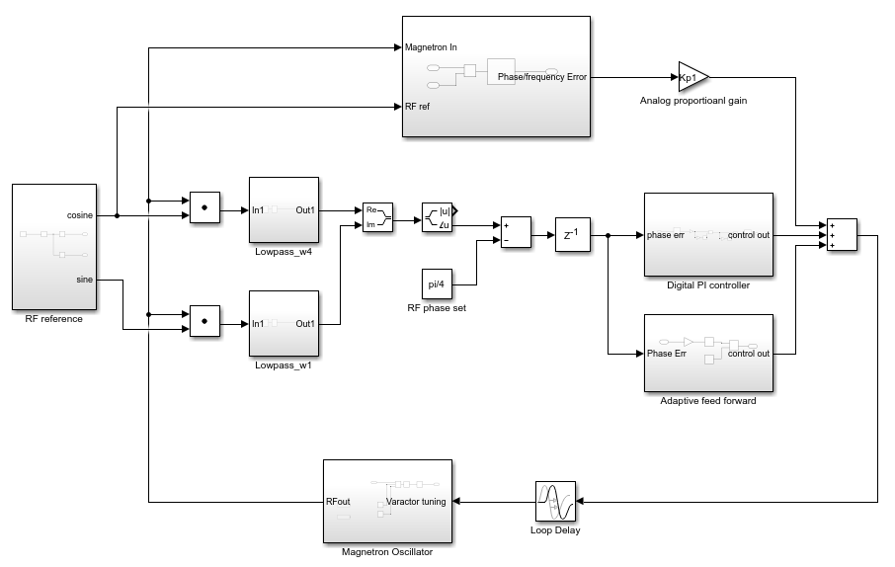
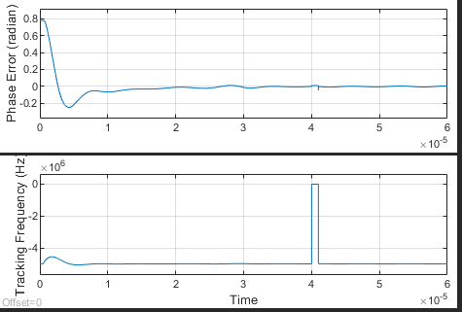

Key Innovations
Adaptive feed forward for frequency tuning
Feed back to control low frequency phase error.
adaptive feed forward to cancel 44kHz power supply resonance.
Optional : analog loop for fast, high bandwidth control.
CCR preparing proposal for high power system for accelerators
Fast Analog Control System
Phase error
Digital Control system
Digital feed back
Frequency step out
Adaptive feed forward

Slide 15
A 1.3 GHz 100 kW Ultra-high Efficiency Klystron
Michael Read¹, Aaron Jensen², R. Lawrence Ives¹, Thomas Haberman¹, David Marsden¹, and George Collins¹
[1] Calabazas Creek Research Inc., 490 Port Drive San Mateo, CA 94404
[2] Leidos, Center for EM Manager DEOST, Billerica, MA 01821
Communications & Power Industries, LLC, Palo Alto, CA 95304
Funded by the US Department of Energy under SBIR grant DE-SC0017789.

Slide 16
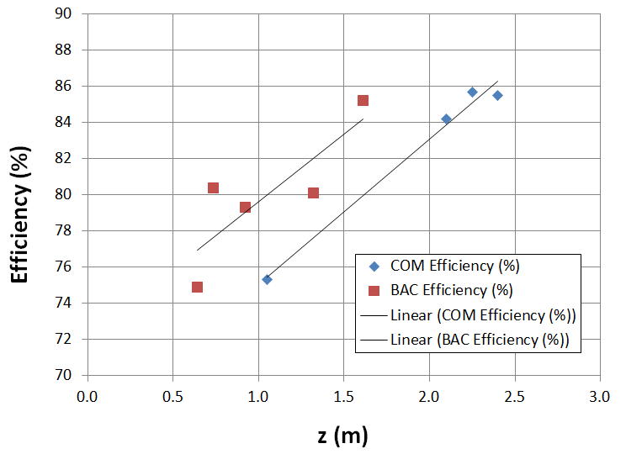
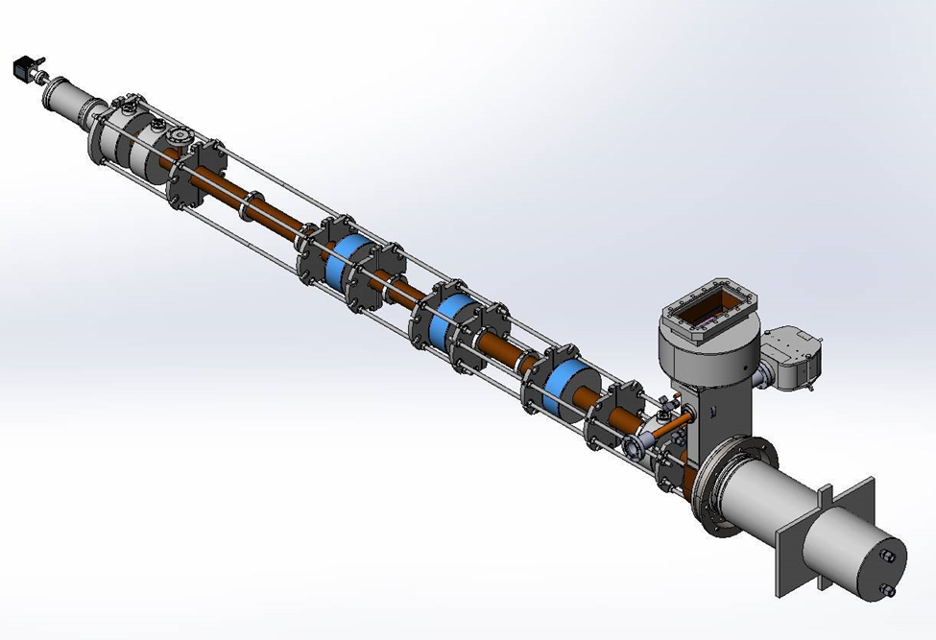
Core Oscillation Method (COM)*
  Voltage 53.5 kV
  Current 2.46 A (0.2 mpervs)
  Cavities 7
  Simul. Efficiency 83%
  RF structure length 250 cm

Slide 17
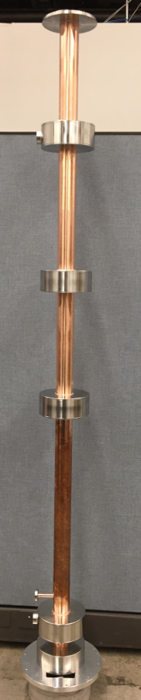
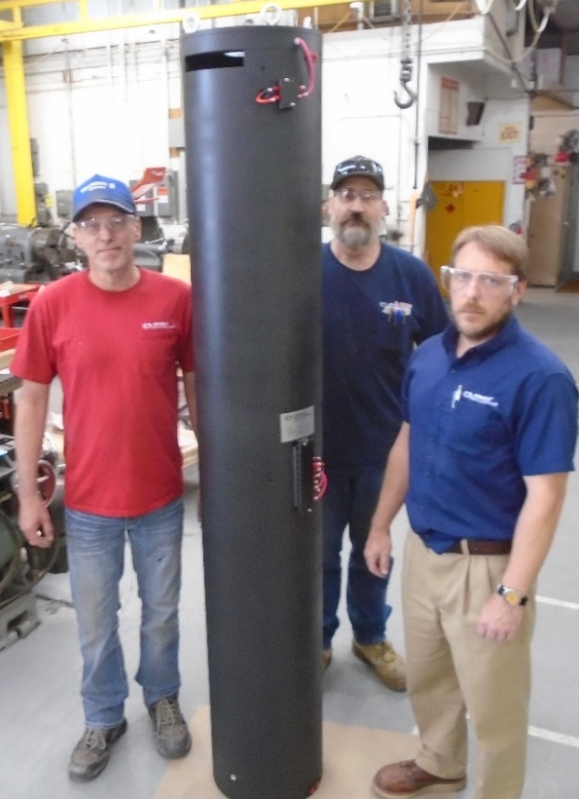
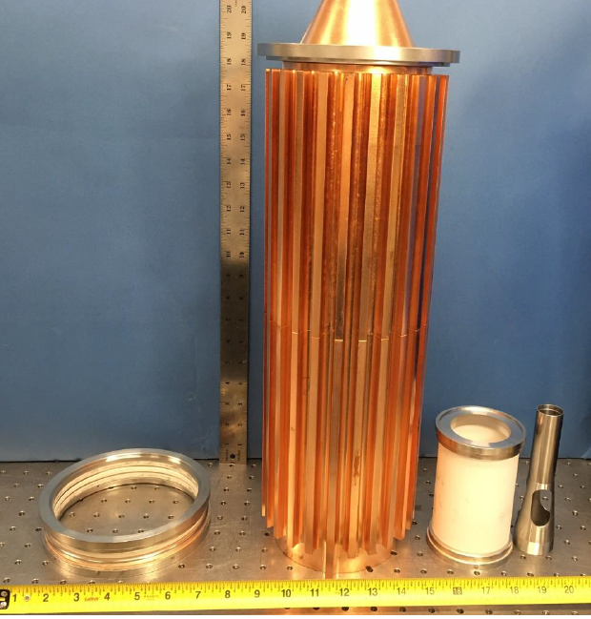
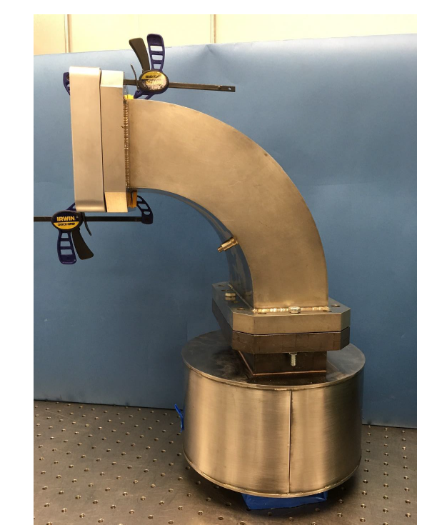
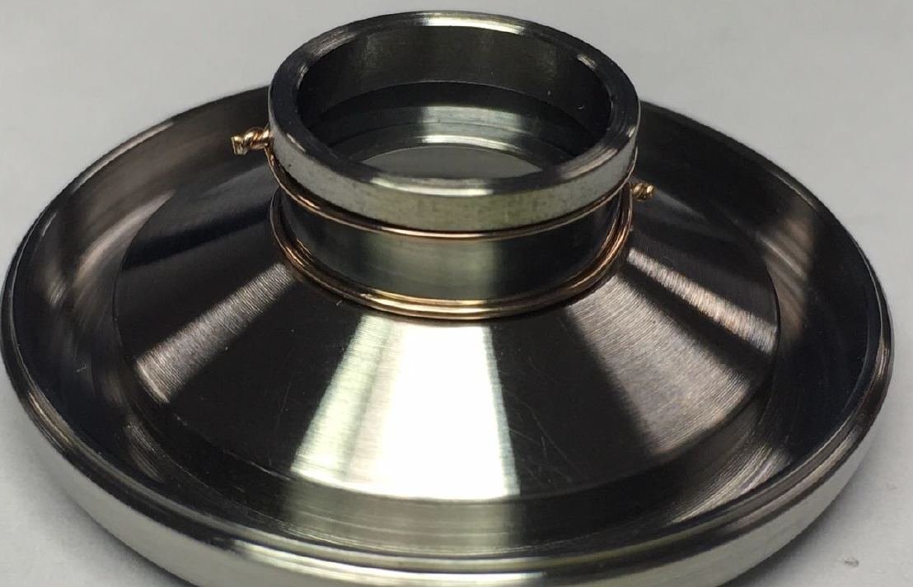
Assembly in Progress
Most all parts received
Cold test and assembly in progress
Test set being configured
Testing in February-March 2020

Slide 18
Multiple Beam Power Grid Tubes for High
Frequency and High-Power Operation
Lawrence Ives, Michael Read,
David Marsden, Thuc Bui
Calabazas Creek Research, San Mateo, CA. USA
Ricky Ho, Nileshwar Chaudar,
Christopher McVey, Tom Cox
Communications & Power Industries, LLC
Palo Alto, CA 94304 USA
James M. Potter
JP Accelerator Works
Los Alamos, NM USA
This research funded by DOE SBIR Grant DE-SC0018838
.

Slide 19
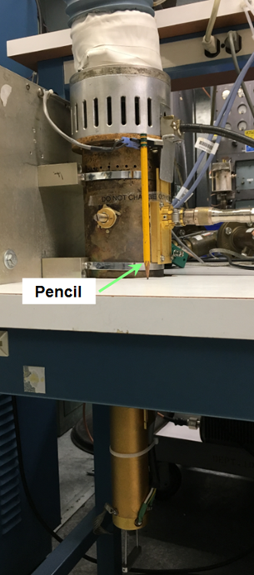
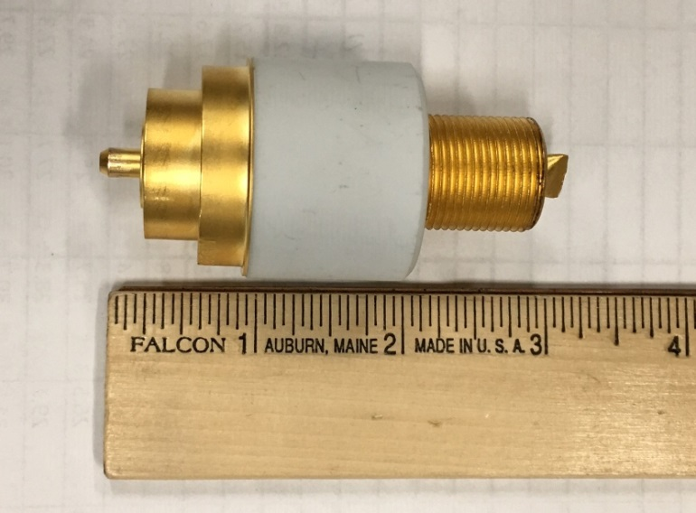
25 kW 425 MHz
Triode-based RF Source
YU-176 Triode
Efficiency 90% (Class C)

Slide 20
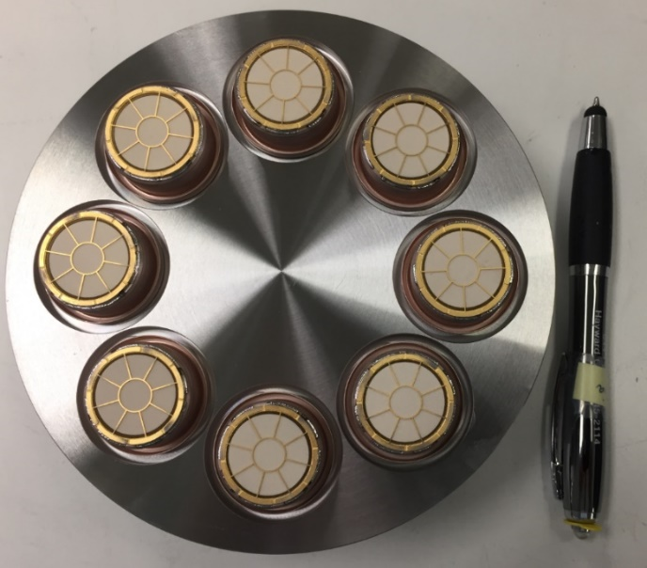
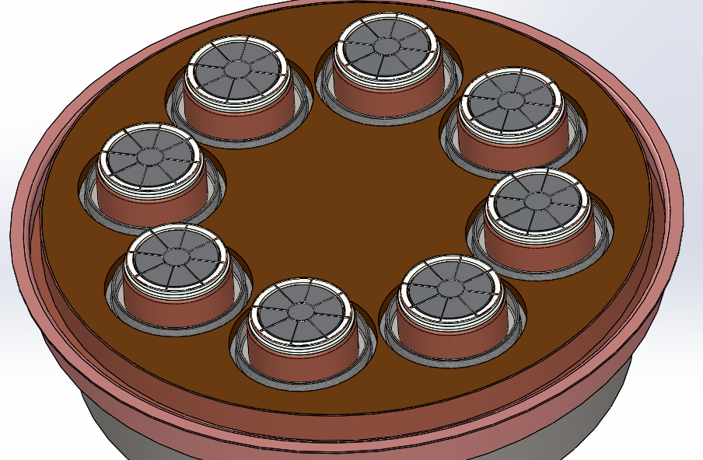
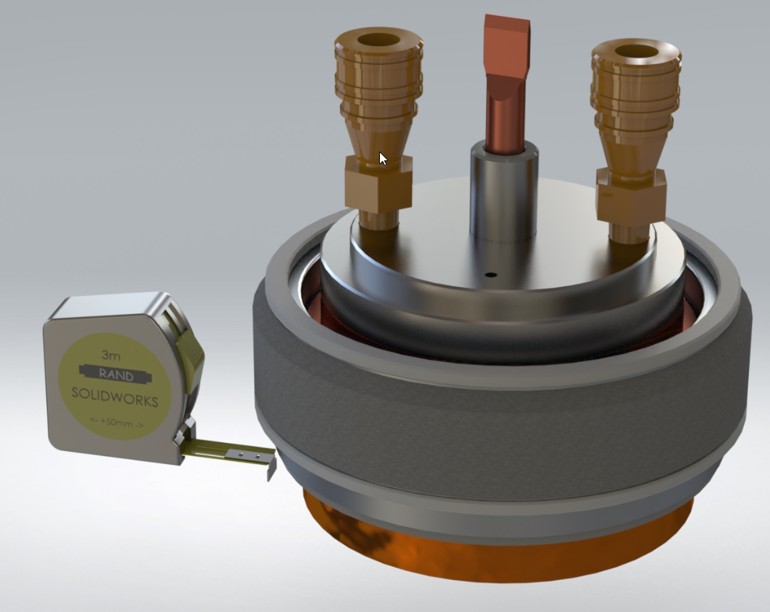
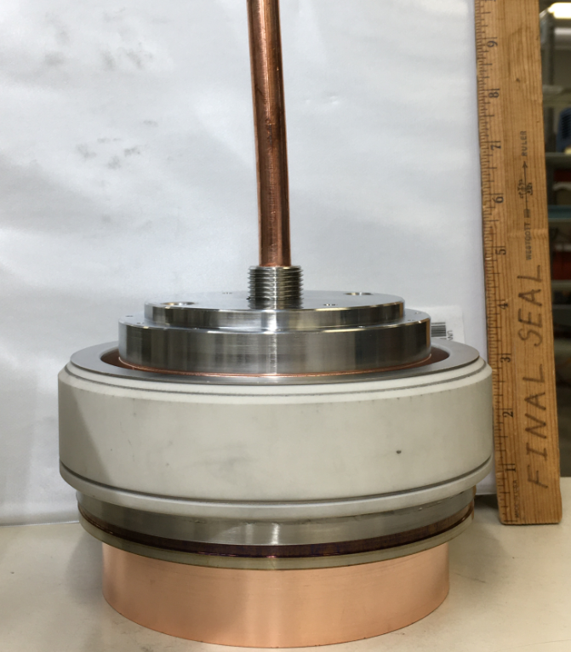
Beam Power for 200 kW RF Source
Eight YU-176 grid cathode assemblies
230 kW of beam power

Slide 21
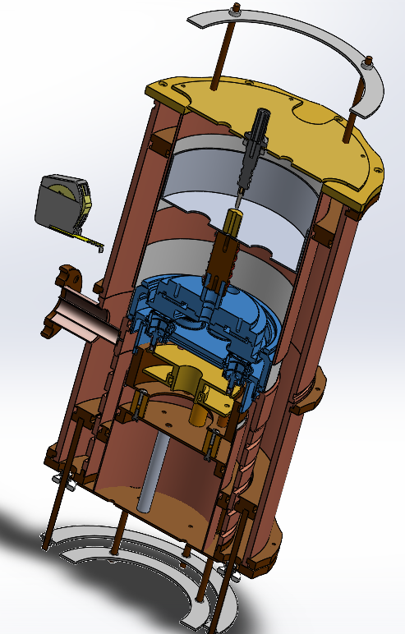
350 MHz Cavities
MB triode tube installs from top (blue)
Single input cavity below tube
Upper and lower output cavities with coax output between
Upper cavity is frequency tuning element
Lower cavity is variable output coupling element

Slide 22
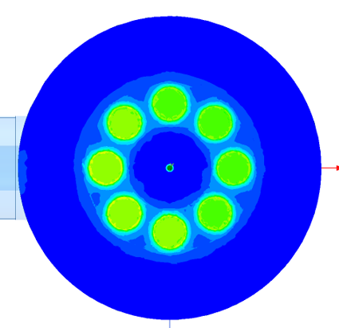
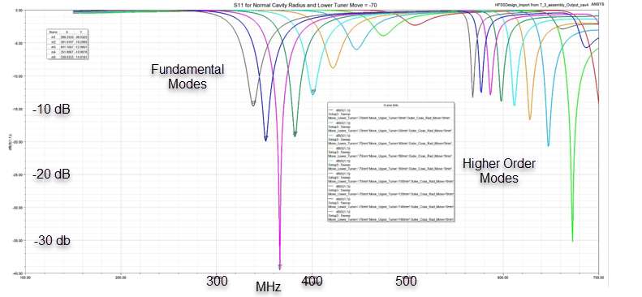
Output Cavity
Simulation
Tuning range for output cavity (325 – 500 MHz)

Slide 23
Gain
Gain ~14 dB for triode-based sources
Requires 6.5 kW driver 200 kW RF source
Driver options:
- Solid State – expensive, may be difficult to find
Developing Single-beam triode driver

Slide 24
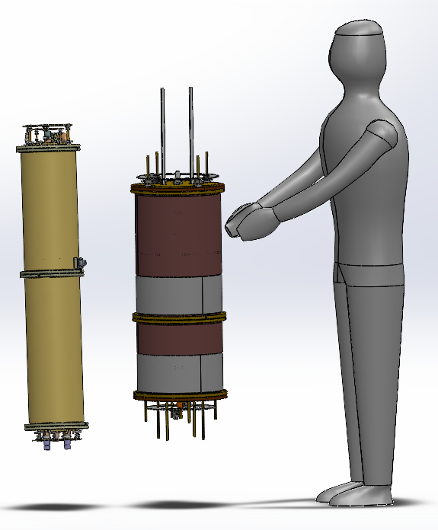
200 kW CW, 350 MHz RF System
Net Gain 28 dB
Net Efficiency ~72%
High power tests scheduled for January – February 2021

Slide 25
200 kW CW RF Source Cost
350 – 700 MHz
Product Price Efficiency
15 kW Driver $45K 90%
200 KW MB source $55K 80%
Total $100K
Triode-based system $0.50/Watt ~72%
Klystron: ($4/W) 50-60%
MBIOT: ($2-$4/W) 65-70%
Solid State: ($4/W) ~50%

Slide 26
HIGH-EFFICENCY, HIGH AVERAGE POWER INDUCTIVE OUTPUT TUBES
H.P. Freund,¹ R.L. Ives,¹ W. D. Sessions² and T. Bui¹
¹Calabazas Creek Research, San Mateo, CA
²Georgia Tech Research Institute, Atlanta, GA
Communications & Power Industries, LLC, Palo Alto, CA
Work supported by the US Department of Energy Grant No. DE-SC0019800

Slide 27
MBIOT SIMULATON
Adding 3rd harmonic to drive signal to increase efficiency
Six beam Design
f =700 MHz
30 kV/6.67 A
  Simulated efficiency with the 3rd harmonic ≈ 91%
3rd harmonic power ½ of fundamental drive power
Performance as function of relative phase of fundamental and 3rd harmonic

Slide 28
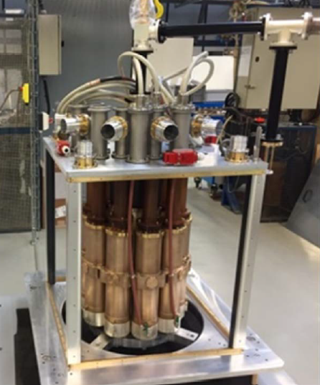
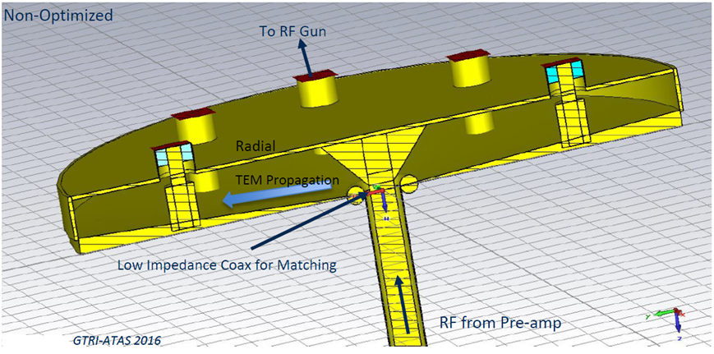
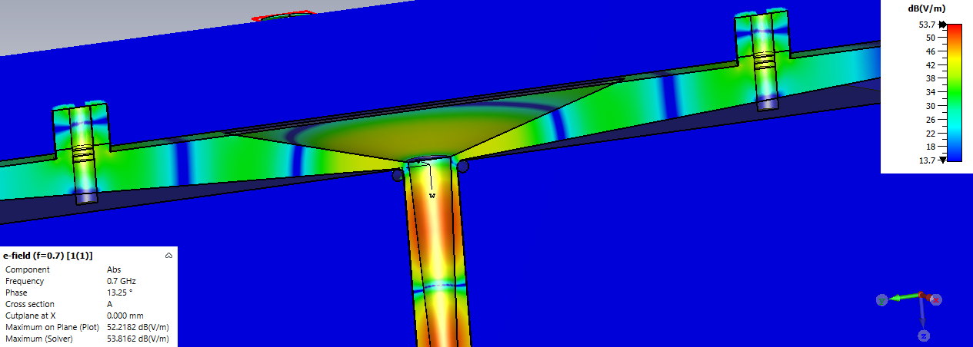
THE INPUT COUPLER
Simulations via CST-MWS®
N-Beam, Coax-Conical-Coax Power Splitter
  Single RF Driver
  Direct coupling to individual guns
  Challenge: Include 3rd Harmonic Drive
Input coupler for CPI-Thales 700 MHz MBIOT

Slide 29
METAL GRID DESIGN
Current IOTs use pyrolytic graphite (PG) grids
Difficult to fabricate
Expensive
Relatively low yield
This MBIOT will use molybdenum grids
Reduced power loading with multiple beams
Thermomechanical analysis predicts good performance
Significantly cheaper with higher yield
Two-year program to design, build and test MBIOT started in August

Slide 30
Summary
RF Sources and Key Features
Magnetron System 100 kW 1.3 GHz Amp/Phase Control $1/Watt
Completed
High Efficiency Klystron 100 kW CW 1.3 GHz 80% Freq/Pwr Scalable
Triode-base RF sources 200 kW CW 350–700 MHz $0.5/Watt compact
Design complete – assembly in progress
Multiple Beam IOT 700 MHz 200 CW kW 80% Reduced cost
Fully Funded – Final design in progress – high power testing 2022
Magnetron using varactors S-Band 5 MHz tuning Very compact
Proof of principle design complete – proposals in progress

