Slide 1
Higher Efficiency
High Power RF Generation
Erk Jensen/CERN

Slide 2

Improving Energy Efficiency: a Duty and an Opportunity
www.iea.org: Energy Efficiency is one of the cornerstones of any strategy
Our obligations:
  Be aware and make aware of efficient energy use and energy conversion
  Make good design choices to minimize “waste”!
  Design and use energy-efficient equipment!
  Monitor and plan energy use (Energy Management)
  Recover otherwise “wasted” energy!
This is our duty to society, but also a necessity for acceptance of future projects!
The size of HEP projects, $𝒪\left(200 MW\right)$ or $𝒪\left({TWh}/y\right)$, allows dedicated R&D. Benefits:
  Concepts and designs developed to improve energy efficiency in accelerators will be relevant for society at large.
  Significant savings in operational cost.
  From: European Strategy Open Forum, Granada 2019,”Energy Efficiency of HEP Infrastructures” https://indico.cern.ch/event/808335/contributions/3365146/

Slide 3
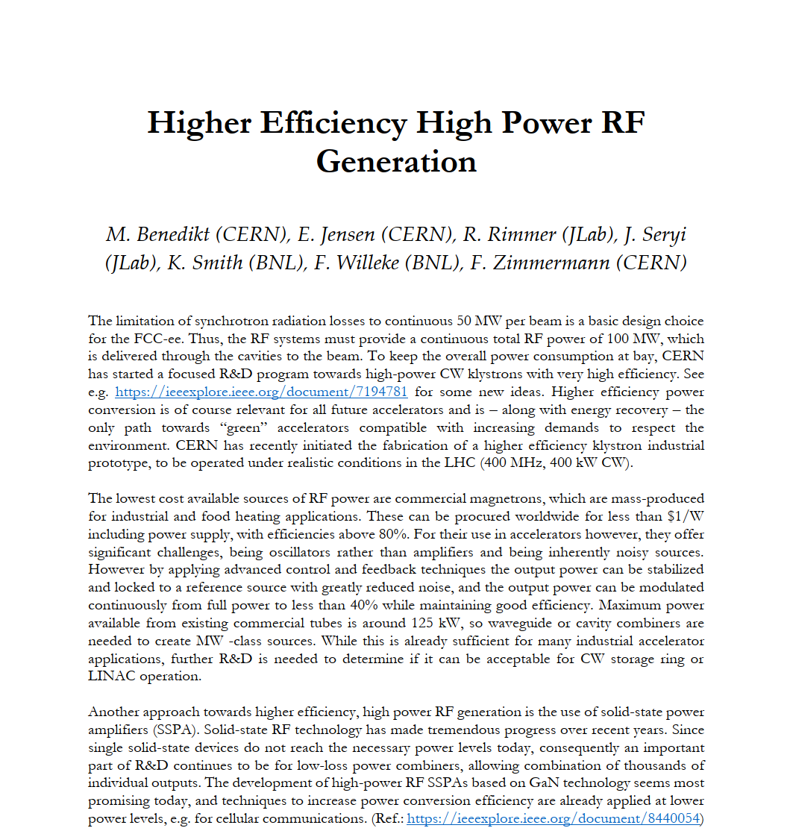
Excerpt from Letter of Intent: Areas of R&D:
Higher efficiency klystron development involving modern concepts like “BAC”, “COM”, “CSM” and others. Application also to Inductive Output Tubes (IOTs),
Investigate stabilization, phase control and combination of magnetron RF sources for possible accelerator use.
Development of scalable power combiners to combine thousands of inputs (of kW level) in few stages to reach power levels necessary to operate large particle accelerators,
Development, jointly with industry, GaN-based SSPA modules, applying techniques to increase efficiency at high power levels (Class F, multi-harmonic terminations …)

Slide 4
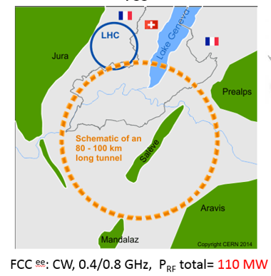
Example FCC-ee: Energy Needs
FCC-ee is a large (Ø 31 km) Electron-Positron Ring Collider
FCC-ee will be dominated by synchrotron radiation losses.
It requires 110 MW RF power in CW!
The yearly energy consumption for the
FCC-ee alone (assuming 5500 h operation and
an overall conversion efficiency of 50%) will
be in the order of 1.2 TWh – the consumption
of a small town!
Higher efficiency → less waste → gained resources!

Slide 5
Example FCC-ee: Energy Conversion
Grid to DC:
RF power generation!
Note: largest impact by RF power generation
RF distribution!
losses in cavities
RF to beam

Slide 6
A scalable problem – a scalable solution
The need to improve energy efficiency is most visible with a large, energy hungry installation like FCC-ee.
But 10 smaller infrastructures requiring “only” 10% of its energy, have the exact same problem.
… or 100 “small” infrastructures requiring only 1% of its energy need …
There exist maybe 30,000 smaller accelerators in the world (medical, industrial, …) with together a huge consumption and a large potential to save resources.
If we find a solution for higher efficiency RF sources, RF sources for all applications will potentially profit!

Slide 7
High Efficiency Klystrons

Slide 8
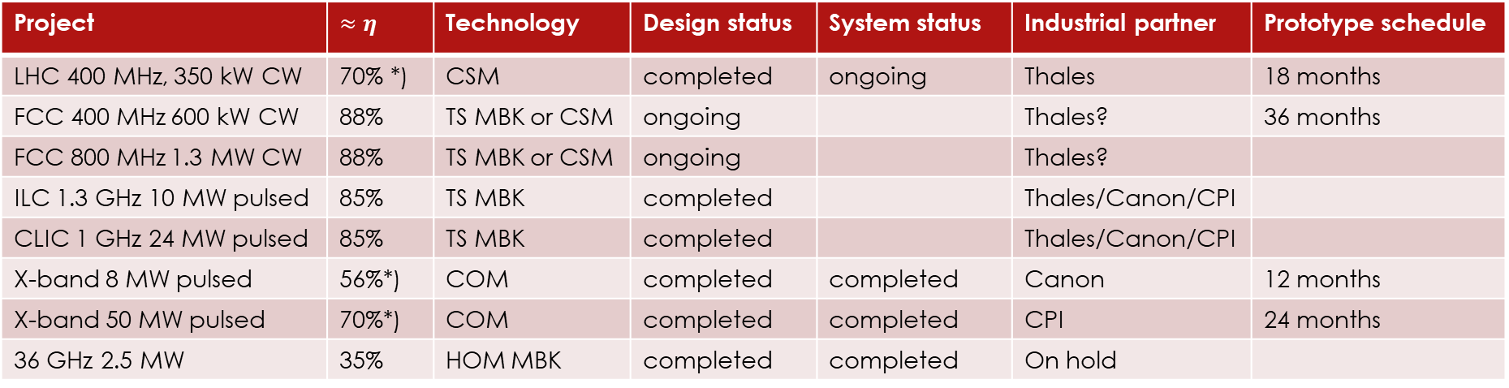
High-Efficiency klystron activities at CERN
Project | $≈η$ | Technology | Design status | System status | Industrial partner | Prototype schedule
LHC 400 MHz, 350 kW CW | 70% *) | CSM | completed | ongoing | Thales | 18 months
FCC 400 MHz 600 kW CW | 88% | TS MBK or CSM | ongoing |  | Thales? | 36 months
FCC 800 MHz 1.3 MW CW | 88% | TS MBK or CSM | ongoing |  | Thales?
ILC 1.3 GHz 10 MW pulsed | 85% | TS MBK | completed |  | Thales/Canon/CPI
CLIC 1 GHz 24 MW pulsed | 85% | TS MBK | completed |  | Thales/Canon/CPI
X-band 8 MW pulsed | 56%*) | COM | completed | completed | Canon | 12 months
X-band 50 MW pulsed | 70%*) | COM | completed | completed | CPI | 24 months
36 GHz 2.5 MW | 35% | HOM MBK | completed | completed | On hold
*) Retrofit to existing tube, re-use of modulator, solenoid and frame.
  CSM: Core Stabilisation Method
  TS: Two-stage
  MBK: Multi-beam Klystron

Slide 9
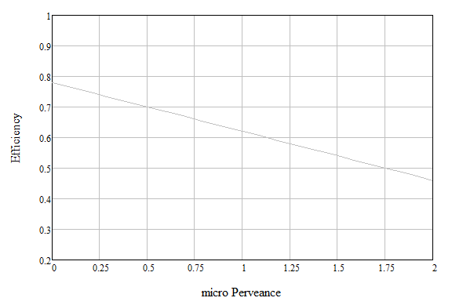
High-Efficiency klystron activities at CERN
L-MBK/TS
CLIC, 24 MW
L-FCC, 1.5 MW
L-MBK ILC, 10 MW
UHF-LHC
0.35 MW
L-MBK CLIC, 20 MW
L-SNS, 0.55 MW
X-CERN/CPI
50 MW
L-ESS,1.5 MW
X-CERN/Canon 8 MW
S-Canon
7.5 MW
X-BVERI
50 MW
UHF-LHC
0.3 MW
UHF-B-factory
1.25 MW
X-Toshiba
PPM, 50 MW
X-Canon
6 MW
S-SLAC
65 MW
X-CPI
50 MW
S-band
Industry
S-SLAC
150 MW
Klystrons for science
ITT 2960
33 MW
HE design, CERN (PIC simulations)
HE industrial prototype ; off shelf
(µA/V^{1.5})

Slide 10
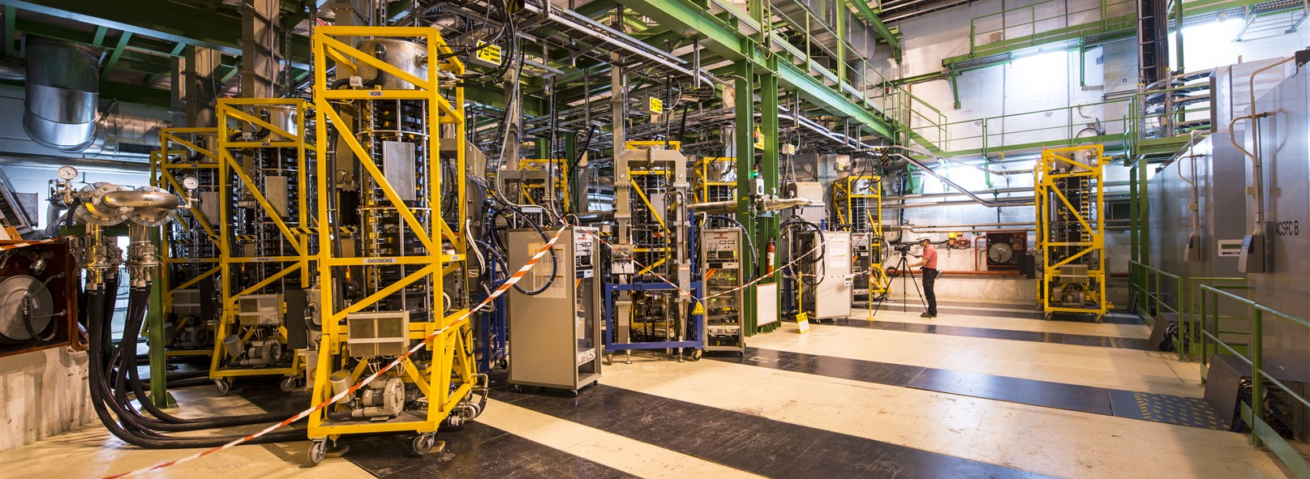
LHC RF System – a 1st step for validation
These 16 klystrons TH2167 provide the necessary RF power to accelerate the LHC beams to collision energy.
O. Brunner

Slide 11
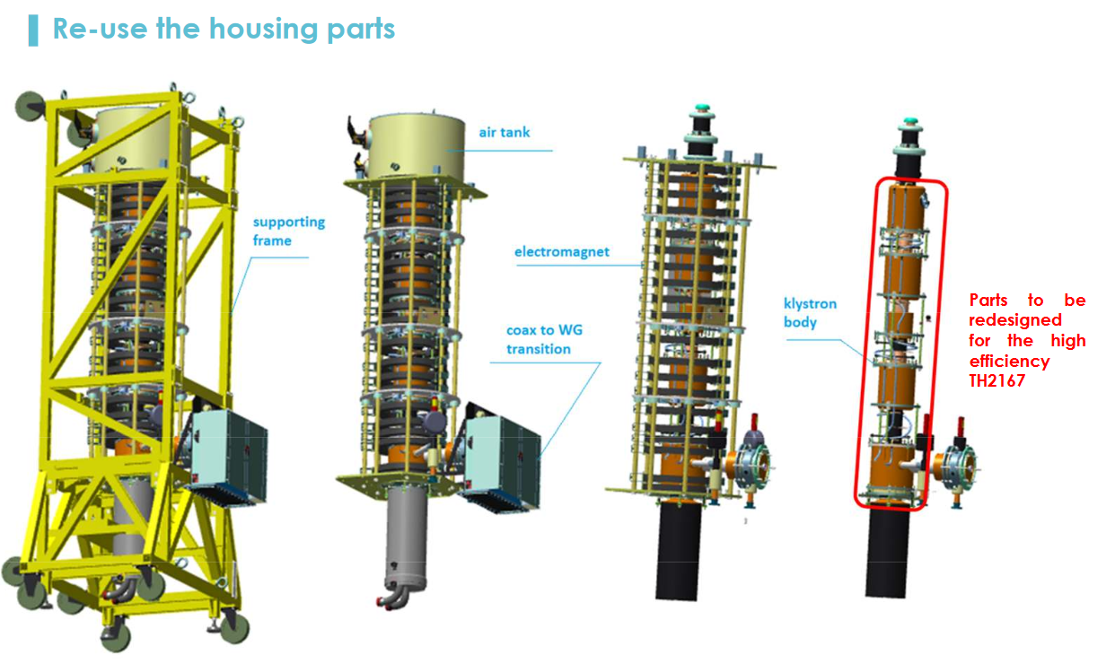
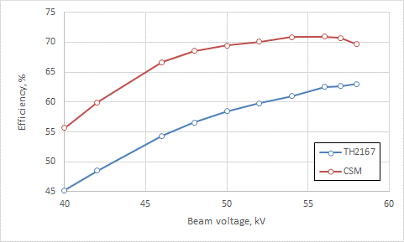
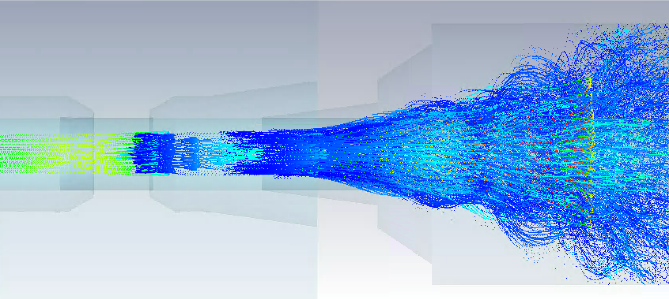
LHC RF System – a 1st step for validation
KlyC simulations
TH2167HE
TH2167
CST PIC Simulation:
output cavity to collector
A. Beunas: “Towards High Efficiency Klystrons for LHC”, FCC Week, Brussels, 2019
A. Buenas, I. Syratchev, J. Cai

Slide 12
KlyC.v5 and CGUN
Codes developed at CERN by Jinchi Cai (U. Lancaster) and Igor Syratchev. The codes are or will be in the public domain.
KlyC: 1.5 D klystron simulation and optimisation code, including EM model, coupled cavities module, monotron oscillations module, Poisson module, klystron optimizer module, parameter scaling module. Allows import of HFSS/CST data.
CGUN: Electrostatic and magnetostatic modules, suited e.g. for e-guns and two-stage klystrons, including e-beam tracking. Can be called from KlyC if needed.
https://indico.cern.ch/event/921325/contributions/3870852/
https://cds.cern.ch/record/2649486

Slide 13
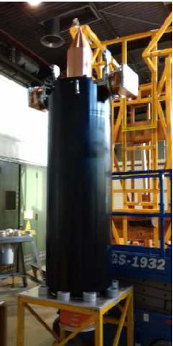
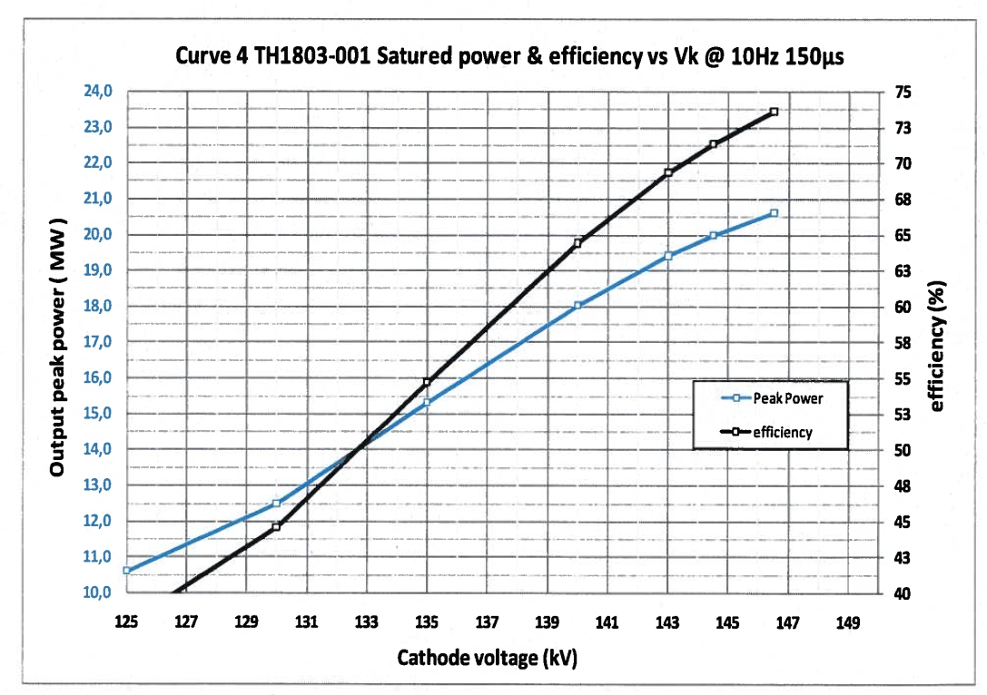


Recent L-band industrial prototypes
$f=999.5 MHz$
$P_{max}=21 MW$
$T=150 ms$
$V=159.4 kV$
$I_{total}=180 A$
$η=70.5\%$
Perveance: $0.47 μA∙V^{−3/2}$
Gain: $53.9 dB$
$f=999.5 MHz$
$P_{max}=21 MW$
$T=150 ms$
$V=146.5 kV$
$I_{total}=191 A$
$η=73.5\%$
Perveance: $0.341 μA∙V^{−3/2}$
Gain: $51.5 dB$
Canon E37503
6-beam MBK
Thales TH1803
10-beam MBK
G. McMonagle, I. Syratchev, J. Cai

Slide 14





Two-stage MBK technology (TS MBK)
Conventional HE MBK
$$η≈70\%$$
Cathode
Specific features:
Bunching at low voltage (high perveance). Very compact RF bunching circuit.
Bunched beam acceleration and cooling (reducing Δp/p) along the short DC voltage post-accelerating gap.
Final power extraction from high voltage (low perveance) beam. High efficiency.
Additional advantages:
The 2nd stage can be operated in DC, simplifying the modulator and increasing its conversion efficiency.
Simplified feedback for the first stage pulsed voltage. Improved klystron RF phase and amplitude stability.
Gap’s accelerating DC voltage is a natural barrier for reflected electrons. Improved tube stability.
$$V_{1}+V_{2}$$
TS MBK
$$η≈85\%$$
HV insulators
$$V_{1}$$
Stage 1
$$V_{2}$$
Post accelerating gap
Stage 2
Collector
I. Syratchev, J. Cai

Slide 15
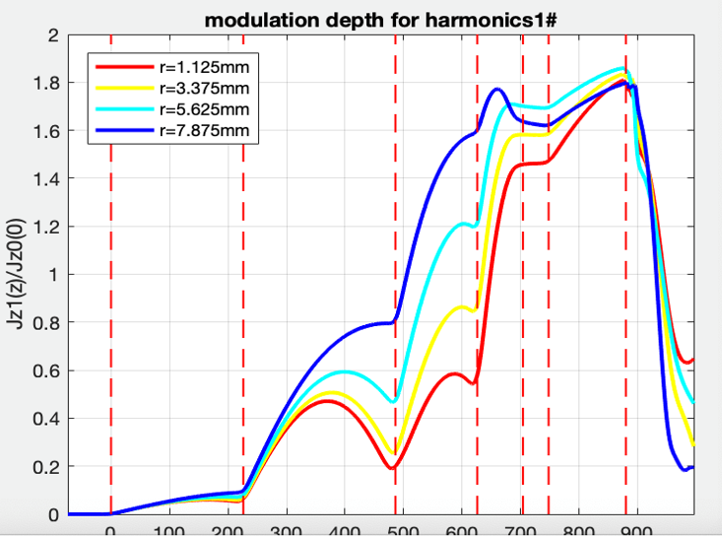
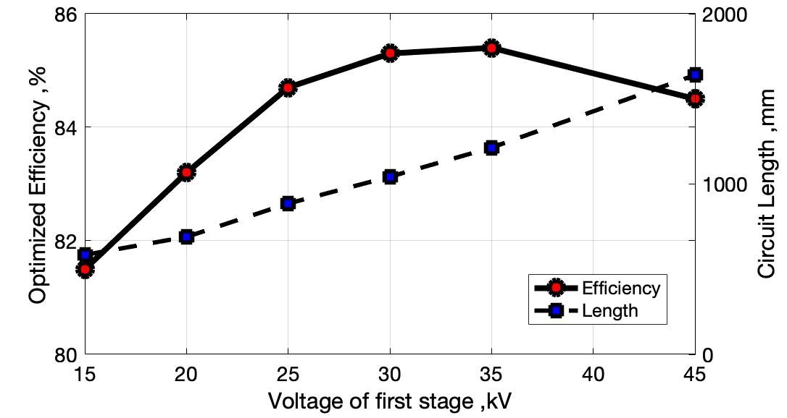
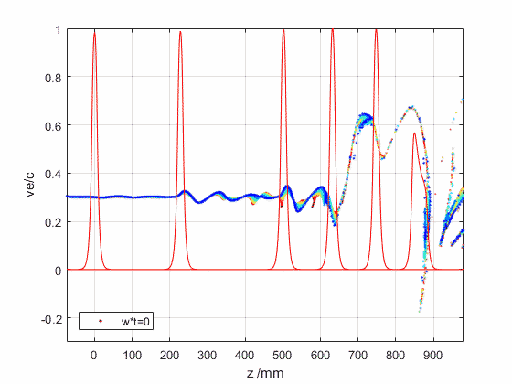
Example: 1 GHz, 24 MW TS-MBK
KlyC optimization results
Note the flat, cylindrical bunch
DC gap
selected
V _{total} = 140 kV
I. Syratchev, J. Cai

Slide 16
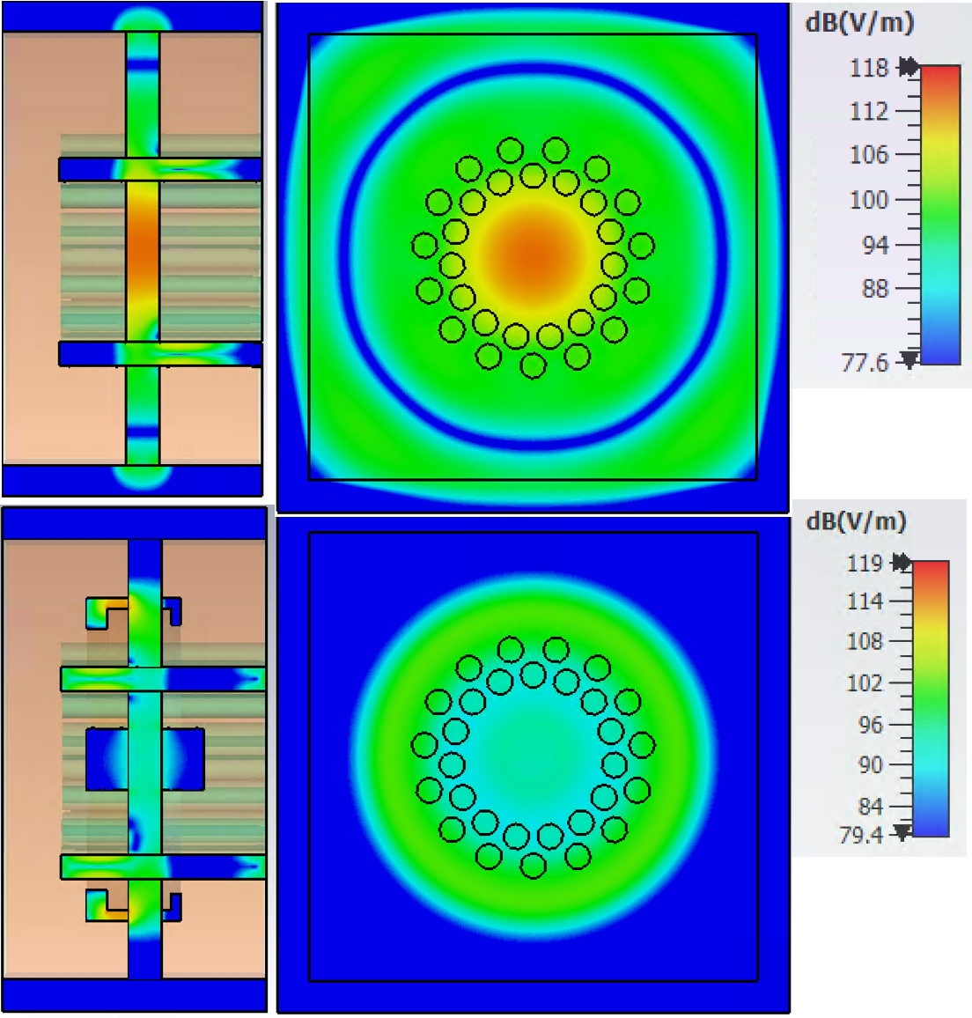
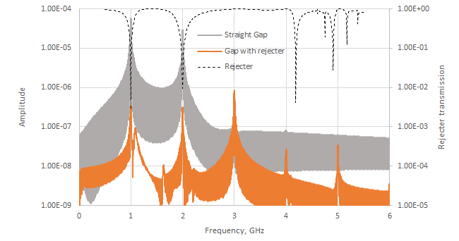

Radial gap RF isolation
Straight gap
Gap with rejector filter
Without rejector, about -21 dB of beam power would leak through DC gap.
The dual-harmonic rejection filter reduces this to -57 dB. Required mechanical tolerance: $±0.2 mm$ to stay below -50 dB.
I. Syratchev, J. Cai

Slide 17
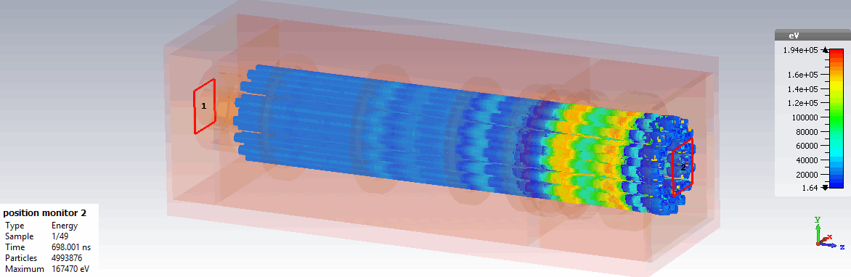
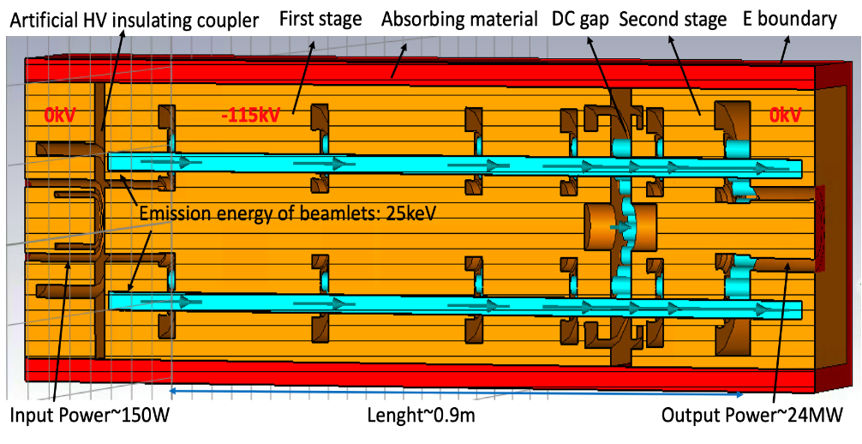
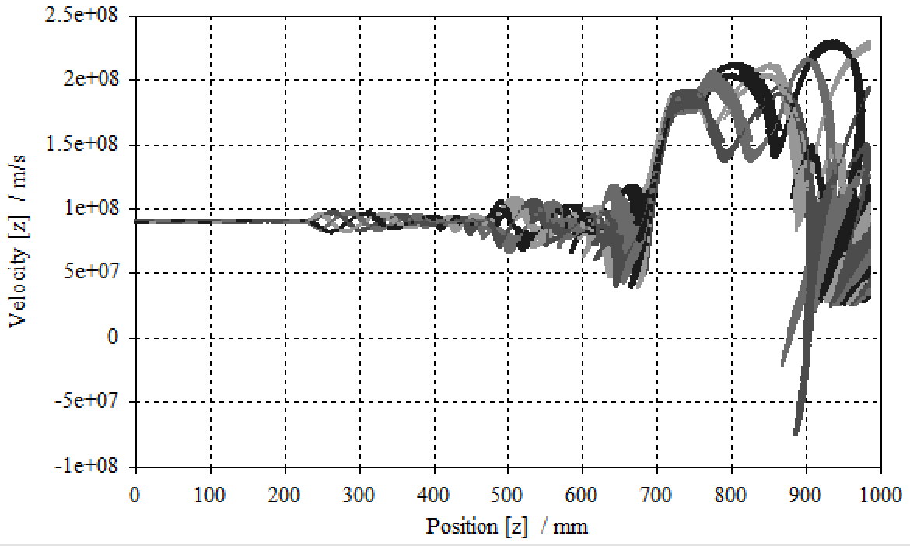
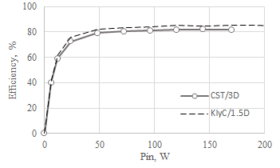
Example: 1 GHz, 24 MW TS-MBK:
Simulated overall performance
stage 1
stage 2
The record high efficiency of 82% is achieved in 3D PIC simulation

Slide 18
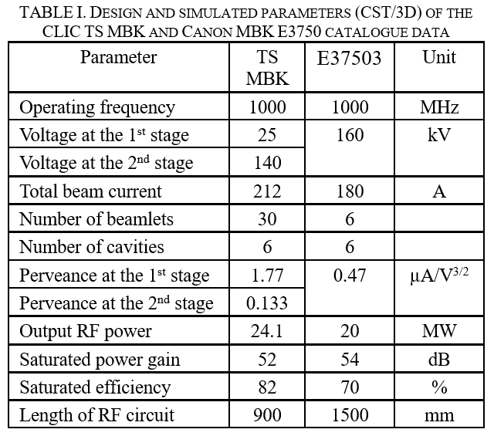
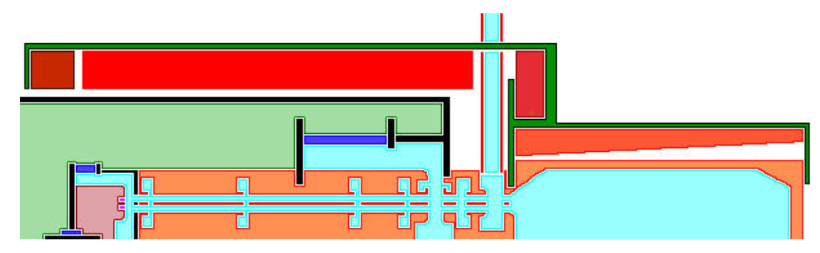
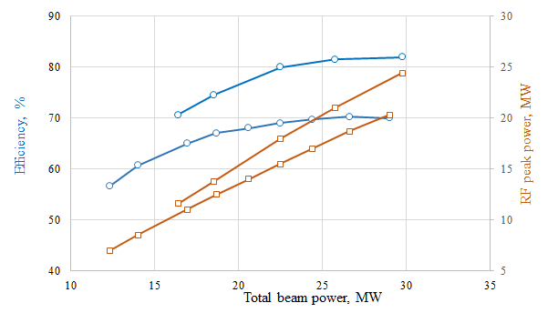
Example: 1 GHz, 24 MW TS-MBK
Magnetic circuit
Local oil tank
Cathode ceramic (25 kV)
Main solenoid
1st stage
2nd HV insulating ceramic (115 kV)
2nd stage
PA gap
Output waveguide
Output coil
TS MBK
Beam collector
Collector coil
E37503

Slide 19
Magnetrons?
Interesting, but I don’t feel competent to talk about magnetrons.

Slide 20
Solid State Power Amplifiers (SSPAs)

Slide 21
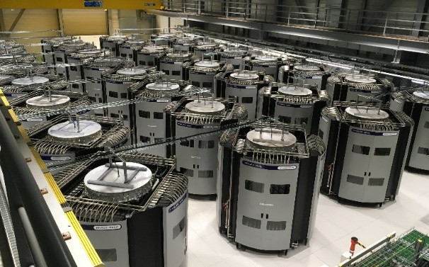
SSPA – today’s state of the art: CERN SPS 200 MHz
Present day technology: e.g. CERN SPS recent power upgrade: 4.6 MW with 32 SSPA towers, based on recent LDMOS technology and 80-fold cavity-combiners.
This approach was very successful, but was not (yet) optimized for energy efficiency.
E. Montesinos

Slide 22

SSPA – how to get to MW levels?
The single transistor level will probably remain in the 1 to 2 kW range.
The space requirement for the SPS system:
19 m x 36 m x 12 m for 4.6 MW!
Scaling to 100 MW would lead to impractical size!
Scaling to 100 MW would require combination factors $𝒪\left(100,000\right)$!
We need smaller, smart, scalable power combiners!

Slide 23
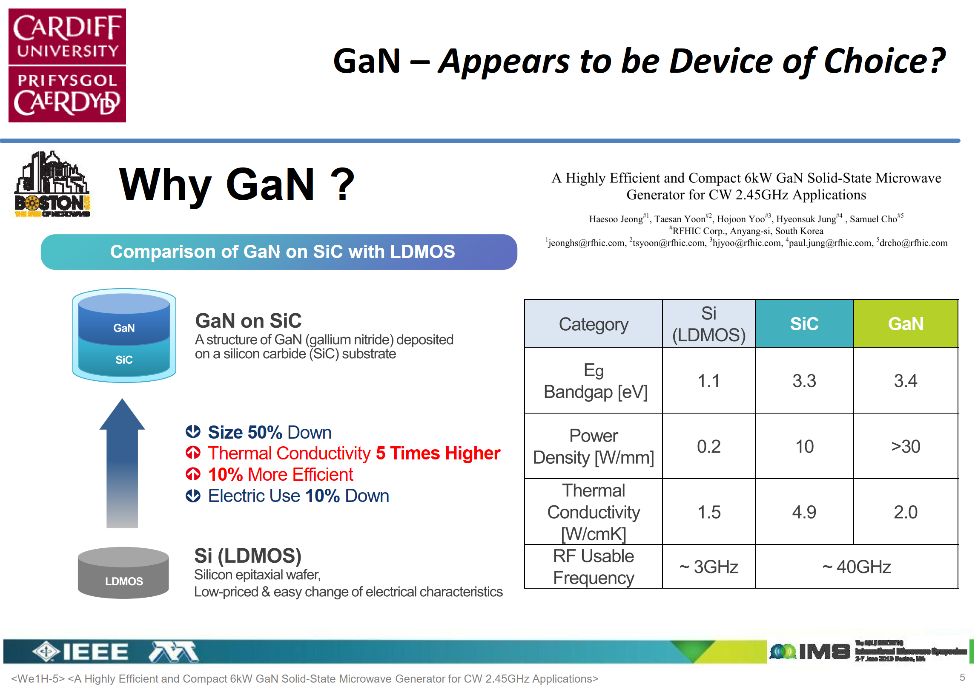
SSPAs – how to get to high efficiency?
Paul J. Tasker: “Technical limits of solid state efficiency,”
P. Tasker
https://indico.uu.se/event/515/contributions/760/

Slide 24
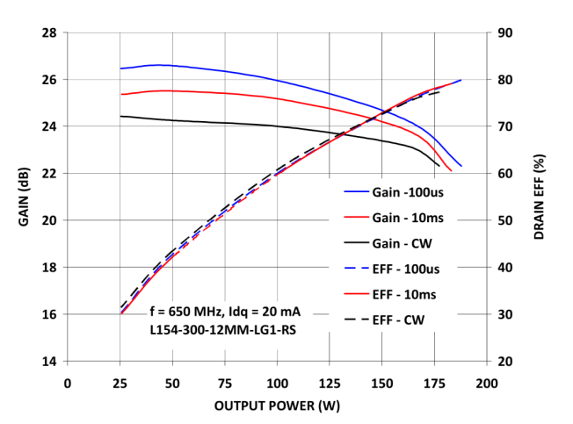

Efficiencies in SSPA’s
$μ_{PAE}=\frac{G−1}{G}×μ_{DE}$ (power added efficiency)
$μ_{DE}=μ_{mode,BW}×μ_{knee}×μ_{loss}$ (drain efficiency)
$μ_{mode,BW}$: dominated by mode chosen and impedance matching. Class F operation and matching multiple harmonics may lead to practical: 90%
$μ_{knee}$: impact of knee voltage ($≈1−{V_{min}}/{V_{DC}}$), typical for GaN: 97%
$μ_{loss}$: impact of matching/combining losses – target: 97.5%
Overall “realistic” but challenging target: 82%
G. Formicone (Integra): A Highly Manufacturable 75–150 VDC GaN-SiC RF Technology for Radars and Particle Accelerators https://ieeexplore.ieee.org/document/8440054
P. Tasker

Slide 25
Thank you very much for your attention!

