Slide 1
AF7 - Subgroup RF - miniWorkshop on RF Systems and Sources
Dec. 17, 2020
Sergey Belomestnykh
Emilio Nanni
Hans Weise

Slide 2
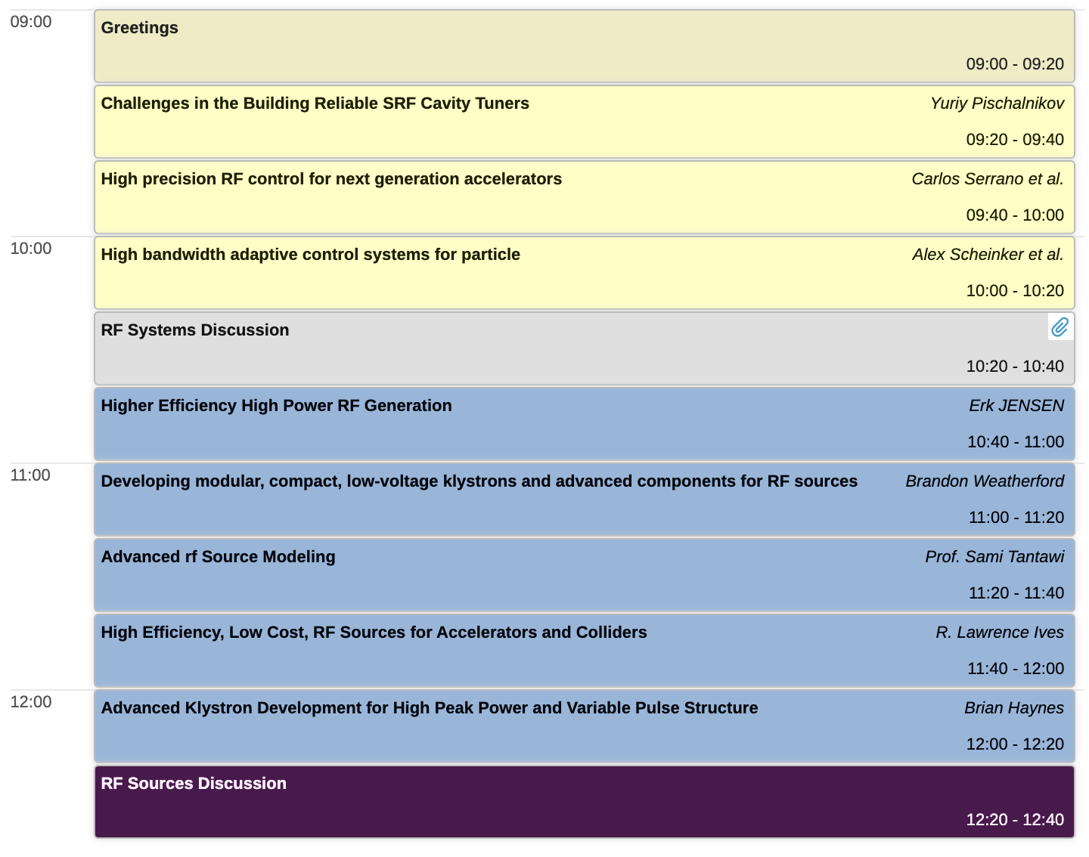
Agenda
20 minutes: overview of Snowmass, RF acceleration R&D sub-topic, upcoming activities

Slide 3
AF7rf: RF
Updates:
  Sergey Belomestnykh to replace Sam Posen as convener
  Congrats to Sam on new position and welcome Sergey!
  After CPM convener meetings to plan
  Contributed papers will be a major topic at workshops
Plans include :
Workshop on “Cavity Performance Frontier” – Feb. 16th Tentative
Workshop on “RF Sources & Auxiliaries” – Dec. 17th
  https://indico.fnal.gov/event/46775/
Workshop on “Innovative Design and Modelling” – Jan 26th Tentative
Upcoming:
  Joint workshops with other groups for other four categories, or have smaller mini-workshops
  Also plan to continue seminar series – see previous seminars at indico.fnal.gov/category/1117/

Slide 4
AF7-rf LISTSERV
Dear Snowmass Accelerator Frontier / RF Accelerator Technology (AF7-RF) enthusiasts,
Please sign up and encourage others who are interested in this topic to join the list by sending a “SUBSCRIBE SNOWMASS-AF7-RF firstname lastname” (without quotation marks and substituting “firstname lastname” with their first and last names) command to listserv@fnal.gov.
You may leave the list at any time by sending a "SIGNOFF SNOWMASS-AF7-RF" (without quotation marks) command to listserv@fnal.gov.

Slide 5
Snowmass
Snowmass is a long-term planning exercise for the particle physics community, organized by the American Physical Society (APS)
Opportunity for the entire particle physics community to come together to identify and document a vision for the future of particle physics in the U.S. and together with its international partners
Contributions provide important input that influences future projects and scientific programs.

Slide 6
Snowmass 2021 Organization
10 Frontiers
  Energy Frontier
  Neutrino Physics Frontier
  Rare Processes and Precision
  Cosmic Frontier
  Theory Frontier
  Accelerator Frontier
  Instrumentation Frontier
  Computational Frontier
  Underground Facilities
  Community Engagement Frontier

Slide 7
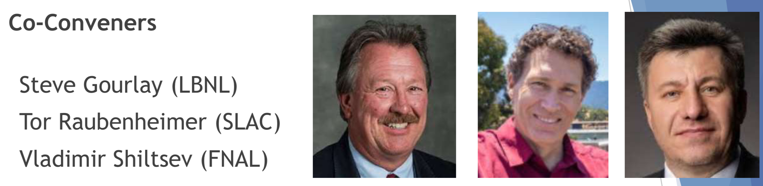
Snowmass Accelerator Frontier Organization
Frontier Conveners
Topical Group | Group Co-Conveners
AF1. Beam Physics and Education | Z. Huang (Stanford) | M. Bei (GSI) | S. Lund (MSU)
AF2. Accelerators for Neutrinos | J. Galambos (ORNL) | B. Zwaska (FNAL) | G. Arduini (CERN)
AF3. Accelerators for EW/Higgs | M. Ross (SLAC) | A. Seryi (JLAB) | Q. Qin (IHEP, Beijing)
AF4. Multi-TeV Colliders | M. Palmer (BNL) | A. Valishev (FNAL) | N. Pastrone (INFN, Torino)
AF5. Accelerators for PBC and Rare Processes | E. Prebys (UC Davis) | M. Lamont (CERN) | Richard Milner (MIT)
AF6. Advanced Accelerator Concepts | C. Geddes (LBNL) | M. Hogan (SLAC) | P. Musumeci (UCLA) | R. Assmann (DESY)
AF7. Accelerator Technology R&D
Sub-group RF | E. Nanni (SLAC) | S. Belomestnykh (FNAL) | H. Weise (DESY)
Sub-Group Magnets | G. Sabbi (LBNL) | S. Zlobin (FNAL) | S. Izquierdo Bermudez (CERN)
Sub-group Targets/Sources | Charlotte Barbier (ORNL) | Yin-E Sun (ANL) | Frederique Pellemoine (MSU/FNAL)

Slide 8
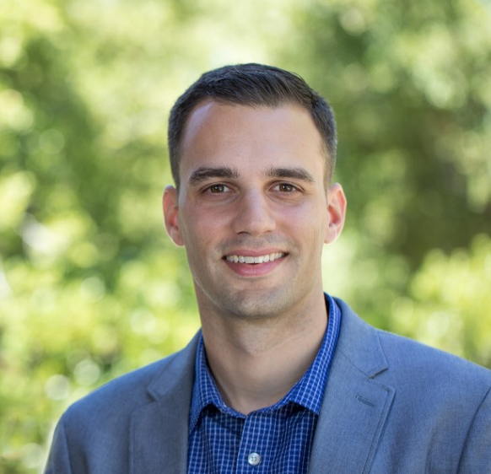
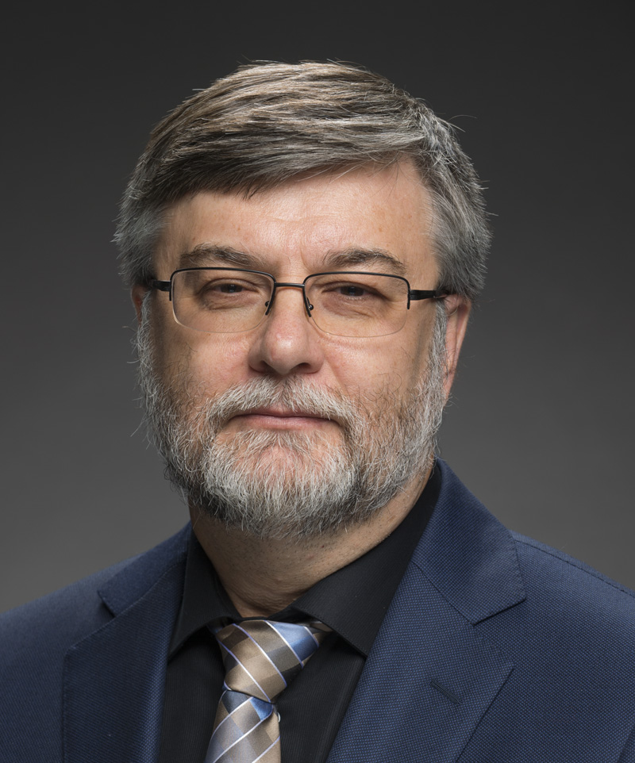
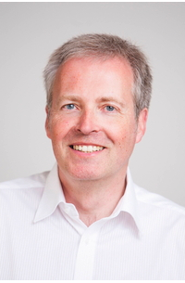
Accelerator Frontier 7: Accelerator Technology R&D
RF Subtopical Group
Accelerator Technology is the enabling foundation for accelerator-based HEP.
RF acceleration – primarily divided into SRF and NCRF, plus consideration for regions of overlap, e.g. RF sources
AF7 - RF Conveners
Emilio Nanni
SLAC
nanni@slac.stanford.edu
Sam Belomestnykh
Fermilab
sbelomes@fnal.gov
Hans Weise
DESY
hans.weise@desy.de

Slide 9
Snowmass Submissions
Snowmass submissions will take the form of Contributed Papers, such as white papers on specific scientific areas, with a maximum length of 10 pages each, due July 31, 2021 (THIS DATE MAY CHANGE)
Contributed papers are typically expected to be preceded by Letters of Interest (LoI), with a maximum length of 2 pages each, due August 31, 2020
We encourage LoI submitters to form teams for contributions (where appropriate)
Rally support behind contributions from others

Slide 10
Impact of Submissions
Snowmass is our opportunity to inform the community on R&D opportunities in our field
DOE’s P5 will follow Snowmass and utilize this information to lay out a decadal vision
  Accelerator Subpanel deliberations during the last P5 made a significant impact on resources for R&D
Contributions will have more impact if community works together
https://snowmass21.org/loi

Slide 11
miniWorkshop on RF Systems and Sources
Goal of this workshop:
  Discuss the submitted LOIs in this topic
  Learn about future research plans
  Discuss important HEP technical challenges
  Strategize as a community for our collective contribution to Snowmass
Events will be held in coming months for additional categories of LOIs submitted to AF7-rf.

Slide 12
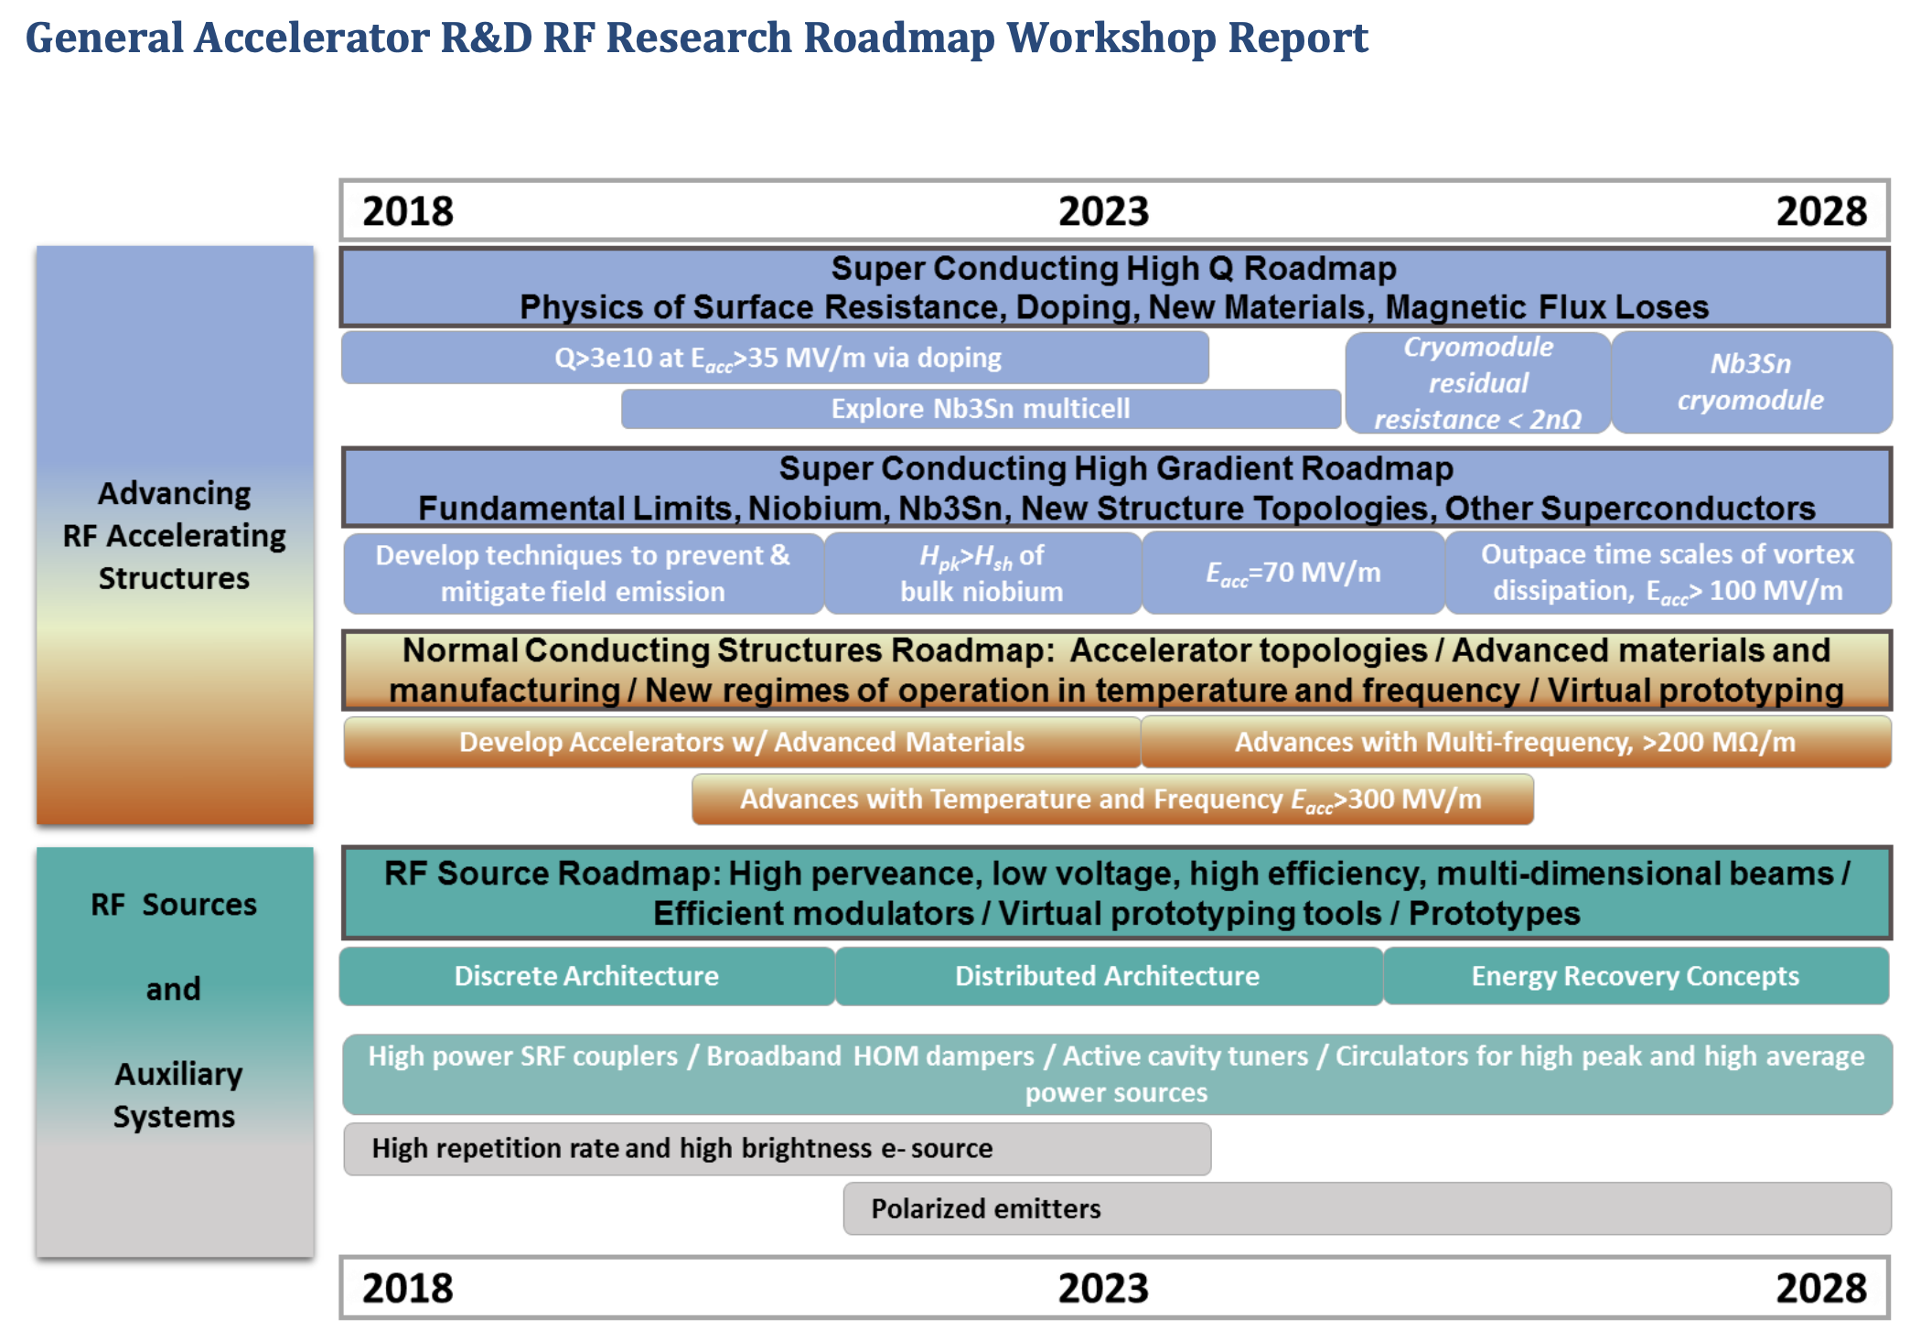
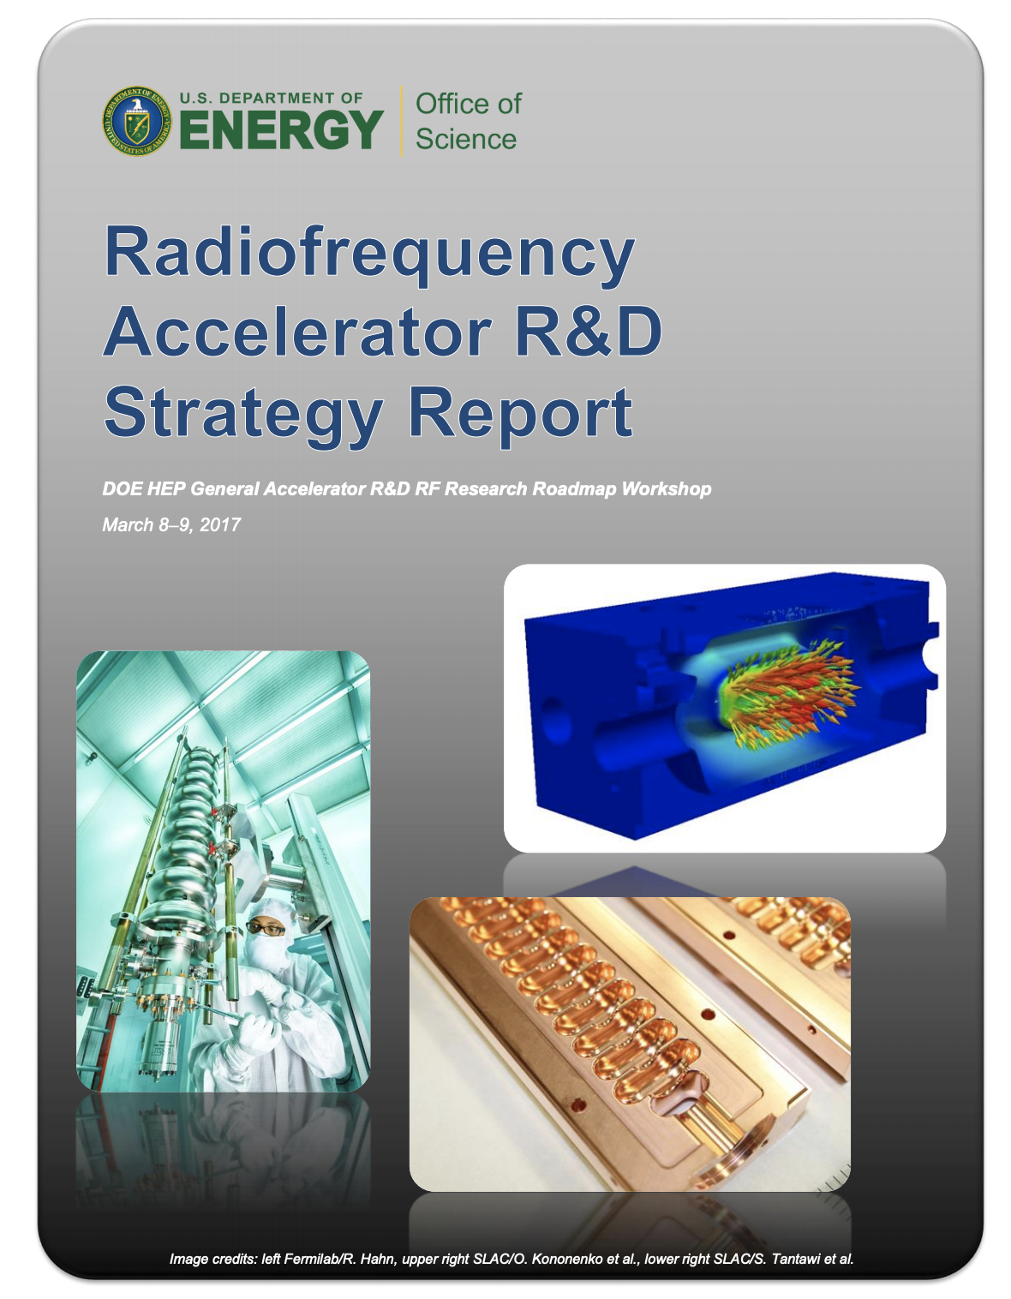
GARD RF Acceleration R&D Roadmap
Structure some discussion around DOE RF Accelerator Roadmap
  Does it capture the right topics / are we making progress?
In addition explore new or overlooked concepts/topics

Slide 13
GARD-RF R&D alignment with future HEP particle accelerators

Slide 15
Resources
Snowmass website, including upload for LOIs and contributed papers – https://snowmass21.org/start
Slack Channel – https://snowmass2021.slack.com/
GARD Roadmap https://www.osti.gov/servlets/purl/1631119
Snowmass 2013 proceedings – https://www.slac.stanford.edu/econf/C1307292/

Slide 16
Questions / Discussion Topics
Questions on Contributed Papers?
What contributions are you considering?
Can we build teams to submit contributions with strong impact?
What would those categories be for RF Systems and Sources?
Who or what would you like to hear from for future seminars ?

