Slide 1
a unique facility for neutrino physics and muon-collider test bed

Slide 2
Neutrinos from stored muons
Scientific objectives:
  %-level (ν_{e}N) cross sections
    Double differential
  Sterile-neutrino/BSM search
    Beyond Fermilab SBN
Precise neutrino flux:
  Normalisation: < 1%
  Energy (and flavour) precise
π ⇢ μ injection pass:
  “Flash” of muon neutrinos

Slide 3
The opportunity
nuSTORM will be a unique facility:
  %-level electron and muon neutrino cross-sections
  Exquisitely sensitive sterile neutrino searches
  Muon collider demonstrator and technology test bed
Feasibility of executing nuSTORM at CERN:
  Established through Physics Beyond Colliders study
nuSTORM: a step towards the muon collider:
  Proof-of-principle and test bed for stored muons for particle physics
  Ionization cooling:
    Experimental demonstration of 6D ionization cooling
      Required in p-driven neutrino factory and muon collider

Slide 4
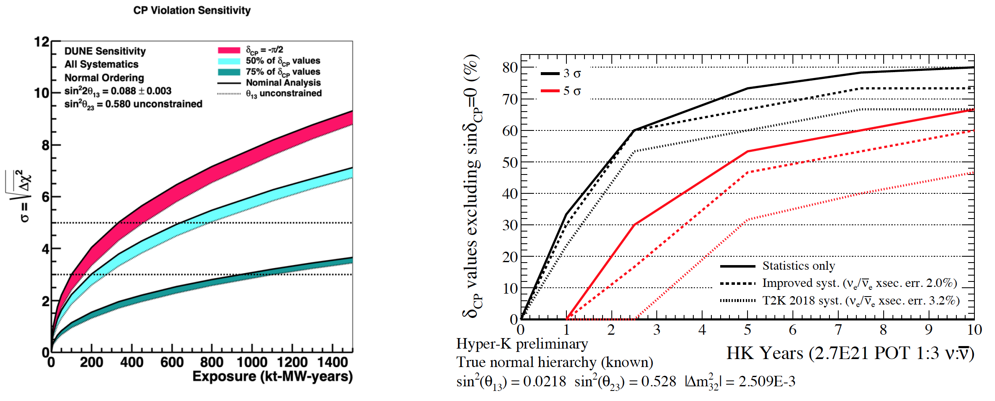
Search for CPiV in lbl oscillations
In search for CPiV in lbl experiments …
Lack of knowledge of cross-sections leads to:
  Systematic uncertainties; and
  Biases; pernicious if ν and ν differ
11

Slide 5
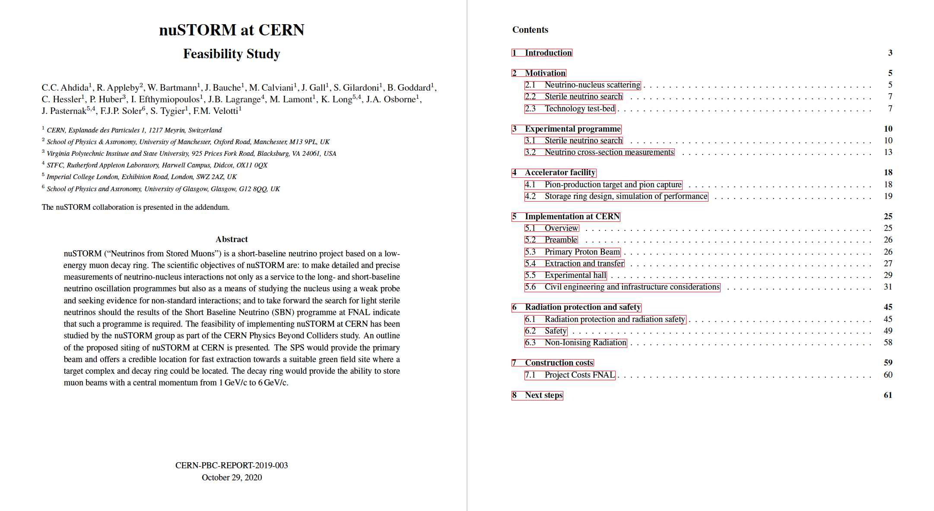
Collaboration list presented in appendix
(updated from Snowmass LoI author list, see later)

Slide 6
Specification: energy range
Guidance from:
  Models:
    Region of overlap
    0.5—8 GeV
  DUNE/Hyper-K far detector spectra:
    0.3—6 GeV
Cross sections depend on:
  Q² and W:
    Assume (or specify) a detector capable of:
      Measuring exclusive final states
      Reconstructing Q² and W
    → E_{μ} < 6 GeV
So, stored muon energy range:
DUNE
Hyper-K
HyperK
1 < E_{μ} < 6 GeV

Slide 7
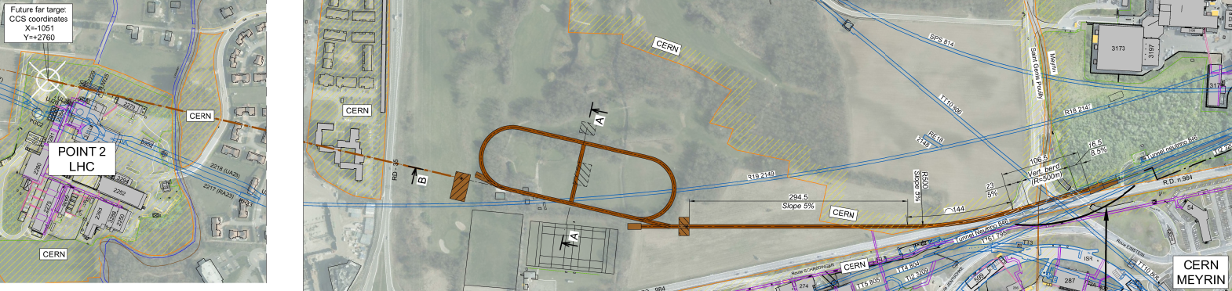
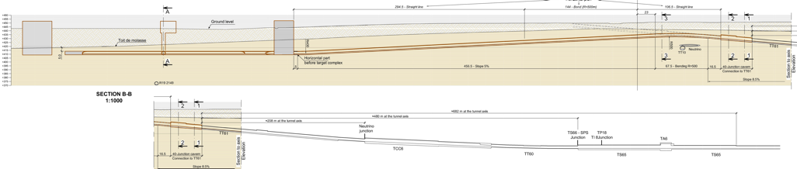
Overview
CERN-PBC-2019-003
Extraction from SPS through existing tunnel
Siting of storage ring:
  Allows measurements to be made ‘on or off axis’
  Preserves sterile-neutrino search option

Slide 8
Accelerator

Slide 9
Neutrino flux
10.1146/annurev-nucl-102014-021930
ν_{μ} flash:
  Pion: 6.3 × 10¹⁶ m⁻² at 50m
  Kaon: 3.8 × 10¹⁴ m⁻² at 50m
    Well separated from pion neutrinos
ν_{e} and ν_{μ} from muon decay:
  ~10 times as many ν_{e} as, e.g. J-PARC beam
  Flavour composition, energy spectrum
    Use for energy calibration

Slide 10
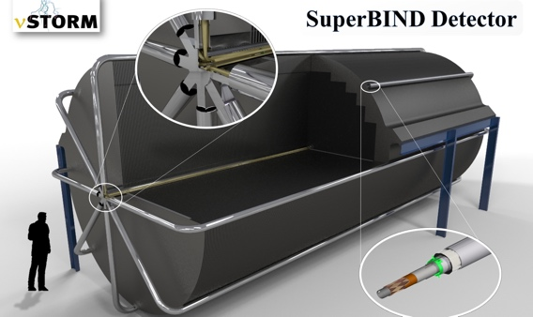
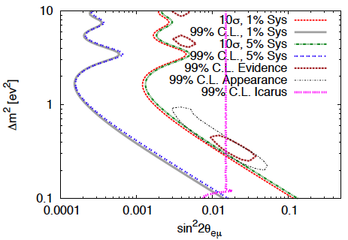
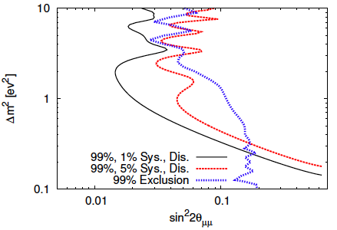
Sterile neutrino search @ FNAL
Adey et al., PRD 89 (2014) 071301

Slide 11
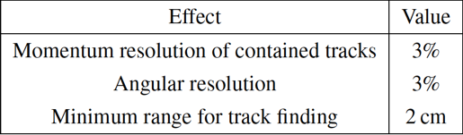
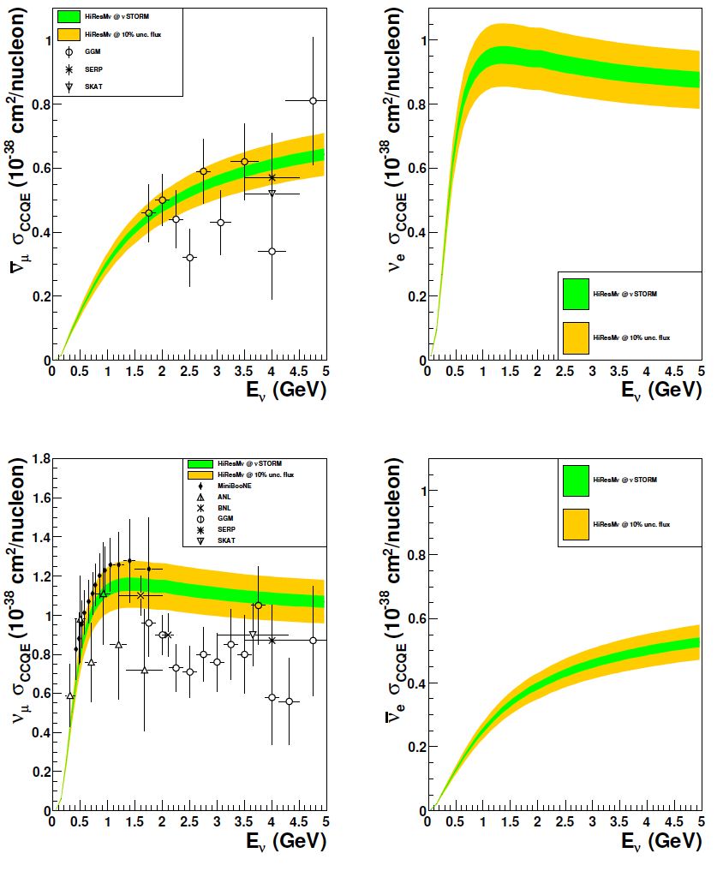
CCQE measurement at nuSTORM
10.1103/PhysRevD.89.071301; arXiv:1305.1419
1% & 10% flux
uncertainty
CCQE at nuSTORM:
  Six-fold improvement in beam systematic uncertainty compared with (present) “state of the art”
  Electron-neutrino cross section measurement unique(ish)
Require to demonstrate:
  ~<1% precision on flux
Cf/synergy with EnuBET
Individual ν_{e} measurements from T2K and MINERvA
[10.1103/PhysRevLett.113.241803, 10.1103/PhysRevLett.116.081802 ]

Slide 12
Americas: 29
Asia: 7
Europe: 81
Total: 117

Slide 13
European Strategy for PP update
High-priority future initiatives
Other essential scientific
activities for particle physics
Opportunity …
Exploit synergies:
Articulate the need
Common requirement:
Advanced neutrino detector
Andrea Longhin, Neutrino 2020

Slide 14
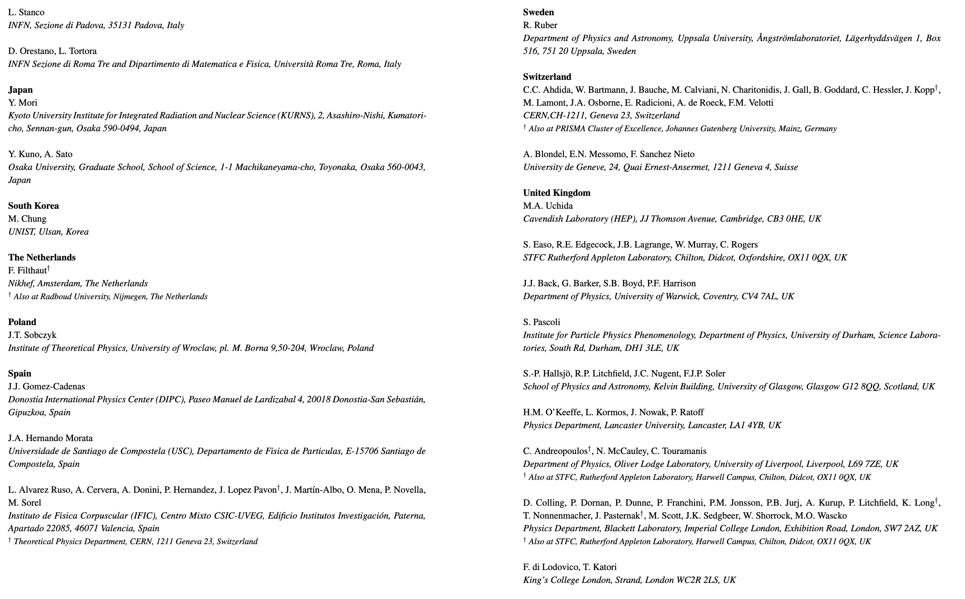
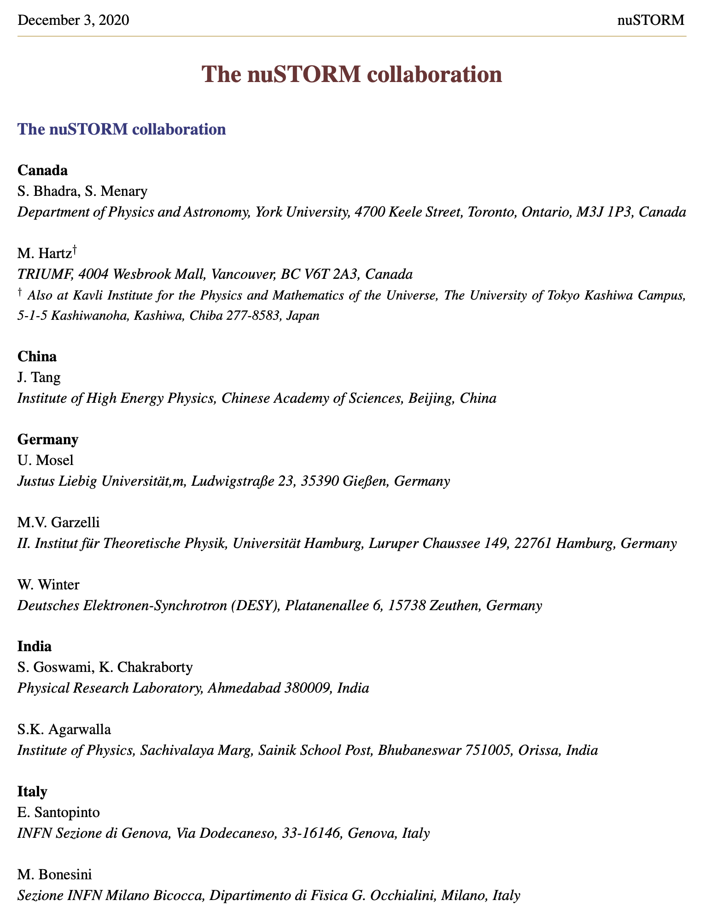
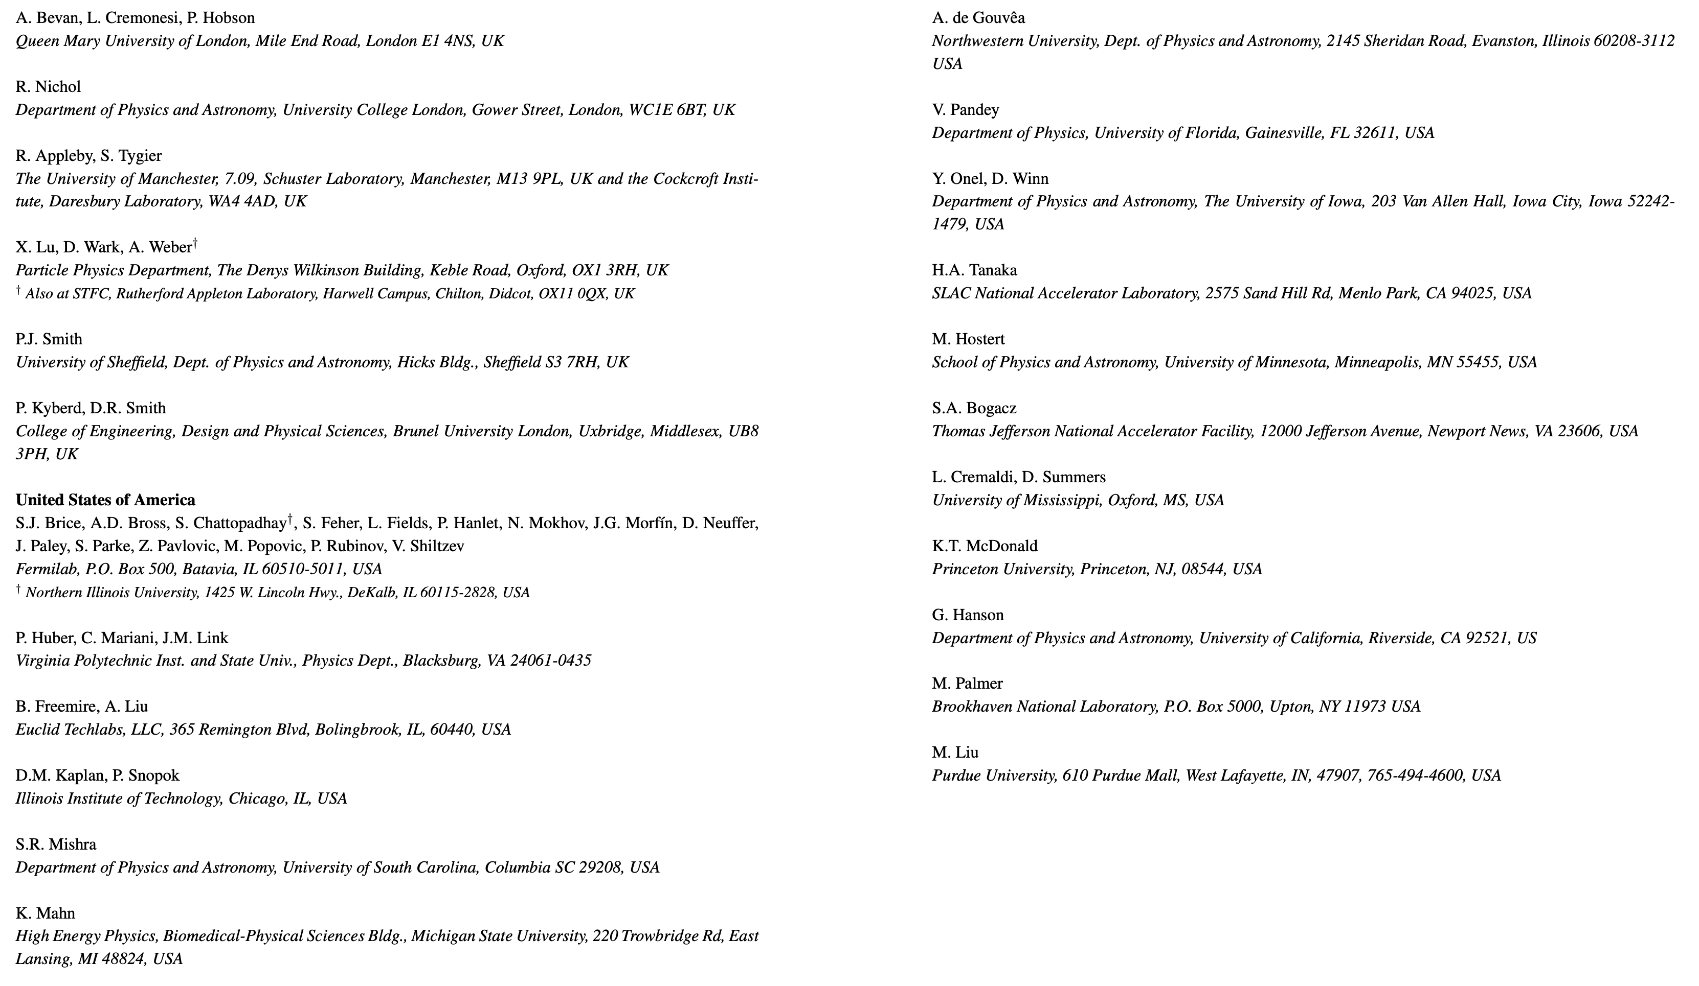
Americas: 40
Asia: 8
Europe: 90
Total: 138

Slide 15
Muon collider: benefit and options
Benefit:
  Fundamental fermion:
    Cf pp beam energy available in collision
Options:
  Proton driven (MAP); positron driven (LEMMA)
Personal conviction:
  Programme requires demonstrators of increasing complexity

Slide 16
nuSTORM as part of the muon collider programme
European Strategy for Particle Physics
update
Development of
muon collider requires:
  Technology demonstrator(s) and R&D test bed(s)
nuSTORM:
  Is the first in the required series of demonstrators; and
  Delivers important physics measurements too

Slide 17
nuSTORM as muon-collider test bed
R&D that could be supported by nuSTORM facility:
Target and capture
Large-aperture ring
  Demonstrator for, e.g.:
    LEMMA accumulator ring, muon acceleration ring, …
6D cooling experiment to follow MICE
Storage-ring instrumentation:
  Luminosity, polarization, energy spectrum, …

Slide 18
Moving forward
Building activities to address three threads (pillars):
  Physics:
    Cross section
    BSM:
      Sterile, but more broadly
  Detectors:
    Cross section and BSM
      Common requirement: exclusive final state detection
  Accelerator:
    nuSTORM from SPS to beam dump
    Muon collider test bed and technology demonstrator
Now planning an IPPP workshop:
  Physics with high-brightness muon beams:
    Afternoons of 11/12 February 2021 … to be announced

Slide 19
Conclusions
nuSTORM will be a unique facility:
  %-level electron and muon neutrino cross-sections
  Exquisitely sensitive sterile neutrino searches
  Serve 6D cooling experiment & muon accelerator test bed
Feasibility of executing nuSTORM at CERN:
  Established through Physics Beyond Colliders study
nuSTORM: a step towards the muon collider:
  Proof-of-principle and test bed for stored muons for particle physics
  Ionization cooling:
    Experimental demonstration of 6D ionization cooling
      Required in p-driven neutrino factory and muon collider

Slide 21
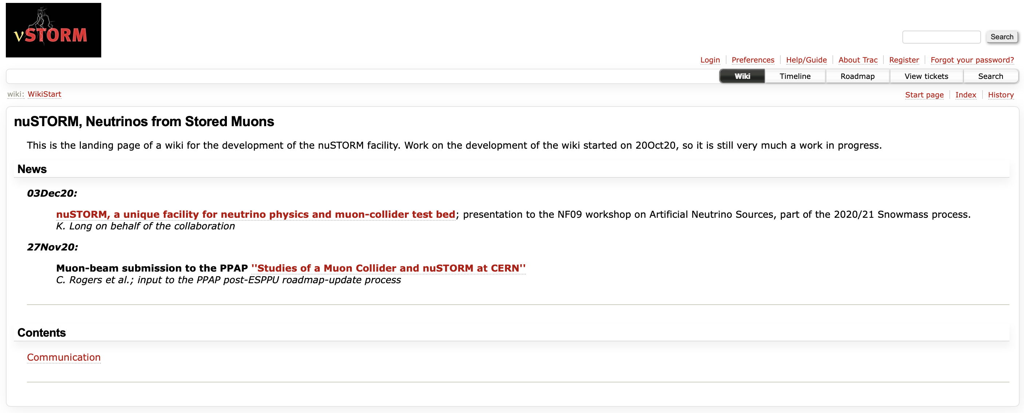
https://www.nustorm.org/trac/

Slide 22
