Slide 1
Towards a Quantum Internet
Panagiotis Spentzouris
Computational Science Seminar
December 9th, 2020

Slide 2
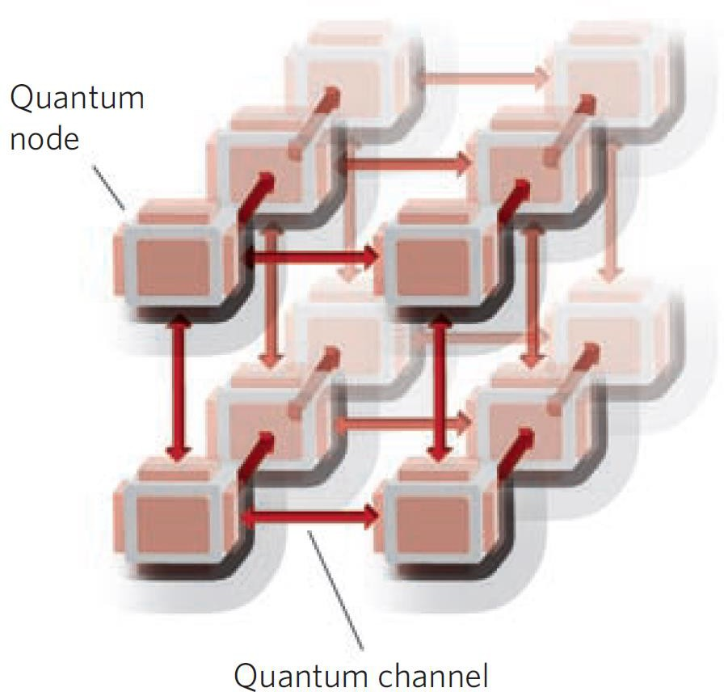
Quantum network
Quantum nodes: quantum information is stored and processed
  “atoms”
    stationary qubits
Quantum channels: quantum information is transported
  Photons
    flying qubits
This picture is missing the classical channels necessary for a functional quantum network
  photons
H. J. Kimble, Nature 453, 1023 (2008)

Slide 3
The Quantum Internet
What will it do
  Connect any 2 points on earth via quantum communications
What is it
  A network of quantum networks (over arbitrarily long distances)
How will it do it
  Interconnect nodes based on heterogeneous set of technologies
  Enable the realization of a diverse set of quantum protocols that will allow quantum resources (sensors, processors, …) to form networks
    Most likely operating in parallel with the classical internet
Why build it
  to achieve capabilities beyond what is achievable through classical means

Slide 4
Quantum networks bring new capabilities and enable new applications
Sensing
Crypto functions
Distributed clocks
Interferometry
optical and IR telescope arrays
Cosmology
…
Quantum Key Distribution
Leader election
Byzantine agreement
…
Low bandwidth
High bandwidth
Quantum Computing (QC)
Blind QC
Client-server QC
Distributed QC
…
High to very high bandwidth

Slide 5
Quantum network deployment - I
It is desirable to take advantage of existing telecom fiber infrastructure (cost)
  coexistence with classical info
No cloning theorem results in significant transmission distance limitations for quantum information communication
  transmissivity of fiber channels scales exponentially with distance, rates at most ~ transmittivity
For general quantum network applications rely on entanglement distribution and teleportation for quantum communications, to protect the “fragile” quantum information

Slide 6
Teleportation for Quantum Communications
Quantum teleportation is the disembodied transfer of a quantum state (not the qubit carrier!)
“Alice” has a photon in an arbitrary qubit state (information to be transmitted)
“Bob” has an entangled pair of photons
“Charlie” entangles Alice’s qubit with one of Bob’s in a Bell state measurement
Alice’s quantum state is teleported to Bob’s other photon
  after unitary operation, requiring 2 bits of classical info

Slide 7
Quantum network vs p2p quantum communication
Addressing resources
  naming
Resource management
Topology awareness
  dealing with out-of-date information
  Discovery
Routing
Heterogeneity
  In technology, resources
Operations robustness
Scale

Slide 8
Example quantum network use case: entanglement distribution
Distribute Bell pairs on request across the network:
  Need to select a path (routing)
  Plan set of operations
  Convey operations steps to nodes
    Utilize node characteristics
  Constraints/assumptions
  Links are heterogeneous and not a priori known
  Resource management

Slide 9
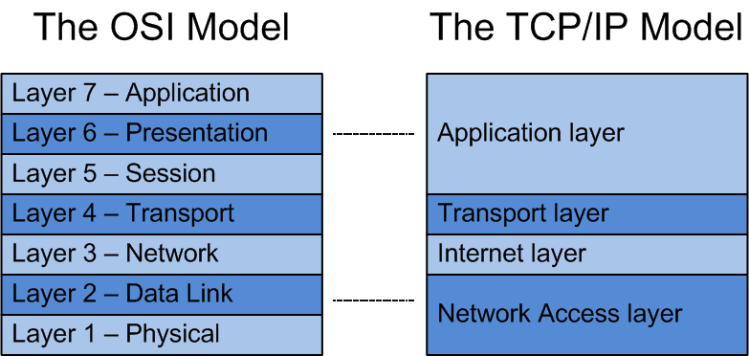
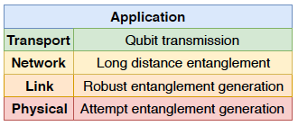
Quantum Network deployment - II
R&D is needed at every level
  Devices, …, systems
  Architecture, network model, protocols
classical
quantum
conceptual protocol
SIGCOMM '19: Proceedings of the ACM Special Interest Group on Data CommunicationAugust 2019 Pages 159–173https://doi.org/10.1145/3341302.3342070

Slide 10
Physical Layer components
Lasers
Entangled photon pair sources
  E.g crystals (SPDC)
Single-photon detectors
  E.g SNSPD
Bell state analyzers
Wavelength converters
  To telecom wavelengths
Transducers
Quantum memories that emit photons entangled with qubit states
Quantum gates
Building blocks for quantum nodes & quantum repeater nodes

Slide 11
Quantum Repeaters
Facilitate end-to-end entanglement in the network
  Realize entanglement over a physical link
  Link entangled-links to realize application
Contribute to managing loss and operation errors
Different schemes & different physical implementations

Slide 12
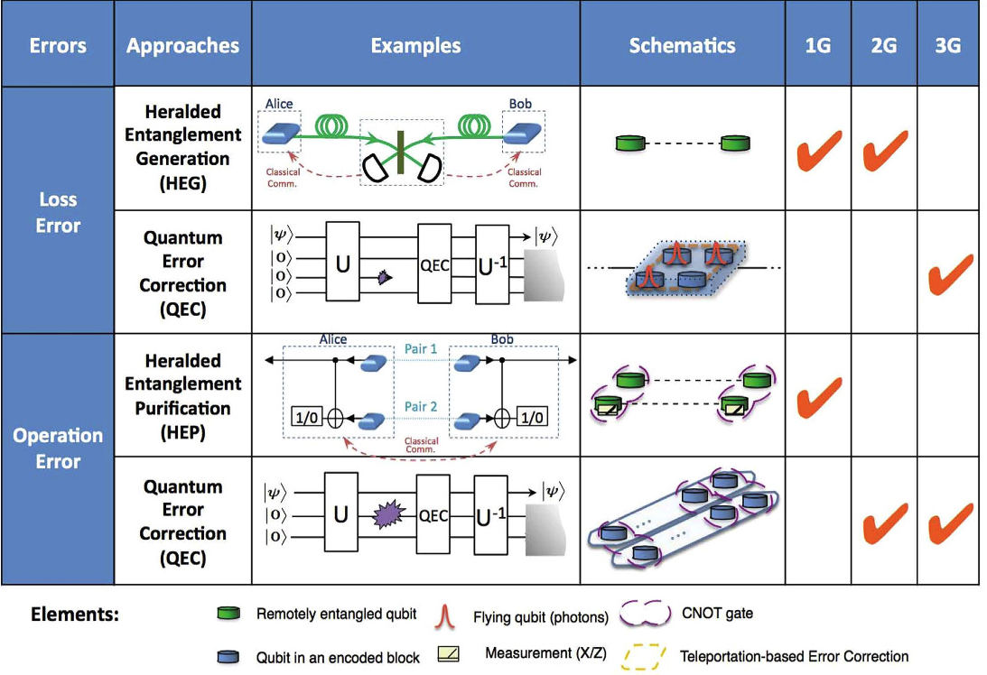
Repeater architectures
Link
network
Muralidharan, et al; Scientific Reports | 6:20463 | DOI: 10.1038/srep20463

Slide 13
Still working on first generation deployment
Many challenges, both intrinsic (protocol) and hardware performance limitations
  Entanglement success probability is low
  Large number of round trips in protocols
  Few qubits per node, memory lifetime
  Getting & keeping a Bell pair to the left at the same time as Bell pair to the right to enable swapping
  Getting & keeping two Bell pairs for purification
  Gate errors in both purification and swapping

Slide 14
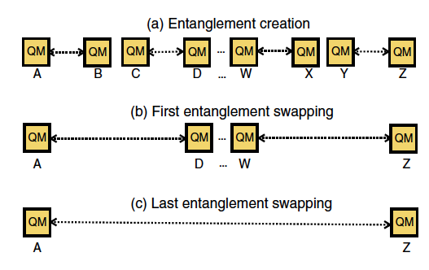
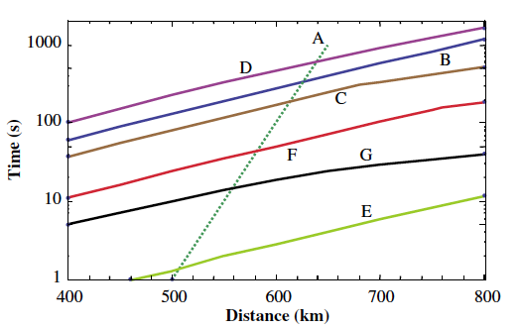
Performance characteristics vary, even within generation and implementation, based on protocol
E.g performance of first-generation protocols, evaluated using atomic ensemble characteristics:
time required for distributing a single entangled pair as a function of distance for different protocols for the same set of assumptions
Direct transmission
Images from Review of Modern Physics, vol 83, Jan-March 2011

Slide 15
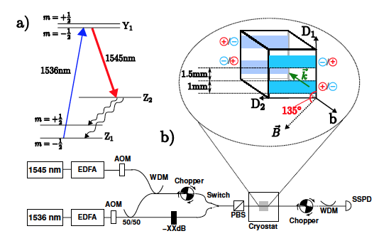
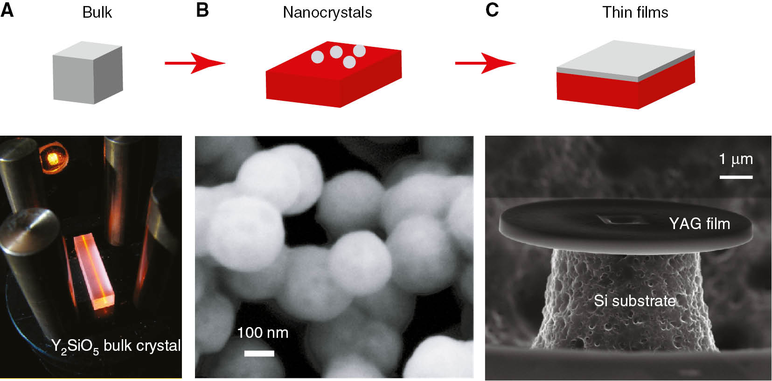
Quantum memories
Function of quantum memory:
  convert a flying qubit into a stationary qubit
  store the quantum state for the required time
  convert the stationary qubit back into a flying qubit at a required time
  Also, can convert a heralded single-photon-pair source into a deterministic source
Variety of schemes and implementations, cross-cutting R&D needs
Image from Phys. Rev. Lett. 104, 080502782 (2010).
Image from https://doi.org/10.1515/nanoph-2019-0185 .

Slide 16
Quantum Memory approaches
Technology | Efficiency | Bandwidth | Storage time | Fidelity | Implementation/scaling
Atomic Gas |  |  |  |  | Pulse shaping, vapor cells
Cold Gas |  |  |  |  | Cryogenics, atom trapping, laser cooling
Raman Gas |  |  |  |  | pulse shaping, vapor cells
Rare Earth Doped crystal |  |  |  |  | Cryogenics
NV centers in diamond |  |  |  |  | Nanofabrication
Quantum Dots |  |  |  |  | Nanofabrication, cryogenics
Trapped atoms |  |  |  |  | Atom trapping
Metric range | >0.8 0.3-0.8 <0.3 | >GHz O(100MHz) <10MHz | >1ms O(100μs) O(10ns) | >0.9 0.8-0.9 <0.8 | Showing currently demonstrated values, not limits

Slide 17
Technology stack
R&D areas for realizing quantum repeater networks, targeting efficiency and operations stability (robustness)
Quantum Memories | Coupling to photons (transduction) | Heralded storage |  | Portability, scalability
Entanglement Stations | Entanglement source (rate, efficiency) |  | Single photon detectors (fast, timing resolution)
Lasers | Fast, stable, locking over long distance
Monitoring and Control | Fast timing and feedback, automation |  | Support stable and robust operations
Integration | Scalable memory & entanglement stations |  | System integration for high-efficiency, low noise operations
Requirements for rate and operation parameters are application dependent

Slide 18
The case for developing and deploying a repeaterless Quantum Network
The majority of R&D projects in the area of Quantum Communications and Networks focuses on technology development and point-to-point communication demonstrators. There is great need to develop architecture for fully dynamic and automated quantum networks and deploy using existing technologies to demonstrate capabilities for secure communications, quantum sensing, and distributed quantum computing in metropolitan scales (deployable without the need of mature repeater technologies)
Advancing network architecture, system design, system integration
  With deployment and testing for real world applications in realistic environment
Pushing the limits of device and system performance to achieve fidelity and operational robustness toward applications beyond the “demonstrator” stage

Slide 19
Testbeds for technology development: IEQNET
web site: https://ieqnet.fnal.gov
Design & develop a repeaterless transparent optical quantum network in the Chicago metropolitan area that demonstrates quantum network capabilities beyond point-to-point communications.
Architecture allows to incorporate new components as they become available
Funded by ASCR (Sep 2019), leveraging HEP and AT&T investment and capabilities though the INQNET program.

Slide 20
Technical Approach
Support multi-node, flexible, and resilient network configuration
Support multi-user operation
Adopt a layered architecture and a centralized control
  Decouple control and data planes
Design and implementation for an automated dynamic network
  Control and management software for routing and quantum channel assignment, dynamical path establishment, and entanglement distribution
  Software-defined networking (SDN) enabled optical switches, multi-wavelength entangled photon sources, precision controls of qubit DOFs
Coexist with traditional networks in the same optical transmission systems
CV/DV and hybrid encoding

Slide 21
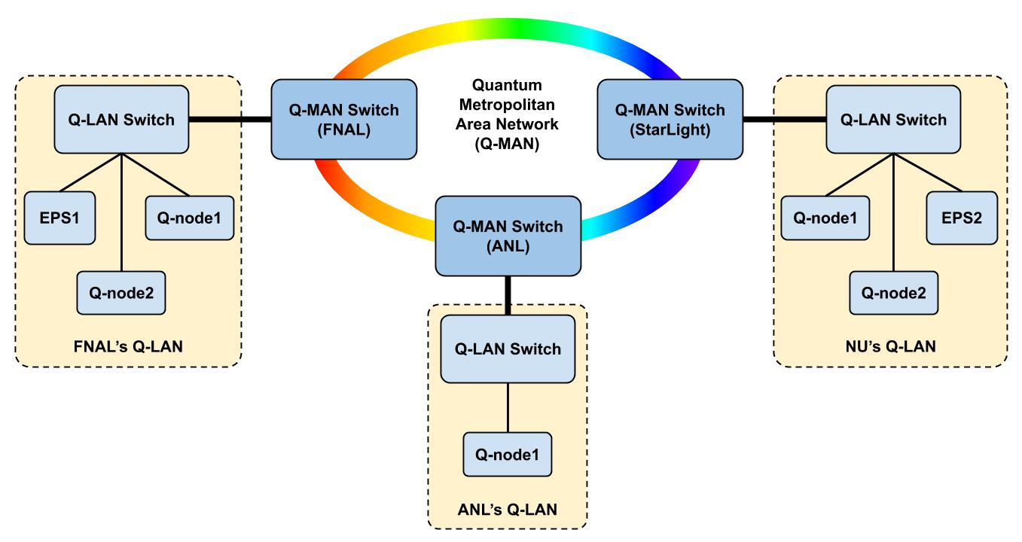
IEQNET Topology
web site: https://ieqnet.fnal.gov

Slide 22
Architecture examples: Q-Node Design - I
Q-nodes represent the communication parties in quantum networks.
A Q-Node performs both conventional and quantum functions.

Slide 23
Q-Node Design - II
Quantum Functions (building blocks) of an IEQNET Q-node (composable):
Entanglement generation
BSM (interfere 2 pulses)
Qubit receiver (measure single pulse in a q basis)
Qubit sender
Qubit generator
Note that the current IEQNET design does not employ quantum memories or repeaters.

Slide 24
Q-Node Design – III
Classic Functions (building blocks) of an IEQNET Q-node:
Addressing & identification
Classical communication
  quantum measurement auxiliary information
  timing information
Synchronization and stabilization
Classical computation
  Processing of the classical information
Network resource reservation (through interactions with SDN controller)

Slide 25
SDN-based control plane - I
Discovery and build up network topology
Path routing and wavelength assignment for classic and quantum channels
Discovery & Build up
Network Topology
Wavelength
Routing & Assignment
Establish
Optical/quantum paths

Slide 26
SDN-based control plane – II
Optical plane: optical switches
Control plane: SDN controller
Features required:
  Automatic node discovery & registration
  Automatic neighbor discovery
  Automatic network change detection & notification
IEQNET
ONOS
Controller
Driver
NETCONF
O-sw1
O-sw2
Q-node 1
O-sw2
Q-node 2
Q-node 3

Slide 27
SDN-based control plane – III
Path Routing and Wavelength Assignment
  Establish optical connections between Q-Nodes
Optical paths types
  Quantum channels
  Classical channels
    CLK channels
    Classical communication channels
      BSM results
      SYN messages to handle various mismatches

Slide 28
SDN-based control plane– IV
Wavelength Routing and Assignment (RWA)
We represent the network by an undirected graph, G.
  Each node in the graph → a node in the network.
    Insertion loss, Polarization dependent loss, PMD
  Each edge in the graph → a link in the network
    Link length, Total number of wavelengths, number of wavelengths available, Loss
RWA is typically formulated as a multicommodity flow problem
  NP-hard problem, typically solved with heuristic algorithms
IEQNET considers the following algorithm
  The set of shortest paths between a source-destination pair is ordered in some manner
  The set of wavelength is ordered in some manner
  A new connection is routed on the first path on which a wavelength is available
  Among the set of available wavelengths on that path, the first one is selected, or the one that meets the requirement is selected
  If no path, or no wavelength can be found, the connection is considered blocked

Slide 29
IEQNET entanglement distribution use case
NU Q-node 2 communicates to IEQNET controller
  Classical channel
IEQNET controller establishes channels between NU Q-node 2, FNAL Q-node 2, and EPS
  Quantum channels
  Classical channels
Channel confirmation and verification
  NU Q-node-2, FNAL Q-node 2, EPS, IEQNET controller
EPS starts to send entangled photons to NU Q-node 2 and FNAL Q-node 2
NU Q-node 2 and FNAL Q-node 2 can verify entanglement by measuring their photons and announcing the outcome
Command & Control

Slide 30
Q-node deployment and implementation
Leverage deployment and R&D at the FQNET and CQNET teleportation experiments
  Optical photonic qubits over telecom fiber, cutting edge single photon detectors (SNSPD), electronics and control systems developed for HEP experiments
  Achieving excellent teleportation fidelity and record stability of operations for p2p communications in lab controlled environment

Slide 31


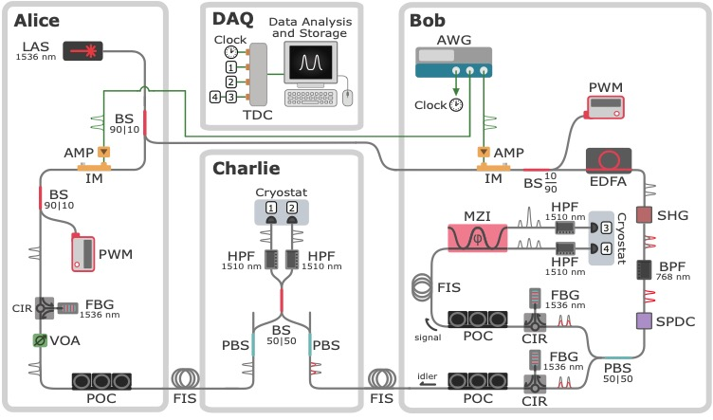

CQNET-setup
Fiber coupled of-the-shelf components combined with state-of-art detectors.
Setup aims towards compatibility with deployed networks.
High fidelity teleportation over 44 km using time-bin qubits.
R. Valivarthi et al., PRX Quantum 1, 020317 (2020)."
Notes:
Briefly describe the motivation behind the thesis and the aim of this project.

Slide 32


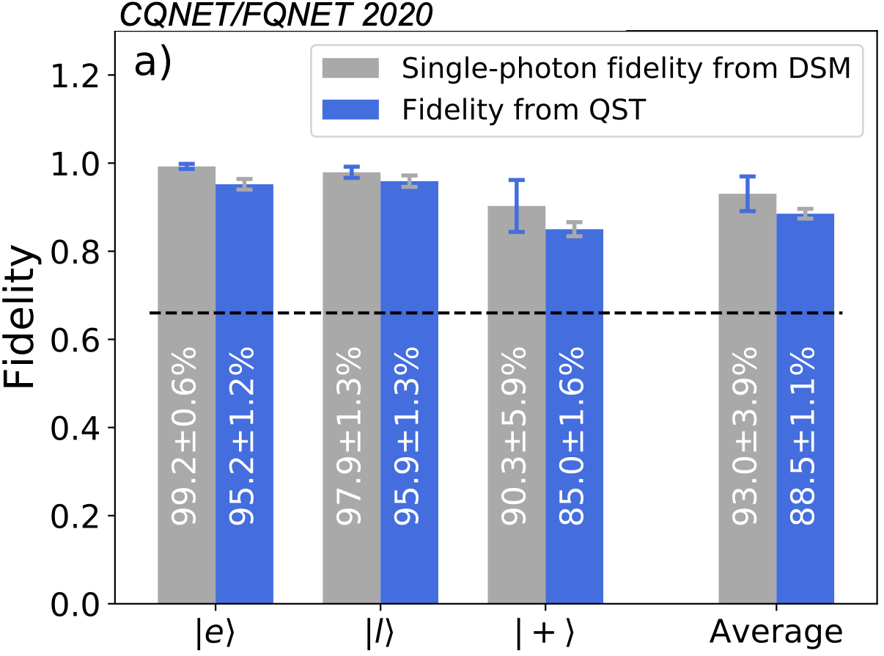
Results
Record time-bin qubit teleportation fidelities over metropolitan scale distance of 44 km.
Fidelities determined from quantum state tomography measurements.
Single photon fidelities extracted using decoy state analysis.
R. Valivarthi et al., PRX Quantum 1, 020317 (2020)."
Notes:
Dos gráficos en una mismo slide entran en conflicto de tamaños. El de pastel se convirtió en un punto y el de barras tomó protagonismo. Al mostrar los valores, éstos no se muestran centrados como solían hacer antes.

Slide 33
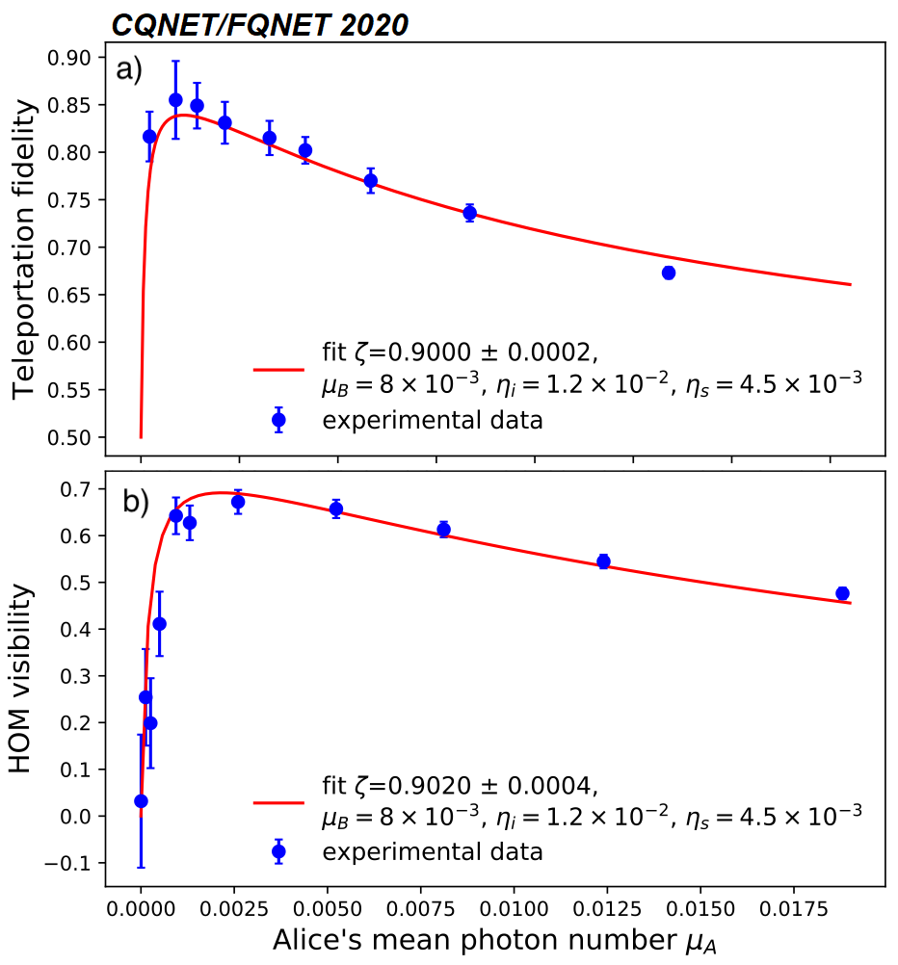
Results
Derived analytical model that includes all relevant experimental imperfections, such as detector inefficiencies, transmission losses and photon distinguishability.
Model was used to identify straight-forward improvement directions towards ideal fidelities.
R. Valivarthi et al., PRX Quantum 1, 020317 (2020)."
Notes:
Dos gráficos en una mismo slide entran en conflicto de tamaños. El de pastel se convirtió en un punto y el de barras tomó protagonismo. Al mostrar los valores, éstos no se muestran centrados como solían hacer antes.

Slide 34

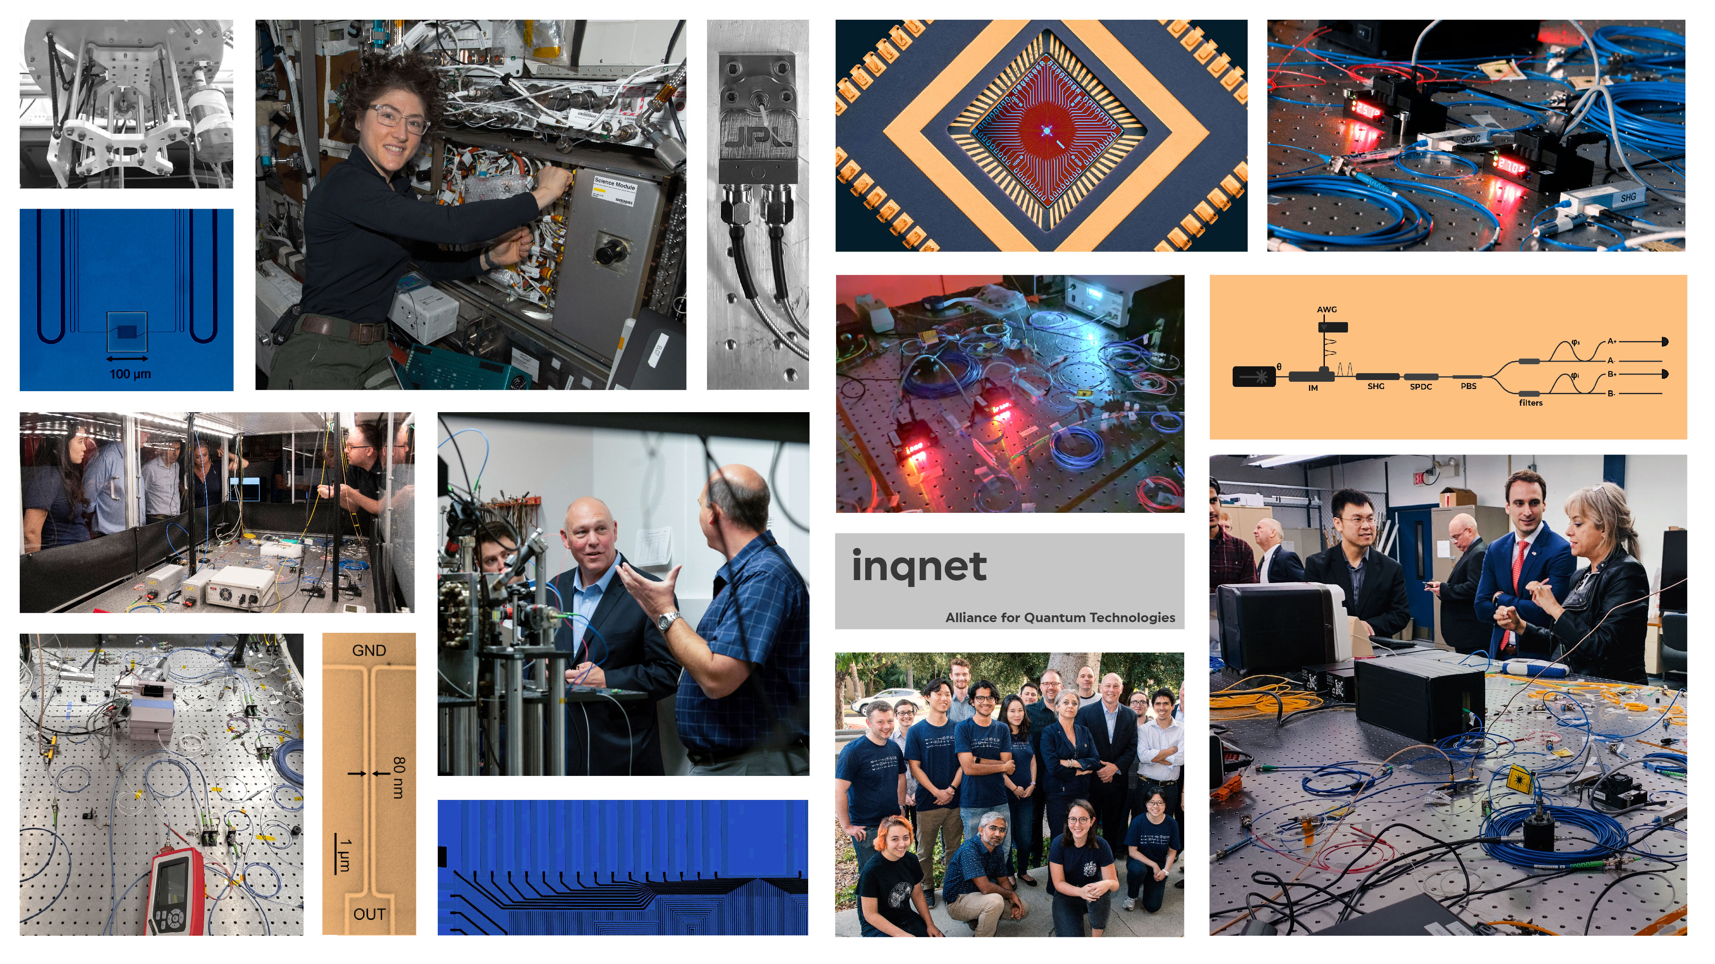
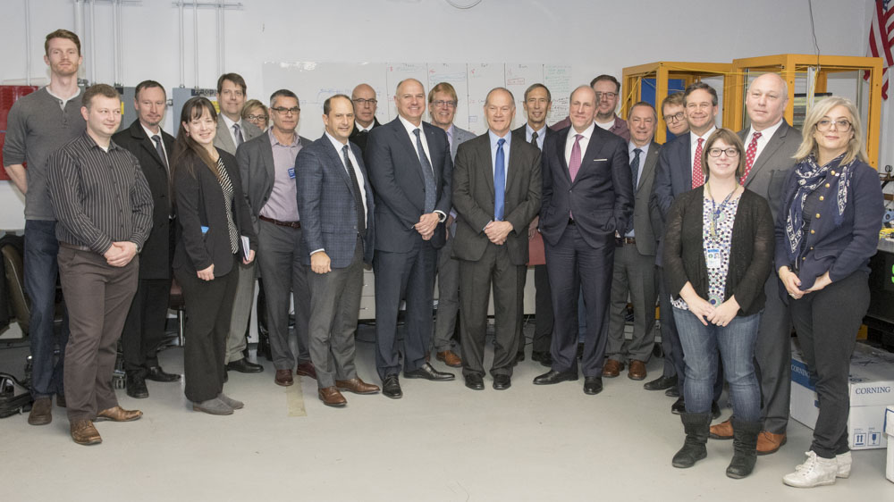
Partnership (academia/lab/industry) supported the efforts leading to these results

Slide 35
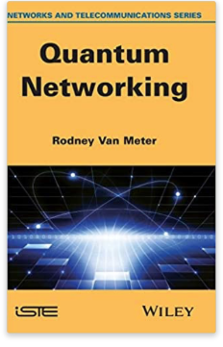
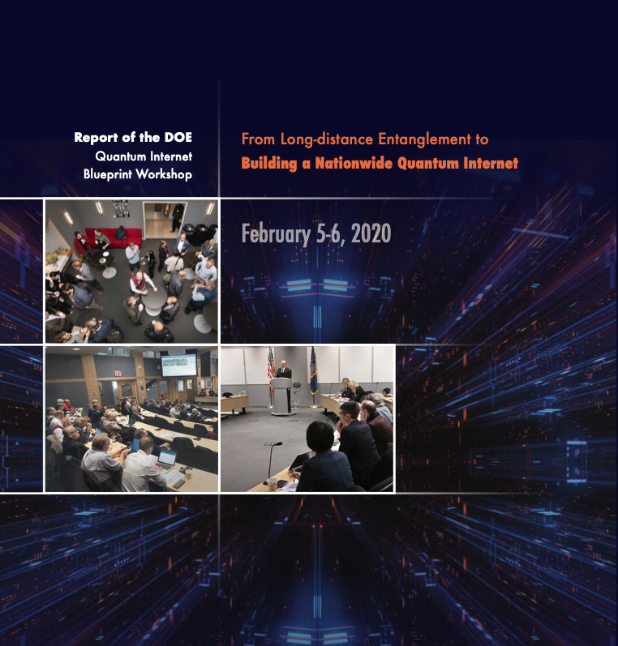
Suggested references
“Quantum Networking” by Rodney Van Meter
DOE Quantum Internet Workshop Report
  https://www.energy.gov/sites/prod/files/2020/07/f76/QuantumWkshpRpt20FINAL_Nav_0.pdf

Slide 36
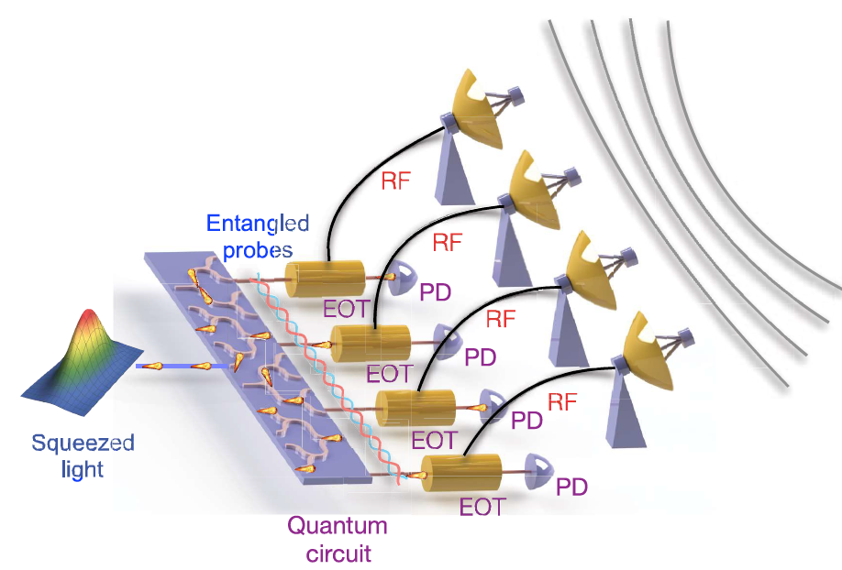
Quantum Sensor Networks
A sensor network exploits the correlations across the sensors to enhance the sensitivity and measurement capabilities of the system, with potential applications measurements that require
  estimating many parameters at once (or a function of those parameters), e.g. nanoscale nuclear magnetic resonance imaging
  measuring global parameters e.g. mapping magnetic fields, phase imaging, precision clocks
In general, sensor networks require end nodes with local memory and controls that allow implementation of complex protocols, multipartite entangled states, entanglement distillation, and deterministic teleportation
Both discrete-variable (DV) and continuous-variable (CV) multipartite entanglement protocols have been developed
Demonstration using entangled radiofrequency (rf) photonic sensor network with multipartite CV entanglement to enhance precision of measuring the rf wave’s properties.
  A concept demonstrator, not a general sensor network use case (no repeater or memory employed)

Slide 37
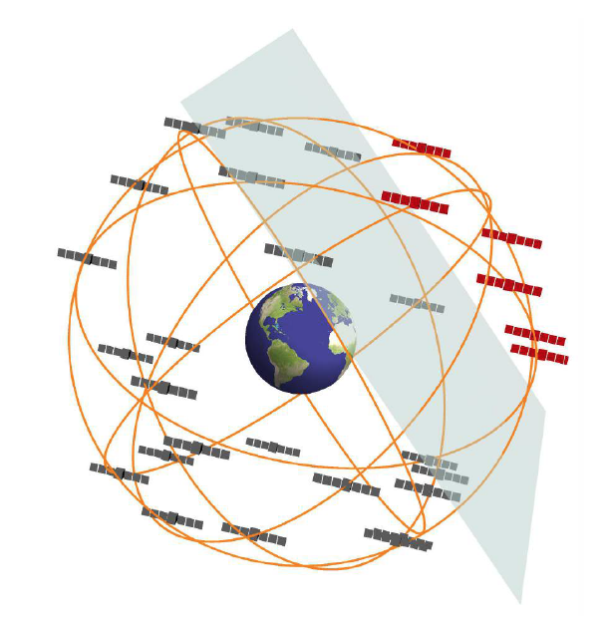
Networks of atomic clocks
A network of atomic clocks could achieve transformational improvements in precision and security over conventional classical solutions
  Standalone atomic clocks already close to the SQL
  quantum-correlated states of remote clocks yield the best possible clock signal allowed by quantum theory
Applications of such networks enable
  a world platform for time and frequency metrology
  improved gravity models for earth sciences
  investigations of fundamental laws of nature, such as relativity, the connection between quantum and gravitational physics
  Searches for macroscopic dark matter objects
Realization of such a quantum network requires several advances in quantum network technology
  quantum links with high repetition rate and fidelity capability for entanglement distribution
  quantum repeaters and entanglement purification.
  Applications could involve space flight capable nodes, generating additional technology development requirements.
Image from Nat Commun 8, 1195 (2017).

Slide 38
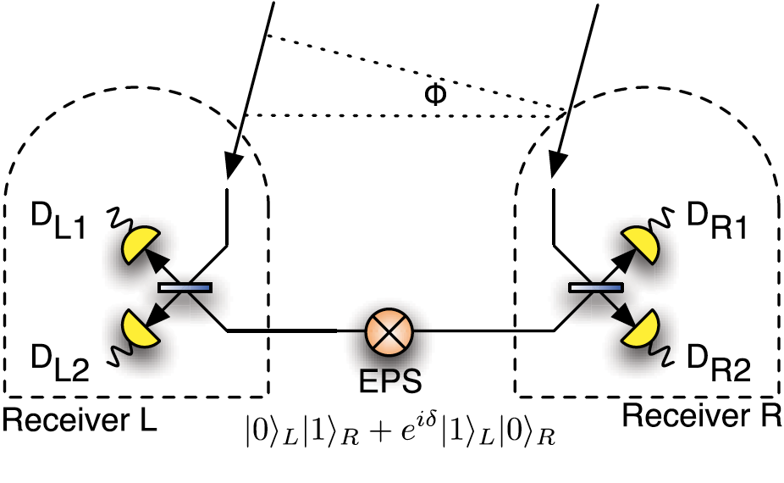
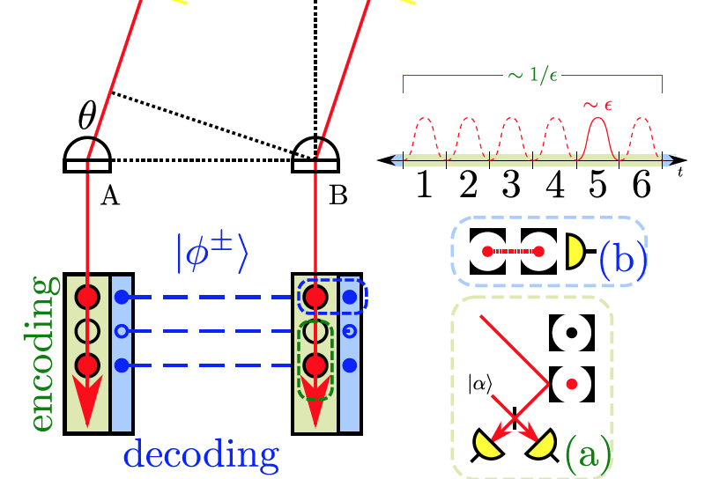
Networks enabling sensor phase information transfer
Applications take advantage of improved baseline for interference measurements of optical and IR interferometric telescope arrays
  studies of active galactic nuclei, improved sensitivity parallax measurements to enhance knowledge of stellar distances, and imaging of extra-solar planets.
Initial concept involved long-baseline optical telescopes, requiring
  quantum teleportation and quantum repeaters
  entanglement distillation and repeater protocols to control noise and losses.
A more recent approach employs quantum memories allowing for
  relaxation of the entanglement rate requirements
  also extending applicability to more than two sites.
Fundamental physics applications: assuming discovery of dark matter waves, determine instantaneous wave fronts and directions of propagation to map their distribution in the galaxy.
  spatially extended wave front manifests as non-local correlations in the field displacements at distributed detector sites
Image from PRL 109, 070503 (2012)
Image from Phys. Rev. A 100, 022316

Slide 39
Quantum Network evolution timeline
Define stages of quantum internet development based on the requirements for the specific network functionality
For each stage incorporate R&D for optimizing performance
  Including deployment specifics (distance, scale)
Goal to transform time ordered stack to a timeline with milestones, including R&D, testbeds, and demonstrators

