Slide 1
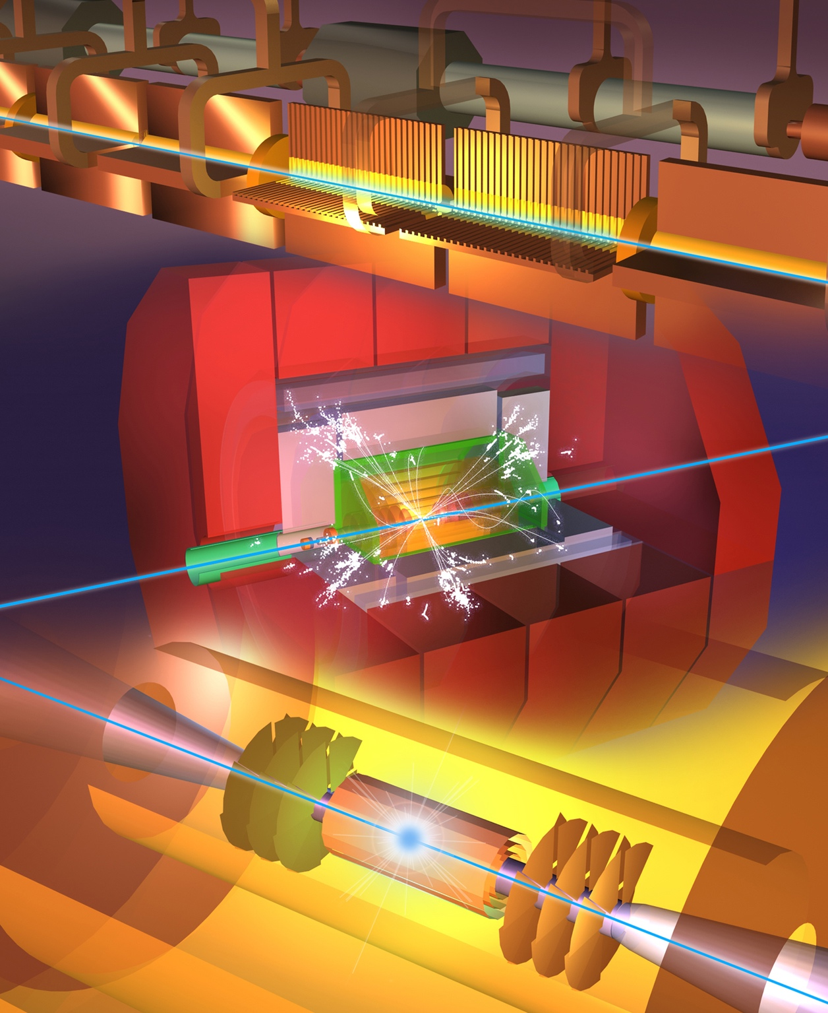
Steinar Stapnes
on behalf of CLIC
The Compact Linear Collider (CLIC)
Outline
CLIC stages
Schedule estimates
Additional slides on technical areas an plans (extras)
Additional slides on power, cost and energy (extras)
Snowmass
December 15th, 2020

Slide 2
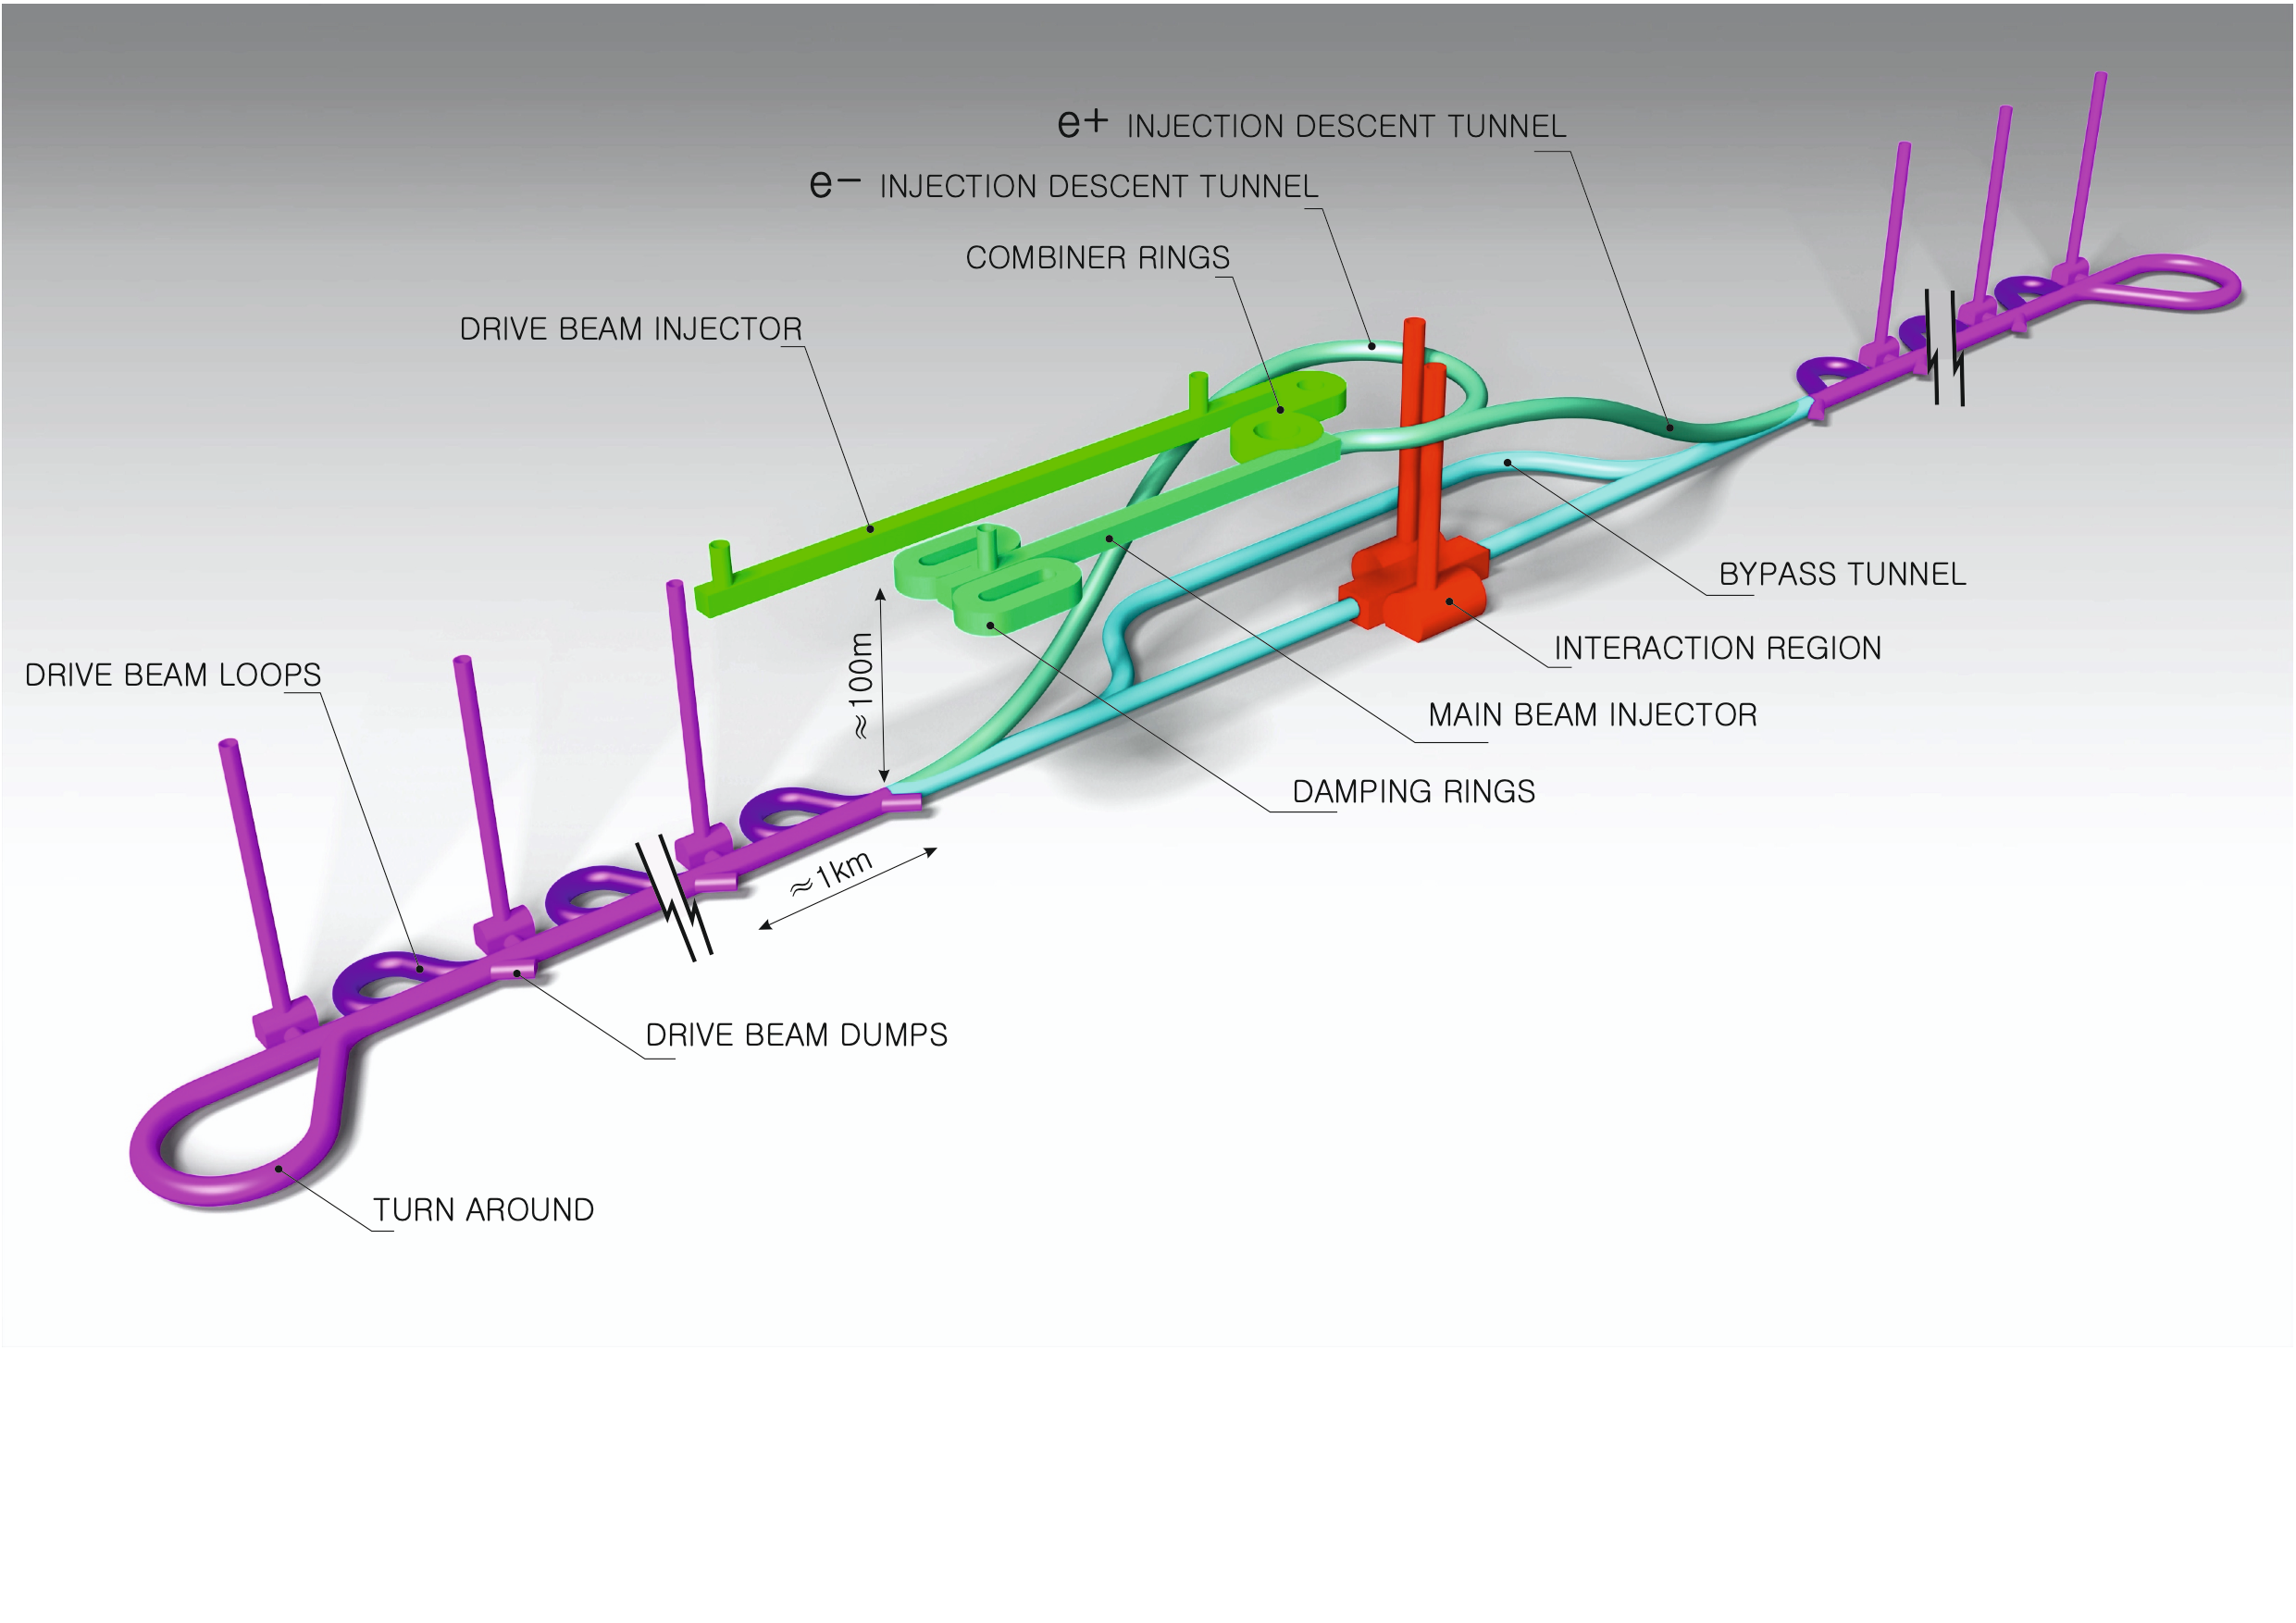
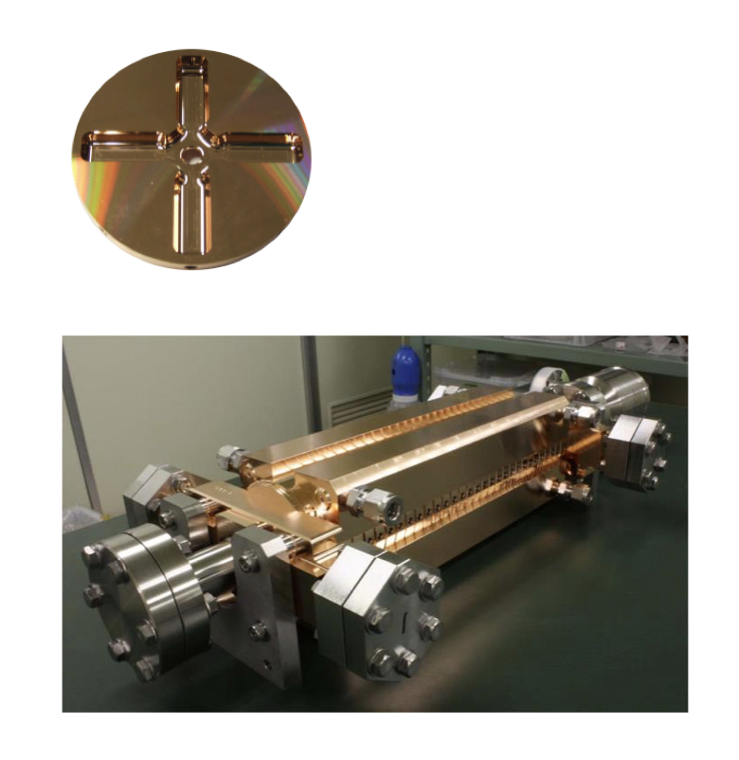
Proposed e⁺e– linear colliders – CLIC
The Compact Linear Collider (CLIC)
  Timeline: Electron-positron linear collider at CERN for the era beyond HL-LHC (~2035 Technical Schedule)
  Compact: Novel and unique two-beam accelerating technique with high-gradient room temperature RF cavities (~20’500 cavities at 380 GeV), ~11km in its initial phase
  Expandable: Staged programme with collision energies from 380 GeV (Higgs/top) up to 3 TeV (Energy Frontier)
  CDR in 2012. Updated project overview documents in 2018 (Project Implementation Plan). See resource slide.
  Cost: 5.9 BCHF for 380 GeV (stable wrt 2012)
  Power: 168 MW at 380 GeV (reduced wrt 2012),
  some further reductions possible
  Comprehensive Detector and Physics studies
Accelerating structure prototype for CLIC:
12 GHz (L~25 cm)

Slide 3
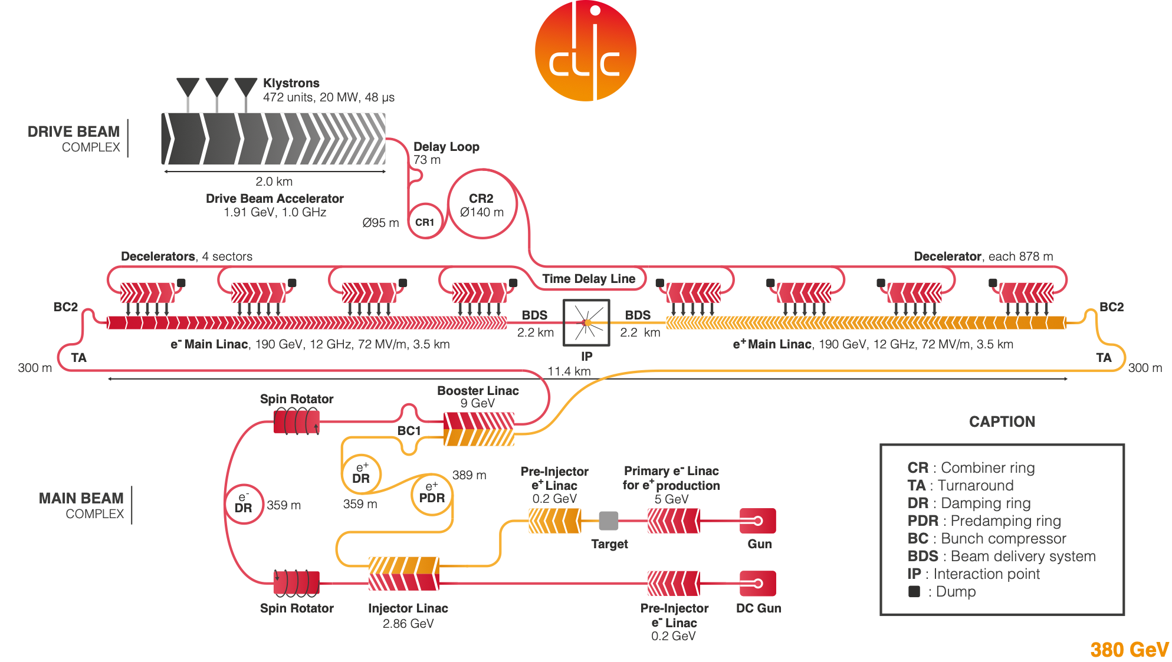
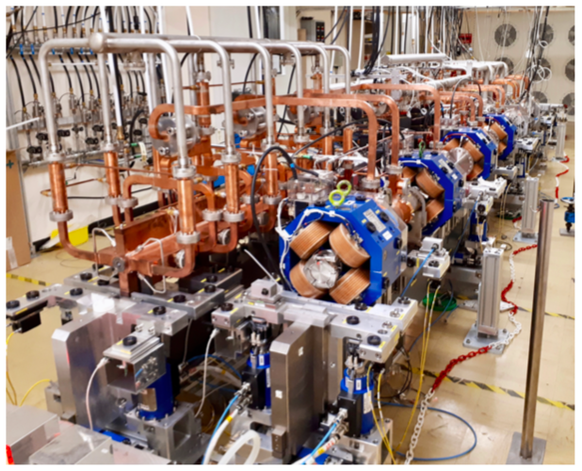
  Drive beam accelerated to ~2 GeV using conventional klystrons
  Intensity increased using a series of delay loops and combiner rings
  Drive beam decelerated and produces high-RF
  Feed high-RF to the less intense main beam using waveguides

Slide 4
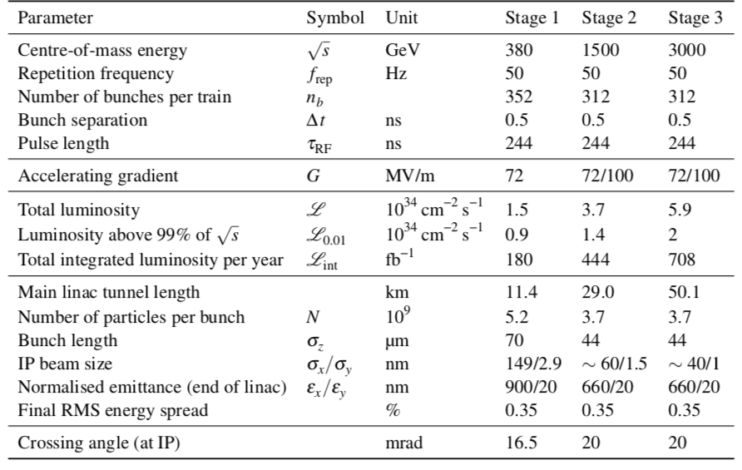
CLIC parameters

Slide 5
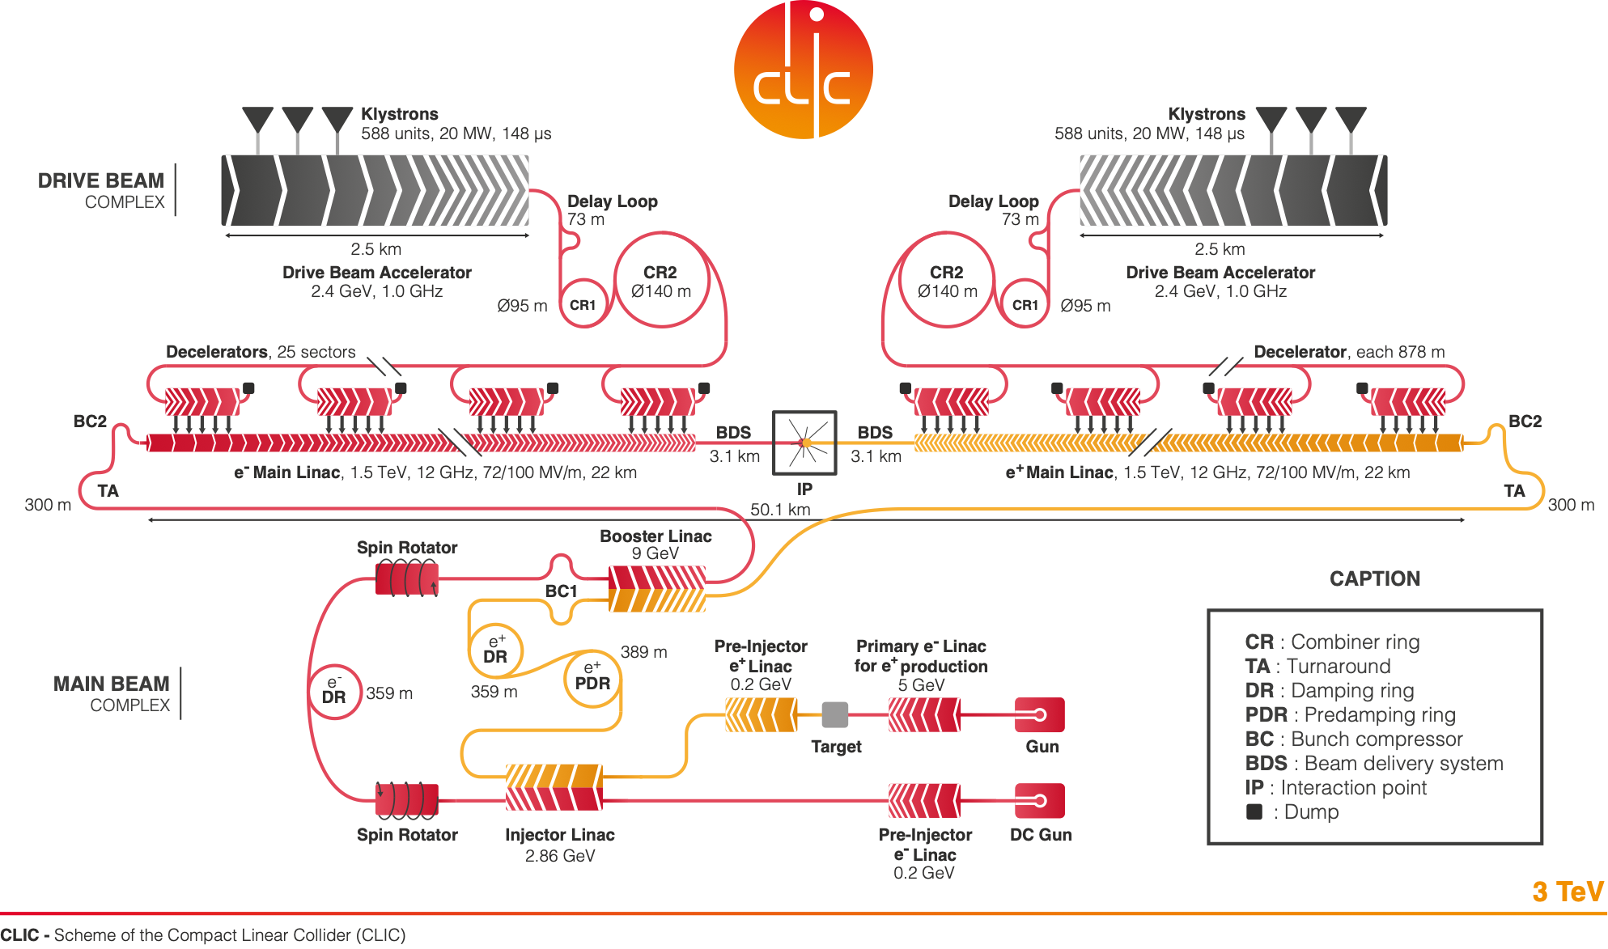

Slide 6
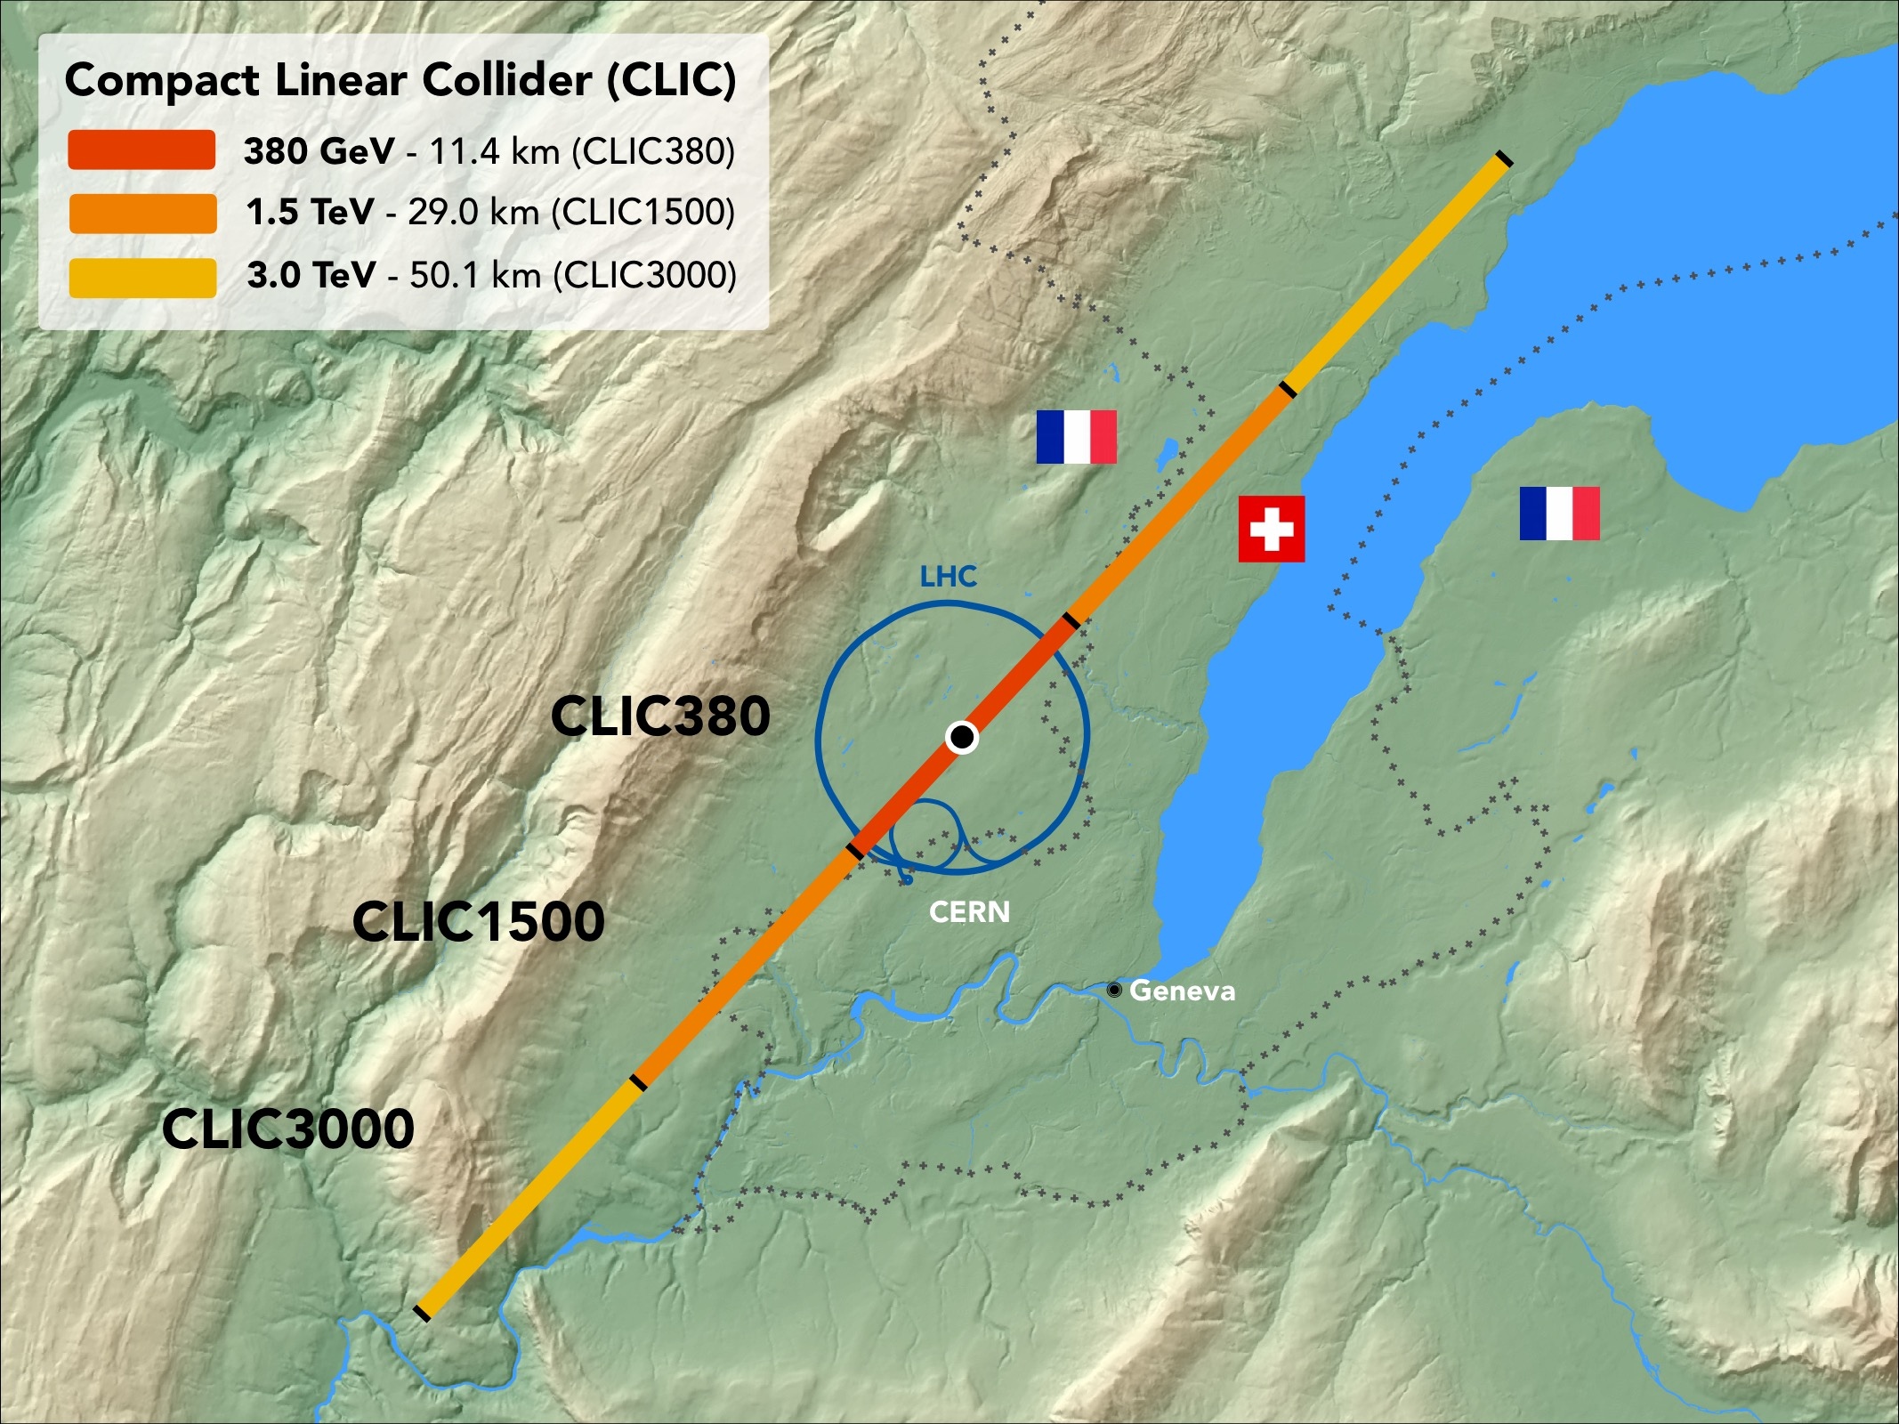
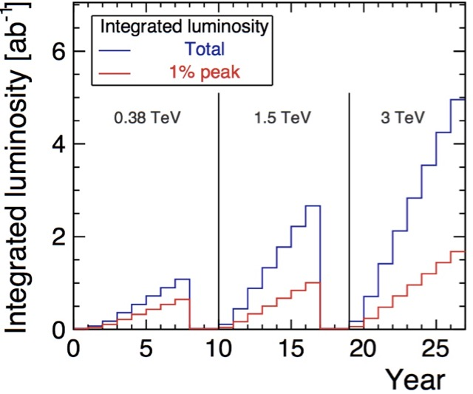
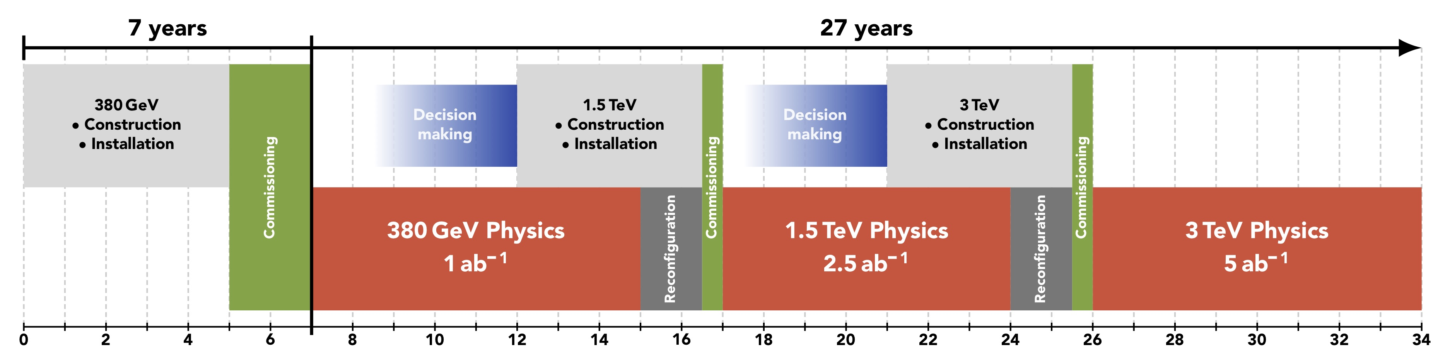
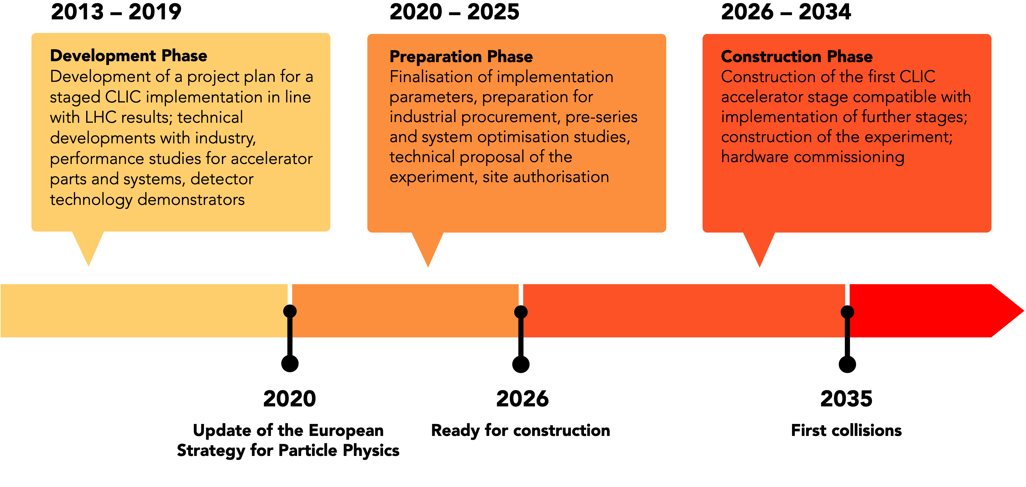
CLIC timeline
Ramp-up and up-time assumptions: arXiv:1810.13022, Bordry et al.
Technology Driven Schedule from start of construction:
First collisions by ~2035
Baseline scenario of operation ~30 years

Slide 7
CLIC timeline
Ramp-up and up-time assumptions: arXiv:1810.13022, Bordry et al.
Technology Driven Schedule from start of construction shown above.
A preparation phase of ~5 years is needed before (estimated resource need for this phase is ~4% of overall project costs)

Slide 8
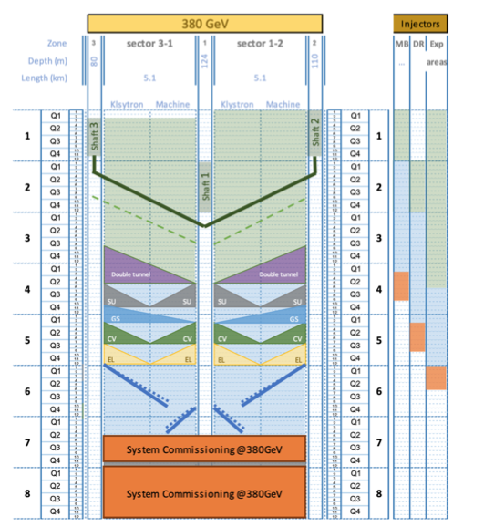
Based on detailed breakdown of tasks, rates,
access/zoning/transport, prod. rates, etc

Slide 9
Next (will not show)
Technical challenges and the work done to address them (RF, “nanobeam”, prototypes of all key elements for injectors, drivebeam, main linac) – more related to next agenda point
Recent work on luminosity performance
Technical development programme for 2021-2025

Slide 10
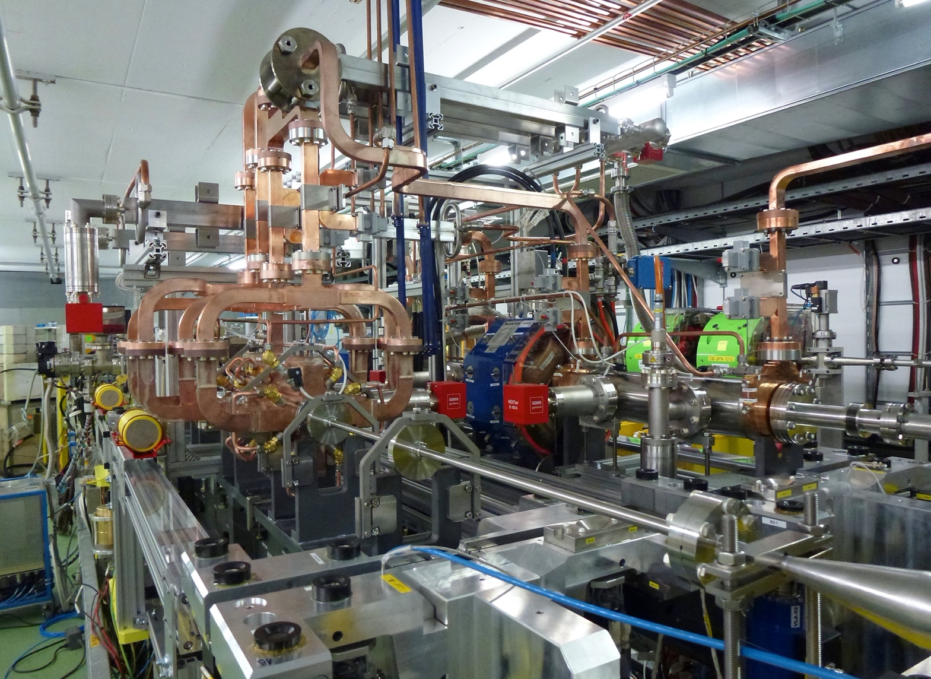
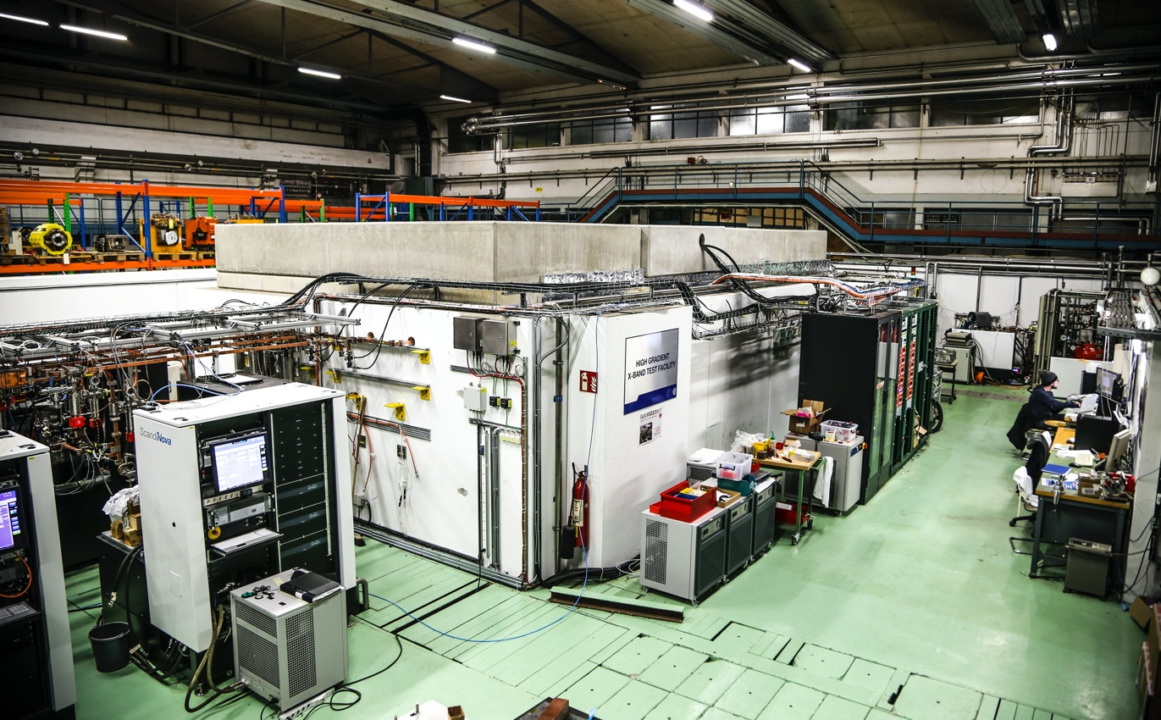
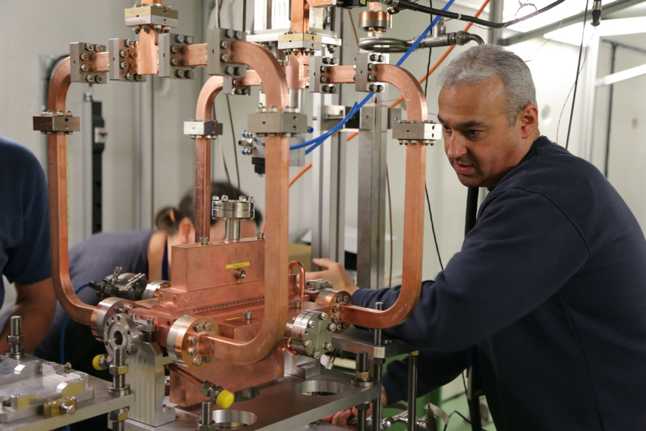
Accelerator challenges
Details in PIP, DOI: http://dx.doi.org/10.23731/CYRM-2018-004
CLIC baseline – a drive-beam based machine with an initial stage at 380 GeV
Four main challenges
  High-current drive beam bunched at 12 GHz
  Power transfer and main-beam acceleration
  Towards 100 MV/m gradient in main-beam cavities
  Alignment and stability (“nano-beams”)
The CTF3 (CLIC Test Facility at CERN) programme addressed all drive-beam production issues
Other critical technical systems (alignment, damping rings, beam delivery, etc.) addressed via design and/or test-facility demonstrations
X-band technology developed and verified with prototyping, test-stands, and use in smaller systems
Two C-band XFELS (SACLA and SwissFEL – the latter particularly relevant) now operational: large-scale demonstrations of normal-conducting, high-frequency, low-emittance linacs

Slide 11
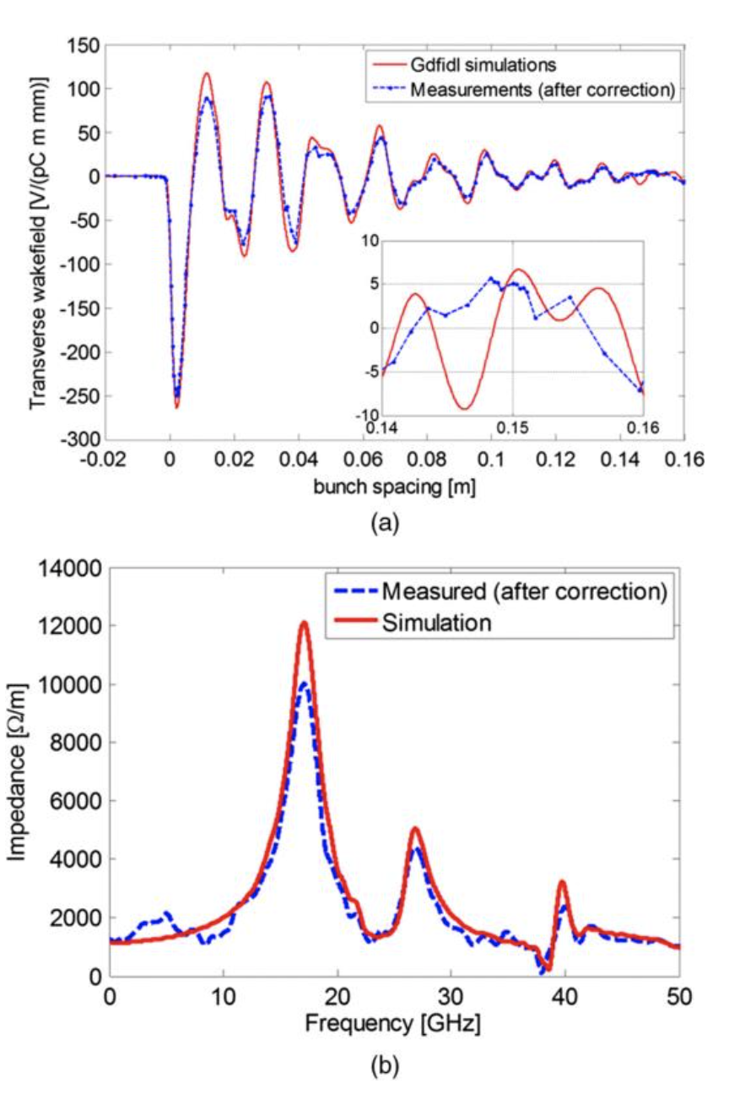
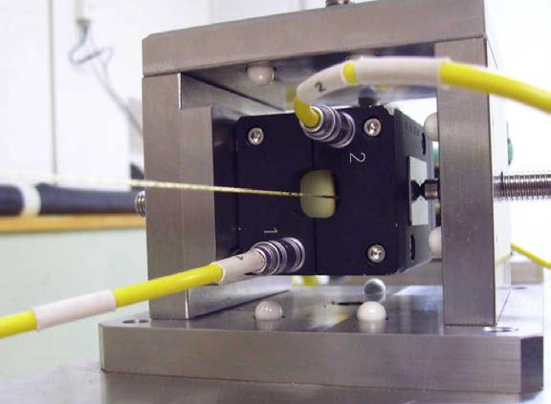
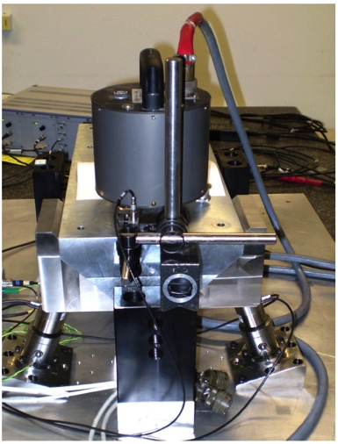
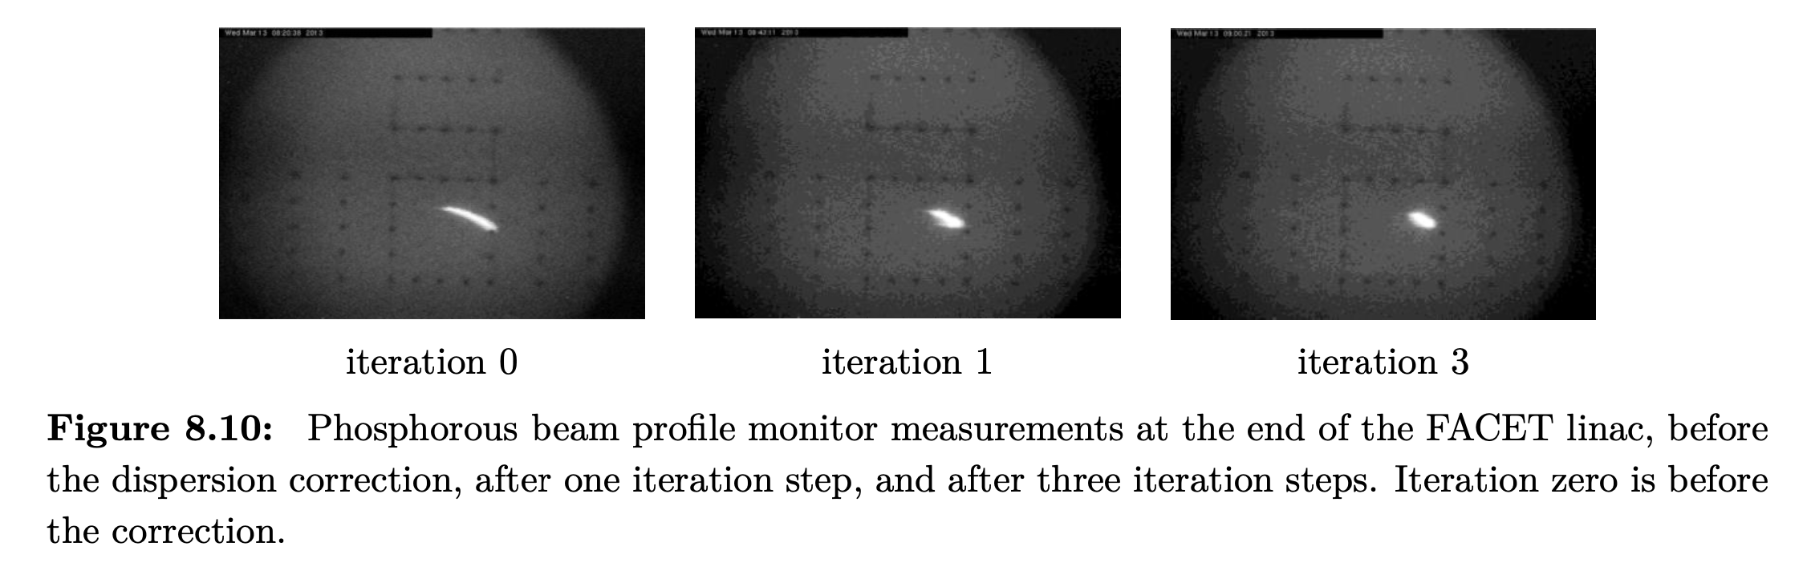
Low emittance generation and preservation
Low emittance damping rings
Preserve by
Align components (10 μm over 200 m)
Control/damp vibrations (from ground to accelerator)
Beam based measurements
– allow to steer beam and optimize positions
Algorithms for measurements, beam and component optimization, feedbacks
Experimental tests in existing accelerators of equipment and algorithms
(FACET at Stanford, ATF2 at KEK, CTF3, Light-sources)
Target and achieved emittance in existing and planned machines
2018
2008
Wake-field measurements in FACET
(a) Wakefield plots compared with numerical simulations.
(b) Spectrum of measured data versus numerical simulation.

Slide 12
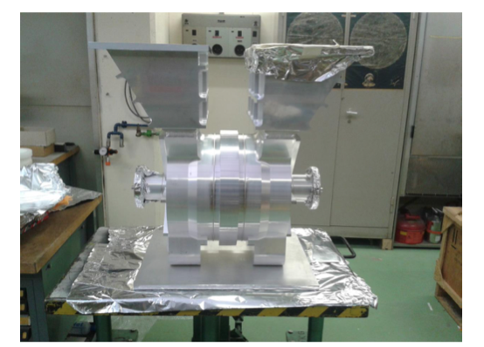
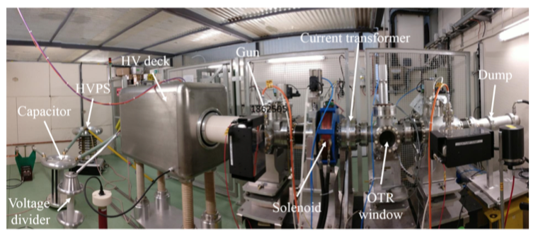
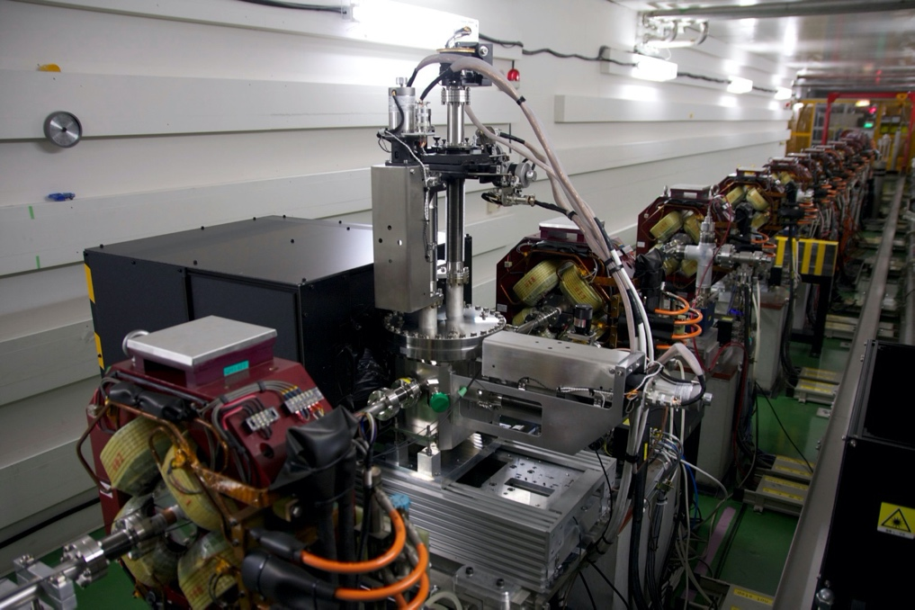
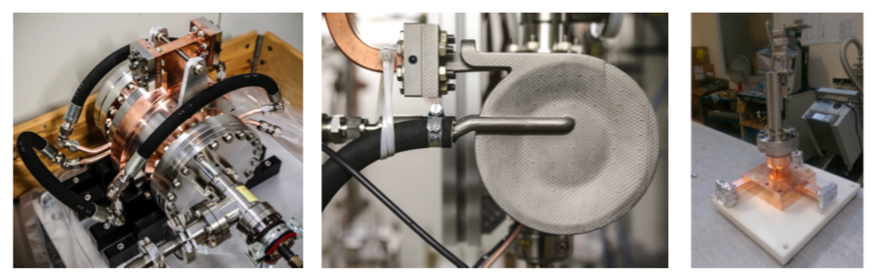
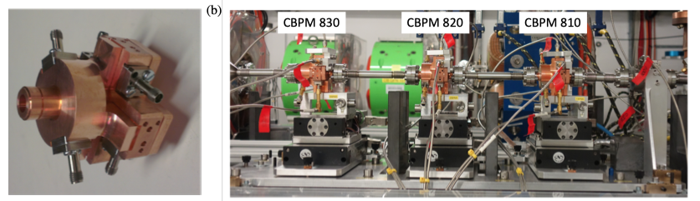
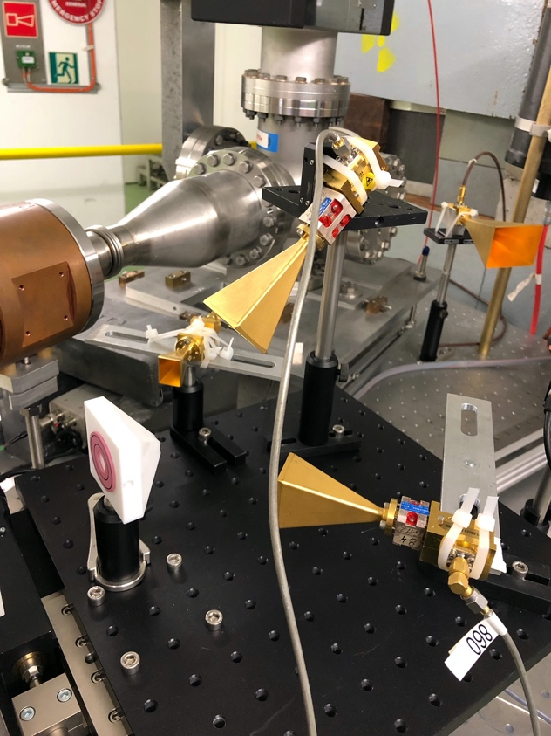
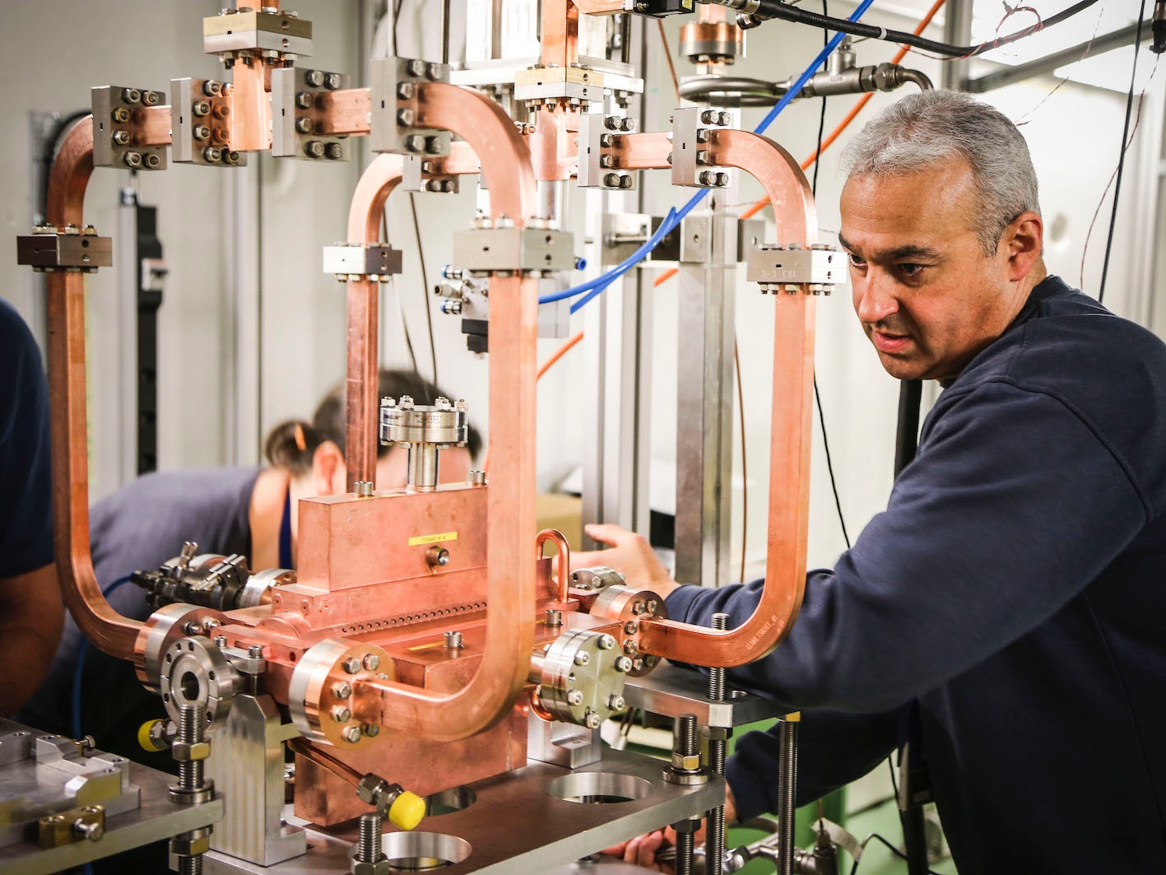
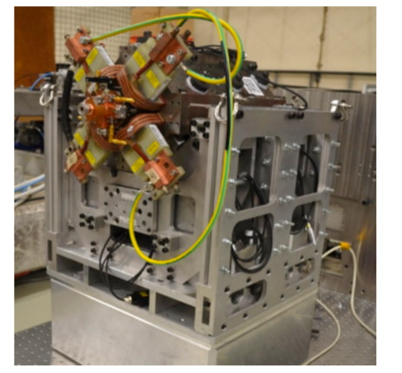
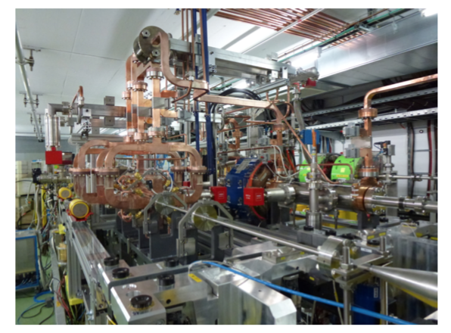
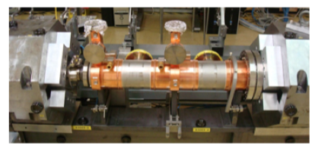
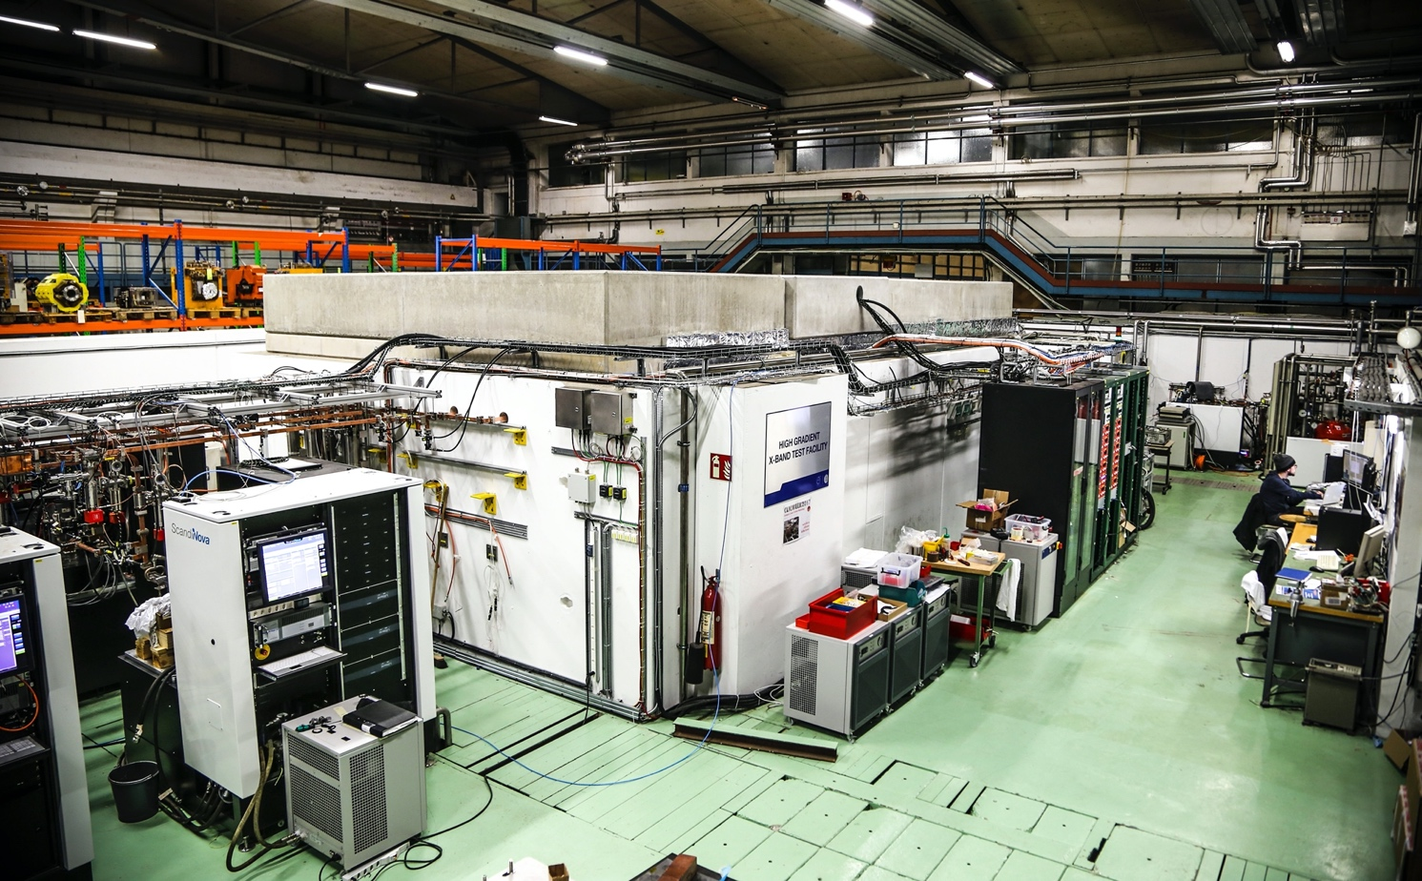
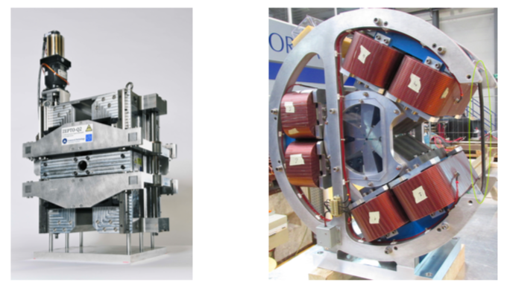
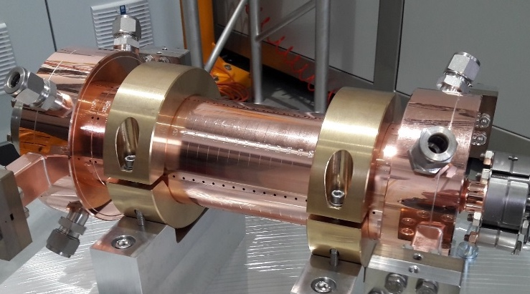
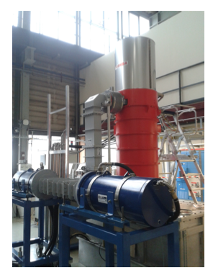
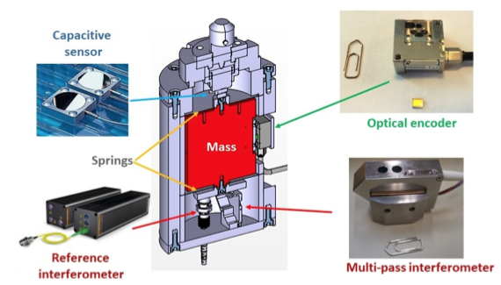
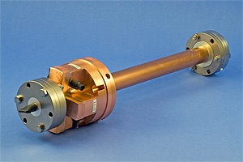
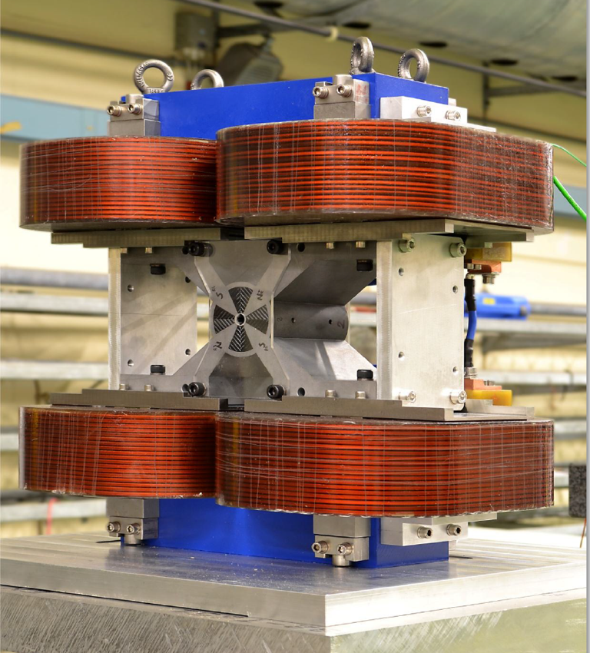
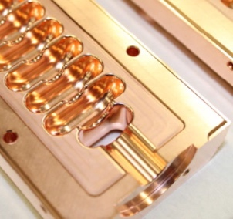
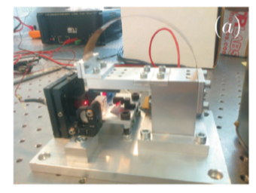
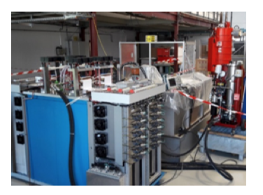
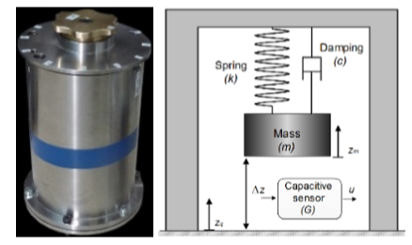
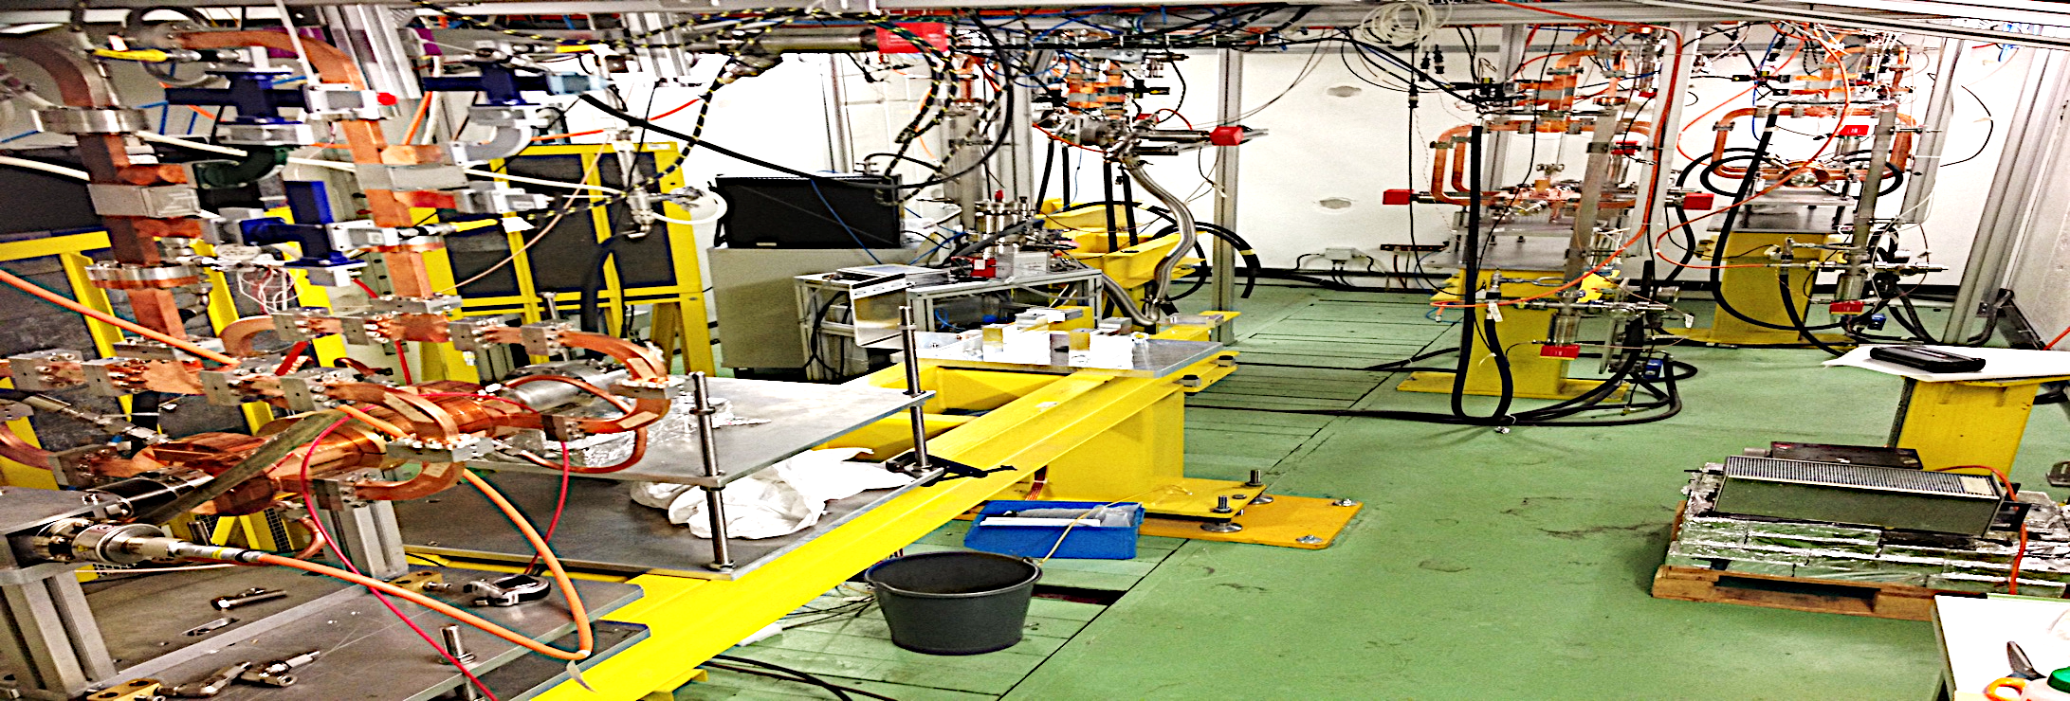
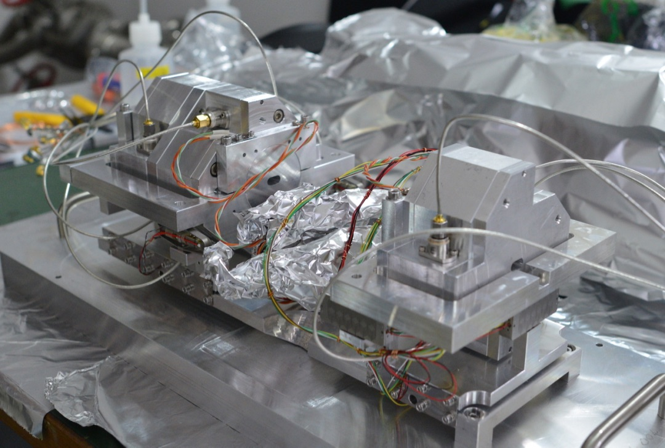
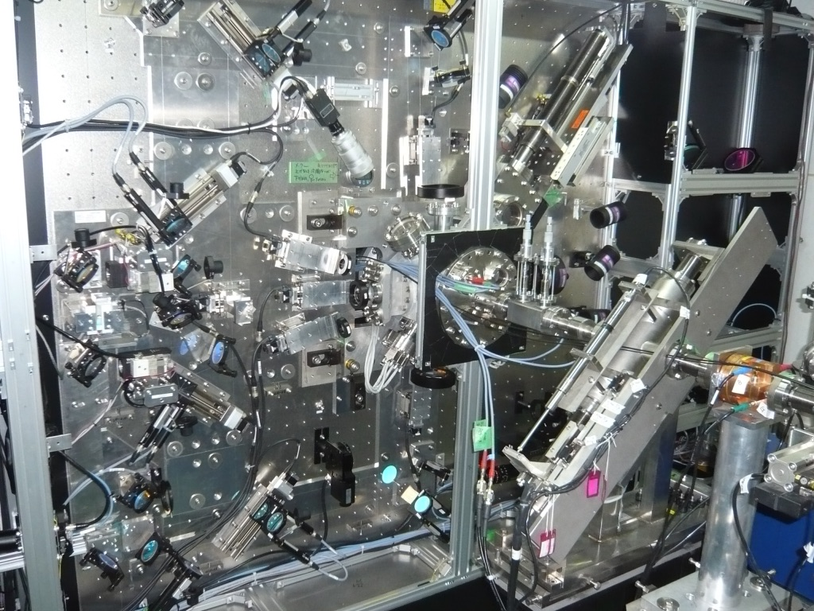
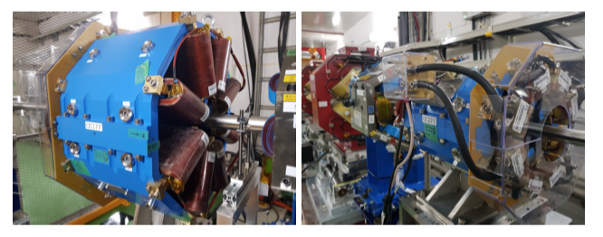
Technical Developments

Slide 13
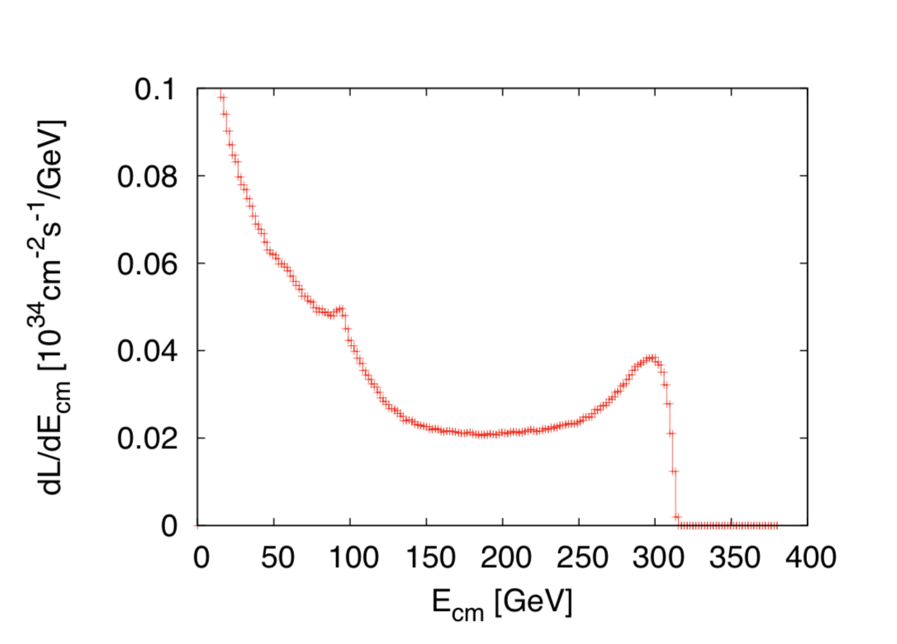
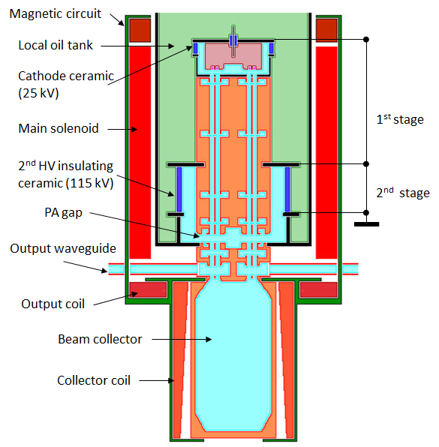
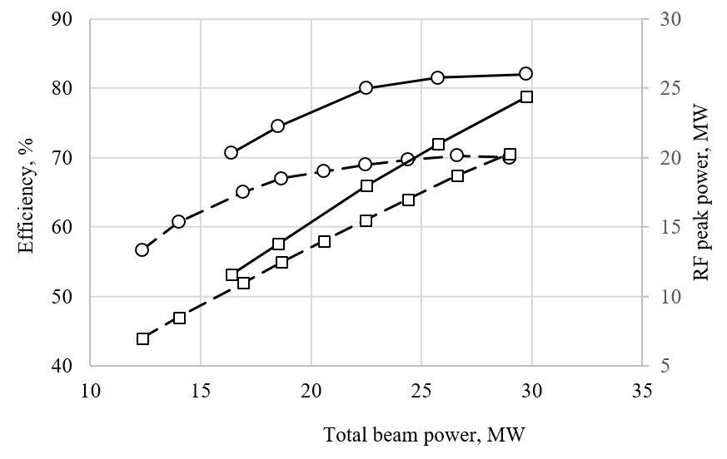
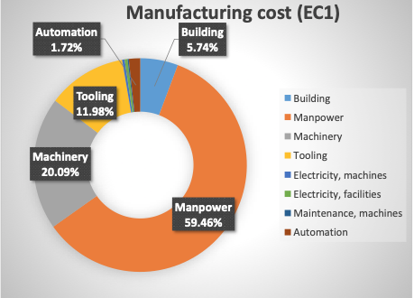
CLIC acc. studies 2019/20 – some examples
Further work on luminosity performance, possible improvements and margins, operation at the Z-pole and gamma-gamma
    Z pole performance, 2.3x10³² – 0.4x10³⁴ cm⁻² s⁻¹
      The latter number when accelerator configured for Z running (e.g. early or end of first stage)
      Gamma – Gamma spectrum (example)
      Luminosity margins and increases
      Baseline includes estimates static and dynamic degradations from damping ring to IP: 1.5 x 10³⁴ cm⁻² s⁻¹, a “perfect” machine will give : 4.3 x 10³⁴ cm⁻² s⁻¹, so significant upside
      In addition: doubling the frequency (50 Hz to 100 Hz) would double the luminosity, at a cost of +50 MW and ~5% cost increase
    CLIC note about these studies
Industrial questionnaire:
Based on the companies feedback, the preparation phase to the mass production could take about five years. Capacity clearly available. Talk of of Anastasiya
Drivebeam klystron: The klystron efficiency (circles) and the peak RF power (squares) simulated for the CLIC TS MBK (solid lines) and measured for the Canon MBK E37503 (dashed lines) vs total beam power. See more later.
Publication: https://ieeexplore.ieee.org/document/9115885

Slide 14
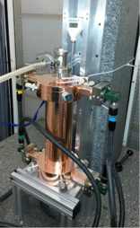
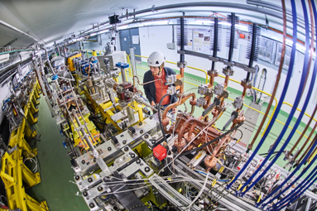




CLIC studies 2021-25
X-band technology:
Design and manufacturing of X-band structures and components
Study structures breakdown limits and optimization, operation and conditioning
Baseline verification and explore new ideas
Assembly and industry qualification
Structures for applications, FELs, medical, etc
Technical and experimental studies, design and parameters:
Module studies (see some targets for development below)
Beamdynamics and parameters: Nanobeams (focus on beam-delivery), pushing multi TeV region (parameters and beam structure vs energy efficiency)
Tests in CLEAR (wakefields, instrumentation) and other facilities (e.g. ATF2)
High efficiency klystrons
Injector studies suitable for X-band linacs (coll. with Frascati)
Application of X-band technology (examples):
A compact FEL (CompactLight: EU Design Study 2018-21)
Compact Medical linacs (proton and electrons)
Inverse Compton Scattering Source (SmartLight)
Linearizers and deflectors in FELs (PSI, DESY, more)
1 GeV X-band linac at LNF
eSPS for light dark matter searches (within the PBC-project)
More information: CLIC mini week (1.10.2020)

Slide 15
More if needed on:
Power, energy
Cost (construction of first stage and further stages, FTEs, operation costs)

Slide 16




Power and energy
Power estimate bottom up (concentrating on 380 GeV systems)
Very large reductions since CDR, better estimates of nominal settings, much more optimised drivebeam complex and more efficient klystrons, injectors more optimisation, etc
Further savings possible, main target damping ring RF
From running model and power estimates at various states – the energy consumption can be estimated
CERN is currently consuming ~1.2 TWh yearly (~90% in accelerators)
Will look also more closely at 1.5 and 3 TeV numbers next (in blue in figure to illustrate not optimized as for 380 GeV), Hi-Eff L-band klystrons development (see later), damping ring RF as mentioned, include reduction using permanent magnets

Slide 17



Cost - I
Machine has been re-costed bottom-up in 2017-18
Methods and costings validated at review on 7 November 2018 – similar to LHC, ILC, CLIC CDR
Technical uncertainty and commercial uncertainty estimated

Slide 18

Cost - II
Other cost estimates:
Construction:
From 380 GeV to 1.5 TeV, add 5.1 BCHF (drive-beam RF upgrade and lengthening of ML)
From 1.5 TeV to 3 TeV, add 7.3 BCHF (second drive-beam complex and lengthening of ML)
Labour estimate: ~11500 FTE for the 380 GeV construction
Operation:
116 MCHF (see assumptions in box below)
Energy costs

Slide 19
Snowmass papers
Several LoIs have been submitted on behalf of CLIC and CLICdp to the Snowmass process:
The CLIC accelerator study: Link
Beam-dynamics focused on very high energies: Link
The physics potential: Link
Detector: Link

Slide 20











Resources
3-volume CDR 2012
Updated Staging Baseline 2016
Available at:
clic.cern/european-strategy
4 CERN Yellow Reports 2018
Two formal submissions to the ESPPU 2018
Details about the accelerator, detector R&D, physics studies for Higgs/top and BSM

