Slide 1
XFEL-based γγ Collider Higgs Factory
Tim Barklow
AF03 Summary Report Meeting
Dec 16, 2020

Slide 2
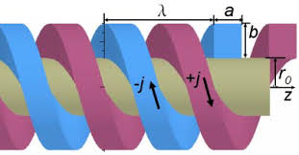
XFEL-based γγ Collider Higgs Factory Schematic
62.8 GeV electrons
converted to 62.5 GeV
photons through Compton
collision with 1 keV x-rays
Final focus squeezes round e⁻ beam to radius σ_{r}= 8 nm at primary IP
(few 100 meters in length)
γ (62.5 GeV)
γ (62.5 GeV)
e⁻
(62.8 GeV)
e⁻
(62.8 GeV)
KB mirrors focus
x-ray pulse to 40 nm radius
at Compton IP
e⁻
(31 GeV)
XFEL helical undulator converts e⁻ energy to
1 keV x-rays, 0.7 Joules/pulse
(few 100 meters in length)
e⁻
(31 GeV)
Every other bunch in train is kicked to XFEL line at the 31 GeV point in LINAC
(2 ns bunch separation
C³ LINAC with 100 MeV/m accelerates electrons to 62.8 GeV
(650 meters in length)
~2 km total length
Polarized RF gun produces low
emittance round e⁻ beams (no
need for damping rings)

Slide 3
γγ Luminosity Spectra x=4.8 vs. x=1000 (CAIN MC)

Slide 4
γγ Luminosity Spectra 2P_{c}λ_{e} = +0.9 vs -0.9

Slide 5
σ_{ez} and a_{γ} scans vs. γγ Luminosity (CAIN MC)

Slide 6
XFEL
Due to high B field and electron energy, quantum diffusion energy spread in
must be properly included in the design.
With permanent magnet undulator, peak B field slightly above 1 Tesla, <β>=12m,
1 keV X-rays with pulse energy ~ 0.07 J can be produced with negligible diffusion
With seeded FEL and taper of undulator K parameter after saturation, pulse energy
of 0.7 J can be achieved
Overall length of XFEL is ~ 200 m

Slide 7
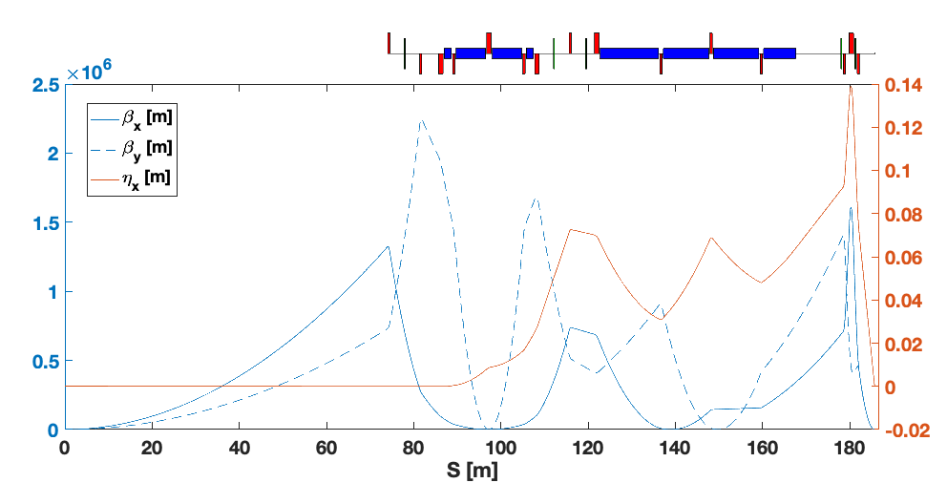
Final Focus (initial study by Glen White)
110 m
IP
Based on local chromatic correction scheme of Raimondi-Seryi
Includes 3 families of bend magnets, 5 sextupoles, plus octupoles & decupoles
Round beams at the IP ➔ preference for final triplet instead of doublet. The
required angular dispersion at the IP is about double that for ILC/CLIC. This
will have an adverse effect on the momentum acceptance of the extraction line
and may lead to increased detector backgrounds.
The IP beta functions are 0.03 mm in both planes, compared with 11 x 0.48 mm for
the baseline ILC design. The much smaller β* values generate significantly
higher chromatic distortions, requiring stronger sextupole corrections ➔
tolerances become rapidly tighter and online tuning becomes harder
Operational experience at ATF2 showed that tuning becomes more difficult with
smaller β*_{x} : β*_{y} ratios

Slide 8
Some current topics of study
Overall geometric layout of accelerator, XFEL, X-ray focusing, and final focus line.
Damage threshold of the KB mirrors
Final focus optics
Machine detector interface including background from the low energy e⁺e⁻ pairs and γ’s
produced at the Compton IP
Physics study of Higgs couplings -- can this collider yield precisions comparable to ILC?
With an equal number of Higgs bosons and an 8 MeV total Higgs width measurement
there is a chance.
.

