Slide 1
Snowmass AF3 Joint Technology Topics
ILC
C³
CLIC
CEPC
ERL FCCee
FCCee
HE-LHC
SRF
NRF
RF sources (toward 80%)
Special NC Magnets
SC Magnets
Lasers
Plasma
Nanobeams (alignment and stability)

Slide 2
ILC Technical Maturity
( International Linear Collider )

Slide 3
ILC Technical Maturity
( International Linear Collider )

Slide 4
ILC Technical Maturity
( International Linear Collider )

Slide 5
C3 Technical Maturity (Cool Copper Collider)

Slide 6
SRF

Slide 7
SRF
CLIC Accelerator Challenges ( Compact Linear Collider)

Slide 8
CepC Accelerator R&D ( Chinese electron positron Collider )

Slide 9
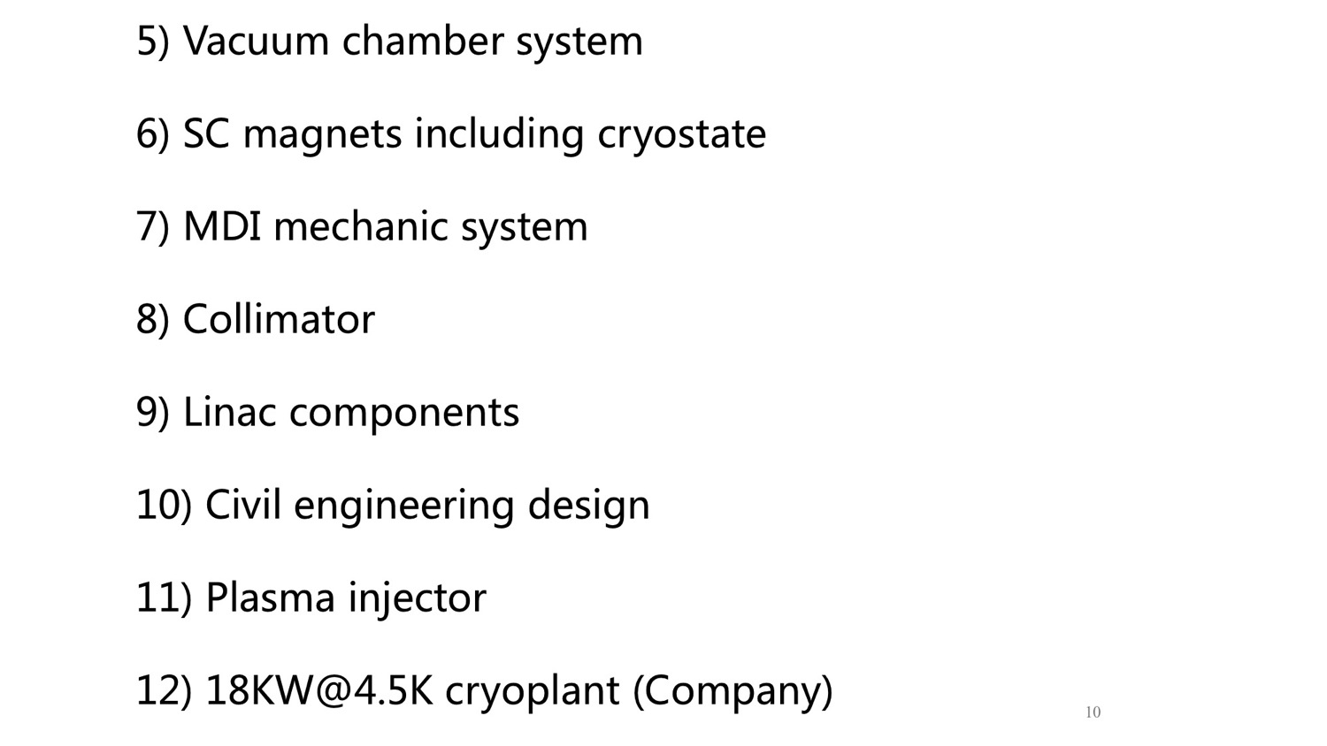
SRF
CepC Accelerator R&D ( Chinese electron positron Collider )

Slide 10
SRF Topics - FCCee

Slide 11
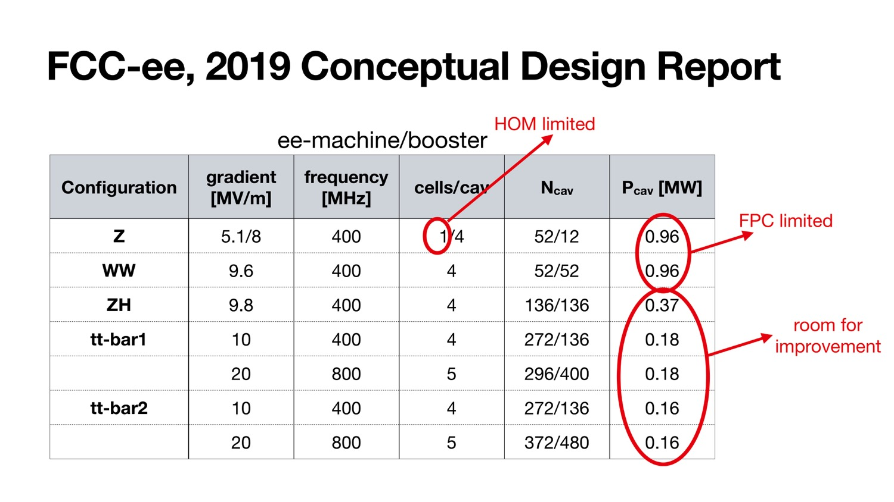
SRF Topics - FCCee

Slide 12
ERL FCCee Challenges and Opportunities ( Energy Recovery Linac Future Circular Collider )

Slide 13
SRF
HE-LHC topics for special attention
( High Energy Large Hadron Collider)

Slide 14
SRF
HE-LHC Technical Maturity
( High Energy Large Hadron Collider)

Slide 15
SRF Topics - FCCee

Slide 16
SRF Topics

Slide 17
SRF Topics - ILC

Slide 18
SRF Topics - ILC

Slide 19
SRF Topics - ILC

Slide 20
SRF Topics - ILC

Slide 21
SRF Topics - ILC

Slide 22
SRF Topics - ILC

Slide 23
SRF Topics - CepC

Slide 24
SRF Topics - CepC

Slide 25
SRF Topics - CepC

Slide 26
SRF Topics - FCCee

Slide 27
SRF Topics - FCCee

Slide 28
SRF Topics - FCCee

Slide 29
SRF Topics - FCCee

Slide 30
SRF Topics - FCCee

Slide 31
SRF Topics - FCCee

Slide 32
SRF Topics - FCCee

Slide 33
NRF

Slide 34
NRF
NRF Topics – C³

Slide 35
NRF Topics - CLIC

Slide 36
RF sources

Slide 37
RF Source Topics – C³

Slide 38
RF Source Topics - CLIC

Slide 39
RF Source Topics - CepC

Slide 40
Specialized Magnets

Slide 41
Specialized Magnets - CepC

Slide 42
Specialized Magnets – HE-LHC

Slide 43
Specialized Magnets - CepC

Slide 44
Superconducting Magnets

Slide 45
Superconducting Magnets – HE-LHC

Slide 46
Lasers

Slide 47
Lasers – FEL based γγ

Slide 48
Electron Sources

Slide 49
Electron Source Topics - CLIC
ILC

Slide 50
Snowmass AF3 Joint Technology Topics
ILC

Slide 51
Specialized vacuum

Slide 52
Specialized Vacuum Topics - CepC

Slide 53
Specialized vacuum chambers
Specialized Vacuum Topics – HE-LHC

Slide 54
Collimation
Specialized Vacuum Topics – HE-LHC

Slide 55
Nanobeams
SRF
NRF
RF sources (toward 80%)
Magnets (e.g. dual aperture)
SC Magnets
Lasers
Sources
Plasma
Nanobeams (alignment and stability)

Slide 56
Nanobeam Topics - ILC

