Slide 1

CEPC Critical Technologies
J. Gao
IHEP
On behalf of CEPC Group
CEPC-SppC
AF03 Kick off Meeting 2020, Dec. 16，2020

Slide 2
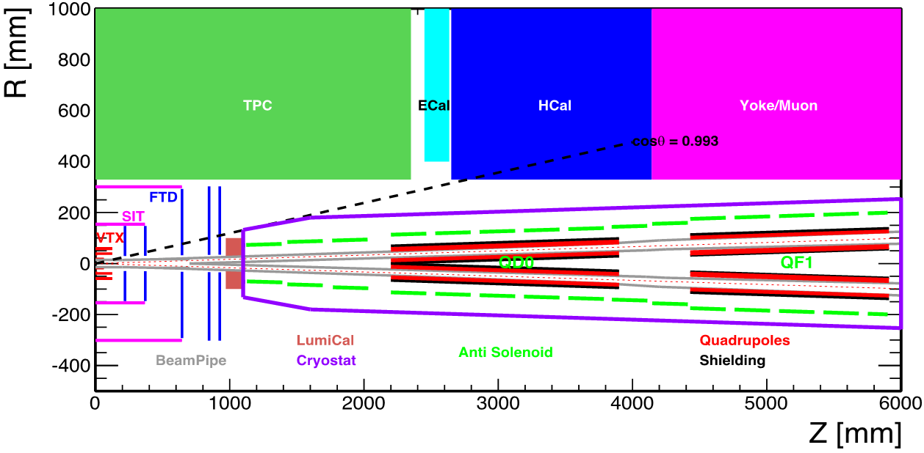
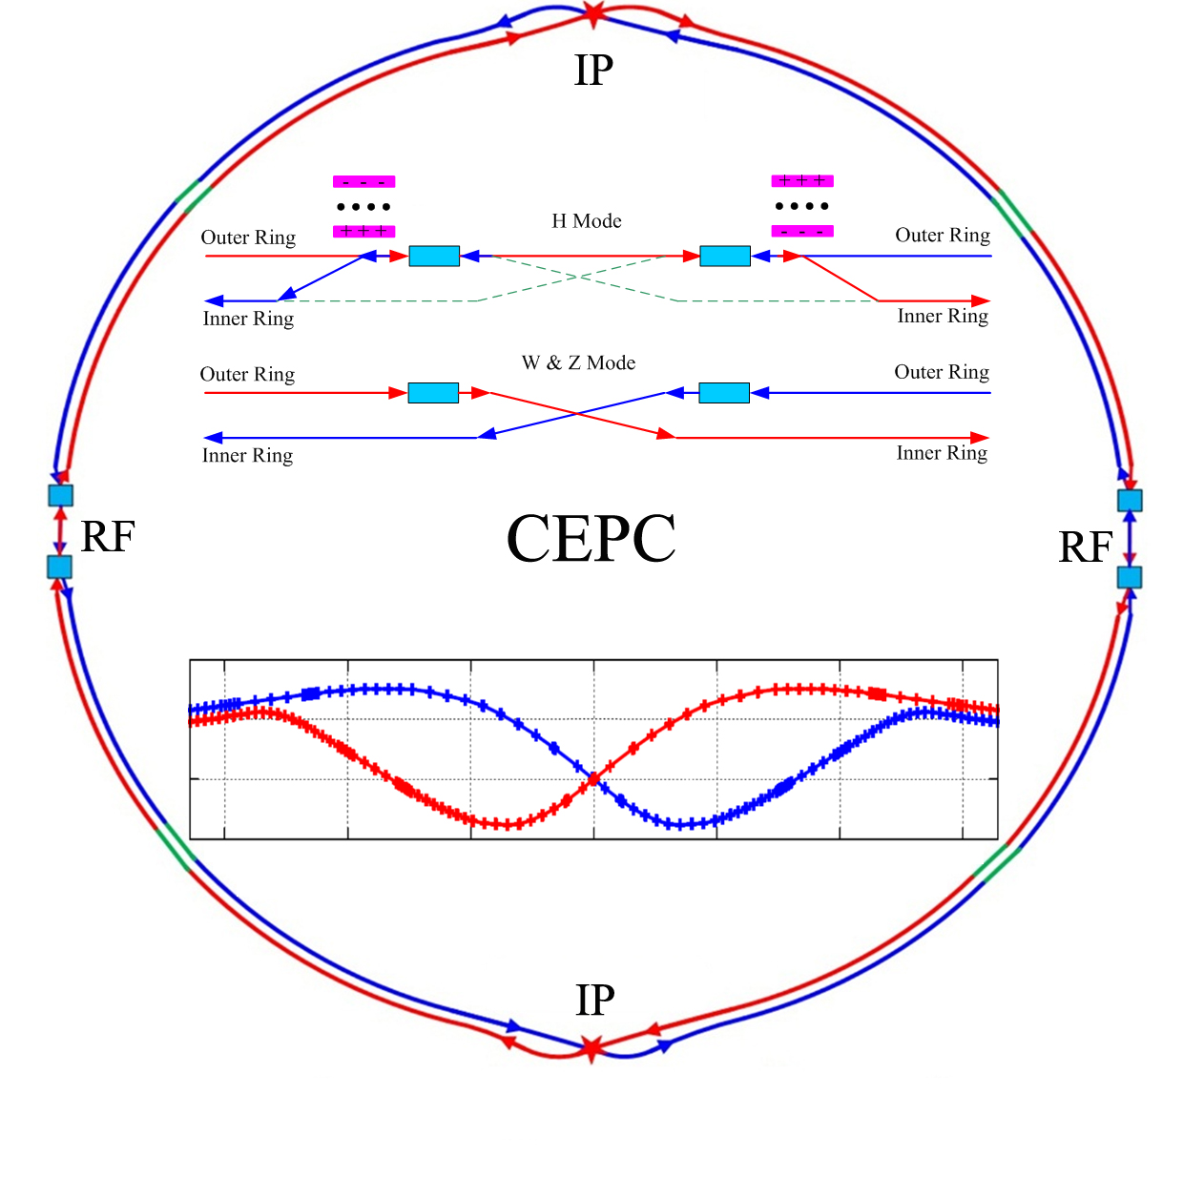
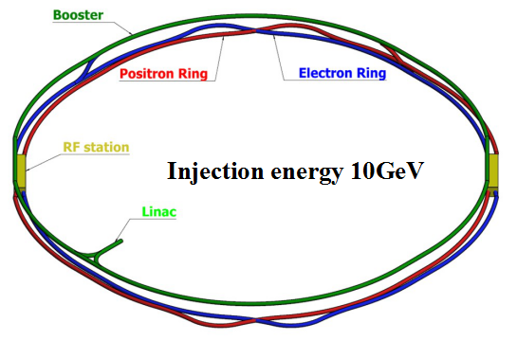
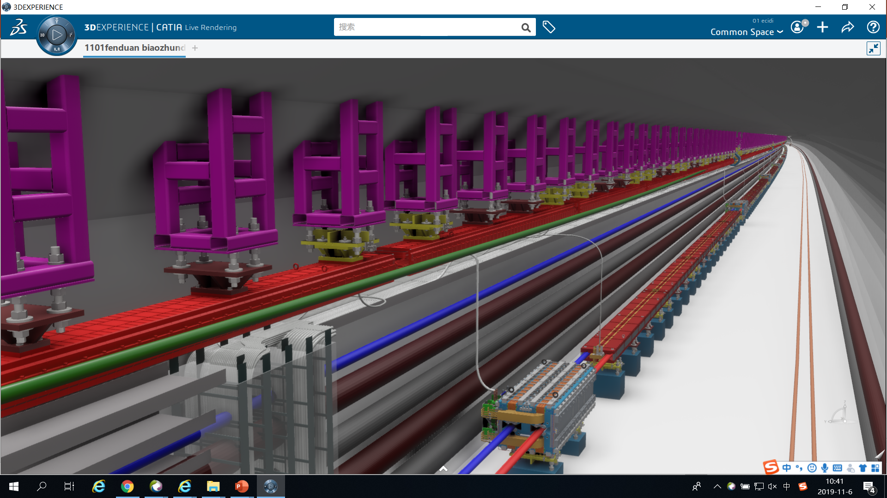
CEPC CDR Baseline Layout
CEPC as a Higgs Factory： H, W, Z, followed by a SppC ~100TeV
H
W and Z
CEPC collider ring (100km)
CEPC booster ring (100km)
CEPC Linac injector (1.2km, 10GeV)

Slide 3
CEPC Accelerator R&D Item list (incomplete)
(Some key common technoloties in red)
1) CEPC 650MHz 800kW high efficiency klystron (80%)
2) High precision booster dipole magnet (critical for booster operation)
3) CEPC 650MHz SC accelerator system, including SC cavities and cryomules (high Q high field 650MHz cavity)
4) Collider dual aperture dipole magnets and dual aperture qudrupoles
3

Slide 4
5) Vacuum chamber system
6) SC magnets including cryostate
7) MDI mechanic system
8) Collimator
9) Linac components
10) Civil engineering design
11) Plasma injector
12) 18KW@4.5K cryoplant (Company)
4

Slide 5
CEPC SRF Parameter with By Pass Schemes
 | BEPCII 500 MHz 4.2 K | BEPC3 500 MHz 4.2 K | CEPC CDR H 30 MW 3E34 | CEPC CDR Z 16.5 MW 32E34 | CEPC 1-cell H 30 MW 3E34 | CEPC TDR Z 30 MW 100E34 | CEPC TDR H 30 MW 3E34 | CEPC TDR W 30 MW 10E34 | CEPC Ultimate Z 50 MW 167E34
Beam current (mA) | 400 (600) | 900 | 2 x 17.4 | 460 | 2 x 17.4 | 838 | 2 x 17.4 | 2 x 87.7 | 1400
Cell number | 1 | 1 | 2 |  | 1 | 1 | 2/1 | 2/1 | 1
Cavity number / ring | 1 | 2 | 2 x 120 | 60 | 2 x 120 | 60 | 2x(90+60) | 2x(90+60) | 60
Eacc (MV/m) | 6 (1.5 MV) | 10 (2.5 MV) | 19.7 | 3.6 | 40 | 9.4 | 19.7 | 4.2 | 9.4
Q₀ @ 4.2 K / 2 K | 1E9 | 1E9 | 1.5E10 | 1.5E10 | 3E10 | 1.5E10 | 1.5E10 | 1.5E10 | 1.5E10
Total wall loss (kW) |  |  | 6.1 | 0.1 | 6.1 | 0.35 | 6.1 | 0.27 | 0.35
Input power (kW) | 110 | 150 | 250 | 275 | 250 | 500 | 250/125 | 250/125 | 835
Cavity# / klystron | 1 | 1 SSA | 2 |  | 2/1 | 1 | 2/1 | 2/1 | 1
Klystron power (kW) | 250 | 150 SSA | 800 | 800 | 800 | 800 | 800 | 800 | 1200
Total KLY number | 2 | 4 | 120 |  | 60+120 | 120 | 90+120 | 90+120 | 120
HOM damper | Absorber | Absorber | Hook+ Absorber |  | Hook+ Absorber | Absorber | Hook+ Absorber | Hook+ Absorber | Absorber
HOM power (kW) | 8* | 20 | 0.6 | 1.9 | 0.23 | 2.4 | 0.46 / 0.23 | 1.5 / 0.75 | 4
* Bunch length 15 mm, cavity cell HOM loss factor 0.1 V/pC, tapers 0.06 V/pC, absorbers 0.26 V/pC.

Slide 6
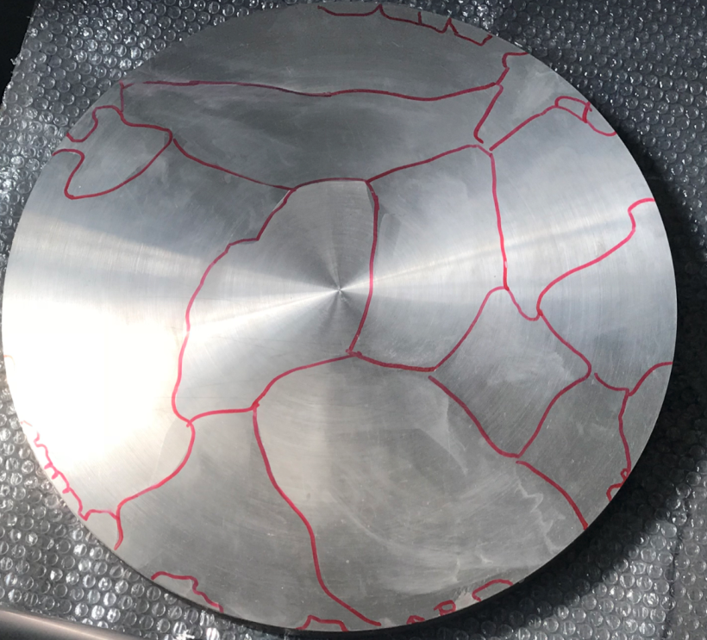
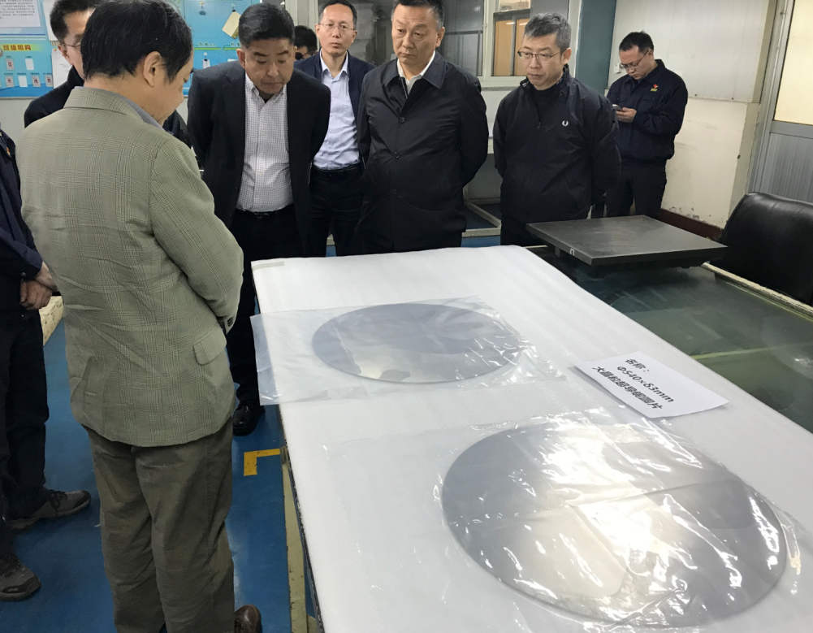
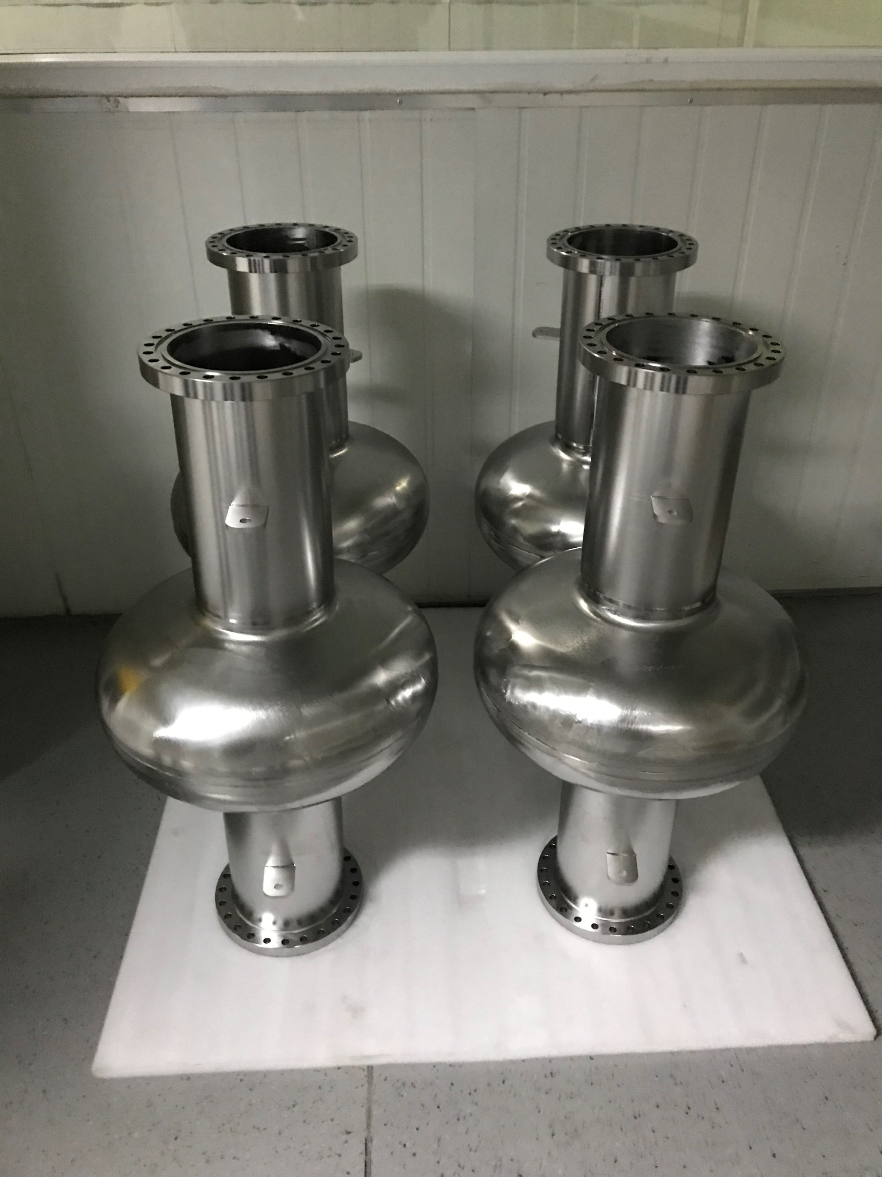
High Q high gradient 650 MHz 1-Cell Cavity (Large Grain)
650 MHz 1-cell cavity (large grain) is favorable for HL-Z, which have higher Q and gradient than fine grain.
Target of Vertical test: 5E10 @ 42MV/m at 2.0 K.
Four cavities are under fabrication now and under surface treatment studies
Large grain Nb sheets made by OTIC
Thin film coating high gradient hihg temperature SC cavity (at 4K) might be another R&D issues

Slide 7
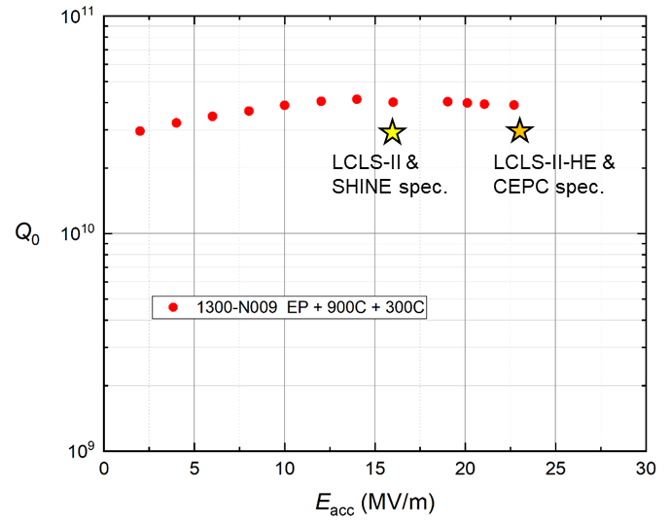
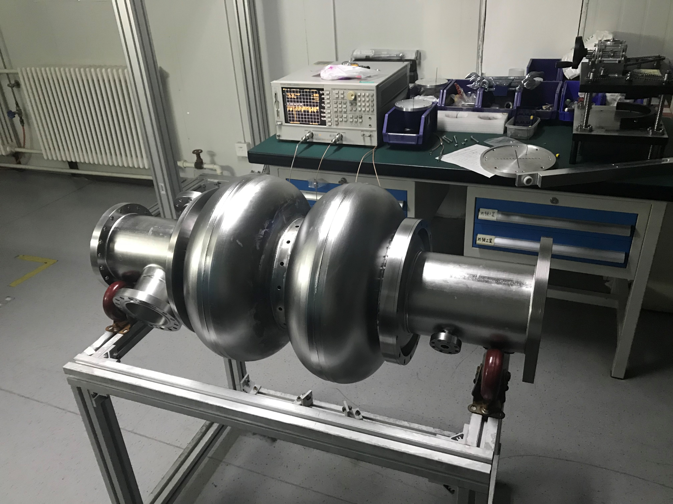
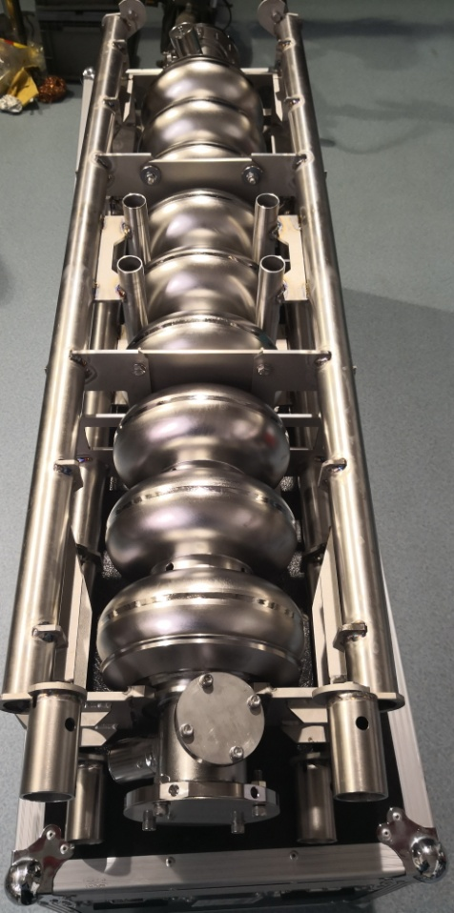
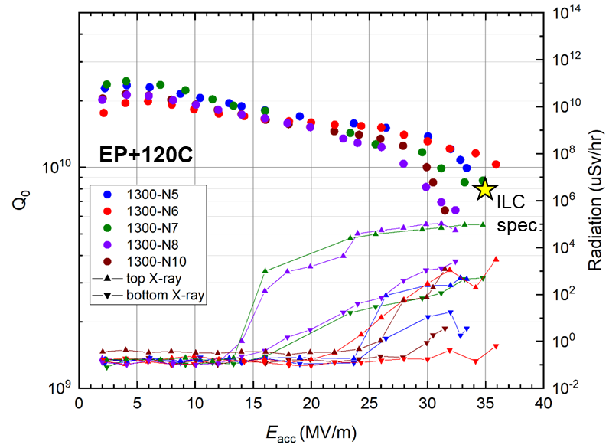
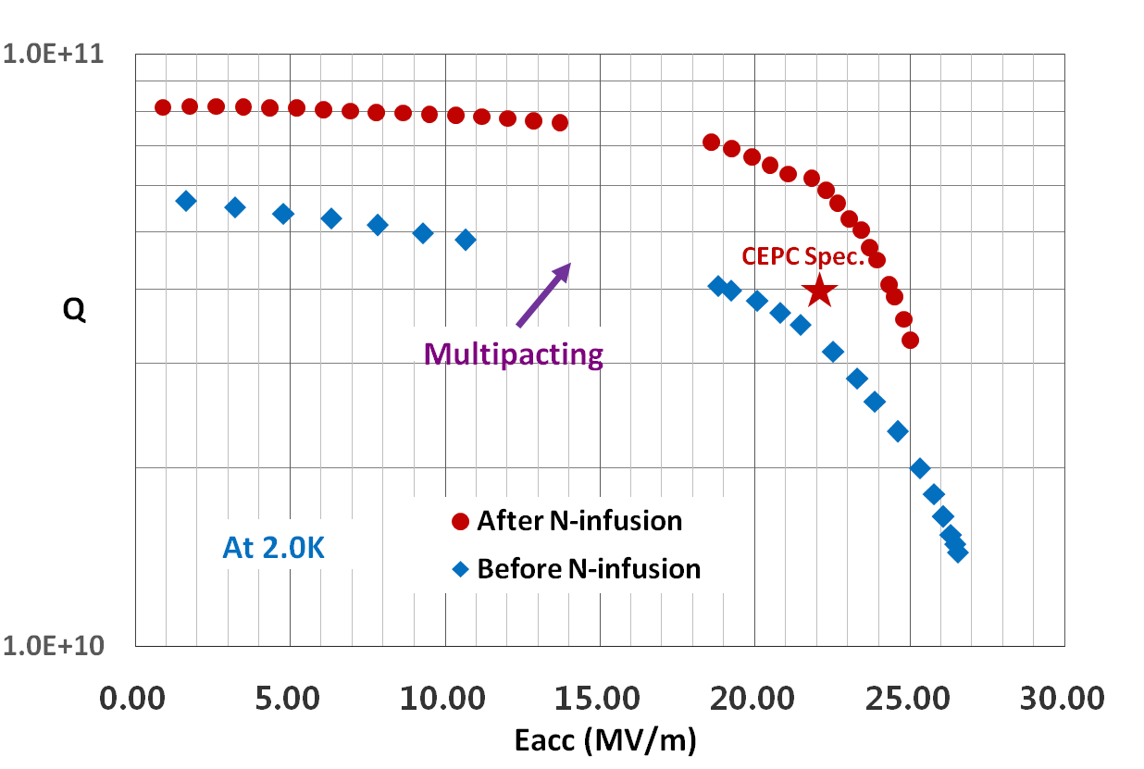
CEPC 650MHz 2cell and 1.3 GHz 9-cell Cavities
Collider ring 650 MHz 2 cell cavity
Booster 1.3GHz 9 cell cavity
650 MHz 2-cell cavity reached 6E10@22MV/m after N-infusion, which has exceeded CEPC Spec （Q=4E10@Eacc=22MV/m）.

Slide 8
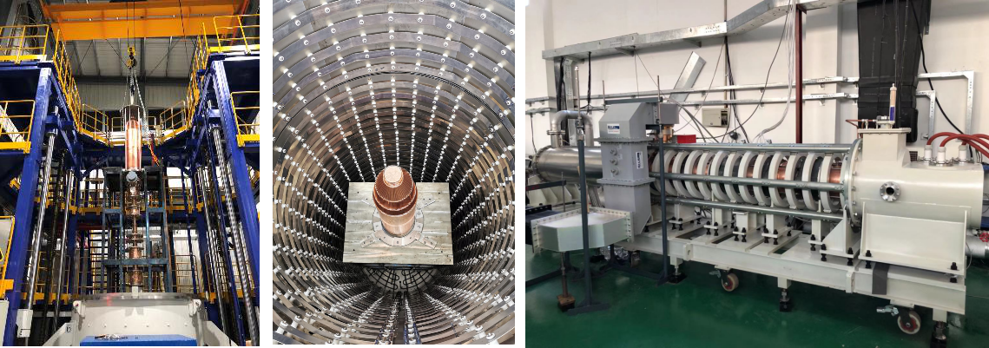
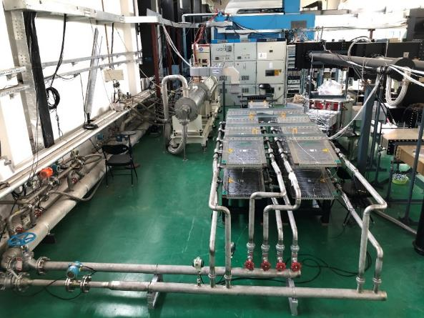
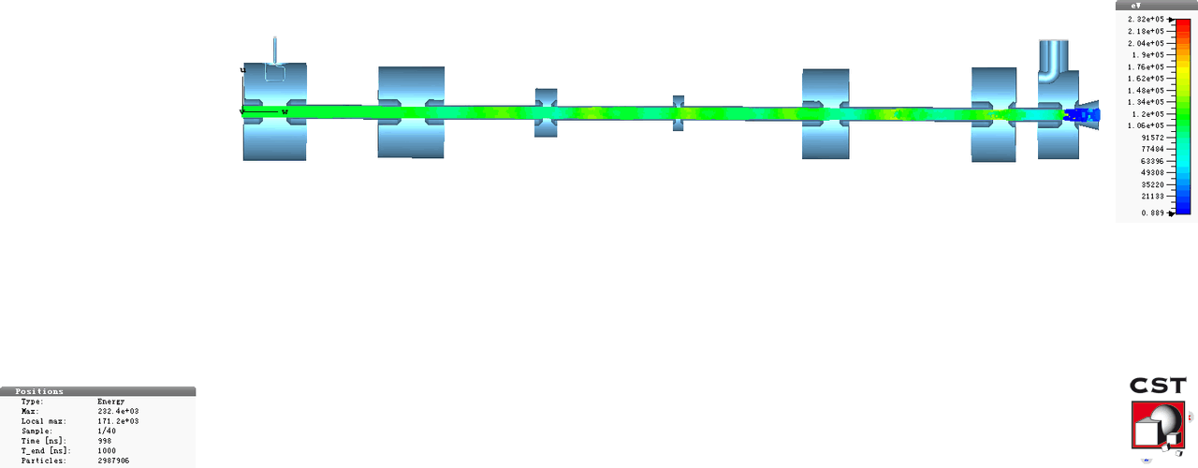
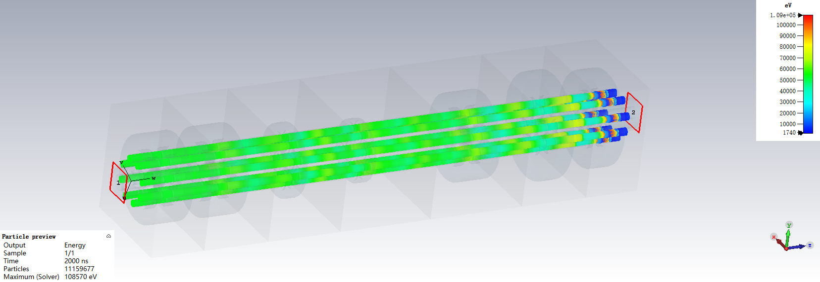
CEPC 650MHz High Efficiency Klystron Development
  Facility: CEPC high power and high efficincy test facility (lab) is located in IHEP
Established “High efficiency klystron collaboration consortium”, including IHEP & IE(Institute of Electronic) of CAS, and Kunshan Guoli Science and Tech.
Reached
  2016 – 2018： Design conventional & high efficiency klystron
  2017 – 2018：Fabricate conventional klystron & test
  2018 - 2019 ：Fabricate 1st high efficiency klystron & test
  2020 - 2021 ：Fabricate 2nd high efficiency klystron & test
  2021 - 2022 ：Fabricate 3rd high efficiency klystron & test
Parameters | Conventional efficiency | High efficiency
Centre frequency (MHz) | 650+/-0.5 | 650+/-0.5
Output power (kW) | 800 | 800
Beam voltage (kV) | 80 | -
Beam current (A) | 16 | -
Efficiency (%) | ~ 65 | > 80
Goal
On March 10， 2020，the first CEPC650Mhz klystron output power has reached pulsed power of 800kW (400kW CW due to test load limitation), efficiency 62% and band width>+-0.5Mhz.
1st Klystron of 62% efficiency
3nd Klystron of 80% efficiency
2nd Klystron of 77% efficiency
800kW Load

Slide 9
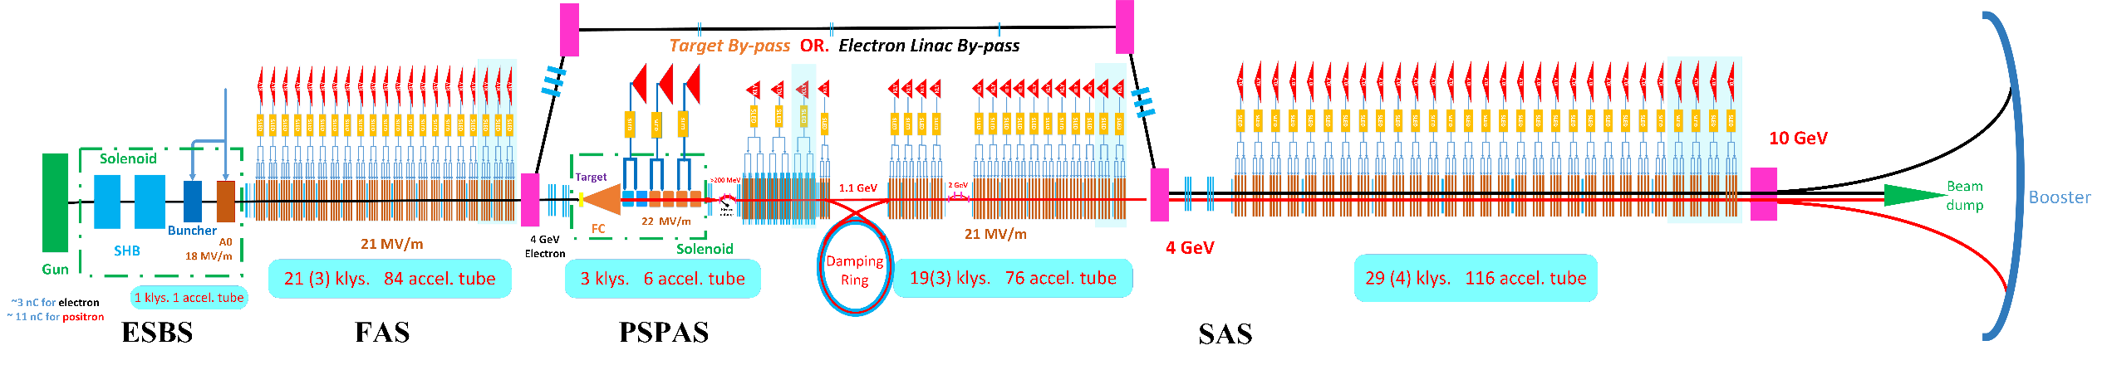
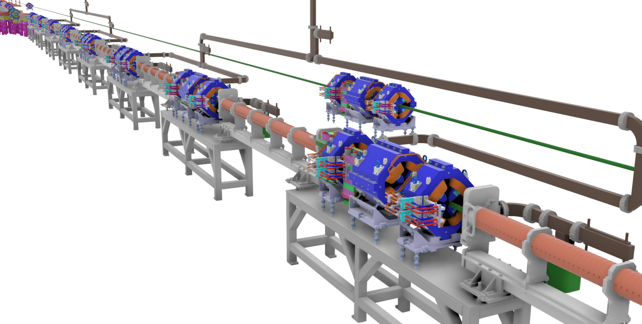
CEPC Linac Injector (CDR)
Parameter | Symbol | Unit | Baseline | Design reached
e⁻ /e⁺ beam energy | E_{e-}/E_{e+} | GeV | 10 | 10
Repetition rate | f_{rep} | Hz | 100 | 100
e⁻ /e⁺ bunch population | N_{e-}/N_{e+} |  | > 9.4×10⁹ | 1.9×10¹⁰ / 1.9×10¹⁰
 |  | nC | > 1.5 | 3.0
Energy spread (e⁻ /e⁺ ) | σ_{e} |  | < 2×10⁻³ | 1.5×10⁻³ / 1.6×10⁻³
Emittance (e⁻ /e⁺ ) | ε_{r} | nm⋅ rad | < 120 | 5 / 40 ~120
Bunch length (e⁻ /e⁺ ) | σ_{l} | mm |  | 1 / 1
e⁻ beam energy on Target |  | GeV | 4 | 4
e⁻ bunch charge on Target |  | nC | 10 | 10

Slide 10
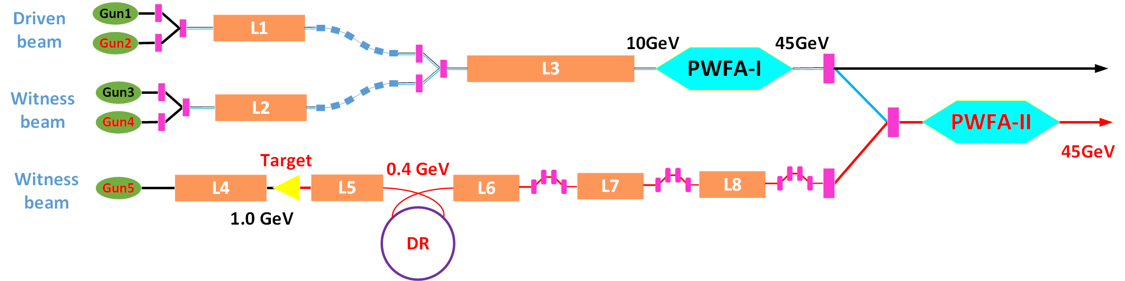
CEPC Plasma Injector： alternative design
e1
e2
e3
e3
e4
e4
p1 1.2nC, 2.4 GeV
p1
p1
 | e1/e3 Before PWFA-I | e3 After PWFA-I | e2/e4 Before PWFA-I | e4 After PWFA-I | p1 Before PWFA-II | p1 After PWFA-II | Booster Requirement
Energy (GeV) | 10/10 | 45.5 | 10/10 | 45.5 | 2.4 | 45.5 | 45.5
Bunch Charge (nC) | 5.8/0.84 | 1 | 15/4.5 | >3 | 1.2 | 1 | 0.78
Bunch length (ps) | 2/0.257 | <1 | 3/0.7 | <1 | 0.07 | <1 | <10
Energy Spread | ~/0.2% | ~1% | ~/0.2% | 1% | 0.2% | ~1% | 0.2%
E_{normal} (μm⸱rad) | <20*/<100 | ~100 | <50*/<100 | ~100 | <50 | ~100 | <800
Bunch Size (μm) | 3.87/8.65 | <20 | 30/20 | <20 | 20 | <20 | <2000
  The plasma accelerator performance has been checked numerically with the real linac beam quality,
  and it almost reached the design goal, but need experimental verfication

Slide 11
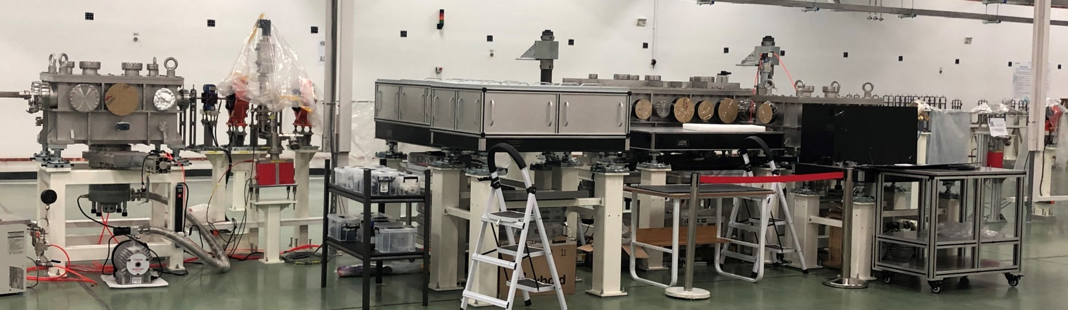
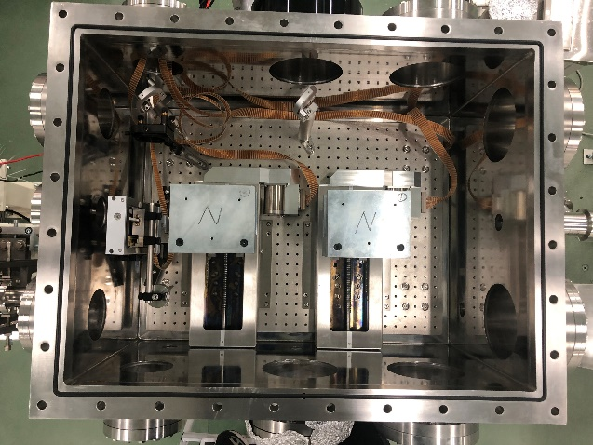
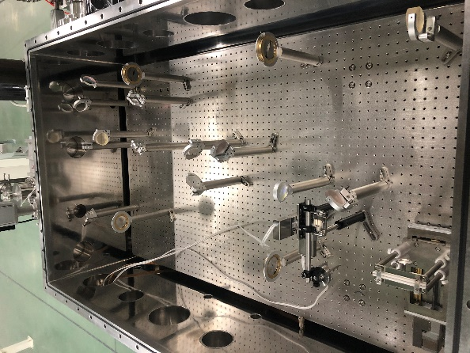
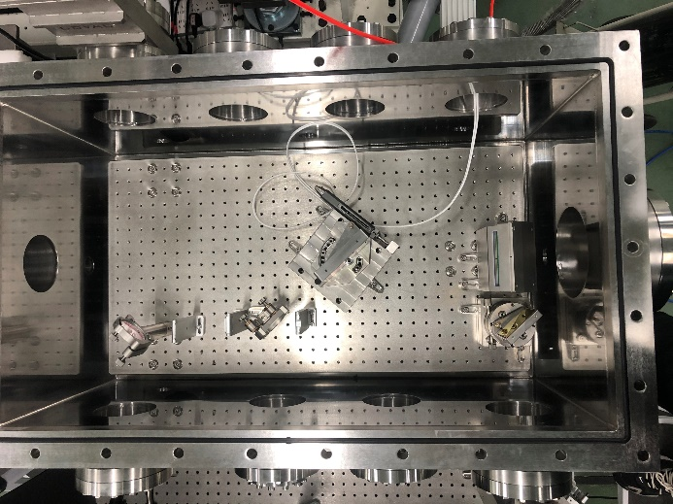
CEPC Plasma Injector Experimental Platform
  Facilities: Shanghai S-XFEL facility for electron acceleration and FACETII at SLAC for positron
Plasma experimental station: preliminary set up on Shanghai Soft XFEL facility Vacuum system: installation & testing preparation (to e tested in 2021)
  Light path
  Beam diagnostic system
Beam test room
main room
Laser compressor
Notes:
束流诊断：1、束测室: 能谱的诊断;2、主动室：横向尺寸的测量

Slide 12
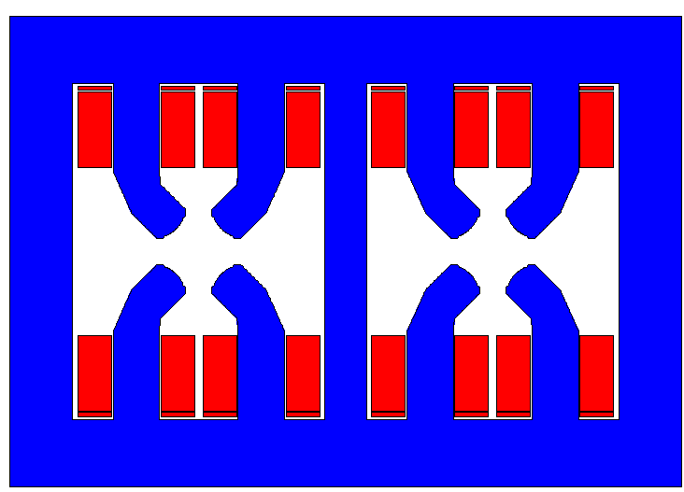
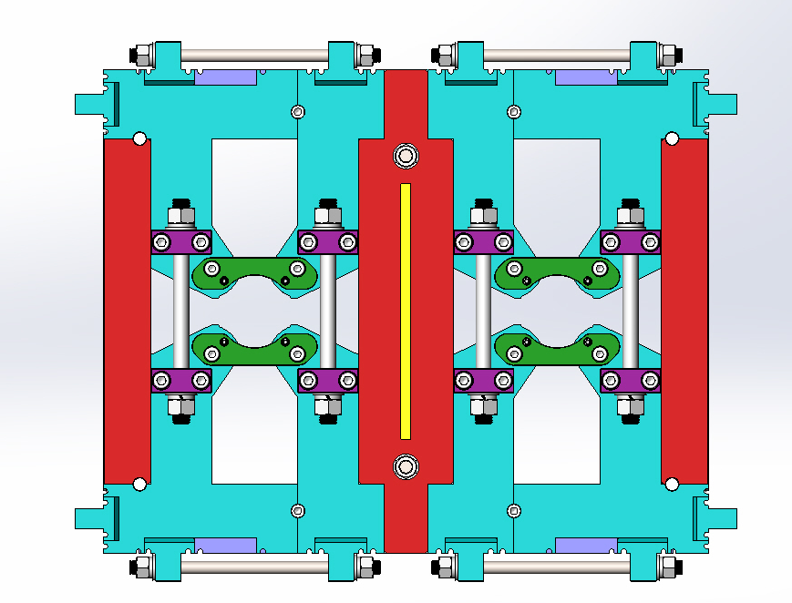
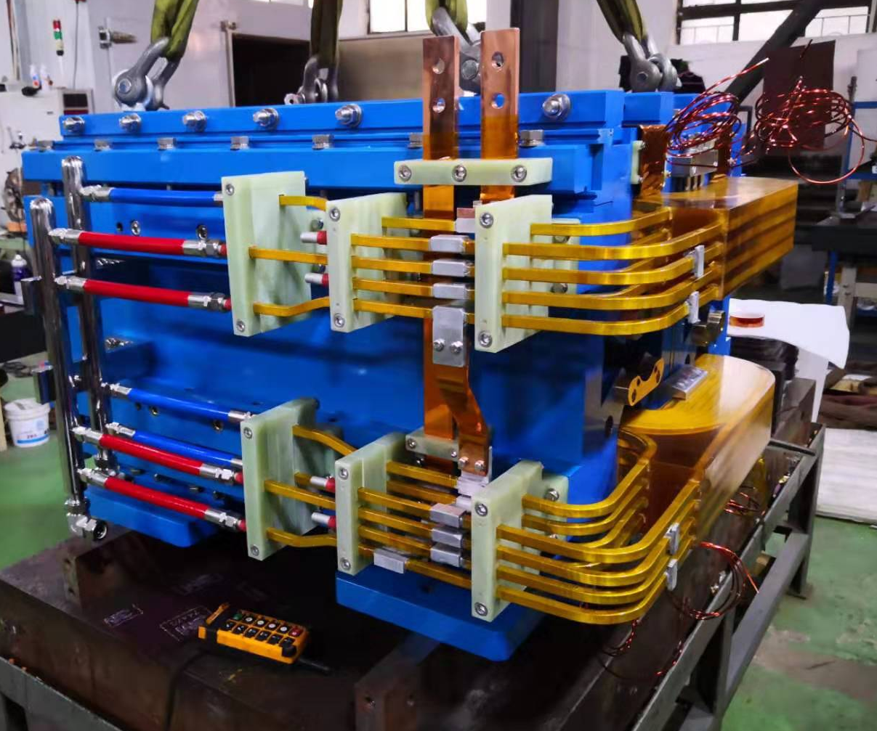
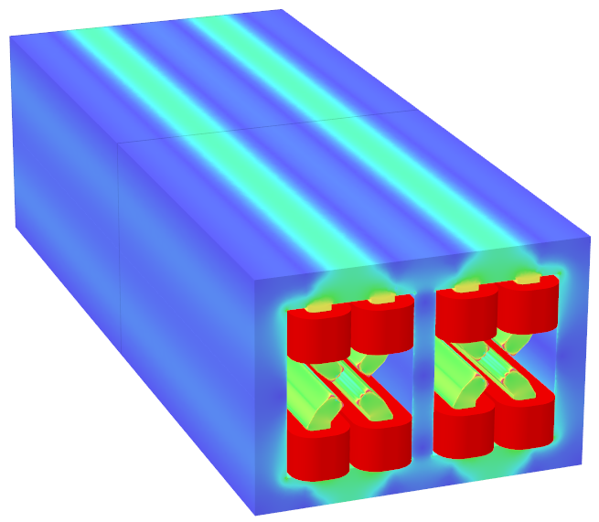
CEPC Collider Ring Dual Aperture Quadropole
(might be common technology with FCCee)
  Dual aperture quadrupole
New design
DT4补偿块
冲片1
冲片2
冲片2
冲片1
不锈钢
截面图
  The first dual apertture quadrupole model, not yet working, new design underway
  Key R&D item

Slide 13
CEPC submissions to Snowmass21
Technologies
LOI
Collider Design
SCRF
Klystron
Linac+plasma accelerator injector
Cost
Submitted July
21, 2020
Submitted June 23, 2020
Including SppC and siting

Slide 14
Thanks
14

