Slide 1
Snowmass 2021 – AF03 Report Planning Meeting
Mark Palmer
December 16, 2020
Notes:
Please use the Notes field for each slide to prepare the course instructor guide as you go

Slide 2
Plans: Timeline, Cost, Upgradeability
This presentation focuses on how we coordinate the overall report – primarily with respect to Upgradeability
This topic has strong overlap with AF04 (Multi-TeV Colliders)
Will focus on the interface issues

Slide 3
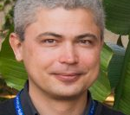
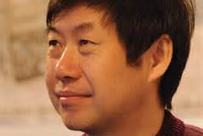
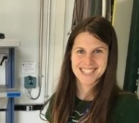
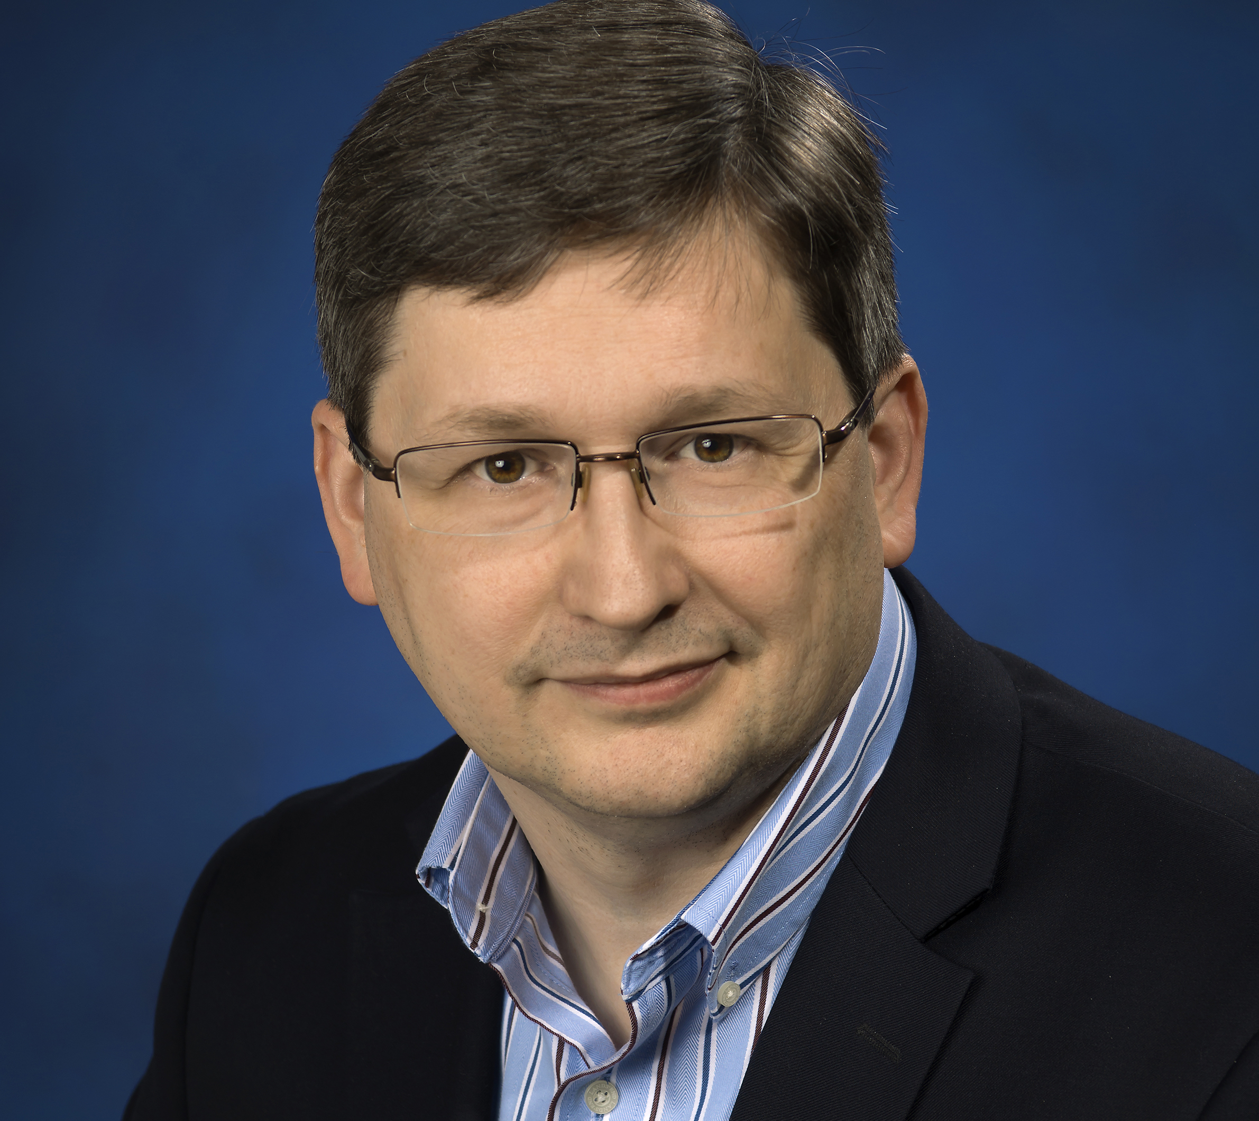
Multi-TeV Conveners
Nadia Pastrone pastrone@to.infn.it
Jingyu Tang tangjy@ihep.ac.cn
Alexander Valishev valishev@fnal.gov
Marlene Turner (Snowmass Young) marleneturner@lbl.gov
Mark Palmer mpalmer@bnl.gov

Slide 4
AF04 Focus: Machines with 1 to >100 TeV Energy Reach, and Beyond...
Working Group will explore
Potential Machine Routes
R&D Requirements
Potential Readiness Timelines
Common Issues at the very high energy scale such as energy efficiency and cost
It will coordinate with the Energy Frontier Physics Group to identify
Connections between the physics needs and accelerator types
Detailed machine requirements to achieve the community's physics goals

Slide 5
Machines with E_{cm} ≥ 1 TeV and Collaborations
Electron-Positron: ILC, CLIC, Wakefield concepts
Gamma-Gamma:
Muon: MAP, LEMMA, NEW International MC Collab
Hadron: FCC-hh, SPPC, Collider in the Sea
High Energy Electron-Ion: LHeC, FCC-eh, other options
Other possibilities?

Slide 6
High-Level Multi-TeV Report Structure
Design Overview
Status
Concept-only
Pre-CDR (with significant, but no end-to-end design work available)
CDR
TDR
other
Performance Matrix
Potential energy and luminosity reach
Required injector/driver systems
Facility scale
Power Requirements
Etc.
Design Summary
Design Challenges
Technology Requirements
Staging Options and Upgrades
Synergies with other concepts and/or existing facilities
Evaluate Maturity of Concepts and Required Design and R&D Challenges

Slide 7
Coordination
On average, the maturity of AF04 Concepts is significantly lower than for AF04.
Also, the spread in maturity is extremely broad.
However, the staging options and synergies with regards to AF03 concepts is critical
Will work closely with AF03 and AF06 to ensure that report sections provide a useful analysis for our EF colleagues to evaluate potential PATHWAYS moving forward
Ultimate Limits - AF01/04/06 have a seminar series underway discussing ultimate limits of beams (e.g. one session being planned will touch on potential quantum limits for electron-positron collisions – 1/15/2021?)

Slide 8
Backup Slides Follow

Slide 9
Each AF Working Group
Charged with addressing the following questions:
What is needed to advance the physics?
What is currently available (state of the art) around the world?
What new accelerator facilities could be available on the next decade (or next next decade)?
What R&D would enable these future opportunities?
What are the time and cost scales of the R&D and associated test facilities as well as the time and cost scale of the facility?
Liaisons with other parts of the Snowmass 2021 effort:
Theory Frontier - LianTao Wang
Rare Processes - Robert Bernstein
Energy Frontier - Meenakshi Narain and Dmitri Denisov
Instrumentation Frontier - Andy White

Slide 10
Snowmass 2021 Letters of Interest
Submission Period: April 1, 2020 – August 31, 2020
Letters of interest allow Snowmass conveners to see what proposals to expect and to encourage the community to begin studying them. They will help conveners to prepare the Snowmass Planning Meeting that will take place on November 4 - 6, 2020 at Fermilab. Letters should give brief descriptions of the proposal and cite the relevant papers to study. Instructions for submitting letters are available at https://snowmass21.org/loi. Authors of the letters are encouraged to submit a full writeup for their work as a contributed paper.

Slide 11
AF4 Request for Letters of Intent
Request for LOIs To Focus On:
Machine concept
R&D needs to deliver a potential future capability
Connections of the technology to existing facilities (e.g. to provide potential facility construction and/or R&D pathways)
LoIs are short – so multiple LoIs from each team are acceptable
The conveners will work with the contributors to organize a coherent and integrated final set of submissions and presentations
We want to make sure the US community has everything it needs to develop its future Energy Frontier plans
An email list has been created: MULTITEV-SNOWMASS21@fnal.gov
We are planning a series of Joint Working Group meetings as we move through the Snowmass process

Slide 12
Questions?

