Slide 1
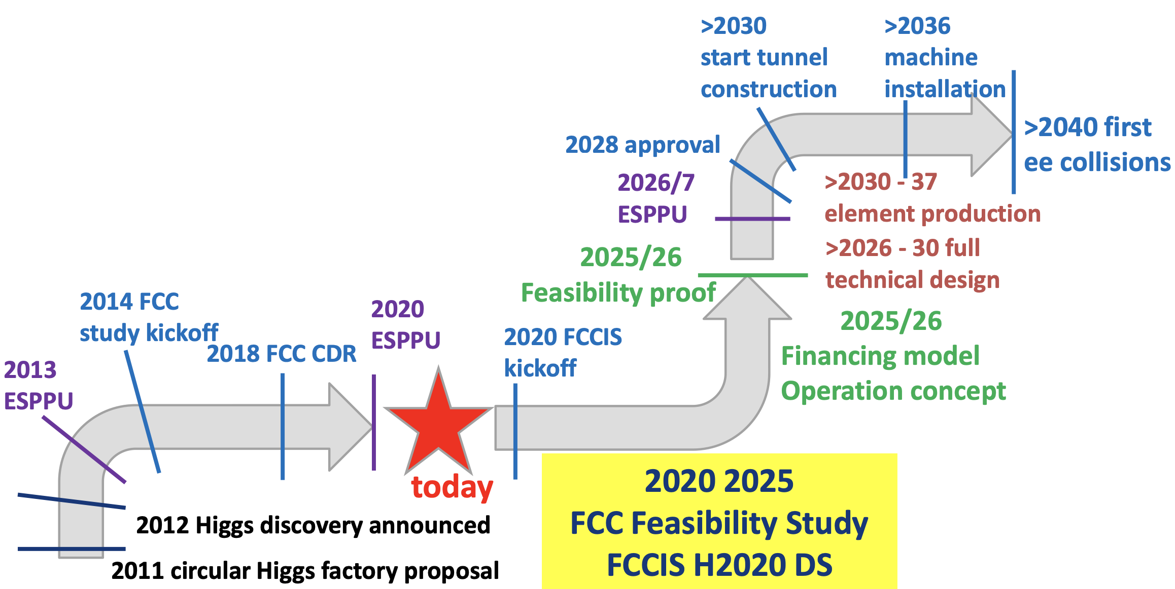
Preceded by ~5 year prep. phase

Slide 2
Possible follow ups towards report – for discussion
All these (on previous page) are technical schedules. All of them have extended timelines into the future.
One can/should add more machines – most less mature.
Several changes since the ESPP.
Possible Qs to address:
Are the technical schedules comparably estimated (maybe a small group can assess this) ?
Resources will drive the real schedule. Cost is also estimated for each. We should also look at FTEyear estimates and their maturity.
What are the decision procedures (these will introduce delays for sure, but how to we asses them) – but they can be summarized
How compatible is the preparation and construction with the resource availability in the host regions – given other commitment and “constant plus a bit budgets” in US/Canada/Europe. Again, can this be assessed rationally (and usefully) ?
Another easier approach: how do we involve/expand the world resources best for this machine - and a next one (the challenge of accessing fresh HEP funding and personnel resources). This can be discussed.
Another possible and sobering exercise, estimated start date as function of time, versus real start for some recent large accelerator projects ….

